Slide 2
Identify and describe the histological structure of the three types of muscle cells and list the differences between them.

Slide 3
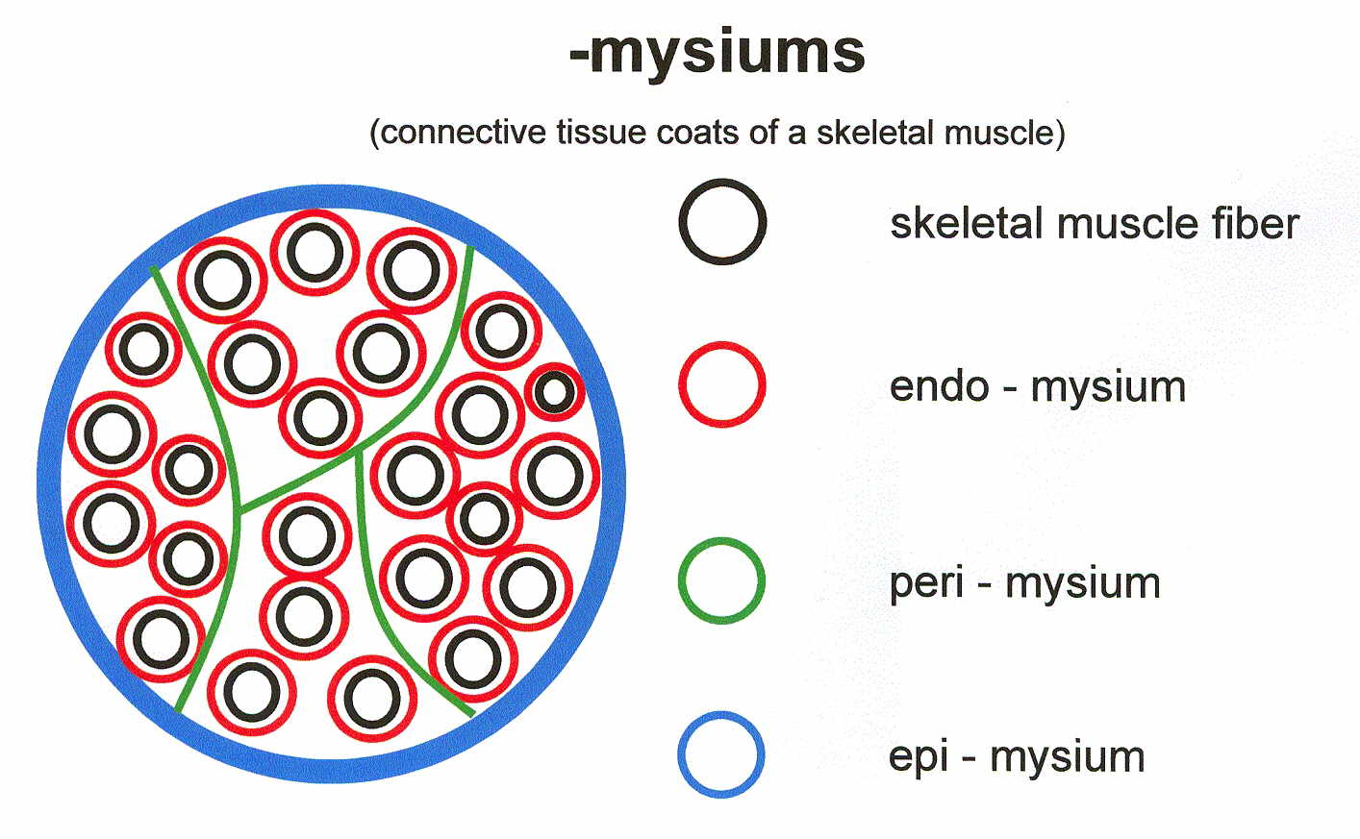
Extra picture for explanation only

Slide 4
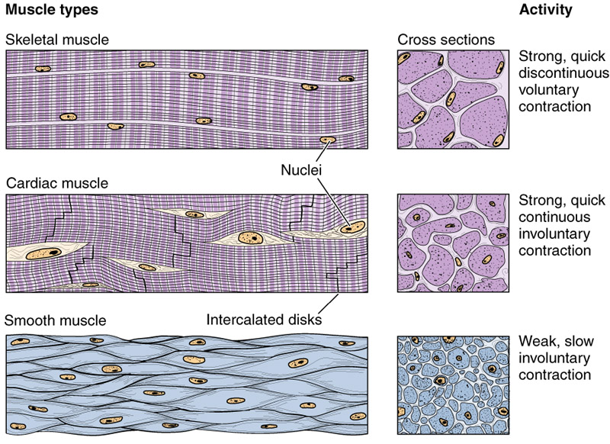
MUSCULAR TISSUE =carco=myo=mysium
Made of elongated muscle cells (fibers)
Muscle cell is only cell that we can see by naked eye
Muscle supply by somatic nerve
types of muscles
(muscle fibers)
Skeletal
striated, voluntary
The Cells are the fibers
Cardiac
striated, involuntary
The fibers are segmented to cells
Smooth
non-striated, involuntary
The Cells are the fibers

Slide 5
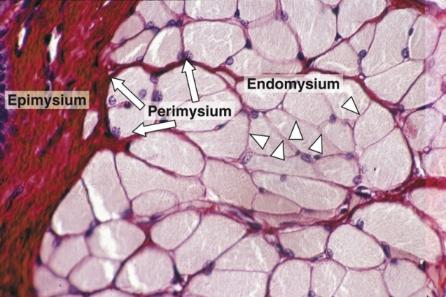
SKELETAL MUSCLE
The whole muscle is covered by a connective tissue covering called the epimysium “consist of dense collagen irregular connective tissue”
Consists of parallel skeletal muscle fibers, arranged in bundles, separated by connective tissue septa called the perimysium “consist of loose connective tissue”
The individual fibers are separated by connective tissue called endomysium.
Mysium = Flesh
Epi = Over
Peri = Surrounding

Slide 6
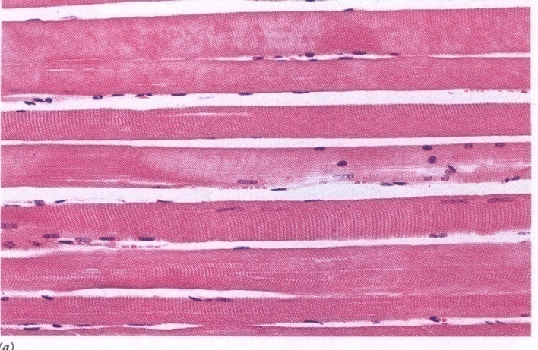
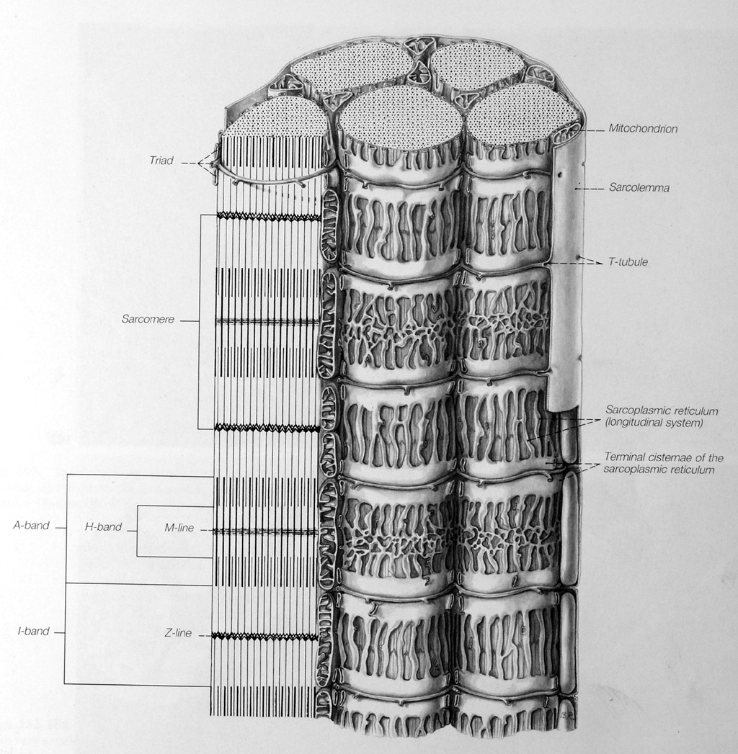
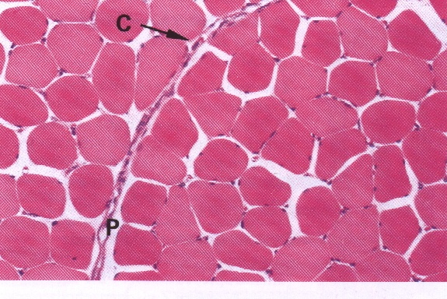
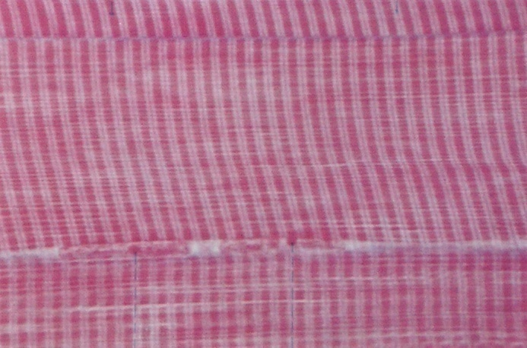
Skeletal Muscle Fibers under Microscope
E.M. Picture |  | L.M. Picture
 | Sarcoplasm contains: Parallel myofibrils. Numerous mitochondria, arranged in rows between the myofibrils. Well developed smooth endoplasmic reticulum (sarcoplasmic reticulum-SR). Myoglobin pigment. “myoglobin is protein high affinity for oxygen” Glycogen Glycogen is food for muscles” Glycogen + Ca+ = contraction High concentration of Ca+ that release from smooth ER increase cause muscle contraction |  | Cylindrical in shape. Non-branched. Covered by a clear cell membrane, the sarcolemma. Multinucleated: nuclei are multiple and are peripherally located (close to the sarcolemma). Cytoplasm (sarcoplasm) is acidophilic and shows clear transverse striations.

Slide 7
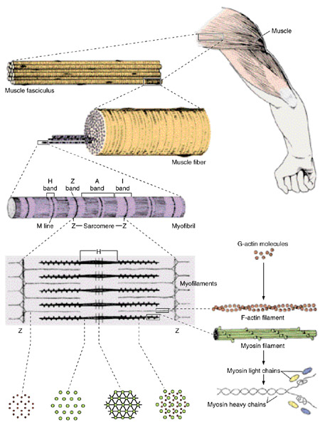
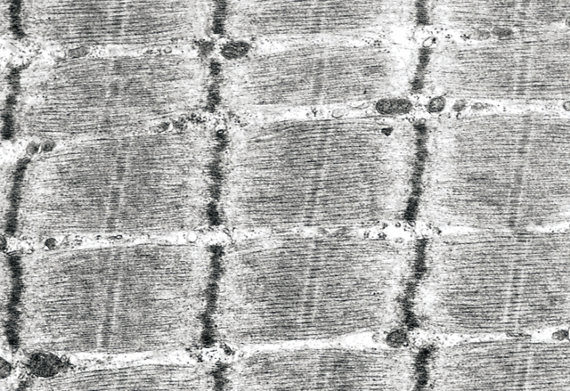
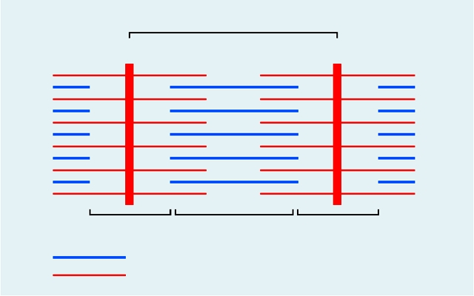
Myofibrils of Skeletal Muscles
E.M. Picture of Myofibrils:
  Contractile threads (organelles), arranged longitudinally in the sarcoplasm.
  Each myofibril shows alternating dark (A) and light bands (I).
  The (A) band shows a pale area in the middle (H band) which is divided by a dark line (M line).
  The (I) band shows a dark line in the middle (Z line).
  The sarcomere is the segment between 2 successive Z lines. It is the contractile unit of a myofibril.
  The myofibrils are formed of myofilaments (thick myosin and thin actin).
  The (A) band is formed of myosin myofilaments mainly and the terminal ends of actin myofilaments.
  The (I) band is formed of actin myofilaments.
  The (A) band is dark because it contains both myosin and actin. The (I) band and the (H) zone are light because they have only one type of myofilaments (actin in I and myosin in H).
Sarcomere
Z
Z
I
A
I
Myosin
Actin

Slide 8
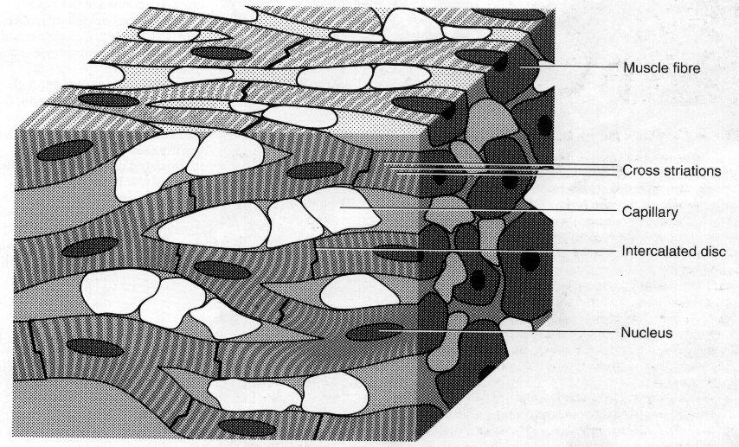
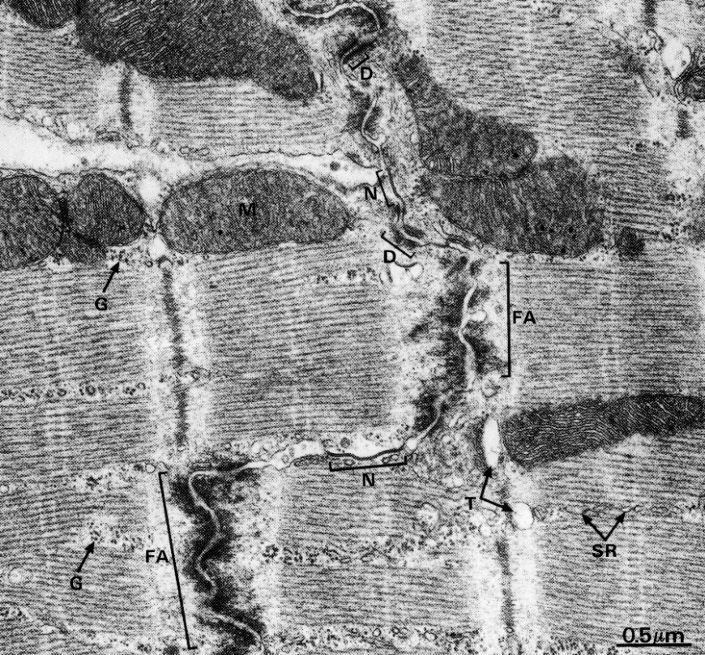
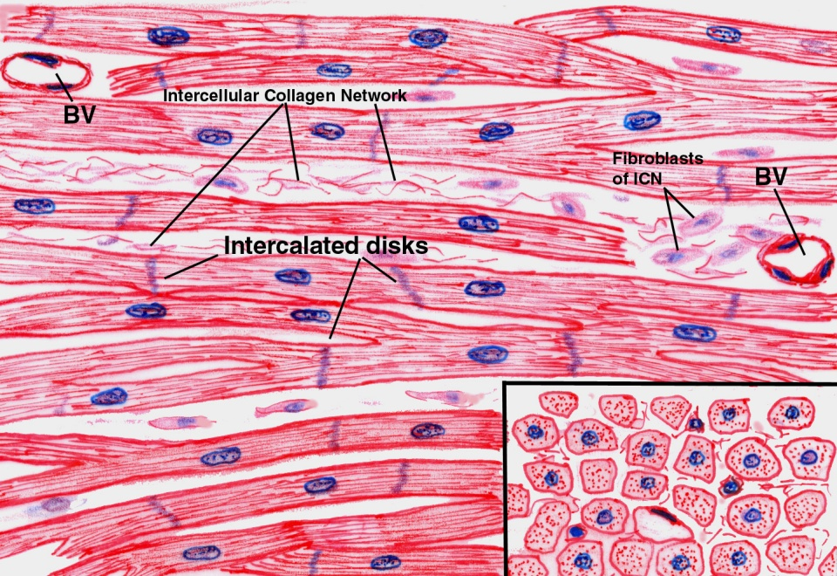
CARDIAC MUSCLE
Found in the myocardium. Striated and involuntary. Have only Endomysium.
E.M. Picture |  | L.M. Picture
 | Few myofibrils. Numerous mitochondria. Less abundant SR. Glycogen & myoglobin. Intercalated discs: are formed of the two cell membranes of 2 successive cardiac muscle cells, connected together by junctional complexes (desmosomes and gap junctions*). *Gap junctions allow communication and passage of impulses between cardiac muscle cells |  | Cylindrical in shape. Intermediate in diameter between skeletal and smooth muscle fibers. Branch and anastomose. Covered by a thin sarcolemma. Mononucleated. Nuclei are oval and central. Sarcoplasm is acidophilic and shows non-clear striations (fewer myofibrils). Divided into short segments (cells) by the intercalated discs.

Slide 9
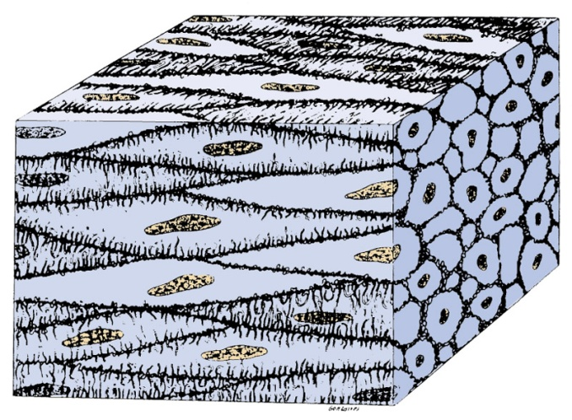
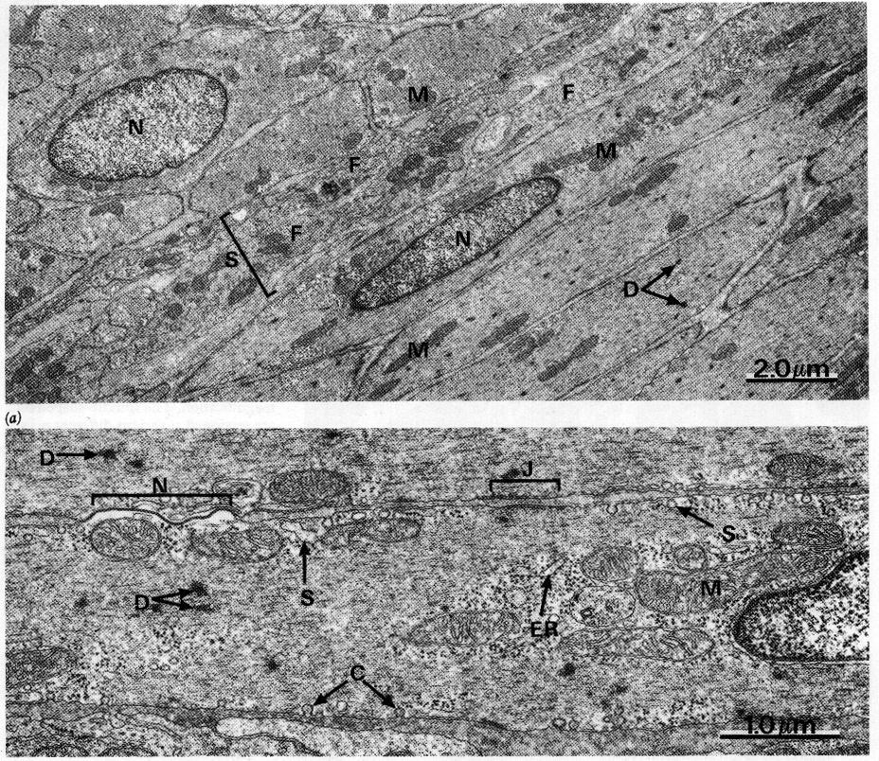
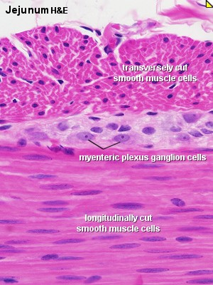
SMOOTH MUSCLE
Present in walls of blood vessels and viscera (digestive, urinary, genital .... etc). Non-striated and involuntary. Smooth muscle have dense body that help in contraction Gap junction found cardiac & smooth muscle
E.M. Picture |  | L.M. Picture
 | Sarcoplasm contains mitochondria and sarcoplasmic reticulum. Myosin & actin filaments are irregularly arranged (that’s why no striations could be observed). Cells are connected together by gap junctions for cell communication. |  | Fusiform in shape (spindle-shaped). Small diameter. Non-branched. Thin sarcolemma. Mononucleated. Nuclei are oval & central in position. Sarcoplasm is non-striated and acidophilic.

Slide 10
REGENERATION OF MUSCLE
(1) Skeletal muscle cells:
- Can not divide.
Limited regeneration by satellite cells (stem cells on the muscle cell’s surface)
(2) Cardiac muscle cells:
- No regenerative capacity.
(3) Smooth muscle cells:
- Can divide.
- Regenerate from pericytes.
→ active regenerative response.
- mitosis for other healthy cell | stem cell
Comparison between different types of muscle fibers
SMOOTH | CARDIAC | SKELETAL
Viscera, e.g. stomach | Myocardium of the heart | Muscle attached to skeleton | Site
Fusiform | Cylindrical | Cylindrical | Shape
Smallest | Medium-sized | Largest | Diameter
Non-branched | Branched | Non-branched | Branching
Absent | Not clear | Clear | Striations
Absent | Present | Absent | Intercalated discs
One central nucleus | One central nucleus | Numerous and peripheral | Nuclei
Involuntary | Involuntary | Voluntary | Action
Active | No | Limited | Regeneration

Slide 11
QUESTIONS:
Q1:What is the name of the dark line in the middle of The ( I ) band?
A) M line B) Z line C) H line D) E line
Q2:Which one of the following not striated?
A) Cardiac muscle B) Skeletal muscle C) Smooth muscle D) All of them
Q3: Intercalated discs is present in which of the following type of muscle fibers?
A) Cardiac muscle B) Skeletal muscle C) Smooth muscle D) All of them
Q4: one of the following is a common feature in both smooth and cardiac muscles?
A) Multinucleated B) Steriation C) Fusiform cells D) Gap junctions
Q5: Which one is never regenerate?
A) Cardiac muscle B) Skeletal muscle C) Smooth muscle D)all of them
1-B
2-C
3-A
4-D
5-A

Slide 12
Q6: Whose have largest dimeter?
A) Cardiac muscle B) Skeletal muscle C) Smooth muscle D) A&B
Q7: Which of the following C.T. separates each individual skeletal muscle fibers?
A) Sarcoplasm B) Perimysium C) Endomysium D) Epimysium
Q8: the contractile unit of a myofibril?
A) Sarcomere B) Sarcoplasm C) Sarcoplasmic reticulum D) Sarcolemma
Q9: The shape of smooth muscle is?
A) Cylindrical B) Circular C) Triangular D) Fusiform
Q10: Sarcomere is the distance between two?
A) M lines B) Z lines C) H lines D) E lines
Q11:Which one of the following muscle fibers can divide?
A) Cardiac muscle B) Skeletal muscle C) Smooth muscle D) All of them
6-B
7-C
8-A
9-D
10-B
11-C

