Slide 1
Microbiology - Skin and Soft-Tissue Infections
Team 437
Please check our editing file frequently.
Msk editing file
Red : Important!
Black: Doctors slides
Grey : Extra Info
Green: Notes

Slide 2
Objectives
Describe the anatomical structure of skin and soft tissues.
Differentiate the various types of skin and soft tissue infections and their clinical presentation.
Name bacteria commonly involved in skin and soft tissue infections
Describe the pathogenesis of various types of skin and soft tissue infections
Recognize specimens that are acceptable and unacceptable for different types of skin and soft tissue infections
Describe the microscopic and colony morphology and the results of differentiating bacteria isolates in addition to other non-microbiological investigation
Discuss antimicrobial susceptibility testing of anaerobes including methods and antimicrobial agents to be tested.
Describe the major approaches to treat of skin and soft tissue infections
either medical or surgical.

Slide 3
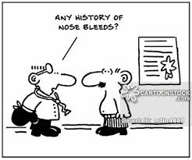
Key to developing an adequate differential diagnosis requires:
History:
Patient’s immune status,
the geographical locale,
travel history,
recent trauma or surgery,
previous antimicrobial therapy, lifestyle,
animal exposure or bites
Physical examination:
To determine the severity of infection
Investigation:
CBCs, Chemistry
Swab, biopsy or aspiration (Aspirate :For pus or exudate)
Radiographic procedures (X-rays, CT, MRI) ( primary to determine if there is bone infection or if there is gas.)
Level of infection and the presence of gas or abscess.
Diagnostic and therapeutic:
Surgical exploration or debridement “diagnostic (very important to determine the infection and whether it is deep or superficial ) and therapeutic (if it's severe it might need amputating”
Antibiotics treatment

Slide 4
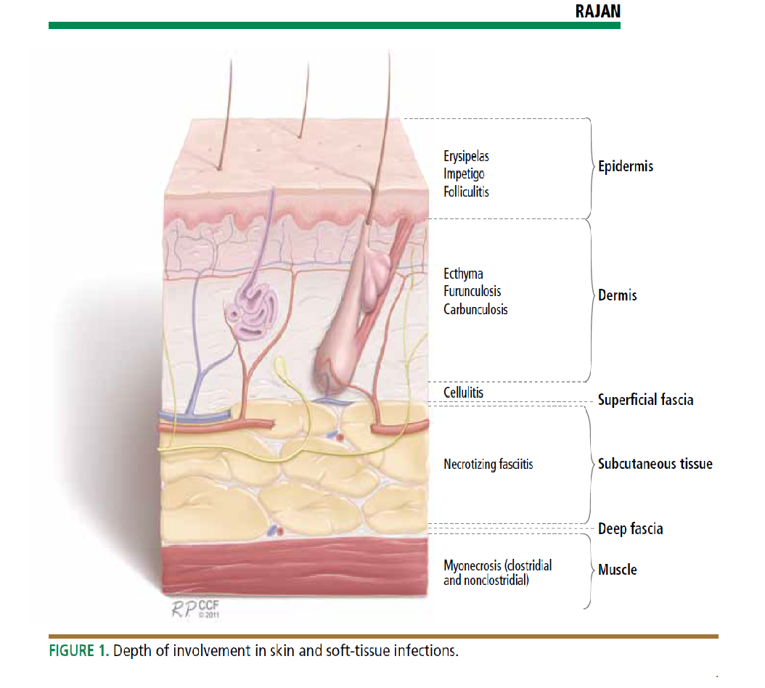
Introduction:
Soft tissue definition: anything other than bones.
Soft tissue infections : It is a Common disease.
Can be mild to moderate or severe. Muscle or bone and lungs or heart valves infection.
Most common Cause are: Staphylococcus aureus and streptococcus.
Emerging antibiotic resistance among:
-Staphylococcus aureus (methicillin resistance).
-Methicillin drug is the laboratory name for cloxicillin drug
-Streptococcus pyogenes (erythromycin resistance).
You should differentiate between epidermis, dermis, subcutaneous infections and is it invading other tissues like muscles or bones to choose the right management.
The more the organism has powerful toxins and enzyme the more it spread deeply, and he may devolve gas gangrene. For example : clostridium perfringase
Important to know the:
1- Name of the syndrome.
2- Organisms causing it.
3- Clinical presentation.
4- Antibiotics.

Slide 5
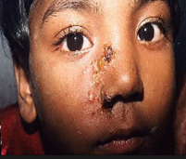
Impetigo - (pyoderma)
It’s a common skin infection, in Children 2–5 years in tropical or subtropical regions. Very superficial in epidermis
Always caused by β-hemolytic streptococci ((Nonbullous) and, or staphylococcus aureus “bollus”( rarely alone)
Characteristics:
Systemic symptoms are usually absent.
Consists of discrete purulent lesions Blister if it rupture, it’s produce fluid (honey cust
Exposed areas of the body( face and extremities)
Skin colonization- Inoculation by abrasions, minor trauma, or insect bites
Poststreptococcal glomerulonephritis*.
(anti–DNAse B) :(antideoxyribonuclease B) ; if there is a lot of AntiDNAse in the test then it means he have impetigo .
Treatment:
Cefazolin: covers Both Staphylococcus and streptococcus.
Cloxacillin: covers Staphylococcus only
Erythromycin: covers streptococcus only
Mupirocin : It may lead to immune complication in some cases.
If patient has cellulitis, 1st drug you think of
= Cefazolin
*Group A streptococci are sensitive to penicillin
Pyoderma : skin disease that is pyogenic (has pus).
Bullous: Involves the formation of bullae (blisters).

Slide 6
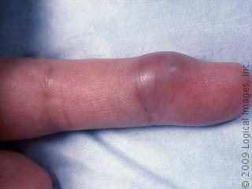
Cutaneous abscesses.
Collections of pus within the dermis and deeper skin tissues.
Typically polymicrobial (caused by several types of microorganisms )S. aureus alone in ∼ 25 %
Treatment:
Incision and evacuation of the pus.(فتح الخراج واستخراج الصديد منه)
Antibody: Cloxacillin (S.Aureus only)
Characteristics:
Painful, tender, and fluctuant
Multiple lesions:
cutaneous gangrene.
severely impaired host defenses.
extensive surrounding cellulitis.
high fever.
Diagnosis:
Gram stain, culture and systemic antibiotics

Slide 7
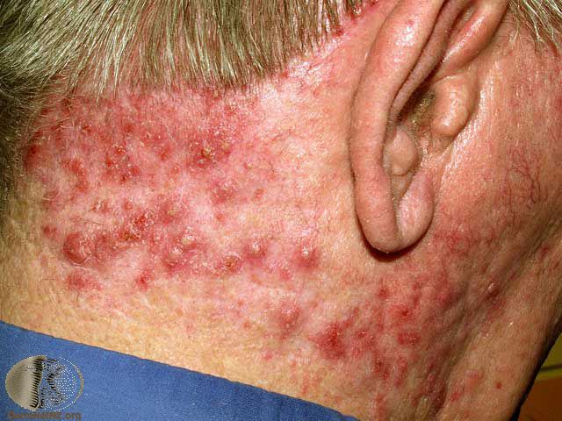
Furuncles and carbuncles
MSSA :Methicillin‐ sensitive Staphylococcus aureus
MRSA : Methicillin‐ resistant Staphylococcus aureus
Furuncles (or “boils”) are infections of the hair follicle (folliculitis ), usually caused by S. aureus, in which suppuration extends through the dermis into the subcutaneous tissue. One or separated hair follicles.
Carbuncle: extension to involve several adjacent follicles with coalescent inflammatory mass. Present in back of the neck, especially in diabetics.
usually caused by S. aureus
Characteristics:
extends through the dermis into the subcutaneous tissue (so it is Deeper than Cutaneous abscesses.)
Carbuncle present in the back of neck especially diabetes patients
Treatment:
Larger furuncles and all carbuncles require incision and drainage.
Mupirocin ointment: eradicate staphylococcal carriage and nasal colonization.
Systemic antibiotics are usually unnecessary
Outbreaks of furunculosis caused by MSSA* and MRSA*.
Families, prisons ,sports teams
Inadequate personal hygiene
Repeated attacks of furunculosis
Presence of S. aureus in the anterior nares- 20-40%
إذا فيه إصابة في العائلة راح تاخذهم كلهم وتاخذ منهم
Nose swap
وتشوف مين يحمل البكتيريا وتسوي له
Decolonization
وتعطيه معقمات ، للاستحمام مثلا
+ topical antibiotics

Slide 8
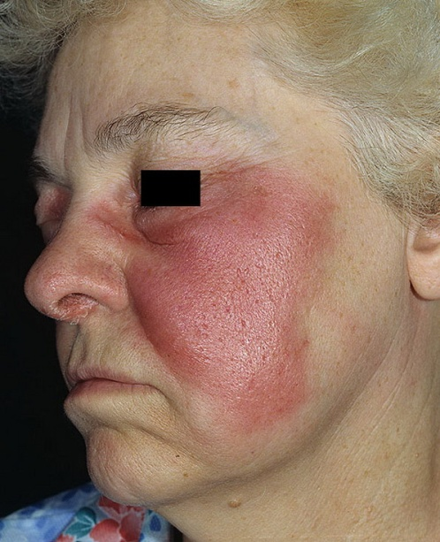
Erysipelas and Cellulitis
Diffuse spreading skin infections, excluding infections associated with underlying suppurative foci
Most of the infections arise from streptococci, often group A, but also from other groups, such as B, C, or G.
Erysipelas
Affects the upper dermis (raised-clear line of demarcation)
Red, tender, painful plaque
Infants, young children-
Caused by:
β-hemolytic streptococci ( group A or S. pyogenes)
Treated by:
Penicillin-IV or oral.
Erysipelas: in the whole epidermis and dermis and it is caused mainly by group A streptococci
Well Demarcated
Swelling
Edema
Redness

Slide 9
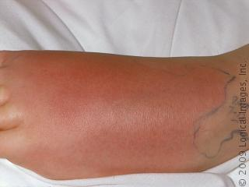
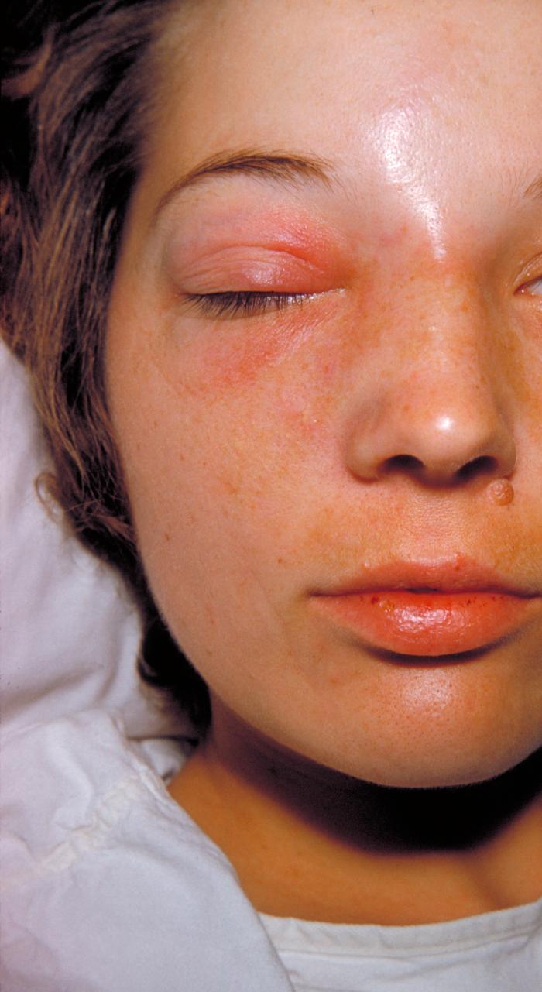
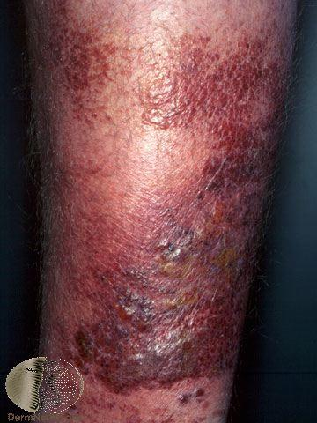
Cellulitis
Acute spreading infection involves the deeper dermis and subcutaneous tissues.
Caused by:
β-hemolytic streptococci, Group A streptococci, and group B streptococci-in diabetics
S. aureus : commonly causes cellulitis- penetrating trauma.
Haemophilus influenzae periorbital cellulitis in children
Risk factors: Obesity, venous insufficiency, lymphatic obstruction (operations), preexisting skin infections- ulceration, or eczema,
CA-MRSA (Community Associated MRSA):
Carry Panton-Valentine leukocidin gene
More sensitive to antibiotics
Can lead to severe skin and soft tissue infection or septic shock

Slide 10
Cellulitis
Clinical diagnosis Symptoms and Signs:
High WBCs, blood culture rarely needed
Aspiration and biopsy might be needed in diabetes mellitus, malignancy, animal bites, neutropenia (Pseudomonas aeruginosa ),immunodeficiency, obesity and renal failure
Observe for progression to severe infection(increased in size with systemic manifestation ie . fever, leukocytosis)
Treatment:
cover streptococcus and staphylococcus
Penicillin, cloxacillin, cefazolin (cephalexin),clindamycin
Vancomycin or linazolid in case of MRSA
Clindamycin, TMP-SMZ for CaMRSA

Slide 11
Summary
Basically, the most important things you must know so far is that:
Impetigo and the rest of diseases are caused by both staphylococcus aureus and streptococcus.
Folliculitis is caused by staphylococcus aureus.
Erysipelas is caused by Group A streptococci. (This group could cause sore throat and pharyngitis).

Slide 12
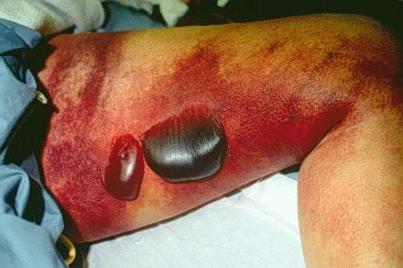
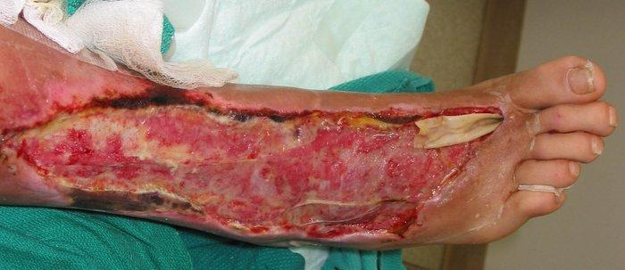
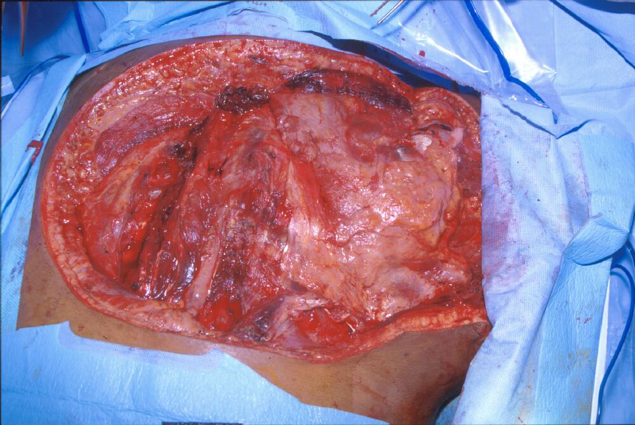
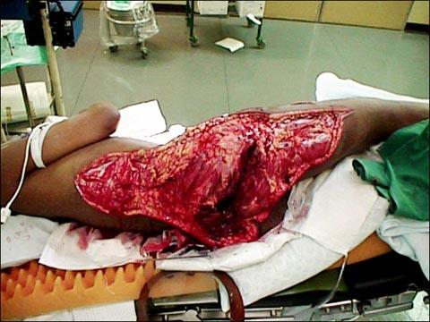
Necrotizing fasciitis
(Flesh-eating disease)
It is a rare deep skin and subcutaneous tissues infection
Necrotizing fasciitis
Caused by multiple organisms
Type 1
Polymicrobial
Type 2
monomicrobial
caused by only Group A strept
Most common in the arms, legs, and abdominal wall and is fatal in 30%-40% of cases.
Fournier's gangrene (testicular), Necrotizing cellulitis
Mortality as high as 73 % if untreated

Slide 13
Causing microbes: | Risk factors | Pathophysiology | Signs and symptoms
Group A streptococcus It produces toxins that causes a septic shock Clostridium perfringens (gas in tissues) It’s a normal flora of the GI -A wound can causes the Clostridium perfringens to spread in other tissues -It has a high virulent factor we call it {Phospholipase} which causes a necrosis of the fascia of the muscle ,it can lead to Death due to hypotension. Staphylococcus aureus or CA-MRSA (Streptococcus pyogenes) Bacteroides fragilis Vibrio vulnificus (liver function) Gram-negative bacteria (synergy). E. coli, Klebsiella, Pseudomonas Fungi | -Immune-suppression -Chronic diseases: ( diabetes, liver and kidney diseases, malignancy -Trauma:(laceration, cut, abrasion, contusion, burn, bite, subcutaneous injection, operative incision) -Recent viral infection rash (chickenpox) -Steroids -Alcoholism -Malnutrition -Idiopathic | Destruction of skin and muscle by releasing toxins Streptococcal pyogenic exotoxins Superantigen Non-specific activation of T-cells Overproduction of cytokines Severe systemic illness (Toxic shock syndrome) كلام د الصميلي: Edema will press on the nerves (causing a severe pain) and blood vessels which will lead to necrosis and death of the supplied tissue | Rapid progression of severe pain with fever , chills (typical) Swelling , redness, hotness, blister, gas formation, gangrene and necrosis Blisters with subsequent necrosis , necrotic eschars Diarrhea and vomiting (very ill) Mortality as high as 73% if left untreated Shock organ failure Hypotension

Slide 14
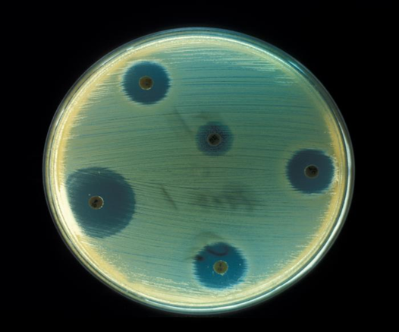
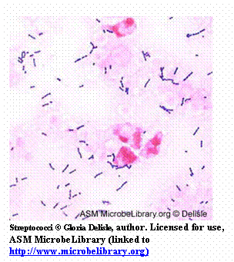
Diagnosis of Necrotizing fasciitis
A delay in diagnosis is associated with a grave prognosis and increased mortality to check for renal failure
Diagnosis
Clinical-high index of suspicion
Blood tests
Surgery debridement amputation
Radiographic studies
Microbiology
X-rays : subcutaneous gases
Culture &Gram's stain
( blood, tissue, pus aspirate)
WBC
CT or MRI
To evaluate the spread
CBC
Susceptibility tests
ESR
BUN (blood urea nitrogen)
to check for renal failure.

Slide 15
Treatment of Necrotizing fasciitis
If clinically suspected patient needs to be hospitalized OR require admission to ICU.
Start intravenous antibiotics immediately.
Antibiotic selection based on bacteria suspected
broad spectrum antibiotic combinations against:
methicillin-resistant Staphylococcus aureus .(A)
anaerobic bacteria.
Gram-negative and gram-positive bacilli.
Antibiotics combinations:
Penicillin-clindamycin-gentamicin.
(Given together, and they’re the most important)
Ampicillin/sulbactam.
Cefazolin plus metronidazole.
Piperacillin/tazobactam.
Clostridium perfringens - penicillin G.
Hyperbaric oxygen therapy (HBO) treatment.
Surgeon consultation:
Extensive Debridement of necrotic tissue and collection of tissue samples.
Can reduce morbidity and mortality.
Why clindamycin?
Surgery
Removing of fascia and dead tissue
(don’t close the wound) (:
Antibiotics
Penicillin + Clindamycin
Because it’s a ribosome inhibitor which will lead to inhibition of toxic formation
Perfusion of the tissue is better than penicillin
Clindamycin is better used in the “Lag” phase of the infection

Slide 16
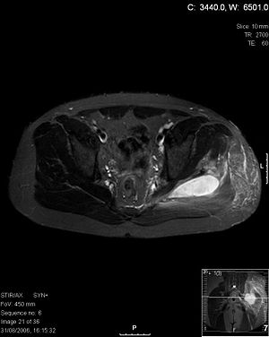
Pyomyositis:
Definition: Acute bacterial infection of skeletal muscle, usually caused by Staph. Aureus.
No predisposing penetrating wound, vascular insufficiency or contiguous infection.
Most cases occur in the tropics (الدول الاستوائية).
60% of cases outside of tropics have predisposing risk factors (RF):
Diabetes mellitus, ethyl alcohol, liver disease, steroid prescriptions, HIV, hematologic malignancy.
History:
- Blunt trauma or vigorous exercise (50%), then period of swelling without pain.
- 10-21 days later : pain, tenderness, swelling and fever.
Pus can be aspirated from muscle.
3rd stage: sepsis, later metastatic abscesses if untreated.
Diagnosis:
X-ray, US, MRI or CT.
Treatment:
Surgical drainage and antibiotics.
The doctor barely explained this slide

Slide 17
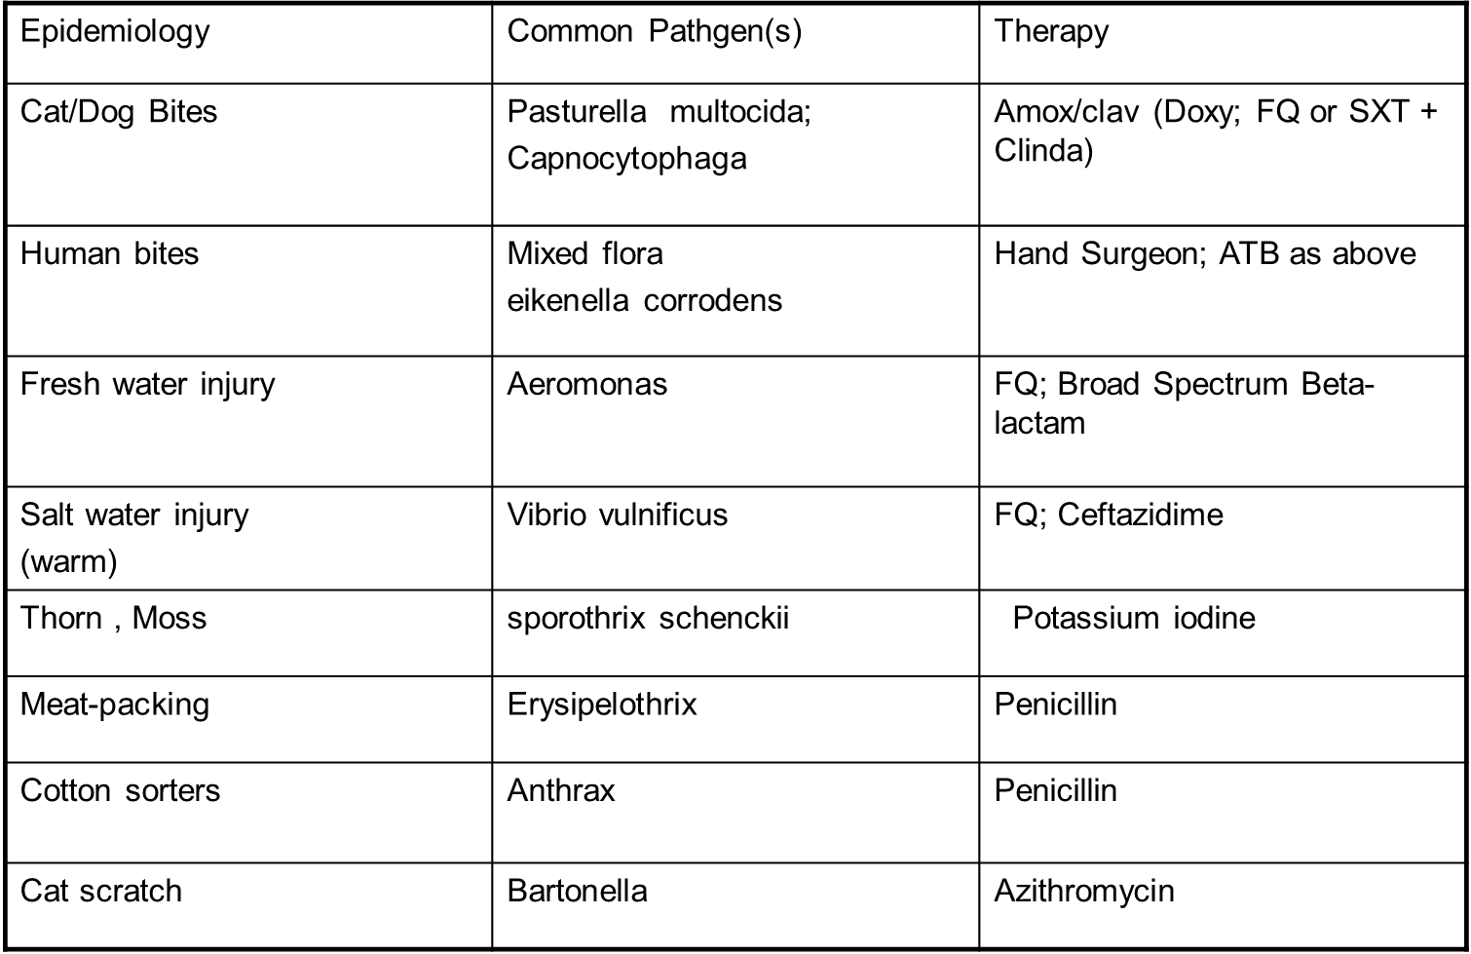
Other Specific Skin Infections

Slide 18
Take home points
Most commonly caused by Staphylococcus aureus and Streptococcus pyogenes
Risk factors for developing SSTIs include breakdown of the epidermis, surgical procedures ,crowding, comorbidities, venous stasis, lymphedema
Most of the infection are mild and can be managed on an outpatient basis In case
Most SSTIs can be managed on an outpatient basis, although patients with evidence of rapidly progressive infection, high fevers, or other signs of systemic inflammatory response should be monitored in the hospital setting.
Superficial SSTIs typically do not require systemic antibiotic treatment and can be managed with topical antibiotic agents, heat packs, or incision and drainage.
Systemic antibiotic agents that provide coverage for both Staphylococcus aureus and Streptococcus pyogenes are most commonly used as empiric therapy for both uncomplicated and complicated deeper infections.

Slide 19
Quiz
Please take a look at team 436 SAQ
1-Which of the following organism cause gas in tissue ?
A- s.aureus B- c.perfringens C- group A streptococcus D- E.coli
2- Which of the flowing disease treat with penicillin?
A-Erysipelas B-cellulitis C -Necrotizing fasciitis D-impetigo
3- Know as flesh eating disease?
A-Erysipelas B-cellulitis C-Necrotizing fasciitis D-impetigo
4- Which of the following best treatment to necrotizing fasciitis?
A-penicillin with clindamycin B-surgery C-ampicillin D-metronidazole
5- Which of the following disease localized in the epidermis ?
A-Erysipelas B-cellulitis C-Necrotizing fasciitis D-impetigo
6- Which of the following disease cause infection to the skeletal muscle?
A-Erysipelas B-pyomyositis C-Necrotizing fasciitis D-impetigo
1- B, 2- A, 3-C, 4-B, 5-A, 6-B

Slide 20
رهف الشمري
هديل عورتاني
رناد المقرن
شوق القحطاني
الهام العلامي
الهنوف الجلعود
Team members:
Some videos for understanding the lecture:
1-Impetigo https://www.youtube.com/watch?v=hQ9xv2cTAyw
2- abscesses https://www.youtube.com/watch?v=pL6rP8C1e7w
3- MRSA https://www.youtube.com/watch?v=tI7aXjgy_Vk
عمر الفوزان
عبدالله الزهراني
معن شكر
محمد إبراهيم
عمر السحيباني
عبدالعزيز الجهني
سيف المشاري
سعد العقيلي
حسين علامي
فهد الفايز
سعد الهداب
خالد المطيري
أنس السيف
عبدالجبار اليماني
عبدالله السرجاني
عادل العريني
محمد الدويغري
Team leaders:
غادة الحيدري و علي شحادة

