Slide 1
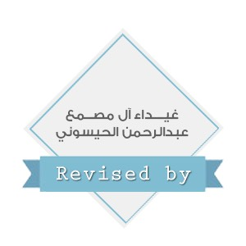
Microbiology - Bone and joint infections
Team 437
Please check our editing file frequently.
Msk editing file
Red : Important
Black: Doctors slides
Grey : Extra Info
Green: Notes

Slide 2
Objectives
Define osteomyelitis and arthritis
Know that the two conditions can happen together or separately
Differentiate between acute and chronic osteomyelitis and arthritis
Know the pathogenesis and risk factors of both osteomyelitis and arthritis
Realize that bone and joint infections can be acquired through blood or directly from adjacent affected organs and tissues.
Know the commonest causative agents of arthritis and osteomyelitis.
Know the laboratory diagnosis and investigation of both conditions.
know the management and treatment of both osteomyelitis and arthritis.

Slide 3
Introduction
Contiguous: Spreads via surrounding infected tissues. (Usually after surgeries, fractures and car accidents.)
Blood-borne: Spread through contamination by blood. (Usually with systemic infections.)
Bone & joint infections may exist separately or together.
Both are more common in infants and children.
Usually caused by blood borne spread ,but can result from local trauma or spread from contiguous soft tissue infection.
Often associated with foreign body at the primary wound site.
If not treated leads to devastating effect.
Adults are more prone to undergo surgeries more often than children, while children are usually more active and so are more prone to trauma. That explains the different ways of how the infection gets introduced in comparison to the patient's history. (Age, accidents, recent surgeries... etc.)
If not treated leads to devastating effect.
Because the accumulation of pus destroys blood vessels. Infection causes inflammation and resultant tissue necrosis producing serious damage. If this developed, cartilage or bone becomes totally separated from blood flow, and then, no healing process will occur.
Osteomyelitis overview

Slide 4
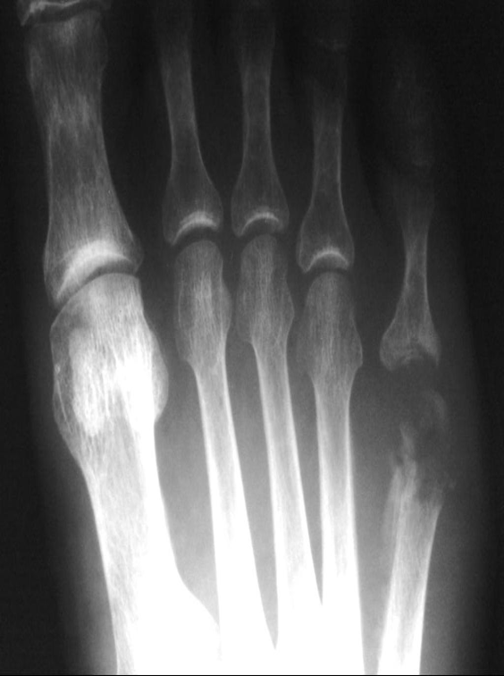
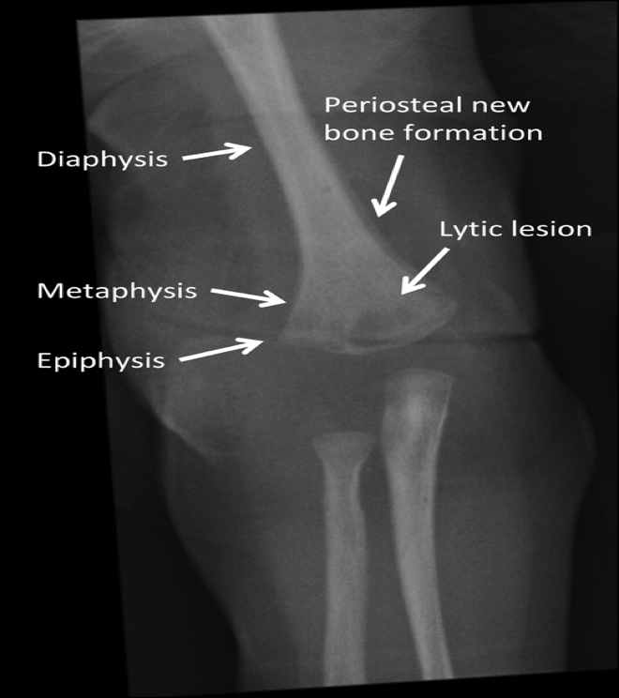
Acute Osteomyelitis
Radiography of acute osteomyelitis
Definition: An acute infectious process of the bone and bone marrow.
How the pathogen reaches the bone:
Hematogenous route (blood)
Contiguous soft tissue focus (postoperative infection, contaminated open fracture, soft tissue infection , puncture wounds)
In association with peripheral vascular disease “chronic diseases” (diabetes mellitus ,severe atherosclerosis, vasculitis)
Duration:
short duration ( few days for hematogenously acquired infection).
last several weeks to months (if secondary to contiguous focus of infection).

Slide 5
Etiology, Epidemiology & Risk Factors
Infants: S.aureus, group B streptococci, E.coli.
Children: S.aureus, group A streptococci, H.influenzae.
Site : Metaphysis of long bones (femur,tibia & humerus )
Primary hematogenous is most common in infants & children.
Adults: Hematogenous cases less common, but may occur due to reactivation of a quiescent(state of inactivity) because of infection from infancy or childhood.
Most cases are due to S.aureus.
Septic arthritis is common as the infection begins in the Diaphysis.

Slide 6
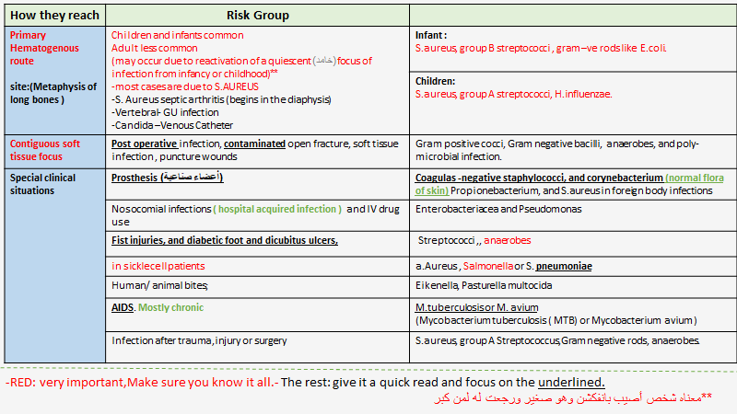
Team 436

Slide 7
Clinical presentation & investigation findings
Acute osteomyelitis usually of abrupt “sudden” onset
Systemic manifestations occurs in less than 50% of patients
Acute onset of bone pain, fever with rigors and diaphoresisغزير تعرق.
Symptoms usually of less than 3 week’s duration
Differential diagnosis ( different diseases)
Clinically
Blood findings
X-ray findings
Primary and metastatic bone malignancies
Trauma
Acute rheumatic arthritis
Hemarthrosis
Ewing sarcoma
Vertebral compression fracture.
- fever
- localized pain
- heat
- swelling
- tenderness of affected site ( one or more bones or joints affected in hematogenous spread)
- May be local tissue infection ( abscess or wound) .
-leukocytosis
-High ESR
-High C-reactive protein.
Early stages:
normal
Later stages: Swelling of soft tissues followed by elevation of periosteum ,demineralization and calcification of bone.

Slide 8
Diagnosis of acute osteomyelitis
Management & Treatment
Blood test:
complete blood and differential counts
Erythrocyte sedimentation rate ( ESR): elevated but could be normal
C-reactive protein
Imaging studies:
X-RAY, MRI,
CT-SCAN
MSSA (methicillin sensitive S.aureus): Cloxacillin, or Clindamycin .
MRSA( methicillin resistant S.aureus): Vancomycin , Clindamycin, Linezolid, or TMP-SMX.
Polymicrobial infection:
Piperacillin-Tazobactam or Quinolone with Metronidazole.
-
Duration: several weeks to ensure cure and prevent progression to chronic osteomyelitis.
-
Surgical drainage: (as needed) if there is local purulent process.
Blood culture:
Bacteremia “presence of bacteria in blood” common
If blood culture is negative: biopsy of periosteum or bone,
or needle aspiration of overlying abscess

Slide 9
Management and treatment from team 436 (Parts in red are most important, the doctor highlighted in the lecture

Slide 10
Chronic Osteomyelitis
General Risk Factors: | Host Risk Factors
1. Penetrating trauma 2. Prosthetic devices 3. Animal bites 4. IV drug use | 1. Peripheral vascular disease 2. Peripheral neuropathy 3. Sickle cell disease 4. Diabetes mellitus 5.Immunocompromised states
What is it? A chronic infection of the bone and bone marrow usually secondary to inadequately treated or relapse of acute osteomyelitis.
Management difficult , prognosis poor. Prognosis: the end result
Infection may not completely cured.
May recur many years or decades after initial episode.
Most infections are secondary to a contiguous focus or peripheral vascular disease.
Chronic infection due to hematological spread is rare.
TB and Fungal are common causes ( if patient is taking too long to heal then think of TB especially in elderly and immunocompromised patients)
Acute is caused mostly from blood
Chronic from peptic vascular disease.

Slide 11
Chronic Osteomyelitis
Polymicrobial (more than one organism) infection common with decubitus ulcers and diabetic foot infections
TB and fungal osteomyelitis clinically have indolent (lazy\idle) “chronic” course
Mycobacteria and fungi (ex: candida and aspergillus) may be the cause in immunosuppressed patients.
MTB osteomyelitis primarily results from haematogenous spread from lung foci or as an extension from a caseating lymph bone ( 50% in spine). It resembles Brucella osteomyelitis.
TB & Brucella are common in KSA. may come as saq case.
Haematogenous osteomyelitis due to fungi eg. Candida species, Aspergillus species and other fungi may occur
Most common pathogen:
S. Aureus
Other pathogens causing chronic osteomyelitis
S. epidermidis
Enterococci
Streptococci
Enterobacterias
Pseudomonas
Anaerobes
All are endogenous.

Slide 12
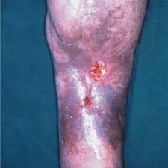
Patient presentation and Differential Diagnosis
Patient Presentation
Differential Diagnosis
• Acute symptoms and systemic manifestations are uncommon.
• Sinus tract
• Persistent wound drainage
• Chronic non-healing ulcer
• Local signs may be absent except during acute exacerbation.
• Overlying skin may be scarred and adherent to the involved bone.
• Osteoid osteoma
• Osteosarcoma
• Secondary bony metastases
• Paget’s disease of the bone
• Gout

Slide 13
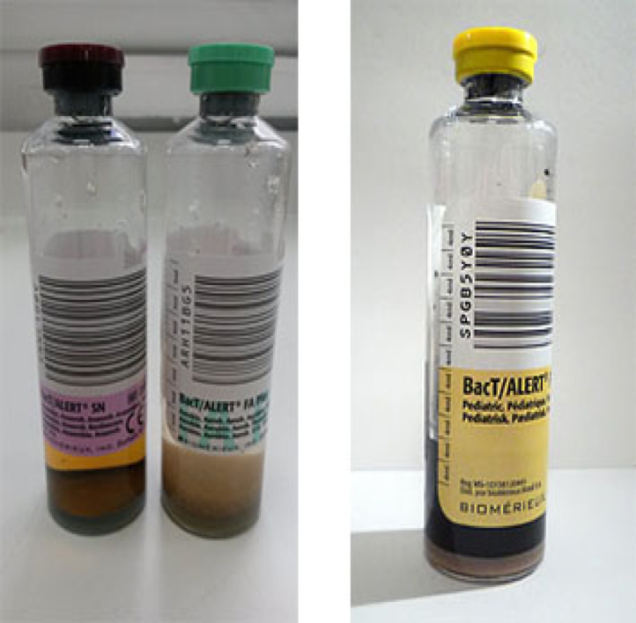
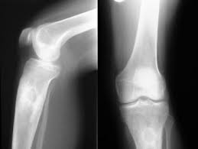
Diagnosis of chronic osteomyelitis
Radiological
Laboratory
• Radiologic changes complicated by the presence of bony abnormalities
• MRI helpful for diagnosis and evaluation of extent of disease.
• Combined bone scan and Indium WBC scan.
• WBC normal, ESR elevated but not specific.
• Blood culture not very helpful- because as bacteremia rare.
• Definite microbiological diagnosis by culture of bone biopsy or FNA & Histological examination
• Surgery for diagnosis and therapeutic purposes
• Wound /sinus culture not reliable. Isolation of MRSA or vancomycin resistant enterococci should initiate infection control measures.
Blood culture bottles

Slide 14
Management and Treatment
Extensive surgical debridement with antibiotic therapy.
Parenteral antibiotics for 3-6 days weeks followed by long term oral suppressive therapy.
Some patient may require life long antibiotic, others for acute exacerbations.
MSSA: Cloxacillin
MRSA & S.epidermidis: Vancomycin then oral clindamycin or TMP-SMX.
MTB: -4 drugs-:
1-INH, 2-RIF, 3-Pyrazinamide, 4-Ethambutol for 2 months, followed by RIF + INH for additional 4 months.
Brucella: is treated with Tetracycline and Rifampicin for 2 to 3 months.
Total=6month
بعض المرضى يحتاجون سنة أو ٩ شهور
Other bacteria: treat as acute osteomyelitis.

Slide 15
Complications & Prognosis
Complications
Prognosis
• Recurrence
• Loss of limb
• Pathological fractures
• Primary epidermoid carcinoma of sinus tract
• Malignant histocytoma
• Secondary amyloidosis
• Lymphoma & multiple myeloma( rare)
• Relapses are Frequent

Slide 16
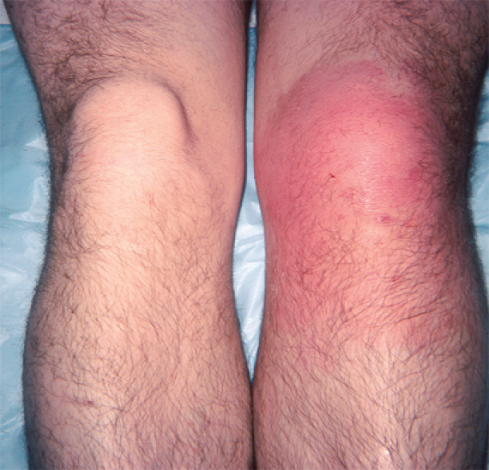
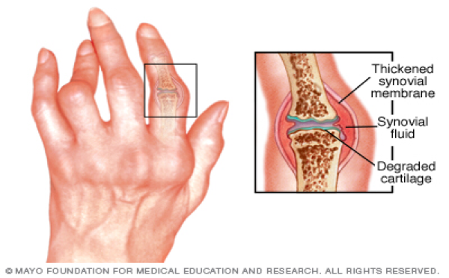
Septic Arthritis
Septic(infectious)Arthritis: is inflammation of the joint space secondary to infection.
Generally affects a single joint and result in suppurative inflammation.
Maybe caused by bacteria(Most common and acute) or viruses.
Haematogenous of joint is most common.
Common symptoms:
1- pain.
2- swelling.
3- limitation of movement.
Diagnosis by Arthrocentesis to obtain synovial fluid —>For analysis: Gram culture & sensitivity.
Drainage & antimicrobial therapy important management.
يدخلون إبرة للمفصل ويسحبون synovial fluid ويعملون analysis

Slide 17
Common causes of septic arthritis
Staph.aureus is the most common organsim
Age/special conditions | Common organism
Neonates | S.aureus Group B Streptococcus Gram negative rods ( eg. E.coli, Klebsiella, Proteus, Pseudomonas) .
Infants/ children | 1- Staph.aureus 2- Group A Streptococcus 3- Strept.pneumoniae 4- Hemophilia. influenzae type b
Adults | 1- S.aureus 2- Neisseria gonorrhoeae is a pathogen not normal flora!!
Sickle cell disease | 1- Salmonella species 2- S.aureus
Trauma/ surgical procedure | S.aureus
Chronic arthritis | 1- MTB 2- Fungi
Prosthetic arthritis | Skin flora

Slide 18
Other causes of Arthritis
-Self limiting: A disease restricted in duration by its own pattern of characteristics and not by other influences.
-Reactive arthritis means that the arthritis is from previous infections.
Viruses
Reactive arthritis
Due to
Non-infectious causes
Rubella
Hepatitis B
Mumps
Parvovirus B19
Varicella
EBV
Adenovirus ..etc.
These are self-limiting
Campylobacter jejuni causes diarrhea
Yersinia enterocolitica not common in ksa
Some Salmonella species
Rheumatoid arthritis
Gout
Traumatic arthritis
Degenerative arthritis

Slide 19
Risk factors & Pathogenesis
1- Gonococcal infection
2- Nongonococcal arthritis
Common cause in young, sexually active adults.
Caused by Neisseria gonorrheae.
Leads to disseminated infection secondary to urethritis/cervicitis.
Initially present with polyarthralgia, tenosynovitis, fever, skin lesions.
If untreated leads to suppurative monoarthritis.
Occurs in older adults.
Results from introduction of organisms into joint space as a results of bacteremia or fungaemia from infection at other body sites.
Occasionally results from direct trauma, procedures (arthroscopy) or from contiguous soft tissue infection.
S.aureus is most common cause.
Other organisms : Streptococci and Aerobic Gram negative bacilli.
Due to tick bite in endemic areas (uncommon in KSA) may come as saq case
Gonococcal infection never happens in old people.
May come as a case:
Lyme disease is common in Scandinavia
A patient will present with skin rash and arthritis due to a tick bite.
3- Lyme disease
4- In Sickle Cell disease
Arthritis may be caused by Salmonella species.
5- Chronic arthritis
May be due to MTB or Fungi.
Risk factors for long term adverse sequelae include: Age, prior rheumatoid arthritis, polyarticular joint involvement, hip or shoulder involvement, virulent pathogens and delayed initiation or response to therapy

Slide 20
Diagnosis of Septic Arthritis
1-History/examination to exclude systemic illness.
4-Arthrocentesis should be done as soon as possible:
5- If Gonococcal infection suspected:
Note: history of tick exposure in endemic areas
1-Synovial fluid is cloudy and purulent.
2- Leukocyte count generally > 25,000/mm3,with predominant neutrophils.
3- Gram stain and culture are positive in >90% of cases.
4-Exclude crystal deposition arthritis or noninfectious inflammatory arthritis.
take specimen for culture from cervix, urethra, rectum & pharynx
DNA testing for N.gonorrheae.
Investigate for other sexually transmitted diseases.
2-Culture of joint fluid and skin lesions .
3-Blood cultures indicated

Slide 21
Treatment & Management,
Arthrocentesis with drainage of infected synovial fluid.
Repeated therapeutic Arthrocentesis often needed.
Occasionally, arthroscopic or surgical drainage/debridement
Risk factors for long –term adverse sequelae include:
Prognosis and complications:
Age
Prior rheumatoid arthritis
Poly-articular joint involvement
Hip or shoulder involvement
Virulent pathogens
Delayed initiation or response to therapy
Gonococcal arthritis has an excellent outcome
Non-Gonococcal arthritis: can result in scarring with limitation of movement, ambulation is affected in 50% of cases.

Slide 22
Treatment and management of nongonococcal infectious arthritis
MSSA: Cloxacillin or Cefazolin (it covers everything)
MRSA: Vancomycin
Streptococci: Penicillin or Ceftriaxone or Cefazolin
Enterobacetriacae: Ceftriaxone or Fluroquinolone
Pseudomonas: Piperacillin and Aminoglycoside
Animal bite : Ampicillin-Sulbactam
lyme disease arthritis: Doxycycline for one month.
Change the antibiotics according to sensitivity, Arthrocentesis can repeated and Surgery rarely required
Antimicrobial therapy should be directed at the suspected organism and susceptibility results:
1. Gonococcal arthritis: IV Ceftriaxone (or Ciprofloxacin or Ofloxacin) then switch to oral Quinolone or Cefixime for 7-10 days.

Slide 23
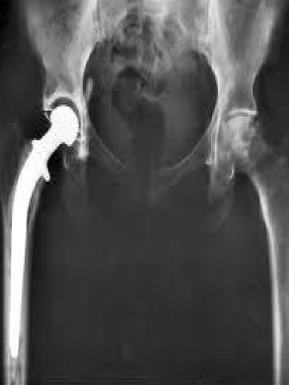
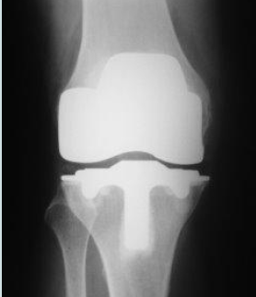
Infections of Joint Prosthesis
Occur in 1 - 5 % of total joint replacement.
Most infections occur within 5 years of joint replacement.
Often caused by skin flora.
Diagnostic aspiration of joint fluid necessary .
Result in significant morbidity and health care costs.
Successful outcomes results from multidisciplinary approach.
Risk factors: history of superficial wound infection, post surgical complications, underlying illness, any source of bacteremia.
Diagnosis of Prosthetic Arthritis:
Differential Diagnosis
exploration to obtain specimen for culture , sensitivity testing & histopathology.
Skin flora regarded as pathogens if isolated from multiple deep tissue cultures.
Plain X-ray may not be helpful.
Arthrography may help define sinus tracts.
Bone scan-not specific for infection.
ESR and C-reactive protein( CRP ) may be high
Aseptic loosening or dislocation of prosthetic joint
Prosthetic debris induced cynovitis &
hemarthrosis

Slide 24
Team 436

Slide 25
Management & Treatment:
Surgical debridement and prolonged antimicrobial therapy
Surgery: removal of prosthesis
Antibiotic –impregnated cement during reimplantation
Antimicrobial for 6 weeks: Begin empiric IV antibiotic to cover MRSA and Gram negative rods ( Vancomycin+ Cefepime, Ciprofloxacin, or Aminoglycoside)
Chronic therapy with oral drug if removal of prosthesis not possible.

Slide 26
Quiz
1. Which of the following is the cause of septic arthritis for children :
a.Group A streptococcus b.Group B streptococcus c.Neisseria gonorrhoeae
2.The most common cause of osteomyelitis is:
a.Staphylococcus Aureus b.Streptococcus c.Salmonella
3.Gonococcal infection is common for :
a.Old adults b.Young sexually active adults
4.Gonococcal has what type of outcome?
A.excellent b.bad c.needs lifelong treatment to live
1.A 2.A 3.B 4.A

Slide 27
SAQ
A man presents with persistent wound drainage, skin scarring overlying affected bone, and non-healing ulcers.After taking history we find he has camels that he often drinks their milk.
What is the disease? Chronic osteomyelitis
What caused it? Brucella from the unpasteurized milk.
Treatment? Tetracycline and Rifampicin for 2 to 3 months.
A man from scandinavia presents with tick bites and pain , swelling of his joints along with limitations of movement.
What is his disease? Septic arthritis
How is diagnosed? Arthrocentesis, synovial fluid should be cloudy and purulent.
How should we treat it? Repeated therapeutic Arthrocentesis often needed.Occasionally, arthroscopic or surgical drainage/debridement.

Slide 28
رهف الشمري
هديل عورتاني
رناد المقرن
شوق القحطاني
إلهام علامي
الهنوف الجلعود
Team members:
Some videos for understanding the lecture:
bone infection
Overview of this lecture
فهد الفايز
سعد الهداب
خالد المطيري
أنس السيف
عبدالجبار اليماني
عبدالله السرجاني
عادل العريني
محمد الدويغري
عمر الفوزان
عبدالله الزهراني
معن شكر
محمد إبراهيم
عمر السحيباني
عبدالعزيز الجهني
سيف المشاري
سعد العقيلي
حسين علامي
Team leaders:
غادة الحيدري و علي شحادة

