Slide 1
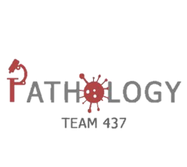
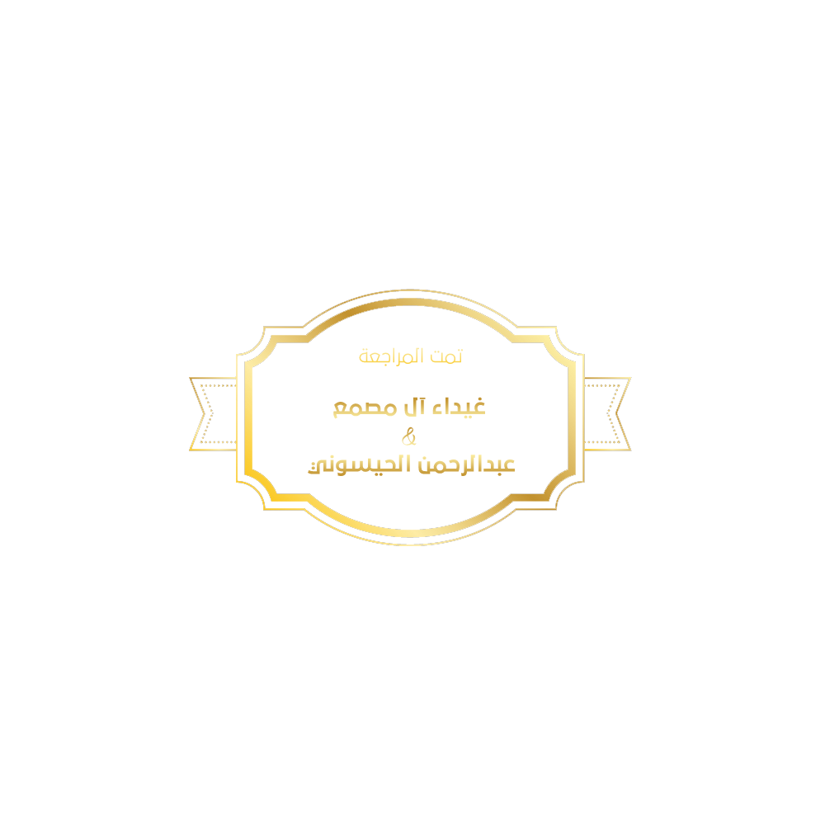
Pathology
teamwork 437
Lecture Four (4) : Osteomyelitis and septic arthritis.
Color Index :-
VERY IMPORTANT
Extra explanation
Examples
Diseases names: Underlined
Definitions
نَستهِّينُ كل غالٍ كي نُحقِقَ الحُلم ..إن سئمِّنا لا نُبالي بل نسِّير للأمام.. إنِّ قمِةَ الجِبالِ تسَّتحِقُ لا جَرم

Slide 2
Objectives:
Understand the etiology, pathogenesis and clinical features of osteomyelitis.
Be familiar with some of the terminology used in bone infections like: sequestrum, involucrum, Brodie abscess and Pott’s disease.
Understand the clinicopathological features of tuberculous osteomyelitis
Identify he bacteria commonly involved in septic arthritis, the clinicopathological features and the characteristics of the joint fluid

Slide 3
Osteomyelitis
Osteomyelitis:- refers to inflammation of the bone and marrow and is usually the result of infection
Osteomyelitis Etiology :
All types of organisms including : Viruses , Parasites , Fungi , and Bacteria
Can produce
Osteomyelitis
The most common are infections caused by certain pyogenic bacteria and mycobacteria
Pyogenic Osteomyelitis :
In case of في حالة | Organism
Most frequent | Staphylococcus aureus
Neonates | Escherichia coli and group B streptococci.
Patients with sickle cell disease | Salmonella
1- Patients with genitourinary tract infections 2- Patients with intravenous drug abusers | E.coli, Klebsiella and Pseudomonas
Direct spread during surgery or open fractures (secondary to bone trauma) | Mixed bacterial infections, including anaerobes
Routes of infection
Hematogenousعن طريق الدم dissemination
(most common)
Extension from an infection in adjacent
joint or soft tissue
يعني جاي من مفصل أو نسيج ثاني و انتقل للعظم
Traumatic implantation
After compound fractures or orthopedic procedures
بعد الكسور خاصة

Slide 4
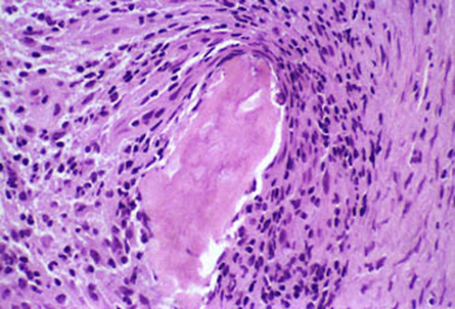
PYOGENIC OSTEOMYELITIS
Bacteria proliferate, inducing an acute inflammatory reaction, with consequent cell death.
Entrapped bone rapidly becomes necrotic; this non-viable bone is called a sequestrum. عبارة عن نسيج من عظم ميت .. داخل العظم نفسه
Bacteria and inflammation can percolate throughout the Haversian systems to reach the periosteum.
Brodie abscess is a small intraosseous abscess that frequently involves the cortex.
An analogous(مماثل) process can involve vertebrae, with an infection destroying intervertebral discs and spreading into adjacent vertebrae.
In children
the periosteum is loosely attached to the cortex; therefore, sizable “major” sub periosteal abscesses can form and extend for long distances along the bone surface
In infants & uncommonly in adults
epiphyseal infection can spread into the adjoining joint to produce suppurative arthritis, sometimes with extensive destruction of the articular cartilage and permanent disability.

Slide 5
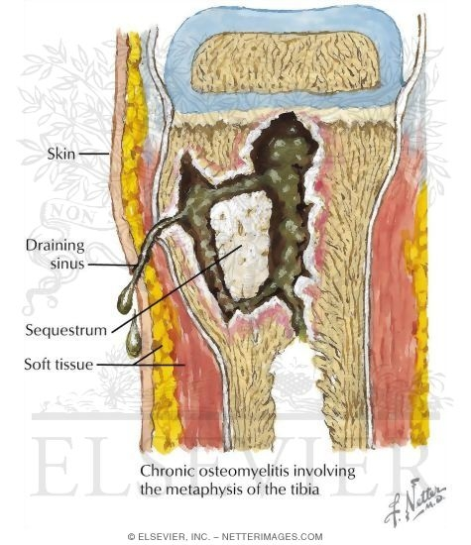
Cont..
Rupture
Rupture of the periosteum
lead to
to abscess formation in the surrounding soft tissue
may lead
draining sinus Sometimes the sequestrum crumbles, releasing fragments
pass
through the sinus tract.
After the first week of infection chronic inflammatory cells become more numerous.
Leukocyte cytokine release stimulates osteoclastic bone resorption, fibrous tissue ingrowth, and bone formation in the periphery.
Reactive woven or lamellar bone can be deposited; when it forms a shell of living tissue around a sequestrum, it is called an involucrum.
Viable organisms can persist in the sequestrum for years after the original infection.
Osteomyelitis classically manifests as an acute systemic illness, with malaise, fever, leukocytosis, and throbbing “ارتجاف - خفقان” pain over the affected region.
Symptoms also can be subtle, with only unexplained fever, particularly in infants, only localized pain in the adult.
Clinical Features :-

Slide 6
PYOGENIC OSTEOMYELITIS Diagnosis
PYOGENIC OSTEOMYELITIS Clinical features
Osteomyelitis classically manifests as an acute systemic illness, with malaise (tired) fever, leukocytosis, and throbbing pain over the affected region.
Symptoms also can be subtle, with only unexplained fever, particularly in infants, or only localized pain in the adult.
Sign/symptoms. الأعراض يلي تشوفها
X-ray: a lytic focus of bone surrounded by a zone of sclerosis we (can see the formation of sequestrum)
Blood cultures (we can see the bacteria that affect patient)
Biopsy (we can see the necrotic bone & inflammatory cells )
In many untreated cases, blood cultures are positive, but biopsy and bone cultures are usually required to identify the pathogen.
Here sometimes the blood culture appear negative-absence of bacteria- that’s why we take biopsy

Slide 7
Treatment
Treatment requires aggressive antibiotic therapy.
Inadequate treatment of acute osteomyelitis may lead to chronic osteomyelitis which is notoriously (بشكل ملحوظ )difficult to manage.
Surgical removal of bony tissue may be required.
Chronicity may develop with
الحالات التي يمكن أن يصير فيها المرض مزمن
delay in diagnosis
extensive bone necrosis
abbreviated antibiotic therapy
inadequate surgical debridement,
weakened host defenses. Immunity low
Complications
Pathologic fracture.
Secondary amyloidosis
Endocarditis
Sepsis
Rarely sarcoma in the affected bone
Squamous cell carcinoma if the infection creates a sinus tract.
https://www.youtube.com/watch?v=MNkI6Of2PRs
https://www.youtube.com/watch?v=kta5vCz_8Lw

Slide 8
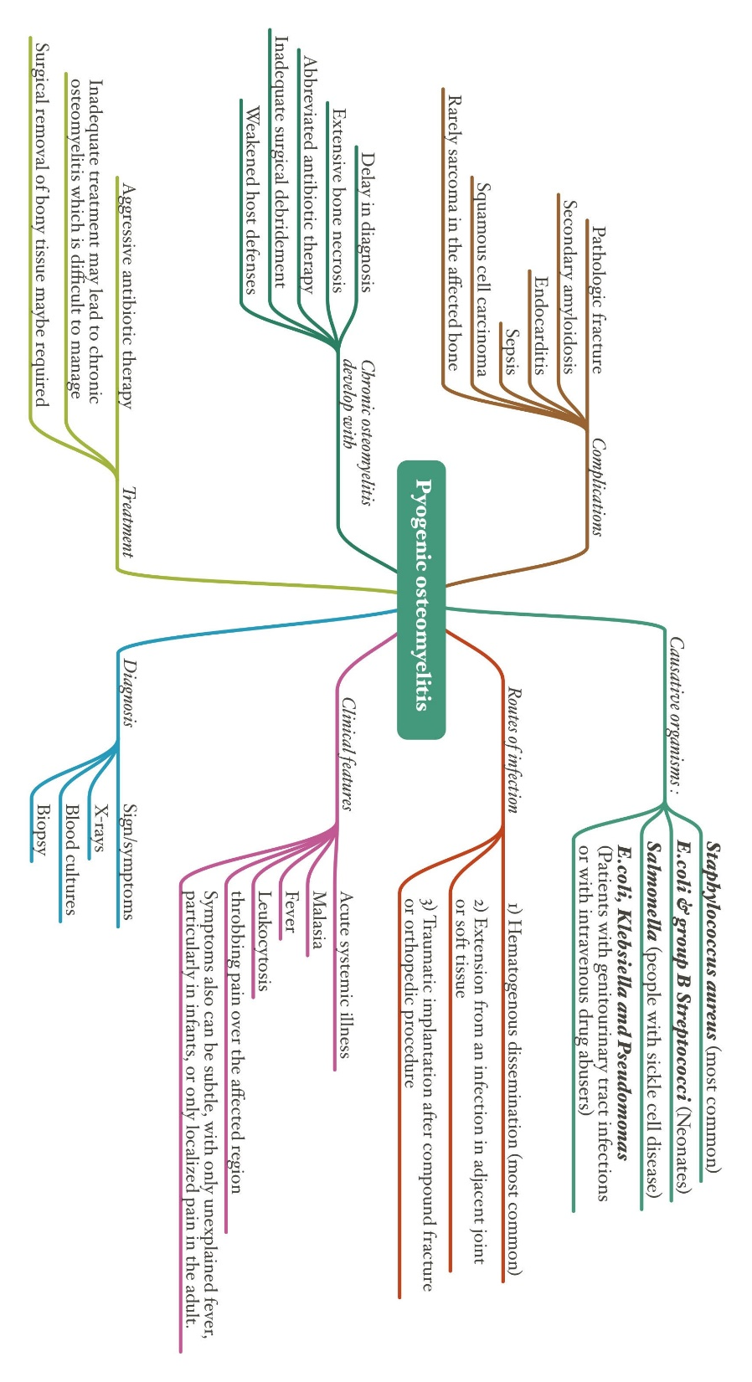

Slide 9
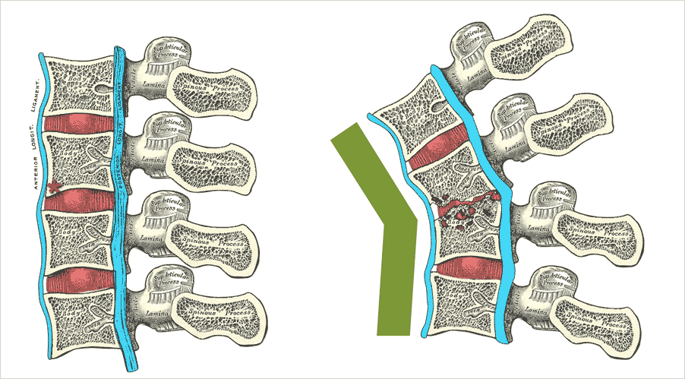
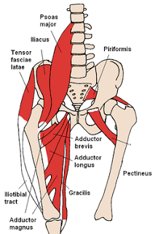
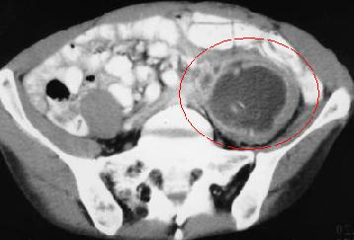
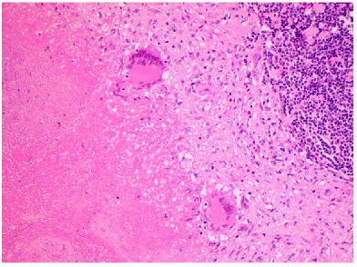
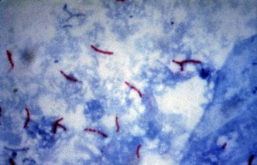
Tuberculous osteomyelitis
Pott’s disease is a form of tuberculosis that happens OUTSIDE the lungs.
second most common after pyogenic.
What is the routes of entry ?
Usually blood borne and originate from a focus of active visceral disease.
Direct extension e.g. from a pulmonary focus into a rib or from tracheobronchial nodes into adjacent vertebrae , or spread via draining lymphatics.
What are the most common sites of skeletal involvement?
Thoracic and lumbar vertebrae followed by the knees and hips
Pott’s disease is the involvement of spine
What are the pathogenesis ?
The infection breaks through the intervertebral
discs and extends into the soft tissues forming
abscesses.
In Pott’s disease, the infection may
breaks through the intervertebral discs
and extends into the muscle forming
Psoas abscesses ( psoas is the name of
the muscle).
What is the Histopathology of Tuberculous osteomyelitis ?
collections of epithelioid histiocytes and lymphocytes with caseation necrosis with multinucleated giant cells.
What are the Clinical features?
Pain
Fever
Weight loss
May form an inguinal mass “ psoas abscess”.
In patients with AIDS frequently multifocal
Due to low immunity , more than one vertebrae is involved
Ziehl Neelsen stain
Special stain for mycobacterial organisms.

Slide 11
Infectious Arthritis
Very good video
Microorganisms of all types can seed joints during hematogenous dissemination.
Articular structures can also become infected by direct inoculation or from contiguous spread from a soft-tissue abscess or focus of osteomyelitis.
Infectious arthritis is potentially serious why? (Possible Question in SAQ)
because it can cause rapid destruction of the joint and produce permanent deformities
The infection involves only a single joint ( monoarthritis) usually:
Joint aspiration is typically purulent
How can you identify the causal agent ?
By Performing Culture
knee
hip
shoulder
elbow
wrist
Sternoclavicular joints
The order is important

Slide 12
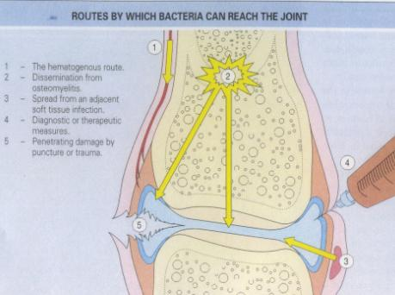
Routes of infection:
Hematogenous عبر الدم
Contiguous spread from osteomyelitis
Contiguous spread from a soft tissue abscess
Iatrogenic غلط من الدكتور أو الجراح
Traumatic
Infectious Arthritis-bacterial
predominates in children under age 2 years | Haemophilus influenzae
main causative agent in children and adults | S. aureus (staphylococcus aureus)
prevalent during late adolescence and young adulthood | Gonococcus * ( Neisseria gonorrhoeae)
Individuals with sickle cell disease at any age. | Salmonella
Bacterial infections almost always cause an acute suppurative arthritis
* Sexually transmitted

Slide 13
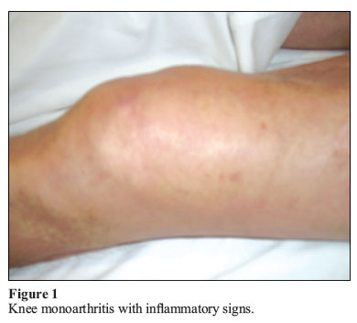
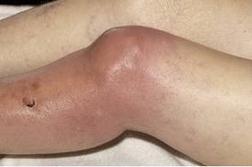
Risk factors
Clinical
features
Immune deficiencies (congenital and acquired)
Debilitating illness
Joint trauma
Intravenous drug abuse
redness, and swelling of the joint with restricted range of motion.
Fever, leukocytosis, and elevated erythrocyte sedimentation rate (ERS)
Complication
Septic arthritis can lead to ankylosis * and even fatal septicemia**.
However, prompt antibiotic therapy and joint aspiration or drainage cures most patients.
sudden onset of pain
Infectious arthritis must be rapidly diagnosed and treated promptly, why?
to prevent irreversible and permanent joint damage.
تصلب المفاصل*
تسمم الدم**

Slide 14
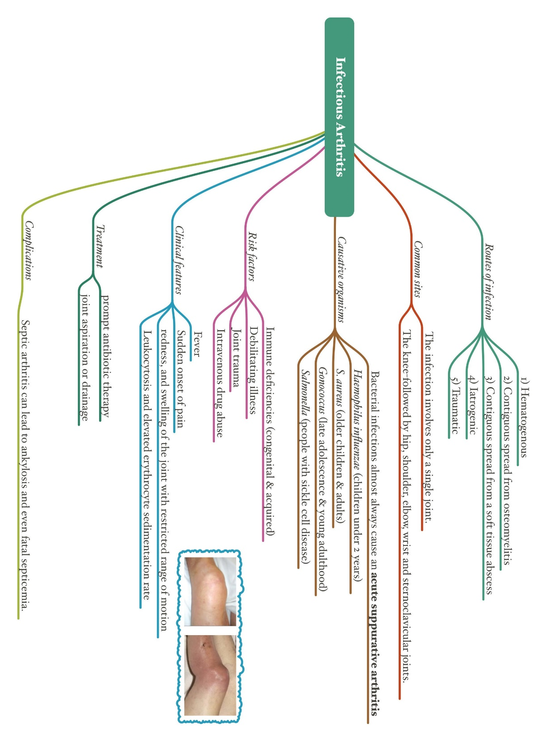

Slide 15
Mcqs
1) In PYOGENIC OSTEOMYELITIS, there's chronic inflammatory cells become more numerous after .............of infection.
1- 1 hour
2- 1 day
3- 1 week
4- 1 month
2) We can diagnosis pyogenic osteomyelitis by:
1- x-ray
2- biopsy
3- 1&2
4- non
3) Tuberculous osteomyelitis is collections of epithelioid histiocytes and lymphocytes with:
1- caseation necrosis
2- Gangrene necrosis
3- fat necrosis
4- coagulative necrosis
4) Clinical features of Tuberculous osteomyelitis:
1- weight gain
2- pain
3- redness
4- 1&3
5) Risk factors ofInfectious Arthritis:
1-Joint trauma
2- Immune deficiencies
3- no risk factor
4- 1&2
6) osteomyelitis Etiology is:
1- trauma
2- genetic disorder
3-All types of organisms, including bacteria
4- unknown etiology
3
3
1
2
4
3

Slide 16
Members :
Males:
-Leader : فيصل الطحان
عبدالجبار اليماني
محمد باحاذق
أحمد الراشد
عبدالله بالعبيد
عبدالله السرجاني
أحمد الحربي
أنس السيف
داود إسماعيل
فهد الفايز
محمد بن معيوف
فهد النهابي
سعد الفوزان
سيف المشاري
تميم الوهيبي
خالد العقيلي
محمد الصويغ
محمد الأصقه
نواف السبيعي
عبدالعزيز المهنا
عبدالله المعيذر
فايز الدرسوني
رشيد البلاع
Females:
-Leader : بثينة آل ماجد
روان الحربي
وفاء العتيبي
الجوهرة الشنيفي
رزان الزهراني
رهف الشمري
روان مشعل
منيره المسعد
نوف العتيبي
رزان الزهراني
هديل عورتاني
فاطمة بالشرف
ابتسام المطيري
رناد الفرم
غرام جليدان
بلقيس الراجحي
نورة القاضي
آلاء الصويغ
ريم القحطاني

Slide 17
Kindly contact us if you have any questions/comments and suggestions:
* EMAIL: pathology437@gmail.com
* TWITTER : @pathology437
Resources:-
1- Females slides
2- Robbin’s Basic Pathology
GOOD LUCK! ☺
Pathology
teamwork 437

