Slide 1



Pathology
teamwork 437
Lecture Five (5) : Arthritis .
Color Index :-
VERY IMPORTANT
Extra explanation
Examples
Diseases names: Underlined
Definitions
          نَستهِّينُ كل غالٍ كي نُحقِقَ الحُلم ..إن سئمِّنا لا نُبالي بل نسِّير للأمام.. إنِّ قمِةَ الجِبالِ تسَّتحِقُ لا جَرم

Slide 2
Objectives:
Know the pathogenesis and clinicopathological features of osteoarthritis (degenerative joint disease),
Know the pathogenesis and clinicopathological features of rheumatoid arthritis
Know the pathogenesis and clinicopathological features of gout and calcium pyrophosphate arthropathy [pseudogout]

Slide 3
Inflammatory disease of joints
( arthritis and synovitis )
Has four main causes
Degeneration
Autoimmunity
Crystal deposition
Infection
e.g. osteoarthritis
e.g. rheumatoid arthritis, SLE
e.g. gout and other crystalline arthropathies
e.g.septic arthritis tuberculous arthritis
OSTEOARTHRITIS :
Definition and incidence :
Osteoarthritis (degenerative joint disease) is the most common
Joint disease and is characterized by the progressive degeneration of articular cartilage
In weight- bearing joints.
mostly old people (over 50)
affects females more than males
Osteoarthritis can be : primary or secondary
Primary osteoarthritis:
Appears insidiously with age and without apparent initiating cause
Usually affecting only a few joints
Cause is usually IDIOPATHIC
Secondary osteoarthritis: ( Known Cause )
Some predisposing condition, such as previous traumatic injury,
developmental deformity, or underlying systemic disease such as
diabetes, hemochromatosis, or marked obesity
  Secondary osteoarthritis affects young people
  often involves one or several predisposed joints
  less than 5% of cases
  Pathogenesis: Articular cartilage bears the brunt of the degenerative change in osteoarthritis
Normal articular cartilage performs two functions:
(1) Along with the synovial fluid, it provides virtually friction-free movement within the joint
(2) In weight-bearing joints, it spreads the load across the joint surface

Slide 4
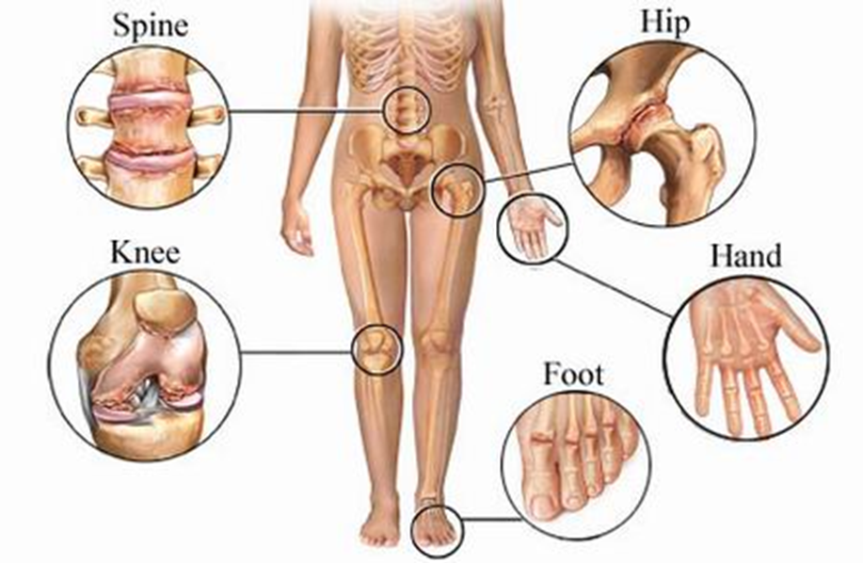
These functions require the cartilage to be elastic (i.e., to regain normal architecture after compression) and to have high tensile strength. These attributes are provided by proteoglycans and type II collagen, both produced by chondrocytes
Chondrocytes function is affected by a variety of influences:
-Mechanical stress - Aging - Genetic factor
Regardless of the inciting stimulus, there is an imbalance in the expression, activity, and signaling of cytokines and growth factors that results in degradation and loss of matrix.
Early osteoarthritis is marked by:
degenerating cartilage containing: more water and less proteoglycan
The type II collagen network also is diminished, presumably as a result of decreased local synthesis and increased breakdown
Important for Cartillages
Gender has some influence:
Women : knees and hands
Men : hips
Osteoarthritis Common sites :

Slide 5
Osteophytes
Small cysts develop in the bone ( Due to forced leakage of synovial fluid into the subchondral region )
Constant friction of bone surfaces, leading to a polished ivory bony articular surface (eburnation)

Slide 6
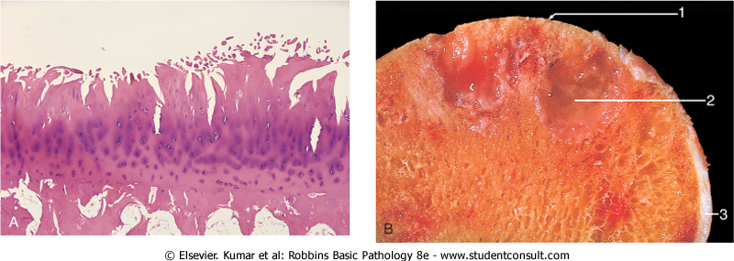
Morphology
fibrillation and cracking of the matrix occur as the superficial layers of the cartilage are degraded
Eventually, full-thickness portions of the cartilage are lost, and the subchondral bone plate is exposed and is smoothened by friction, giving it the appearance of polished ivory (bone eburnation)
الغشاء يلي مفروض يمنعها من الاحتكاك مب موجود , فتصير العظام تحكتك مع بعض فيصير شكلها كانها مصقولة
Small fractures can dislodge pieces of cartilage and subchondral bone into the joint, forming loose bodies (joint mice). ( That runs in MULTIPLE Directions )
The fracture gaps allow synovial fluid to be forced into the subchondral regions to form fibrous walled cysts.
Mushroom-shaped osteophytes (bony outgrowths) develop at the margins of the articular surface
Osteoarthritis. : Histologic demonstration of the characteristic fibrillation of the articular cartilage.

Slide 7
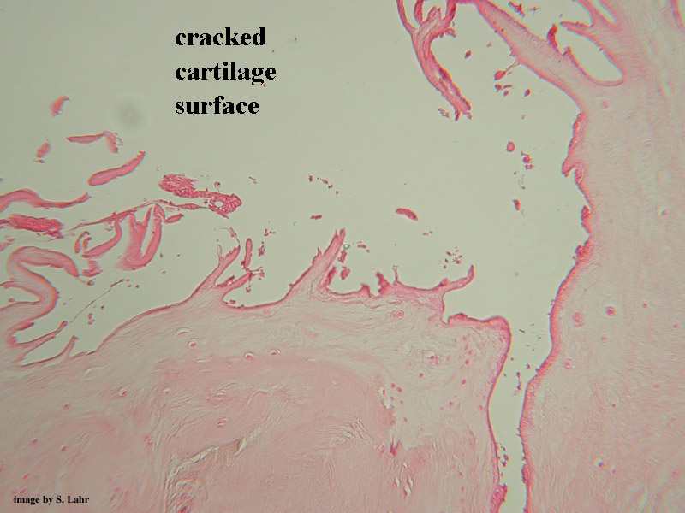
Severe Osteoarthritis
Cracking and fibrillation of cartilage
Eburnated articular surface exposing subchondral bone
Subchondral cyst
Residual articular cartilage

Slide 8

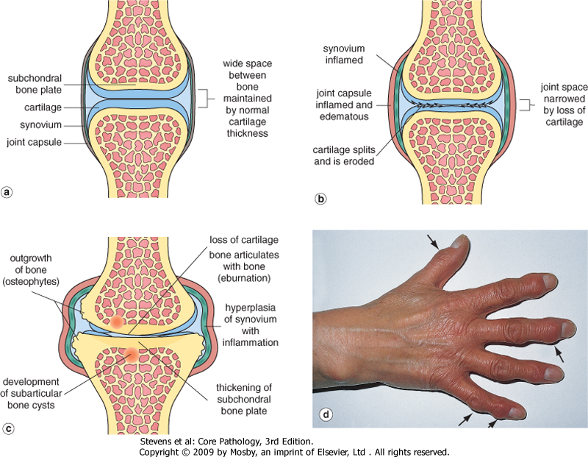
Pathological changes in osteoarthritis
Very good Video ☺
Heberden’s nodes (osteophytes on the distal interphalangeal joints of the fingers)
Bouchard nodes (osteophytes on the metacarpophalangeal (proximal) joints of the hand)

Slide 9

Clinical course
Characteristic symptoms and signs include deep, aching pain exacerbated by use, morning stiffness, crepitus (grating or popping sensation in the joint), and limitation in range of movement.
Osteophyte impingement on spinal foramina can cause nerve root compression with radicular pain and neurologic deficits.
Hips, knees, lower lumbar and cervical vertebrae, proximal and distal interphalangeal joints of the fingers, first carpometacarpal joints, and first tarsometatarsal joints of the feet are commonly involved. Heberden nodes in the fingers, representing prominent osteophytes at the distal interphalangeal joints, are characteristic in women.
N.B :- Here the DIP & PIP ( in Hand ) are NOT spared , while in Rheumatoid arthiritis , the DIP is spared and it affects PIP.
Course & Prognosis
Slowly Progressive
With time, significant joint deformity can occur, Treatment usually is based on symptoms, with joint replacement in severe cases.

Slide 10
rheumatoid arthritis
What is Rheumatoid Arthritis?
    RA is a systemic, chronic inflammatory autoimmune disease affecting many tissues but principally attacking the joints.
    It causes a nonsuppurative proliferative synovitis that frequently progresses to destroy articular cartilage and underlying bone with resulting disabling arthritis.
    Its an Autoimmune , So of course it will be more prevalent in Women more than men
    The peak incidence is in the second to fourth decades of life, but no age is immune.
What are the pathogenesis?
    The pathologic changes are caused mainly by cytokine-mediated inflammation, with CD4+ T cells being the principal source of the cytokines.
    Many patients also produce antibodies against cyclic citrullinated peptides (CCPs), which may contribute to the joint lesions In RA,antibodies to citrullinated fibrinogen, type II collagen, α-enolase,and vimentin are the most important and may form immune complexes that deposit in the joints. These antibodies are a diagnostic marker for the disease and may be involved in tissue injury.
    Genetic factors: Mainly involves HLA-DRB1
    Environmental factors: Many candidate infectious agents whose antigens may activate T or B cells have even considered, but none has been conclusively implicates .
    About 80% of patients have serum immunoglobulin M (IgM) (and, autoantibodies that bind to the Fc portions of their own (self) IgG.
    These autoantibodies are called rheumatoid factor. They may form immune complexes with self-IgG that deposit in joints and other tissues, leading to inflammation and tissue damage. However, the role of rheumatoid factor in the pathogenesis of the joint or extraarticular lesions has not been established.

Slide 11
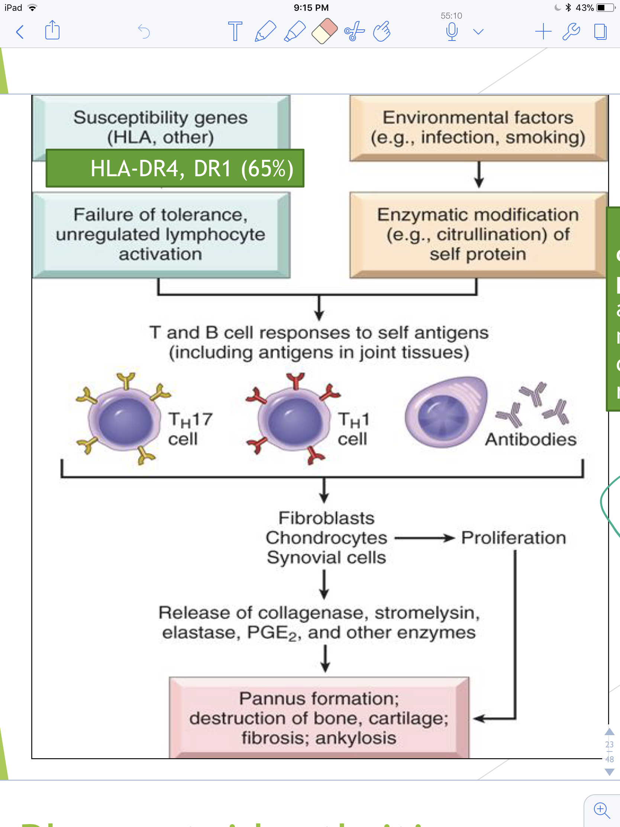
Antibodies against cyclic citrullinated peptides (CCP protein antibodies) is the most specific for a diagnosis of rheumatoid arthritis

Slide 12
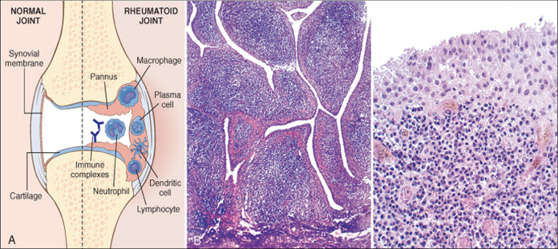
Rheumatoid Arthritis
Laboratory Findings:
Rheumatoid factor: 80% have IgM autoantibodies that act on Fc portion of IgG
It is NOT Specific , Although it is sensitive and can come out positive in almost 20% of patients
Anti-CCP (cyclic citrullinated peptides) protein antibodies most specific for a diagnosis of rheumatoid arthritis
ESR and C-reactive protein. ( But its not that important as Anti CCP )
Pathologic Features:
Step 1
Step 2
Step 3
Step 4
Step 5
synovial cell hyperplasia and proliferation
Dense perivascular inflammatory cell infiltrates (Chronic
synovitis) frequently forming lymphoid follicles in the synovium composed of :
CD4+ T cells
plasma cells
macrophages
increased vascularity due to angiogenesis
( Formation of new vessels )
neutrophils and aggregates of organizing fibrin on the synovial surface
increased osteoclast activity in the underlying bone.
bone erosion
Pannus (important pathological feature):
Formed by proliferating synovial-lining cells admixed with inflammatory cells, granulation tissue, and fibrous connective tissue
Eventually the pannus fills the joint space, and subsequent fibrosis and calcification may cause permanent ankylosis (stiffness and immobility of joint).

Slide 13
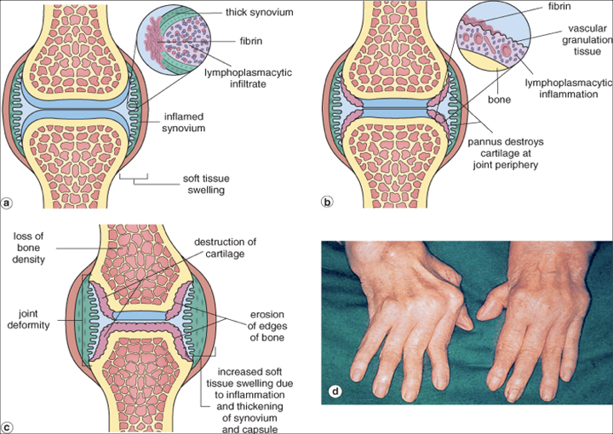
Rheumatoid Arthritis
A
B
dense perivascular inflammatory cell infiltrates
increased vascularity
neutrophils and aggregates of organizing fibrin on the synovial surface.
Pannus formation
synovial cell hyperplasia and proliferation
C
D
increased osteoclast activity in the underlying bone ➔ bone erosion
swan neck finger

Slide 14
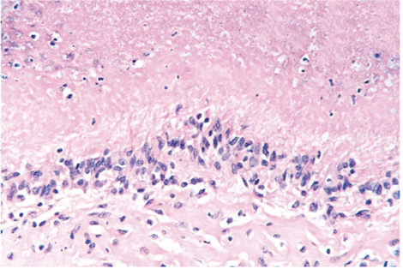
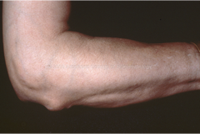
Rheumatoid Arthritis
Rheumatoid Subcutaneous Nodules:
develop in about one fourth of patients
occurring along the extensor surface of the forearm
Rheumatoid nodules are firm, non-tender, oval or rounded masses as large as 2 cm in diameter.
They are characterized microscopically by a central focus of fibrinoid necrosis surrounded by a palisade of macrophages, which in turn is rimmed by granulation tissue and lymphocytes
Clinical Features:
symmetric arthritis, principally affecting the small joints of the hands and feet, ankles, knees, wrists, elbows, and shoulders.
Most often, the proximal interphalangeal and metacarpophalangeal joints are affected, but distal interphalangeal joints are spared.
Axial involvement, when it occurs, is limited to the upper cervical spine; similarly, hip joint involvement is extremely uncommon.

Slide 15
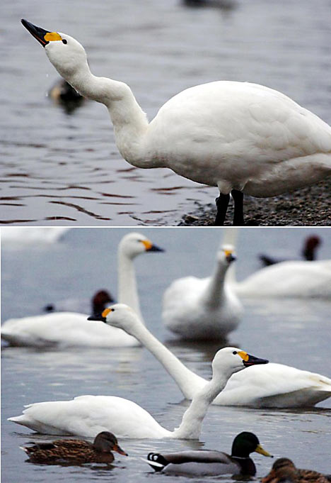
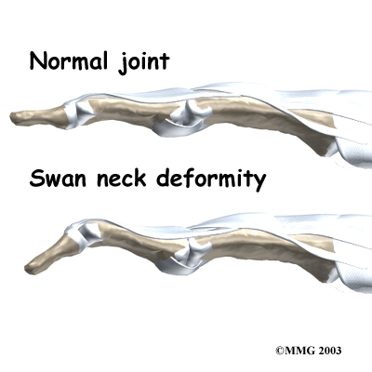
RA Clinical features
symmetric arthritis, principally affecting the small joints of the hands and feet, ankles, knees, wrists, elbows, and shoulders.
Most often, the proximal interphalangeal and metacarpophalangeal joints are affected, but distal interphalangeal joints are spared.
Axial involvement, when it occurs, is limited to the upper cervical spine; similarly, hip joint involvement is extremely uncommon.
Weakness , low grade fever
aching and stiffness of the joints, particularly in the morning
As the disease advances, the joints become enlarged, motion is limited
characteristic derformities develop. These include:
Radial deviation at the wrists.
Ulnar deviation at the fingers.
Flexion and hyperextension deformities of the fingers (swan neck and boutonniere deformities).
boutonniere deformity

Slide 16
Rheumatoid arthritis
X-ray
Loss of articular cartilage leading to narrowing of the joint space.
Joint effusions.
Erosions
Prognosis
The clinical course of RA is highly variable.
In a minority of patients, the disease may stabilize or even regress
in most patients it pursues a chronic, remitting-relapsing course.
progressive joint destruction leading to disability after 10 to 15 years. The outcome has been dramatically improved by recent advances in therapy.
RA is an important cause of reactive amyloidosis, which develops in 5% to 10% of these patients, particularly those with long-standing severe disease

Slide 17
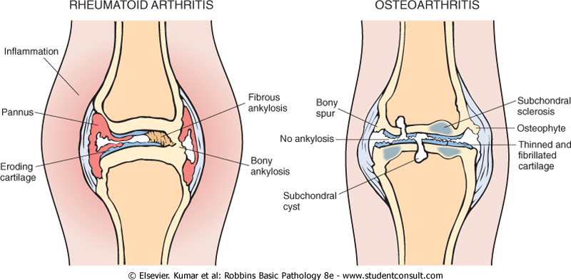
Comparison of the morphologic features of RA and osteoarthritis
Comparison of
Osteoarthrosis & Rheumatoid Arthritis

Slide 18
Link it with “Gout” from Biochemistry , it will be extremely easy ☺
Gout (monosodium urate crystals)
Gout affects about 1% of the population, and shows a predeliction for males.(most common in males)
It is caused by excessive amounts of uric acid
Monosodium urate crystals precipitate from supersaturated body fluids and induce an acute inflammatory reaction.
What is Gout marked by?
  recurrent episodes of acute arthritis
  sometimes accompanied by the formation of large crystalline aggregates called tophi ((حصوات
  eventual permanent joint deformity.
What are the risk factors for gout?
  Obesity
  consumption of purine-rich foods (such as meat)
  excess alcohol intake
  Diabetes
  the metabolic syndrome
  Renal failure (because there will be underexcretion of uric acid => accumulation of uric acid => hyperuricemia which may lead to gout but not always)
Don’t skip the table
Gout
Primary (most common)
90%
Secondary
10%

Slide 19
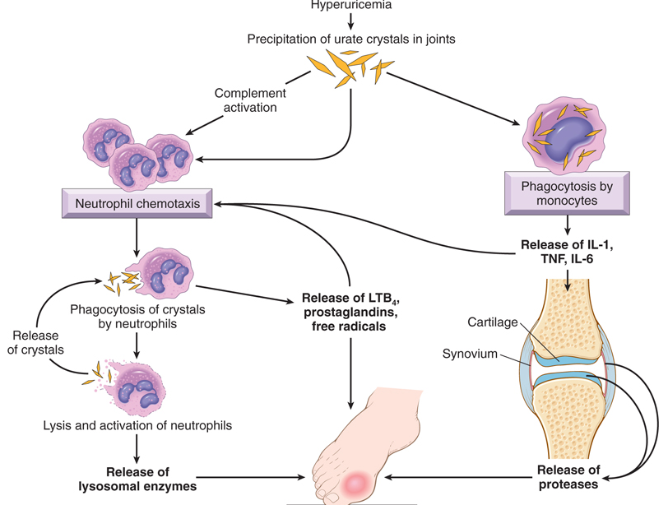
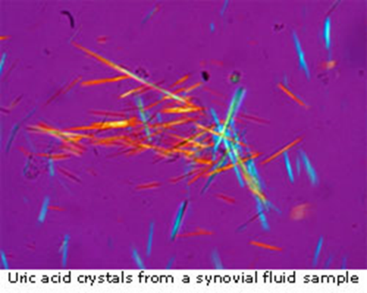
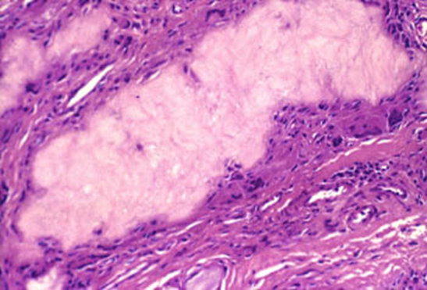
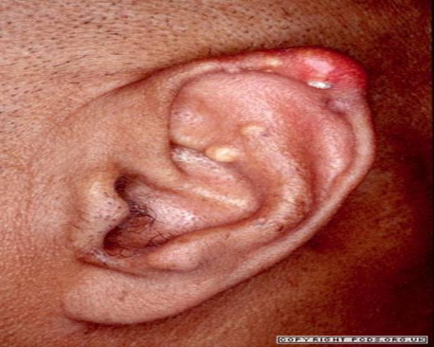
Gout Morphology:
Acute arthritis: is characterized by a dense neutrophilic infiltrate permeating the synovium and synovial fluid. Long, slender, needle-shaped monosodium urate crystals frequently are.( look at pic 1 you have to now the shape)
Chronic tophaceous arthritis: evolves from repetitive precipitation of urate crystals during acute attacks. The synovium becomes hyperplastic, fibrotic, and thickened by inflammatory cells.
Tophi are pathognomonic for gout: They are formed by large aggregations of urate crystals surrounded by an intense inflammatory reaction of lymphocytes, macrophages, and foreign-body giant cells. (look at pic 2)
    Tophi can appear in the articular cartilage of joints and in the soft tissues, including the ear lobes & nasal cartilages (look at pic 3)
Pic 1
Pic 2
Pic 3

Slide 20
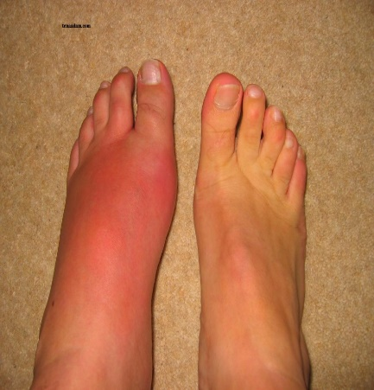
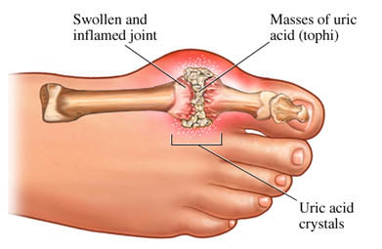
Clinical Features
The most commonly affected site is: first metatarsophalangeal joint.
It is swollen, red, and very painful.
Renal manifestations of gout can appear as renal colic associated with the passage of gravel and stones
Pseudogout (Calcium pyrophosphate crystals)
This condition is due to the deposition of calcium pyrophosphate crystals in the synovium (pseudogout) and articular cartilage (chondrocalcinosis).
It can occur in three main settings:
  Sporadic (more common in the elderly).
  Hereditary.
  Secondary to other conditions, such as previous joint damage, hyperparathyroidism, hypothyroidism, haemochromatosis and diabetes.
The crystals first develop in the articular cartilage (chondrocalcinosis), which is usually asymptomatic. From here, the crystals may shed into the joint cavity resulting in an acute arthritis, which mimics gout and is therefore called pseudogout.*
* في البدايه يتجمع في articular cartilage وهنا ما راح يكون لها اعراض بعدين ممكن تروح joint وتسبب اعراض تشبه gout عشان كذا يكون اسمها pesodogout

Slide 21
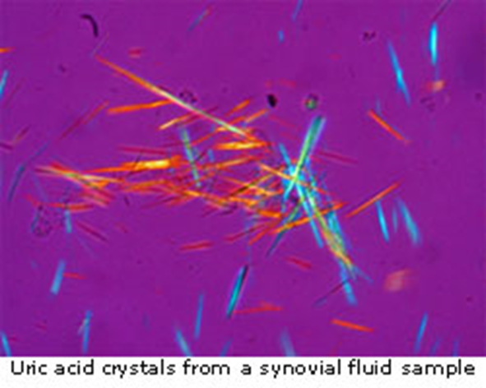
Pseudogout | Gout
The knee is most commonly involved. | first metatarsophalangeal joint is most commonly involved
X-rays show the characteristic line of calcification of the articular cartilage. | _
rhomboid shaped crystals | Long, slender, needle-shaped crystals
calcium pyrophosphate crystals | monosodium urate crystals

Slide 22
Members :
Females:
-Leader : بثينة آل ماجد
روان الحربي
وفاء العتيبي
الجوهرة الشنيفي
رزان الزهراني
رهف الشمري
روان مشعل
منيره المسعد
لميس السويلم
نوف العتيبي
رزان الزهراني
هديل عورتاني
فاطمة بالشرف
ابتسام المطيري
رناد الفرم
غرام جليدان
بلقيس الراجحي
نورة القاضي
آلاء الصويغ
ريم القحطاني
Males:
-Leader : فيصل الطحان
عبدالجبار اليماني
محمد باحاذق
أحمد الراشد
عبدالله بالعبيد
عبدالله السرجاني
أحمد الحربي
أنس السيف
فايز الدرسوني
داود إسماعيل
فهد الفايز
محمد بن معيوف
فهد النهابي
سعد الفوزان
سيف المشاري
تميم الوهيبي
رشيد البلاع
عبدالله المعيذر
محمد الأصقه
محمد الصويغ
عبدالعزيز المهنا
نواف السبيعي
خالد العقيلي

Slide 23

Gently contact us if you have any questions/comments and suggestions:
* EMAIL: pathology437@gmail.com
* TWITTER : @pathology437
Resources:-
1- Females slides
2- Robbins reference book
GOOD LUCK! ☺
Pathology
teamwork 437

