Slide 1
Non-steroidal Anti-inflammatory Drugs
“NSAIDs”
Objectives:
To focus on the general mechanism of action of NSAIDs
To outline the common pharmacodynamic effects and ADRs of NSAIDs
To classify NSAIDs on basis of their specifity to COX enzyme
To detail on the pharmacokinetic properties and pharmacodynamic effects of selected NSAIDs
Editing File
Important Notes Extra

Slide 2
Overview Of NSAIDs
What are NSAIDs?
A drug class that provide analgesic (pain killer) and antipyretic effect (lower temperature) and have anti- inflammatory effects. In addition, it’s called (non- steroid) to distinguish from steroid drugs.
Mechanism of action:
Inhibition of Cyclo Oxygenase (COX) enzyme which lead to the inhibition of Prostaglandin synthesis. All actions and side effects are due to this inhibition.
COX Isoforms :
COX-1:
Hemostatic functions
Its inhibition is not desirable due to its ADRS
COX-2:
Inflammation inducer
Its inhibition is desirable.
COX-3:
Found in the brain.
Pharmacodynamic effects (action of) NSAIDs:
1- Analgesic :
NSAIDs inhibit the formation of PGE2 & PGF2 causing analgesia (pain killer) in peripheral tissue. Prostaglandin stimulates the pain receptors (Nociceptors) so inhibiting its synthesis will relieve pain. (More details about pain will be discussed in CNS block).
2- Antipyretic :
NSAIDs inhibit the formation of PGE2 which activates the thermoregulatory center to raise Heat production and inhibit dissipation (Fever) in CNS. Act on relieving moderate fever not a severe one. It decreases heat by causing vasodilatation and sweating.
3-Anti-inflammatory:
NSAIDs inhibit the formation of PGE2 & PGF2 which cause Redness, swelling, Heat and Pain in association with Bradykinin, Histamine and 5-HT. site of action : peripheral tissue. All have this effect except Paracetamol.

Slide 3
Clinical uses of Analgesic, Antipyretic, and Anti-inflammatory :
Fever
Headache, Migraine (only in mild to moderate migraine)
Dental pain, Dysmenorrhea (painful period)
Common cold
Rheumatoid arthritis / myositis
NSAIDs are given to relieve mild to moderate pain not severe one!
General ADRS: GIT side effects are VERY important!
NSAIDs cause hemodynamically- mediated acute renal failure. With large doses.
GIT upsets ( nausea, vomiting)
GIT bleeding & ulceration with prolong use and overdose may lead to perforating peptic ulcer
Hypersensitivity reactions (Because of Leukotrienes which their enzyme –Lipoxygenase- is not inhibited)
Inhibition of uterine contraction it can be used during labor
Salt & water retention
Classification of NSAIDs
EXAMPLE | TYPE
Aspirin and Diclofenac | Nonselective (inhibit COX1&2)
Coxibs | Selective COX-2 ( inhibit only COX-2 )
Meloxicam | Preferential COX-2 inhibitors
Paracetamol | COX-3 inhibitors
Note that nonselective must be taken after eating while selective COX-2 can be taken on an empty stomach.

Slide 4
Non selective COX inhibitors:
This class inhibits both COX-1 and COX-2 but its effect is more potent on COX-1 (many ADRS). Those drugs include:
Aspirin
Diclofenac
Ibuprofen
Ketoprofen
Naproxen
Piroxicam
Indomethacin
Note that Ibuprofen is a potent anti-inflammatory drug.
Indomethacin is not used anymore due its severe ADRS.
Drug | Aspirin (Acetylsalicylate)
MOA | Inhibits COX (non selective) irreversibly by acetylation.
P.K | 1. Higher dose of aspirin has a long plasma half- life. 2. Metabolized by hydrolysis and then conjugation. 3. Zero order kinetic elimination. The rate of elimination is constant even if you increased the dose causing accumulation. Due to plasma protein binding- zero order of kinetics – wild volume of distribution
Clinical Uses | 1. Acute rheumatic fever. 2. Reducing the risk of myocardial infarction (cardioprotective). Inhibition of thrombosis formation. Small doses are used as prophylactic therapy. 3. Prevention of pre-eclampsia.تسمم الحمل 4. Chronic use of small doses reduce the incidence of colon cancer. The reason is unknown.
ADRs | Clinical dose: Hypersensitivity bronchospasm, rhinitis, conjunctivitis, urticaria Acute gouty arthritis (low doses) Reye's syndrome. Affects children with viral infection who takes aspirin. Impaired hemostasis. Bleeding GIT side effects, dyspepsia, nausea and vomiting Mucosal damage → hemorrhage | Overdose: Salicylism (ringing of ear, vertigo) Hyperthermia while therapeutic dose decreases the fever Gastric ulceration & bleeding

Slide 5
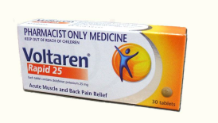
Aspirin cont..
Contraindication | 1. Peptic ulcer. 2. Patients taking Anticoagulants. 3. Hemophilic patients. 4. Children with viral infections. 5. Pregnancy. 6. Gout (small doses). 7-Asthmatic patients. Aspirin induced asthma
Drug interaction | Taking Aspirin with antacid should be avoided because it reduces the absorption of aspirin by reducing the acidity media which is required for aspirin absorption.
(Reye’s Syndrome)
Aspirin dose:
Low dose:
Large dose:
uric acid retention, prevent urate
secretion to proximal
tubular cell, hence, High in blood, low in urine.
Cause GOUT
Prevent Urate from reabsorption hence high in urine, low in blood
Uricosuria
Treat GOUT
Drug | Diclofenac
Clinical uses | 1. Analgesic. 2. Antipyretic. 3. Anti-inflammatory. Strong effect 4. Acute gouty arthritis. 5. Locally to prevent post-operative ophthalmic inflammation.
Preparations | • Diclofenac (could be given) with misoprostol (type of PGE1) decreases upper gastrointestinal ulceration , but result in diarrhea. • Diclofenac with omeprazole (decrease acidity) to prevent recurrent bleeding. • 0.1% ophthalmic preparation for postoperative ophthalmic inflammation. • A topical gel 3% for solar keratoses. • Rectal suppository as analgesic . Given to children with fever • Oral mouth wash. • Intramuscular preparations.

Slide 6
Selective COX-2 inhibitors:
This group of drugs of NSAIDs inhibit COX-2 selectively with no effect on COX-1. Those drugs include:
Valdecoxib is converted into Rofecoxib
Celecoxib
Etoricoxib
Paracoxib
Lumiracoxib
Rofecoxib
*Valdecoxib
*It is withdrawn because of risk of myocardial infarction and stroke
General Action | • Potent anti-inflammatory. • Antipyretic & analgesic. • Lower incidence of gastric upset. • No effect on platelet aggregation(COX-1) No cardioprotective effect
General ADRs | • Renal toxicity • Cardio vascular do not offer the cardio-protective effects of non-selective group (not anti-platelet) COX-2 is found only in endothelial cells where Prostacyclin is found and Thromboxane is NOT found. • Dyspepsia & Allergy heartburn it is not as potent as the one caused by COX-1 inhibitors • Allergy
Clinical Uses | 1. Short-term use in post operative patients to reduce inflammation and increased body temperature 2. Acute gouty arthritis 3. Acute musculoskeletal pain (cause it’s potent anti-inflammatory). 4. Ankylosing spondylitis (inflammation in the joints of spine, leading to pain and stiffness) (muscle pain)
Contradiction | Shouldn’t be given to a patient with CV diseases.

Slide 7
Drug | Celecoxib | Meloxicam, Nimesulide, Nambumetone
P.K | Half-life 11 hours Food decreases its absorption (Not given with food) Highly bounded to plasma proteins | Half-life 20 hours prolong effect
MOA | Selective COX-2 inhibitor It is the best among those inhibitors | Preferentially inhibits COX-2 over COX-1, particularly at low dose The most important one is Meloxicam
Indication | - | Used for Osteoarthritis and rheumatoid arthritis
ADRs | - | Associated with lower GIT symptoms and complains compared to non-selective COX inhibitors
Contradiction | Contraindicated in patients with Sulphonamides allergy. | -

Slide 8
Selective COX-3 inhibitors:
Drug | Paracetamol (Acetaminophen)
MOA | Selectively inhibits the COX-3. Found in the brain. Weak anti-inflammatory effect. It is not given in conditions associated with inflammation
P.K | Given orally , well absorbed. t½=2-4 h. Metabolized by conjugation at therapeutic doses. Binding of paracetamol to COX is inhibited by peroxides produce in inflammatory sites. There is no evidence that COX3 exists in humans.
Indications | Commonly used analgesic antipyretic instead of Aspirin in cases of: Peptic or gastric ulcers Bleeding tendency Allergy to Aspirin Viral infections in children Pregnancy
ADRs | Mainly on the liver due to its active metabolite (N- acetyl-p-benzoquinone imine) with large doses which causes liver damage (Hepatotoxicity). Therapeutic doses causes only liver enzymes elevation. No significant ADRS. Chronic abuse causes Nephrotoxicity.
Toxicity | The toxicity caused by large doses of Paracetamol is treated by N- acetylcysteine to neutralize the toxic metabolite. VERY IMPORTANT! Note: Any drug used to overcome a toxicity we call it Antidot.

Slide 9
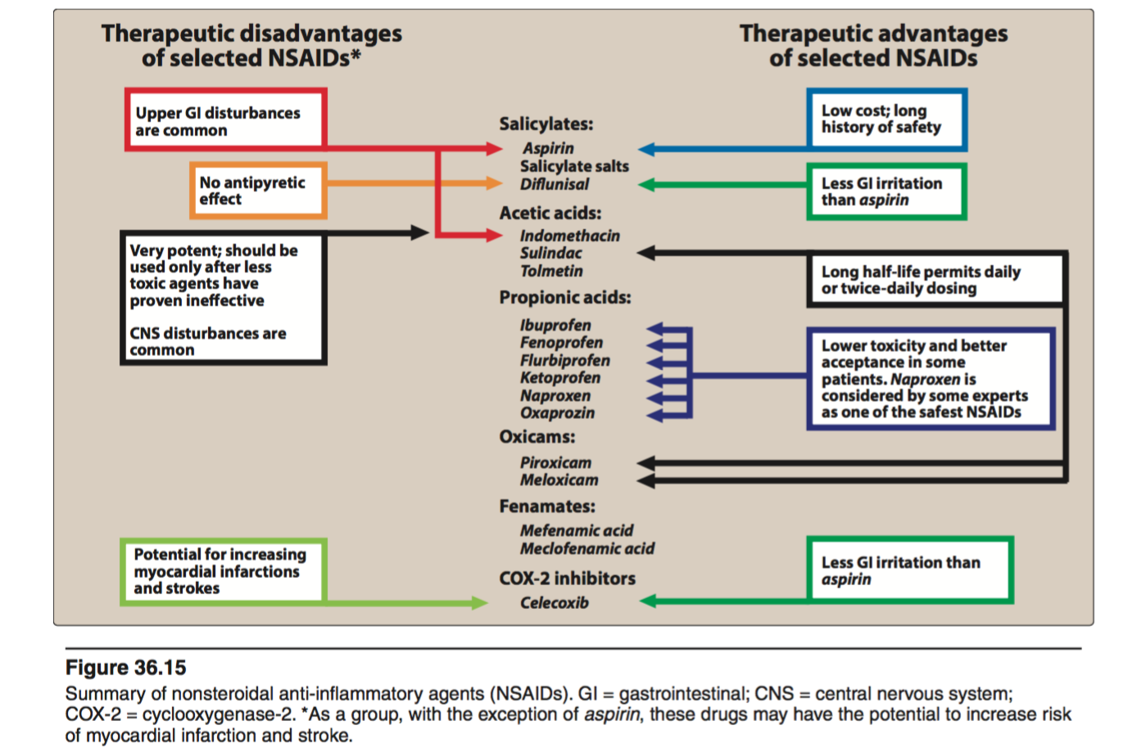
Summary
Paracetamol VS Aspirin:
Clinical uses of Paracetamol | Contraindications of Aspirin
Peptic or gastric ulcers | Peptic ulcer
Bleeding tendency | Hemophilic Patients, Patients taking Anticoagulants.
Viral infections in children | Children with viral infections
Pregnancy | Pregnancy
Allergy to aspirin | Gout ( small doses )
*This summary is from Lippincott
Helpful videos:
https://www.youtube.com/watch?v=LQpQtBEGkU4&index=33&list=WL
https://www.youtube.com/watch?v=VXR0Xiif25M&list=WL&index=34 ( turn off the volume )

Slide 10
Questions
MCQs:
1-A five years boy was brought to the ER by his older brother complaining from runny nose and severe headache. Which of the following drugs can be used with this patient?
A)Aspirin
B)Paracetamol
C)Diclofenac
2-The bronchospasm effect of NSAIDs is due to
A)Stimulation of COX
B)Overproduction of Prostaglandin
C)Lipoxygenase effect
3-The possible cause of Acute renal failure mediated by Paracoxib is
A)Water retention
B)Vasoconstriction of afferent and efferent blood vessels
C)Stimulation of PGE2
4-A 67 years old lady was found dead in her home. At autopsy , it was found that her liver is pale and full of fibers. Refining her medical records it was found that she had peptic ulcers and asthma. Which of the following could be the reason behind the damaged liver?
A)Overdose of Acetaminophen
B)Using N-acetylcysteine
C)Aspirin
5-Celecoxib is contradicted with what?
A)Asthmatic patients
B)Chronic heart disease
C)Sulphonamides allergy
Answers:
1-B
2-C
3-B
4-A
5-C

Slide 11
Cont..
SAQ:
A woman complaining from migraine was prescribed Ibuprofen. Based on those information, answer the following:
A-Mention the class and the mechanism of action of Ibuprofen
Nonselective COX-1 and COX-2 inhibitor
B-In brief, talk about the possible cause of pain in this patient
PGE2 and PGF2 are released in the brain tissue to stimulate pain receptors which causes the pain sensation in migraine.
C-Mention 3 ADRS of this drug
1-GIT upsets
2-Bleeding
3-water and salt retention
D-What protective effect does this drug have?
Cardioprotective effects by inhibiting the formation of thrombosis

Slide 12
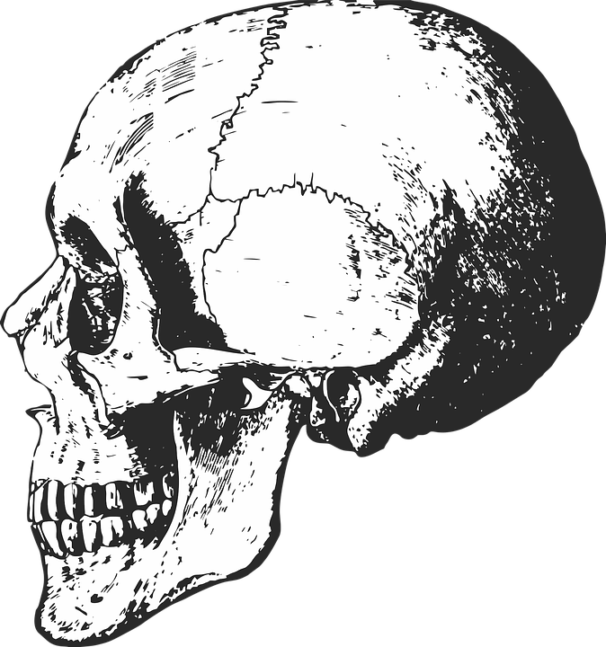
“It is not hard, you just made it to the end!”
Team Leaders:
Yazeed Al-Harbi & Aseel Badukhon
Thanks for those who worked on this lecture:
Reem Al-Qarni
Dana Al-Rasheed
Rahaf Al-Thnayan
Haifa Al-Essa
Ghada Al-Qarni
شكرًا جزيلًا للزميلة لين التميمي من دفعة 436 على تعاونها اللطيف و نصائحها الغنية لإتمام هذا العمل.
References:
Team436
Doctors’ notes and slides
@Pharma4370
pharmacology437@gmail.com

