Slide 1
Skeletal Muscle Relaxants
Objectives:
Identify classification of skeletal muscle relaxants.
Describe the pharmacokinetics and dynamics of neuromuscular relaxants.
Recognize the clinical application for neuromuscular blockers
Know the different types of spasmolytic.
Describe the pharmacokinetics and dynamics of spasmolytic drugs.
Recognize the clinical application for spasmolytic drugs.
Editing File
We recommend you to study NEUROMUSCLAR JUNCTION
Lecture in physiology.
Important Notes Extra

Slide 2
Skeletal Muscle Relaxants
What are Skeletal Muscle Relaxants?
Drugs used to induce skeletal muscles relaxation.
Classification of Skeletal Muscle Relaxants:
Skeletal muscle relaxants
Neuromuscular blockers or motor end plate blockers
Atracurium
Mivacurium
Spasmolytic
Centrally acting
Pancuronium
Vecuronium
D-tubocurarine
or Curare
(Prototype*)
Depolarizing blockers
Non-depolarizing blockers (competetive)
Succinylcholine
Direct acting
Baclofen (act on spinal cord)
Diazepam
(act on spinl cord)
Dantrolene
Peripherally acting
They are classified according to the mechanism of action into:
*Prototype is the first drug discovered in a particular class. Related drugs are compared with it.

Slide 3
Peripheral Acting Drugs:
Mainly and widely used
Neuromuscular Blockers (Peripheral Acting)
M.O.A |  | Act by blocking neuromuscular junction or motor end plate leading to skeletal muscle relaxation.
Classification |  | According to the mechanism of Action:
1-Competitive (Non-depolarizing) Blockers |  |  | 2-Depolarizing Blockers
M.O.A | Compete with Ach for the nicotinic receptors present in postjunctional membrane of neuromuscular junction or motor end plate. No depolarization of postjunctional membrane (non depolarizing). التنافس يكون على حسب التركيز! |  | combine with nicotinic receptors in postjunctional membrane of neuromuscular junction → initial depolarization of motor end plate → muscle twitching → persistent depolarization → SKM relaxation
Drugs | According to the duration of action: Type of inhibition Long acting: D-tubocurarine(Prototype)(Curare not used anymore) Pancuronium Intermediate acting: Atracurium Vecuronium Short acting: Mivacurium (Ester) |  | Succinylcholine (Suxamethonium)
P.K | Polar compound Inactive orally, taken parentally Don’t cross Blood brain barrier (No central acting) Don’t cross placenta (Can be used with pregnant women) Metabolism by either liver or kidney EXCEPT : Mivacurium (by Acetyl cholinesterase) Atracurium (Spontaneous degradation in blood)
Variation of duration depends on metabolism
Metabolism by liver means intermediate duration.
Metabolism by kidney means long duration
Pseudocholinesterase works at blood circulation
Acetyl cholinesterase works at NMJ
Degradation in blood due differences in pH between drug and blood

Slide 4
Cont..
Pharmacodynamics | 1-Skeletal muscle relaxation. 2-They produce different effects on CVS 3-Some release histamine and produce hypotension; o d-Tubocurarine (Severe release) o Atracurium (Moderate release) o Mivacurium (Mild release) 4-Others produce tachycardia (↑ H.R); oPancuronium (No release of Histamine) | -
Uses of Neuromuscular Blockers | control convulsion → electroshock therapy in psychotic patients. Relieve of tetanus and epileptic convulsion. As adjuvant in general anesthesia to induce muscle relaxation Facilitate endotracheal intubation Orthopedic surgery
Modify the effects of NM blockers | There are diseases and drugs that modify the effects of Neuromuscular blockers which are: Diseases: Myasthenia Gravis increases the response to those drugs Drugs: As Aminoglycosides (e.g. Streptomycin), Magnesium Sulphate and General anesthesia can potentiate or enhance the effects of NM blockers
The increase in H.R by Pancuronium is due to stimulation of Sympathetic system
Diseases caused by Drugs:
Malignant Hyperthermia
the rare bizarre inherited condition of having a body temperature greatly above normal. occurs upon administration of drugs as: ◦ general anesthesia e.g. halothane ◦ neuromuscular blockers e.g. succinylcholine Mechanism of the disease: • Inability to bind calcium by sarcoplasmic reticulum in some patients due to genetic defect . • ↑ Ca release • intense muscle spasm • Hyperthermia Treatment : Dantrolene

Slide 5
Competitive (Non-depolarizing) Blockers :
It just prevents the effect of Ach but doesn’t produce an action
They have common suffix curium or curonium
Drug | D-tubocurarine | Pancuronium | Atracurium | Vecuronium | Mivacurium
P.K | Long Duration (1-2h) Eliminated mainly by kidney 60%, liver 40% | More potent than Curare (6 times) Excreted by kidney 80% Long duration of action | Intermediate duration (30 mins) Eliminated by non enzymatic chemical degradation in plasma (Hydrolysis at body pH) As potent as curare | More potent than tubocurarine (6 times) Metabolized mainly by the liver and excreted in Bile Intermediate duration | Fast onset of action Has the shortest duration (15 mins) of all NM blockers Metabolized by Pseudo-cholinesterase Chemically related to Atracurium
ADRS | Not used clinically due to its side effects. Histamine releaser leading to: Bronchospasm Hypotension Tachycardia (Reflex for hypotension) More safer derivatives are now available . | Hypertension, Tachycardia due to increase Norepinephrine release from adrenergic nerve endings Anticholinergic action (Block parasympathetic effects) Block muscarinic receptors in SA node of heart | Liberates Histamine causing transient hypotension. Bronchospasm Pretreatment may prevent those side effects | Has few side effects: No Histamine release No Tachycardia (No Ganglionic block nor anticholinergic effects) | Transient Hypotension due to Histamine release
Uses | - | - | Drug of choice in liver and kidney failure patients | Given with renal failure patients. | -

Slide 6
Cont..
Contraindication | - | Patients with coronary diseases | Asthmatic patients because of release of Histamine |  | Longer duration in liver diseases or Genetic Cholinesterase deficiency or malnutrition
Liver produces enzymes.
Malnutrition causes reduction in amino acids which essential in the synthesis of proteins
Depolarizing NM Blockers:
Twitching means individual contraction of muscle fibers
Drug | Succinylcholine (Suxamethonium)
P.K | Fast onset of action (1 min.). Short duration of action (5-10 min.). Metabolized by pseudo-cholinesterase in plasma Half life is prolonged in ◦ Neonates (Low enzymes) ◦ Elderly (Liver function declined due to aging) ◦ Pseudo-cholinesterase deficiency (liver disease or malnutrition or genetic cholinesterase deficiency). | Contraindications | Glaucoma Patient with cardiac diseases.
Pharmacodynamics | Skeletal muscles: twitching → relaxation (Usually used before surgery) Hyperkalemia: Cardiac arrest. CVS: arrhythmia Eye: ↑ intraocular pressure (due to contraction of extra-ocular muscle)
ADRS | Hyperkalemia causing cardiac arrest CVS arrhythmia ↑ Intraocular pressure contraindicated in glaucoma Can produce malignant hyperthermia May cause succinylcholine apnea due to deficiency of pseudo-cholinesterase.(affects intercostal and diaghram muscles) GIT: increased intra-gastric pressure leads to regurgitation of gastric.

Slide 7
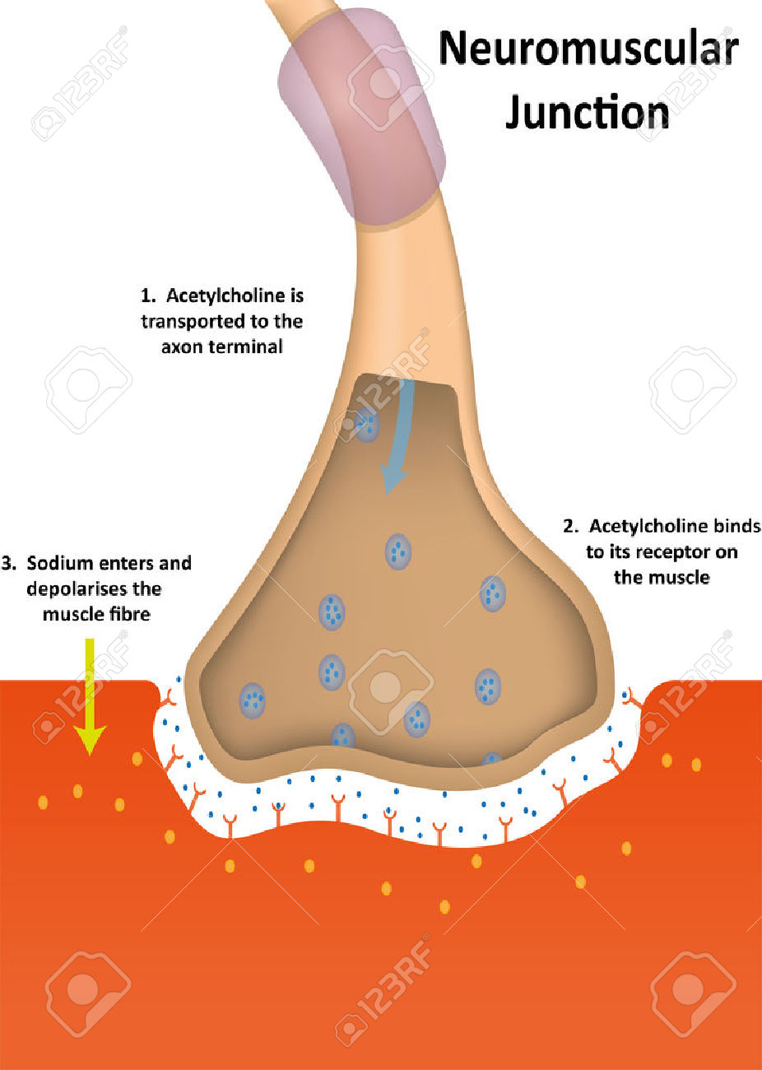
Extra Explanations
Mechanism of action of NM Blockers:
Extra explanation from 436:
Normally in the neuromuscular junction, the acetylcholine will attach with the acetyl choline receptors (in skeletal muscle the receptors are nicotinic receptors type 1 after that a lot of changes will happen and then the muscle will contract. The Neuromuscular blockers basically will block the nicotinic receptors so the acetyl choline can not bind with the receptors and produce its action (muscle contraction) and if the muscle will not contract it will relax ☺.
Mechanism of action of Depolarizing Blockers:
Don’t skip this part!
They fool Ach receptors in the MEP by attaching to them and stimulating the same effect as the Ach(acetylcholine) so they initiate the contractions of muscles fasciculation (twitching) by opening the Na++ sodium voltage channels. in the beginning. but after the sodium inside the muscle is used. the depolarizing blocker will still be attached to the Ach receptors. which will prevent repolarization. this is called hyperpolarization so no more contractions will occur.
e.g of depolarization NMB is (succinylcholine)
They are agonist drugs
https://www.youtube.com/watch?v=1YkMzGXq2Z8 note : watch first minute only
MEP: muscular end point

Slide 8
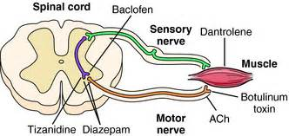
Spasmolytic
M.O.A | Reduce muscle spasm in spastic states Centrally acting ,Example: Baclofen GABA (gamma-amino butyric acid ‘GABA’)* agonist. Acts on spinal cord, Example: Diazepam (Benzodiazepines): facilitate GABA* action on CNS Direct action on skeletal muscles, Example: Dantrolene
Uses | They reduce muscle spasm in spastic static state produced by neurological disorders such as: • spinal cord injury • Cerebral stroke • Cerebral palsy Note: they also work as sedimentation drugs.
Dantrolene
M.OA | Acts directly on skeletal muscles. It interferes with the release of calcium from its stores in skeletal muscles (sarcoplasmic reticulum). It inhibits excitation-contraction coupling in the muscle fiber.
P.K | Orally, IV, (t ½ = 8 - 9 h).
Uses | Spastic states Malignant hyperthermia (The drug of choice)
Extra picture:

Slide 9
Summary
This table was taken from Prof.Hanan’s lecture
Notes | Side effects | Duration | Drug
# Renal failure | Hypotension | Long 1-2 h | Tubocurarine
# Renal failure | Tachycardia | Long 1-2 h | Pancuronium
Spontaneous degradation Used in liver and kidney failure | Transient hypotension Histamine release | Short 30 min. | Atracurium
# Liver failure | Few side effects | Short 40 min. | Vecuronium
Metabolized by pseudocholinesterase # Choline esterase deficiency | Similar to atracurium | Short 15 min. | Mivacurium
# CVS Diseases # Glaucoma # Liver disease | Hyperkalemia Arrhythmia Increase IOP | Short 10 min. | Succinyl choline
Mnemonics:
From 436
Dantrolene | Diazepam | Baclofen
دا (Da)هوا (natrilene) اللي تدور عليه يله(Act dirctly) ايش تنتظر | نقسم اسم الدرق قسمين الأول (Diaze) يشبه كلمة dizzy والدوار يصير بالرأس معناته هالدواء يشتغل على (CNS) والقسم الثاني (zepam) يشبه spasm والتشنج له علاقة بالعضلات, فلما نجمعهم مع بعض نتذكر ان هالدواء يشتغل على الجهاز العصبي المركزي ويعالج العضلات المتشنجة | البكله (Baclo) فين (fen) براسك يعني(CNS acting) وينها بالضبط طيب رابطة شعرك (Act on spinal cord) “تخيلوا المخ راسها والحبل الشوكي شعرها ف البكله وين؟ اكيد بالشعر يعني تشتغل على الحبل الشوكي“

Slide 10
Questions
MCQs:
1-Depolarization NMB are an ……..drug?
A)Antagonist. B)Agoist.
C)Physiological. D)All of them.
2-muscle relaxant might cause ?
A)spasm. B)hyperthermia.
C)hyperkalemia. D)b and c.
3-Which of the following acts directly on the muscle:
A)Dantrolene. B)Diazepam.
C)Baclofen. D)Vecuronuim.
4-Which of the following is a depolarizing blocker?
A)Atracurium. B)D-tubocuranine.
C)Succinylcholine. D)Baclofen.
5-Patients with coronary diseases must avoid which Relaxant ?
A) Vecuronium B) Pancuronium
C) Mivacurium D) Atracurium
6-Which one of the following Relaxants has the shortest Duration of Action ?
A)d-Tubocurarine B)Atracurium
C)Mivacurium D)Vecuronium
7-Vecuronium Metabolized Mainly By ……
A)Liver.
B)Kidney.
C)Spontaneous Hydrolysis at body pH.
D)Pseudo-Cholinestrase.
Answers:
1-B
2-D
3-A
4-C
5-B
6-C
7-A

Slide 11
Cont..
SAQ:
1)Malignant hyperthermia occurs as a bizarre ADR of some muscle relaxant name two of them ?
1-halothane
2-neuromuscular blockers e.g. succinylcholine
2)Why using muscle relaxant during caesarean surgery doesn’t affect the baby?
Because the drug doesn’t cross into the placenta.
3) Why using muscle relaxant during caesarean surgery doesn’t affect Uterus?
Because it doesn’t affect smooth muscle.

Slide 12
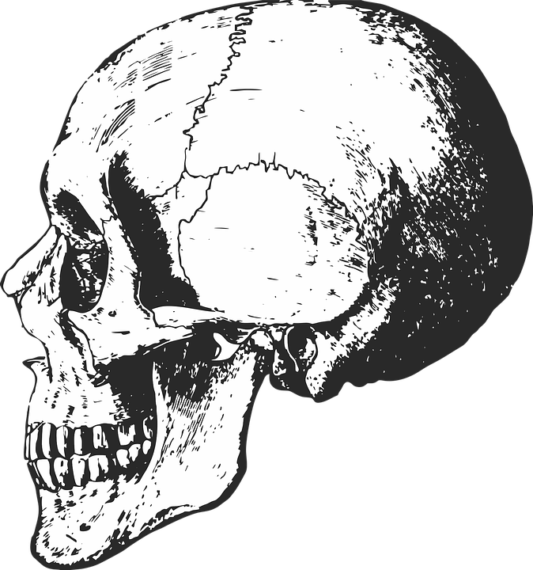
“It is not hard, you just made it to the end!”
Team Leaders:
Yazeed Alharbi & Aseel Badukhon
Thanks for those who worked on this lecture:
Abdullah abdurahman al-asseri
Abdulhakim Alonaiq Bader Altamimi Fayez Ghiyath Aldarsouni Maan Abdulrahman Shukr Mohammed alnajeim Omar Alsuhaibani Sultan Omar Almalki Yazeed abdullah alkhayyal
Ahmed Lateef Alanzy
Adel Alorainy
References:
Team436
Doctors’ notes and slides
@Pharma4370
pharmacology437@gmail.com

