Slide 1
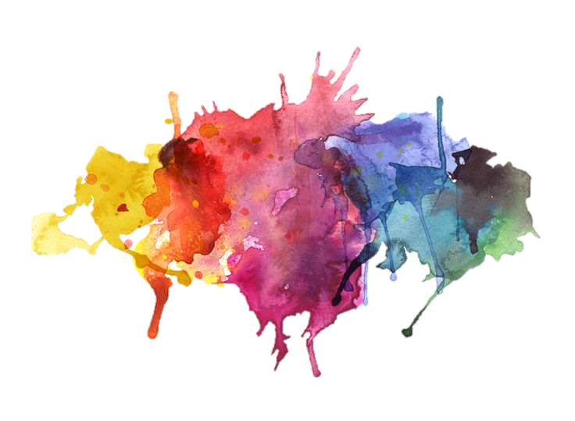
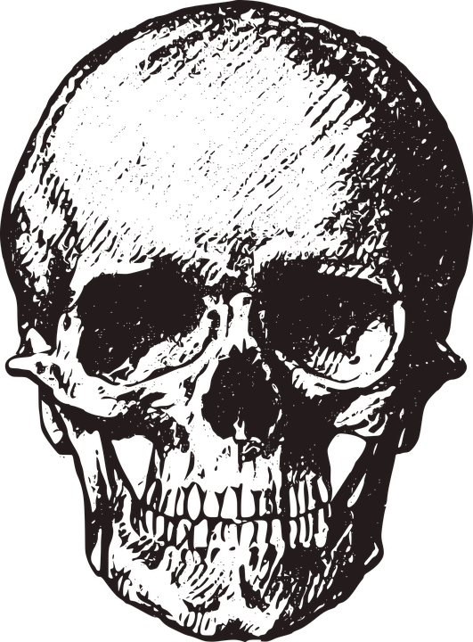
Drugs in Gout
Objectives:
Know the pathophysiology of Gout
Outline the stages of Gout and the therapeutic objective in each stage
Describe drug and non drug treatment of Gout
Classify drugs used for the treatment of gout
Identify the mechanism of action of drugs used for the treatment of gout
Study in detail the pharmacology of drugs used for the treatment of gout
Editing File
Important Notes Extra

Slide 2
Overview of Gout
What is Gout?
Gout is usually characterized by recurrent attacks of acute inflammatory arthritis with red, tender, hot and swollen joints.
It usually happens in small joints specially foot.
Pathogenesis (cause) of Gout:
Deposits of sodium urate crystals in articular, periarticular, and subcutaneous tissues. This is what causes the inflammatory process in Gout.
Types of Gout:
Gout
Primary Gout
(Genetic)
Secondary Gout
(Acquired)
hereditary error of purine metabolism
drugs that inhibit uric acid excretion or increase rate of cell death or another acquired disorder
Untreated Gout leads to:
Tophaceous: Masses of MSU (Tofi) (Monosodium Urate) in cartilages, joints, subcutaneous tissues.
Nephrolithiasis: Renal stones caused by the 70% uric acid excreted by the kidney and 30% by gut elimination.
Urate Nephropathy: Renal failure caused by high levels of uric acid.
Joint inflammation and cardiovascular damage in advanced stages.

Slide 3
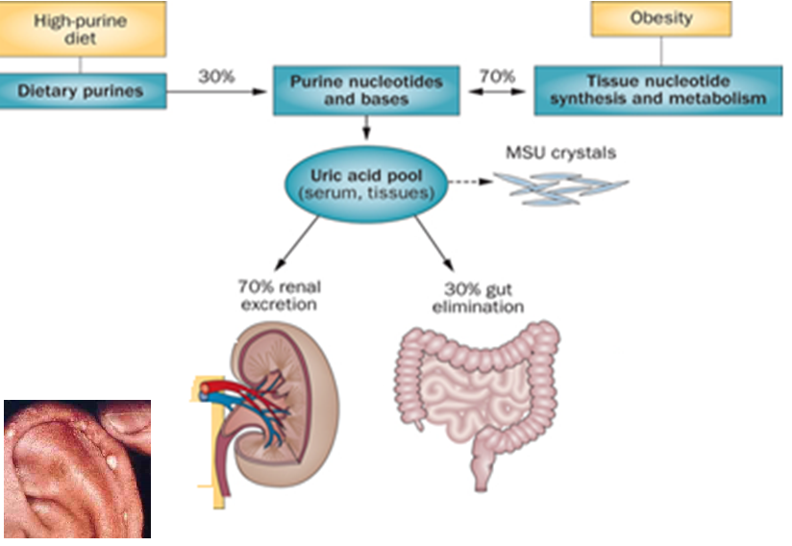
Continue of untreated gout:
Epidemiology:
Gout was historically known as "the disease of kings" or "rich man's disease."
Prevalence of hyperuricemia 5% . Not all of them will develop the disease.
Prevalence of gout 0.2%
Male to female ratio 10:1
Pathophysiology:
Prof.Yeldez explained it.
Urate crystals are initially phagocytosed by synoviocytes, which then release prostaglandins, lysosomal enzymes, and interleukin-1 which attract and activate polymorphonuclear leukocytes (PMN) and mononuclear phagocytes (MNP) (macrophages). This is why we use NSAIDs.
Attracted by these chemotactic mediators, polymorphonuclear leukocytes and mononuclear phagocytes migrate into the joint space and amplify the ongoing inflammatory process.
In the later phases of the attack, increased numbers of mononuclear phagocytes (macrophages) appear, ingest the urate crystals, and release more inflammatory mediators.
Diagnosis:
In most cases diagnosis of gout is based on clinical presentation, which is quite characteristic: severe pain developing within hours, tenderness, warmth, swelling and erythema, e. g. in the first metatarsophalangeal or metacarpophalangeal joint. Frequently, gout flares up following rich meals and alcohol consumption, in the middle of the night.

Slide 4
Stages of Gout:
Symptoms start at this stage
Asymptomatic hyperuricemia *
acute inflammation in joint caused by free urate crystals
Management: Terminate the attack
Intercritical stage
The interval between acute flares
Management: Prevent recurrent attacks
Chronic gout
Long-term gout complication
Management: - Prevent complications - Lower serum uric acid
Acute intermittent gout
Elevated serum urate with no clinical manifestation of gout
Treat or not to treat?
Complications
Asymptomatic Hyperuricemia
>7mg/dl (M)
>6mg/dl (F)
Hypertension
CV Disease
Stroke
Renal Disease
Metabolic Syndrome
Cause
Treatment of Gout:
*If we found out that the patient is having Hyperuricemia during routine blood test then we have to start an early treatment at the asymptomatic stage.
Treatment of Gout
Non-pharmacologic
Lifestyle modifications
- Loss of weight
- Exercise
- Diet control
- Smoking cessation and avoid alcohol
Pharmacologic
Uricostatic
Anti-inflammatory
Tubulin inhibitors
Uricosuric
Allopurinol
Febuxostat
Probenecid
Sulfinpyrazone
NSAIDs
Steroids
Colchicine

Slide 5
Aim of Pharmacotherapy:
Most therapeutic strategies for gout involve lowering the uric acid level below the saturation point (<6 mg/dL), thus preventing the deposition of urate crystals.
This can be accomplished by: How those drugs work
interfering with uric acid synthesis with allopurinol, Febuxostat.
increasing uric acid excretion with probenecid or sulfinpyrazone.
inhibiting leukocyte entry into the affected joint with colchicine.
administration of NSAIDs. Anti-inflammatory and analgesic effects.
Treatment of acute gout
NSAIDS
the most commonly used first-line treatment. Head-to-head studies show few differences between drugs. Drugs of this class are similar. Full doses of NSAID should be initiated immediately and tapered after resolution of symptoms . لا نبدأ بجرعات صغيرة
Contraindicated | 1-GI ulcer 2- Bleeding or perforation. 3-Renal insufficiency leads to congestive HF 4- Heart failure. 5-Use of oral anticoagulants. increases the bleeding Recall: lecture 2 NSAIDs – ASPIRIN ADRs
Steroids
Corticosteroids are a good alternative where NSAIDs and colchicine cannot be used or in refractory cases. Studies showed equal efficacy between corticosteroid and NSAIDs, with no reported side-effects with short-term use of corticosteroids.
Uses | In elderly people, patients with liver or hepatic impairment, IHD (ischemic heart disease), PUD (Peptic ulcer disease), hypersensitivity to NSAIDs.
Route of administration | Intra articularly (preferred route if one or two joints affected).long use causes joint damage and increases risk of infections leading to sevre arthritis Orally. Intramuscularly or intravenously.
Stronger than NSAIDs

Slide 6
Cont..
Colchicine
Origin | Alkaloid obtained from autumn crocus (flowering plant) The effect: Minimal effect on uric acid synthesis , excretion & is not analgesic
Mmechanism | Binds to microtubules in neutrophils Inhibits cell division by: 1- Inhibits chemotactic factors. 2- Inhibits inflammasomes & IL-1 production.
Pharmacokinetic | Route of administration: orally. Absorption: rapidly absorbed from the GI tract. Half-life: Reaches peak plasma levels within 2 hours. Rrecycling: in the bile. Enterohepatic circulation Excretion: unchanged in the faeces or urine. Should be avoid in : patients with a creatinine clearance of less than 50 mL/min.
Clinical Uses | 1- Treatment of gout flares 2- Prophylaxis (الوقاية) of gout flares in between attacks 3- Treatment of Mediterranean (inflammatory) fever with arthritis, polyserositis.
Side effect | 1- abdominal: Diarrhea (sometimes severe), Nausea, Vomiting, Abdominal cramps, Dehydration. 2- immune: Bone marrow depression. may cause hair fall like in chemotherapy 3- cardiac(in toxic doses): Cardiac toxicity, arrhythmia, Vascular collapse, Hepatotoxicity , alopecia
VERY IMPORTANT!
ممكن يجي عليها سؤال!
Renal failure patients
Prevention of Recurrent attacks
Summary:
Inhibition of uric acid synthesis
Allopurinol
Febuxostat
Prevention of recurrent attack
Uricosuric drugs (increasing uric acid execration)
Probenacid
Sulfinpyrazone
Mamalian Uricase (convert uric acid to a more soluble form)
Pegloticase
Acts on the uric acid its self.

Slide 7
Inhibitors of Uric acid synthesis:
UAS Inhibitors
MOA | Inhibit the xanthine oxidase which catalyzes its formation from xanthine and hypoxanthine.
P.K | Absorption 70% Protein Binding neglible 5% Hepatic metabolism, 70% converted into active metabolite (Oxypurinol) which is eliminated unchanged in the urine.
ADRS | Those side effects are due to the active metabolite 1- Diarrhea, nausea, abnormal liver tests. 2- Acute attacks of gout. Fluctuation effect at the start of treatment 3- Fever, rash, toxic epidermal necrolysis*(Severe ADRS),hepatotoxicity, marrow suppression vasculitis. 4- DRESS syndrome (Drug Reaction, Eosinophilia, Systemic Symptoms). 5- 20% mortality rate. 6-Hypersensitivty.
Drug | Allopurinol | Febuxostat
Clinical Uses | • Management of hyperuricemia of gout. mainly • Uric acid stones or nephropathy. • It is a drug of choice in patients with both gout & ischemic heart disease. • Severe tophaceous deposits (uric acid deposits in tissues). • Management of hyperuricemia associated with chemotherapy.(when cells are destroyed, a lot of purine is diffused) • Prevention of recurrent calcium oxalate kidney stones which can cause acute renal failure | Indicated for the management of hyperuricemia in patients with gout (as it reduces serum uric acid levels) . * Chemically distinct from allopurinol (non purine) . * Can be used in patients with renal disease . Oral specific xanthine oxidase inhibitor .
*Toxic epidermal necrolysis causes ulcers which leads to infections

Slide 8
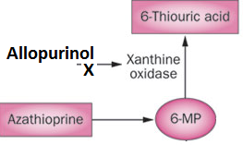
Cont..
P.K | • Metabolism: it is metabolized by xanthine oxidase into alloxanthin which is pharmacologically active. | Route of administration: Given orally once daily. Absorption: well absorbed (85%). Metabolism: Metabolized in liver , mainly conjugated to glucouronic acid. Protein binding: 99%. Half-life: (girl’s slide: 8 hours) , (boy’s slide: 4-18 hours) Given to patients who do not tolerate allopurinol.
ADRS | The side effects are due to the active metabolite which are: Allopurinol Hypersensitivity Syndrome Toxic Epidermal Necrolysis Dress Syndrome | • Increases number of gout attacks during the first few months of treatment. • Increases level of liver enzymes. • Nausea, Diarrhea. • Numbness of arm or leg. • Headache.
Drug Interaction | Warfarin & dicoumarol: inhibits their metabolism (Bleeding) 6-mercaptopurine and azathioprine (anti-cancer drugs):Reduce their metabolism ampicillin : Increases frequency of skin rash
Very important!
The active metabolite inhibits the enzyme.
It is required for their degradation
Uricosuric Drugs:
*Increases stone formation.
Mechanism of action | Effect | Contraindication
Blocks tubular reabsorption of uric acid & enhances urine uric acid excretion. | 1-Control hyperuricemia and prevent tophus formation. 2-Increases risk of nephrolithiasis. * Some drugs reduce efficacy (e.g., aspirin). | 1-patients with renal disease*. 2-History of nephrolithiasis. 3-Recent acute gout. 4-Less effective in elderly patients.

Slide 9
Drug | Probenecid | Sulfinpyrazone
Features | ADRS (side effect): Exacerbation of acute attack Risk of uric acid stone GIT upset Allergic rash. | •Can aggravate peptic ulcer disease. • Aspirin reduces efficacy of sulfinpyrazone. • enhance the action of certain antidiabetic drugs.Lower blood glucose
MOA | Probenecid inhibits Urate Transporters (URAT1) in the apical membrane of the proximal tubule It also inhibits organic acid transporter(OAT)→↑plasma concentration of penicillin. | Sulfinpyrazol inhibits URAT1 & OAT4.
Effect | 1-moderately effective. | _
Recombinant mammalian uricase:
Pegloticase
Mechanism | A uric acid specific enzyme which is a recombinant modified mammalian uricase enzyme through genetic engineering Enzymatically convert urate to allantoin, which is more soluble and readily excreted in the urine. كانها الن تلينين فتلين وتصير سايلة وتطلع من الجسم.
Clinical use | Used for the treatment of chronic gout in adult patients refractory to conventional therapy. Expensive therapy
VERY IMPORTANT!
P.K | peak decline in uric acid level within 24-72 hours Route of administration: IV

Slide 10
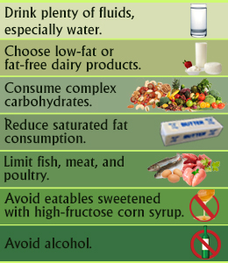
Cont..
ADRS (side effect) | Infusion reactions. Fever and skin rash Anaphylaxis. Life threating Gout flare Arthralgia (arthra: joints, algia: pain) Muscle spasm. During infusion and after it Nephrolithiasis
Picture regarding the non drug treatment:
We add it because Prof.Yeldez commented on it.
Summary:
 |  | Lifestyle modifications - Loss of weight - Exercise - Diet control - Smoking cessation and avoid alcohol
 |  | Treatment of acute gout | NSAIDs | First line treatment Contraindicated : heart failure
 |  |  | steroids | -Stronger than NSAIDs -Uses in elderly people or hypersensitivity to NSAIDs
 |  |  | Colchicine | Treatment of Mediterranean (inflammatory) fever
 |  | Prevention of recurrent attacks | Inhibition of uric acid synthesis | Allopurinol drug of choice in patients with both gout & ischemic heart disease. | Febuxostate Patients with renal disease
 |  |  | Uricosuric drugs | Probenecid ↑plasma concentration of penicillin. | Sulfinpyrazone inhibits URAT1 & OAT4.
 |  |  | Mamalian uricase | Pegloticase : convert urate to allantoin
Non
pharmacologic
Treatment of gout
Pharmacologic

Slide 11
Questions
MCQ:
1-Which of the following causes the inflammatory process in Gout?
A-Deposits of Sodium Urate Crystals
B-High serum Uric acid
C-Cytokines
2-A 50 years old man came to the ER complaining from severe pain in his toes joints with hotness on them. Blood sample was taken from him and it revealed high uric acid with creatine clearance rate of 23 mL/min. Which of the following should be avoided in treating his Gout?
A-NSAIDs
B-Colchicine
C-Febuxostat
3-Allopurinol is metabolized into Alloxanthin by
A-Aspirin
B-Xanthine oxidase
C-Pegloticase
4-Jamal is a 35 years old man with known history of Gout was diagnosed with bacterial infection and was prescribed penicillin. Which drug of Gout his doctor must stop it in this case due to interaction ?
A-Probenecid
B-Febuxostat
C-Steroids
5-If a Gout patient has ischemic heart disease, what is the drug of choice?
A-Pegloticase
B-Allopurinol
C-Colchicine
1-A
2-B
3-B
4-A
5-B

Slide 12
Questions
SAQ:
Based on your study of Gout and its treatment, answer the following:
A- What are the stages of Gout?
Four distinct stages:
a)asymptomatic hyper-uricemia
b) acute intermittent gout
c)Intercritical stage
d) chronic gout
B-How to manage each stage?
Asymptotic: Life style modification
Acute: terminate the attack
Intercritical: Prevent the recurrent attacks
Chronic: prevent complication and lower serum uric acid
C-In Gout we have acute treatment and prophylactic therapy. According to the previous statement, answer the following:
Write Colchicine mechanism of action and clinical uses:
Slide 6 in Colchicine part.
Mention one class that is used a preventive therapy with two ADRs:
Any class with its ADRs

Slide 13
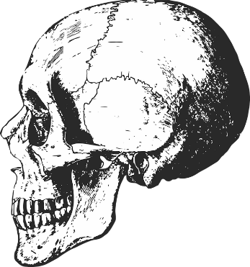
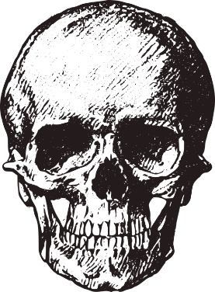
“It is not hard, you just made it to the end!”
Team Leaders:
Yazeed Al-Harbi & Aseel Ba Dukhon
Thanks for those who worked on this lecture:
Renad Al-Gharebi
Alanoud Al-Essa
Nourah Bin Hassan
Alfahdah Al-Saleem
References:
Team436
Doctors’ notes and slides
@Pharma4370
pharmacology437@gmail.com

