Slide 1





Disease Modifying Anti-rheumatic Drugs
“DMARDs”
Objectives:
Editing File
Know the pathogenesis of rheumatoid joint damage
Emphasize the rational for early treatment of RA
Define and classify DMARDs
Compare and contrast the advantages and disadvantages of NSAIDs, Steroids and DMARDs in treatment of RA
Know some examples of drugs related to DMARDs.
Explore the pharmacokinetic and pharmacodynamic aspects of the selected DMARDs
Describe the mechanism of action , specific clinical uses, adverse effects of individual drugs.
Important Notes Extra

Slide 2
Overview of Rheumatoid Arthritis
What is Rheumatoid Arthritis?
It is a chronic autoimmune) (Normally our immune system is directed towards invaders) disorder in which the normal immune response is directed against an individual's own tissue causing destruction to those tissue.
This disorder leads to:
Decline in functional status
Work disability & socioeconomic costs.
Systemic complications. Affects other tissues
Co-morbidity & Increased mortality.
Epidemiology of RA:
Affects 1-2 % of the adult population.
It’s common in women than men (2 or 3 times) (It is an autoimmune disease so it is common in females than males) .
Usually appears between ages 25 and 40 years(middle age).
The incidence also increases with age, peaking between the 4th and 6th decades. Sometimes occurs within childhood, it is called (systemic juvenile arthritis)
Causes pain,deformity,stiffness, disability* and loss of function.
*For example patient can’t hold a cup with her hand!

Slide 3
Cont.
Characteristic of RA:
Bone erosion
Inflammation and hyperplasia of synovial membrane (Swelling)
Systemic complications of RA:
Anemia
Weight loss
Osteoporosis
Amyloidosis
Renal, cardiovascular and neurological complications
Pathogenesis of RA:
Further explanations are in next slide!
1-Synovial inflammation and hyperplasia | 2-Autoantibody production (Rheumatoid factor) | 3-Cartilage and bone destruction (Deformity)
First there will be inflammation in the joint (especially in the synovial fluid) associated with hyperplasia (the place of the joint got bigger) | The inflammation started, so the T cells and B-cells will stimulate and that will produce antibodies in patient’s serum. | the cytokines producing from the inflammatory cells will stimulate the osteoclast (TNF-α) and chondrocyte (which degrades the collagens “cartilage’).

Slide 4
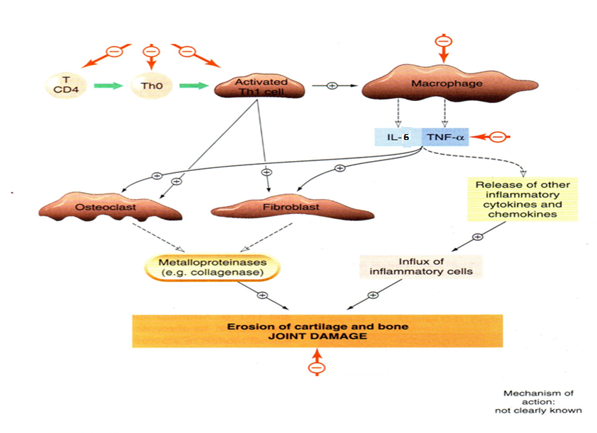
To Understand Better!
Activated T helper cells leads to the activation of osteoclasts and fibroblasts which causes erosion of cartilage and bone destruction. Those activated cells stimulate macrophages that release certain cytokines or inflammatory cytokines which we target in treatment; TNF-alpha and Interleukins.
The drugs we use in the treatment act on:
Th-cells
B-lymphocytes
TNF-alpha
IL-6
Both are inflammatory cytokines
More details are discussed in Pathology.

Slide 5
Drugs use for Rheumatoid Arthritis
Glucocorticoids | Strong Anti-inflammatory drugs with an intermediate rate of action (slower than NSAIDs but faster than other DMARDs). May be administered in low to moderate doses to achieve rapid disease control before the onset of fully effective DMARD therapy. Used in acute diseases with DMARDs just to relieve the pain until the DMARDs start to produce their action Reserved for temporary control of severe exacerbations and long-term use in patients with severe disease not controlled by other agents. too toxic for routine chronic use. that means we use glucocorticoids for short time, if we use it for long time it will be toxic. Worse than NSAIDS.
NSAIDs | Rapid onset of action Used in acute cases to relief inflammation & pain Provide partial relief of pain and stiffness (Gives temporary relief and she/he can moves joint easily) Do not slow the progression of the disease hence can not stop formation of new deformity Chronic use (long use or high dose) should be minimized due to the possibility of side effects, including gastritis and peptic ulcer disease as well as impairment of renal function. NSAIDs and Glucocorticoids are both used in acute stage to reduce pain and inflammation so they don’t give good prognosis since can’t stop progression of the disease.
DMARDs | Slow onset of action Arrest progression of the disease Prevent formation of new deformity Used in chronic cases when deformity is existing
Good prognosis but can’t treat previous deformity.
NSAIDs VS DMARDs:
DMARDs |  | NSAIDs
Onset | Slow الأبطأ بينهم | Rapid الأسرع بينهم
Effect of Rheumatoid arthritis | Arrest progression of the disease | No effect on the disease Only analgesic and anti-inflammatory

Slide 6
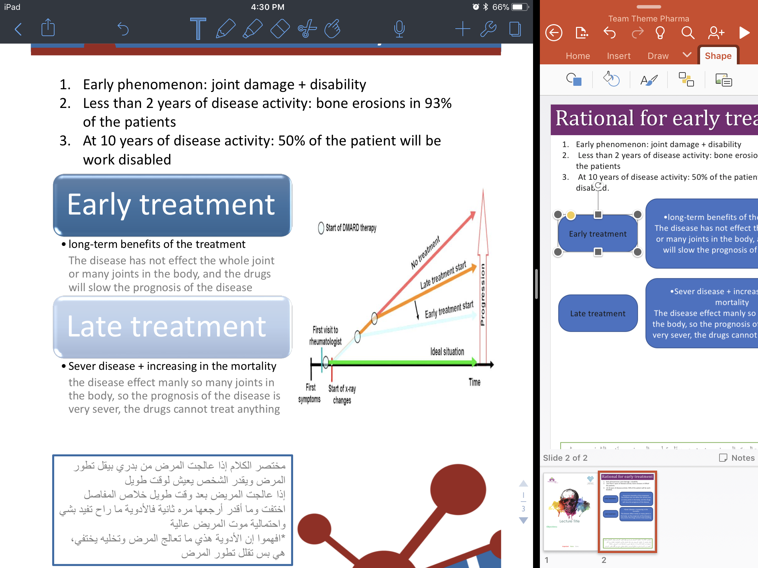
Cont. NSAIDs VS DMARDs:
Deformity | Prevent new deformity | Can not stop the new deformity
Uses | In chronic cases if there is deformity | In acute cases to relief the pain and the inflammation
Rational for early treatment
Stages of disease development:
Early Phenomenon | Less than 2 years of the disease activity | At 10 years of disease activity
joint damage + disability | bone erosions in 93%of the patients | 50% of the patient will be work disabled.
Joint damage (It is symmetrical) starts early in the disease so any delay in treatment will lead to severe deformity of the joint. Early diagnosis and aggressive treatment must be done.

Slide 7
Cont. Rational for early treatment
Types of treatment:
Early Treatment | Late Treatment
•long-term benefits of the treatment The disease has not effect the whole joint or many joints in the body, and the drugs will slow the prognosis of the disease | •Sever disease + increasing in the mortality The disease effect manly so many joints in the body, so the prognosis of the disease is very sever, the drugs cannot treat anything
Classification of DMARDS
Class | DMARDs
Sub-class | Biologic | Classical
Drugs | Infliximab (famous) Tocilizumab more important and more expensive subclass | Methotrexate Anti-cancer Hydroxychloroquine
M.O.A | Act on the immune system to slow the progression of Rheumatoid Arthritis.
General features | Used when the disease is progressing and causing deformities Can not repair the existing damage but prevent further deformity Have no analgesic effect (no effect on Prostaglandins). That’s why we use NSAIDs or Glucocorticoids with them Their effects take from 6 weeks up to 6 months to be evident.

Slide 8
Classical DMARDs:
Low molecular weight
Adequate hydration (drinking a lot of water) is important in high dose of Methotrexate
Drug | Methotrexate
Special Features | “Gold standard” for DMARD therapy & is the first-line DMARD for treating RA and is used in 50-70% of patients. Active in RA at much lower doses than those needed in cancer chemotherapy.
Mechanism of action | At High Dose (Anti-cancer): Inhibits Dihydrofolate Reductase (to convert Folic acid into tetrahydrofolate) which is responsible for formation of Thymidine and purine which is important for DNA (No DNA means no proliferation of the cells) At Low Dose (Treat RA): Anti-inflammatory effect by stimulating adenosine release from cells Inhibition of Polymorphonuclear chemotaxis so don’t migrate to inflammation site Inhibition of T-cells (Cell-mediated immune reactions)
P.K | Approximately 70% absorbed after oral administration> can be given by any rout Metabolized to a less active hydroxylated product. Half-life is usually only 6-9 hours. Excreted principally in the urine, but up to 30% may excrete in bile. Enterohepatic circulation Given 7.5-30 mg weekly.
ADRs | Bone marrow suppression. due inhibition of mitosis Dyspepsia, mucosal ulcers*. Hepatotoxicity*. Pneumonitis*. Inflammation of lung Teratogenicity*. In pregnancy Leukopenia, anemia, stomatitis, GI ulcerations, & alopecia are probably the result of inhibiting cellular proliferation*. Folic acid reduces GI & bone marrow effects. Monitoring: Full blood count, ALT (liver enzyme),Creatinine.
تأثير الدواء و عمله يعتمد على مقدار الجرعة
*Anti-cancer effect
in rapidly dividing cells

Slide 9
Cont. of Classical drugs
Drug | Hydroxychloroquine
M.O.A | Stabilization of lysosomal enzyme activity. Trapping free radicals. Those reactive substances are found in all inflammatory processes Suppression of T lymphocyte cells response to mitogens. Inhibition of leukocyte chemotaxis. It is a drug that acts on cells.
P.K | Rapidly absorbed and 50% protein-bound. Extensively tissue-bound, particularly in melanin-containing tissues such as the eyes. ocular side effects Elimination half-life up to 45 days. Highly concentrated within cells which increases intracellular pH.
ADRs | Doesn’t have a lot of ADRs unlike Methotrexate. Least toxic, no blood tests is required. Nausea & vomiting. Corneal deposits*. Irreversible retinal damage*. Ophthalmologic evaluation every 6 months*.
Clinical uses | Has not been shown to delay radiographic progression of disease. Generally used for treatment of early, mild disease or as adjunctive therapy in combination with other DMARDs. Used in increasing methotrexate efficacy. 6 months response, mild anti-rheumatic effect.
*Ocular (eyes) side effects mainly!!!
Biologic Disease Modifier:
Genetically engineered drugs that are used to modify imbalances of the immune system in autoimmune diseases.

Slide 10
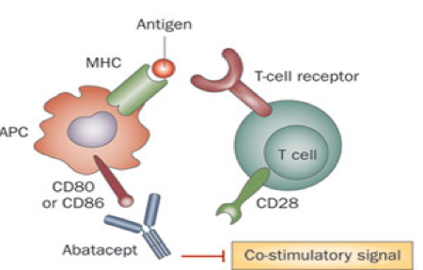
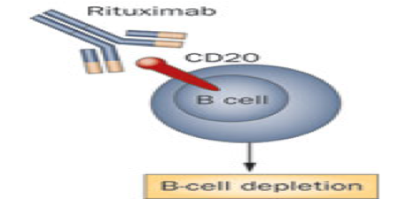
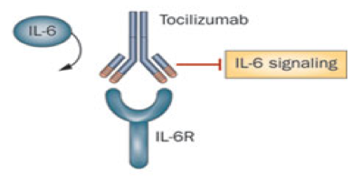
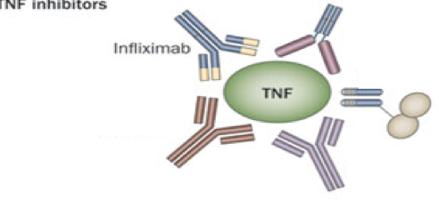
Cont. of Biologic Disease Modifier:
The drugs work by:
1. Work as agents block or
2. modify the activity of selected cells in the immune system. Act on T-cells or B-cells or any immune system cells
3. blocking cytokines, that send signals between those cells.
The drugs are expensive, high molecular weight and genetically synthesized
Classification of Biologic Disease Modifier
VERY IMPORTANT!
T-cell modulating drug (Abatacept)
Its modulates the immune response by binding to CD80/CD86 on an antigen presenting cell (APC), such as a dendritic cell, thus preventing costimulatory binding to CD28 on naïve T-cell and attenuating T-cell activation.
B-cell cytotoxic agent ( Rituximab)
The drugs are look like antibodies which will go to the B-cells and bind with the antigen on the surface of the B-cells, after the drug binds with the antigen it will destroy the B-cells
VERY IMPORTANT!
VERY IMPORTANT!
Anti-IL-6 receptor antibody (Tocilizumab)
The drug binds with the IL-6 receptors, so the IL-6 will not bind with the receptor, so no IL-6 effect
TNF- blocking agents (Infliximab)
The drugs look like antibodies which will bind with the TNF-α and inhibit this cytokines to produce its action (inflammation)
VERY IMPORTANT!

Slide 11
Drug | Infliximab (TNF-α blocking agents) | Tocilizumab (IL-6 blockers) VERY IMPORTANT!
Definition | A chimeric (two sources; human+mouse) IgG₁ monoclonal antibody (25% mouse, 75% human) | IL-6 is a proinflammatory cytokine implicated in the pathogenesis of RA With detrimental effects on both joint inflammation and cartilage damage
Mechanism of action | It complexes with soluble TNF-α (and possibly membrane- bound TNF-α)and prevents its interaction with the cell surface receptors (signaling). This results in down-regulation of macrophage and T-cell function. TNF has two forms free and bounded | binds to membrane IL-6 receptors, blocking the activity of IL-6 (soluble form) in mediating signals that affect cytokine production, osteoclast activation
P.K | intravenous infusion with “induction” at 0, 2, and 6 weeks and maintenance every 8 weeks thereafter 9–12 days | Intravenous (IV) monthly Half life: dose-dependent
Clinical uses | use in autoimmune disease like (RA, Ankylosing spondylitis, Crohn’s disease, ulcerative colitis) not only RA It may combined with methotrexate, hydroxychloroquine and other non biological DMARDs | As monotherapy: In adult has rheumatoid arthritis In children over 2 years with systemic juvenile arthritis (more aggressive) |  | Combination with methotrexate or other non-biologic DMARDs: Patients with active rheumatoid arthritis not responding to TNF blockers or other biologic drugs (Refractory cases)
Side effects | Upper respiratory tract infections Activation of latent tuberculosis Infusion site reaction Headache Cough Increase the risk of skin cancers including melanoma | Infusion reactions (allergic reaction) Serious infections ( bacterial, tuberculosis ,fungal ) Increase in cholesterol level Neutropenia, and thrombocytopenia (reversible upon stopping the drug) Decrease in WBCs (bone morrow) Increase in liver enzymes
Special features | This drug has chimeric IgG₁ monoclonal antibody so the body could reject it After intermittent administration by elicits human antichimeric antibodies in up to 62% of patients. To prevent the rejection we use the drug in Concurrent therapy with methotrexate | Drug interactions: *IL-6 inhibits CYP450, and as you now Tocilizumab inhibit IL-6, so the drug restores the activity of the enzyme (essential for the metabolism of some drugs such as cyclosporine, warfarin).
TNF-alpha Destructive role | Acts on osteoclasts leading to bone erosion Acts on synoviocytes leading to pain and swelling Acts on chondrocytes leading to joint space narrowing | Mentoring | Blood tests monthly to see increase in cholesterol liver enzymes decrease in WBCs
*no drug interaction.

Slide 12
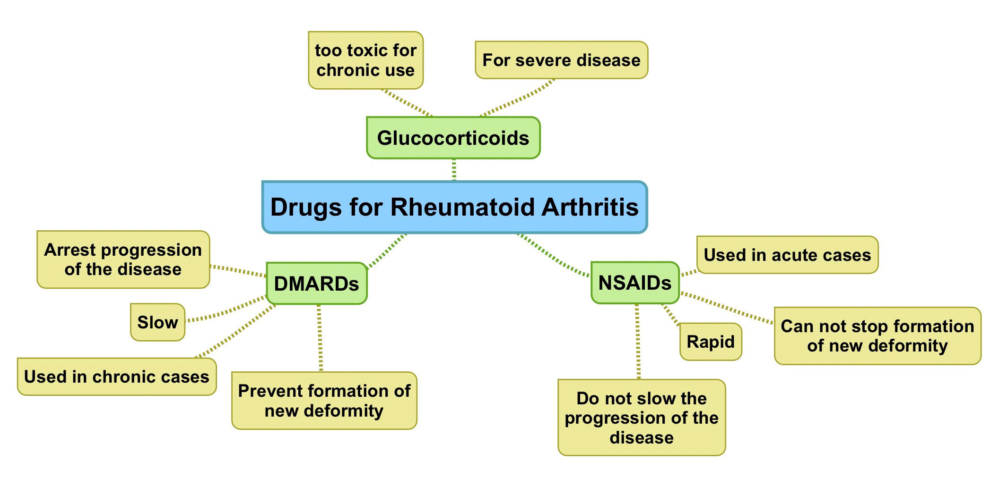
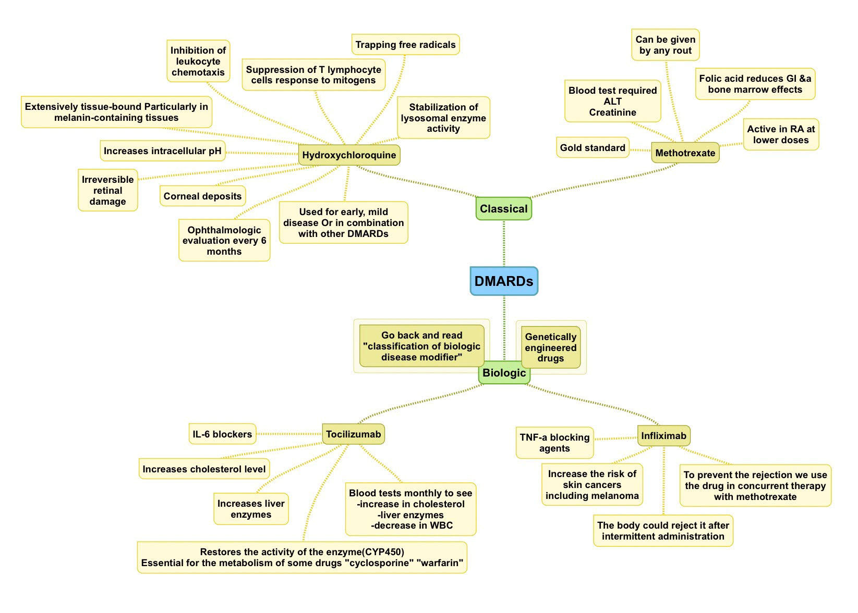
Summary

Slide 13
Questions
MCQs:
1-A 67 years man with history of Rheumatoid arthritis was referred to ER department after severe chest pain and collapsing. He was having heart attack and died at hospital after many tries of CPR. At autopsy , they found Atheroma (Fat plaque) obstructing his main coronary artery. Which drug he was on and that possibly caused atherosclerosis?
A)Tocilizumab
B)Infliximab
C)Ibuprofen
2-Could be used as antioxidant
A)Isoniazid
B)Hydroxychloroquine
C) Methotrexate
3-”Stimulating adenosine release from cells”, it is the mechanism of action of which of the following DMARDs?
A)Methotrexate
B)Tocilizumab
C)Infliximab
4-Salma is a CEO at company and lately was diagnosed with Melanoma after 2 years of suffering from Rheumatoid arthritis. Which drug had caused this side effect to her?
A)Infliximab
B) Abatacept
C)Rituximab
5-To avoid deformities in RA, what should be done?
A)Starts with NSAIDs
B)Start treatment early with NSAIDs to relieve pain until DMARDs shows their effect
C)Surgery to wash out deposits and then start Steroids
1-A
2-B
3-A
4-A
5-B

Slide 14
Questions
SAQ:
Mention all biologic disease modifiers classes with their mechanism of action and give one example of each.
Answer is in slide 10.
Make sure to write drugs name correctly.
Why do we have to start treatment early with RA? Also, talk about one drug that’s used to treat RA.
To avoid progressive deformities and disability.
You can mention any drug you want with its MOA and ADRs and uses.
DMARDs act on what?
Acts on immune system by affecting:
Th-cells
B-lymphocytes
TNF-alpha
IL-6

Slide 15



“It is not hard, you just made it to the end!”
Team Leaders:
Yazeed Al-Harbi & Aseel Ba Dukhon
Thanks for those who worked on this lecture:
Hind Al-Oraier
Sarah Al-Blaihed
Rahaf Al-Shammari
Layla Al-Sabagh
Noura Al-Othaim
Special thanks for:
Hadeel Awartani
References:
Team436
Doctors’ notes and slides
@Pharma4370
pharmacology437@gmail.com

