Slide 1
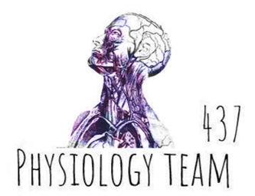
Physiology of
the bone
Color index:
Red: important
Green: doctor’s notes
Grey: extra information
Pink: found only in female’s slides
blue: found only in male’s slides
Physiology 437 team work

Slide 2
objectives:
By the end of the lecture you will be able to:
1- Define bone and differentiate cortical & trabecular bone (sites and function of each).
2- State the normal levels and forms of ca++ in the ECF and its relation to PO4.
3- Identify the bone cells and the function of each.
4- Define bone remodelling and explain the mechanism of bone formation.
5- Define osteoporosis.
6- Discuss the effect of different hormones on bone physiology.

Slide 3
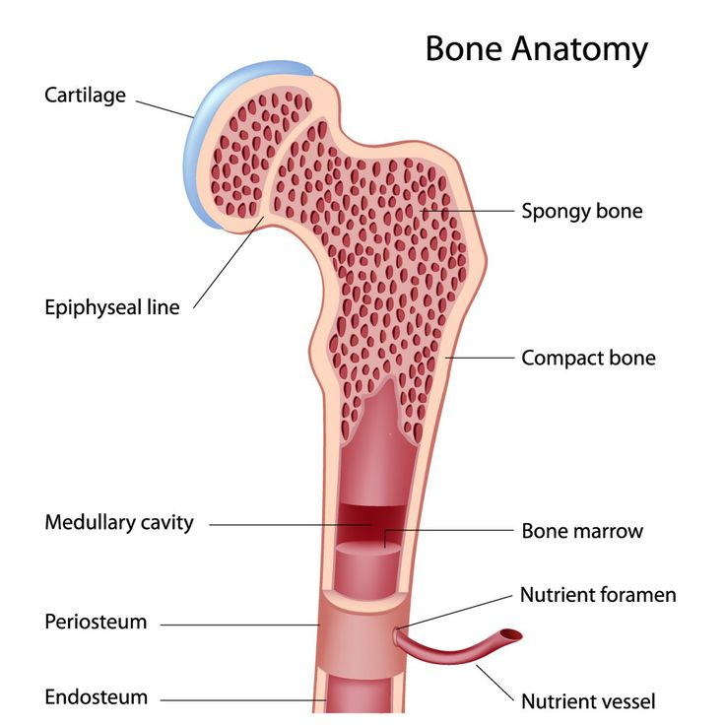
Physiology of bone
Bone is a special form of connective tissue.
It is well vascularized with total blood flow of 200–400 mL/min in adult humans.
The ends of each long bone (epiphyses) are separated from the shaft of the bone by a plate of actively proliferating cartilage, the epiphyseal plate.
Linear bone growth can occur as long as the epiphyses are separated from the shaft of the bone, but such growth ceases (stops) after the epiphyses unite with the shaft (epiphyseal closure)*.
*for interesting extra informations watch the video (2:51 mins)

Slide 4
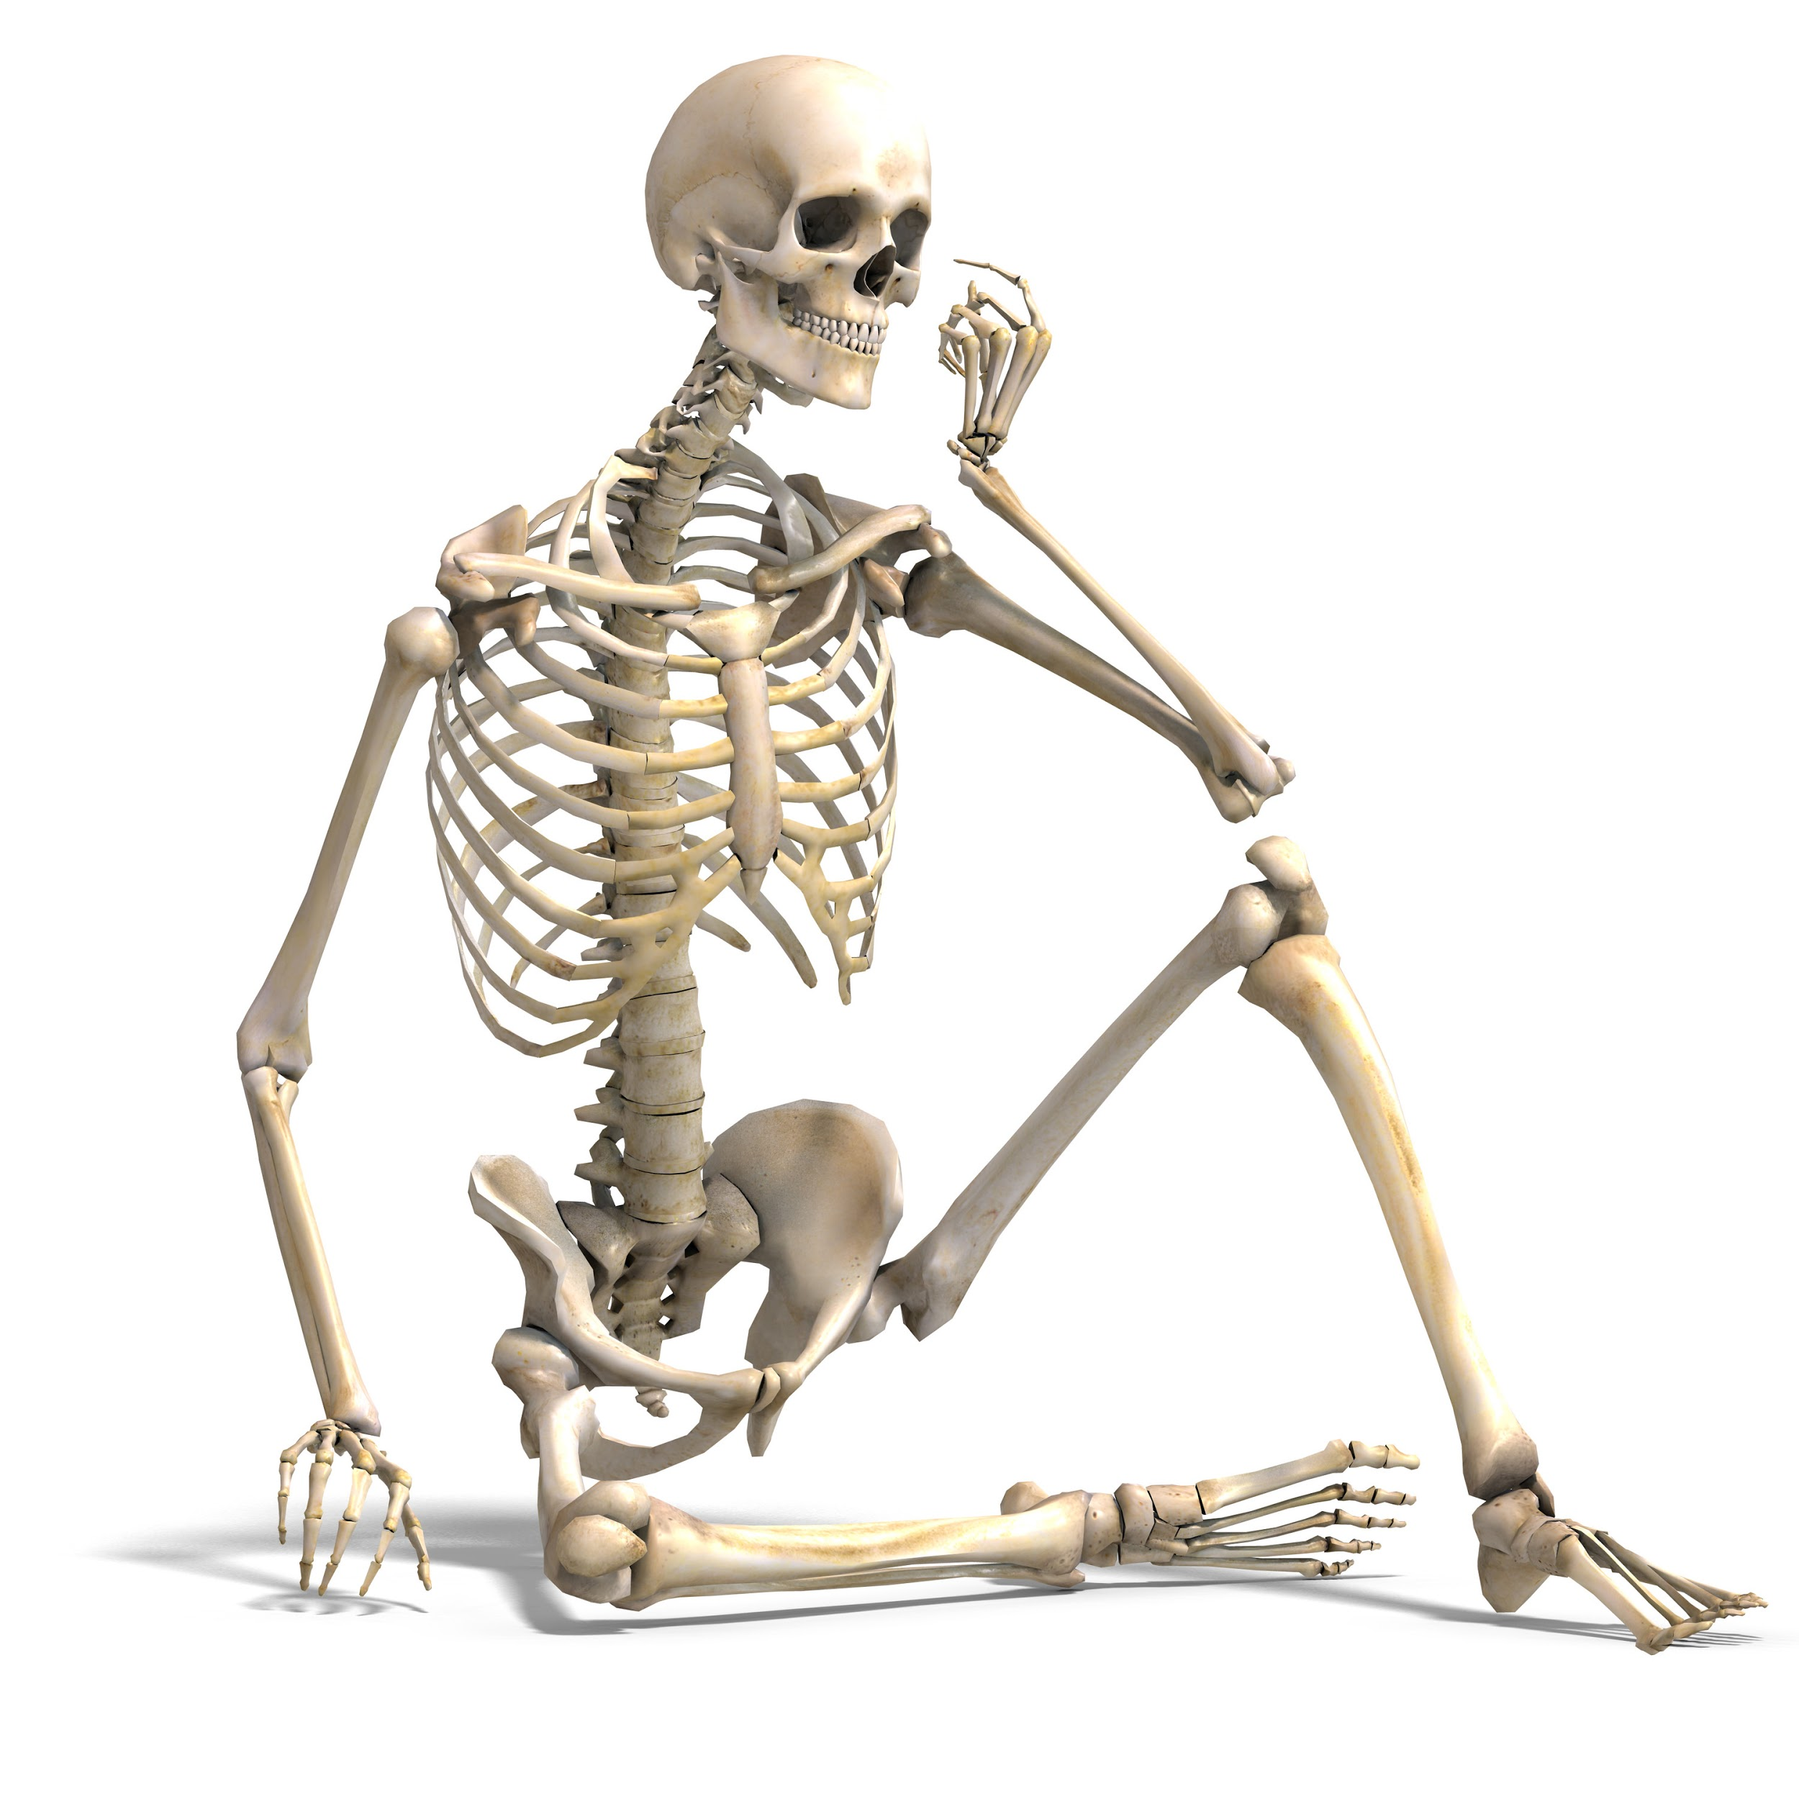
Function of bone
Is involved in the overall Ca++ and PO4– homeostasis (regulation).
Protects the vital organs,
Permits locomotion and support against gravity.
Contains the bone marrow (blood cells formation).
Reservoir for calcium & phosphate .

Slide 5
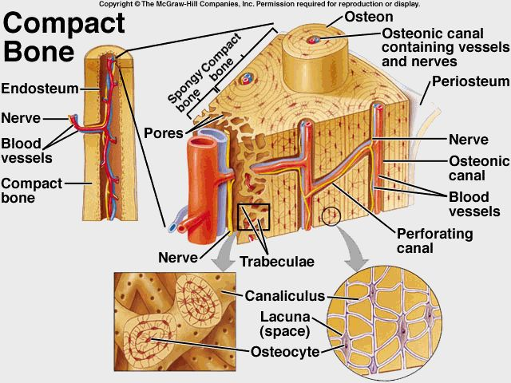
Types and structure of bone
Compact or Cortical bone
-Compact or cortical bone: in the outer layer of most bones is (80%) of the bones in the body.
-the bone cells lie in lacunae. They receive nutrients by way of canaliculi from haversian canals vessels.
-Collagen is arranged in concentric layers, around the haversian canals forming cylinders called osteons or haversian systems. Imagine a bullseye, the collagen = rings and haversian canal is center of the the target.
-It has more bone tissue and less bone space -Has high resistance to bending and torsion (twisting) -It is composed of overlapping circular structures (formations) called Haversian Systems or Osteons. Each osteon has a central canal called Osteonic Canal or Haversian Canal - The Osteonic Canal contain blood vessels (capillaries, arterioles, venules ), nerves and lymphatics. - Between Haversian systems are concentric layers of mineralized bone called interstitial

Slide 6
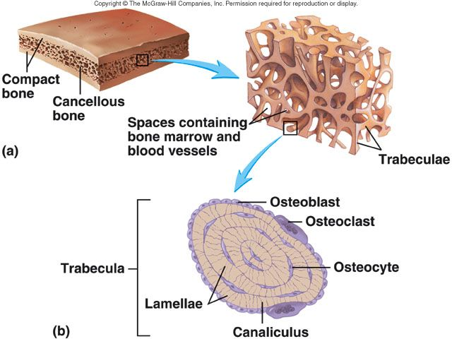
Types and structure of bone
Trabecular or spongy bone
inside the cortical bone, it is 20% of the body bone.
is made up of spicules (شويكات) or plates. Nutrients diffuse from bone extracellular fluid (ECF) into the trabeculae.
Though it represents only 20% of the skeletal mass, it has 5 times greater surface area than cortical bone يأخذ مساحة كبيرة لكن بكثافة قليلة Because of its large surface, it has faster turnover rate than cortical bone ;hence it is more important than cortical bone in terms of calcium turnover compared to cortical bone , it is: (1) less dense, (2) more elastic and (3) has a higher turnover rate than compact bone . The center of the bone contains red, yellow marrow, bone cells and other tissues.

Slide 7
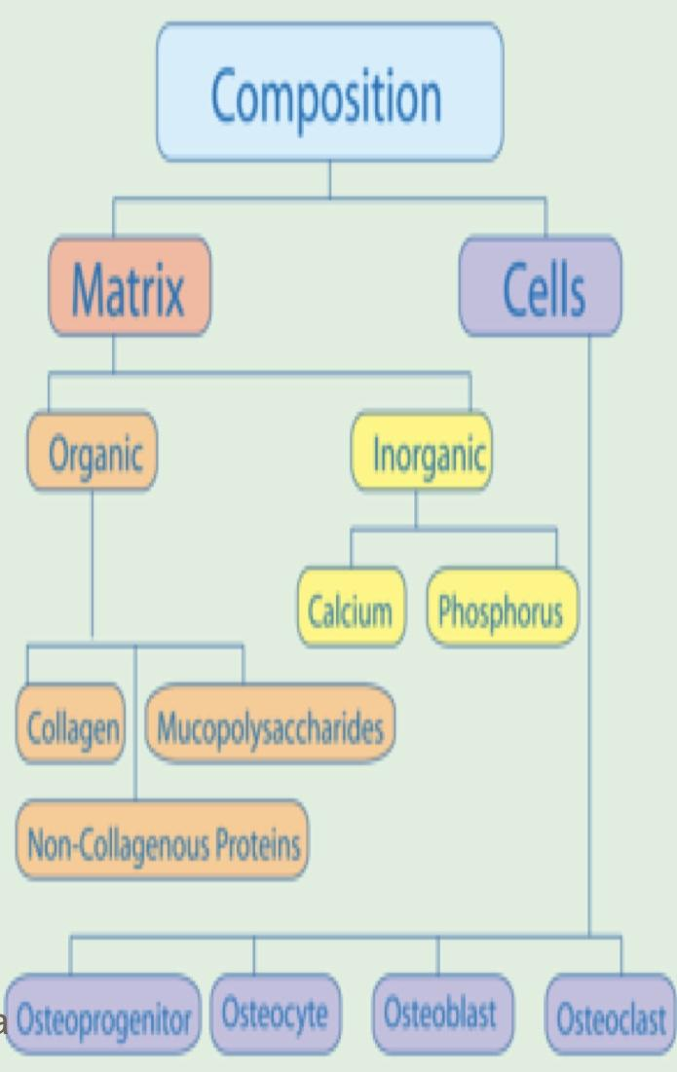
Composition of Compact Bone
Matrix
30% is organic Matrix: composed of
Collagen fibers 90-95%: extend primarily along the lines of tensional force and give bone its powerful tensile strength.
Ground substance 5-10%: ECF and Proteoglycans* hyaluronic acid.
*are proteins that fill up the bone extracellular matrix and regulate collagen fibrillogenesis.
70% is bone Salts:
Crystalline salts of Ca++ and PO4 (Hydroxyapatite) the ratio of Ca/P ratio is 1.5- 2).
Mg+, Na+, K+, Carbonate ions are also present.
NB: newly formed bone have a considerably higher percentage of matrix in relation to salts. (Which is why newborn’s bones are soft)
Organic matrix makes the bone soft, bone salts are inorganic substances that make the bone hard.

Slide 8
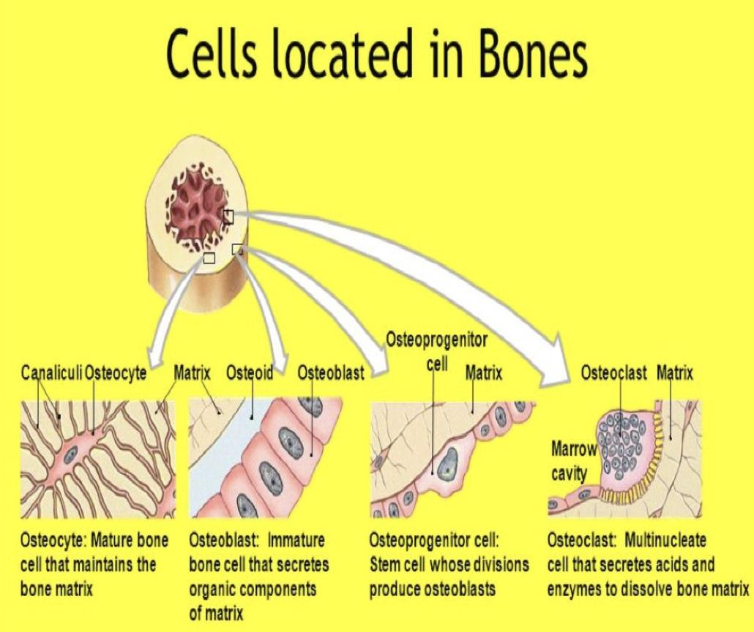
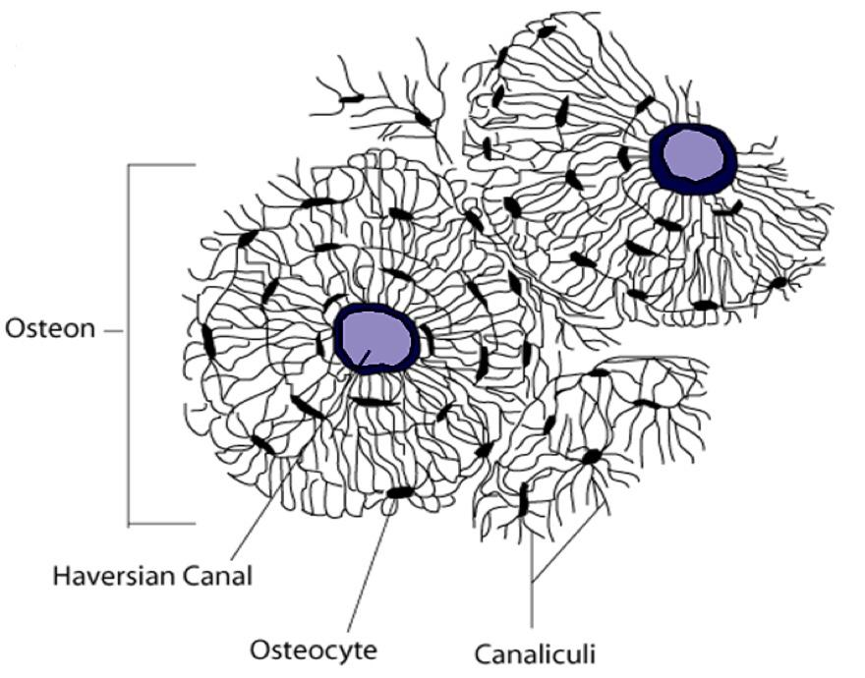
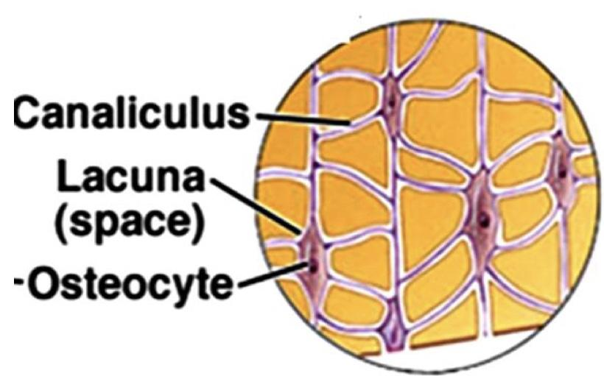
B) Bone Cells
Note osteoblast and osteocyte are forming cells but osteoclasts are destructing cells
Are the bone forming cells that secrete collagen forming a matrix around themselves which then calcifies.
Osteoblasts regulate Ca and Phosphate concentration in bone fluid.
Osteoblasts
Functioning cells.
Calcification
are surrounded by calcified matrix, and send processes into the canaliculi that ramify (branch out) throughout the bone.
Osteocytes
None functioning, give the bone its strength.
Are multinuclear cells that erode and resorb previously formed bone. They phagocytose bone, digesting it in their cytoplasm.
Osteoclasts*
*rich in lysosomes

Slide 9
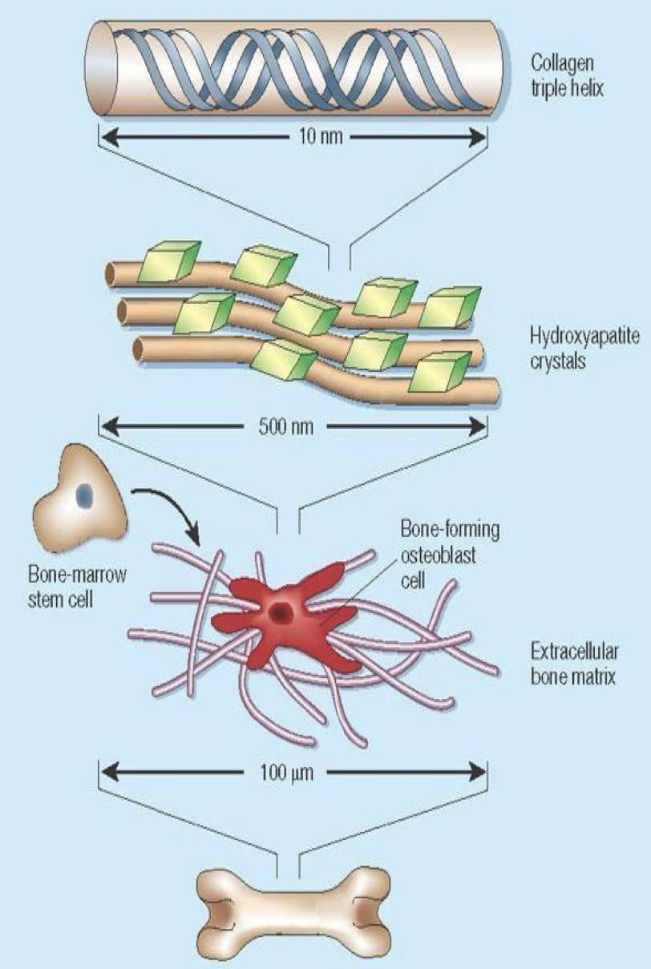
Mechanism of Bone Calcification
Osteoblasts secrete collagen (monomers) and ground substance (proteoglycans).
The collagen monomers polymerize to collagen fibers.
The resultant tissue becomes osteoid, a cartilage-like material differing from cartilage in that calcium salts readily precipitate in it.
Osteoblasts become entrapped in the osteoid and are now called osteocytes.
After the osteoid is formed, calcium salts begin to precipitate on the collagen fibers forming the Hydroxyapatite crystals.

Slide 10
From 436
*للتوضیح: ال osteoblast في النسیج العظمي تفرز حول نفسھا collagen بعدھا راح یصیر في النسیج fibers collagen وعندھا یسمى ھذا النسیج ب osteoid ، ثم یبدأ الكالسیوم بالترسب والأرتباط بالكولاجین مما یكون crystals hydroxyapatite . حین تنتهي ھذة العملیة یكون قد تكون حول ال ostoblast ال osteoid فتنتهي مهمتها فتتحول لل Inactive form اللي ھو الosteocytes

Slide 11
Tensile and Compressional Strength of Bone
The collagen fibers of bone, like those of tendons, have great tensile strength.
The calcium salts have great compressional strength.
N.B: hydroxyapatite crystals fail to be formed in normal
tissues except in bone despite the high levels of Ca & P ions due to the presence of an inhibitor of precipitation called pyrophosphate.
These combined properties plus the degree of bondage between the collagen fibers and the crystals provide a bony structure that has both extreme tensile strength and extreme compressional strength.
Pyrophosphate is protective against calcification of the soft tissues.
Deficiency of pyrophosphate (Inhibitor of precipitation) leads to extra articular calcifications,
for example: calcifications in the form of stones in the kidney.
From 436:
للتوضیح: لماذا لا یتكون الcrystals hydroxyapatite في الأنسجة الأخرى غیر العظام؟ مع الرغم من وجود الكولاجین والكالسیوم فیھم؟
لأن الأنسجة الأخرى تحتوي على مثبط لأرتباط الكالسیوم بالكولاجین یسمى ب pyrophosphate

Slide 12
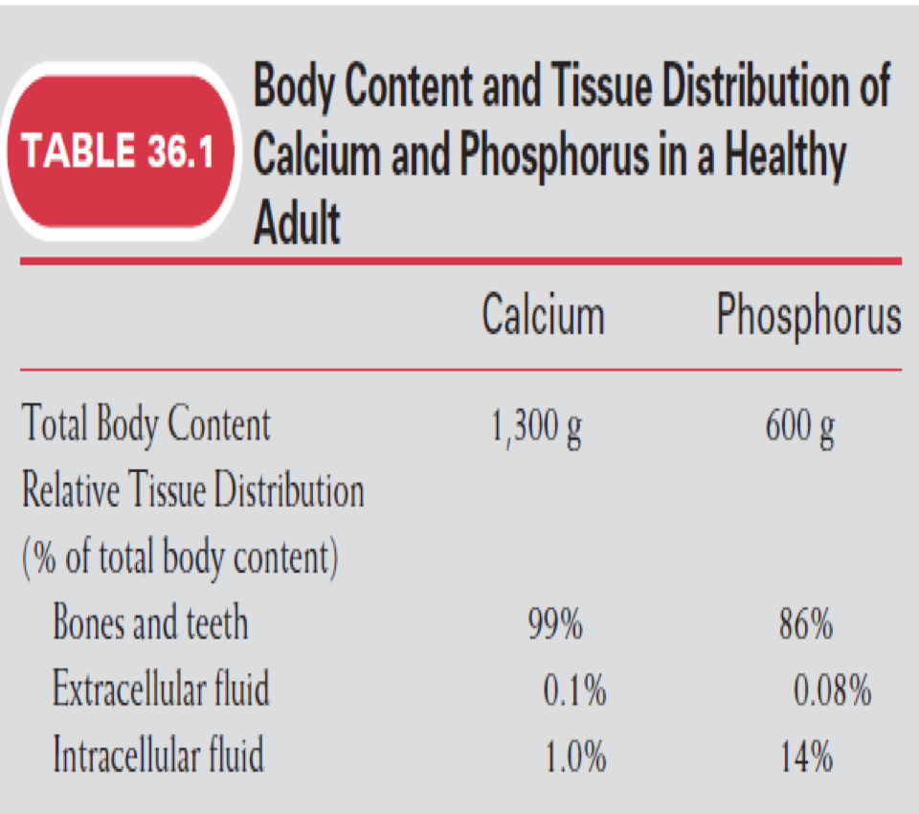
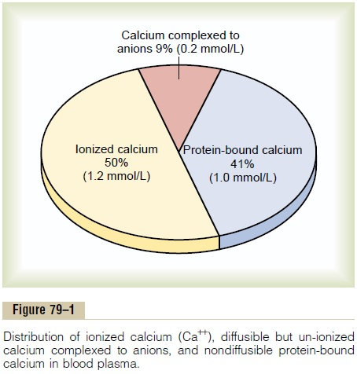
Calcium Levels
1.5% of body weight is Calcium, about 1100 - 1300 gm.
99% is in the skeleton.
Plasma Calcium
(9 -11 mg/dl)
average: 9.4 mg/dl
protein bound (non diffusible) 41%
(diffusible)
59%
Used in Ca functions because it can cross capillary wall.
Balance
In plasma (storage sites)
Ioinized 50%
Complexed 9%
The following was only found in female’s slides

Slide 13
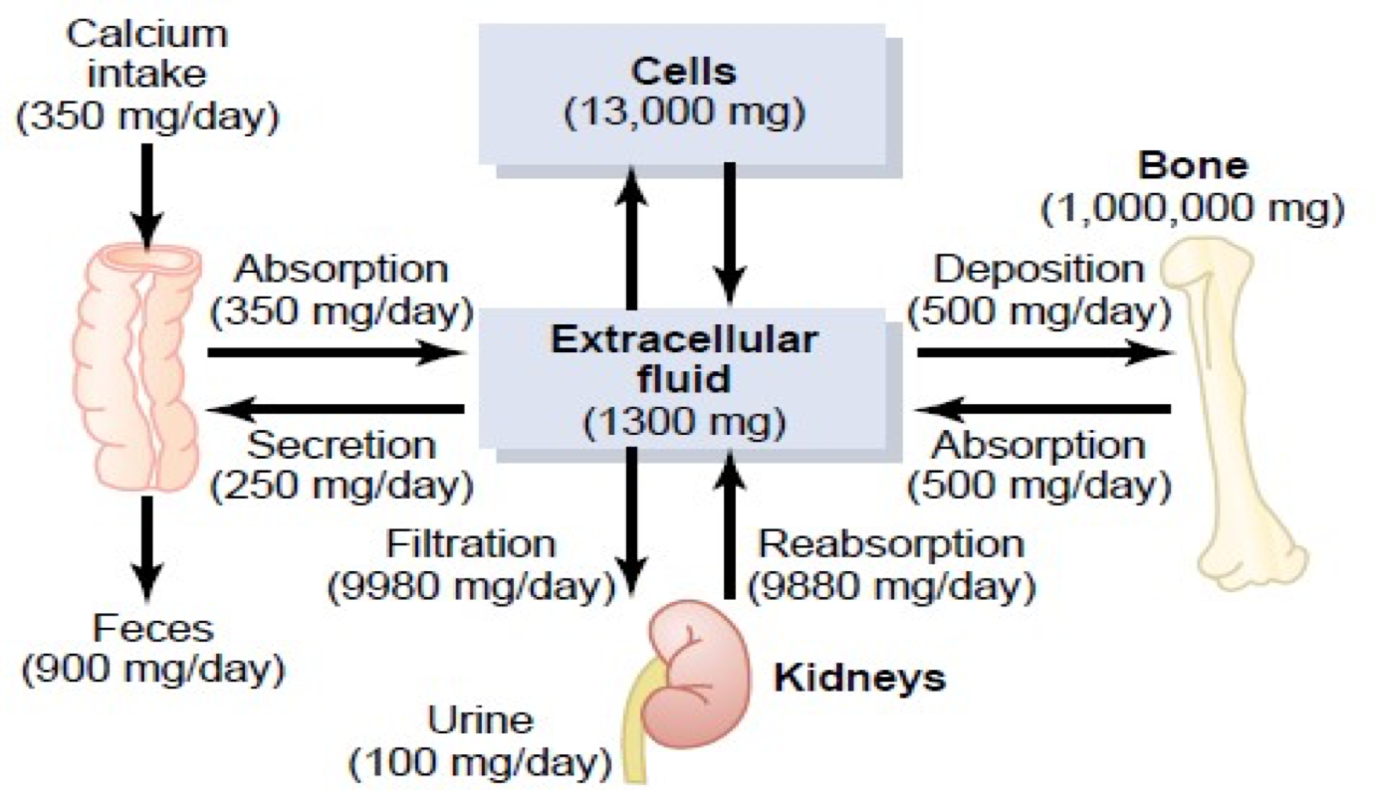
Calcium homeostasis in human body

Slide 14
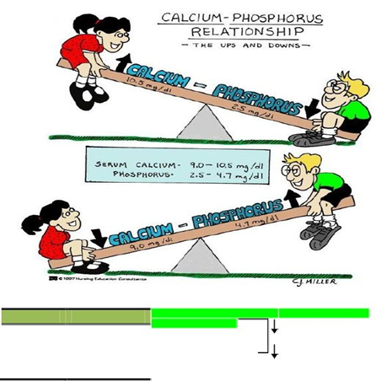
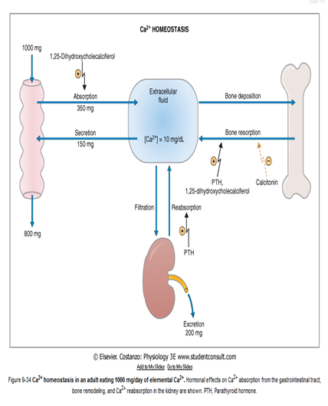
Serum calcium phosphate
Calcium and phosphorus relationship
If the calcium get increase the phosphorus will decrease
If the calcium get decrease the phosphorus will increase
Calcium and phosphorus in the body have an inversely proportional relationship. When one increases, the other decreases.
اذا زاد الكالسيوم يقل الفسفور و العكس صحيح، الآهم في الاخير يكون مجموعهم ثابت.
Calcium is more than phosphorus in the serum because it is needed in many cellular processes like nerve conduction and blood coagulation.
Notes:
Serum calcium and Phosphate

Slide 15
Calcium Exchange Between Bone and ECF
The bone contains a type of exchangeable calcium that is always in equilibrium with the Ca++ ions in the ECF
It normally amounts to about (0.4-1%) of the total bone calcium.
This calcium is a form of readily mobilizable salt such as CaHPO4 and other amorphous calcium salts.
The importance of exchangeable calcium is that it provides a rapid buffering mechanism to keep the Ca++ ions concentration in ECF from rising to excessive levels or falling to very low levels under transient conditions of excess or decreased availability of calcium.
Important to keep the calcium homeostasis.This form of calcium is mobilizable (قابل للحركه) , this calcium is combined with phosphate but this is a different combination than the one in the Hydroxyapatite. Hydroxyapatite is more solid and stable , therefore it is not considered exchangeable.

Slide 16
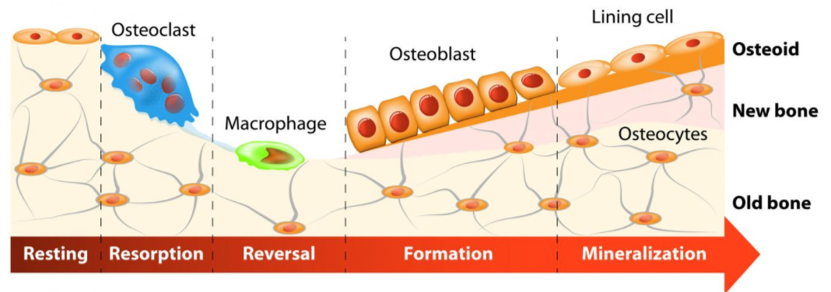
Remodeling of Bone
Deposition and Absorption of Bone
عملية تجديد للعظام. العمليتين الاحلال و التجديد يشتغلون مع بعض.
Bone remodeling is the continuous process of bone absorption (by osteoclasts,) and then its deposition (by osteoblasts.)
Osteoblasts:
Osteoblasts are found on the outer surfaces of the bones and in the bone cavities.
A small amount of osteoblastic activity occurs on about 4% of all bone surfaces at any given time in an adult, so that at least some new bone is being formed constantly.
The renewal rate is about 4% per year for compact bone and 20% per year for trabecular bone.
Bone is continually deposited by osteoblasts , and absorbed where osteoclasts are active.

Slide 17
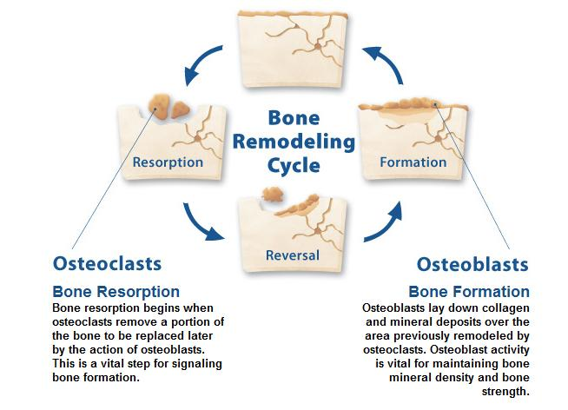
*For more understanding (extra):
Remodeling of bone = الosteoclasts ينحتوا العظام الى شكلها الطبيعي اللي نعرفها
Stops over deposition and accumulation of bone

Slide 18
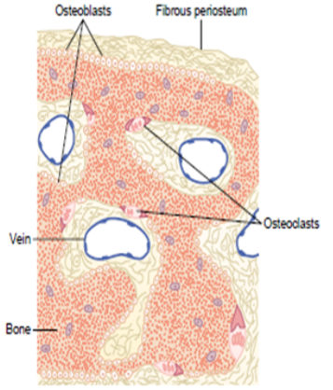
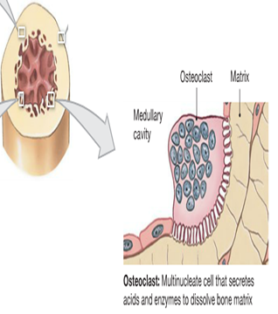
Osteoclasts
Osteoclasts are large phagocytic multinucleated cells
They are normally active on less than 1% of the bone surfaces of an adult.
The osteoclasts secrete
two types of substances:
The osteoclastic cells also phagocytose minute particles of bone matrix and crystals, dissoluting them and releasing the products into the blood.
 | Proteolytic enzymes | Several acids
Location of origin | from the lysosomes | from the mitochondria and secretory vesicles
purpose | dissolve the organic matrix | solution of the bone salts

Slide 19
Value of Continual Bone Remodeling
Bone adjusts its strength in proportion to the degree of bone stress and it thicken when subjected to heavy loads. (more stress = stronger)
The shape of the bone can be rearranged for proper support of mechanical forces by deposition and absorption of bone in accordance with stress patterns.
Because old bone becomes relatively brittle (هش) and weak, new organic matrix is needed as the old organic matrix degenerates. In this manner, the normal toughness of bone is maintained. (.بسبب الاستعمال المتكرر للعظام، العظام القديمة تضعف. فتتحلل العظام القديمة، وتستبدل بالجديدة)
Therefore, the bones of children are less brittle than the bones of the elderly, due to more remodeling in the children.
عملية التجديد عند الاطفال اعلى من الكبار في السن.

Slide 20
Control of the Rate of Bone Deposition by Bone “Stress”
-Continual physical stress stimulates osteoblastic deposition and calcification of bone.
-Bone stress also determines the shape of bones under certain circumstances. (e.g. Healing of fractures may start angulated in children then become straight).
-Bone is deposited in proportion to the load that it must carry.
-The bones of athletes become considerably heavier than those of non-athletes. Also, the bone of the leg in the cast becomes thin and up to 30 % decalcified within a few weeks.
Bone stress=continual use of bone, so when we are wearing a cast the bone is immobilized and so no stress is on it = no need for it to be thick and it becomes thinner and lighter

Slide 21
Repair of a Fracture Activates Osteoblasts
-Fracture of a bone activates all the periosteal and intraosseous osteoblasts involved in the break.
-Large numbers of new osteoblasts are formed from osteoprogenitor cells, which are bone stem cells in the surface tissue lining bone, called the "bone membrane”.
-Shortly a large bulge of osteoblastic tissue and new organic bone matrix, develops between the two broken ends of the bone followed shortly by the deposition of calcium salts. This is called a callus*. Callus is not final stage of bone healing, fracture can re-occur to the same area even with callus if no caution is taken.
Activation of osteoblasts
Osteoblasts formation from osteoprogenitor (stem cell)
Developing of large bulge of osteoblastic tissue + new organic matrix between the two broken ends.
Deposition of calcium salts
*callus means the bony healing tissue which forms around the ends of broken bone

Slide 22
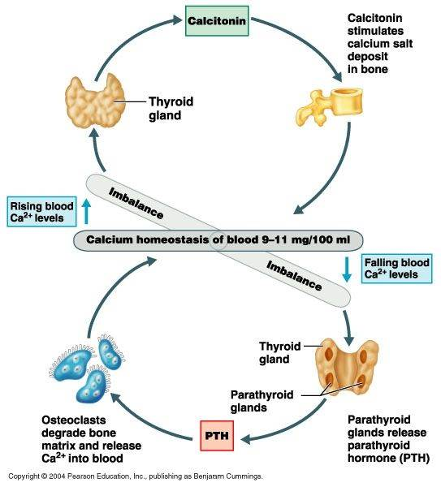
Hormonal Control of Calcium Metabolism & Physiology of Bone
Three major hormones
Active Vitamin D
1, 25 dihydroxycholecalciferol
Parathyroid hormone (PTH)
Calcitonin
a steroid hormone formed from Vitamin D.
secreted by parathyroid gland
secreted by c-cells in the thyroid gland.
Main goal of PTH is to work when the serum level of Calcium is low.
Main goal of calcitonin is to work when the serum level of Calcium is high.
-To a lesser extent; Glucocorticoids, GH, estrogens & various growth factors also affect Calcium Metabolism.

Slide 23
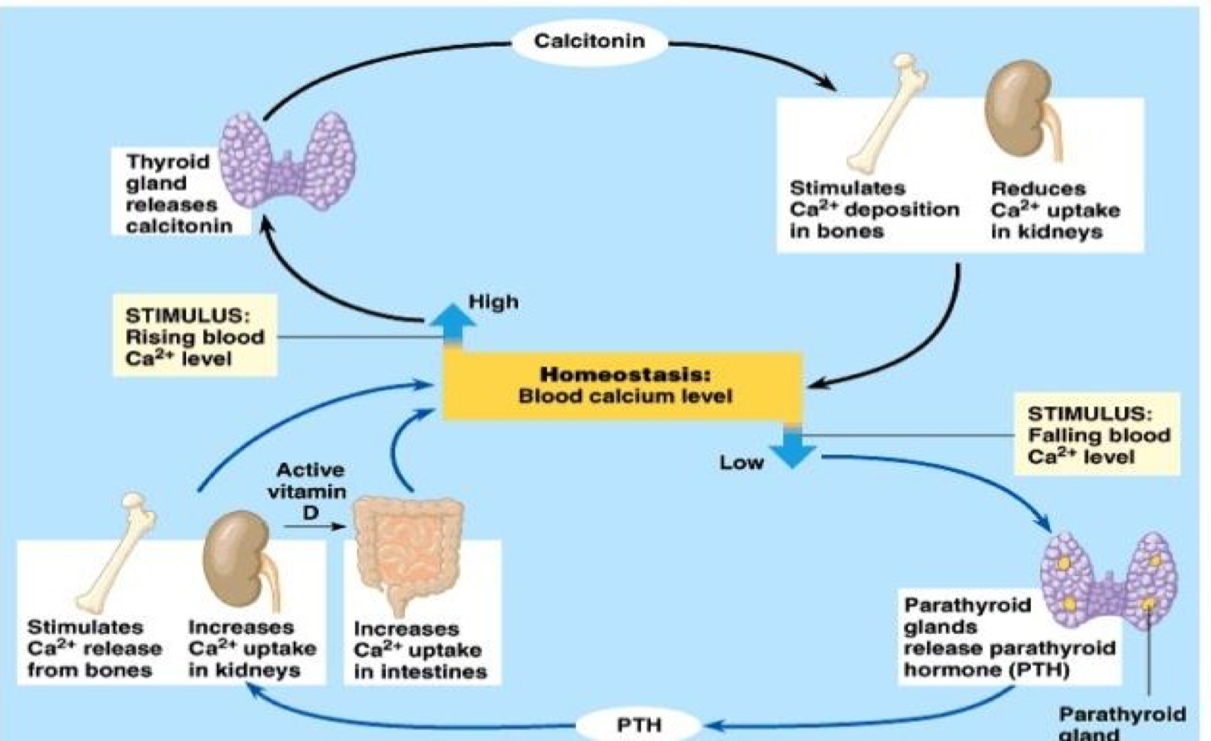

Slide 24
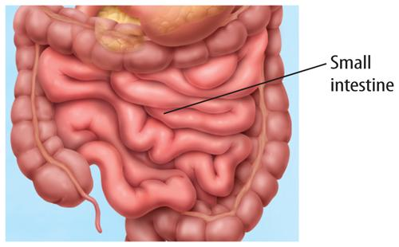
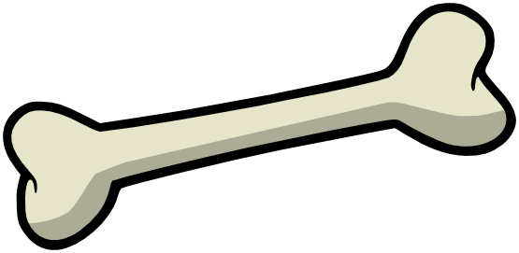
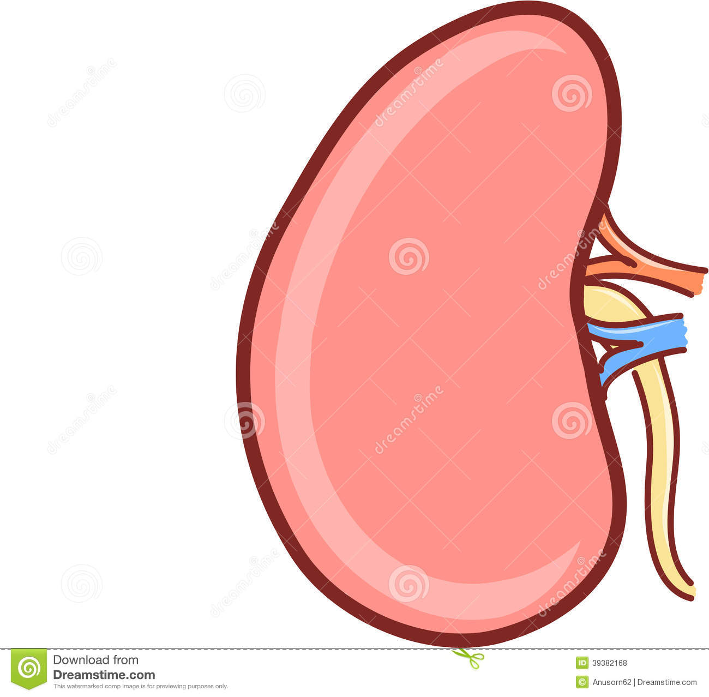
Vitamin D - ACTION OF CALCITRIOL
-Increases the intestinal absorption of calcium and phosphate by increased synthesis of calcium binding protein (calbindin D28k)
-Mineralization of bone at low doses
-Mobilization of calcium from bone at high doses
-increased reabsorption of calcium and phosphorus
-decreased excretion of calcium and phosphorus

Slide 25
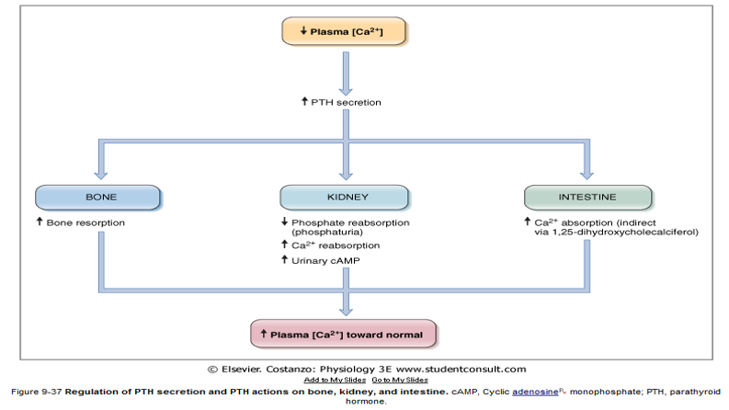
Parathyroid Hormone (PTH)
Bone resorption = release of bone Ca++ into the plasma.
Here we want to increase Ca++ level in plasma
Resorption ≠ reabsorption

Slide 26
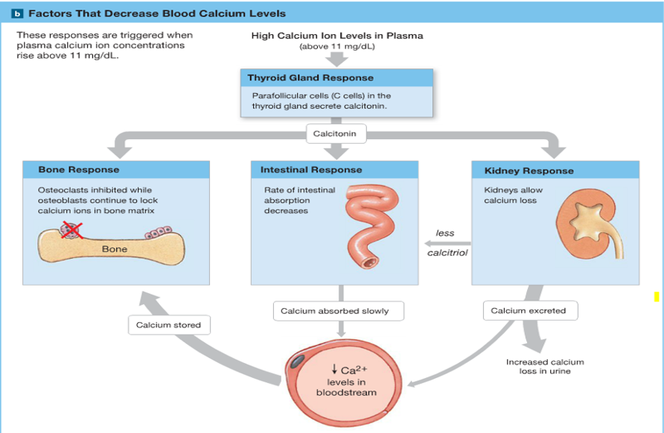
Calcitonin Hormone

Slide 27
Osteoporosis
Osteoporosis: means reduced bone density and mass
Is caused by decrease of osteoblastic activity or occasionally due to relative excess of osteoclastic function. Loss of bone matrix is marked. Matrix and mineral are both lost and there is a loss of bone mass. Due to :
Lack of physical stress
Malnutrition
lack of vitamin C
Old Age
Postmenopausal lack of estrogen
Cushing’s syndrome.

Slide 28
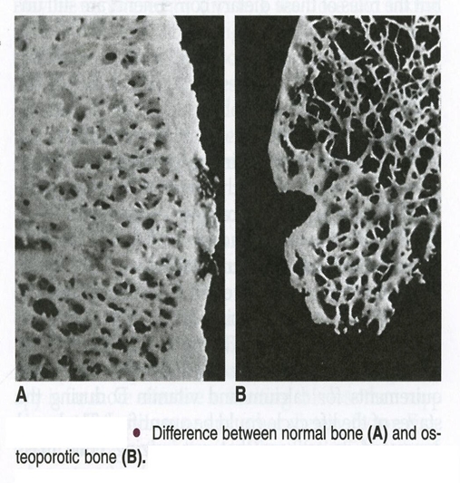
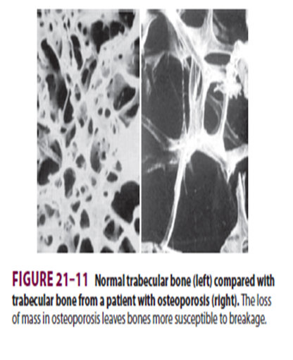
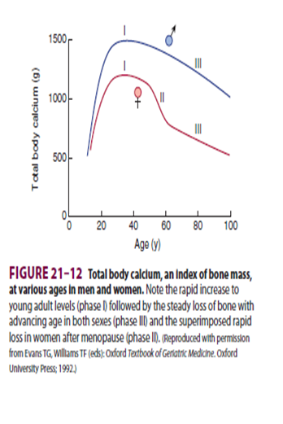
Osteoporosis

Slide 29
Complications of Osteoporosis
The incidence of fractures is increased particularly in the :
1.distal forearm (Colles fracture) 2.vertebral body 3.hip.
WHY?: These areas have a high content of trabecular bone, which is more active metabolically, it is lost more rapidly.
Fractures of the vertebrae with kyphosis produces “widow’s hump” in elderly women with osteoporosis. (Kyphosis is the extreme curvature of the back)
Fractures of the hip in elderly are associated with a mortality rate of 12–20%, and half of those who survive require prolonged expensive care.
Increased intake of calcium and moderate exercise may help prevent or slow the progress of osteoporosis.

Slide 30
Summary

Slide 31
Quiz
1) Which one of these are multinuclear cells that phagocytose bone? A. osteoblasts B. osteoclasts C. osteocytes 2) Calcium salts have great tensile strength. A. True B. False 3) Body weight calcium in a healthy adult : A. 1900 g B. 700 g C. 1300 g D. 2100 g
Correct answers: 1: B 2: B 3: C

Slide 32
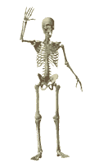
Team Leaders:
Abdulhakim AlOnaiq
Alanoud Salman
Female’s team:
Ahad Algrain
Hadeel
Maha Alnahdi
Majd AlBarrak
Rahaf Alshammari
Rinad Alghoraiby
Munira Alhadlg
Sarah AlBlaihed
Male’s team:
Anas Alsaif
Mohammed Alhassan
Omar Alfawzan
Saad Alhadab
Anas alsuwaida
Khaled alogaili
contact us at:
physiologyteam437@gmail.com
@physio437
editing file
Notes:
team members please put your names here

