Slide 1
Nerve Conduction studies and Electromyography
Color index:
Red: important
Green: doctor’s notes
Grey: extra information
Pink: found only in female’s slides
blue: found only in male’s slides
Physiology 437 team work

Slide 2
objectives:
By the end of the lecture you will be able to:
Define nerve conduction study (NCS) and electromyography ( EMG).
Explain the procedure of NCS
Define the normal conduction velocity in upper limb and lower limb nerves.
Define the motor unit potentials ( MUPs) and how they are changed in muscle and nerve diseases.

Slide 3
Videos for over view
تطبيق مع شرح مبسط 11:06
female doctor videos :
nerve conduction study :
https://www.youtube.com/watch?v=avl2rS3siig 2:36
EMG :
https://youtu.be/gpgsR5jcI8M 3:25

Slide 4
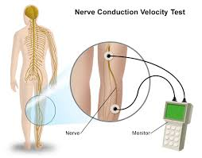
Nerve Conduction studies
A nerve conduction study (NCS) is a test commonly used to evaluate the function, especially the ability of electrical conduction, of the motor and sensory nerves of the human body.
* Nerve conduction velocity (NCV) is a common measurement made during this test.
Motor nerve conduction study
The recorded potential, known as the compound muscle action potential (CMAP), represents the summation of all underlying individual muscle fiber action potentials.
CMAP is a biphasic (ثنائي الموجة) potential with an initial upward deflection from the baseline
For each stimulation site : the latency, amplitude, duration, of the CMAP are measured .
A motor conduction velocity can be calculated after two sites of stimulation, one distal and one proximal.
Male’s slides
It could be:
Motor NCS
Only one will be discussed
Mixed NCS
sensory NCS

Slide 5
Motor nerve conduction velocity
Male’s slides
Motor nerve conduction velocity of peripheral nerves may be closely correlated to their functional integrity or to their structural abnormalities.
Based on the nature of conduction abnormalities two principal types of peripheral nerve lesions can be identified: Axonal degeneration and segmental demyelination.
In the patients of muscular weakness, muscle atrophy, traumatic or metabolic neuropathy, these tests are considered as an extension of the physical examination rather than a simple laboratory procedure.

Slide 6
Amplitude
• it is most commonly measured from baseline to the peak (baseline-to-peak) and less commonly from the first upward peak to the next downward peak (peak-to-peak).
CMAP amplitude reflects the number of muscle fibers that depolarize.
• low CMAP amplitudes most often result from loss of axons (as in a typical axonal neuropathy)
• average CMAP amplitude 3 mv
Conduction Velocity
• It’s measurement of the speed of the fastest conducting nerve axons
• It is calculated by dividing the change in distance (between proximal stimulation site & distal stimulation site in mm) by the change in time (proximal latency in milliseconds (ms) minus distal latency in ms)
Duration
• This is measured from the initial deflection from baseline to the final return
• Duration characteristically increases in conditions that result in slowing of some motor fibers (e.g., in a demyelinating lesion).
Latency
• The latency is the time from the stimulus to the initial deflection from baseline
•Latency measurements usually are made in milliseconds (ms).

Slide 7
Team 436

Slide 8
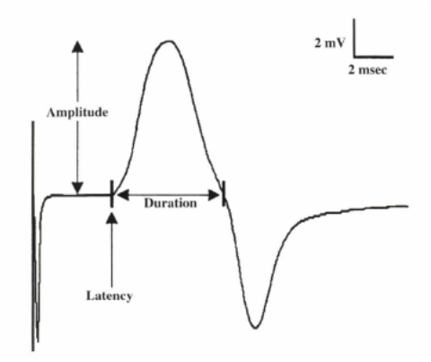
MOTOR CONDUCTION STUDIES
The recorded potential, known as the compound muscle action potential (CMAP), represents the summation of all underlying individual muscle fiber action potentials.
CMAP is a biphasic (ثنائي الموجة) potential with an initial upward deflection from the baseline
For each stimulation site : the latency, amplitude, duration, of the CMAP are measured .
A motor conduction velocity can be calculated after two sites of stimulation, one distal and one proximal.

Slide 9
extra
Motor NCS are performed by electrical stimulation of a peripheral nerve and recording from a muscle supplied by this nerve. The time it takes for the electrical impulse to travel from the stimulation to the recording site is measured. This value is called the latency and is measured in milliseconds (ms). The size of the response - called the amplitude - is also measured. Motor amplitudes are measured in millivolts (mV). By stimulating in two or more different locations along the same nerve, the NCV across different segments can be determined. Calculations are performed using the distance between the different stimulating electrodes and the difference in latencies.

Slide 10
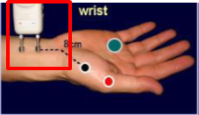
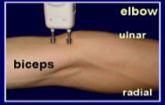
MCS Procedure
An electrical stimulus is applied over a nerve ( e.g., median nerve )
at two sites :
1- a distal site ( wrist ).
2-proximal one ( antecubital fossa , elbow).
An active recording electrode (G1) is place over the belly of the muscle supplied
by that motor nerve (over the motor endplate) . The muscle is the thenar eminence which consist of multiple muscle one of them is the Abductor Pollicis Brevis (the muscle that we use in a routine test ).

Slide 11
Procedure (cont.)
The reference recording electrode (G2) about 3-4 cm away from G1 .
The stimulator then is placed over the nerve that supplies the muscle.
The oscilloscope ( CRO for cathode-ray oscilloscope) sweep speed is
adjusted to 2 ms/cm.
Oscilloscope : used to observe the change of an electrical signal over time.
The stimulus duration used is 0.2 ms(milliseconds) and stimulus frequency to 1 / sec.
As current slowly increases (from a baseline), more nerve fibers reach stimulation threshold (brought to Action Potential). This will lead to more muscle fiber action potentials.

Slide 12
Procedure (cont.)
Most nerves require a current in the range from 20 to 50 mA to achieve supramaximal stimulation.
When the current reaches the point where CMAP no longer increases, we assume reaching the supramaximal stimulation. The current is increased by 20% to be sure.
1- Apply the stimulus and record the response from stimulation at the wrist.
Store the CMAP ( compound muscle action potential ) in the first channel of the oscilloscope .
2- Change the stimulating site from wrist to antecubital fossa ( elbow ).
Stimulate the nerve & record the CMAP for median nerve stimulation at the elbow.

Slide 13
Team 436

Slide 14
Team 436

Slide 15
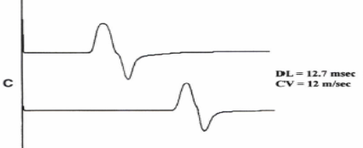
Patterns of nerve conduction Normal study of median nerve
Normal median distal latency (DL)
3 ms
Conduction velocity (CV)
> 49 mls
Amplitude
> 4 mV
Axonal Loss and Demyelination
 | Axonal loss | Demyelination
Amplitude | decrease | No change
Distal latency | Normal or slightly prolonged | Prolonged ( 130% upper the normal limit)
Morphology of potential between proximal and distal sites | No change | No change
Conduction velocity | Normal or slightly slowed | Markedly slowed (75% lower than normal limit)

Slide 16
Electromyography ( EMG)
EMG: is a technique for evaluating and recording physiologic properties of muscles at rest and while contracting .
Mechanism: It is a recording of electrical activity of the muscle by inserting needle electrode in the belly of the muscles ( needle EMG ) or by applying the surface electrodes ( surface EMG ).

Slide 17
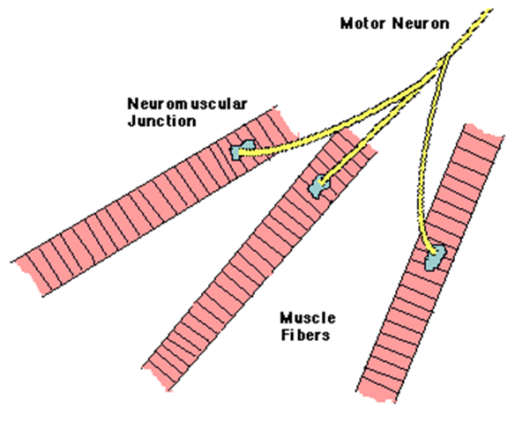
•A motor unit is defined as one motor neuron and all of the muscle fibers it innervates.
In the slides notes :
A motor unit is defined as one motor neuron and all of the muscle fibers it innervates. When a motor unit fires, the impulse (called an action potential) is carried down the motor neuron to the muscle. The area where the nerve contacts the muscle is called the neuromuscular junction, or the motor end plate. After the action potential is transmitted across the neuromuscular junction, an action potential is elicited in all of the innervated muscle fibres of that particular motor unit. The sum of all this electrical activity is known as a motor unit action potential (MUAP). This electrophysiologic activity from multiple motor units is typically evaluated during an EMG. The composition of the motor unit, the number of muscle fibres per motor unit, the metabolic type of muscle fibres and many other factors affect the shape of the motor unit potentials in the myogram.

Slide 18
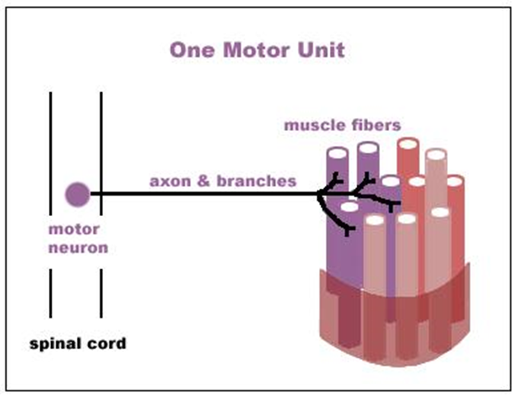

Slide 19
Analysis
EMG
Spontaneous activity
–The skeletal muscle is silent at rest, hence spontaneous activity is absent.
Normal MUPs
Bi – Triphasic
Duration – 3 – 15 mSec.
Amplitude – 300μV – 5 mV

Slide 20
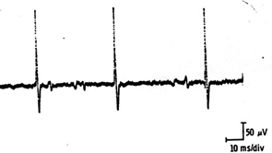
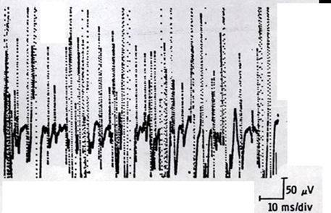
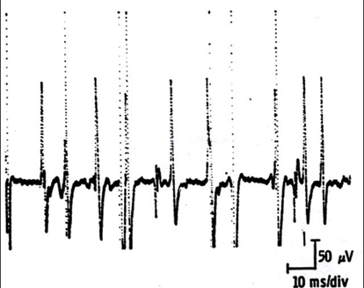
MUPs (2)
During Mild Effort
During Full Voluntary Effort .
There is full recruitment ( you
can not see the baseline )
During Moderate Effort -> note recruitment of additional motoneurons

Slide 21
Normal Muscle

Slide 22
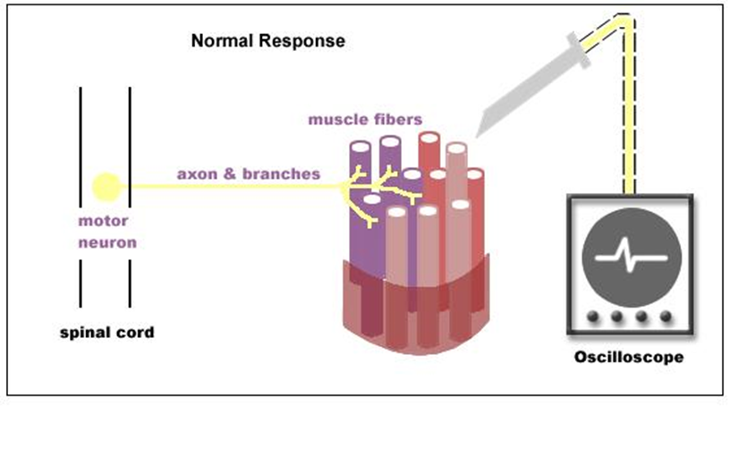
NORMAL EMG

Slide 23
Abnormal MUPs
In neurogenic lesion or in active myositis, the following spontaneous activity is noted
Positive sharp wave:
A small potential of 50 to 100 µV, 5 to 10 msec duration with abrupt onset and slow outset.
Fibrillation potential:
these are randomly occurring small amplitude potentials or may appear in runs. The audio amplifier gives sounds, as if somebody listen sounds of rains in a tin shade house. These potentials are generated from the single muscle fiber of a denervated muscle, possibly due to denervation hypersensitivity to acetylcholine.

Slide 24
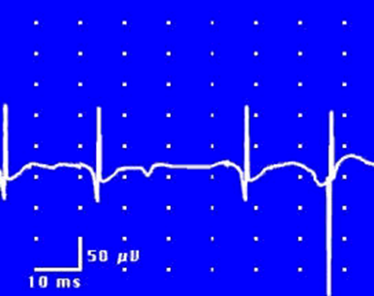
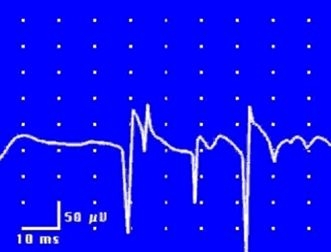
Fibrillation Potentials
Positive Sharp Waves

Slide 25
Cont…
Fasciculation potentials:
These are high voltage, polyphasic, long duration potentials appear spontaneously associated with visible contraction of the muscle. They originate from a large motor unit which is formed due to reinnervation of another motor unit from the neighboring motor unit.

Slide 26
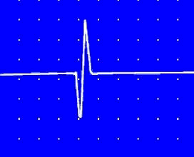
EMG: Spontaneous Activity
Fasciculation Potential

Slide 27
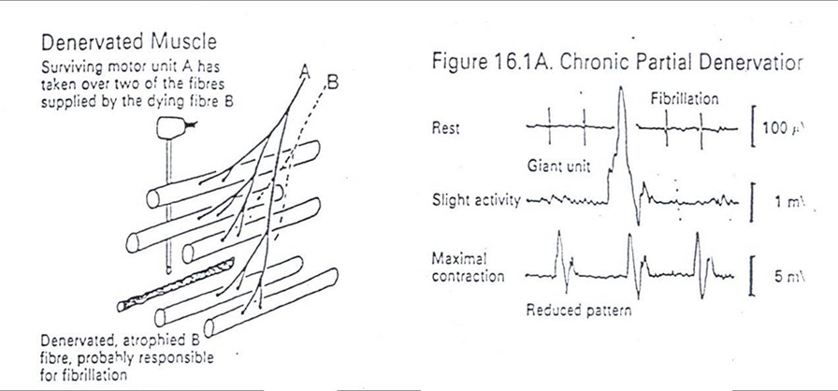
Neuropathic EMG changes

Slide 28
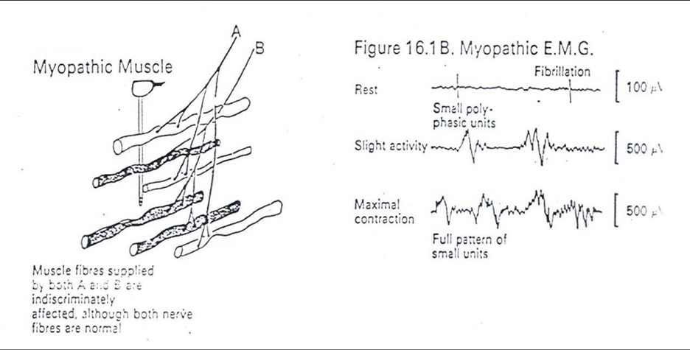
Myopathic EMG changes

Slide 29
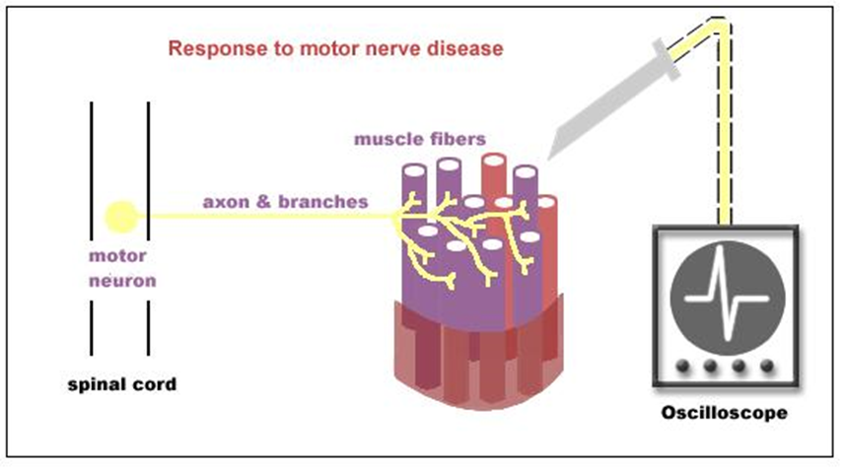
NEUROPATHY

Slide 30
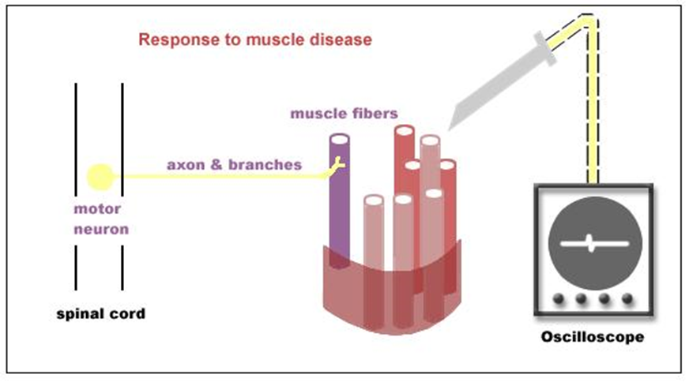
MYOPATHY

Slide 31
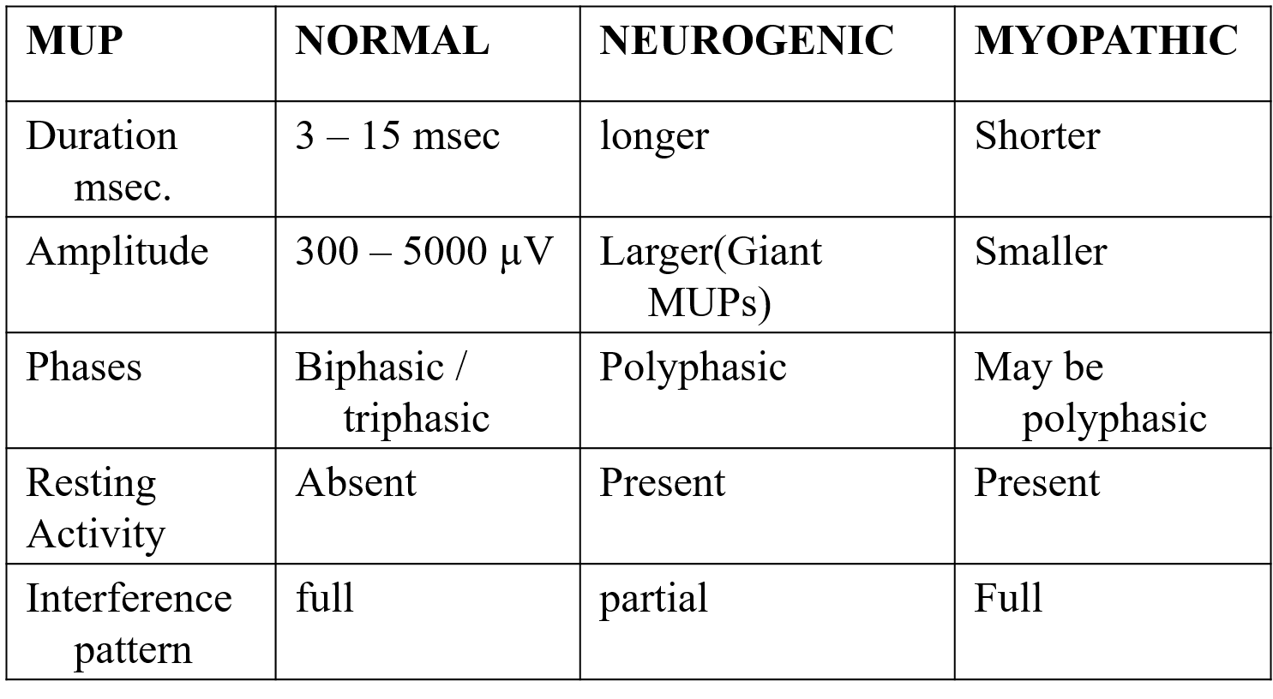
Analysis of a motor unit potentials (MUPs)

Slide 32
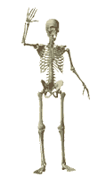
Team Leaders:
Abdulhakim AlOnaiq
Alanoud Salman
Female’s team:
Ahad Algrain
Hadeel
Maha Alnahdi
Majd AlBarrak
Rahaf Alshammari
Rinad Alghoraiby
Munira Alhadlg
Sarah Alblaihed
Renad Almogren
Male’s team:
Naif Almutairi
Saad Alfawzan
Mohammed Alswoaiegh
Saud Alatawy
Saif almeshari
Khalid alogaili
contact us at:
physiologyteam437@gmail.com
@physio437
editing file
Notes:
team members please put your names here

