Slide 1
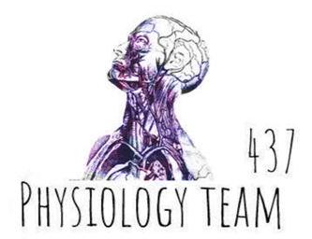
Contraction of Skeletal muscle & Neuromuscular Transmission
Color index:
Red: important
Green: doctor’s notes
Grey: extra information
Pink: found only in female’s slides
blue: found only in male’s slides
Physiology 437 team work

Slide 2
objectives:
By the end of the lecture you will be able to:
1- The physiologic anatomy of the skeletal muscle and NM junction.
2- the general mechanism of skeletal muscle contraction.
3- Motor End Plate potential and how action potential and excitation-contraction coupling are generated in skeletal muscle.
4- the molecular mechanism of skeletal muscle contraction and relaxation.
5- sliding filaments
6- drugs/diseases affecting the neuromuscular transmission.

Slide 3
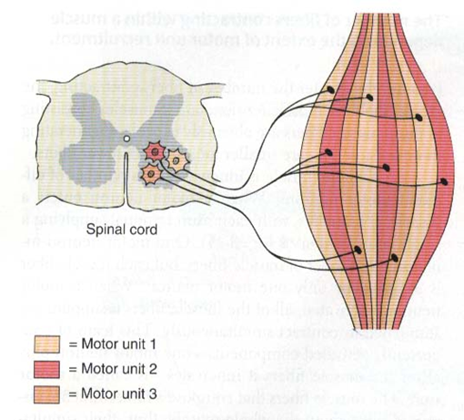
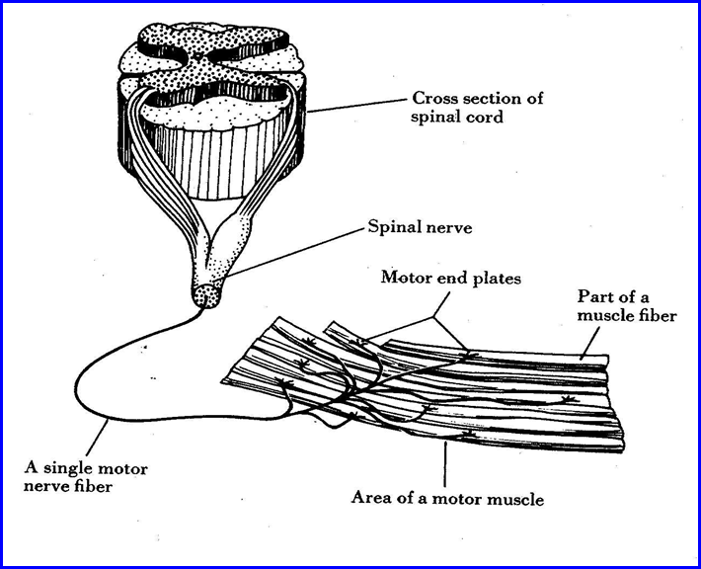
Motor unit
What is the motor unit?
It is the Motor Neuron (Anterior Horn Cell , Axon) and
all the muscle fibers it innervates.
Anterior horn cells = motors
Posterior = sensory

Slide 4
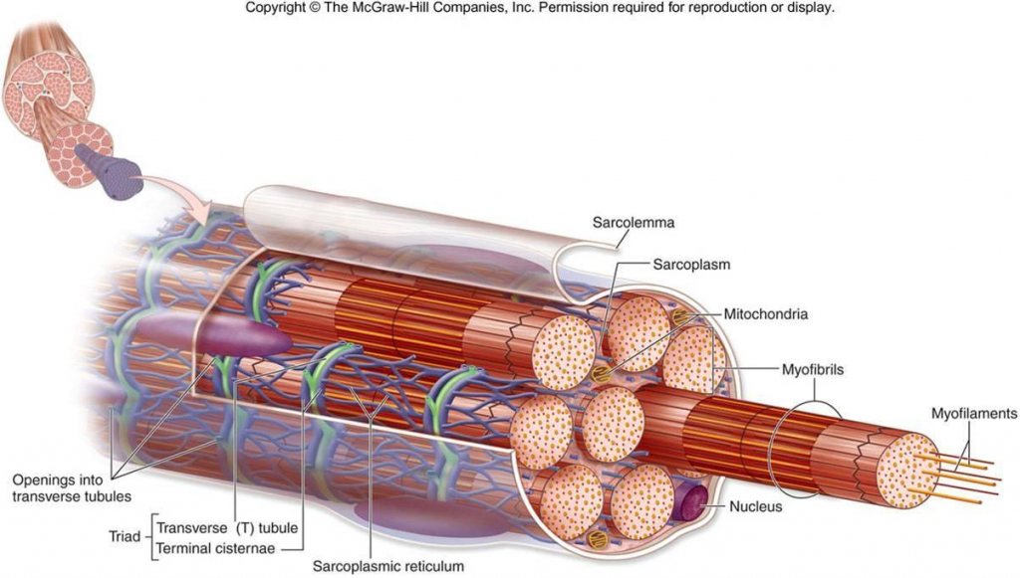
Physiological Anatomy of Skeletal Muscle fiber
A video explaining the structure and function of the muscle fibers.
Important slide for understanding
T tubule opening: its function is transform of action potential from outside into inside
Transverse T tubule :
Deep, transfers the action potential to the fibrils inside
Terminal cisterna: its function :
Calcium
storage
Release
Uptake
Longitudinal elements of sarcoplasmic reticulum:
surround all surfaces of the actual contracting
myofibrils.

Slide 5
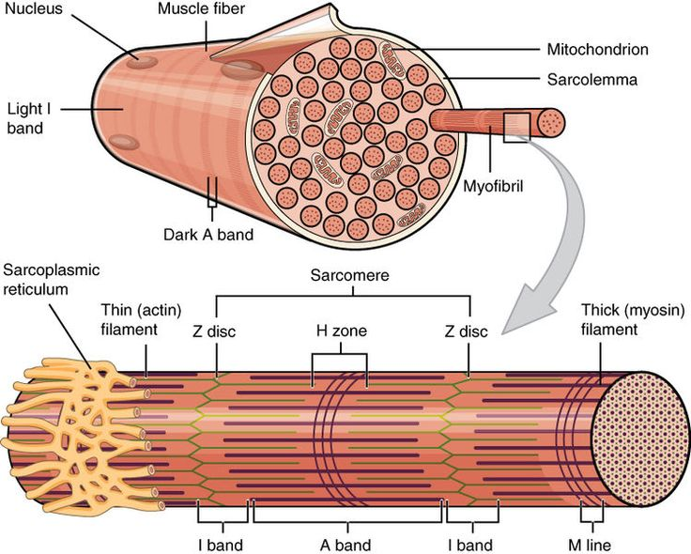
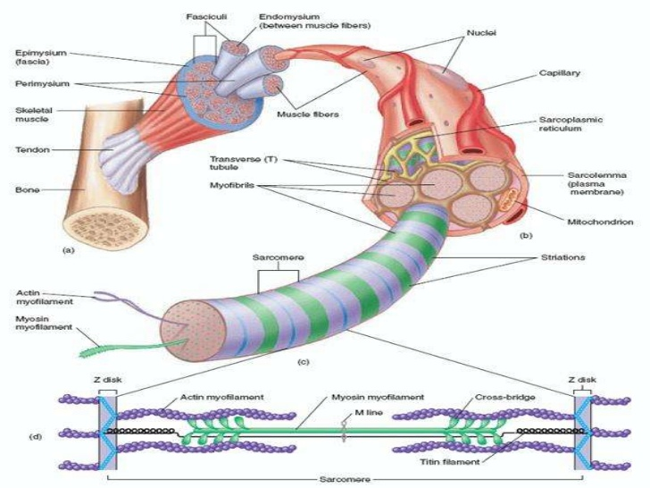
Physiological Anatomy of Skeletal Muscle fiber
3000 actin
1500 myosin (Responsible for the actual muscle contraction)
A simple explanation of the structure of skeletal muscles.
Be careful!

Slide 6
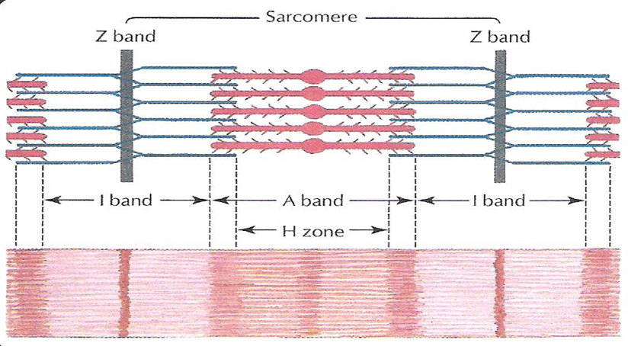
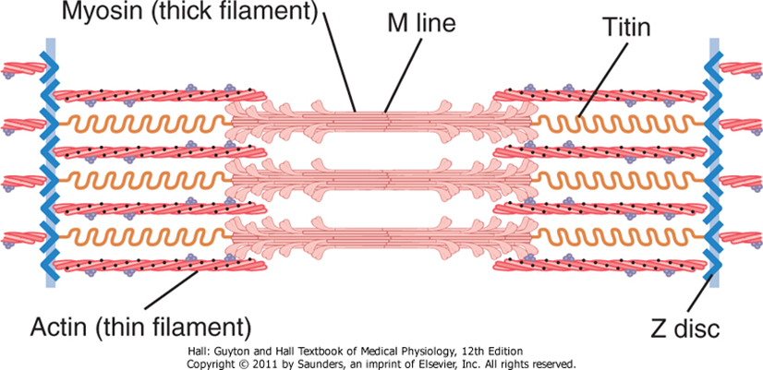
Actin
Myosin
M line
Myofibril
The light and dark bands give skeletal and cardiac muscle their striated appearance.
Titin filaments keep the myosin and actin filaments in place.

Slide 7
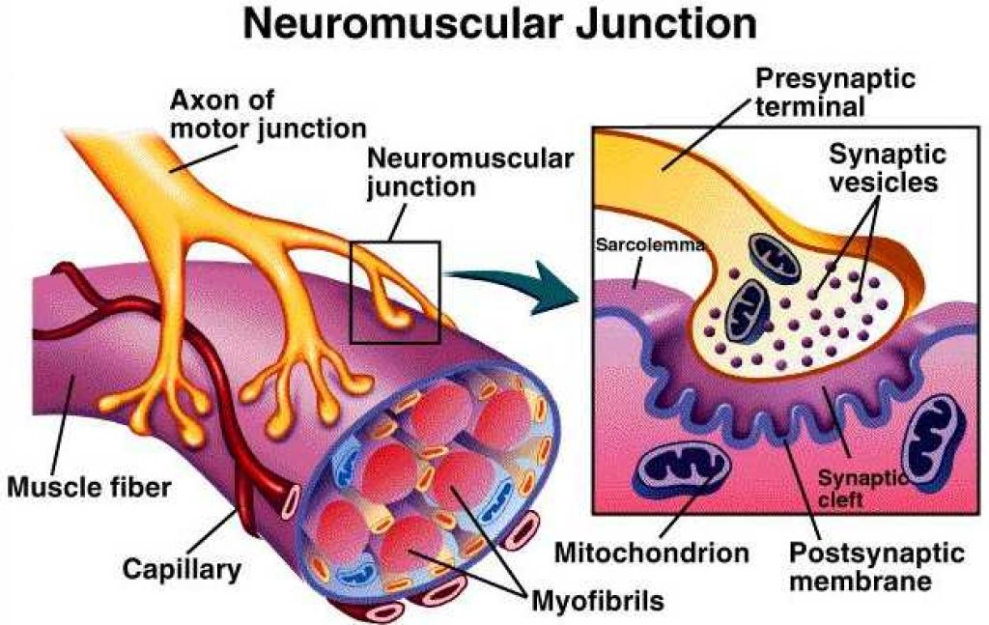
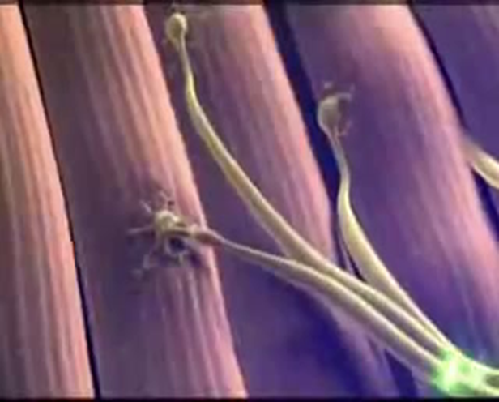
Physiologic Anatomy of the Neuromuscular Junction
Transmission of impulses from nerve endings to skeletal muscle fibers occurs via:
THE NEUROMUSCULAR JUNCTION (NMJ)
مكان التقاء النيرف ايندينق مع العضلة هو النيورومسكلار جنكشين

Slide 8
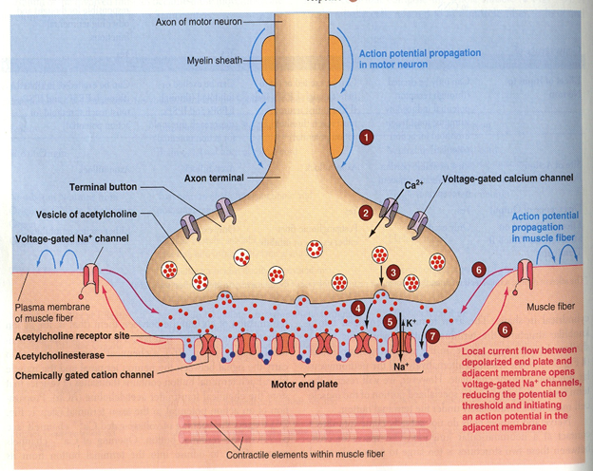
Physiologic Anatomy of the Neuromuscular Junction
Blocking of Na+voltage gated channels will stop action potential > so it causes anesthesia (الفكرة العامة من التخدير).
Motor End Plate (MEP) : is the area where the muscle face nerve endings.
Synaptic trough/ gutter
Presynaptic terminal (motor nerve ending)
Postsynaptic terminal (in muscle)
Synaptic space/cleft
Subneural cleft
Acetylcholine (Ach)
Synaptic vesicles
Acetylcholinesterase (enzymes will break Ach up)
Motor End Plate (MEP) • Synaptic trough/ gutter
• Presynaptic terminal • Postsynaptic terminal
• Synaptic space/cleft • Subneural cleft
• Acetylcholine (Ach) • Synaptic vesicles
• Acetylcholinesterase
Motor end plate: the skeletal muscle here is like a plate for the motor nerve. It’s the same as neuromuscular junction, just a different name. The muscle at the neuromuscular junction is known as synaptic trough or gutter and it is shaped that way to increase the surface area ، تكون العضله في مكان الالتقاء مع العصب كانها مشرشرة مما يزيد من المساحه . the space between the nerve and the muscle is known as synaptic cleft.

Slide 9
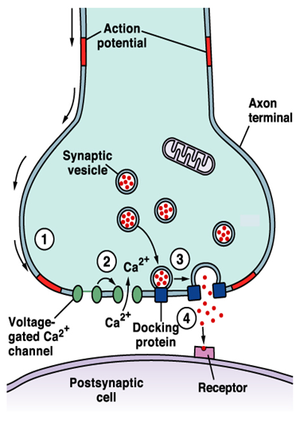
Acetylcholine
Is a neurotransmitter.
Synthesized: from active acetate (acetyl coenzyme A) + choline
Synthesis location: in the cytoplasm of the nerve terminal (axon terminal)
Absorption & Storage: rapidly in synaptic vesicles and stored there
Synaptic vesicles synthesis mechanism :
Synthesized by the Golgi Apparatus in the nerve soma (cell-body),
Then they are carried by Axoplasmic Transport to the nerve terminal (axon terminal) which contains around 300.000 vesicles and each vesicle is filled with around 10.000 Ach molecules

Slide 10
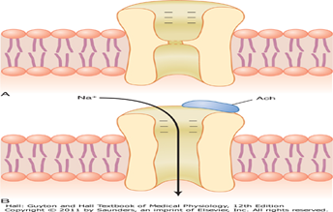
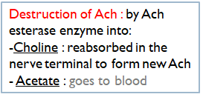
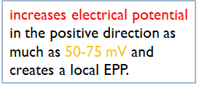
Secretion of Acetylcholine by the nerve terminals
*from 436
Action potential (AP) at the synaptic knob
A nerve impulse reaches the nerve terminal (presynaptic)
إذا الجسم ما تخلص من ACHيسبب انقباض مستمر للعضلة
End-plate potential spreads & triggers a muscle action potential to make contraction
Ca+ Channel open (voltage-gated Ca+ channels) in nerve
Increase Ca+ permeability
Fig 7.3 Ach gated channels
A-Closed B-Open after ach attaches
هناك حد للACH فلما يخلص أو يكون المحفز عالي ومدة مستمرة يحدث fatigue of the junction وهذا أحد safety factor .
Na flow inside to diffuse into muscle causing local non-prognated potential (End-Plate- Potential)
Release of Ach
From synaptic knob to synaptic cleft
This whole process of Ach release, action & destruction takes about 5-10 milliseconds
2 molecules of Ach combines with specific receptor on the subneural cleft
A small amount diffuses out of the synaptic space

Slide 11
Extra Information
A quick overview for the actions happening at the neuromuscular junction
At the beginning, this message was electrical then it becomes chemical.
Action potential > stimulate releasing of chemical substance > that’s why we said “the massage was electrical then it becomes chemical” which called as [Transduction].
presynaptic cell: an axon terminal ( synaptic knob ) which contains synaptic vesicles.
postsynaptic cell: a neuron, muscle fiber, or gland cell.
end plate potential : Different than action potential in that it is not an all or none response , the more neurotransmitter there is the higher the response, and it may not propagate. If there is sufficient Na influx , it will turn to Action Potential and propagate.
How many mV to reach threshold of muscle ? we need 100 ACH vesicles each one will worth 0.4 mV. So all we need is about 40 mV.
Summary :
AP ( neve) > open calcium voltage gated channels > calcium influx > calcium stimulate ACH vesicles > ACH outflex > 2 ACH molecules open ACH receptor channels > +ve ions influx > local positive potential happens > Na+ voltage gated channels sense the change then open > AP in muscle > contraction

Slide 12
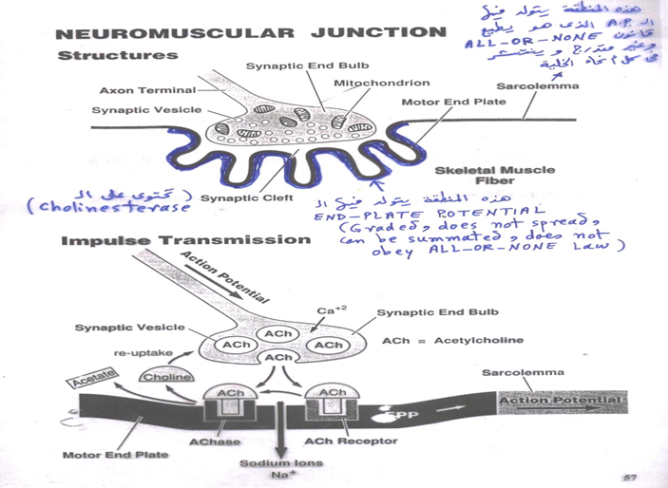

Slide 13
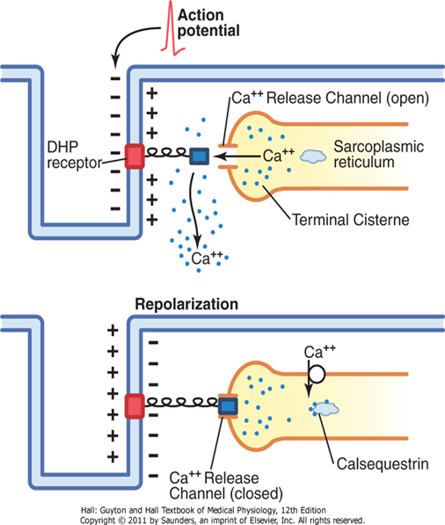
Spread of the Action Potential Via Transverse Tubules
See slide 4
System contains:
T-tubules (transverse tubule)
The sarcoplasmic reticulum
are small junction that runs transverse to the myofibrils and extend from one side to the other .(inside each cell & filled with ECF )
(a place where Ca stored) it is composed of 2 parts:
large chambers called terminal cisternae
long longitudinal tubules
Mechanism
As the AP reaches the T-tubule
the voltage change is sensed by dihydropyridine receptors (DHP)
DHP linked to Ryanodine receptors (calcium release channels) which triggers the release of Ca⁺⁺ from Sarcoplasmic reticulum to initiate contraction.
In SR
This overall process is called excitation-contraction coupling.
DHP is very sensitive to voltage changes
Calcium pump: removes calcium ions after contraction occurs
Calcium binds to calsequestrin.
Ryanodine receptors is a gate on SR

Slide 14
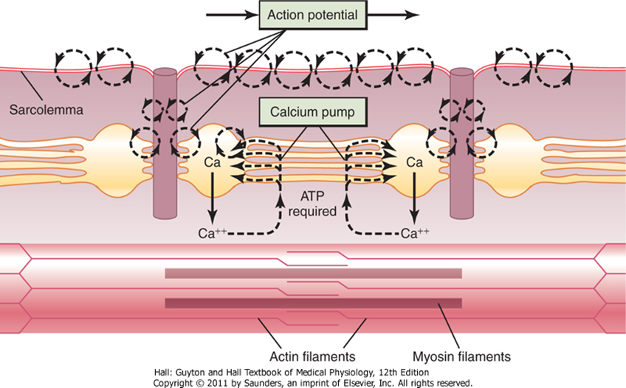
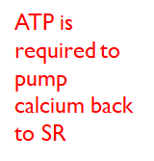
For understanding

Slide 15
Action potential comparison
 | Skeletal muscle | Large nerve
Resting membrane potential | -80 to -90 mV (same) | -80 to -90 mV (same)
Duration of the action potential | Lasts 1-5 msec (slower) | Lasts 0.2-1 msec (faster)
Conduction velocity | 3-5 m/sec (slower) | 39-65 m/sec (faster)

Slide 16
Safety Factor for Transmission at the Neuromuscular Junction 436 male
Fatigue of the Junction:
Each impulse that arrives at the junction causes about 3X as much EPP as required to stimulate the muscle fiber.
> Therefore, the normal NMJ is said to have a high safety factor.
Overstimulation diminishes the number of Ach vesicles.
This situation is called fatigue of the NMJ.
Fatigue of the NMJ occurs rarely and only at exhausting levels of muscle activity.

Slide 17
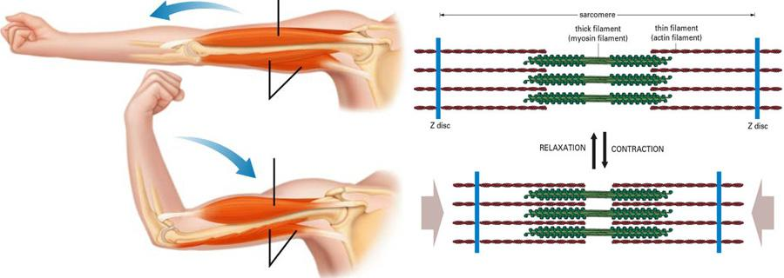
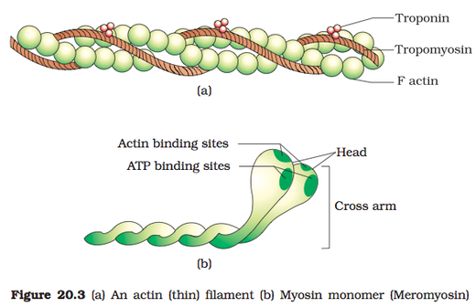
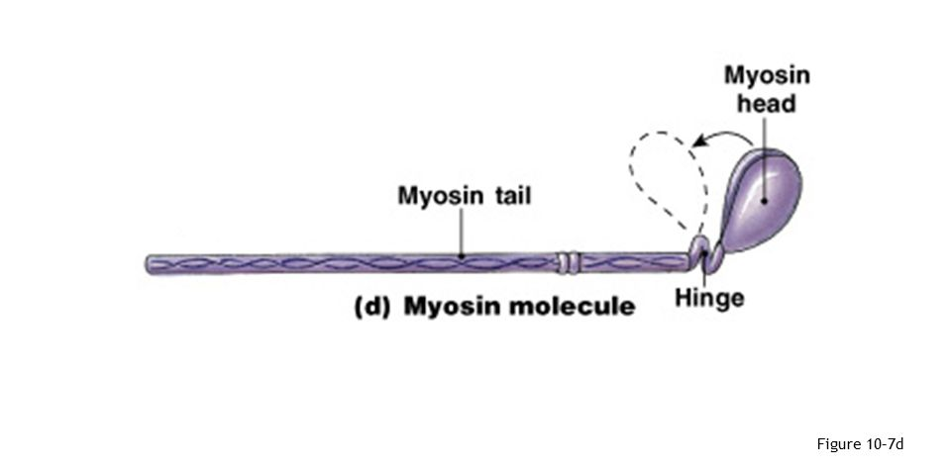
The Molecular Mechanism of Skeletal Muscle Contraction
Muscle Contraction Occurs by a Sliding Filament Mechanism
Molecular Characteristics of the Contractile Filaments:
Myosin filaments are composed of multiple myosin molecules.
Each Myosin molecule has: Each myosin head contains:
(1) Head (1) Actin binding site
(2) Tail (2) Myosin ATPase site
(3) Hinge (joint )
Myosin & actin never change in size
Just the sarcomere will narrowed or shortened

Slide 18
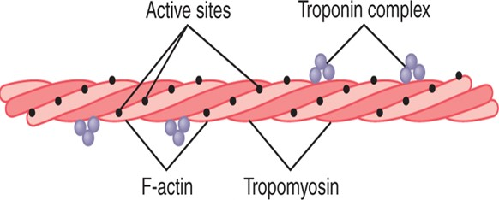
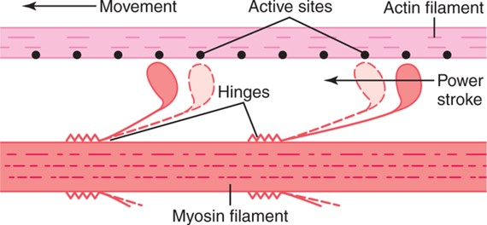
Molecular Characteristics of the Contractile Filaments
Actin filaments are composed of actin, tropomyosin and troponin
Molecular Mechanism:
The heads of the cross-bridges bend back and forth and step by step walk along the actin filament,
pulling the ends of two successive actin filaments toward the center of the myosin filament.
Actin: كأنه عقدين من اللؤلؤ لافين على بعض
Troponin: three balls, one binds with Actin (Ti) . one binds with Tropomyosin(Tt) , and one binds with Calcium(Tc).
Tropomyosin: thread like structure that covers the active site of actin.
Double-Stranded:
the actin filament

Slide 19
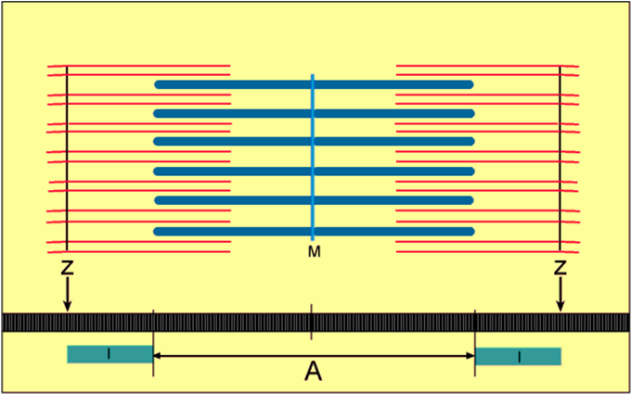
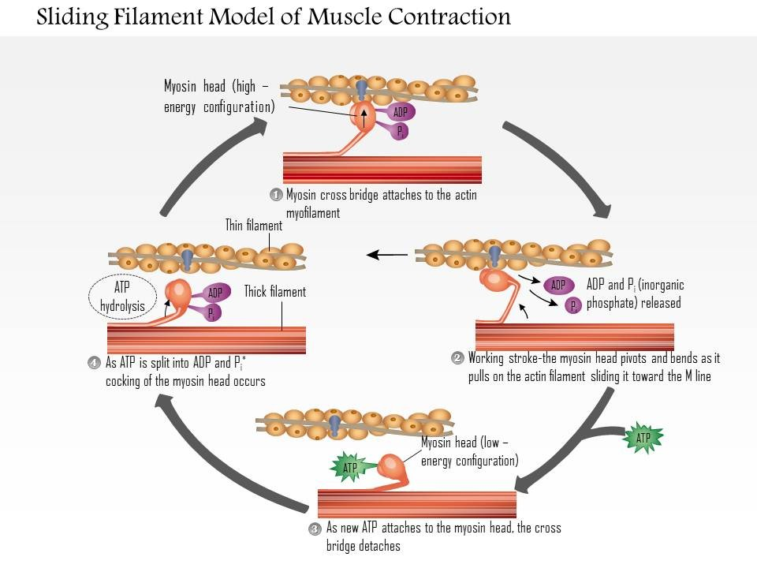
Sliding Filament Mechanism
Steps of Filament Sliding
But what causes the actin filaments to slide inward among the myosin filaments?
Forces generated by interaction of the cross-bridges from the myosin filaments with the actin filaments

Slide 20
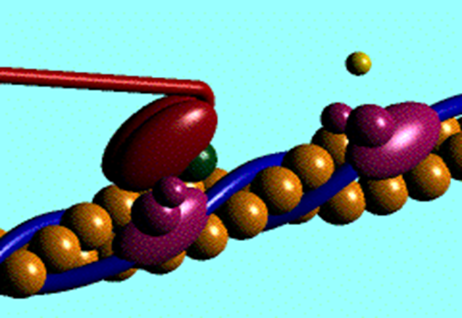
Sliding Muscle Mechanism Cont.
Cross Bridges are myosin filaments heads attached to the actin
Binding the head of the cross-bridge with the active site causes a conformational change in the head, prompting the head to tilt toward the arm of the cross-bridge and providing the power stroke for pulling the actin filament
Rigor Mortis : The contracture of skeletal muscles that begins several hours after death due to the loss of ATP.

Slide 21
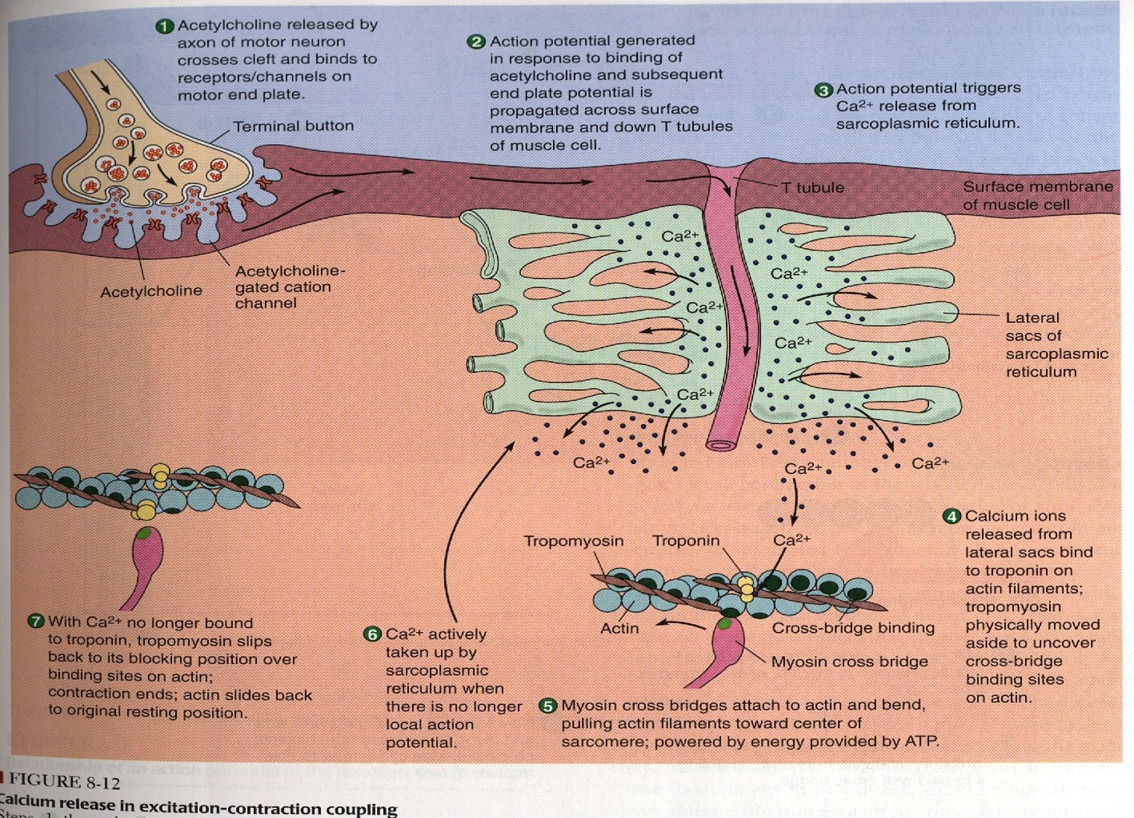

Slide 22
Explanation of previous slide
At the neuromuscular junction acetylcholine is released from the vesicles of the terminal end of axon of motor neuron and crosses the synaptic cleft to bind to its receptor on the the motor end plate.
Acetylcholine gated cation channels open which causes an influx of sodium forming the EPP (Endplate potential).
If enough sodium enters the muscle fiber it will turn to an action potential that will propagate across the surface of membrane and down the T tubules of the muscles (the T tubules are like canals in the sarcolemma of a muscle).
When the action potential travels in the T tubules it will stimulate the sarcoplasmic reticulum to release its stored calcium.
The calcium will go and bind to its site on the troponin, once calcium is bound it will cause a conformational change in the structure of troponin , displacing tropomyosin and exposing the active site of actin.
Myosin cross bridge attaches to the active site of actin, and bend in a movement called (power stroke) , pulling the actin filaments toward the center of sarcomere. This is powered by ATP (the first of the 3 ATP needed in the muscle contraction\relaxation cycle).
Calcium is then actively taken up by the sarcoplasmic reticulum يرجع للمخزن حقه , here we use the 2nd ATP. When calcium is no longer bound to troponin, the tropomyosin will go back to cover the active site of actin , and myosin detaches (ATP is needed for the detachment) leading to relaxation.

Slide 23
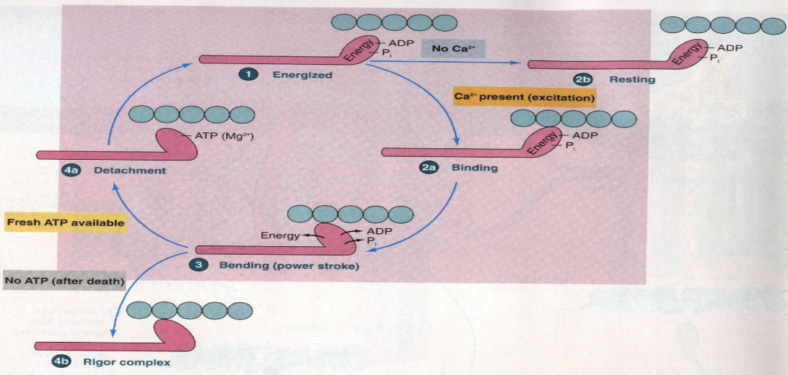
The general mechanism of skeletal muscle contraction.
Ach released by motor nerve » Erythropoietic protoporphyria (EPP) » depolarization of CM (muscle AP).
Spread of AP into T tubule » release of Ca from sarcoplasmic reticulum into the cytoplasm.
Ca combines with troponin C (Tc) » troponin pull tropomyosin sideway » exposing the active site on actin » myosin heads with ATP on them, attached to actin active site.
Myosin cross bridges bend pulling actin toward center of sarcomere (Power stroke) using energy of ATP » ADP & P released » Linkage between actin & myosin broken as new ATP binds to myosin cross bridge » ATP hydrolyzed cross bridge go back to its original conformation.
(remember that we need 2 ATP one for linkage and another breaking).

Slide 24
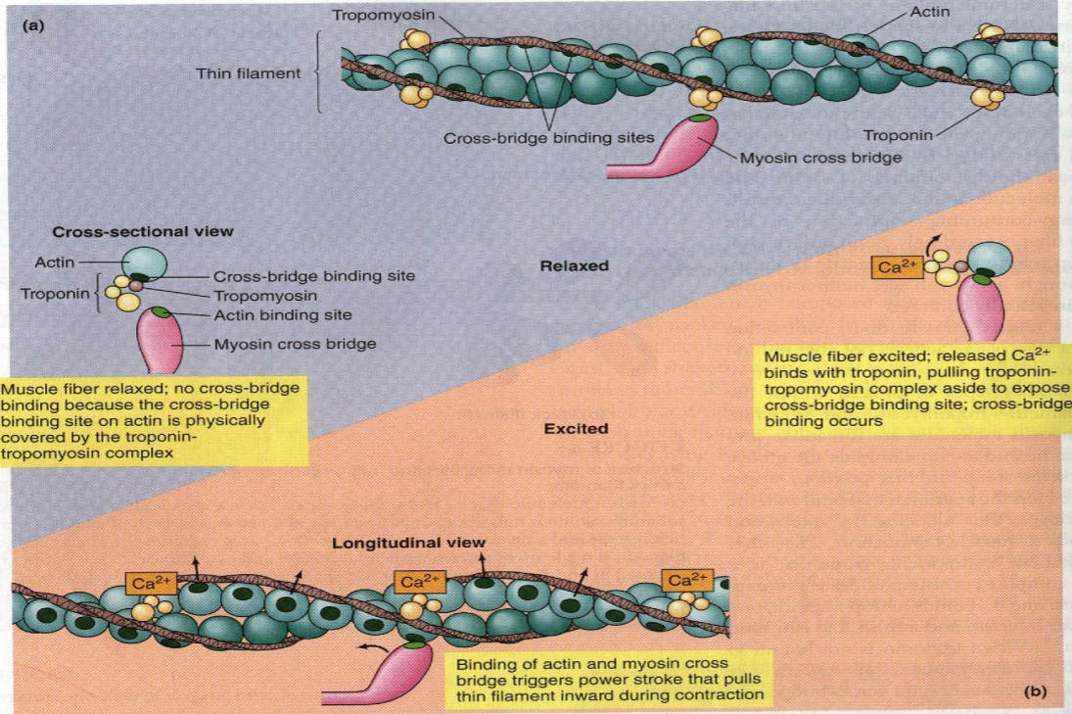
The general mechanism of skeletal muscle contraction cont.
5. When a new ATP occupies the vacant site on the myosin head, this triggers detachment of myosin from actin.
6. The free myosin swings back to its original position, & attached to another actin, & the cycle repeat itself.
7. When Ca is pumped back into sarcoplasmic reticulum » Ca detached from troponin » tropomyosin return to its original position » Covering active site on actin » prevent formation of cross bridge » relaxation.
Therefore , in order to release the head of Myosin from
Actin , a new ATP is needed to come and combine with
the head of Myosin .
Explanation of muscle contraction and relaxation

Slide 25
Drugs That Enhance Transmission at the Neuromuscular Junction
Drugs That Stimulate the Muscle Fiber by Ach-Like Action Dangerous | Drugs That Stimulate the NMJ by Inactivating Acetylcholinesterase Stimulation to contraction More safety
Methacholine Carbachol Nicotine.المادة الي بالدخان | Neostigmine, Physostigmine | Diisopropyl fluorophosphate
They act for minutes or hours (are not destructed by cholinesterase)r | inactivate acetylcholinesterase for several hours | inactivates acetylcholinesterase for weeks (can cause death because of respiratory muscle spasm)
مهم تعرف الميكانزمز

Slide 26
Drugs that Block Transmission at the Neuromuscular Junction
Drugs That Block Transmission at the NMJ
Botulinum Toxin Decrease the contraction | Curare & Curariform like-drugs
Bacterial poison that decreases the quantity of Ach release by the nerve presynaptic terminals. This attack the vesicles that contain Ach so they decrease the quantity of Ach release so the contraction will be weak | Prevent passage of impulses from the nerve ending into the muscle by blocking the action of Ach on its receptors on MEP No contraction act by competitive inhibition to Ach at its receptors & can not cause Depolarization.

Slide 27
Myasthenia Gravis
Disease of adult females affects eyelid, extraocular bulbar and proximal limb muscles.
Presents with ptosis, dysarthria, dysphagia, and proximal limb weakness in hands & feet.
Autoimmune disorder, patients develop antibodies which block or destroy their own Ach receptors (patients have 20% of number of Ach receptors). So they release Ach good and have action potential but their Ach receptors are blocked or destroyed by antibodies and this problem is at the postsynaptic terminal.
The EPPs are too small to trigger action potentials and the muscles cannot contract.
It causes weakness in skeletal muscles
Patient may die of respiratory failure.
Treatment:
Administration of anticholinesterase drugs such as Neostigmine which allows larger than normal amounts of Ach to accumulate in the synaptic space.
Corticosteroids and Immunosuppressant drugs to inhibit the immune system, limiting antibody production so that we don't have antibodies blocking the receptors
-يبدأ بالعضلات الصغيرة ثم للأكبر
- النيرف يكون سليم 100%

Slide 28
Quiz
1. Action potentials travel along the skeletal muscle cell plasma membrane as well as along the t-tubules by saltatory conduction.
(a) TRUE
(b) FALSE
At the neuromuscular junction (NMJ), the end-plate potential:
(a) Is at the end of the plate.
(b) Results from the activation of the nicotinic acetylcholine receptors.
(c) Results from the opening of the voltage-gated Na⁺ channels.
(d) Results from the opening of the voltage-gated K⁺ channels.
In skeletal muscle, the ryanodine receptors are found in the:
(a) sarcolemma
(b) membrane of the sarcoplasmic reticulum
(c) Both A and B
1. B
2. B
3. B

Slide 29
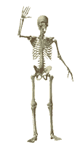
Team Leaders:
Abdulhakim AlOnaiq
Alanoud Salman
Female’s team:
Ahad Algrain
Hadeel
Maha Alnahdi
Majd AlBarrak
Rahaf Alshammari
Rinad Alghoraiby
Munira Alhadlg
Sarah Alblaihed
Renad Almogren
Male’s team:
Saad alhaddab
Khaled Showail
Omar Alfawzan
Anas Alsaif
Anas Al Suwaida
Nawaf
contact us at:
physiologyteam437@gmail.com
@physio437
editing file
Notes:
team members please put your names here

