Slide 1
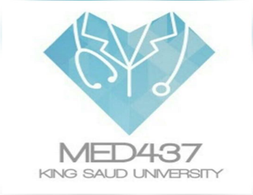
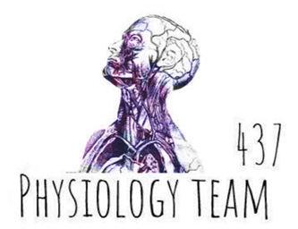
Physical and Physiological Factors in Athletic Performance
Color index:
Red: important
Green: doctor’s notes
Grey: extra information
Pink: found only in female’s slides
blue: found only in male’s slides
Physiology 437 team work

Slide 2
objectives:
By the end of the lecture you will be able to:
1. Identify the muscle metabolic systems and the nutrients used in exercise
Adenosine triphosphate
Phosphocreatine-creatine system
Glycogen-lactic acid & aerobic system
2. Explain the recovery of the muscle metabolic systems after exercise and the phenomena of oxygen debt
3. Discuss the effects of smoking on pulmonary ventilation in exercise.
4. Correlate between heart diseases and the athletic performance in old age.
5. Analyze the changes in body fluids and salts in exercise.
6. Interpret the effects of drugs on athletes.

Slide 3
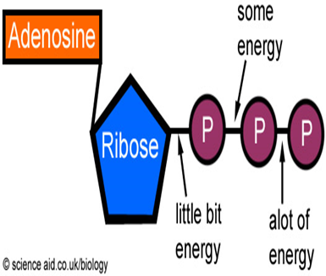
Metabolic Pathways in Skeletal Muscle
Adenosine triphosphate (ATP) is the only energy source used directly by muscles for contractile activities.
The demand and the mechanism of ATP production vary according to the type of work done
At rest, a muscle cell contains a small store of ATP, but it cannot rely on this ATP once it begins contracting (enough for 3 seconds) -> (It will finish quickly so we need to regenerate it)
Muscle cell must get ready for ATP production to keep pace with* the increased rate of utilization.
* To keep pace with : لمواكبة

Slide 4
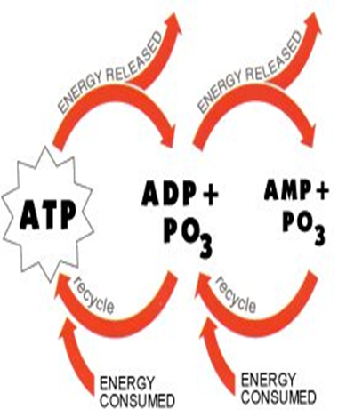
Energy for Muscle Contraction
Mitochondria in the muscle converts glucose, fatty acids, and amino acids into ATP:
(ATP = Adenosine Triphosphate = Adenosine-PO3 ~ PO3 ~ PO3)
Each of the last 2 high energy phosphate bonds in ATP stores 7300 calories per mole of ATP.
All ATP stored in the muscle is sufficient for only 3 seconds (the number will vary) of muscle power. (Enough for one half of a 50-meter dash)
So resting muscles must have energy stored in other ways:
1. Creatine Phosphate (CP) 2. Glycogen 3. Fat & amino acids.

Slide 5
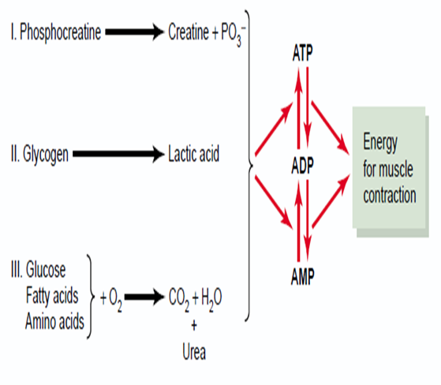
Muscle Metabolic System in Exercise
There are 3 metabolic systems exceedingly (extremely, very) important in understanding the limits of physical activity, those are:
Phosphocreatine-
creatine system
Glycogen-lactic acid system
Aerobic system

Slide 6
ATP Regeneration
As we begin to exercise, we almost immediately use our stored ATP within a few seconds
ATP is regenerated from ADP by:
1) direct phosphorylation of ADP by creatine phosphate (CP) (take the phosphate turn ADP to ATP
2) anaerobic pathway
(glycolysis
Lactic acid)
3) Aerobic respiration
of fatty acids in the
mitochondria
(slow, little intensity)

Slide 7
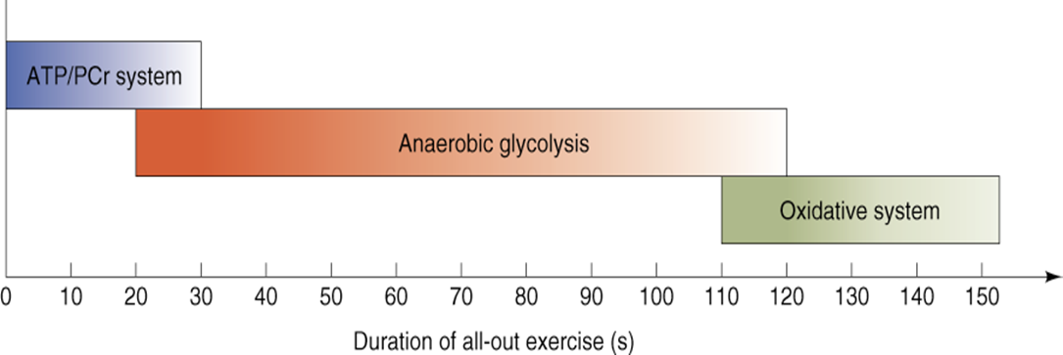
Interaction of Energy Systems

Slide 8
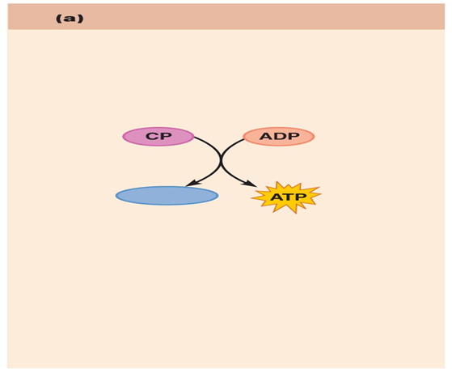
1-Phosphocreatine-creatine System (Creatine Po3):
CP: Contain high energy phosphate bond has 10,300 calories/mole
Most muscle cells have 2-4 times as much CP as ATP
Energy transfer from CP to ATP occurs within a small fraction of a second.
Energy of muscle CP is immediately available for contraction just as stored energy of ATP.
Product: 1 ATP
Direct phosphorylation
Coupled reaction of creatine
Phosphate (CP) and ADP
Energy source: CP
Creatine kinase
Oxygen use: None
Products: 1 ATP per CP, creatine
Duration of energy provided:
15 seconds

Slide 9
Phosphagen Energy System:
Formed of combined amounts of cell ATP + CP
Together provide maximal muscle power for 8-10 seconds
(enough for 100 meter run)
Energy of phosphagen system is useful for maximal short bursts of muscle power ( 8-10 seconds).
(Severe exercise for short duration)

Slide 10
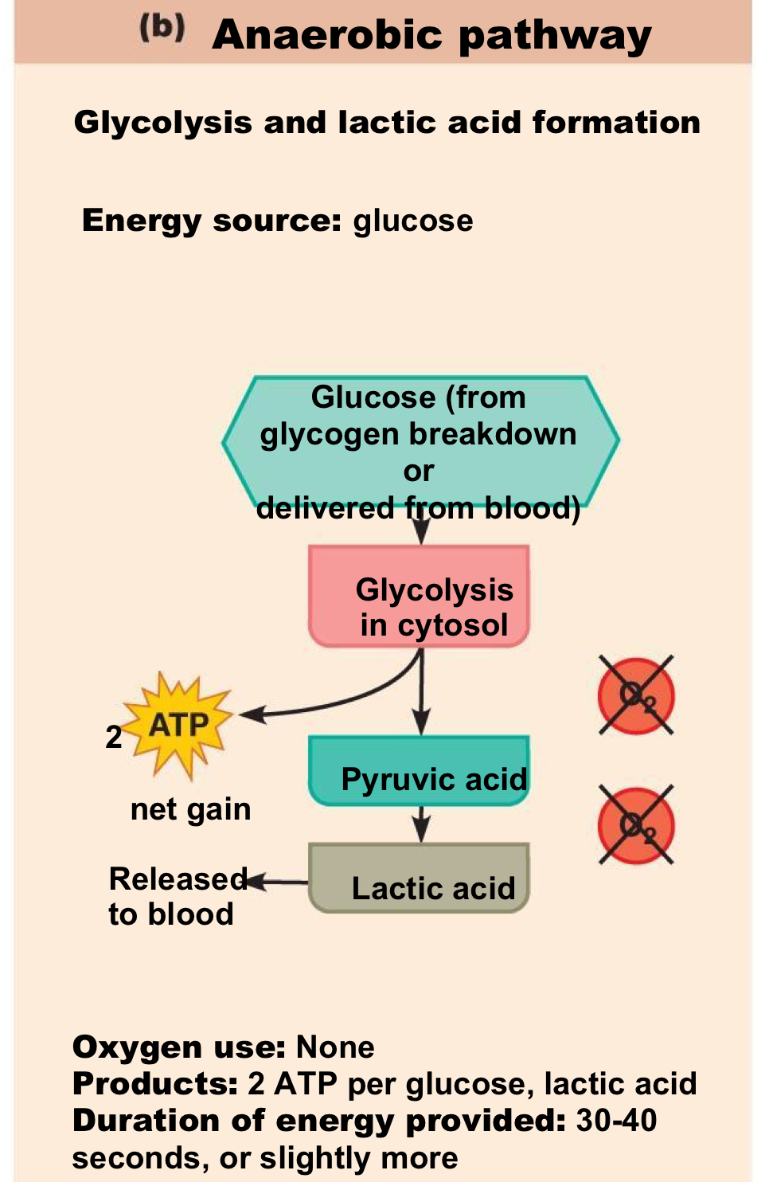
Anaerobic Glycolysis (Glycogen-Lactic acid system) Without Oxygen
Is the primary energy source for peak (sever) muscular activity. It provides 1.3-1.6 minutes of maximal muscle activity
The process of anaerobic metabolism can maintain ATP supply for about 45-60s.
Source of energy: Carbohydrate (glycolysis) , Lactate and ATP
Glycogen
Glucose
2 pyruvic acid
Produces 2 ATP molecules per molecule of glucose + 2 NADH
2 Pyruvic acid
2 lactic acid (2 NAD+)
Lactic acid diffuses out of muscles →blood → taken by the liver → Glucose (by gluconeogenesis) →blood → taken by the muscle again.

Slide 11
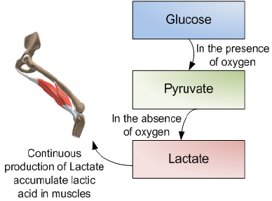
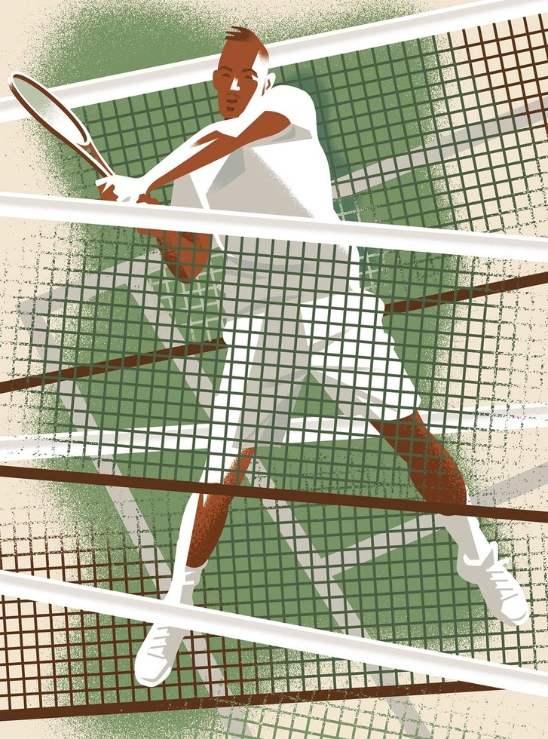
Anaerobic Glycolysis (Glycogen-Lactic acid system)
Anaerobic metabolism is inefficient… Why? 1-Large amounts of glucose are used for very small ATP returns. 2- Lactic acid is produced whose presence contributes to muscle fatigue.
Which type of sports uses anaerobic metabolism? Sports that requires bursts of speed and activity, e.g., basketball , tennis.

Slide 12
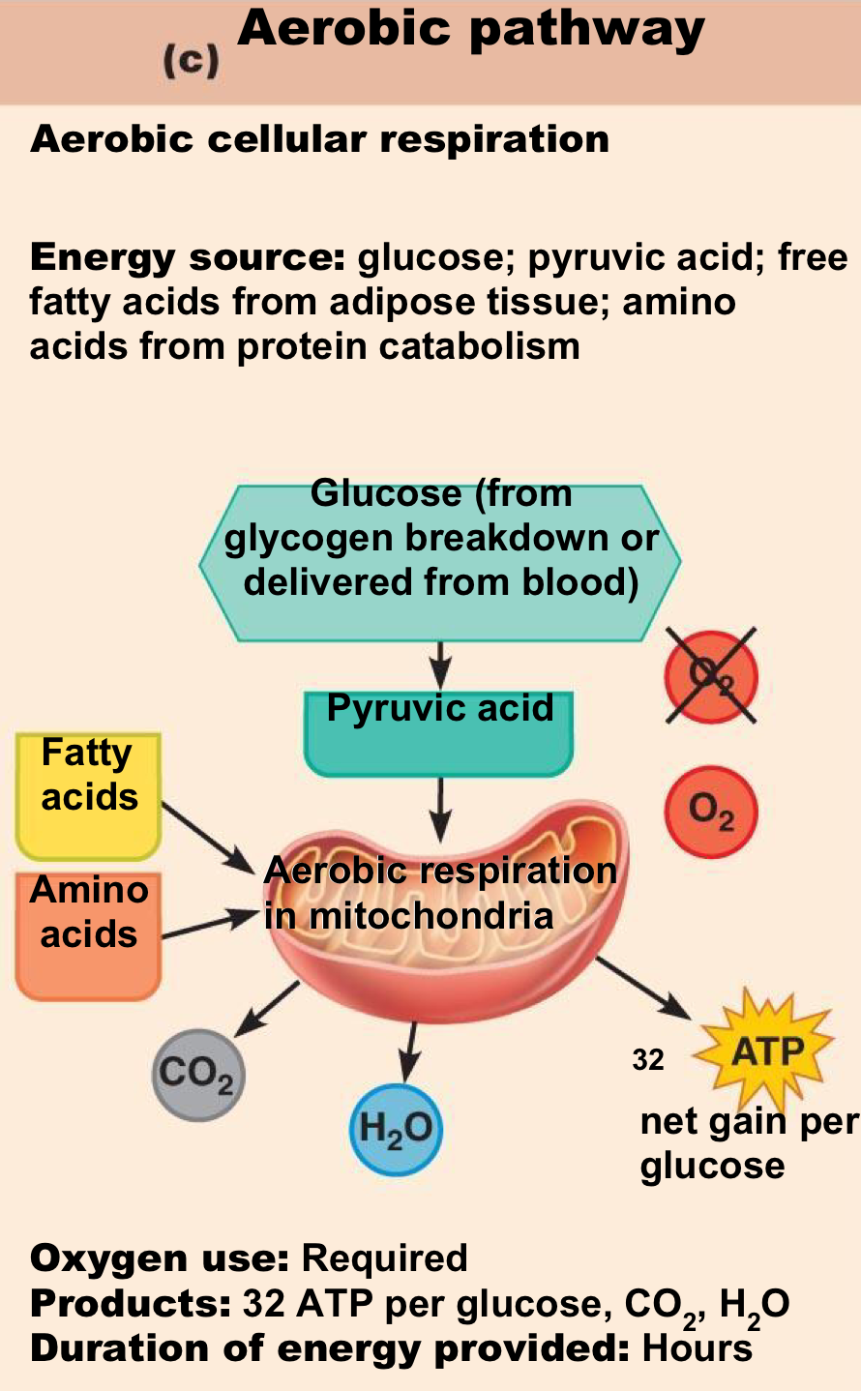
Aerobic Metabolism (With Oxygen)
Is the primary energy source of resting muscles
to convert glucose into glycogen.
to create energy storage compounds as CP.
During rest and light to moderate exercise, aerobic metabolism contributes 95% of the necessary ATP.
It breaks down fatty acids, pyruvic acid (made via glycolysis), and amino acids.
Produces 34 ATP molecules per glucose molecule.
Source of energy: mainly fatty acids, then carbohydrate, amino acids
-CO ₂
-H₂O
-ATP

Slide 13
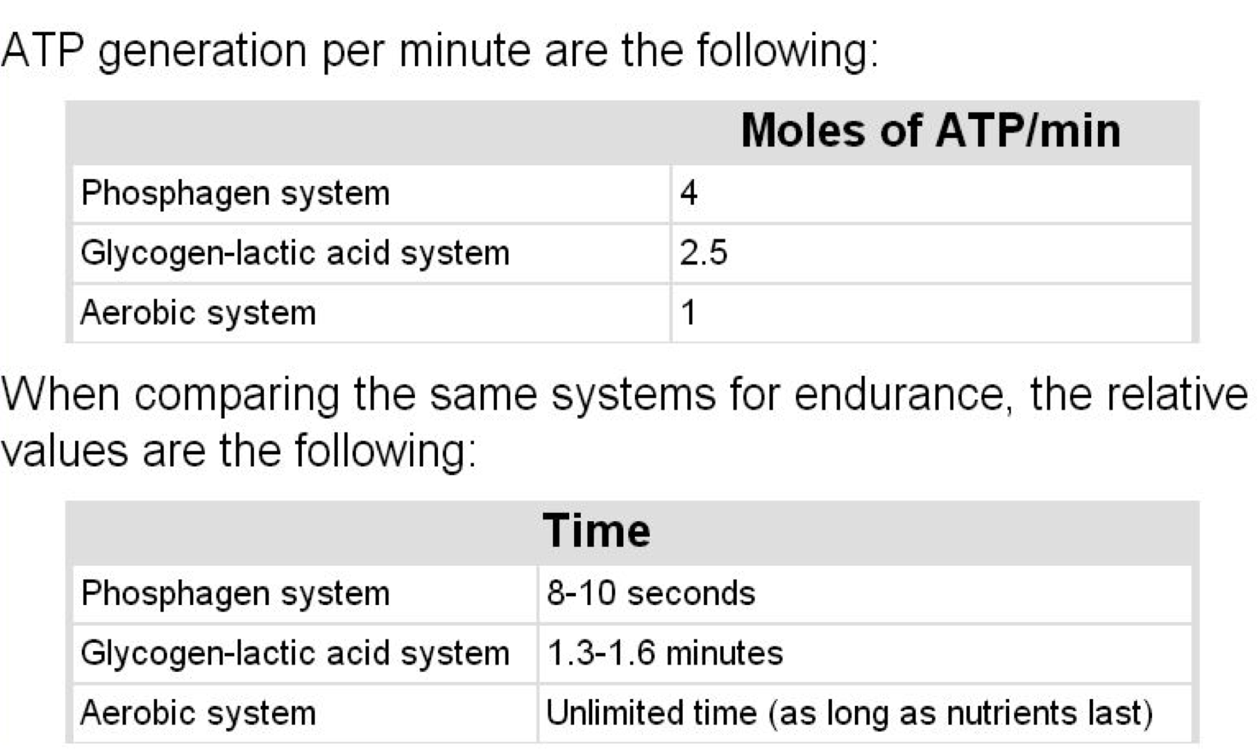
Comparing the Energy Supply of the
1. Phosphagen, 2. Anaerobic, and 3. Aerobic Systems
من الأرقام نستنتج مين اكثر مولات الاول طاقته عالية لكن الفترة قصيره الثاني متوسط الثالث الطاقة قليله لكن الفترة أطول يكون مستمر اكثر

Slide 14
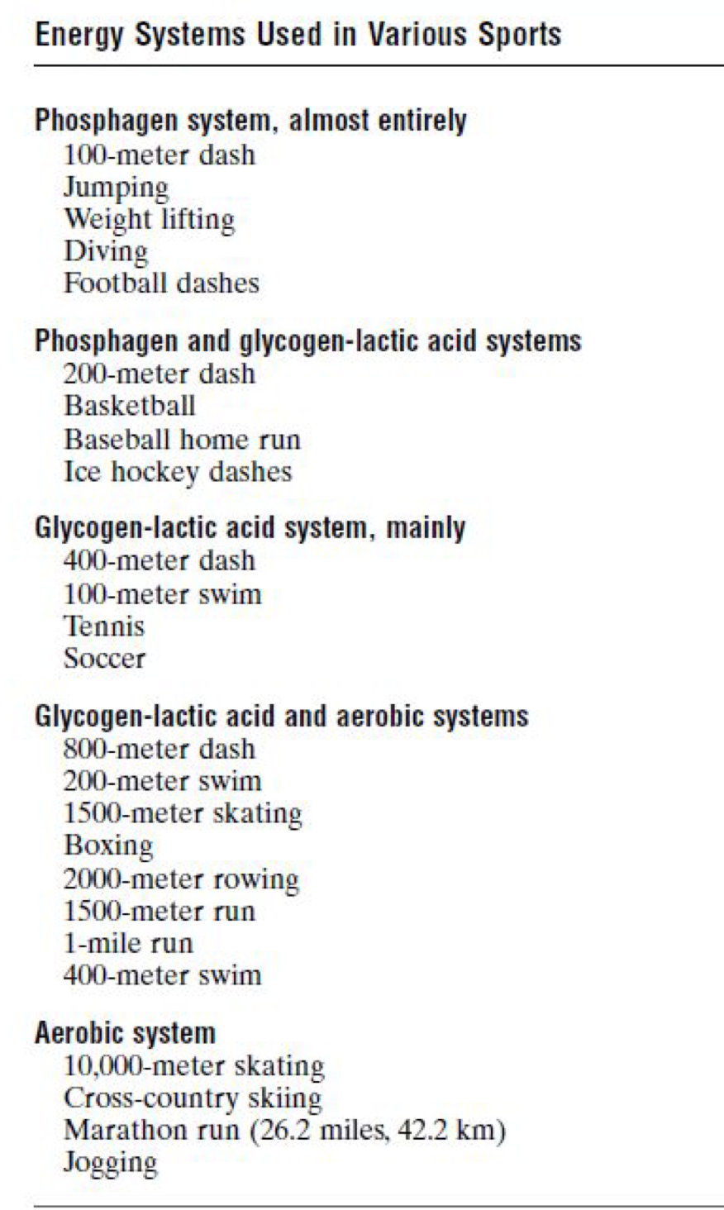
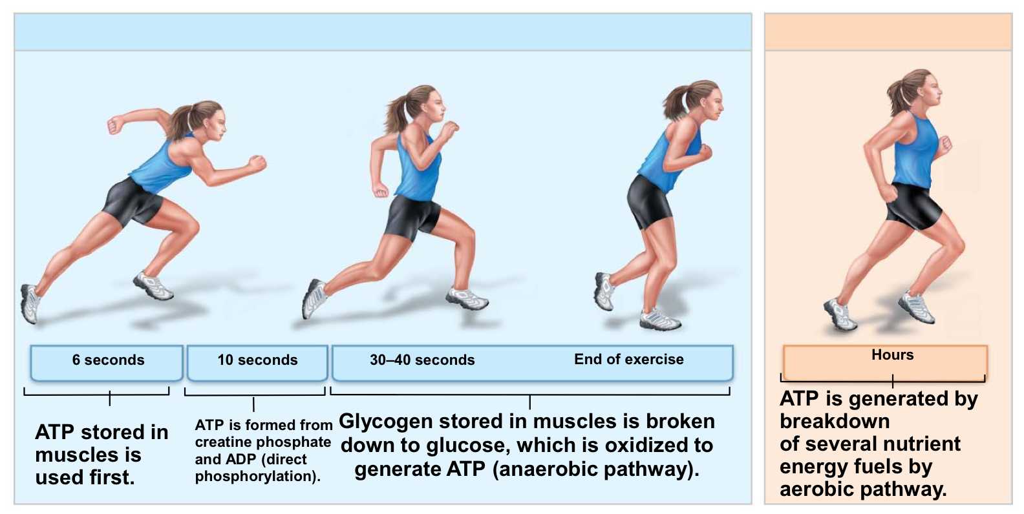
Comparison of Energy Sources Used During Short- Duration Exercise and Prolonged-Duration Exercise
نعرف امثله منها وكذا ، ونفهم بشكل عام مثلاَ ان اول وحده اهي للرياضات الي مدتها قصيره زي مثلاً “ القفز” …..الخ

Slide 15
Recovery Of Muscle Metabolic Systems After Exercise
Energy from CP reconstitute (تعيد تكوين) ATP.
Energy from glycogen-lactic acid system reconstitute the phosphagen system (CP+ATP).
Energy from oxidative metabolism of aerobic system reconstitute all other systems: -glycogen- lactic acid system & CP & ATP.
Lactic acid causes fatigue so it should be removed by:
Portion converted into pyruvic acid that is oxidized by all body tissues. (Pyruvic acid > mitochondria > glycolysis)
The remaining is changed into glucose in the liver to replenish glycogen stores of muscles.
Energy from oxidative metabolism of aerobic system reconstitute all other systems.
Energy from glycogen-lactic acid system reconstitute the phosphagen system.
Energy from CP reconstitute ATP.

Slide 16
Oxygen Debt
Oxygen Debt is the amount of extra O2 that must be taken after exercise to restore the muscles to the resting conditions.
When a person stops exercising, the rate of oxygen uptake does not immediately return to pre-exercise levels; it returns slowly (the person continues to breathe heavily for some time afterward).
This extra oxygen is used to repay the oxygen debt acquired during exercise.
When someone does physical exercise they use up the oxygen stored in the body, and when this stops the ventilation rate will increase to make up for the oxygen that has been used, and then muscles will go back to their resting state (recovery).

Slide 17
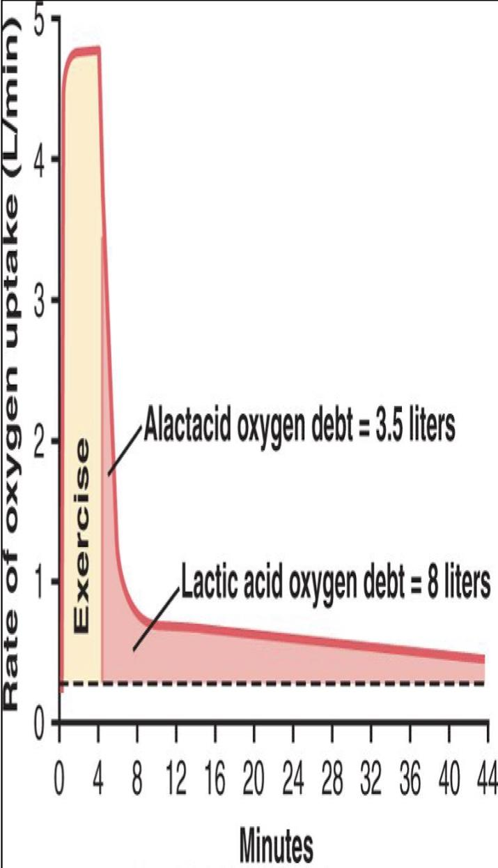
Oxygen Debt
There is an explanation of this in the next slide.
Oxygen Debt is about 11.5 L of O2
A) The body normally contains 2 L of stored oxygen (0.5 L in lungs + 0.25 L dissolved in body fluids + 1.0 L combined with Hb + 0.3 L stored in muscle myoglobin)
This is used within a minute of heavy exercise or for aerobic metabolism.
B) 9 L more O2 is needed to reconstitute the phosphagen and glycogen-lactic acid systems.
At first O2 uptake is high & fast to refill stored O2 & phosphagen system (this is called alactacid O2 debt= 3.5 L)
The later portion of O2 debt takes 40 minutes for lactic acid system removal, it is of lower level breathing, It is called (lactic acid O2 debt =8 L)

Slide 18
Oxygen Debt Explanation for the last slide
Oxygen debt:
When we do physical activity, our bodies use up the oxygen we have stored (2L of O2), that is used up within 1 minute of heavy exercise for aerobic metabolism.
More oxygen is needed after that to reconstitute the phosphagen and glycogen-lactic acid systems that have been used. (9L of O2)
Our bodies return to the resting condition after the following is done (we need extra oxygen to repay the oxygen debt):
At first we breathe really fast for high O2 uptake to refill stored O2 & phosphagen system. (alactacid O2 debt= 3.5 L)
Later, our breathing gets slower and our bodies take 40 minutes for lactic acid removal. (lactic acid O2 debt =8 L)
Remember: Energy from oxidative metabolism of aerobic system reconstitute all other systems. So getting enough oxygen will help me become able to reconstitute all of these systems by aerobic system.

Slide 19
Recovery of Muscle Glycogen
Reduction of glycogen stores by heavy exercise needs days to be replenished.
Therefore, athletes should:
Have high CHO diet before exercise.
Not participate in exhausting exercise during 48 hours preceding the event.
On high CHO (carbohydrates) diet | On high fat, high protein, or no food
Recovery occurs in two days | Very little recovery

Slide 20
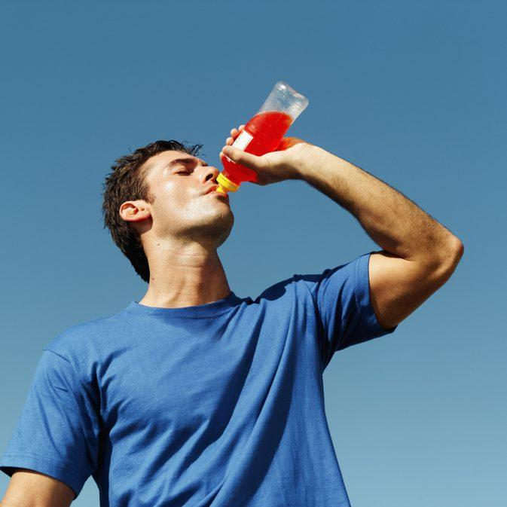
Nutrients used during muscle activity
During early stages of exercise body use CHO of muscle and liver glycogen.
Also in intense muscle activity the body uses fats and very little amino acids.
If endurance athletic events last longer than 4-5 hours & during exhaustion muscle glycogen is depleted and muscle depend on fats.
Glucose solution given to athletes to drink during athletic event supply 30-40% of energy required during prolonged event as marathon race.

Slide 21
Effects of smoking on pulmonary ventilation in exercise
Nicotine constricts the terminal bronchioles and increases resistance of airflow into and out of the lungs.
Smoke irritation causes increased fluid secretion into the bronchial tree and swelling of epithelial layer.
Nicotine paralyze the cilia of the respiratory epithelial cell surface.
All lead to fluid and waste accumulation and reduced level of performance.
Chronic smokers may develop emphysema (obstruction of bronchioles + chronic bronchitis + destruction of alveoli) so slight exercise cause respiratory distress.

Slide 22
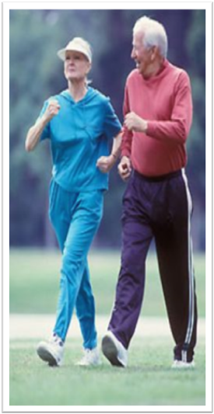
Effects of Heart Disease and Old Age on Athletic Performance
• Cardiac diseases that reduce cardiac output (C.O.P) will reduce muscle power.
• Patient with congestive heart failure has little muscle power to even walk on the floor.
• Recall muscle power : is the amount of work that the muscle perform in a period of time (kg-m/min) .
• N.B the muscle power is inverse proportional with the time.
1.There is 50% decrease in C.O.P between age 18-80 years.
2.There is a decrease in maximal breathing capacity
3.Decrease in muscle mass.
Therefore there is decrease in muscle power with age.

Slide 23
Effect of Body Fluids and Salts in Exercise
• Exercising for 1 hour during endurance athletic events causes 5-10 pounds of weight loss in hot humid atmosphere due to sweat loss.
• Recall: muscle endurance: is the ability of muscles to sustain repeated contractions against a resistance for a period of time.
• Loss of enough sweat reduces performance -5-10% may lead to cramps, nausea & serious effects, so this water lost due to sweat should be replaced.
• Sodium tablets or supplemental fluids which contain potassium in the form of fruit juice are required for athletes.
• Also Acclimatization to exercise by gradual increase over 1-2 weeks instead of maximal exposure is needed.
-Acclimatization: is the process in which an individual organism adjusts to a gradual change in its environment, to maintain performance across a range of environmental conditions. (التاقلم)

Slide 24
Drugs and Athletes
Caffeine increases athletes’ performance
Male sex hormone (Androgens) & other anabolic steroids:
When women use Androgens ,
They develop:
1.Develop facial hair,
2.Stoppage of menses “menstruation”
3.Ruddy “reddish” skin and bass “the lowest adult male singing voice.” voice
1. Increases athletes’ performance
2. Increases the risk of heart attacks due to hypertension,
3. Increase LDL (low-density lipoprotein cholesterol) increasing LDL increase the risk of CVD
4. and decrease HDL. (high-density lipoprotein cholesterol) N.B: LDL also called ("bad" cholesterol) , HDL also called ("good" cholesterol)
5. Decrease testicular functions
6. Decrease natural testosterone secretion in males
Amphetamine & cocaine improve performance
-BUT overuse reduces performance, they are psychic stimuli. *Have a “psychological effect”
-The action of these drugs in addition to epinephrine and norepinephrine (hormones of adrenal medulla ) secreted during exercise lead to death by ventricular fibrillation.

Slide 25
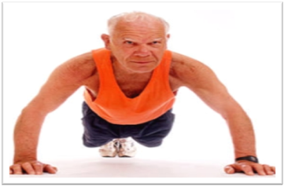
Body Fitness Prolongs Life
Studies show that body fitness, exercise & weight control prolong life (between 50-70 yrs)
Reasons:-
1- Reduce CVD (cardiovascular diseases), heart attacks, brain stroke and kidney disease due to low blood pressure, low blood cholesterol, low LDL, and high HDL.
2- Reduces insulin resistance and type 2 diabetes.
3- Reduces the risk of breast, prostate, and colon cancers and reduces obesity.

Slide 26
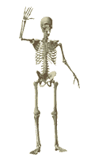
Team Leaders:
Abdulhakim AlOnaiq
Alanoud Salman
Female’s team:
Ahad Algrain
Hadeel
Maha Alnahdi
Majd AlBarrak
Rahaf Alshammari
Rinad Alghoraiby
Munira Alhadlg
Sarah Alblaihed
Renad Almogren
Male’s team:
none
contact us at:
physiologyteam437@gmail.com
@physio437
editing file
Notes:
team members please put your names here

