Slide 1
MUSCLES INVOLVED IN RESPIRATION
By :
Prof. Ahmed Fathalla &
Dr. Sanaa Alsharawy

Slide 2
OBJECTIVES
At the end of the lecture, students should:
Describe the components of the thoracic cage and their articulations.
Describe in brief the respiratory movements.
List the muscles involved in inspiration and in expiration.
Describe the attachments of each muscle to the thoracic cage and its nerve supply.
Describe the origin, insertion, nerve supply of diaphragm.

Slide 3
THORACIC CAGE
Vertebra
Rib

Slide 4
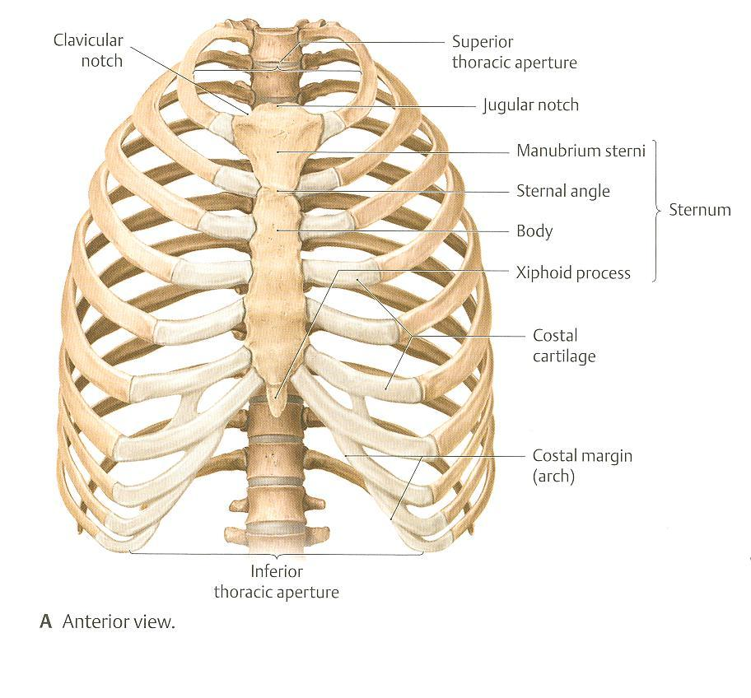
THORACIC CAGE
Conical in shape
Has 2 apertures (openings):
Superior (thoracic outlet): narrow, open, continuous with neck
Inferior: wide, closed by diaphragm
Formed of:
Sternum & costal cartilages: anteriorly
Twelve pairs of ribs: laterally
Twelve thoracic vertebrae: posteriorly

Slide 5
ARTICULATIONS
Sternocostal
Costovertebral
1st costal cartilage: articulates with manubrium by a primary cartilaginous j.
From 2nd to 7th cartilages articulate with sternum by synovial js.
These are plane synovial joints.
Between heads of ribs & thoracic vertebrae.
Costochondral
Between the costal cartilage and the ribs
Cartilagenous j.

Slide 6
ARTICULATIONS
Costovertebral
Plane synovial j.
Costochondral
Cartilegenous j.
Sternocostal
Plane synovial j.

Slide 7
RESPIRATORY MOVEMENTS A- MOVEMENTS OF DIAPHRAGM
Inspiration
Contraction (descent) of diaphragm
Increase of vertical diameter
of thoracic cavity
Expiration
Relaxation (ascent)
of diaphragm)

Slide 8
RESPIRATORY MOVEMENTS B- MOVEMENTS OF RIBS (In Normal Inspiration)
PUMP HANDLE MOVEMENT
Elevation of ribs
Increase in antero-posterior diameter of thoracic cavity
BUCKET HANDLE MOVEMENT
Elevation of ribs
Increase in lateral (transverse) diameter of thoracic cavity

Slide 9
INSPIRATORY MUSCLES
Diaphragm (most important muscle)
Rib elevators: external intercostal muscles
Accessory muscles (only during forced inspiration) :
Muscles attaching cervical vertebrae to first & second rib: scalene muscles
Muscles attaching thoracic cage to upper limb: pectoralis major

Slide 10
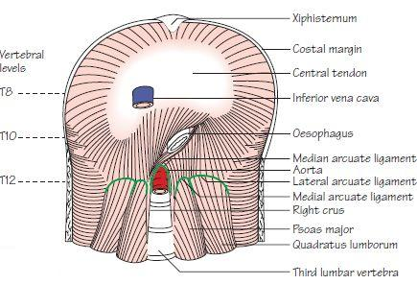
ORIGIN OF DIAPHRAGM
1) Costal: lower 6 costal cartilages
3) Sternal: xiphoid process of sternum
2) Vertebral: upper 3 lumbar vertebrae
(right & left crus + arcuate ligaments)
Lateral arcuate ligament
Medial arcuate
ligament
Lateral arcuate ligament
Medial arcuate ligament
Lateral arcuate ligament
Posterior view
B. Posterior view

Slide 11
INSERTION OF DIAPHRAGM (CENTRAL TENDON)
(lies at the level of xiphisternal joint, at 9th thoracic Vertebra)

Slide 12
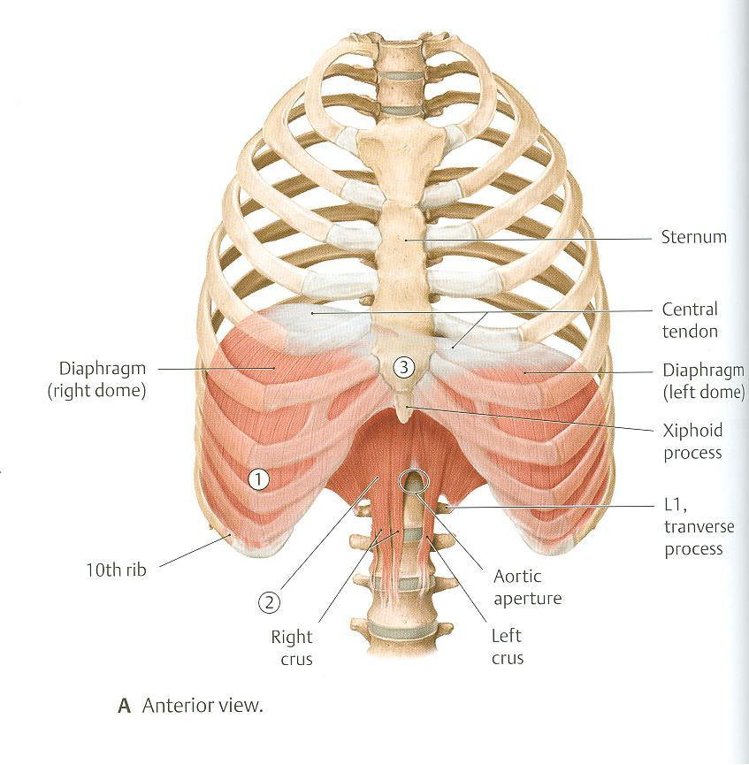
DIAPHRAGM
A musculotendinous partition between thoracic & abdominal cavity
Convex toward thoracic & concave toward abdominal cavity
Attached to: sternum, costal cartilages,12th rib & lumbar vertebrae
Fibers converge to join and inserted into the central tendon
Nerve supply: phrenic nerve (C3,4,5), penetrates diaphragm & innervates it from abdominal surface
Action: contraction (descent) of diaphragm increase vertical diameter of thoracic cavity (essential for normal breathing)

Slide 13
EXTERNAL INTERCOSTAL (Inspiratory Muscle)
Attachments: from lower border of rib above to upper border of rib below
Direction of fibers: downward & medially
Nerve supply: intercostal nerves
Action: rib elevators (inspiratory)

Slide 14
SCALENE MUSCLES (In Forced Inspiration)
5- Scalenus anterior
6. Scalenus medius
7. Scalenus posterior
Origin: cervical vertebrae
Insertion: 1st & 2nd ribs
Action: elevates 1st & 2nd ribs (inspiratory)
Cervical vertebrae
1st rib
2nd rib

Slide 15
PECTORALIS MAJOR (In Forced Inspiration)
Action: increases antero-posterior diameter of thoracic cavity, when arm is fixed (inspiratory)
Origin: sternum + costal cartilages
Insertion: humerus

Slide 16
EXPIRATORY MUSCLES
Act only during forced expiration
Rib depressors:
Internal intercostal
Innermost intercostal
Subcostals
Transversus thoracis
Anterior abdominal wall muscles:
(Compression of abdominal viscera to help in ascent of diaphragm ).
External oblique
Internal oblique
Transversus abdominis
Rectus abdominis

Slide 17
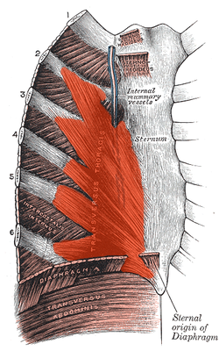
RIB DEPRESSORS: REST OF INTERCOSTAL MUSCLES
1. Internal intercostal
2. Innermost intercostal
Direction: upward & medially
3. Subcostal
4. Transversus thoracis
Nerve supply: intercostal nerves (ventral rami of T1-T11)
Intercostal vessles&nerve lie in intercostal space behind the internal intercostal muscle.
Posterior surface of sternum and costal cartilages, showing transversus thoracis.

Slide 18
ANTERIOR ABDOMINAL WALL
External oblique (outer layer)
Direction: downward & medially
Internal oblique (middle layer)
Direction: upward & medially
Linea
alba

Slide 19
ANTERIOR ABDOMINAL WALL
Transversus abdominis (inner layer)
Direction: transverse
Rectus abdominis
Direction: vertical
Rectus abdominis
Transversus abdominis

Slide 20
Anterior abdominal wall
Is formed of 3 layers of muscles of fibers running in different directions (to increase strength of anterior abdominal wall)
The 3 muscles form a sheath in which a fourth muscle lies (rectus abdominis)
Muscles are attached to: sternum, costal cartilages and ribs + hip bones
The aponeurosis of the 3 muscles on both sides fuse in the midline to form linea alba
Action (during forced expiration): Compression of abdominal viscera to help in ascent of diaphragm (during forced expiration).
Nerve supply: lower 5 intercostal nerves (T7 – T11), subcostal nerve (T12) and first lumbar nerve (L1).

Slide 21
THANK YOU

