Slide 2
Nose, Nasal cavity, Paranasal Sinuses & Pharynx
Dr. Jamila EL medany Dr. Essam Eldin Salama

Slide 3
Objectives
At the end of the lecture, the students should be able to:
Describe the boundaries of the nasal cavity.
Describe the nasal conchae and meati.
Demonstrate the openings in each meatus.
Describe the paranasal sinuses and their functions
Describe the pharynx and its parts

Slide 4
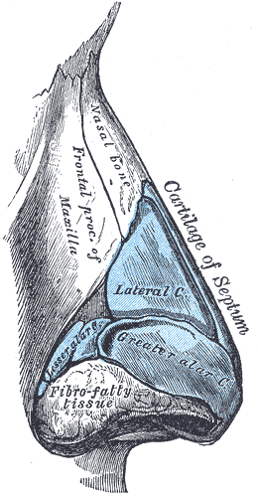
Nose
The external (anterior ) nares or nostrils, lead to the nasal cavity.
root
tip
ala
septum
external nares
Formed above by:
Bony skeleton
1
2
Formed below by plates of hyaline cartilage.
3

Slide 5
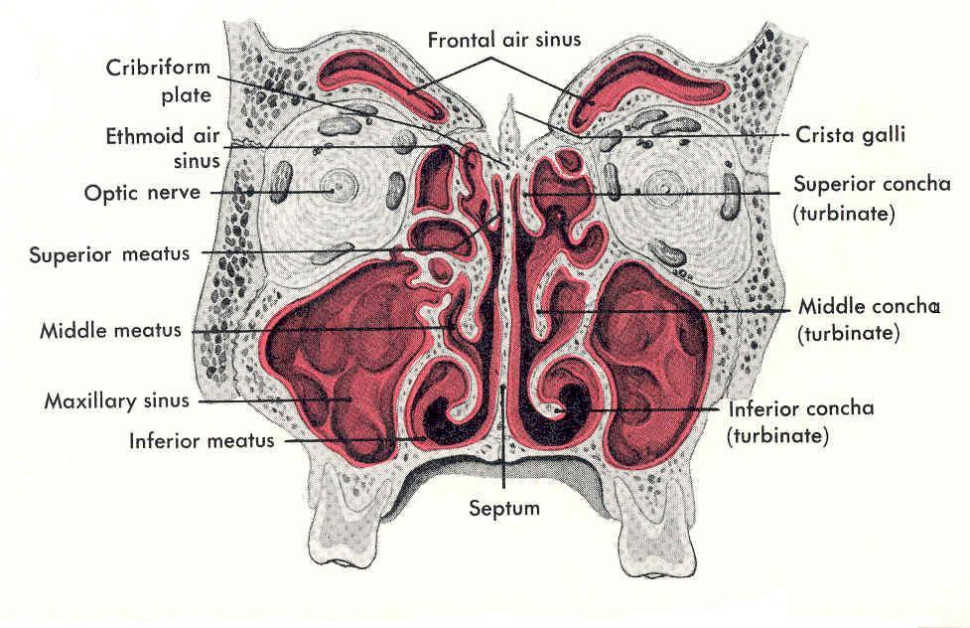
Nasal Cavity
Extends from the external (anterior) nares to the posterior nares (choanae).
Divided into right & left halves by the nasal septum.
Each half has a:
Roof
Lateral wall
Medial wall (septum)
Floor

Slide 6
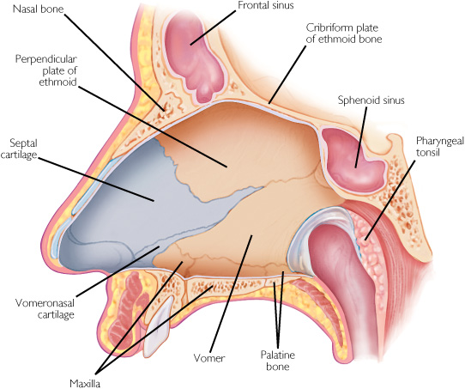
Roof
Narrow & formed (from behind forward) by the:
Body of sphenoid.
Cribriform plate of ethmoid bone.
Frontal bone.
Nasal bone & cartilage
3
2
4
1
Floor
Separates it from the oral cavity.
Formed by the hard (bony) palate.

Slide 7
Medial Wall (Nasal Septum)
Osteocartilaginous partition.
Formed by:
Perpendicular plate of ethmoid bone.
Vomer.
Septal cartilage.
1
3
2

Slide 8
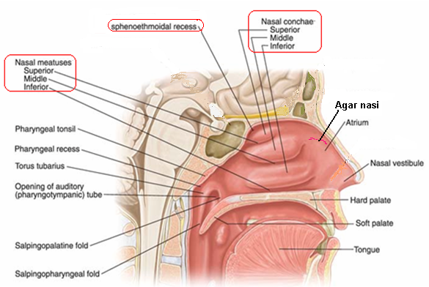
Lateral Wall
Shows three horizontal bony projections, the superior, middle & inferior conchae
The cavity below each concha is called a meatus and are named as superior, middle & inferior corresponding to the conchae.
The small space above the superior concha is the sphenoethmoidal recess.
The conchae increase the surface area of the nasal cavity.
The recess & meati receive the openings of the:
Paranasal sinuses.
Nasolacrimal duct.

Slide 9
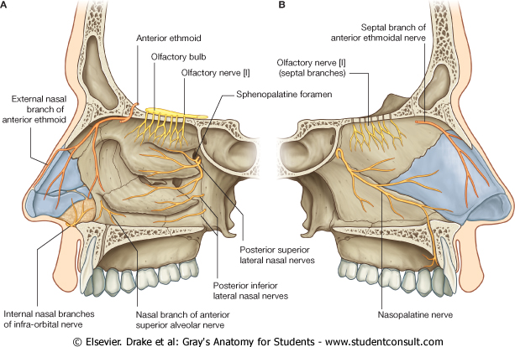
Nasal mucosa
Olfactory :
It is delicate and contains olfactory nerve cells.
It is present in the upper part of nasal cavity:
Roof,
On the lateral wall,
it lines the upper surface of the superior concha and the sphenoethmoidal recess.
On the medial wall, it lines the superior part of the nasal septum.

Slide 10
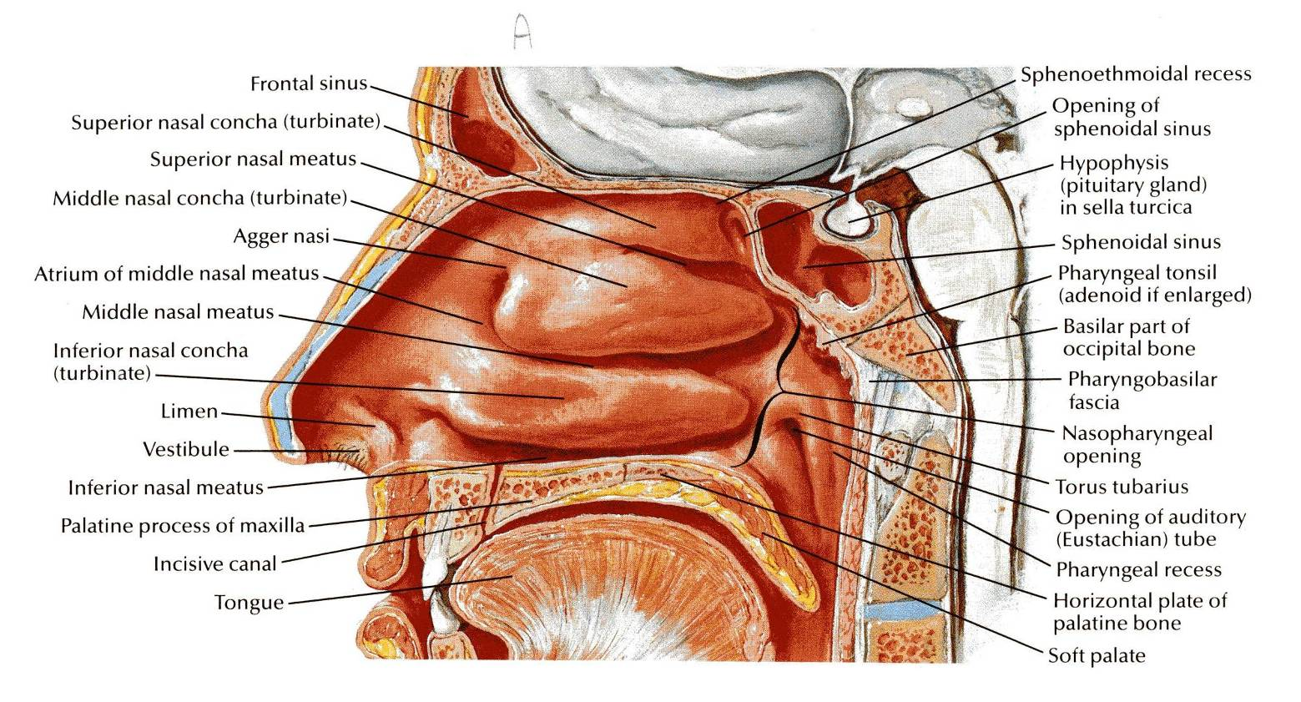
RESPIRATORY MUCOSA
It is thick, ciliated highly vascular and contains mucous glands & goblet cells
It lines the Lower part of the nasal cavity.
It functions to moisten, clean and warm the inspired air.
The air is moistened by the secretion of numerous serous glands.
It is cleaned by the removal of the dust particles by the ciliary action of the columnar ciliated epithelium that covers the mucosa.
The air is warmed by a submucous venous plexus.
The Vestibule is lined by Skin.

Slide 11
Nerve Supply
Olfactory mucosa supplied by olfactory nerves.
Nerves of general sensation are derived from
ophthalmic
maxillary nerves.
Autonomic fibers.

Slide 12
Blood supply
Arterial Supply:
Branches of the
maxillary,
facial &
ophthalmic arteries.
The arteries make a rich anastomosis in the region of the vestibule, and anterior portion of the septum.
Venous Drainage:
drain into the
facial,
ophthalmic, and
spheno-palatine veins.

Slide 13
Lymphatic Drainage
The lymphatics from the:
Vestibule drains into the submandibular lymph nodes.
Rest of the cavity drains into the upper deep cervical lymph nodes.

Slide 14
Paranasal Sinuses
Air filled cavities located in the bones around the nasal cavity: Ethmoid, Sphenoid, Frontal bones Maxillae.
Lined by respiratory mucosa which is continuous with the mucosa of the nasal cavity.
Drain into the nasal cavity.
Functions
Lighten the skull.
Act as resonant chambers for speech.
Air conditioning: The respiratory mucosal lining helps in warming, cleaning and moistening the incoming air.

Slide 15
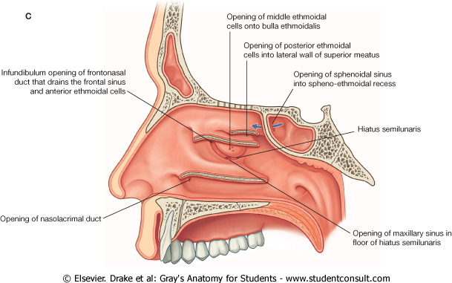
Spheno ethmoidal recess | sphenoidal sinus
Superior meatus | posterior ethmoidal sinus
Middle meatus | middle ethmoidal, maxillary, frontal & the anterior ethmoidal sinuses
Inferior meatus | nasolacrimal duct.

Slide 16
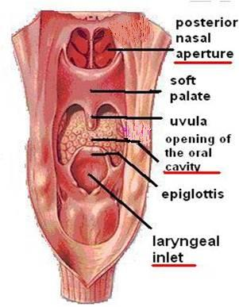
Pharynx
Muscular tube lying behind the nose, oral cavity & larynx.
Extends from the base of the skull to level of the 6th cervical vertebra, where it is continuous with the esophagus
The anterior wall is deficient and shows (from above downward):
Posterior nasal apertures.
Opening of the oral cavity.
Laryngeal inlet.
The muscles arranged in circular and longitudinal layers.
nc
oc
l

Slide 17
Circular (Constrictor) Muscles
Three in number:
Superior constrictor,
Middle constrictor &
Inferior constrictor
The three muscles overlap each other.
S
M
I
Functions:
Propel the bolus of food down into the esophagus.
lower fibers of the inferior constrictor (Cricopharygeus) act as a sphincter, preventing the entry of air into the esophagus between the acts of swallowing.

Slide 18
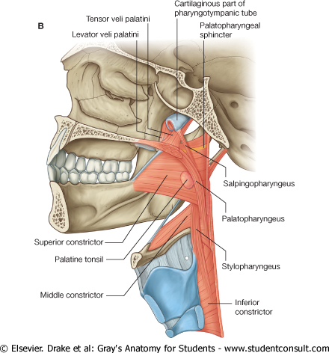
Longitudinal Muscles
Three in number:
Stylopharyngeus
Salpingopharyngeus
Palatpharyngeous
Function:
Elevate the larynx & pharynx during swallowing

Slide 19
Pharynx is divided into three parts:
Nasopharynx.
Oropharynx.
Laryngopharynx.

Slide 20
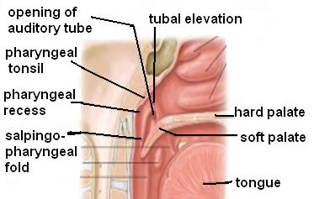
Nasopharynx
Extends from the base of skull to the soft palate.
communicates with the nasal cavity through posterior nasal apertures
Pharyngeal tonsils (Adenoides) present in the submucosa covering the roof.
Lateral wall shows:
Opening of auditory tube.
Tubal elevation (produced by posterior margin of the auditory tube).
Tubal tonsil.
Pharyngeal recess.
Salpingopharyngeal fold (raised by salpingo-pharyngeus muscle).

Slide 21
Oropharynx
Lies behind the mouth, communicates with the oral cavity through the oropharyngeal isthmus
Extends from soft palate to upper border of epiglottis.
Lateral wall shows:
Palatopharyngeal fold.
Palatoglossal fold
Palatine tonsil located between them in a depression called the ‘tonsillar fossa’.

Slide 22
Palatine tonsils
Two masses of lymphoid tissue located in the lateral wall of the oropharynx in the tonsillar fossa,
Each one is covered by mucous membrane and laterally by fibrous tissue (capsule).
It reaches a maximum size during childhood, after puberty it diminishes in size .

Slide 23
Relations
Anteriorly: palatoglossal arch
Posteriorly: palatopharyngeal arch
Superiorly: soft palate
Inferiorly: posterior 1\3 of the tongue.
Medially: cavity of the oropharynx
Laterally: superior constrictor of the pharynx separated from it by lose connective tissue through which descends the external palatine vein , , loop of the facial artery and , the internal carotid artery which lies behind and lateral to the tonsils.

Slide 24
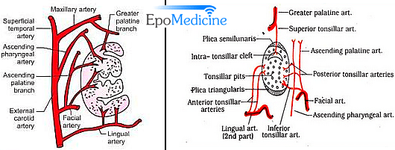
Arterial supply; tonsillar artery from the fascial, lingual and greater palatine.
Venous drainage: join external palatine pharyngeal and fascial veins
Lymphatic drainage; to the upper deep cervical (jugulodigastric node )

Slide 25
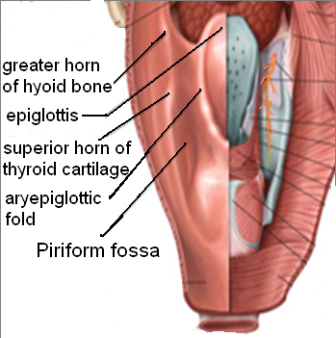
Laryngopharynx
Lies behind the laryngeal inlet & the posterior surface of larynx.
communicates with the larynx through the laryngeal inlet
Extends from upper border of epiglottis to lower border of cricoid cartilage.
A small depression situated on either side of the laryngeal inlet is called ‘Piriform Fossa’.
It is a common site for the lodging of foreign bodies.
Branches of internal laryngeal & recurrent laryngeal nerves lie deep to the mucous membrane of the fossa and are vulnerable to injury during removal of a foreign body.

Slide 26
Arterial supply: from branches of the following arteries:
Ascending pharyngeal
Ascending palatine
Facial
Maxillary
Lingual
Nerve Supply
Sensory:
Nasopharynx: Maxillary nerve
Oropharynx: Glossopharyngeal nerve
Laryngopharynx: Vagus nerve
Motor :
All the muscles of pharynx are supplied by the pharyngeal plexus. Except ; the Stylopharyngeus is supplied by the glossopharyngeal nerve
The Veins drain into pharyngeal venous plexus, which drains into the internal jugular vein
The lymphatics drain into the deep cervical lymph nodes either directly, or indirectly via the retropharyngeal or paratracheal lymph nodes

Slide 27
Thank You & Good Luck

