Slide 1
Larynx
Trachea
&
Bronchi
Prof. Saeed Abuel Makarem & Dr.Sanaa Alshaarawy

Slide 2
Objectives
By the end of the lecture, you should be able to:
Describe the Extent, structure and functions of the larynx.
Describe the Extent, structure and functions of the trachea.
Describe the bronchi and branching of the bronchial tree.
Describe the functions of bronchi and their divisions.

Slide 3
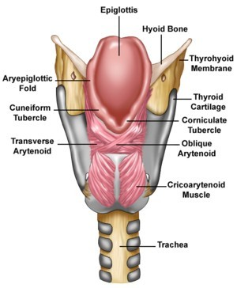
LARYNX
The larynx is the part of the respiratory tract which contains the vocal cords.
In adult it is 2-inch-long tube.
It opens above into the laryngeal part of the pharynx.
Below, it is continuous with the trachea
The larynx has functions in:
Respiration (breathing).
Phonation (voice production).
Deglutition (swallowing).

Slide 4
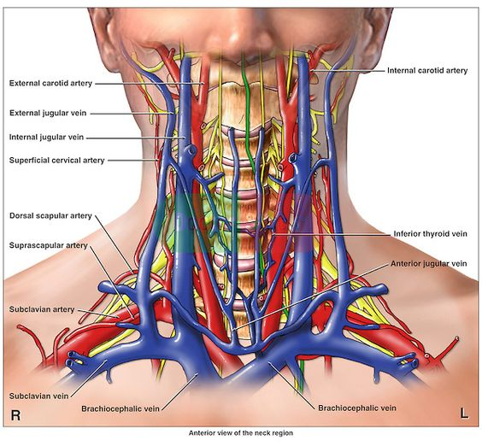
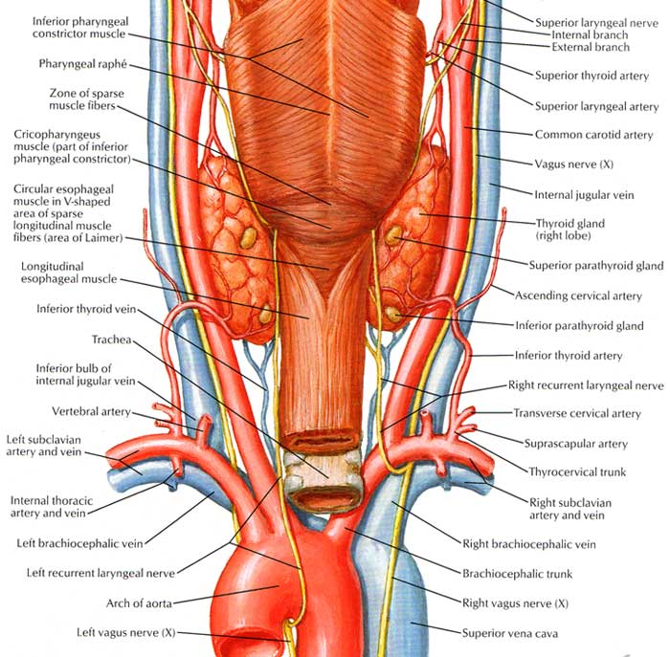
Relations
The larynx is related to major critical structures in the neck.
Arteries:
Carotid arteries: (common, external and internal).
Thyroid arteries: (superior & inferior thyroid arteries).
Veins:
Jugular veins, (external & internal)
Nerves:
Laryngeal nerves: (Superior laryngeal & recurrent laryngeal).
vagus nerve.

Slide 5
Structure
The larynx consists of 4 basic components:
1- Cartilaginous skeleton.
2- Membranes and ligaments.
3- Muscles (Intrinsic & extrinsic muscles).
4- Mucosal lining.

Slide 6
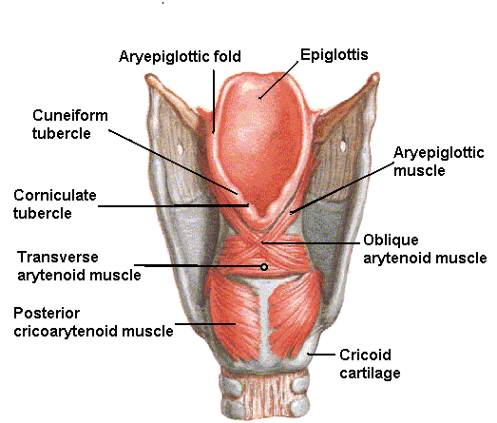
The Cartilages
3
3
The cartilaginous skeleton is composed of:
Thyroid
Cricoid 3 Single
Epiglottis
---------------------------------
4. Arytenoid
5. Corniculate 3 Paired
6. Cuneiform
All the cartilages, are hyaline except the epiglottis which is
Elastic cartilage.
The cartilages are:
Connected by joints,
membranes & ligaments.
Moved by muscles.
1
1
4
4
2
2
6
5

Slide 7
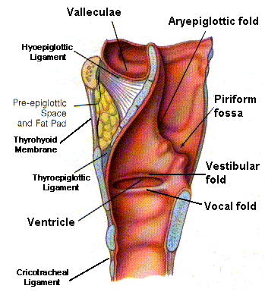
MEMBRANES & LIGAMENTS
Thyrohyoid membrane.
Cricothyroid membrane.
Cricotracheal membrane
Hyoepiglottic ligament.
Thyroepiglottic ligament
The thyrohyoid membrane is thickened in the median plane to form median thyrohyoid ligament and on both sides to form lateral thyrohyoid ligaments.

Slide 8
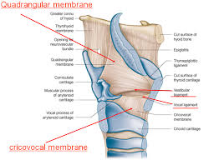
Quadrangular membrane:
Or aryepiglottic membrane,
It extends between the arytenoid and epiglottis.
Its lower free margin forms the vestibular ligament which forms the vestibular fold (false vocal cord).
Cricothyroid membrane (conus elasticus):
Its lower margin is attached to the upper border of cricoid cartilage.
Upper free margin forms Vocal ligament which forms the true vocal cord

Slide 9
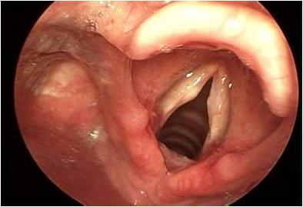
Laryngeal Inlet
It is the upper opening of the larynx.
It faces upward and backward and opens into the laryngeal part of the pharynx, (laryngopharynx).
Bounded by:
Anteriorly: by the upper margin of epiglottis (E)
Posteriorly & below by arytenoid cartilages (A)
Laterally by the Aryepiglottic folds (AEF)
E
CU
CO
AEF
A

Slide 10
Laryngeal Cavity
Extends from laryngeal inlet to lower border of the cricoid cartilage
Narrow in the region of the vestibular folds (rima vestibuli)
Narrowest in the region of the vocal folds (rima glottidis)
Divided into three parts:
Supraglottic part or vestibule: it is the part above the vestibular folds.
Ventricle: it is the part between the vestibular folds & the vocal folds.
Infraglottic part, the part below the vocal folds.
NB. The ventricle has an upward invagination called saccule which is rich in goblet cells.
A
Rima vestibuli
B
C
Rima glottidis
A
B
C

Slide 11
Muscles
Laryngeal muscles are
divided into two groups:
Extrinsic muscles: subdivided into two groups:
Elevators of the larynx.
Depressors of the larynx.
Intrinsic muscles: subdivided into two groups:
Muscles controlling the laryngeal inlet.
Muscles controlling the movements of the vocal cords.
Mucous Membrane
The cavity is lined with ciliated columnar epithelium except the surface of the vocal cords.
The surface of vocal folds, is covered with stratified squamous epithelium because of exposure to continuous trauma during phonation.
It contains many mucous glands, more numerous in the region of the saccule (for lubrication of vocal folds).

Slide 12
Extrinsic muscles of Larynx
Elevators of the Larynx
A- The Suprahyoid Muscles: (MSGD)
Mylohyoid.
Stylohyoid.
Geniohyoid.
Digastric.
B- The Longitudinal Muscles of the Pharynx:
Stylopharyngeus.
Salpingopharyngeus.
Palatopharyngeus.
1
3
2
Depressors of the Larynx
The Infrahyoid Muscles:
1. Sternohyoid.
2. Sternothyroid.
3. Omohyoid.

Slide 13
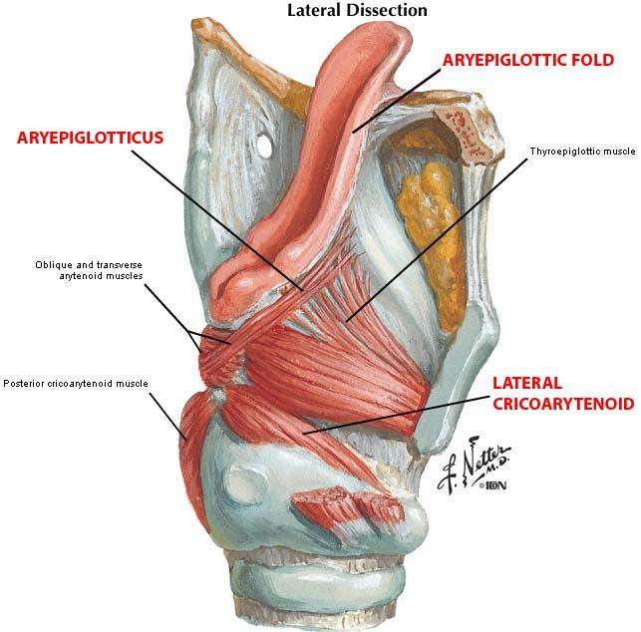
Intrinsic muscles of Larynx
Muscles Controlling the Laryngeal Inlet
Oblique arytenoid.
Aryepiglottic muscle.

Slide 14
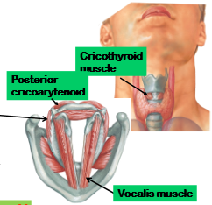
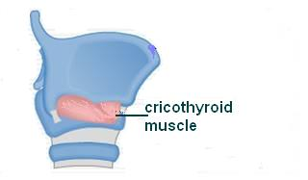
Muscles controlling the vocal cords
Muscle decreasing the Length & Tension of Vocal Cords (relax vocal cords).
Thyroarytenoid (vocalis).
Muscle increasing the Length & Tension of Vocal Cords.
Cricothyroid.
NB. It is the only intrinsic muscle which found outside the larynx.

Slide 15
Muscles controlling the vocal cords
Adductors (close rima glottis)
Lateral cricoarytenoid.
Transverse arytenoid.
Abductor (open rima glottis)
Posterior cricoarytenoid.
Movements of the Vocal Cords
Adduction
Abduction
T
L
P

Slide 16
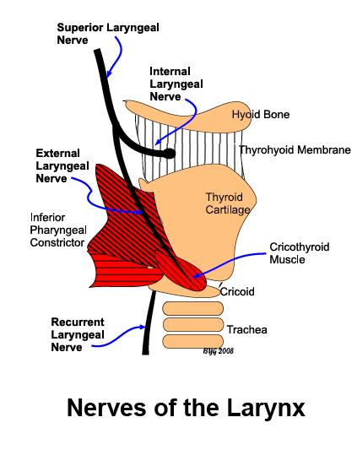
Blood Supply
Arteries:
Upper half: Superior laryngeal artery, branch of superior thyroid artery.
Lower half: Inferior laryngeal artery, branch of inferior thyroid artery.
Veins:
Accompany the corresponding arteries.
Lymphatics:
The lymph vessels drain into the deep cervical lymph nodes.
Nerve Supply (very important)
Sensory
Above the vocal cords: Internal laryngeal nerve, branch of the superior laryngeal of the vagus nerve.
Below the vocal cords: Recurrent laryngeal nerve, of the vagus nerve.
Motor
All intrinsic muscles, are supplied by the recurrent laryngeal nerve except the cricothyroid.
The cricothyroid is supplied by the external laryngeal nerve of superior laryngeal of vagus.

Slide 17
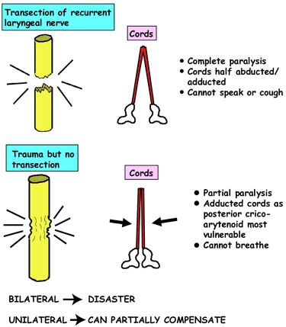
SEMON’S LAW OR DAMAGE OF THE recurrent LARYNGEAL Nerve
Semon’s Law indicates the different effect between damage (surgical trauma) and transection of the recurrent laryngeal nerve due to surgery in region of the neck (e.g. thyroidectomy or parathyroidectomy).
Vocal cords lie in cadaveric position.
Median or paramedian position and air cannot passes.

Slide 18
TRACHEA (windpipe)
Mobile, fibrocartilginous tube, 5 inches long, 1 inch in diameter
Begins: In the neck below the cricoid cartilage of the larynx (at lower border of cricoid cartilage at (C6).
Ends: In the thorax at the level of sternal angle (lower border of T4), by dividing into right and left principal (main, primary) bronchi.
The ridge at the bifurcation from inside is called carina.
It is the most sensitive part of the respiratory tract and is associated with the cough reflex.

Slide 19
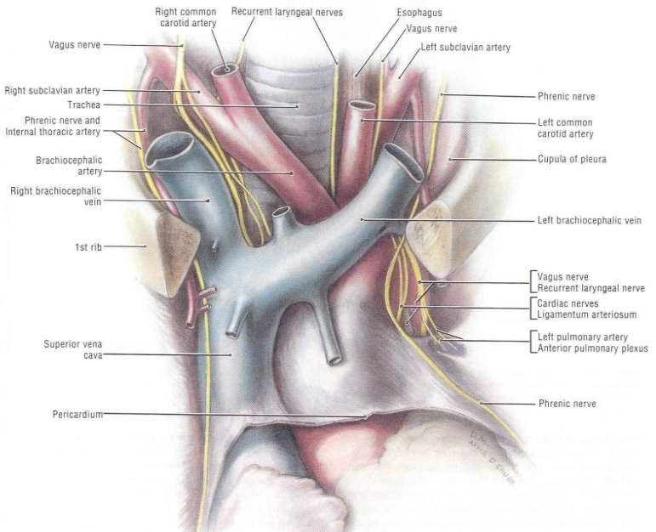
Relations in the Superior Mediastinum
Anterior
Sternum.
Thymus, (remains of thymus gland).
Left brachiocephalic vein.
Arch of aorta.
Origin of:
Brachiocephalic artery.
left common carotid artery.
Left side
Arch of aorta.
Left common carotid artery.
left subclavian artery.
Left vagus nerve.
Left phrenic nerve.
Pleura.
Right side
Azygos vein
Right vagus nerve.
Pleura
Posterior
Esophagus.
Left recurrent laryngeal nerve.

Slide 20
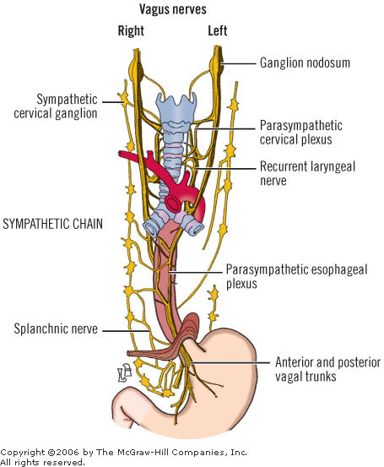
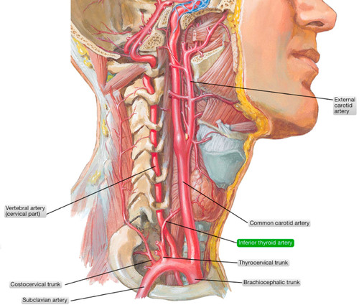
Blood Supply
Arteries: Branches from the inferior thyroid and bronchial arteries (from descending thoracic aorta)
Veins: Drain to inferior thyroid veins.
Nerve Supply
Branches of the vagus nerve and recurrent laryngeal nerve give sensory fibers to supply the mucous membrane.
Branches from the sympathetic trunks supply the trachealis muscle and the blood vessels.
Lymphatic Drainage
Into the pretracheal and paratracheal lymph nodes.

Slide 21
Right Principal Bronchus
About one inch long.
Wider, shorter and more vertical than the left.
Gives superior lobar bronchus before entering the hilum of the right lung.
On entering the hilum it divides into middle and inferior lobar bronchi.
S
S
M
M
I
Left Principal Bronchus
About two inches long.
Narrower, longer and more horizontal than the right.
Passes to the left below the aortic arch and in front of esophagus.
On entering the hilum of the left lung it divides into superior and inferior lobar bronchi.

Slide 22
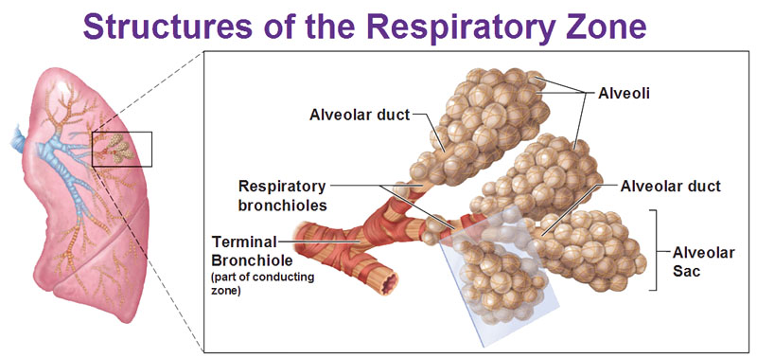
Bronchial Divisions
Within the lung, each bronchus divides and redivides into number of branches that can be divided into two groups:
Conduction zone branches
Primary (main) bronchi.
Secondary (lobar) bronchi.
Tertiary (segmental) bronchi. (supply the bronchopulmonary segment).
Smaller bronchi.
Bronchioles.
Terminal bronchioles.
Respiratory zone branches
Respiratory bronchioles.
Alveolar ducts.
Alveolar sacs.
Alveoli.

Slide 23
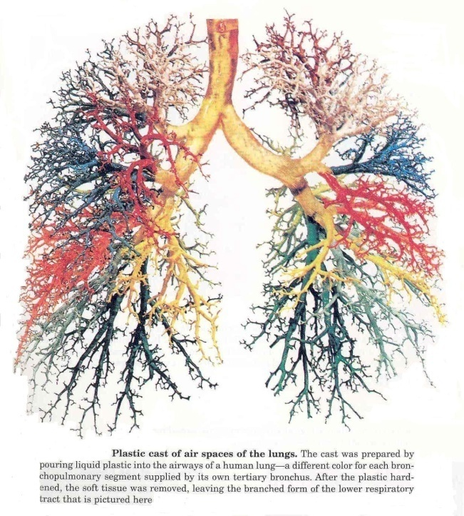
Thank You
&
Good Luck

