Slide 1
MEDIASINUM
Dr Jamila EL medany

Slide 2
OBJECTIVES
At the end of the lecture, students should be able to:
Define the “Mediastinum”.
Differentiate between the divisions of the mediastinum.
List the boundaries and contents of each division.
Describe the relations between the important structures in each division.

Slide 3
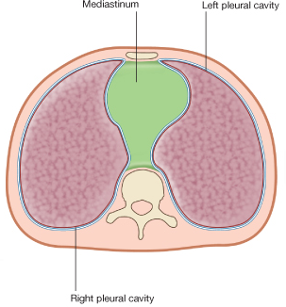
Mediastinum
It is a thick movable partition between the two pleural sacs & lungs.
It contains all the structures which lie in the intermediate compartment of the thoracic cavity.
M

Slide 4
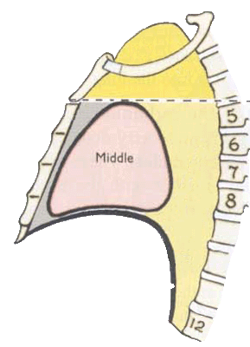
Boundariers
Superior:
Thoracic outlet: (manubrium, 1st rib & 1st thoracic v)
Inferior:
Diaphragm.
Anterior:
Sternum.
Posterior:
The 12 thoracic vertebrae.

Slide 5
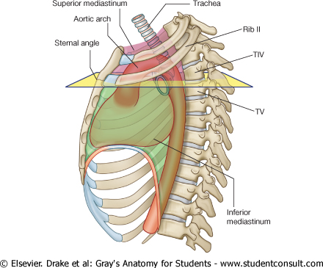
Subdivisions
The mediastinum is subdivided by a Horizontal plane (extending from the Sternal angle to the lower border of T (4) into:
Superior mediastinum (S): above the plane
Inferior mediastinum: below the plane.
S
A
A
M
P

Slide 6
Superior Mediastinum
Boundaries:
Superior: Thoracic outlet.
Inferior: Horizontal plane.
Anterior: Manubrium.
Posterior: Upper (4) thoracic vertebrae.

Slide 7
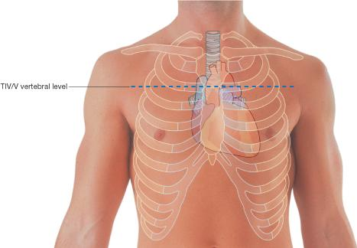
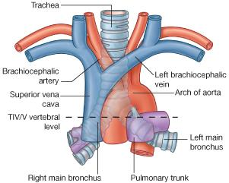
LEVEL OF T4
It is at the Level of:
Sternal angle
Second costal cartilage
1.Bifurcation of trachea
2. Bifurcation of pulmonary
trunk
3. Beginning & termination of
arch of aorta

Slide 8
Contents of Superior Mediastinum
(A) Superficial:
Thymus Gland.
Three Veins:
Left brachiocephalic v.
Right brachiocephalic v.
Superior vena cava
RBV
LBC
SVC
T

Slide 9
(B) Intermediate:
Arch of aorta & its three branches:
Brachiocephalic artery.
L common carotid artery.
L Subclavian artery
Nerves: :
Phrenic
Vagus
LCC
Brachio
L Sub
A arch
Vagus
Phrenic

Slide 10
TD
(c) Deep:
Trachea
Esophagus
Thoracic Duct
T
ES

Slide 11
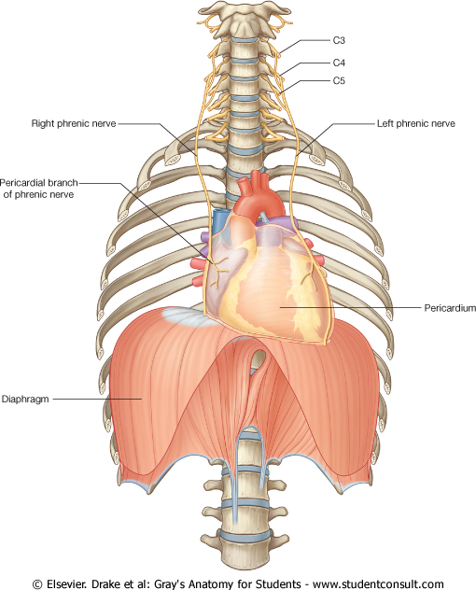
PHRENIC NERVES
Root Value:
C3,4,5
They pass through the Superior & Middle mediastina
Course in Thorax
The right phrenic descends on the right side of SVC & heart.
The left phrenic descends on the left side of heart.
Both nerves terminate in the diaphragm
Branches :
1) Motor & Sensory fibers to Diaphragm
2) Sensory fibers to pleurae & pericardium

Slide 12
Inferior Mediastinum
Subdivided into:
Middle mediastinum (M): contains Heart
Anterior mediastinum (A): in front of Heart
Posterior mediastinum (P): behind Heart
A
M
P

Slide 13
Anterior Mediastinum
Boundaries:
Superior: Horizontal plane
Inferior: Diaphragm
Anterior: Body & xiphoid process of sternum
Posterior: Heart
Lateral: Lungs & pleurae
Contents:
Thymus gland
Lymph nodes

Slide 14
Middle Mediastinum
Site:
Between anterior & posterior mediastina
Contents:
Heart & pericardium
Ascending Aorta
Pulmonary trunk
Superior & Inferior vena cava
Right & left pulmonary veins
Right & left phrenic nerves
Lymph nodes
Left
Pulmonary
veins
R pulmonary VV
Heart
L Phrenic N
Diaphragm

Slide 15
Posterior Mediastinum
Boundaries:
Superior: Horizontal plane
Inferior: Diaphragm
Anterior: Heart
Posterior: Thoracic vertebrae from T5 -T12
Lateral: Lungs & pleurae

Slide 16
Contents:
1. Esophagus,
2. Azygos system of veins,: posterior & to the right of esophagus
3. R & L Thoracic Sympathetic trunks,
4. Mediastinal lymph nodes
5. Vagus nerves

Slide 17
6. Thoracic duct: (posterior to esophagus).
7. Descending aorta: posterior & to the left of esophagus

Slide 18
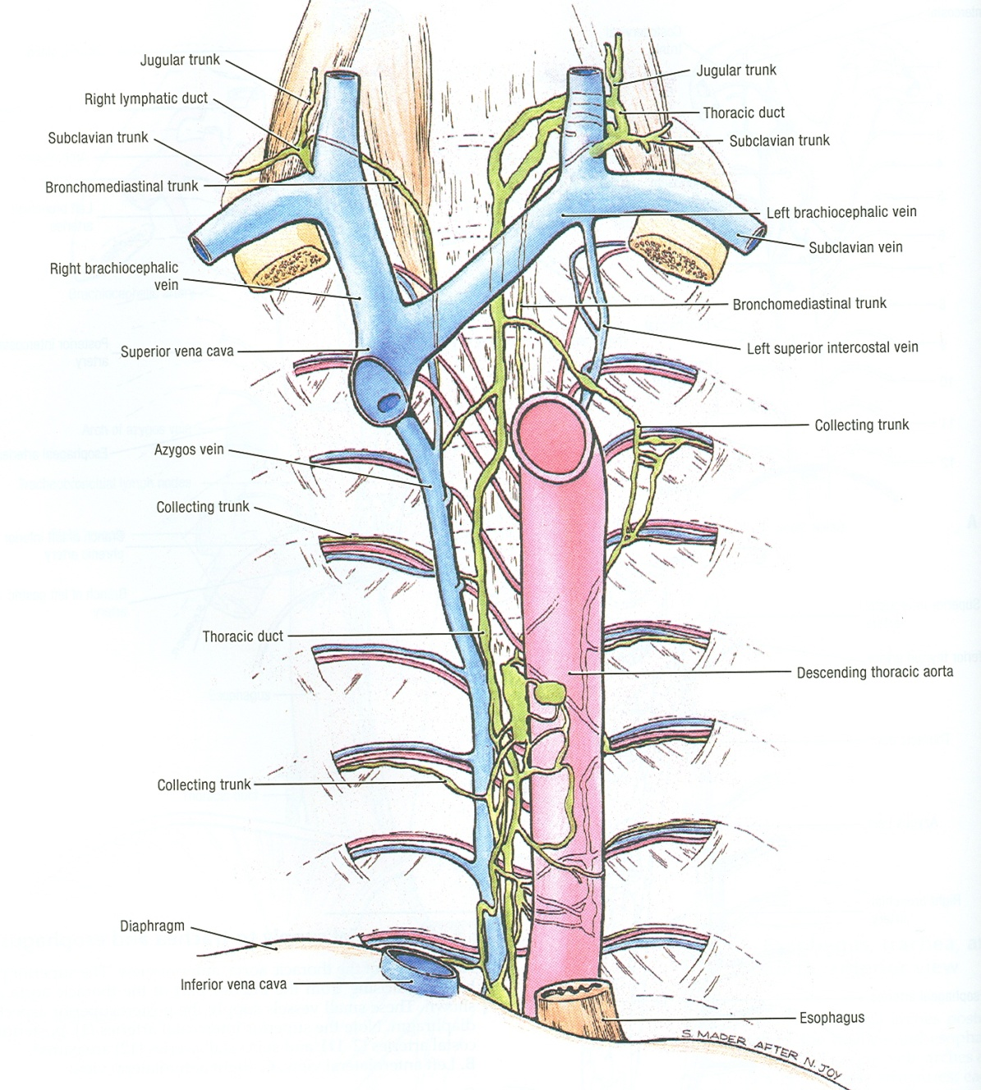
CONTENTS OF POSTERIOR MEDIASTINUM
E
S
O
P
H
A
G
U
S
Right
Sympathetic
Trunk
Left
Sympathetic
Trunk

Slide 19
VAGUS NERVE
It is the 10th cranial nerve.
It descends through the Superior & Posterior mediastina
The right vagus descends to the right side of trachea, forms the posterior esophageal plexus & continues in abdomen as posterior gastric nerve.
The left vagus descends between left common carotid & left subcalavian arteries, forms the anterior esophageal plexus & continues in abdomen as anterior gastric nerve.

Slide 20
AORTA
ASCENDING AORTA:
Beginning: at aortic orifice of left ventricle.
Course: in middle mediastinum
End: continues as arch of aorta (at level of T4)
ARCH OF AORTA:
Course: in superior mediastinum
End: continues as descending thoracic aorta (at level of T4)
Arch
Descending aorta

Slide 21
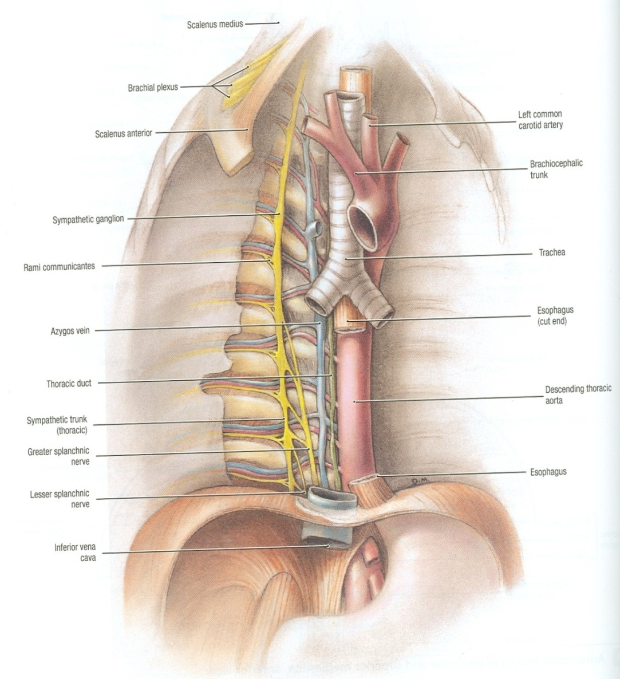
DESCENDING AORTA:
Course: in posterior mediastinum
End: continues as abdominal aorta after it passes through diaphragm

Slide 22
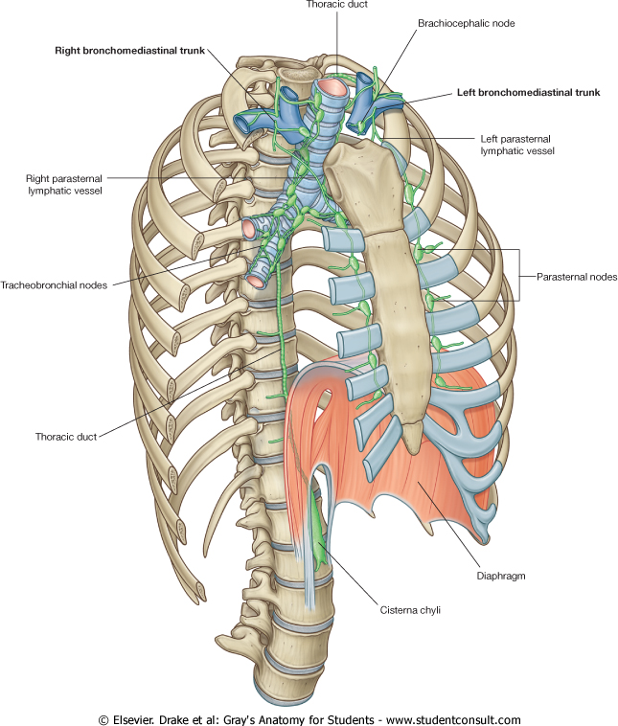
THORACIC DUCT
BEGINNING:
It is the continuation of Cisterna Chyli (at the level of L1).
COURSE:
It passes through aortic opening of diaphragm.
It ascends in Posterior mediastinum (posterior to esophagus).
It ascends in Superior mediastinum (to the left of esophagus).

Slide 23
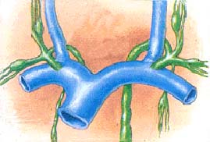
TRIBUTARIES:
It receives:
Lymphatics from all body
EXCEPT:
Right side of thorax, Right upper limb & Right side of head & neck.
END:
It opens in the left brachiocephalic vein.
Th D

Slide 24
LYMPHATIC VESSELS IN THORAX
Lymph form right
side of head & neck
Lymph from left
side of head & neck
Lymph from
right upper limb
Lymph from left
upper limb
end
end
Lymph from right
side of thorax
Lymph from left
side of thorax
Superior
Mediastinum
E
S
O
P
H
A
G
U
S
Posterior
Mediastinum
Cysterna chyli
(contains lymph from lower half of body)

Slide 25
Thank You

