Slide 1
( RESPIRATORY SYSTEM ( I
Histology of the Upper Respiratory Tract
(Nasal cavity, Paranasal sinuses (and Larynx

Slide 2
Objectives:
By the end of this lecture the student should be able to describe the microscopic structures of:
Vestibule of the nasal cavity.
Respiratory mucosa of the nasal cavity.
Nasal septum.
Olfactory mucosa of the nasal cavity.
Mucosa of the paranasal sinuses.
Larynx.

Slide 3
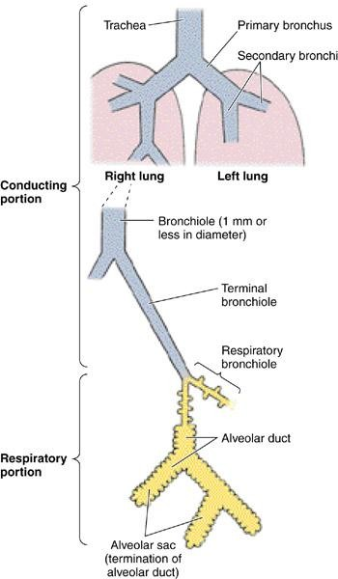
RESPIRATORY SYSTEM
Conducting portion :
  Nasal cavity.
  Nasopharynx.
  Larynx.
  Trachea.
  Primary bronchi (extrapulmonary bronchi). 6- Intrapulmonary bronchi:
    2ry bronchi (lobar bronchi).
    3ry bronchi (segmental bronchi).
7- Primary bronchioles (preterminal bronchioles). 8- Terminal bronchioles.
A) Respiratory portion:
1- Respiratory bronchioles. 2- Alveolar ducts .
Alveolar sacs.
Pulmonary alveoli.

Slide 4
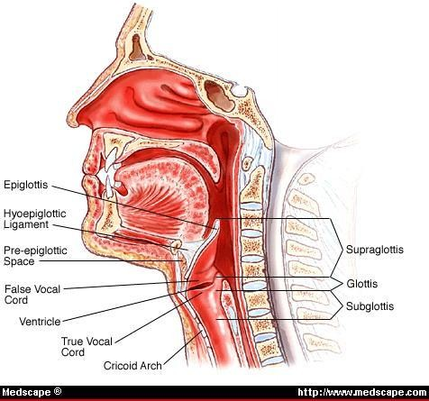
NASAL CAVITY (N.C.)
Anterior portion of N.C.:
Vestibule.
Posterior portion of N.C.: a- Respiratory region.
b- Olfactory region.
N.B. The nasal septum divides the nasal cavity into two halves (right and left).

Slide 5
.VESTIBULE OF N.C
Lining: is lined with thin skin.
Epidermis: (Keratinized stratified Squamous epithelium).
Dermis.
Contents:
Vibrissae: stiff hairs.
Sebaceous glands.
Sweat glands.
Wall:
Hyaline cartilage.
Cancellous (spongy) bone.

Slide 6
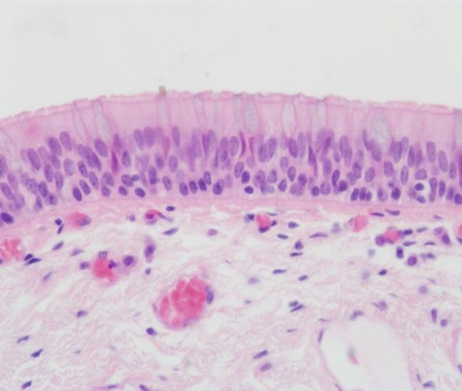
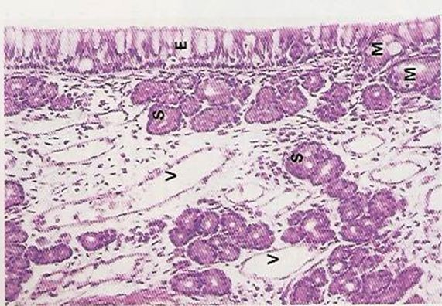
RESPIRATORY REGION (AREA) OF NASAL CAVITY
MUCOSA (MUCOUS MEMBRANE):
(A) Respiratory Epithelium: Pseudo-stratified ciliated columnar epithelium with goblet
cells.
Main Types of cells ( all touch the basement membrane)
1- Ciliated columnar cells. 2- Goblet cells.
Basal cells: are stem cells.
DNES cells: e.g. serotonin.

Slide 7
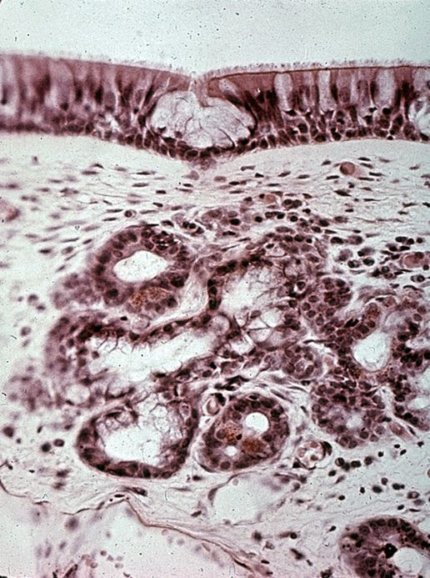
(B) Lamina propria ( Sub-epithelial C.T.): contains:
1- Large arterial plexuses &
venous sinuses
(Highly vascularized C.T.)
3- Many seromucous glands (acini). 4- Abundant lymphoid elements:
Including occasional lymphoid nodules, plasma cells & mast cells.

Slide 8
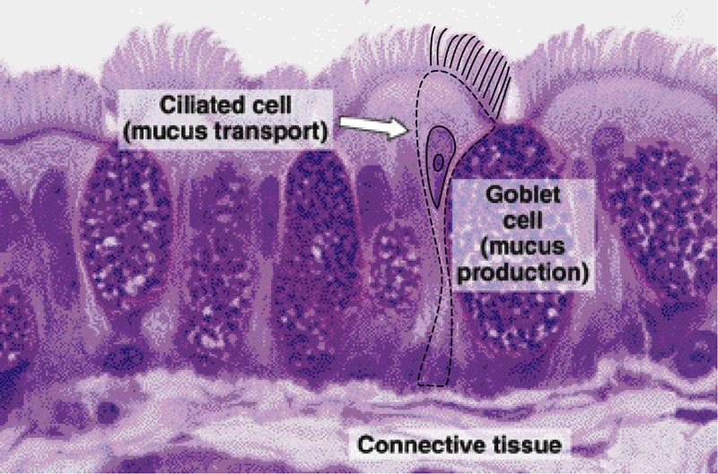
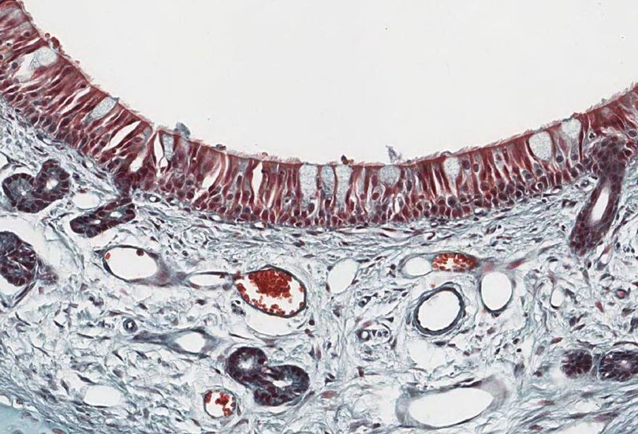
PARANASAL SINUSES
Lining: 1- Respiratory epith. (Mention…….) 2- Lamina propria.
CLINICAL APPLICATION:
Sinusitis.

Slide 9
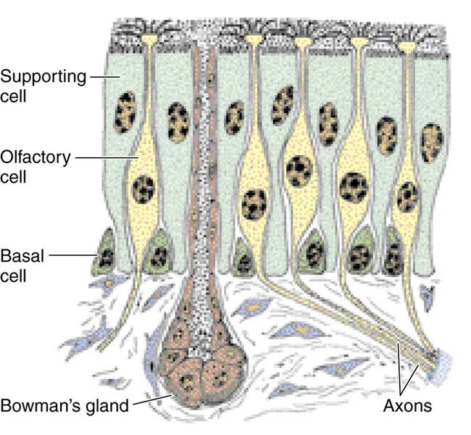
OLFACTORY REGION (AREA) OF NASAL CAVITY
(OLFACTORY MUCOSA)
Site: 1-Roof of nasal cavity.
2-Upper part of nasal septum. 3-over superior concha.
Structure:
A) Olfactory epithelium:
Pseudo-stratified columnar epith.
1- Olfactory cells (olfactory nerve cells) 2- Sustentacular (supporting) cells.
3- Basal cells: Pyramidal in shape,
basal in position and act as stem cells.

Slide 10
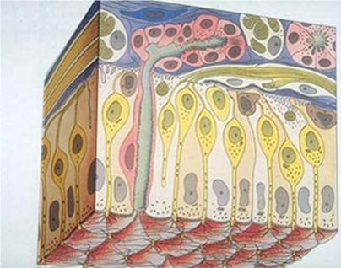
Lamina propria: contains:
  Highly (richly) vascularized loose C.T. 2- Contents:
    Bowman’s glands ( olfactory glands) : are serous acini.
    Bundles of unmyelinated nerve fibers: Are axons of olfactory nerve cells +
Schwann-like cells (glial cells).
    Rich vascular plexus.
    Numerous lymphoid elements.

Slide 11

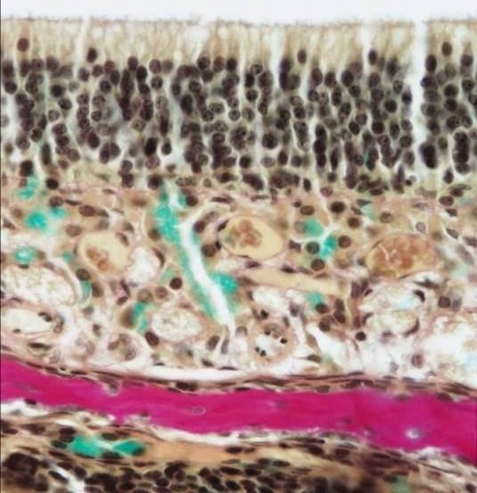
OLFACTORY EPITHELIUM
1- Olfactory cells:
Are bipolar neurons
Dendrite has olfactory vesicle that has nonmotile cilia.
Axons are unmyelinated with Schwann-like cells. Axons will collect in the lamina propria to form bundles of nerve fibers.
Bundles will collect to form the olfactory nerve.
2- Sustentacular (supporting) cells:
Are columnar cells.
Function:
Physical support and nourishment for olfactory cells.

Slide 12
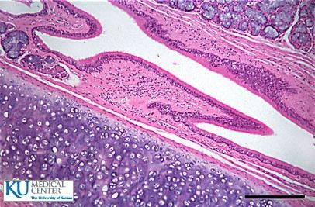
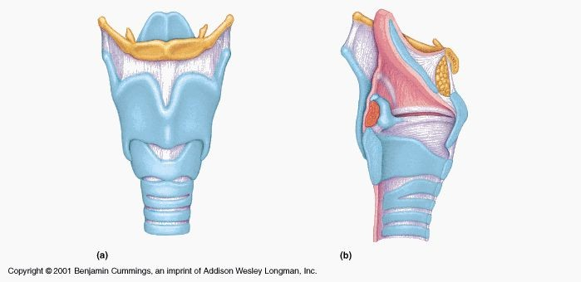
LARYNX
Mucosa (Mucous membrane ):
  Epithelium.
  Lamina propria.
Cartilages.
Extrinsic and intrinsic muscles: all are skeletal.
Ligaments.

Slide 13
LARYNX
Mucosa:
  Epithelium: (2 types)
a- Respiratory epithelium:
Pseudostratified ciliated columnar epithelium with goblet cells.
b- Non keratinized stratified squamous epithelium:
In: -Vocal folds.
- Superior surface of epiglottis
  Lamina propria.

Slide 14
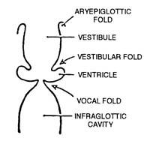
LARYNX
Mucosa (cont.):
There are 2 pairs of shelf-like mucosal folds:
  Vestibular folds:
Are immovable.
L/M: a- Respiratory epithelium. b- Lamina propria:
Loose C.T. with seromucous glands
lymphoid elements & adipose cells.
  VOCAL FOLDS (CORDS): have:
    Epithelium: non keratinized stratified squamous.
    Lamina propria: C.T. containing bundles of elastic fibers and skeletal muscle .
N.B. No lymphoid nodules, No seromucous glands.

Slide 15
(B) Cartilages:
1- Hyaline cartilages:
e.g. Thyroid cartilage.
2- Elastic cartilages:
Epiglottis.
Muscles: all are skeletal.
Ligaments.

Slide 16
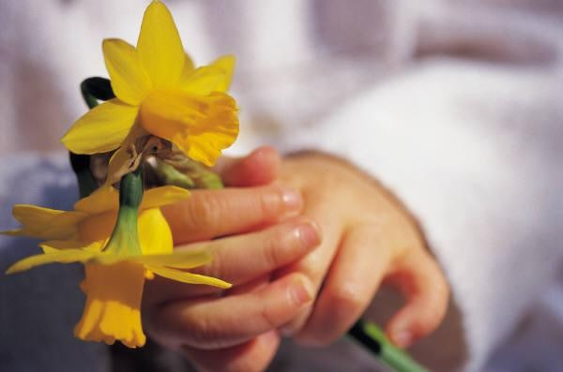
THANK YOU

