Slide 1
RESPIRATORY SYSTEM (II)
Histology of the Lower Respiratory Tract
(Trachea, Bronchi, Bronchioles) & the Lung

Slide 2
Objectives:
By the end of this lecture, the student should be able to describe:
1- The microscopic structures of the wall of:
Trachea.
Primary or extrapulmonary bronchi.
Intrapulmonary (secondary and tertiary) bronchi.
Bronchioles.
2- The microscopic structures of :
Interalveolar septum.
Alveolar phagocytes.
Pleura.

Slide 3
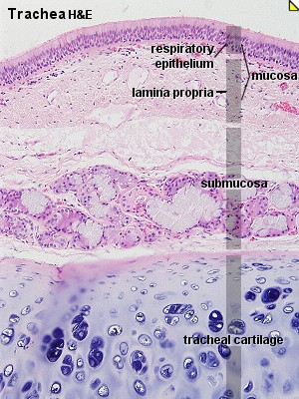
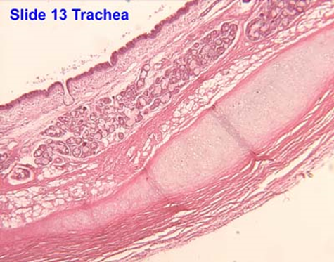
TRACHEA
The wall of trachea is formed of:
Mucosa.
Submucosa.
Adventitia.

Slide 4
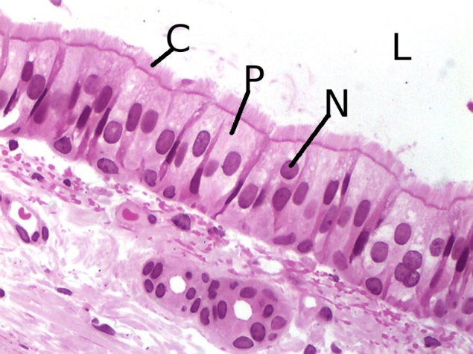
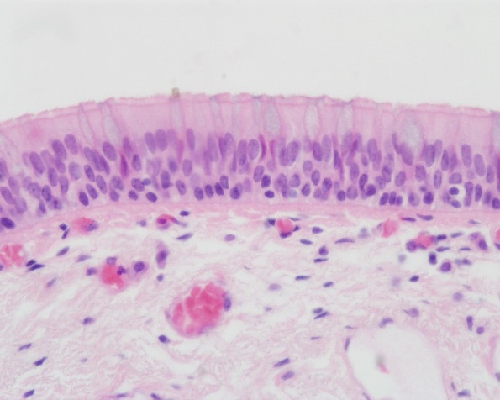
MUCOSA OF TRACHEA
Epithelium: Respiratory epithelium
Lamina propria.
(3) Elastic lamina:
It is formed of elastic fibers.
It separates lamina propria from submucosa.

Slide 5
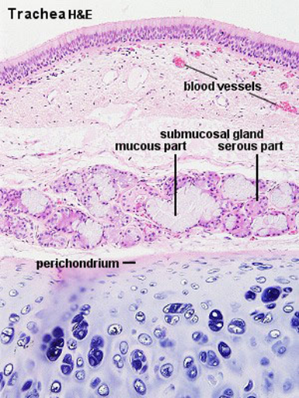
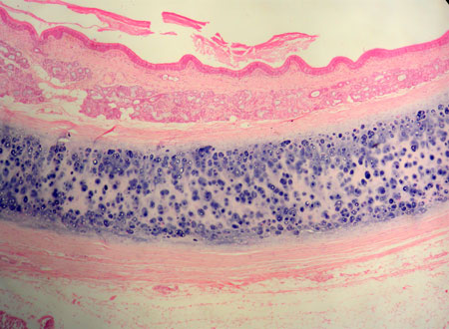
SUBMUCOSA OF TRACHEA
Contents:
1- C.T.
2- Numerous mucous & seromucous glands.
3- Lymphoid elements.

Slide 6
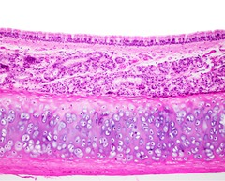
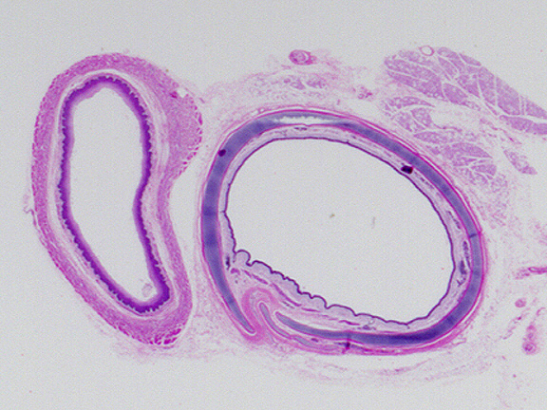
ADVENTITIA OF TRACHEA
Contents:
1- Fibroelastic C.T.
2- C-shaped rings (12-16) of hyaline cartilage.
Trachealis muscle (bundle of smooth muscle fibers) connects the 2 ends of each C-shaped (incomplete) rings of cartilage.

Slide 7
EXTRAPULMONARY BRONCHUS (1ry BRONCHUS)
Generally have the same histological appearance as the trachea.

Slide 8
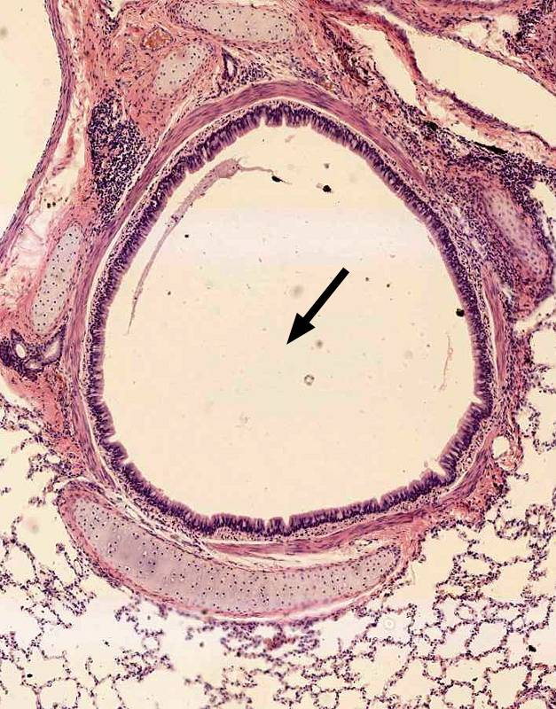
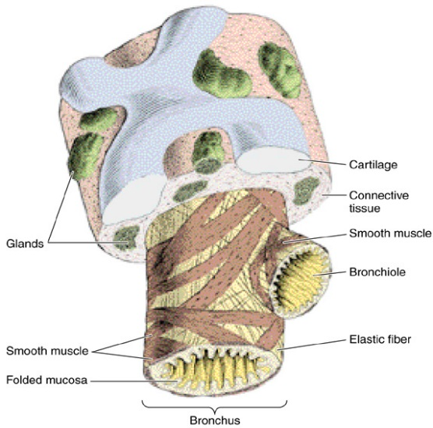
INTRAPULMONARY BRONCHI (2ry & 3ry BRONCHI)
1- Mucosa.
2- Muscle coat.
3- Submucosa.
4- Adventitia.

Slide 9
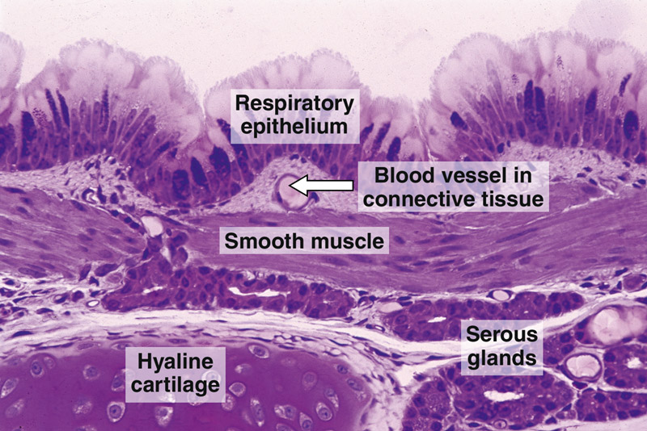
INTRAPULMONARY BRONCHUS
Mucosa:
a- Epithelium: Respiratory epith.
b- Lamina propria.
N.B. No elastic lamina.
(2) Muscle coat (complete):
Two distinct layers of smooth muscle fibers spirally arranged in opposite direction.

Slide 10
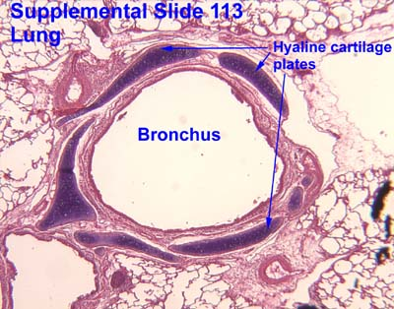
INTRAPULMONARY BRONCHUS
(3) Submucosa:
C.T. contains:
a- Seromucous glands.
b- Lymphoid elements.
(4) Adventitia:
Contents: a- Loose C.T.
b- Irregular plates of hyaline
cartilage (complete layer).
c- Solitary lymphoid nodules.

Slide 11
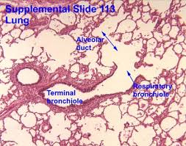
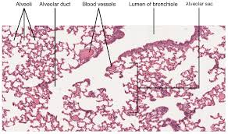
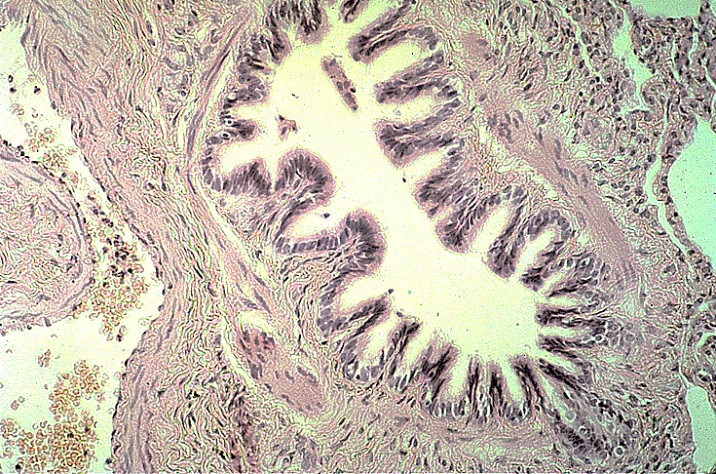
BRONCHIOLES
1- Preterminal ( 1ry ) Bronchioles (Bronchioles):
Are less than 1mm in diameter.
2- Terminal ( 2ry ) Bronchioles.
3- Respiratory ( 3ry ) Bronchioles.

Slide 12
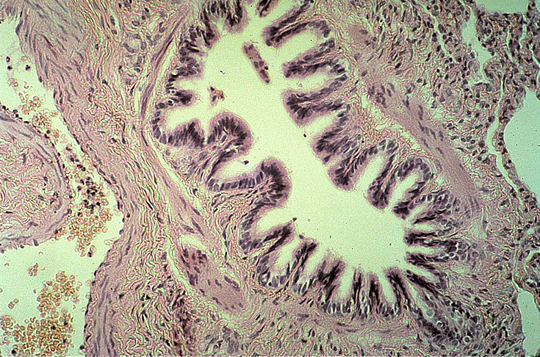
Preterminal Bronchioles
(1) Mucosa: has longitudinal folds:
A- Epithelium:
Simple ciliated columnar epith.
with occasional goblet cells.
B- Lamina propria: C.T. rich in elastic fibers.
(2) Smooth muscle: 2 helically arranged smooth muscle layers.
(3) Adventitia: C.T.
N.B. No cartilage, No seromucous glands, No lymph
nodules.

Slide 13
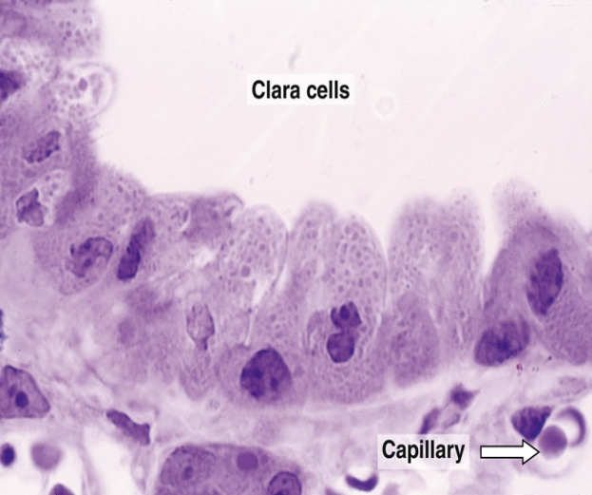
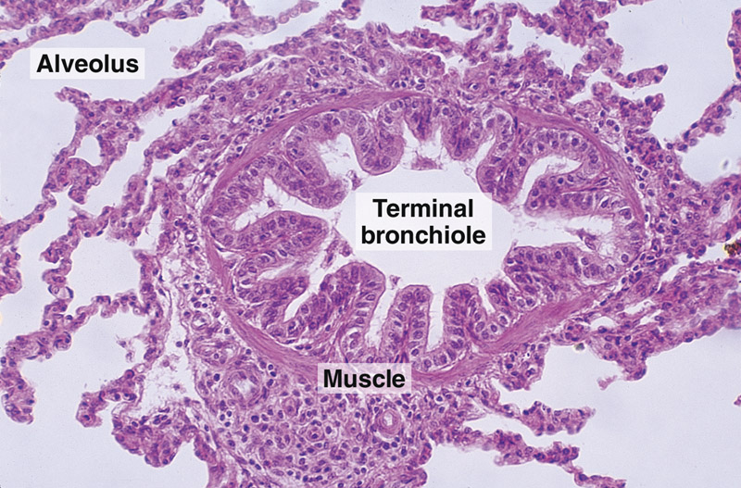
Terminal Bronchioles
Similar structure to preterminal bronchioles, but:
Epithelium:
Simple cuboidal partially ciliated epithelium
With Clara cells ( With NO goblet cells).
N.B. Are less than 0.5mm in diameter.

Slide 14
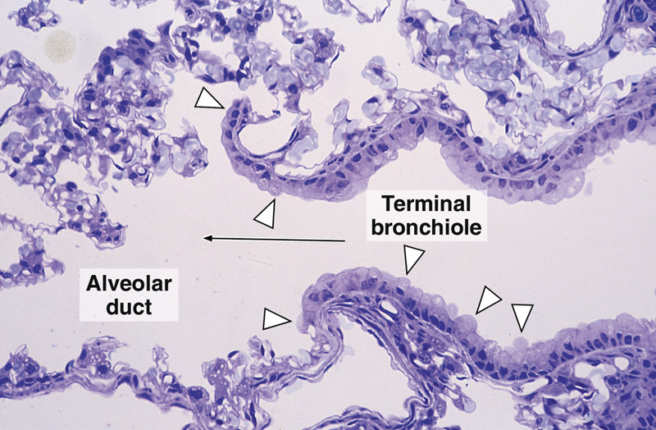
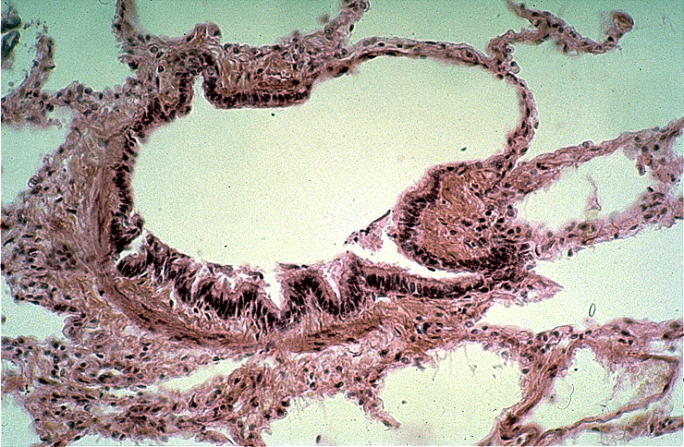
Respiratory Bronchioles
Are similar in structure to terminal bronchioles But: their walls are interrupted by the presence of few pulmonary alveoli.

Slide 15
CLARA CELLS
Structure:
columnar cells (non ciliated).
Function:
1- Degrade toxins in inhaled air.
2- Divide to regenerate the bronchiolar epith.
3- Produce surfactant-like material.

Slide 16
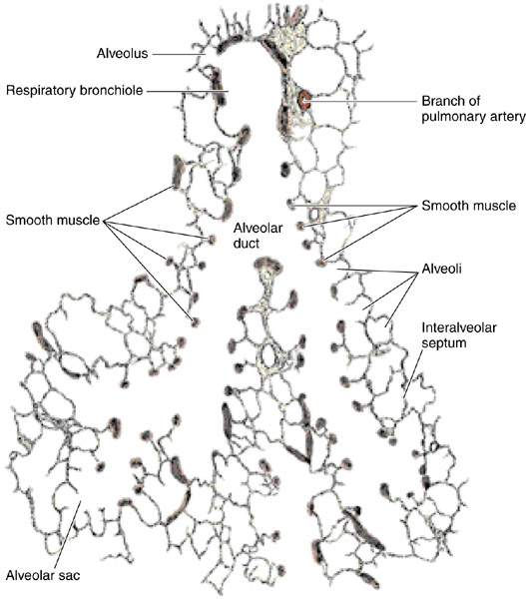
ALVEOLAR DUCTS
The wall of alveolar ducts consist almost of
pulmonary alveoli.
N.B. Alveolar duct → ends by: atrium →
communicates with: 2-3 alveolar sacs

Slide 17
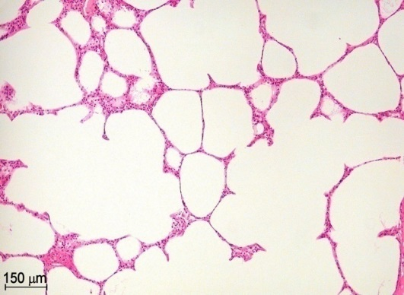
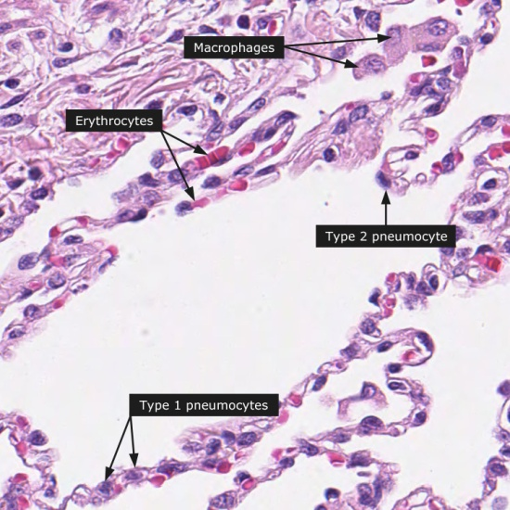
PULMONARY ALVEOLI
Definition:
They are small out-pouching of respiratory
bronchioles, alveolar ducts & alveolar sacs.
Topics:
*Interalveolar septa.
*Alveolar epithelium.
* Alveolar phagocytes
(Lung macrophages).

Slide 18
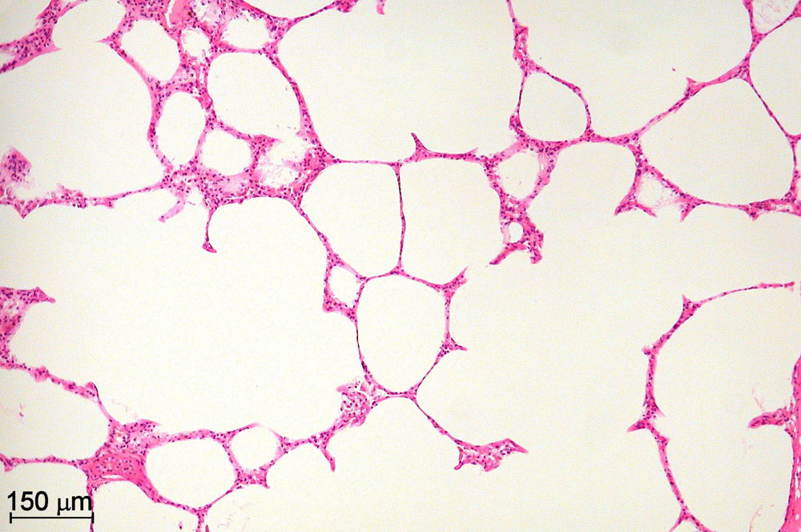
INTERALVEOLAR SEPTA
Definition:
The region between 2 adjacent alveoli.
Components:
Alveolar Epithelium:
lines both sides of interalveolar septum.
(B) Interstitium.

Slide 19
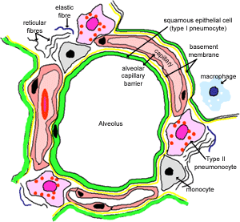
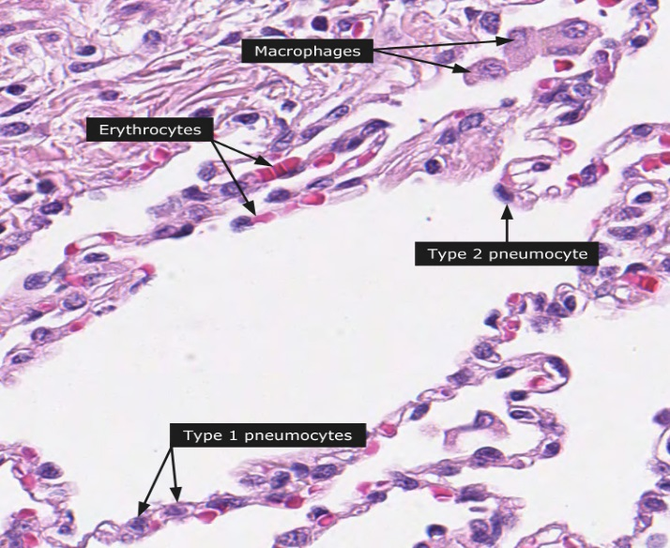
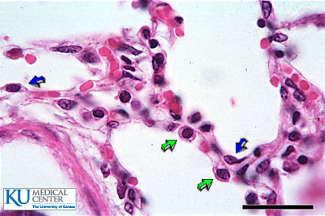
ALVEOLAR EPITHELIUM
Type I Pneumocytes
(2) Type II Pneumocytes

Slide 20
ALVEOLAR EPITHELIUM
Type I Pneumocytes:
- line 95% of the alveolar surface.
- Count: less numerous than type II pneumocytes.
- L/M: simple squamous epith.
-Function:
Exchange of gases.

Slide 21
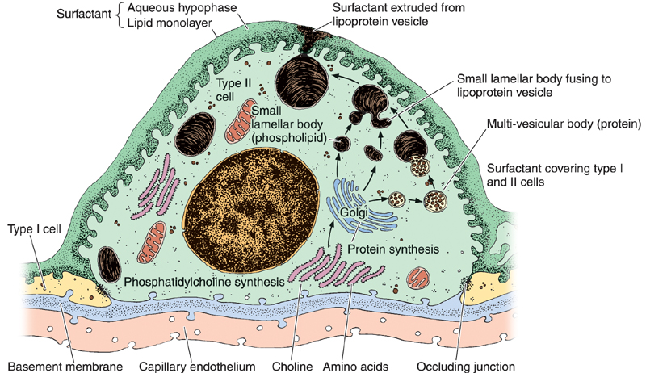
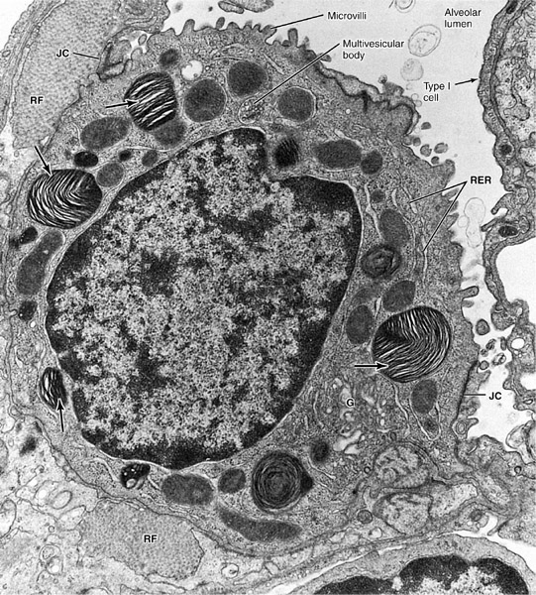
(2) Type II Pneumocytes:
Line 5% of the alveolar surfaces.
Are more numerous than type I pneumocytes.
- Are cuboidal or rounded cells, With Foamy cytoplasm.
Nucleus: central & rounded.
- The cytoplasm contains membrane-
bound Lamellar bodies
(contain pulmonary surfactant).

Slide 22
Type II Pneumocytes:
Function:
1- Synthesis & secretion of pulmonary surfactant.
2- Renewal of alveolar epithelial cells:
Type II cells can divide to regenerate both type I & type II pneumocytes.

Slide 23
Interstitium of interalveolar septa
Continuous Pulmonary Capillaries.
(2) Interstitial C.T.:
a- C.T. Fibers: elastic fibers &
type III collagen (reticular fibers).
b- C.T. Cells: Fibroblasts, Macrophages,
Mast cells, Lymphocytes.

Slide 24
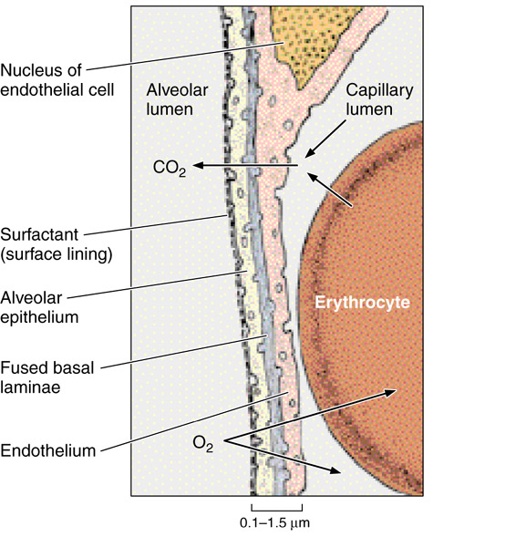
BLOOD-GAS BARRIER (BLOOD-AIR BARRIER)
Definition:
It is the region of the interalveolar septum that is traversed by O2 & CO2
Components:
1- Thin layer of surfactant.
2- Type I pneumocyte.
3- Fused basal laminae of type I pneumocytes &
endothelial cells of the pulmonary capillary.
4- Endothelial cells of the pulmonary capillary.

Slide 25
Alveolar phagocytes (Alveolar Macrophages) (Dust Cells)
Sites:
In the lumen of pulmonary alveoli.
In the interstitium of interalveolar septa.
Function:
Phagocytose particulate matter (e.g. dust) & bacteria in the lumen of pulmonary alveoli and in the interstitium of interalveolar septa.

Slide 26
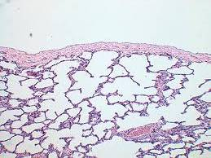
Pleura Is formed of two layers: Parietal and visceral. It is formed of simple squamous mesothelium. The two layers are separated by serous fluid. The visceral layer has sub-epithelium loose C.T that extends into the lung tissue
Notes:
26

Slide 27
THANK YOU

