Slide 1
Respiratory System
Practical Pictures

Slide 2
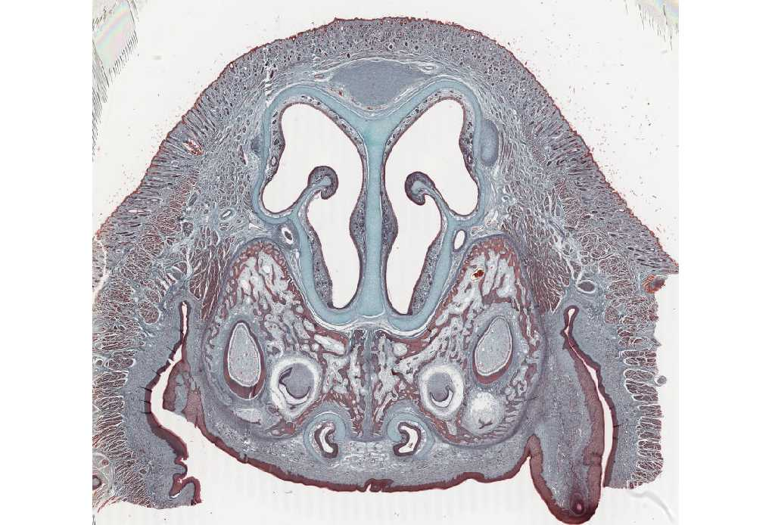
NASAL CAVITY AND SEPTUM

Slide 3
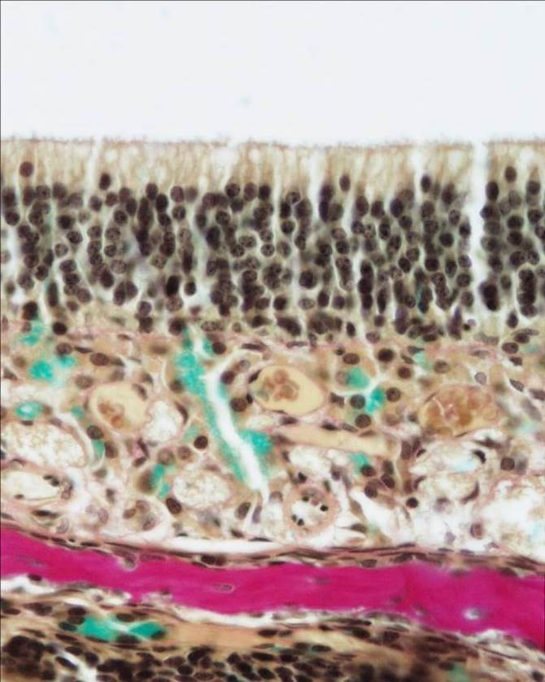
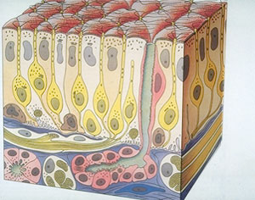
OLFACTORY MUCOSA

Slide 4
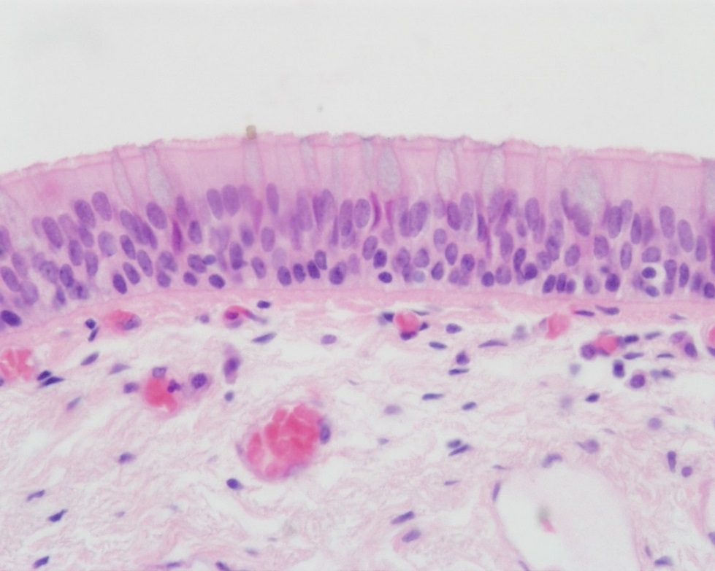
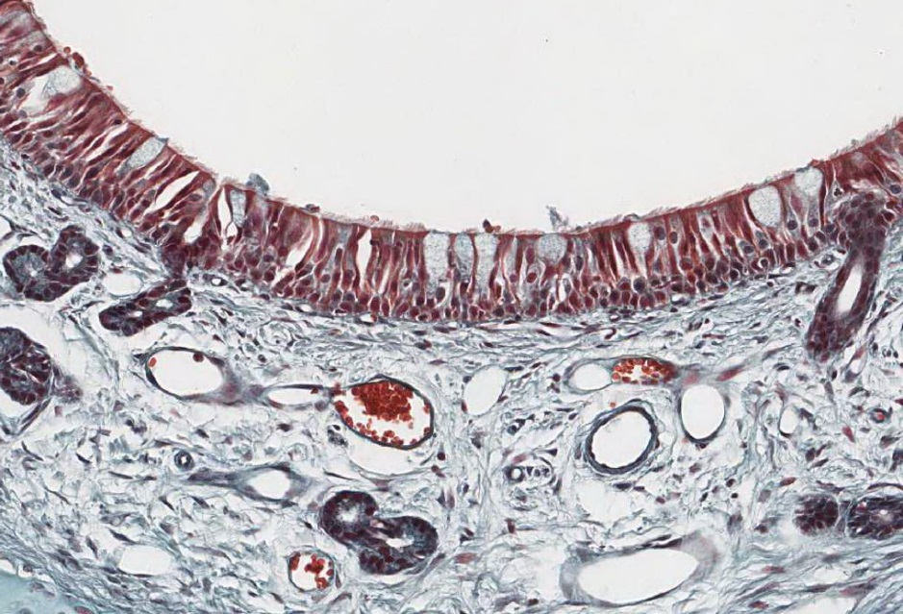
NASAL MUCOSA – respiratory epithelium and lamina propria

Slide 5
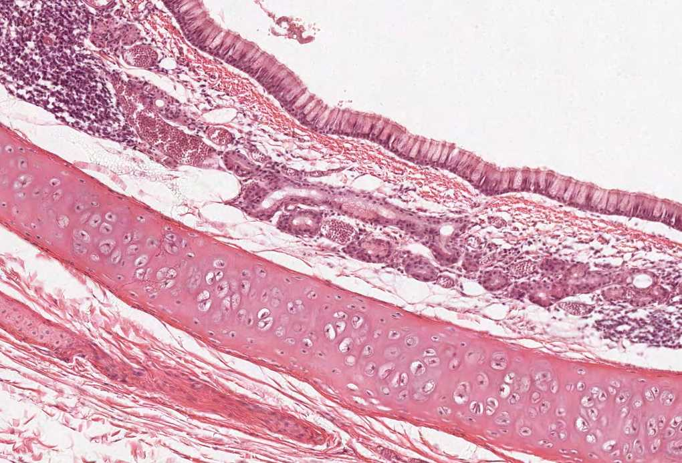
TRACHEA

Slide 6
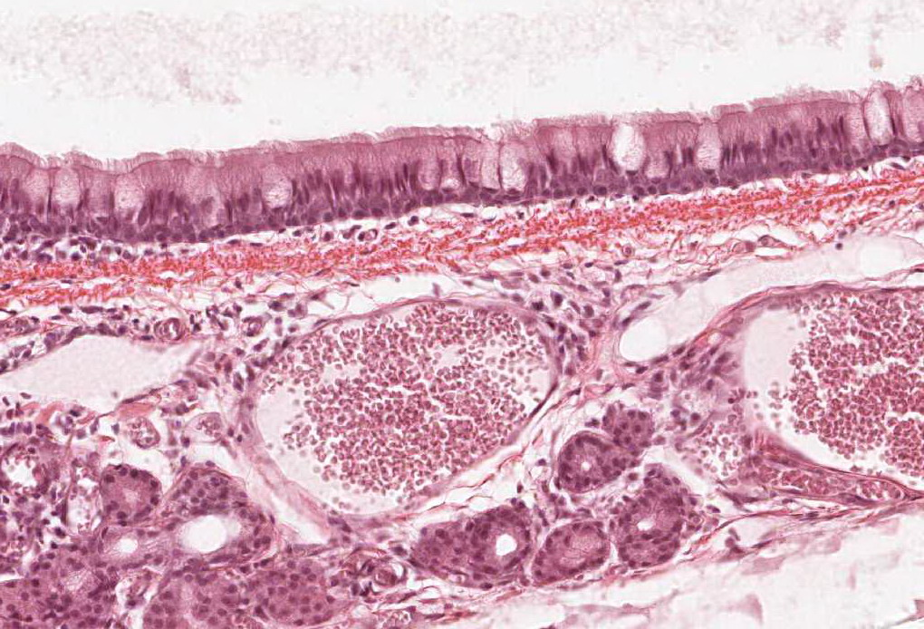
TRACHEA – mucosa (respiratory epithelium) and submucosa

Slide 7
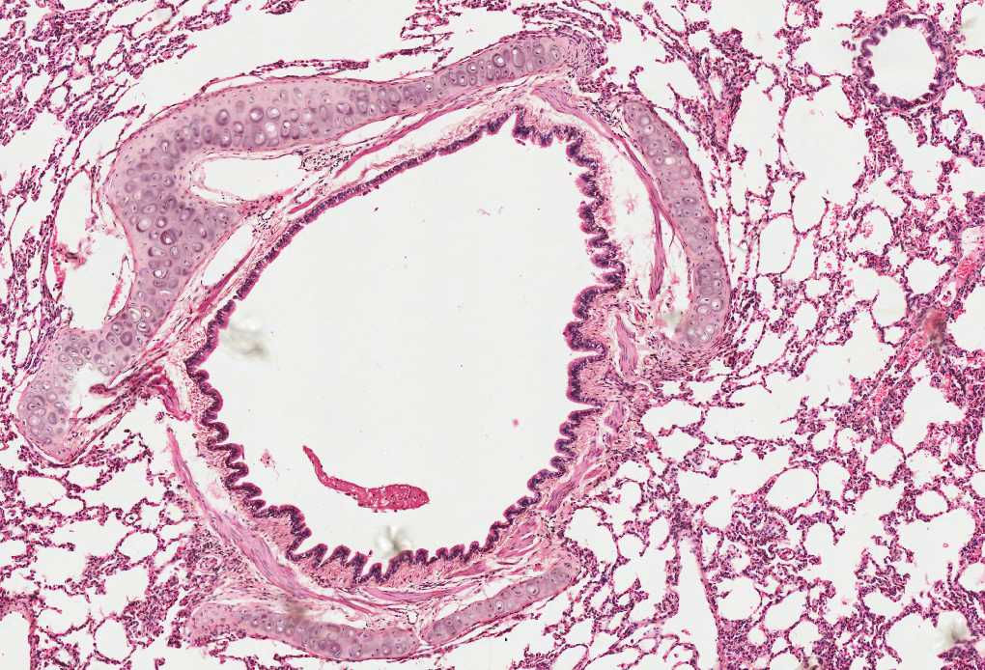
LUNG – intrapulmonary bronchus and bronchiole

Slide 8
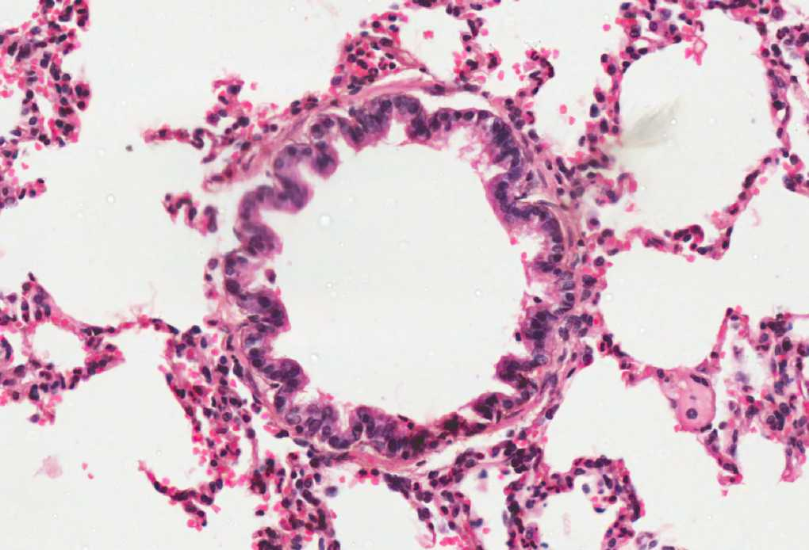
LUNG – Bronchiole (TS)

Slide 9
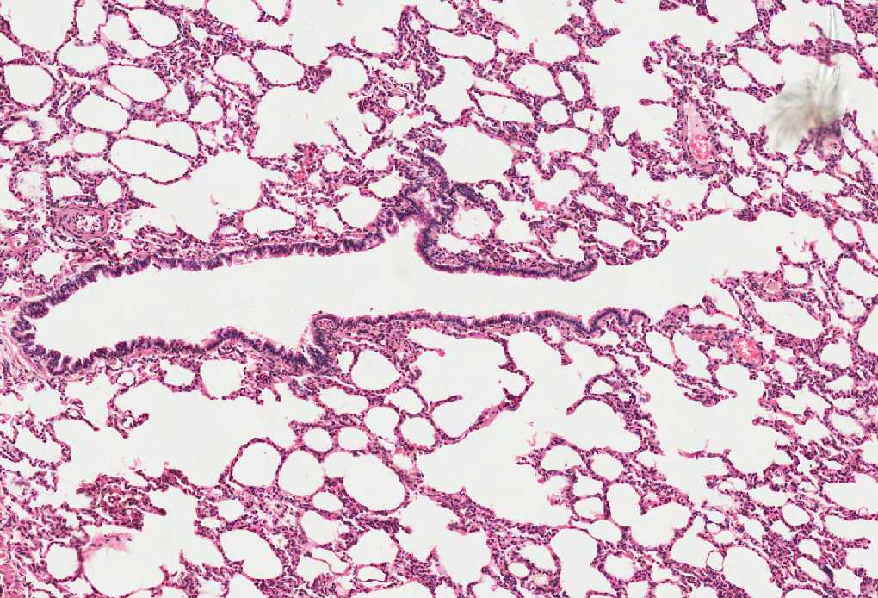
LUNG – Bronchiole (LS)

