Slide 1
MERS-CoV & other viruses
Dr. MONA BADR
Assistant Professor
College of Medicine & KKUH

Slide 2
Objectives
Characteristics of MERS-CoV, Rhinovirus, Coxsackieviruses & other Picronaviruses, Adenovirus, Epstein – Barr virus.
Mode of transmission
Clinical features
Lab diagnosis
Treatment & prevention

Slide 4
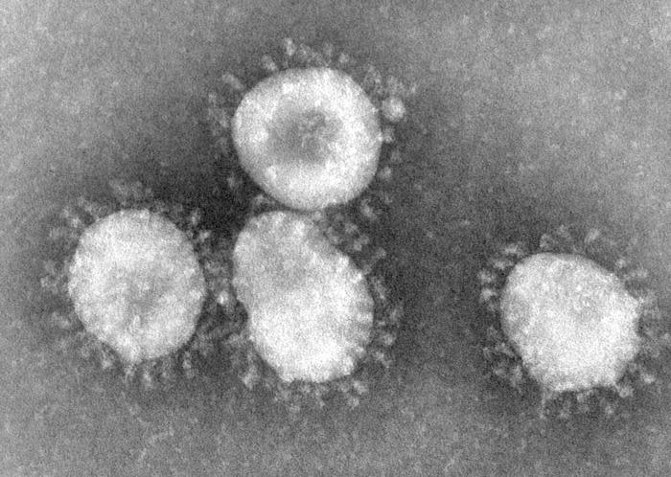
Coronavirus
Family: Coronaviridae.
Structural features: Enveloped virus with + polarity ss-RNA genome.
Transmission: Inhalation of infectious aerosol droplets.
Clinical symptoms: The 2nd cause of common cold.
Coronavirus also causes zoonotic disease (the virus is capable of infecting humans and animals including birds, camels, pigs and others).

Slide 6
SARS-CoV
Severe Acute Respiratory Syndrome (SARS)
In winter of 2002, a new respiratory disease known as (SARS) emerged in China after a new mutation of coronavirus.
The disease spread worldwide due to travelling.
The animal reservoir may be rats or cats.
SARS starts with high fever followed by cough with difficulty in breathing (atypical pneumonia).
Associated with high mortality due to respiratory failure.

Slide 7
MERS-CoV
Middle East Respiratory Syndrome (MERS) is viral respiratory illness first reported in Saudi Arabia in 2012. It is caused by a coronavirus.
Epidemiology: So far, all the cases have been linked to countries in and near the Arabian Peninsula.
Highly infectious.
Incubation period 2-14 days.
Transmission:
This virus spread from ill people to others through close contact. There is no evidence of sustained spreading in community settings.
Evidence also suggested that the virus can be acquired from direct close contact with animals.

Slide 8
Coronavirus
In September 2012 ,a case of novel coronavirus infection was reported involving a man in Saudi Arabia who was admitted to a hospital with pneumonia and acute kidney failure.
This virus has been named as Middle East Respiratory Syndrome- CoronaVirus (MERS-CoV) ,virus closely related to several bat coronaviruses.
MERS-CoV infected several human cells , including lower but not upper respiratory, kidney ,intestinal, and liver cells.

Slide 9
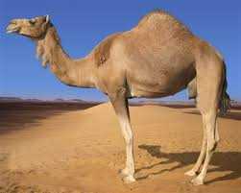

Slide 10
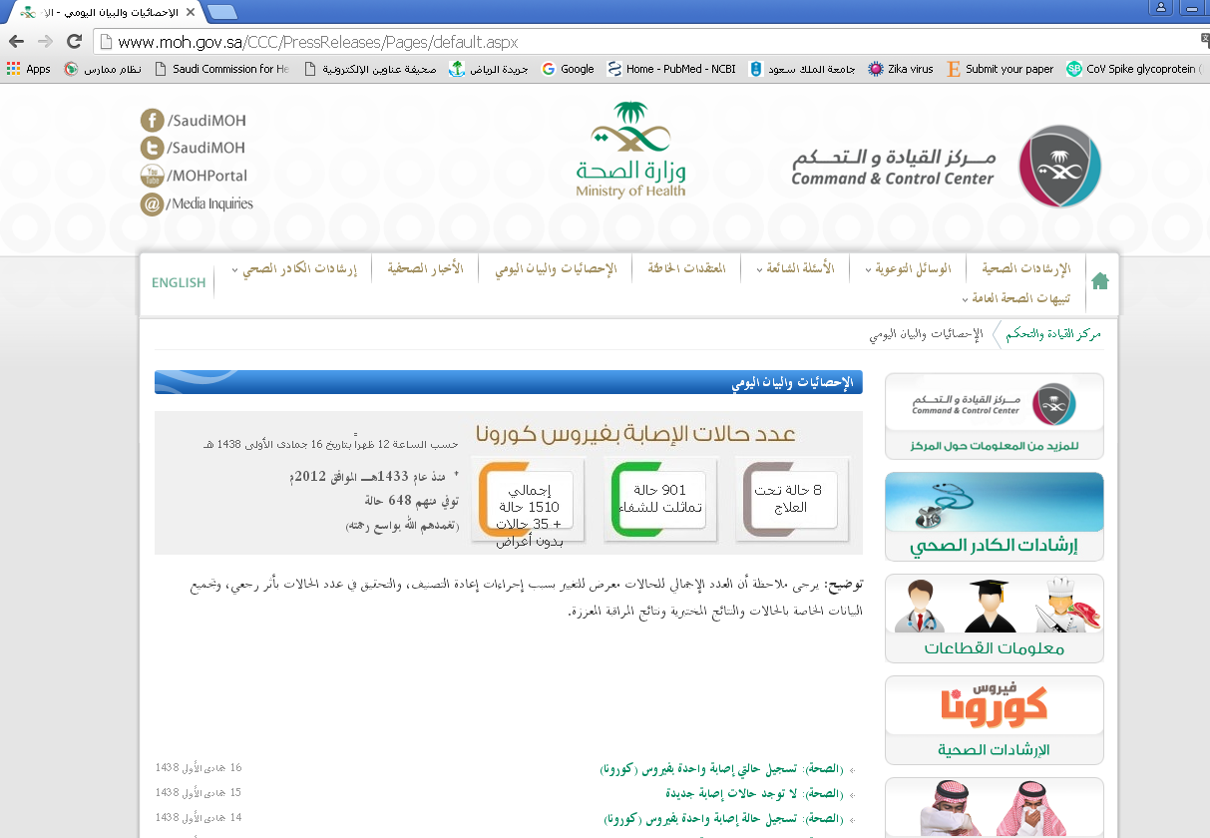

Slide 11
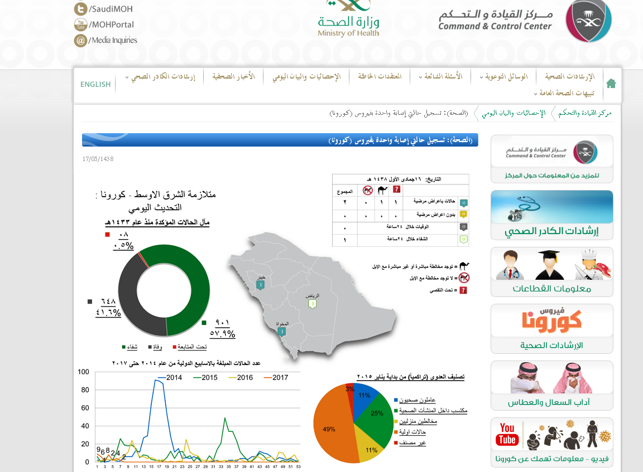

Slide 12
Risk group:
Individuals with weakened immune systems
People with pre-existing medical conditions (or comorbidities) such as diabetes, cancer, and chronic lung, heart, and kidney disease.
Clinical Features:
Symptoms may include fever, cough, and shortness of breath.
Some people also had gastrointestinal symptoms including diarrhea and nausea/vomiting.
Some infected people had mild symptoms (such as cold-like symptoms) or no symptoms at all and they recovered completely.
Most people with comorbidities developed severe acute respiratory illness.
Complications:
Severe complications include pneumonia and kidney failure. About 30% of people infected with MERS died.

Slide 13
Lab diagnosis: Detection of the viral nucleic acid (NA) by PCR. Other methods: Isolation of the virus from NPA by cell culture.
Treatment: No specific antiviral treatment. For severe cases, current treatment includes care to support vital organ functions.
Prevention:
People are advised to protect themselves from respiratory illnesses by taking everyday preventive actions:
• Wash hands often with water and soap or use an alcohol-based hand sanitizer.
• Cover nose and mouth with a tissue when cough or sneeze.
• Avoid touching eyes, nose and mouth with unwashed hands.
• Avoid personal contact with sick people.
• Clean and disinfect frequently touched surfaces such as toys and doorknobs.

Slide 14
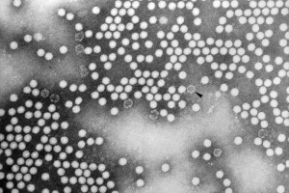
Rhinovirus
Family: Picornaviridae.
Structural features: Non-enveloped virus with + polarity ssRNA genome, more than 100 serotypes available.
Transmission: Inhalation of infectious aerosol droplets.
Clinical symptoms: The 1st cause of common cold. The main symptoms of common cold are sneezing, clear watery nasal discharge with mild sore throat, and cough.
Lab diagnosis: routine testing by detection of the viral NA from NPA using PCR.
Treatment and prevention: Usually self-limiting disease, no specific treatment, and no vaccine available.

Slide 15
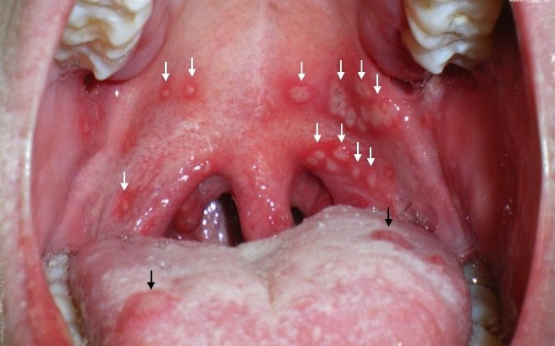
Coxsackieviruses & other Picronaviruses
Family: Picornaviridae.
Structural features: Non-enveloped virus with + polarity ssRNA genome
Coxsackieviruses group A & B,
Echovirus, Enteroviruses.
Transmission:
Inhalation of infectious aerosol droplets.
Clinical symptoms:
Coxsackieviruses cause herpangina and pharyngitis
Echovirus & other Enteroviruses cause respiratory symptoms
Lab diagnosis: routine testing by detection of the viral NA from NPA using PCR.
Treatment and prevention: Usually self-limiting disease, no specific treatment, and no vaccine available.

Slide 16
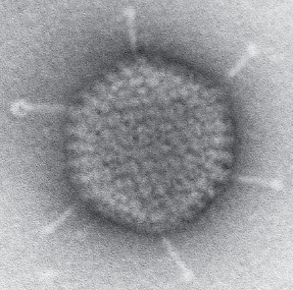
Adenovirus
Family: Adenoviridae.
Structural features: Non-enveloped virus with ds-DNA genome.
Pathogenesis: Adenovirus infects epithelial cell lining respiratory tract, conjunctiva, urinary tract, gastrointestinal tract and genital tract.
Clinical syndrome:
Phrayngitis and tonsilitis.
Pharyngioconjunctivitis
Conjunctivitis.
Pneumonia: in preschool children.
Gastroenteritis.
Acute hemorrhagic cystitis.
UTI (Cervicitis and urethritis).
Lab diagnosis: routine testing by direct detection of the Ag from NPA by direct IFA. Other detection methods: tissue culture, PCR.
Treatment and prevention: No specific treatment or vaccine.

Slide 17
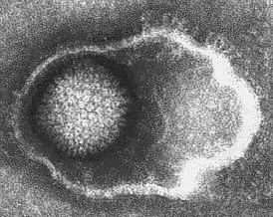
Epstein – Barr Virus (EBV)
Family: Herpesviridae
Structure: Enveloped , icosahedral dsDNA virus
It is lymphotropic.
It has oncogenic properties;
Burkitt’s lymphoma
Nasopharyngeal carcinoma

Slide 18
Epidemiology
Distribution::worldwide (Mainly in teenagers & young adults)
Transmission:
Saliva [kissing disease]
Blood [rarely]
Age:
Socio-economic status: SE
Low SE class early childhood
High SE class adolescence

Slide 19
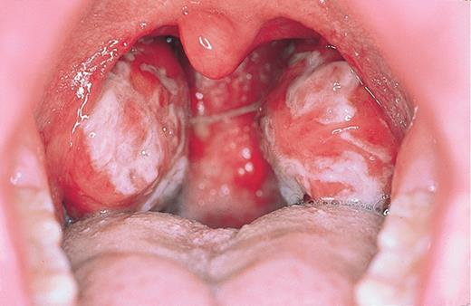
Clinical Features:
Immunocompetent host
Asymptomatic
Infectious mononucleosis
[or glandular fever]
IP = 4-7 weeks
Fever, sore throat, tonsillitis, pharyngitis, malaise, hepatosplenomegaly & abnormal LF, hepatitis.
Complications
(acute airway obstruction, splenic rupture, CNS inf)

Slide 20
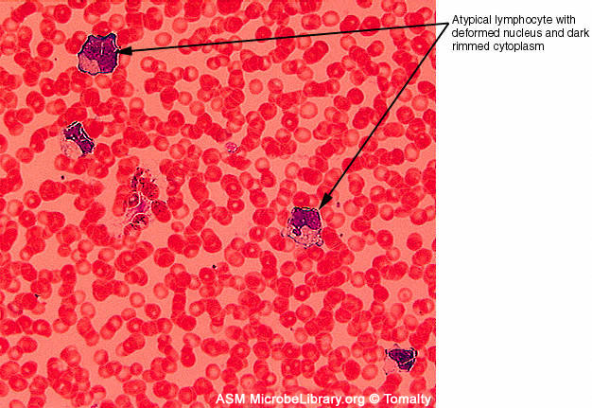
Immunocompromised host
Lymphoproliferative disease ( LD)
Oral hairy leukoplakia (OHL)
Diagnosis:
Hematology:
WBC
lymphocytosis
(Atypical lymphocytes)

Slide 21
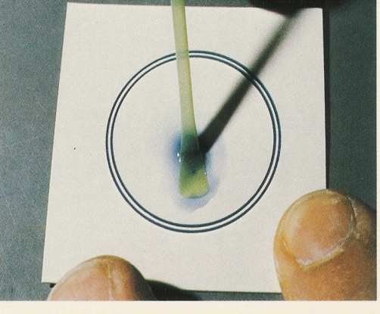
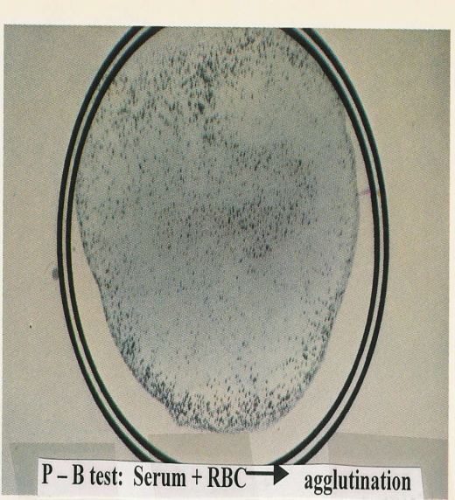
Diagnosis:
Serology tests
Non-specific AB test ;
Heterophile Abs +ve
Paul-Bunnell or
monospot test
EBV-specific AB test: Detection of IgM Abs to EBV capsid antigen by ELISA

Slide 22
Management:
Treatment:
There is no treatment for Infectious mononucleosis
Prevention:
No vaccine

Slide 23
Reference books
Notes on Medical Microbiology
By; Katherine N. Ward, A. Christine McCartney, and Bishan Thakker.
(2009)
Human Virology
By; Leslie Collier and John Oxford.
(2006)

