Slide 1
Pneumonia
Community acquired pneumonia
(CAP)

Slide 2
Objectives
Discuss the epidemiology and pathophysiology of pneumonia and CAP
Explain the different classifications of pneumonia
Recognize clinical presentations associated with CAP
Discuss the diagnosis and treatment of CAP
Identify common etiological agents causing CAP and discuss their laboratory work up
Discuss virulence factors and prevention of Streptococcus pneumoniae

Slide 3
Definition
Pneumonia is an infection that leads to inflammation of the parenchyma of the lung (the alveoli) (consolidation and exudation)
It may present as acute, fulminant clinical disease or as a chronic disease with a more prolonged course

Slide 4
Epidemiology
Overall the rate of CAP 5-6 cases per 1000 persons per year
Mortality 23%
High, especially in old people
Almost 1 million annual episodes of CAP in adults > 65 yrs in the US
Risk factors
Age < 2 yrs, > 65 yrs
Alcoholism
Smoking
Asthma and COPD
Aspiration
Dementia
Prior influenza
HIV
Immunosuppression
Institutionalization
Recent hotel : Legionella
Travel, pets, occupational exposures- birds (C. psittaci)
Notes:
Infections that can spread from animals to humans: zoonotic

Slide 5
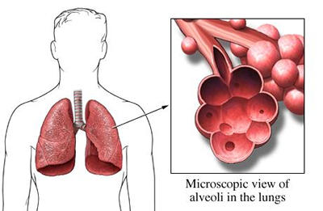
Etiological agents
Infectious:
Bacterial
Fungal
Viral
Parasitic
Non-infectious like:
Chemical
Allergen related

Slide 6
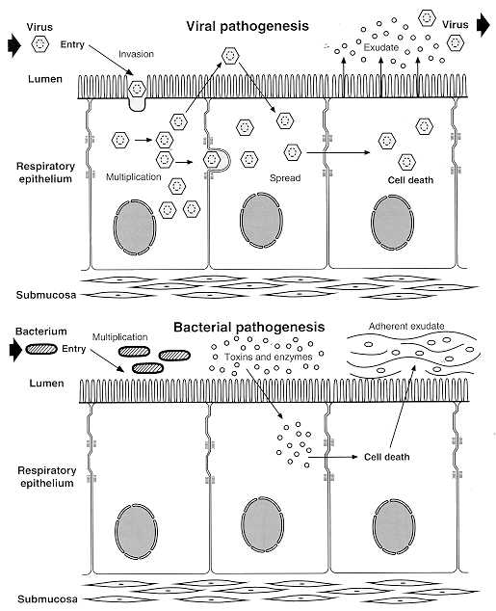
Pathogenesis
Two factors involved in the formation of pneumonia
Pathogens
Host defenses.

Slide 7
Defense mechanism of respiratory tract
Filtration and deposition of environmental pathogens in the upper airways
Cough reflux
Mucociliary clearance
Alveolar macrophages
Humoral and cellular immunity
Oxidative metabolism of neutrophils

Slide 8
Pathophysiology
Inhalation or aspiration of pulmonary pathogenic organisms into a lung segment or lobe.
Results from secondary bacteraemia from a distant source, such as Escherichia coli urinary tract infection and/or bacteraemia (less commonly).
Aspiration of oropharyngeal contents (multiple pathogens).

Slide 9
Classification
Pneumonia classified according to:
Pathogen
Bacterial
Typical
Atypical
Viral
Fungal
Parasite
Anatomy
Acquired environment

Slide 10
Classification by anatomy
1. Lobar: entire lobe
2. Lobular: (bronchopneumonia).
3. Interstitial

Slide 11
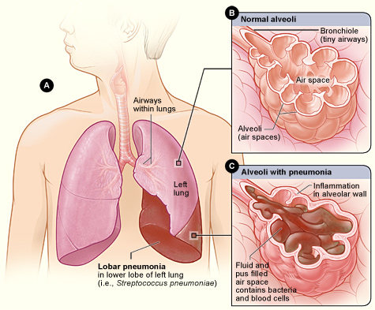
Lobar pneumonia

Slide 12
Classification by acquired environment
Community acquired pneumonia (CAP)
Hospital acquired pneumonia (HAP)
Nursing home acquired pneumonia (NHAP)

Slide 13
CAP- fever+ productive cough + infiltrate
CAP : pneumonia acquired outside of hospitals or extended-care facilities
Typical
Atypical
Strept. pneumoniae
(lobar pneumonia)
Haemophilus influenzae
Moraxella catarrhalis
S. aureus
Gram-negative organisms
Atypical: not detectable on gram stain; won’t grow on standard media
Mycoplasma pneumoniae
Chlamydia pneumoniae
Legionella pneumophila

Slide 14
Community acquired pneumonia
Strep pneumonia 48%
Viral 23%
Atypical orgs (MP,LG,CP) 22%
Haemophilus influenza 7%
Moraxella catharralis 2%
Staph aureus 1.5%
Gram –ive orgs 1.4%
Anaerobes

Slide 15
Typical pneumonia Clinical manifestation
The onset is acute
Prior viral upper respiratory infection
Respiratory symptoms
Fever
Shaking chills
Cough with sputum production (rusty-sputum)
Chest pain- or pleurisy
Shortness of breath

Slide 16
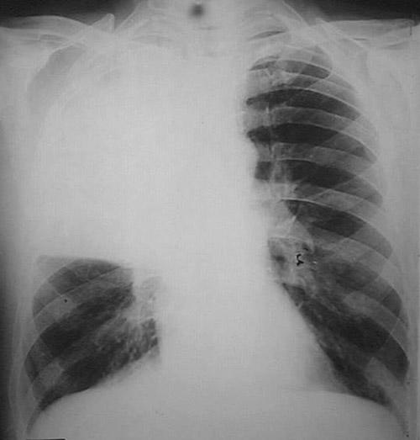
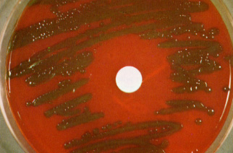
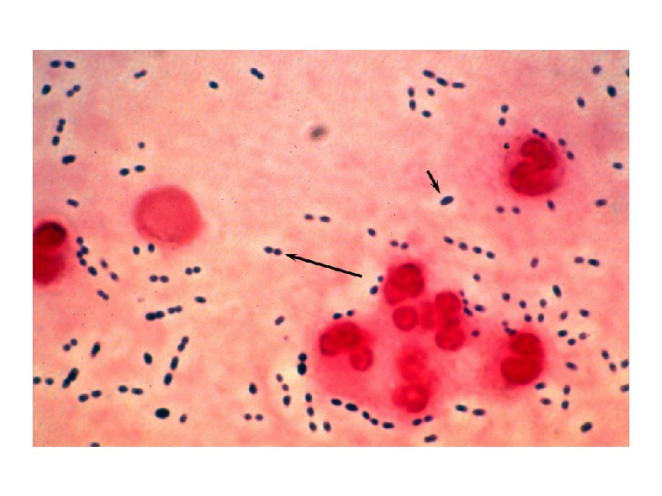
Diagnosis
Clinical
History & physical
X-ray examination
Laboratory
CBC- leukocytosis
Sputum
Gram stain- 15%
Culture
Blood culture- 5-14%
Pleural effusion gram + culture
Pneumococcal pneumonia

Slide 17
Streptococcus pneumoniae
Gram positive diplococci
Alpha hemolytic streptococci
Catalase negative
Normal flora of upper respiratory tract in 20-40% of people
Causes:
Resp infections
pneumonia, sinusitis, otitis,
Non resp infections
bacteremia, meningitis
Notes:
> 90 capsular types

Slide 18
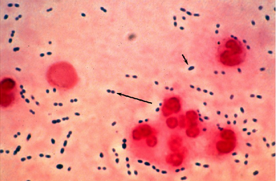
Streptococcus pneumoniae
Virulence factors:
Capsule
More than 90 capsular types
Pneumolysin
Autolysin
Neuraminidase
Prevention: vaccination
Notes:
>90 capsular types
-Pneumolysin: pore forming toxin, also stimulates cytokines and disrupts the cilia of respiratory epithelial cells released on lysis of organism by autolysin
-Neuraminidase cleaves sialic acid

Slide 19
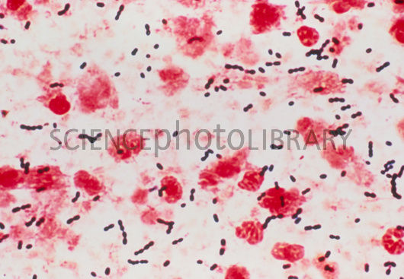
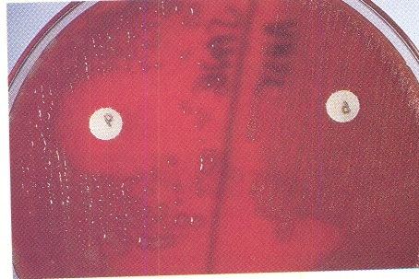
Streptococcus pneumoniae
Sensitive to Optochin
Lysed by bile (bile soluble)

Slide 20
Atypical pneumonia
Chlamydia pneumonia
Mycoplasma pneumonia
Legionella spp
Psittacosis (Chlamydia psittaci)
Q fever (Coxiella burnettii)
Approximately 15% of all CAP
Not detectable on gram stain
Won’t grow on standard media
Most don’t have a bacterial cell wall→ Don’t respond to β-lactams

Slide 21
Atypical pneumonia
Symptoms
Signs
Insidious onset
Mild to severe
Headache
Malaise
Fever
Dry cough
Arthralgia / myalgia
Minimal
Low grade fever
Few crackles
Rhonchi

Slide 22
Diagnosis & Treatment
Diagnosis:
X-ray
CBC
Mild elevation WBC
U&Es
Low serum Na (Legionalla)
LFTs
↑ ALT
↑ Alk Phos
Sputum Culture on special media (BCYE) for Legionella
Urine antigen for Legionella
Serology for detecting antibodies
DNA detection
Treatment:
Macrolide
Quinolones
Tetracycline
B lactams have no activity
Treat for 10-14 days

Slide 23
Mycoplasma pneumonia
Eaton’s agent (1944)
No cell wall
Common
Rare in children and in > 65
People younger than 40.
Crowded places like schools, homeless shelters, prisons.
Can cause URT symptoms
Usually mild and responds well to antibiotics.
Can be very serious
May be associated with extra pulmonary findings:
skin rash, hemolysis, myocarditis, pancreatitis, encephalitis
Diagnosis:
Serology
NAAT
Culture can be done but requires special media and slow grower (weeks)
Notes:
Cold agglutinins test not specific but can be helpful
NAAT: Nucleic acid amplification tests. Done on throat or Np (nasopharynx) swab

Slide 24
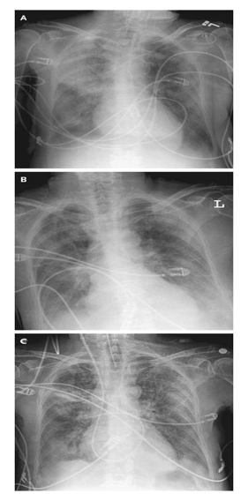
Mycoplasma pneumonia Cx-ray

Slide 25
Chlamydia pneumonia
Obligate intracellular organism
50% of adults sero-positive
Mild disease
Sub clinical infections common
5-10% of community acquired pneumonia
Diagnosis:
Serology
NAAT
Notes:
Diagnosis can be made using serology or NAAT

Slide 26
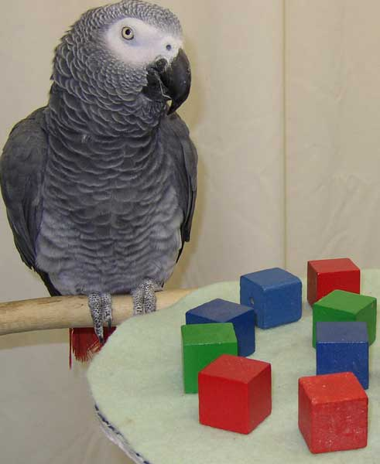
Psittacosis
Chlamydia psittaci
Exposure to birds
Bird owners, pet shop employees, vets
Parrots, pigeons and poultry
Birds often asymptomatic

Slide 27
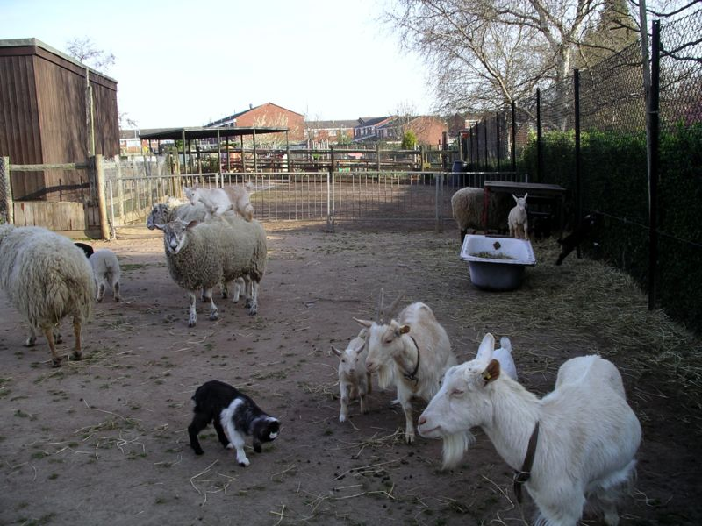
Q fever (Coxiella burnetti)
Exposure to farm animals mainly sheep
Spread by inhalation of infected animal birth products
Pneumonia is acute form of infection
Diagnosis: serology

Slide 28
Legionella pneumophila
Legionnaire's disease
Serious outbreaks linked to exposure to cooling towers
Can be very severe and lead to ICU admission.
Can cause
Hyponatraemia common
(<130mMol)
Bradycardia
WBC < 15,000
Abnormal LFTs
Raised CPK
Acute Renal failure

Slide 29
Legionella pneumophila
Diagnosis:
Specimen: sputum
Culture on specialized media (BCYE)
DFA (low sensitivity)
NAAT
Urine antigen testing
Pontiac fever:
Non pneumonic
Influenza like illness
Self limiting
Related to exposure to environmental aerosols containing Legionella (potentially reaction to bacterial endotoxins)
Notes:
DFA: direct florescent antibody testing
NAAT: Nucleic acid amplification tests.

Slide 30
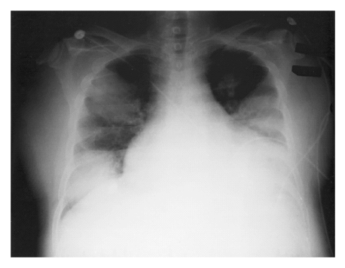
Legionnaires in ICU

Slide 31
Antibiotic Treatment of CAP
Factors to consider in selection of antibiotic:
Co morbidities
Previous antibiotic exposure in last 3 months
Severity
Out patient management vs requiring inpatient admission vs requiring ICU

Slide 32
 |  | Macrolides | Doxycycline | Levofloxacin | B-lactam And Macrolide | B-lactam And Levo
Outpatient, healthy patient with no exposure to antibiotics in the last 3 months | -S. pneumoniae -Atypical pathogens -Viral
Outpatient, patient with comorbidity or exposure to antibiotics in the last 3 months | As above + Anaerobes S. aureus
Inpatient : Not ICU | Same as above + coliforms
Inpatient : ICU | Same as above + Pseudomonas
Notes:
Treatment of CAP

