Slide 1
Bronchial Asthma
RESPIRATORY BLOCK
Dr. Maha Arafah
Department of Pathology
KSU
marafah@ksu.edu.sa
Jan 2018

Slide 2
Objectives
Define asthma (BA)
Know the two types of asthma
1. Extrinsic or atopic allergic
2. Intrinsic asthma.
Understand the pathogenesis of BA
Understanding the morphological changes (gross and microscopic) seen in the lungs in asthmatic patient.
Know the manifestation and clinical coarse of BA
List the complications of BA
Define status asthmaticus
Know the prognosis and prevention of BA

Slide 3
DEFINITION
BRONCHIAL ASTHMA (BA)
BA is an episodic, reversible bronchoconstriction caused by increased responsiveness of the tracheobronchial tree to various stimuli.
There is an increased irritability of the bronchial tree with paroxysmal narrowing of the airways, which may reverse either spontaneously or after treatment with bronchodilators.
It is a chronic relapsing inflammatory obstructive lung disease

Slide 4
BRONCHIAL ASTHMA (BA)
DEFINITION
bronchospasm, oedema and mucous plugging
4 features:
Intermittent and reversible airway obstruction
Chronic bronchial inflammation with eosinophils
Bronchial smooth muscle cell hypertrophy and hyper-reactivity
Increased mucus secretion
Primarily targets: the bronchi and terminal bronchioles
Most common chronic respiratory disease in children.
(More common in children than adults)
Asthma animation: https://www.youtube.com/watch?v=7EDo9pUYvPE

Slide 5
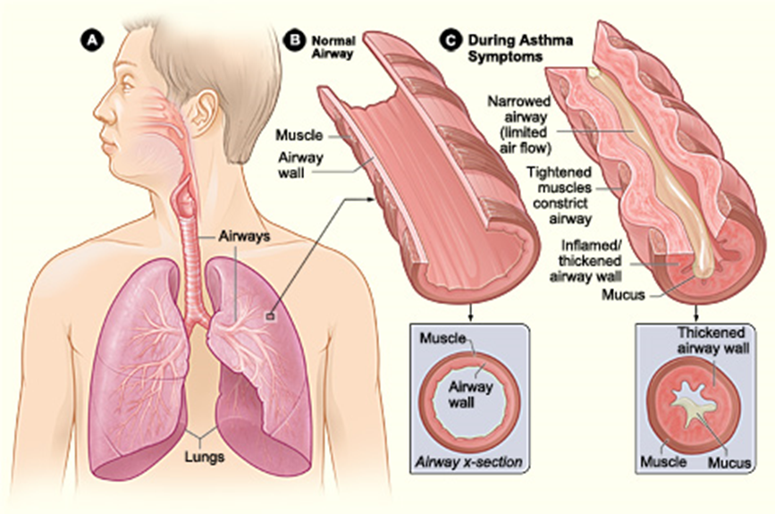

Slide 6
Bronchial asthma : It has been divided into two basic types: 1. Extrinsic asthma. 2. Intrinsic asthma. Sometimes extrinsic and intrinsic can co-exist in the same patient
Types
Extrinsic (atopic, allergic) Asthma 70%
- Initiated by type 1 hypersensivity reaction induced by exposure to extrinsic antigen/allergens e.g. food, pollen, dust, etc.
- Subtypes include:
atopic (allergic)asthma.
occupational asthma.
allergic bronchopulmonary aspergillosis.
- Develop early in life
Intrinsic (non-atopic) Asthma 30%
- Initiated by diverse, non-immune mechanisms e.g. infections, drugs like aspirin, pollutants, inhaled chemical irritants, cold, stress and exercise.
- No personal or family history of allergic reaction.
- Develop later in life

Slide 7
Extrinsic/ Allergic BA
Other names:
allergic asthma
immune mediated asthma
atopic asthma
reaginic asthma.
Bronchospasm is induced by inhaled antigens, usually in children with a personal or family history of allergic disease
Symptoms are brought about by IgE mediated type I hypersensitivity reaction to inhaled allergens.
Serum levels of IgE and eosinophils usually are elevated.

Slide 8
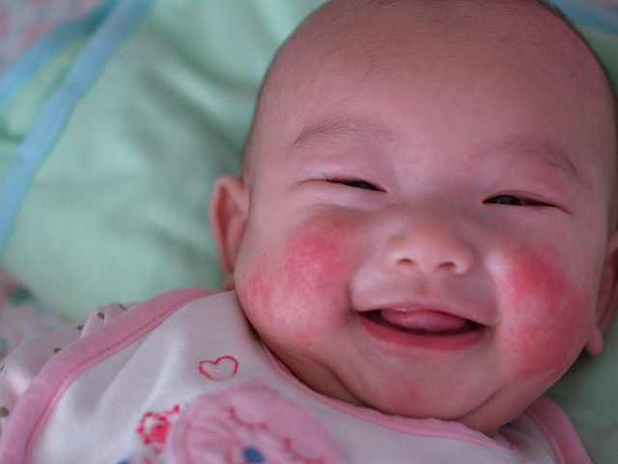
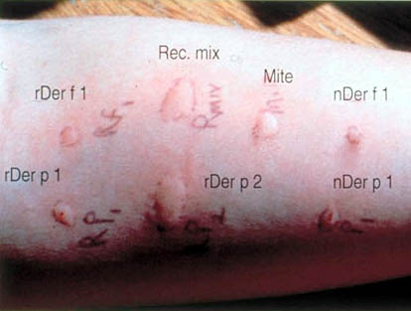
Extrinsic/ Allergic BA
Atopic (allergic) asthma is the most common type and begins in childhood
Other allergic manifestation may be present: allergic rhinitis, urticaria, eczema or hay fever.
Skin test with antigen is positive and results in an immediate wheel and flare reaction
eczema
wheel and flare reaction

Slide 9
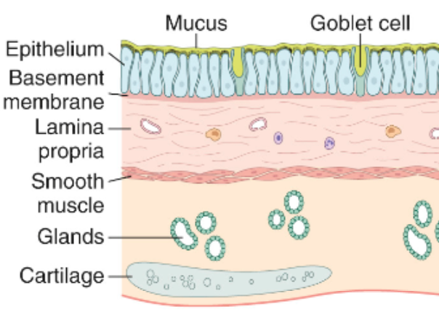
Pathogenesis of Bronchial Asthma Inflammation
Pathogenesis of BA
Normal
Asthma

Slide 10
Pathogenesis of Bronchial Asthma
Pathogenesis of BA
Principal cells in asthma: mast cells, eosinophils, epithelial cells, macrophages, and activated T lymphocytes (TH2 subset) and neutrophils.
T lymphocytes play an important role in the regulation of airway inflammation through the release of numerous cytokines
The pathogenetic mechanisms have been best studied in atopic asthma

Slide 11
Pathogenesis of BA
Pathogenesis of BA
IL-4 plays a role in cross-linking of immunoglobulins in B lymphocytes, promote production of IgE and mast cells
IL-5 stimulates production and activation (recruitment) of eosinophils

Slide 12
Pathogenesis of Bronchial Asthma using type 1 IgE-mediated Atopic Asthma as a model
Pathogenesis of BA
First there is initial sensitization or priming: first time exposure to an inhaled allergen which stimulates induction of Th2-type T cells (CD4 T_{H}2) to produce cytokines(interleukin IL- 4, IL-5 and IL-13)
IL-4 plays a role in cross-linking of immunoglobulins in B lymphocytes, promote production of IgE and mast cells.
IL-5 stimulates production and activation (recruitment) of eosinophils.
IL-13 is needed for IgE formation.
And then there is subsequent re-exposure to the allergen will leads to an IgE mediated reaction.
This IgE-mediated reaction to inhaled allergens elicits:
1. an acute response (within minutes)
2. a late phase reaction (after 4-8 hours)

Slide 13
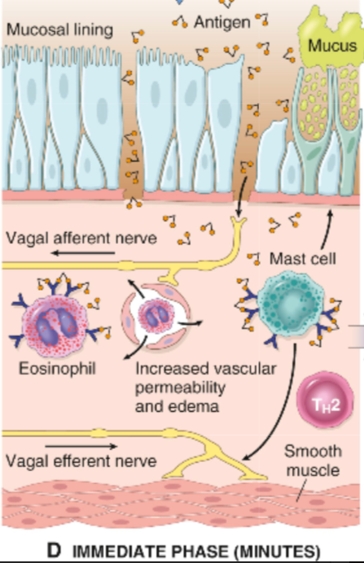
Pathogenesis of BA
Acute-phase response
Begin 30 to 60 minutes after inhalation of antigen/aeroallrgens
(e.g. allergens, drugs, cold, exercise)
The exposure results in the stimulation and degranulation of mast cells, eosinophils, and basophils with the release of inflammatory mediators from these cells and also from activated macrophages.
The released mediators induce:
bronchoconstriction/spasm
increased vascular permeability,
inflammation and injury of the bronchial walls and bronchial epithelium
excess mucous secretion.

Slide 14
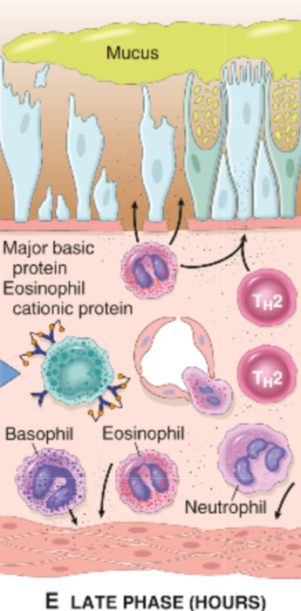
Pathogenesis of BA
Late phase reaction/ late asthmatic response:
Occurs 6-24 hours following allergen exposure.
The arrival of leukocytes at the site of mast cell degranulation leads to release of more mediators to activate more mast cells
Discharge of eosinophil granules releases major basic protein, eosinophilic cationic protein and eosinophil peroxidase into the bronchial lumen. These substances are toxic to epithelial cells.
Eotaxin is secreted by injured bronchial mucosal lining cells and helps in the eosinophils recruitment
Moreover, chemotactic factors like leukotriene B_{4,} eosinophil chemotactic factor and PAF recruit more eosinophils, neutrophils and platelets to the bronchial wall
The vicious circle continues and prolongs and amplifies the asthmatic attack.
All these factors amplify and sustain injury without additional antigen.

Slide 15
Intrinsic / Non-Atopic/ Idiosyncratic BA (non-immune mediated asthma)
Pathogenesis of BA
Intrinsic asthma is a disease of adults in which the bronchial hyper-reactivity is precipitated by a variety of factors unrelated to immune mechanisms.
It has an unknown basis.
Symptoms are precipitated by non allergic factors such as inhaled irritants/pollutants (e.g. sulfur dioxide, ozone) or infection(viruses).
Positive family history is uncommon.
Serum IgE – normal.
No other associated allergies.
Skin test – negative.
Subtypes:
1. Drug-induced asthma (aspirin or nonsteroidal drug sensitivity).
2. Occupational asthma(fumes, dusts, gases)

Slide 16
Pathogenesis of BA

Slide 17
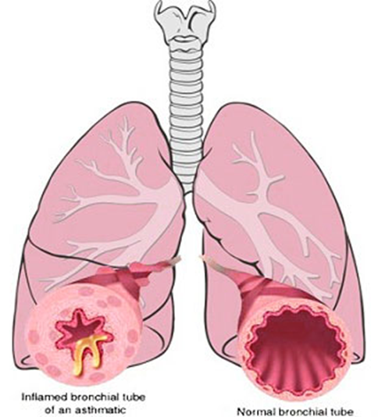
Morphology of Asthma: the pathologic findings are similar in both types BA
Morphology of Asthma
Grossly: - lung over distended (over inflation), occlusion of bronchi and bronchioles by thick mucous.
the bronchi have thickened walls with narrowed lumina and generally are filled with plugs of mucus in acute attack

Slide 18
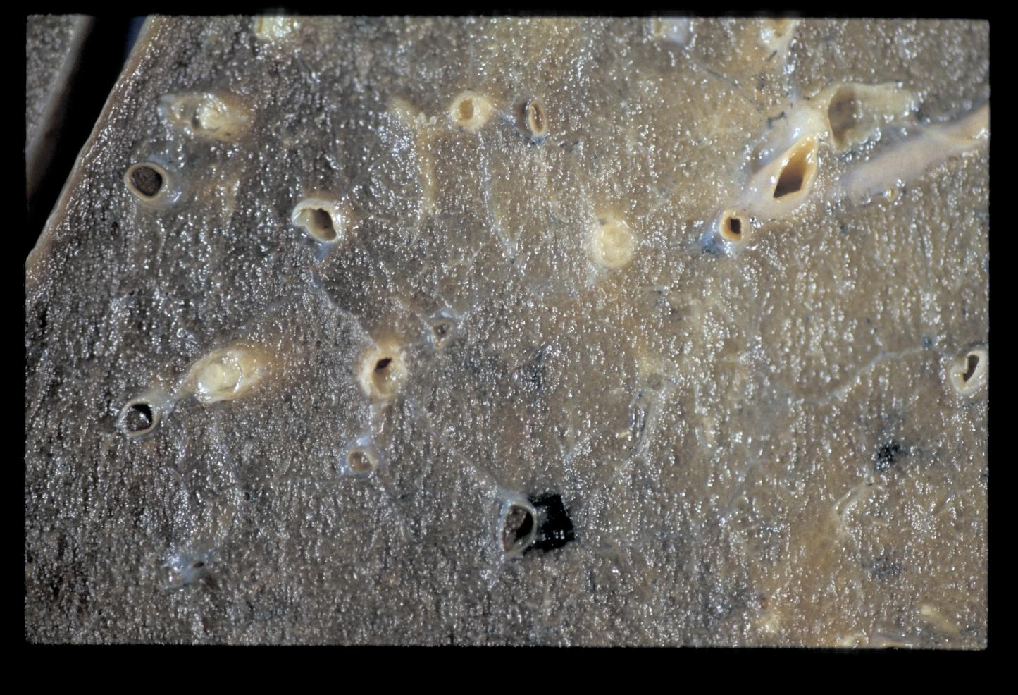
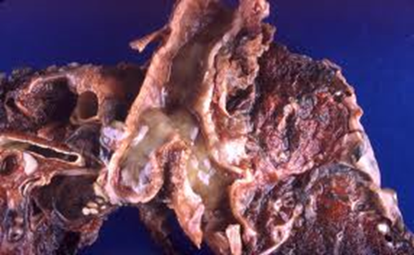
Morphology of Asthma
Mucus plugs

Slide 19
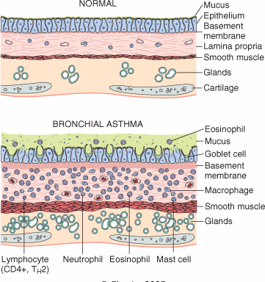
Morphology of Asthma
Morphology of Asthma
Histologic finding:
Thick Basement Membrane.
Edema and inflammatory infiltrate in bronchial wall.
Submucosal glands increased.
Hypertrophy of the bronchial wall muscle.
mucous contain Curschmann spirals, eosinophil and Charcot-Leyden crystals.

Slide 20
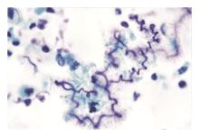
Curschmann spirals
Morphology of Asthma
Coiled, basophilic plugs of mucus formed in the lower airways and found in sputum and tracheal washings

Slide 21
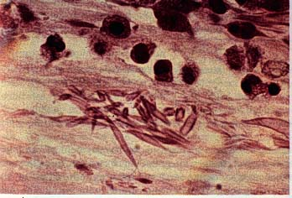
Charcot-Leyden crystals.
Morphology of Asthma
Eosinophilic needle-shaped crystalline structures.

Slide 22
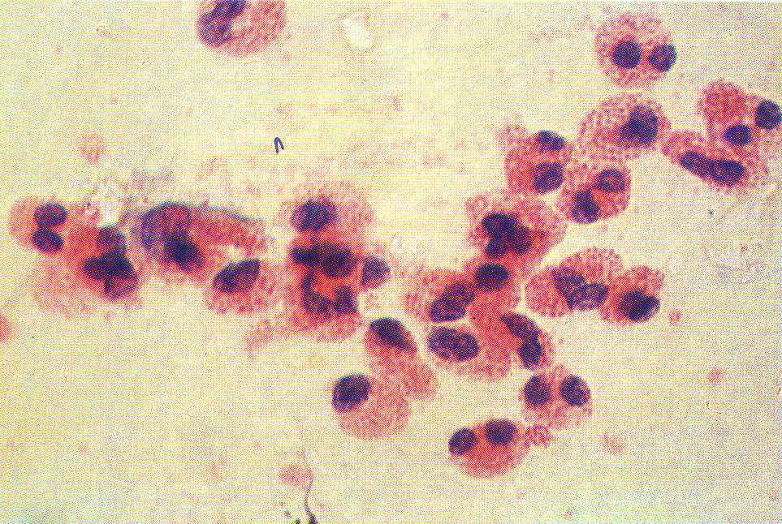
Morphology of Asthma
Eosinophils from a case of Bronchial Asthma

Slide 23
Morphology of Asthma

Slide 24
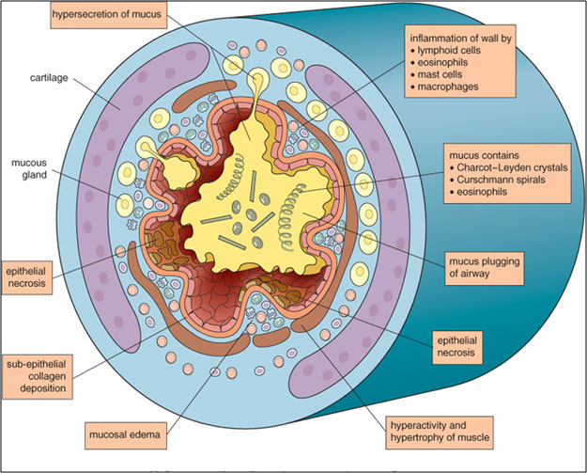
Morphology of Asthma

Slide 25
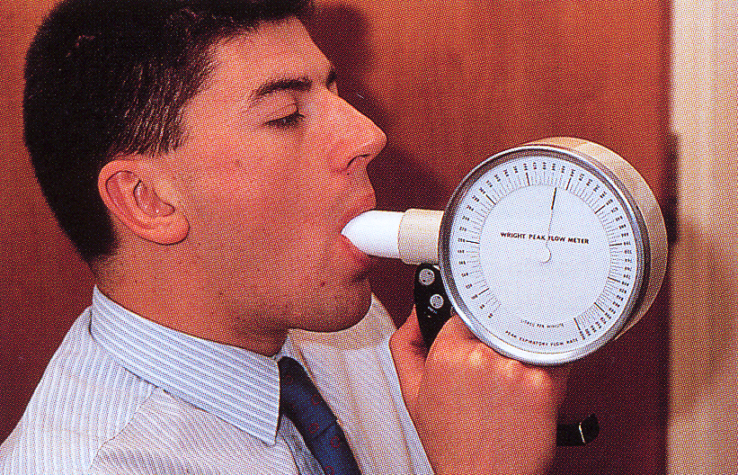
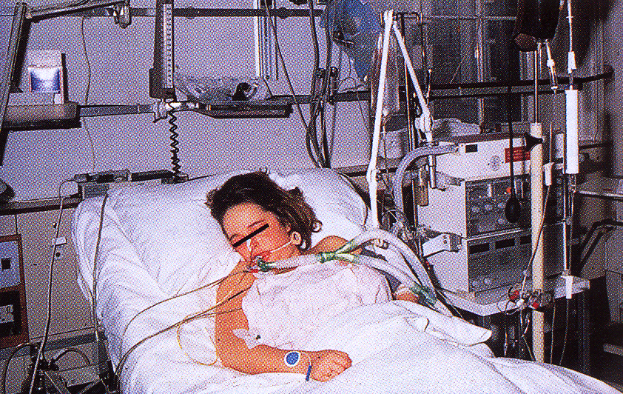
CLINICAL COURSE of BA
Clinical features of Asthma
The clinical manifestations vary from occasional wheezing to paroxysms of dyspnea and respiratory distress.
In a classic asthmatic attack there is dyspnea, cough, difficult expiration, progressive hyperinflation of lung and mucous plug in bronchi. This may resolve spontaneously or with treatment.
Nocturnal cough
Increased anteroposterior diameter, due to air trapping and increase in residual volume
Status asthmaticus – severe cyanosis and persistent dyspnea, may be fatal
The range of presentation in asthma.
medical emergency with acute severe breathlessness, diagnosed as a case of status asthmaticus which required immediate intensive care including intermittent positive-pressure ventilation.
This patient was found incidentally to have a degree of reversible airways obstruction during a routine medical examination.

Slide 26
STATUS ASTHMATICUS
Clinical features of Asthma
It is the most severe form of asthma. It refers to severe bronchoconstriction that does not respond to the drugs that usually abort the acute attack.
This situation is potentially serious and requires hospitalization. Patients in status asthmaticus have hypoxemia and often hypercapnia.
In particularly severe episodes the ventilatory functions may be so impaired so as to cause severe cyanosis and even death.
They require oxygen and other pharmacologic interventions.
It may persists for days and even weeks.

Slide 27
COMPLICATIONS OF ASTHMA
Complications of Asthma
Airway remodeling: some persons with long standing asthma develop permanent structural changes in the airway with hypertrophy of muscle and progressive loss of lung function that increase airflow obstruction and airway responsiveness.
Superimposed infection i.e. pneumonia
Chronic bronchitis (i.e.Asthmatic bronchitis: chronic bronchitis with superimposed asthma)
Emphysema, pneumothorax and pneumomediastinum
Bronchiectasis
Respiratory failure requiring intubation in severe exacerbations i.e. status asthmaticus
In some cases cor pulmonale and heart failure develop.

Slide 28
Prognosis of Asthma
Prognosis
Approximately half the children diagnosed with asthma in childhood outgrow their disease by late adolescence or early adulthood and require no further treatment.
Patients with poorly controlled asthma develop long-term changes over time (i.e. with airway remodeling). This can lead to chronic symptoms and a significant irreversible component to their disease.
Many patients who develop asthma at an older age also tend to have chronic symptoms.

Slide 29
Prognosis
Prognosis of Asthma
Remission—approximately 50% of cases of childhood asthma resolve spontaneously but may recur later in life; remission in adult-onset asthma is less likely.
Mortality—death occurs in approximately 0.2% of asthmatics. Mortality is usually (but not always) preceded by an acute attack and about 50% are more than 65 years old.

Slide 30
Prevention of Asthma
Prevention
Control of factors contributing to asthma severity. Exposure to irritants or allergens has been shown to increase asthma symptoms and cause exacerbations.
Clinicians should evaluate patients with persistent asthma for allergen exposures and sensitivity to seasonal allergens. Skin testing results should be used to assess sensitivity to common indoor allergens.
All patients with asthma should be advised to avoid exposure to allergens to which they are sensitive.

Slide 31
Summary: Asthma: Episodic attacks of bronchoconstriction
Types
Extrinsic asthma: Type 1 Hypersensitivity reaction, IgE, childhood, family Hx of allergy.
Morphology
Hypertrophy of bronchial smooth muscle & hyperplasia of goblet cells e eosinophils, thickened basement membrane
Mucous plug e Curschmann spirals & Charcot-Leyden crystals.
Complication
Superimposed infection
Chronic bronchitis
Pulmonary emphysema
Status asthmaticus
Intrinsic asthma: associated e intake of aspirin, exercise, cold induced. No Hx of allergy

