Slide 1
Chronic obstructive pulmonary disease (COPD)
Respiratory block
2018
Pathology
Dr. Maha Arafah and Prof. Rikabi

Slide 2
Objectives:
Give introduction for diffuse lung disease
Explain why emphysema and bronchitis are both considered to be examples of chronic obstructive pulmonary disease (COPD).
Compare and contrast the major clinical and functional differences between predominant chronic bronchitis versus predominant emphysema in patients with COPD
Chronic Bronchitis
Define chronic bronchitis.
Describe the pathogenesis and the morphology of chronic bronchitis.
Describe the mechanism of airway obstruction in a patient with chronic bronchitis.
Understand that when severe obstruction is present in chronic bronchitis, significant emphysema is nearly always present
Emphysema
Define emphysema.
Describe the gross and microscopic changes in emphysema.
Discuss the typical clinical presentation and causes of death.
Describe the most likely mechanism of emphysema (the protease-antiprotease mechanism).
Describe the pathophysiologic mechanisms of emphysema
Define Bronchiectasis and its causes, presentation, morphology and significant.

Slide 3
Introduction for diffuse lung disease
Spirometer
is an equipments used for measuring the volume of air inspired and expired by the lungs ( Pulmonary Function Tests)

Slide 4
Introduction for diffuse lung disease
Forced expiratory volume (FEV1):
Volume of air blown out forcibly in 1 second.
A function of large airways.

Slide 5
Obstructive and Restrictive Pulmonary Diseases
Introduction for diffuse lung disease
Diffuse pulmonary diseases are divided into:
1. Obstructive disease:
characterized by limitation of airflow owing to partial or complete obstruction at any
level from trachea to respiratory bronchioles.
Pulmonary function test:
limitation of maximal
airflow rate during forced expiration (FEVI).
2. Restrictive disease: characterized by reduced expansion of lung parenchyma with decreased total lung capacity while the expiratory flow rate is near normal.
Occur in:
1. Chest wall disorder.
2. Acute or chronic, interstitial and infiltrative diseases,
e.g. ARDS and pneumoconiosis.

Slide 6
Introduction for diffuse lung disease

Slide 7
Introduction for diffuse lung disease

Slide 8
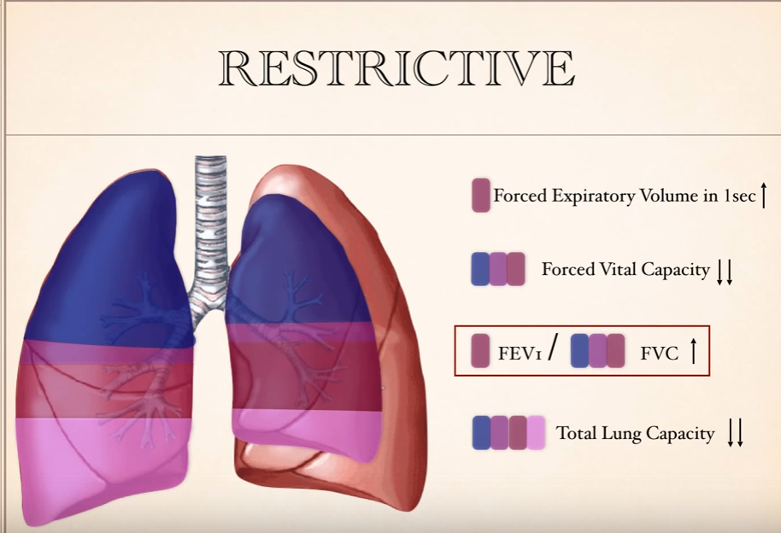
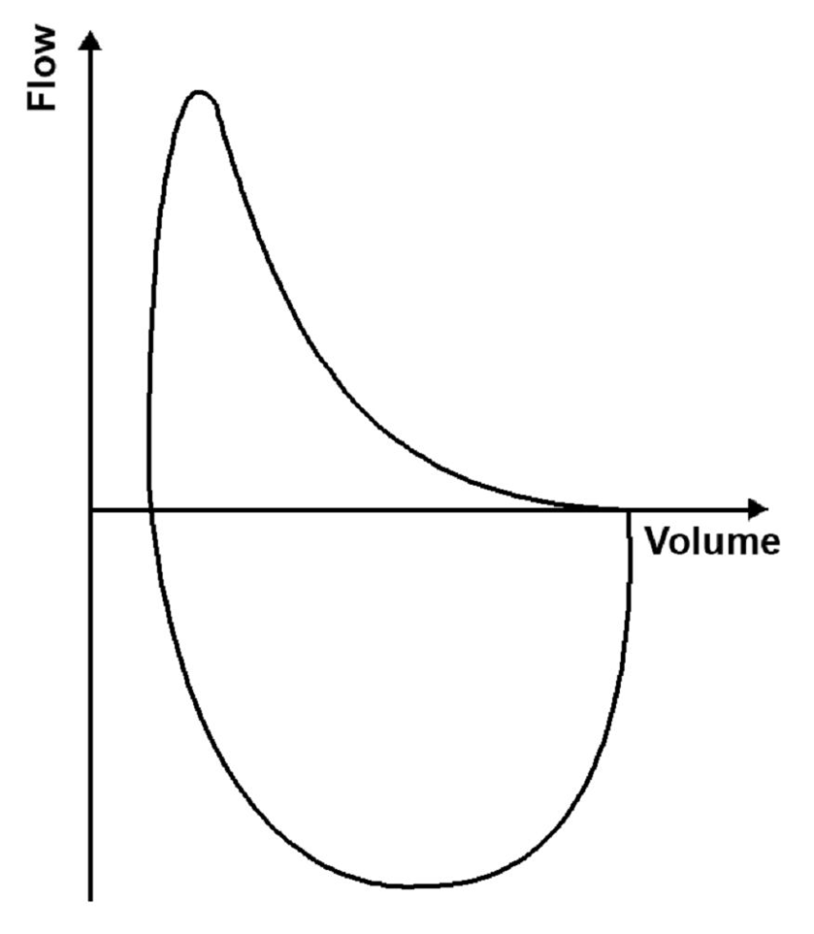
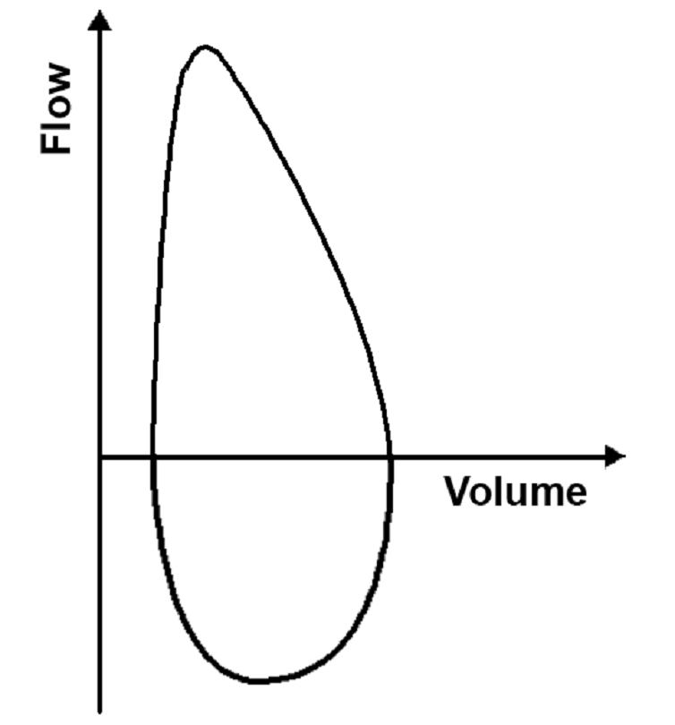
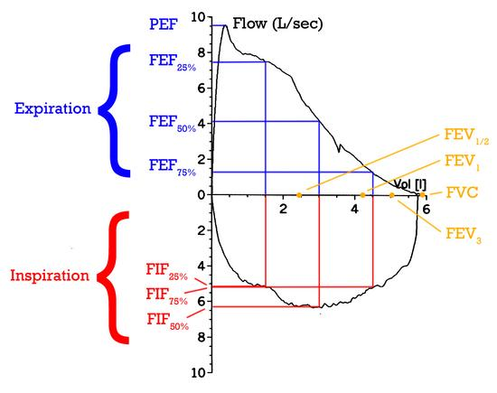
Introduction for diffuse lung disease
Normal

Slide 9
Chronic obstructive Pulmonary Disease (COPD) =Chronic obstructive airway disease (COAD) =Chronic obstructive lung disease (COLD)
Obstructive lung disease
COPD:
Irreversible obstruction to airflow out of the lungs
Cigarette smoking is the principal cause of COPD
Greater than 10% of the population >45 years old has airflow obstruction.
Majority of patients with COPD have both emphysema (air space destruction) and chronic bronchitis

Slide 10
Obstructive Lung Diseases
Obstructive lung disease
(diffuse)
Common symptoms in lung disease
Dyspnea: difficulty with breathing
Cough
Hemoptysis
Bronchial Asthma
2) Chronic obstructive pulmonary disease (COPD) They are of two types:
a) Chronic bronchitis
b) Emphysema
3) Bronchiectasis

Slide 11
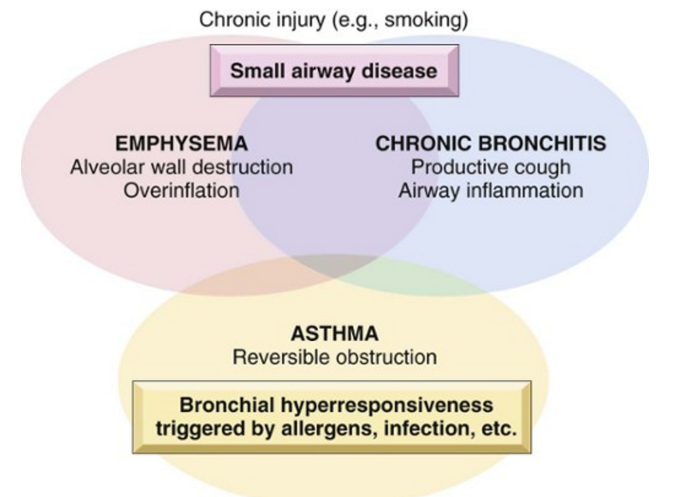
Obstructive lung disease

Slide 12
Chronic Bronchitis
Chronic Bronchitis
Define chronic bronchitis.
Describe the pathogenesis and the morphology of chronic bronchitis.
Describe the mechanism of airway obstruction in a patient with chronic bronchitis.
Understand that when severe obstruction is present in chronic bronchitis, significant emphysema is nearly always present

Slide 13
Chronic Bronchitis
Define chronic bronchitis
The definition of chronic bronchitis is based on clinical features
Persistent productive cough (with sputum) for at least 3 consecutive months in at least 2 consecutive years

Slide 14
Chronic bronchitis
Chronic Bronchitis: causes
Causative factor are:
Cigarette smoking and pollutants. Most patients are smokers
Infection
Genetic factors e.g. cystic fibrosis
Age: 40 to 65

Slide 15
Chronic bronchitis
Chronic Bronchitis: pathogenesis
Pathogenesis
Chronic irritation of inhaled substances or microbial infection leads to:
Hypersecretion of mucus that starts in the large airways with associated hypertrophy of the sub-mucosal glands and inflammation.
Infection. Infection does not initiate chronic bronchitis, but is probably significant in maintaining it and may be critical in producing acute exacerbations.
As chronic bronchitis persists the small bronhi and bronchioles also get affected leading to irreversible bronchiolar wall fibrosis

Slide 16
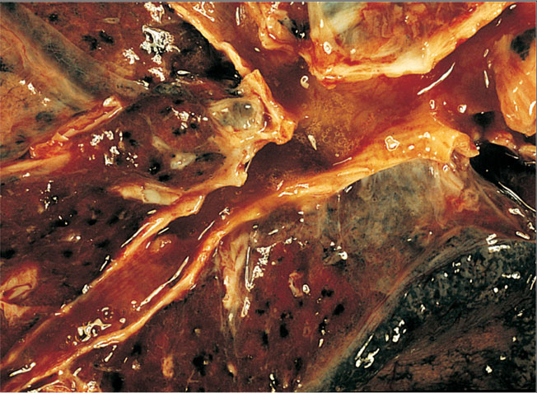
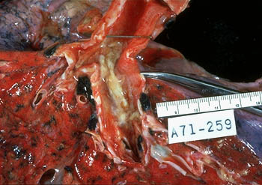
Chronic bronchitis: Pathologic findings
Chronic Bronchitis: morphology
Chronic bronchitis does not have characteristic pathologic findings
In bronchitis the airway mucosa is red and edematous

Slide 17
Chronic bronchitis: morphology
Chronic Bronchitis: morphology
Inflammation of airways, fibrosis and narrowing of bronchioles
Hypertrophy and hyperplasia of mucus producing cells increased number of goblet cells
Squamous metaplasia which can progress to dysplasia and even invasive carcinoma
Injury to cilia with loss of ciliated epithelial cells
Coexistent emphysema
How do these changes differ from the changes seen in a typical case of allergic asthma?
A typical allergic asthma, which also has mucous gland hyperplasia, the bronchial wall has an inflammatory infiltrate in which eosinophils are prominent.
There is also hypertrophy and hyperplasia of smooth muscle cells in asthma.

Slide 18
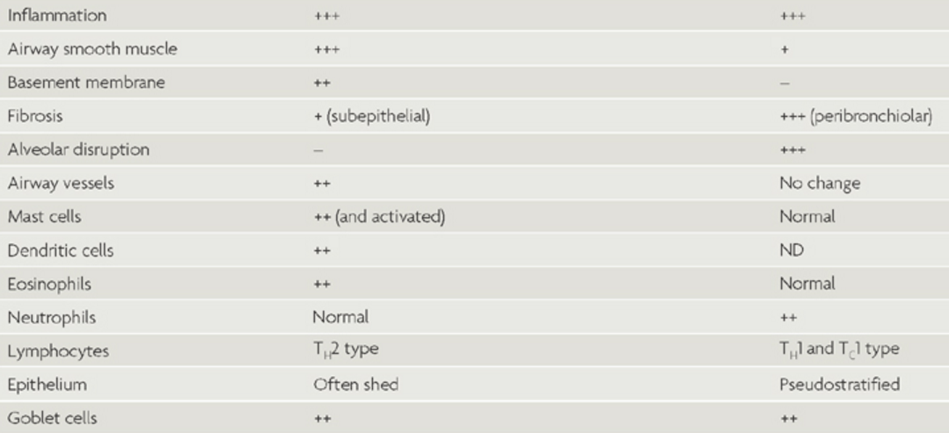
Chronic Bronchitis: Morphology

Slide 19
Chronic bronchitis: Clinical Course
Chronic Bronchitis: Clinical
Prominent cough and the production of sputum.
Hypercapnia, hypoxemia and cyanosis.
Patients with severe chronic bronchitis are termed blue bloaters.
Patients can have:
increased sleepiness due to CO2 narcosis
cyanosis due to very poor oxygenation
elevated red cell counts (secondary polycythemia) as a result of chronic hypoxemia
Cardiac failure (Cor pulmonale/right heart failure): diseases of the lung or pulmonary vasculature leads to pulmonary hypertension which leads to right ventricular dilation and hypertrophy (right heart failure).
Patients with chronic bronchitis and COPD have frequent exacerbations, more rapid disease progression, and poorer outcomes than those with emphysema alone

Slide 20
Chronic Bronchitis: SUMMARY
Chronic Bronchitis: defined as persistent productive cough for at least 3 consecutive months in at least 2 consecutive years
Causes
Cigarette smoking is the most important risk factor; air pollutants also contribute
Features
enlargement of mucous-secreting glands, goblet cell hyperplasia, chronic inflammation, and bronchiolar wall fibrosis.
Complications
Persistent reproductive cough. dyspnea on exertion, hypercapnia, hypoxemia, cyanosis and cor pulmonale
Death may result from further impairment of respiratory function due to superimposed acute infections.

Slide 21
Emphysema Permanent enlargement of all or part of the respiratory unit
Emphysema
Define emphysema.
Describe the gross and microscopic changes in emphysema.
Discuss the typical clinical presentation and causes of death.
Describe the most likely mechanism of emphysema (the protease-antiprotease mechanism).
Describe the pathophysiologic mechanisms of emphysema

Slide 22
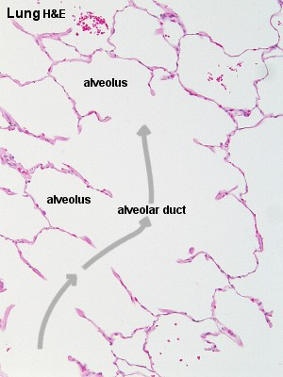
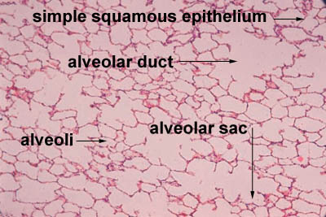
normal
Emphysema

Slide 23
Emphysema
Emphysema: Definition
Is abnormal permanent enlargement of the airspaces distal to the terminal bronchioles accompanied by destruction of their walls, without obvious fibrosis
Element of chronic bronchitis coexists
“Dilatation” is due to destruction and loss of alveolar walls (tissue destruction)
Appears as “holes” in the lung tissue
Emphysema Impairs respiratory function:
- Diminished alveolar surface area for gas exchange (decreased Tco)
- Loss of elastic recoil and support of small airways leading to tendency to collapse with obstruction

Slide 24
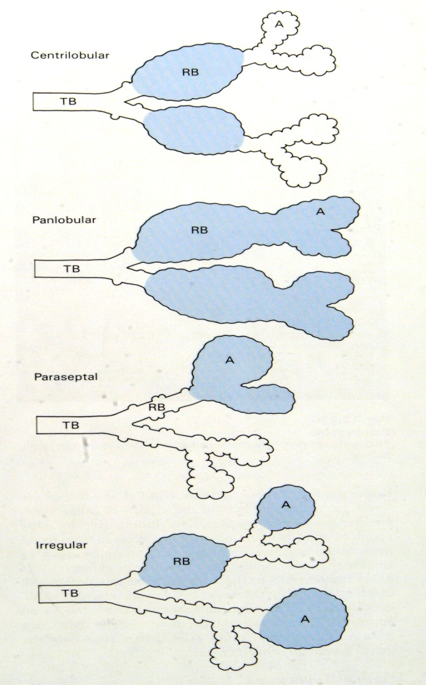
Emphysema: Types
Types of emphysema:
1. Centriacinar
2. Panacinar
3.Distal acinar /paraseptal
4. Irregular

Slide 25
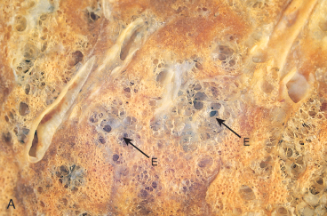
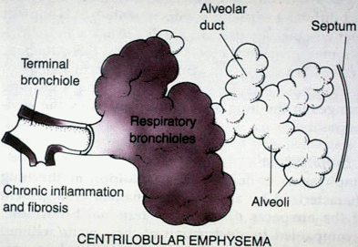
Centriacinar (centrilobular) emphysema
Emphysema: Types
Occur in heavy smoker in association with chronic bronchitis
The central or proximal parts of the acini are affected, while distal alveoli are spared
More common and severe in upper lobes (apical segments)
The walls of the emphysematous
space contain black pigment.
Inflammation around bronchi & bronchioles.

Slide 26
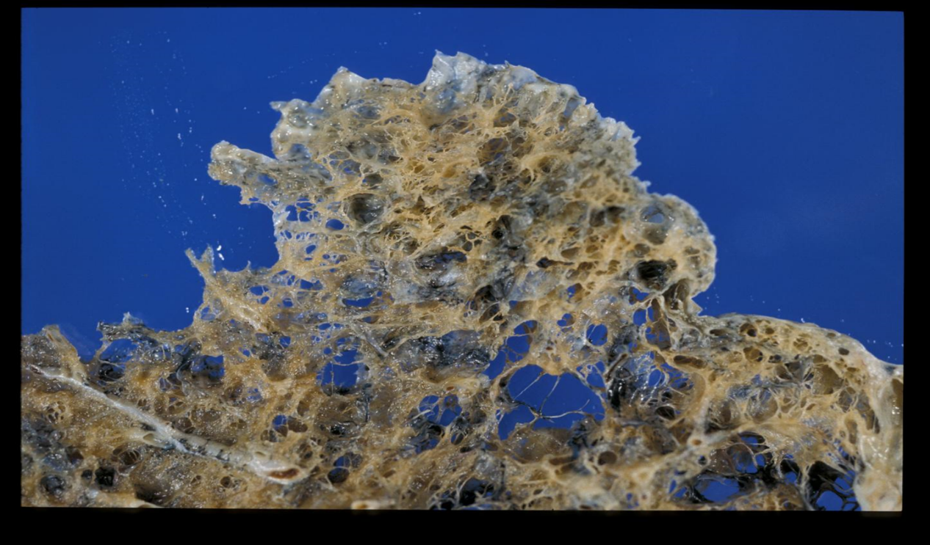
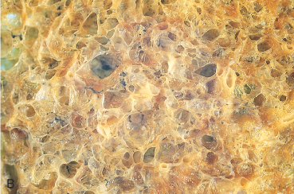
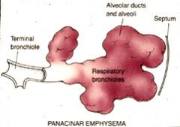
Panacinar (panlobular) emphysema
Emphysema
Emphysema: Types
Cause :Occurs in α₁-anti-trypsin deficiency.
Uniform injury: Acini are uniformly enlarged from the level of the respiratory bronchiole to the terminal blind alveoli.
More commonly in the lower lung zones.

Slide 27
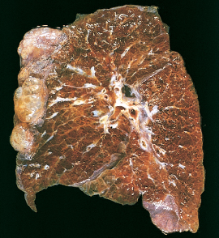
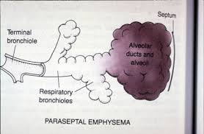
Distal acinar (paraseptal) emphysema
Emphysema
Emphysema: Types
The proximal portion of the acinus is normal but the distal part is dominantly involved.
Occurs adjacent to areas of fibrosis, scarring or atelectasis.
More severe in the upper half of the lungs.
Sometimes forming multiple cyst-like structures with spontaneous pneumothorax.

Slide 28
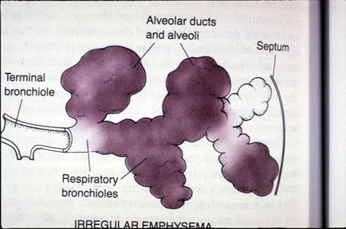
Irregular Emphysema
Emphysema
Emphysema: Types
The acinus is irregularly involved, associated with scarring.
Most common form found in autopsy.
Asymptomatic.
usually a complication of various inflammatory processes including chronic pulmonary tuberculosis

Slide 29
Pathogenesis of Emphysema
Emphysema: Pathogenesis
Is not completely understood
Elastic tissue of the alveolar wall is broken down by action of proteolytic enzymes like protease (e.g.elastase).
Protease is produced by neutrophils and macrophages.
Pathogenesis in α1-anti-trypsin deficiency:
Alpha 1 antitrypsin is an anti-protease (anti-elastase)
is a major inhibitor of proteases.
is normally present in the serum, in tissue fluids and in macrophages.
Normally there is a balance between protease and anti protease activity.
More than 80% of people with genetic deficiency of the α1-anti-trypsin (encoded by a gene in the proteinase inhibitor (Pi) locus on chromosome 14) develop panacinar emphysema.

Slide 30
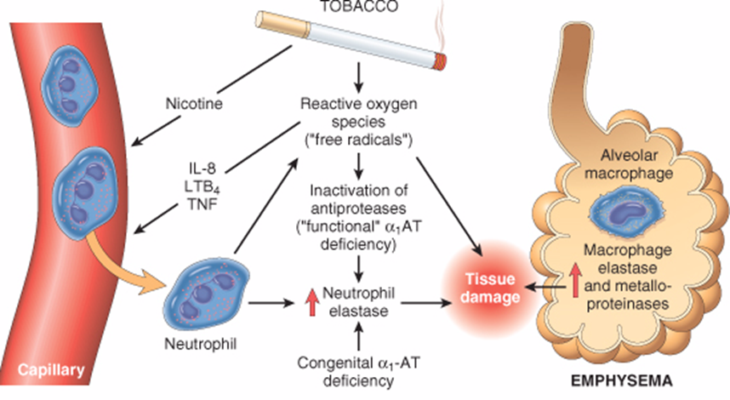
Emphysema
Emphysema: Pathogenesis
Pathogenesis of Emphysema
The protease-antiprotease hypothesis explains the effect of cigarette smoking in the production of centriacinar emphysema
Smokers have increases number of neutrophils and macrophages in their alveoli (increase chemical mediators)
Smoking stimulates release of elastase and enhances elastase activity in macrophages.
Smoking Inhibits alpha 1 antitrypsin.
Tobacco smoke contains reactive oxygen species with inactivation of anti-proteases.

Slide 31
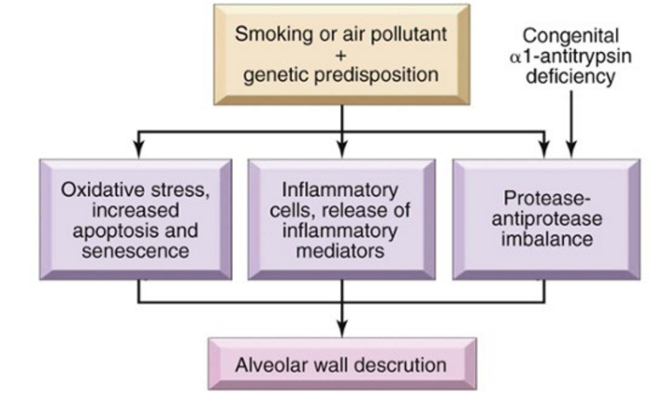
Emphysema
Emphysema: Pathogenesis
Pathogenesis of Emphysema

Slide 32
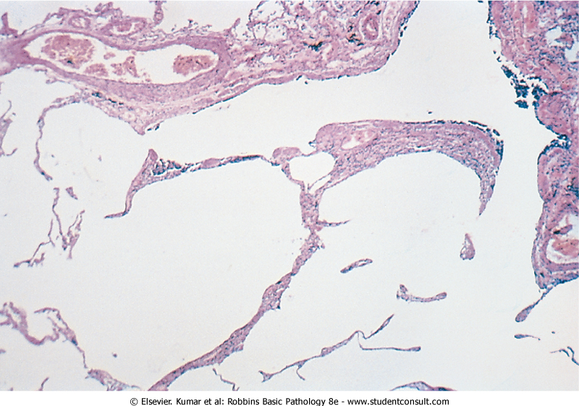
Emphysema: Morphology
Emphysema: Morphology
The lungs are pale, voluminous.
Histologically, thinning and destruction of alveolar walls creating large airspaces.
Loss of elastic tissue.
Reduced radial traction on the small airways.
Alveolar capillaries is diminished.
Accompanying bronchitis and bronchiolitis.

Slide 33
Emphysema
Complications
Coexistent chronic bronchitis
Interstitial emphysema in which air escapes into the interstitial tissues of the chest from a tear in the airways.
may also be complicated by rupture of a surface bleb with resultant Pneumothorax
Death from emphysema is related to::
Pulmonary failure with respiratory acidosis, hypoxia and coma.
Cor pulmonale : (Right-sided heart failure induced by pulmonary disease)
Clinical course
Cough and wheezing
Weight loss
Barrell chest
(increased anteroposterior diameter of chest)
Pulmonary function tests reveal reduced FEV1
Advanced: hypoxia, cyanosis, respiratory acidosis
Patients are known as pink puffers

Slide 34
Emphysema:
Emphysema: SUMMARY
Dilated air spaces beyond respiratory arteriols
Types
Centriacinar: Smoking
Clinical features
Cough and wheezing. Respiratory acidosis
Complications
Pneumothorax
Panacinar: deficiency of α1 AT
Paraseptal
Irregular: scar
Weight loss
Pulmonary function tests reveal low FEV1
Pulmonary failure with respiratory acidosis, hypoxia and coma.
Right-sided heart failure ( Cor pulmnale)
Death from emphysema is related to:

Slide 35
Emphysema and Chronic Bronchitis
Chronic bronchitis Vs. Emphysema
 | Predominant Bronchitis | Predominant Emphysema
Appearance Age Dyspnea Cough Infection Cor pulmonale Airway resistance Elastic recoil Chest radiography PaCO₂ Cyanosis | “Blue bloaters” 40-45 Mild, late Early, copious sputum Common Common Increased Normal Prominent vessels, large heart Increased Present | “Pink Puffers” 50-75 Severe, early Late, scanty sputum Occasional Rare, terminal Normal or slightly increased Low Hyperinflation, small heart Normal to decreased Absent

Slide 36
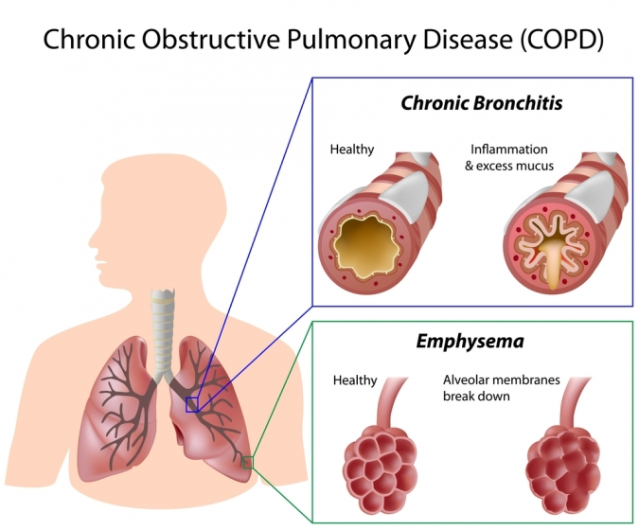
Chronic bronchitis vs. Emphysema
Chronic bronchitis Vs. Emphysema

Slide 37
Bronchiectasis
Define Bronchiectasis and its causes, presentation, morphology and significant

Slide 38
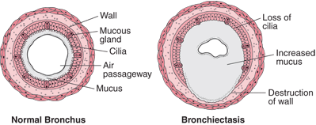
Bronchiectasis
Bronchiectasis
is chronic necrotizing infection and inflammation of the bronchi and bronchioles leading to abnormal permanent dilation of these airways. It represents the end stage of a variety of pathologic processes that cause destruction of the bronchial wall.
most often involves the lower lobes of both lungs.
is characterized by fever and cough with production of copious purulent foul smelling sputum,
and recurrent pulmonary infection that may lead to lung abscess.

Slide 39
Bronchiectasis is a result of chronic inflammation associated with an inability to clear mucoid secretions. Conditions commonly associated with Bronchiectasis are as follows:
Bronchiectasis
Bronchial obstruction
Congenital or hereditary conditions:
Chronic or severe infection / necrotizing pneumonia
Localized:
- tumor, foreign bodies or mucous impaction
Generalized:
- bronchial asthma
- chronic bronchitis
- Congenital bronchiectasis
- Cystic fibrosis.
- Intralobar sequestration of the lung.
- Immunodeficiency status.
- Immotile cilia and kartagner syndrome
Caused by TB, staphylococci or mixed infection.

Slide 40
Pathogenesis
Bronchiectasis
Any of the previously mentioned conditions can cause damage to the airways resulting in impaired mucociliary clearance, mucus stasis and accumulation
The airways become susceptible to microbial colonization lead to a "vicious circle" of inflammation and tissue damage.
Inflammation results in progressive destruction of the normal lung architecture, in particular the elastic fibres of bronchi.
Neutrophils are thought to play a central role in the pathogenesis of tissue damage that occurs in bronchiectasis.

Slide 41
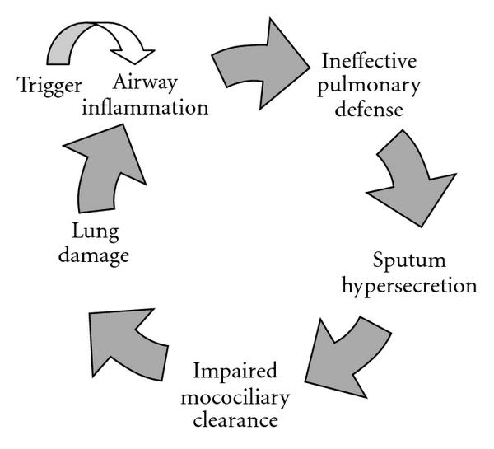
Pathogenesis of bronchiectasis
Bronchiectasis

Slide 42
Kartagener Syndrome/ immotile cilia syndrome
Bronchiectasis
It is a genetic condition resulting in the failure to clear sputum (Primary ciliary dyskinesia) caused by a defect in the motility of respiratory, auditory, and sperm cilia.
Inherited as autosomal recessive trait.
Patient develop bronchiactasis, sinusitis and situs invertus sometimes with hearing loss and male sterility.
Lack of ciliary activity interferers with bronchial clearance of mucus.

Slide 43
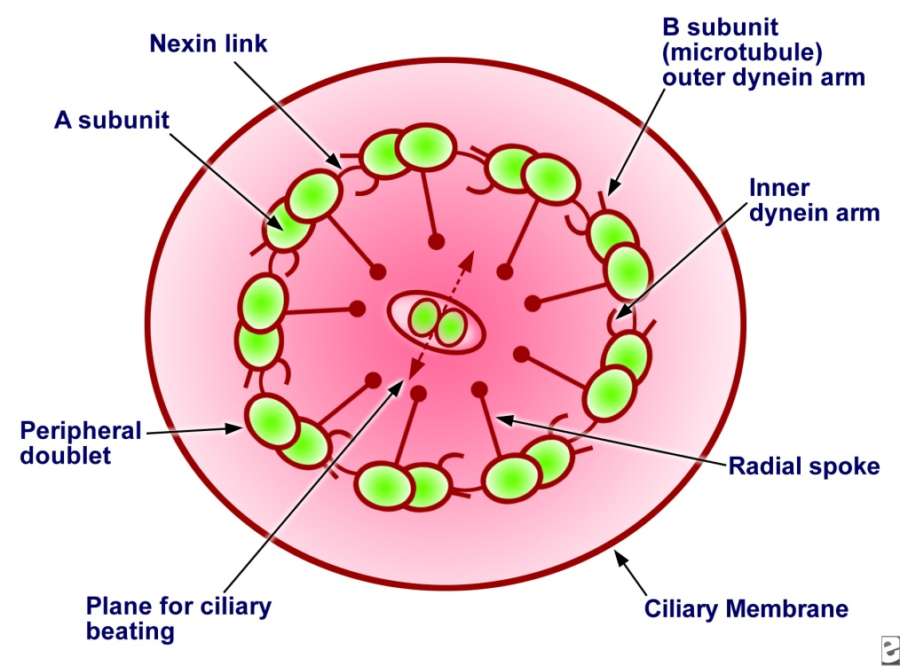
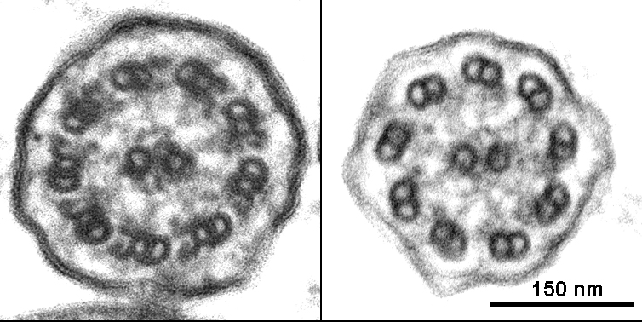
Bronchiectasis
absence of outer and inner dynein arms in a patient with primary ciliary dyskinesia.
Dynein, a type of ATPase, provides energy for microtubule sliding and the longitudinal displacement of adjacent microtubular doublets, resulting in ciliary bending.

Slide 44
Cystic fibrosis
Bronchiectasis
Cystic fibrosis is an inherited disease that causes thick, sticky viscus mucus to build up in the lungs and digestive tract. It is one of the most common chronic lung diseases in children and young adults, and may result in early death.
It may lead to bronchiectasis.

Slide 45
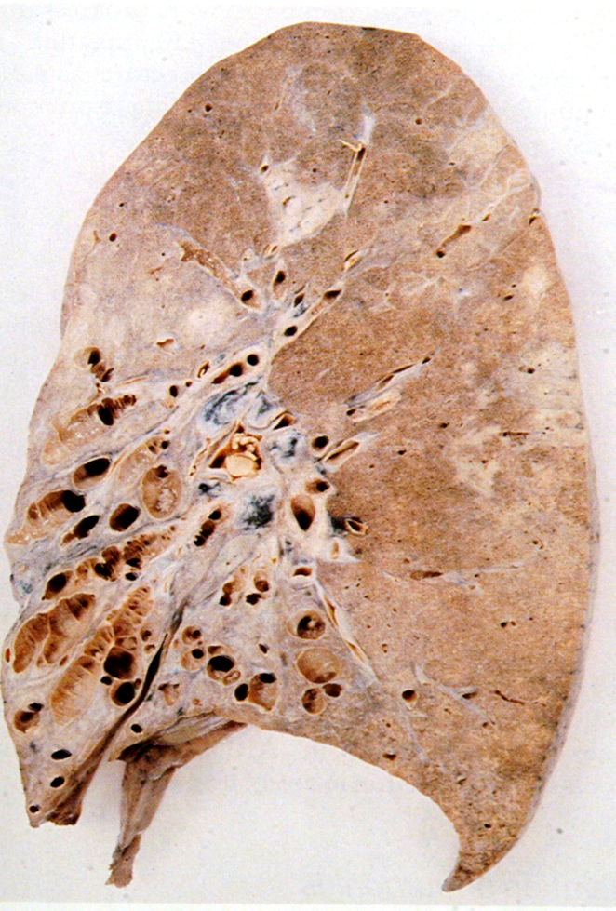
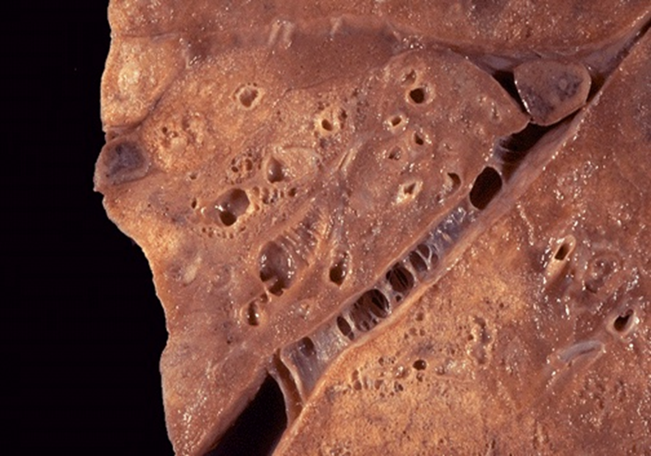
Morphology of Bronchiectasis
Bronchiectasis
Usually affects lower lobes bilaterally (vertical airways).
Dilated airways up to four times of normal, reaching the pleura.
Acute and chronic inflammation (neutrophils, lymphocytes, histiocytes and plasma cells)
Necrosis and ulceration in the wall of the bronchi and bronchioles with loss of cilia, squamous metaplasia and fibrosis.

Slide 46
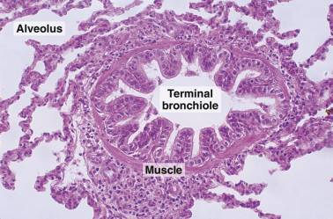
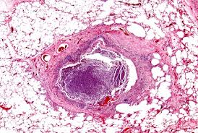
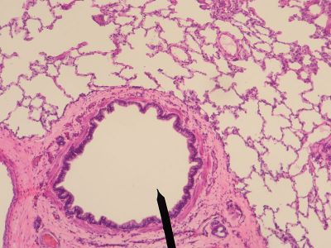
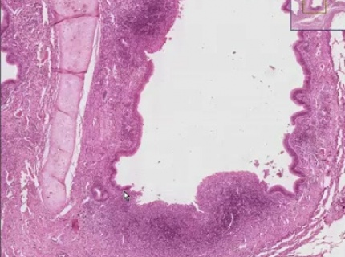
Bronchiectasis
Normal
bronchiectasis
Fibrosis
Dilated airways
Inflammation
Fibrosis

Slide 47
Bronchiectasis
Bronchiectasis
Clinical course:
Sever persistent cough with sputum (mucopurulent, fetid sputum) sometime with with blood.
Clubbing of fingers.
Complication:
If sever, obstructive pulmonary function develop.
Other complications: metastatic brain abscess and amyloidosis

Slide 48
Bronchiectasis:
Bronchiectasis
Dilatation of bronchi and bronchioles secondary to chronic inflammation and obstruction
Causes
Infection/ Necrotizing pneumonia
Congenital (Cystic fibrosis, Kartagener’s Syndrome)
Clinical features
Sever persistent cough with sputum (mucopurulent sputum) sometime with blood.
complications
Rare complications: metastatic brain abscess and amyloidosis.
Obstruction
Clubbing of fingers.
Lung Abscess
If sever, obstructive pulmonary function develop.

