Slide 1
Restrictive Lung Disease
Respiratory block
2018
Dr. Maha Arafah and Prof. Rikabi

Slide 2
Objectives
Understand the structure and constituents of the lung interstitium as well as the restrictive changes which occur in diseases of the interstituim (ILD)
Know the symptoms of ILD: progressive breathlessness and cough
Know subtypes of ILD: acute and chronic
Discuss the causes, morphology and outcome of acute ILD
Appreciate the pathogenesis of chronic ILD regardless of their type.
Become aware of the classification of interstitial lung diseases.
Discuss examples of interstitial lung diseases including:
  idiopathic pulmonary fibrosis
  Pneumoconiosis
  Hypersensitibity pneumonitis
  Goodpasture syndrome
  Sarcoidosis

Slide 3
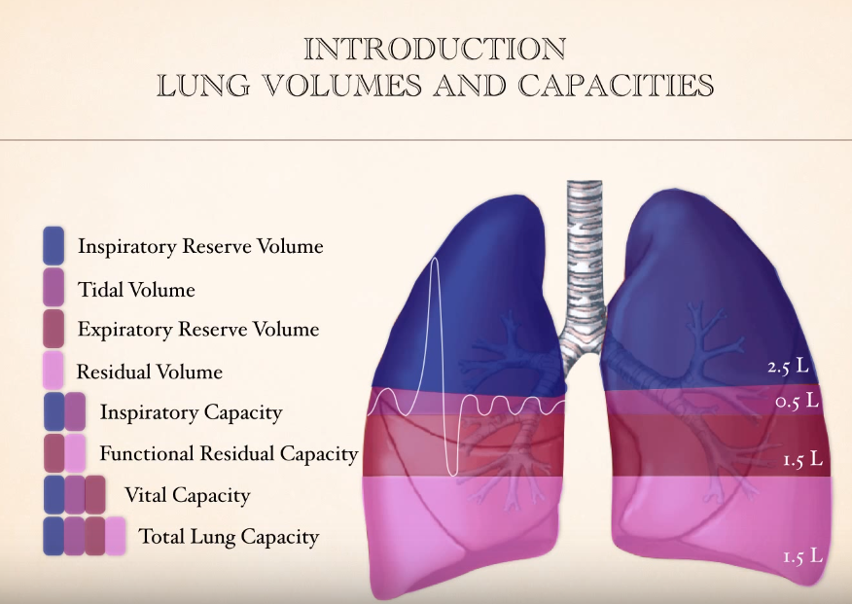
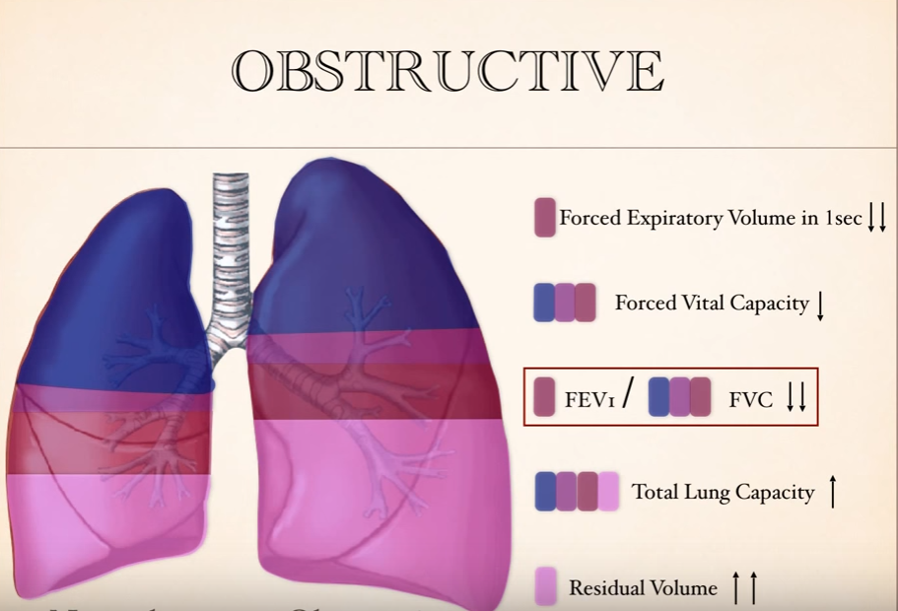
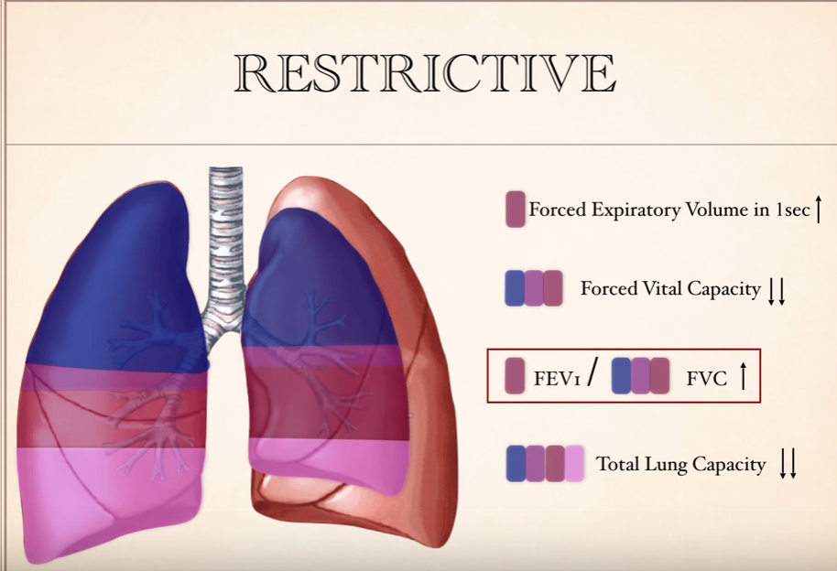

Slide 4
Both forced expiratory volume in one second (FEV1) and forced vital capacity (FVC) are reduced with normal to high FEV1/VC

Slide 5
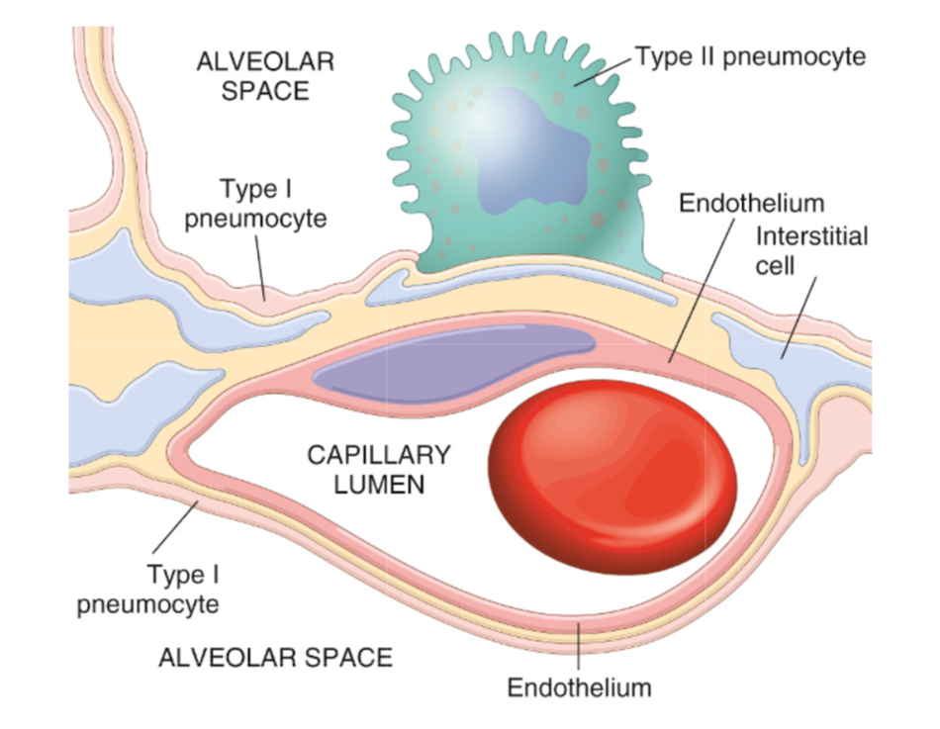
Constituents of the lung interstitium

Slide 6
Restrictive Lung Disease
Causes of interstitial lung diseases
The restrictive lung diseases are divided into:
  Intrinsic lung diseases/ diseases of the lung parenchyma/primary ILD:
  Extrinsic disorders or extraparenchymal diseases:
The diseases cause inflammation or scarring of the lung tissue (ILD) or result in filling of the air spaces with exudate and debris (pneumonitis). They are characterized by inflammatory infiltrates in the interstitial space and the interstitium becomes thickened and fibrotic (Stiff Lung).
Therefore there is decreased oxygen-diffusing capacity.
They are acute or chronic.
  The chest wall, pleura, and respiratory muscles are the components of the respiratory pump, and they need to function normally for effective ventilation. Abnormalities of the chest wall include:
    bony abnormalities (kyphosis or kypho-scoliosis)
    massive pleural effusion,
    morbid obesity
    neuromuscular disease of respiratoy muscles results in respiratory muscle weakness and respiratory failure e.g. myopathy or myositis, quadriplegia, or phrenic neuropathy from infectious or metabolic causes

Slide 7
Intrinsic type of Restrictive lung diseases
Interstitial lung diseases
Characterized by reduced compliance of the lung.
It can be:
- Acute.
- Chronic.
Important signs and symptoms:
- Dyspnea.
- Hypoxia.
- In advanced cases of restrictive lung disease, there is severe hypoxia, hypercapnia and cyanosis, respiratory failure and cor pulmonale.
The final stage of all restrictive lung disease is extensive fibrosis with honeycomb lung. The lung becomes more stiff and solid.
End stage lung disease: Honeycomb lung (both alveoli and bronchioles coalescence to form cysts lined with cuboidal or columnar epithelium and seperated by inflammatory fibrous tissue).

Slide 8
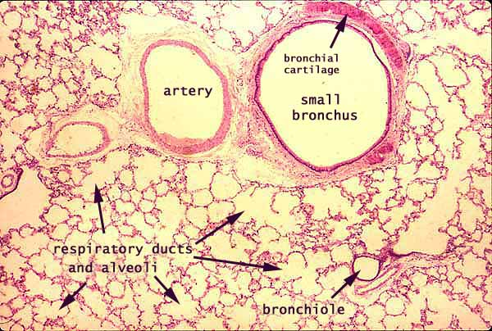
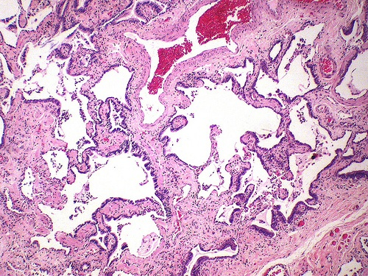
Interstitial lung diseases
Normal
Honeycomb lung

Slide 9
Acute restrictive lung diseases (INTRINSIC TYPE)
Acute restrictive lung diseases
Adult respiratory distress syndromes
Neonatal respiratory distress syndromes

Slide 10
Adult Respiratory Distress Syndrome
(ARDS)
Acute restrictive lung diseases
ARDS is a severe acute lung injury with diffuse alveolar injury.
known as shock lung/ diffuse alveolar damage/ adult respiratory failure/acute alveolar injury/ traumatic wet lung
Features
  rapid acute onset progressive severe life threatening respiratory insufficiency, cyanosis, severe arterial hypoxia
  refractory to oxygen therapy and that may progress to multi-organ failure
  bilateral pulmonary infiltrates (edema) in the absence of evidence of left sided heart failure
It is the most common cause of non-cardiogenic pulmonary edema

Slide 11
ARDS
Can be caused by many conditions:
Acute adult restrictive lung diseases
Pneumonia and sepsis are the most common causes
  Direct injury to lung
  Pneumonia
  Aspiration of gastric contents
  Pulmonary trauma
  Fat embolism
  Near drowning
  Toxic inhalation injury (irritants
  such as chlorine, O2 toxicity)
  Post lung transplant
  Severe acute respiratory
  syndrome (SARS): The virus is
  a coronavirus that destroys the
  type II pneumocytes and
  causes diffuse alveolar damage
  Indirect injury to lung:
  Sepsis
  Severe trauma (e.g. bone fractures, head injury, burns, radiation)
  Shock
  Cardiopulmonary bypass
  Acute pancreatitis
  Transfusion
  Uremia
  Overdose with street drugs such as heroin
  Therapeutic drugs such as bleomycin
  Hematologic conditions e.g multiple transfusion, coagulation disorders

Slide 12
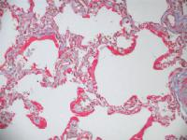
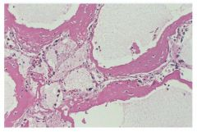
ARDS
Acute adult restrictive lung diseases
Pathophysiology
ARDS is associated with diffuse alveolar damage.
It is initiated by injury to:
  alveolar capillary endothelium with a resultant increase in alveolar capillary permeability
  alveolar epithelium
The injury is induced by the:
(a) Neutrophils releasing substances toxic to alveolar wall.
(b) Activation of the coagulation cascade.
(c) O2 toxicity (due to formation of free radicals).

Slide 13
Pathophysiology of ARDS
Acute adult restrictive lung diseases
This causes leakage of protein-rich fluid into alveoli, form alveolar hyaline membranes, line the inner surface of alveoli (the membrane is composed of fibrin and cellular debris)
The lungs become remarkably heavy and stiff due to inflammation and odema and later interstitial fibrosis.
Chest x-ray: bilateral and diffuse pulmonary infiltrates
Outcome of ARDS:
  Mortality was 100%
  Now 30 -40% with good ICU support
  Poor prognosis: old age, multisystem failure, high level of IL-1

Slide 14
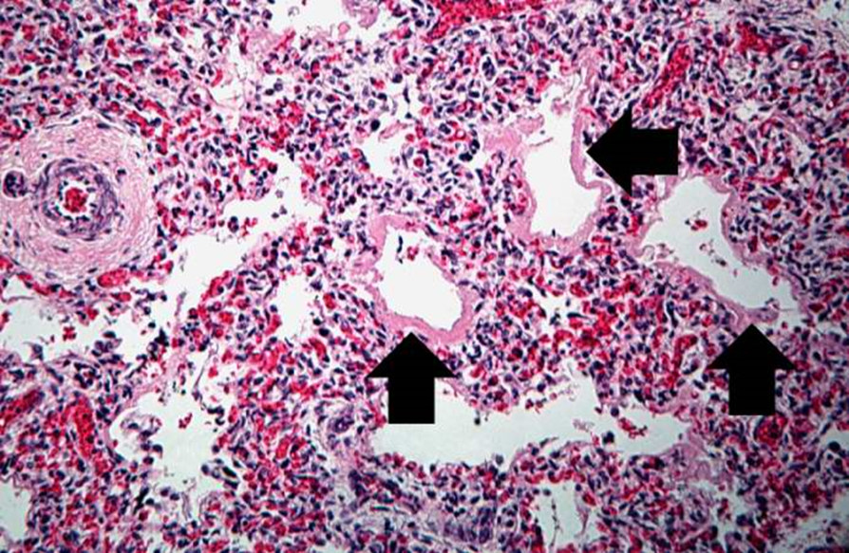
Neonatal Respiratory Distress Syndrome/Hyaline membrane disease
Neonatal Respiratory Distress Syndrome
It is the most common cause of respiratory failure in the newborn and is the most common cause of death in premature infants.
It is the same as ARDS except that it is caused by a deficiency of pulmonary surfactants in new borns, most often as a result of immaturity.

Slide 15
Chronic restrictive lung disease
(INTRINSIC TYPE)

Slide 16
Chronic restrictive lung disease (INTRINSIC TYPE)
Definition
Chronic restrictive lung disease
Are a heterogenous group of diseases.
Many entities are of unknown cause and pathogenesis.
They have similar clinical signs, symptoms, radiographic alterations and pathophysiologic changes.
Account for about 15% of non-infectious lung diseases.
End-stage: diffuse interstitial pulmonary fibrosis.

Slide 17
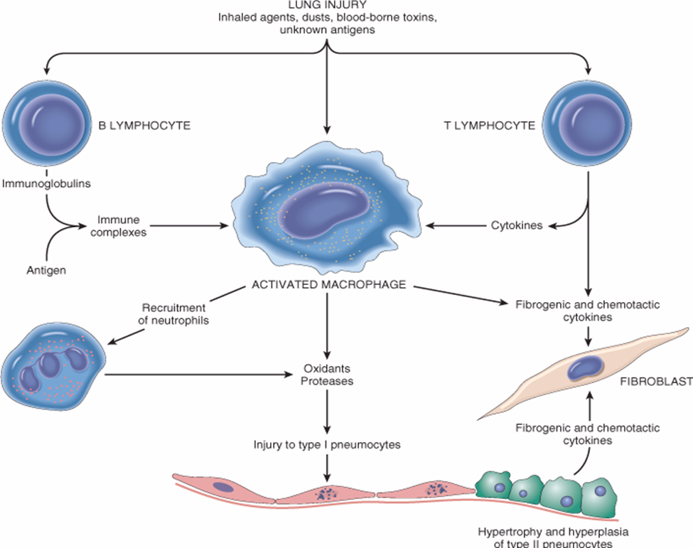
Pathogenesis of intrinsic chronic ILD
Chronic restrictive lung disease: pathogenesis
Lung injury
Influx of inflammatory cells into the alveoli and alveolar walls
Release of chemical mediators and promotion of fibrosis
Distortion of the normal structure of alveoli

Slide 18
Major Categories of Chronic Interstitial Lung Disease
Chronic restrictive lung disease: Categories
Idiopathic fibrosing:
Usual interstitial pneumonia (idiopathic pulmonary fibrosis)
Drug:
Chemotherapy, methotrexate, bleomyxin toxicity
Occupational: Pneumoconiosis
  Anthracosis and coal worker's pneumoconiosis,
  Silicosis
  Berylliosis
  Asbestosis
Smoking related:
Eosinophilic granuloma
Desquamative interstitial pneumonia
Respiratory bronchiolitis-associated interstitial lung disease
Immune diseases:
Sarcoidosis
Goodpasture syndrome
Hypersensitibity pneumonitis (extrinsic allergic alveolitis)
Systemic lupus erythematosus
Systemic sclerosis (scleroderma)
Wegener granulomatosis
Radiation Reactions
Occur after radiation with diffuse alveolar damage, severe atypia of hyperplastic type II cells and fibroblasts

Slide 19
Idiopathic Pulmonary Fibrosis/ Fibrosing Alveolitis/ Hamman-Rich Syndrome /
Usual Interstitial Pneumonia (UIP)

Slide 20
Idiopathic Pulmonary Fibrosis (UIP )
Idiopathic Pulmonary Fibrosis
  UIP is progressive fibrosing disorder of unknown cause. It is an idiopathic interstitial pneumonia with diffuse interstitial fibrosis and inflammation (Scars formation along the interlobular septa)
  Age: Adults 30 to 50 years
  Prognosis: poor.
  Respiratory and heart failure may develop within few years. No effective therapy is available for the treatment of idiopathic pulmonary fibrosis.
  Lung transplant is the only solution

Slide 21
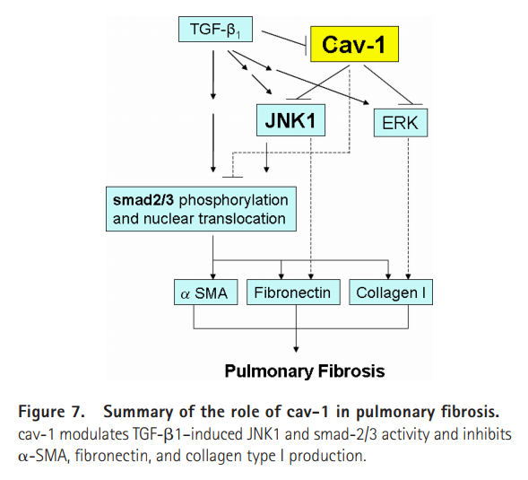
Idiopathic Pulmonary Fibrosis: Pathogenesis
smoke, environmental pollutants, dust, viral infections, gastroesophageal reflux disease
susceptible host
the injured epithelial cells are the source of profibrogenic factors such as down regulation of caveolin-1 by transforming growth factor Beta I
alveolar damage, fibrosis and irreversible destruction of the lung parenchyma.

Slide 22
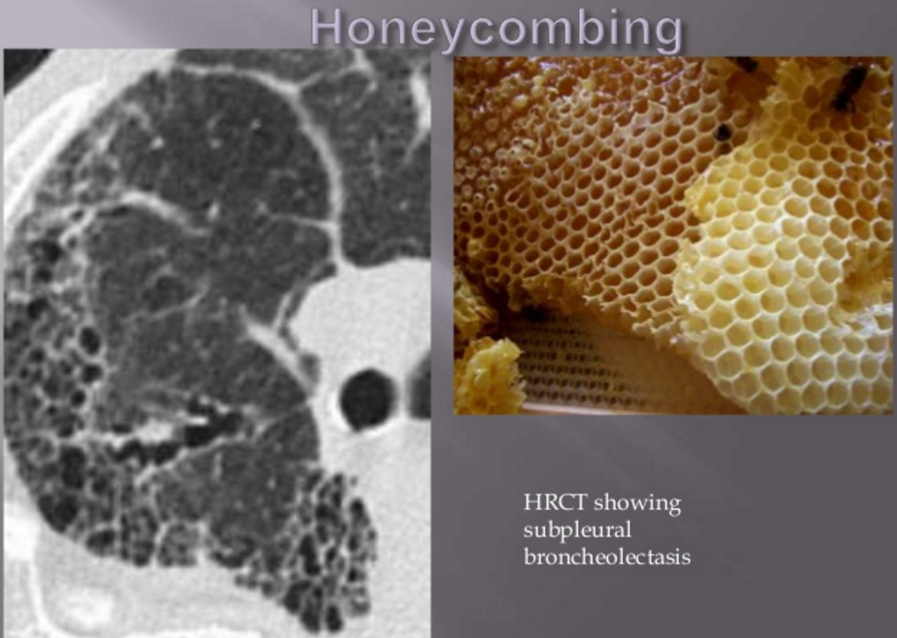
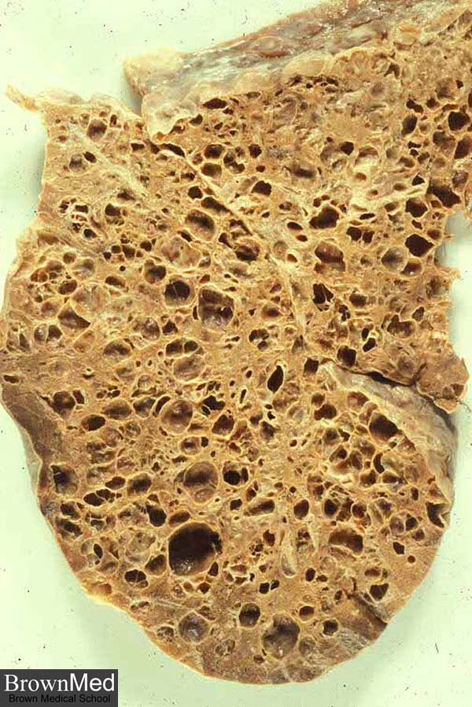
Clinical Features of UIP
Idiopathic Pulmonary Fibrosis: Clinical features
Most patients present with exertional dyspnea and a nonproductive cough
A chest radiograph and high-resolution computed tomography typically reveals diffuse reticular opacities.

Slide 23
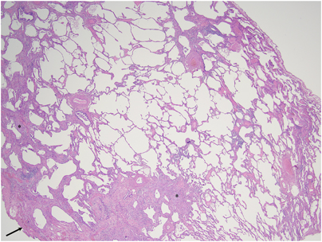
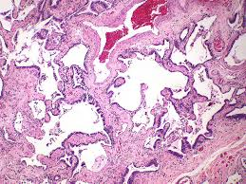
Morphology of UIP
Idiopathic Pulmonary Fibrosis: Morphology
The morphologic changes vary according to the stage of the disease.
Early cases:
- Intra-alveolar and interstial inflammation.
- Hyperplasia of type II pneumocytes
Advancing disease:
- Prominent interstitial fibrosis.
- Alternating areas of fibrosis and normal tissue will be seen.
- In the end, the lung consists of pperipheral cystic spaces lined by cuboidal or columnar epithelium separated by inflammatory fibrous tissue (honeycomb lung). Foci of normal lung tissue were also seen. It is the end stage of lung disease
Scars formation along the interlobular septa

Slide 24
Chronic restrictive lung disease
Major Categories of Chronic Interstitial Lung Disease
Idiopathic fibrosing:
Usual interstitial pneumonia (idiopathic pulmonary fibrosis)
Drug:
Chemotherapy, methotrexate, bleomyxin toxicity
Occupational: Pneumoconiosis
  Anthracosis and coal worker's pneumoconiosis,
  Silicosis
  Berylliosis
  Asbestosis
Smoking related:
Eosinophilic granuloma
Desquamative interstitial pneumonia
Respiratory bronchiolitis-associated interstitial lung disease
Immune diseases:
Hypersensitibity pneumonitis (extrinsic allergic alveolitis)
Sarcoidosis
Goodpasture syndrome
Systemic lupus erythematosus
Systemic sclerosis (scleroderma)
Wegener granulomatosis
Radiation Reactions

Slide 25
Pneumoconiosis
Occupational: Pneumoconiosis
Pneumoconiosis is a group of pulmonary diseases caused by chronic exposure to inorganic mineral dust inhalation and this leads to lung damage.
More than 40 inhaled minerals can cause lung problems.
They include carbon dust, silica, asbestos, beryllium etc.
Pathophysiology:
  Alveolar macrophages ingest the particles, become activated, and release cytokines and chemotactic factors that recruit other inflammatory cells.
  Inflammation damages lung cells and damages the interstitium of the lung by degrading the extracellular matrix glycoproteins
  Fibroblasts are stimulated and proliferated to produce collagen; fibrosis results
  As the disease progresses the blood vessels become compromised, and ischemic necrosis may occur

Slide 26
Pneumoconiosis
Occupational: Pneumoconiosis
The development of pneumoconiosis is dependent on:
- The amount of dust retained in the lung and airways.
    a. Concentration of the dust in the ambient air.
    b. Duration of the exposure.
    c. Effectiveness of the clearance mechanisms.
- The size (1-5μ) shape.
- Their solubility and physiochemical activity.
- The possible additional effects of other irritants, tobacco smoking.

Slide 27
Coal Worker's Pneumoconiosis
Occupational: Coal
Coal worker's pneumoconiosis (CWP) can be defined as the accumulation of coal dust in the lungs and the tissue's reaction to its presence.
The disease is divided into 2 categories:
Simple coal worker’s pneumoconiosis
Complicated coal worker’s pneumoconiosis (CCWP), or pulmonary massive fibrosis (PMF), depending on the extent of the disease.
Pulmonary massive fibrosis in association with rheumatoid arthritis is known as Caplan syndrome.

Slide 28
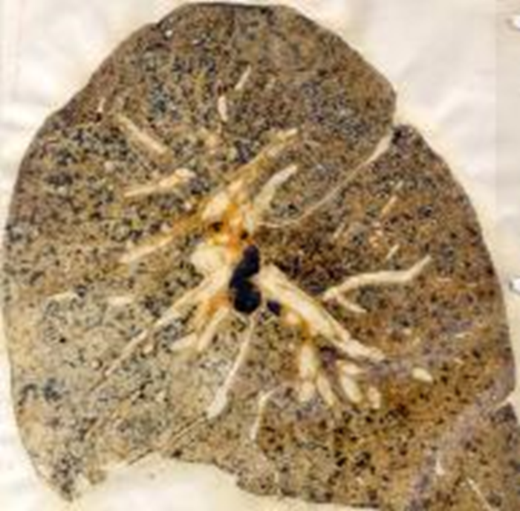
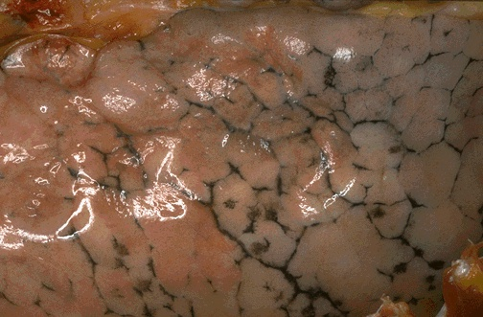
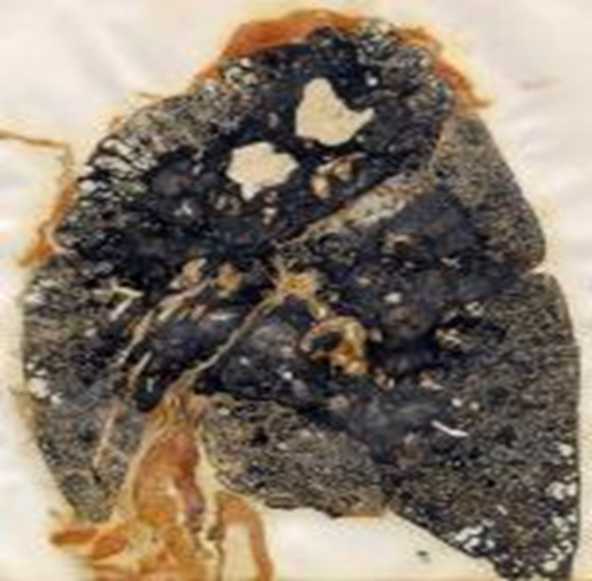
Occupational: Coal
-
Anthracosis
Simple Coal worker pneumoconiosis:
Black macules)1 to 5 mm are scattered through the lung.
Complicated coal worker’s pneumoconiosis:
- Black scars exceed 2 -10 cm
Fibrous scarring appears (progressive massive fibrosis)
produces cough, dyspnea, and lung function impairment.
cor pulmonale
no convincing evidence that coal dust increases susceptibility to tuberculosis or cancer (non-smoker)

Slide 29
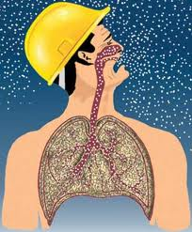
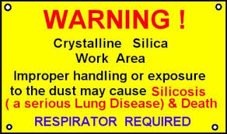
Silicosis
Occupational: Silicosis
Silicosis is a fibro-nodular lung disease caused by long term exposure to inhalation of crystalline silica particles (alpha-quartz or silicon dioxide).
Industrial exposure: mining of gold, tin, copper and coal, sandblasting, metal grinding, ceramic manufacturing.
Chronic forms manifest after several years of exposure
The symptoms may be indolent or progressive: complicated progressive massive fibrosis.
Silicosis predispose to lung cancer and tuberculosis.
Pathogenesis:
Crystalline silica is highly fibrogenic.
Scattered lymphocytes and macrophages are drawn rapidly with fibrosis.
Some particles are transported to lymph nodes.

Slide 30
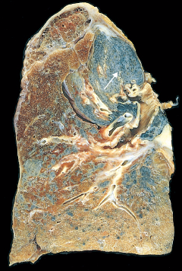
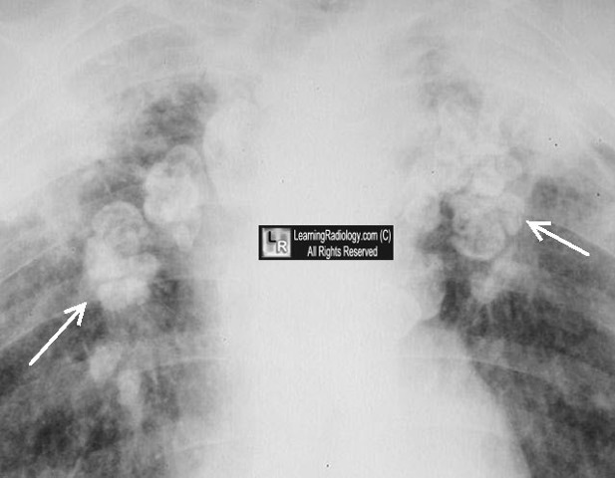
Morphology
Occupational: Silicosis
Tiny collagenous nodules that enlarge forming stony-hard large fibrous scars usually in the upper lobes.
Calcifications may appear (eggshell calcification)
Similar collagenous nodules within the lymph nodes.
Fibrous pleural plaques may develop.

Slide 31
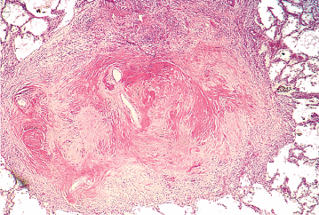
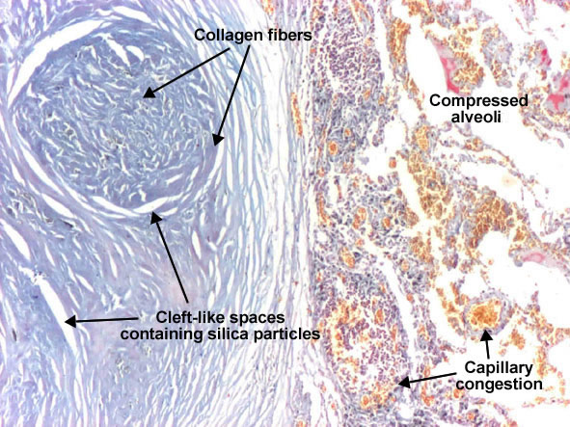
Occupational: Silicosis
Morphology:
-Hyalinized collagen fiber surround an amorphous center (fibrous nodules).
- Scarring progress to progressive massive fibrosis.
Prognosis:
- Scarring extending and encroching the pulmonary arteries leading to Cor pulmonale.
Increased susceptibility to tuberculosis (crystalline silica inhibits the ability of pulmonary macrophages to kill phagocytosed mycobacteria)
Patients with silicosis have double the risk for developing lung cancer

Slide 32
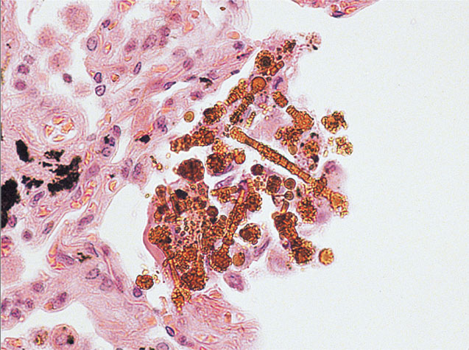
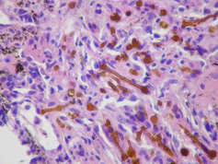
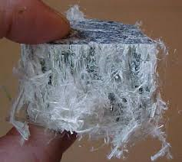
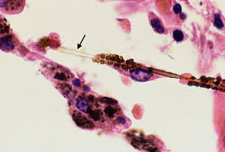
Asbestosis
Occupational: Asbestosis
Caused by asbestos inhalation
Asbestos fibers are long and thin. They can curved or straight.
All types of asbestos (crocidolite and amosite) are fibrogenic to lungs.
Asbestosis occurs decades after exposure has ended.
Characterized by scars containing asbestos bodies.
They can cause
  pleural effusion.
  pleural adhesions.
  parietal pleural fibrocalcific plaques
  Some types of asbestos are carcinogenic (especially crocidolite) and prolong asbestos exposure can predisposes to bronchogenic carcinoma and malignant mesothelioma.
Asbestos bodies are long, thin asbestos fibers coated with hemosiderin and protein to form brown filaments with a beaded or drumstick pattern.

Slide 33
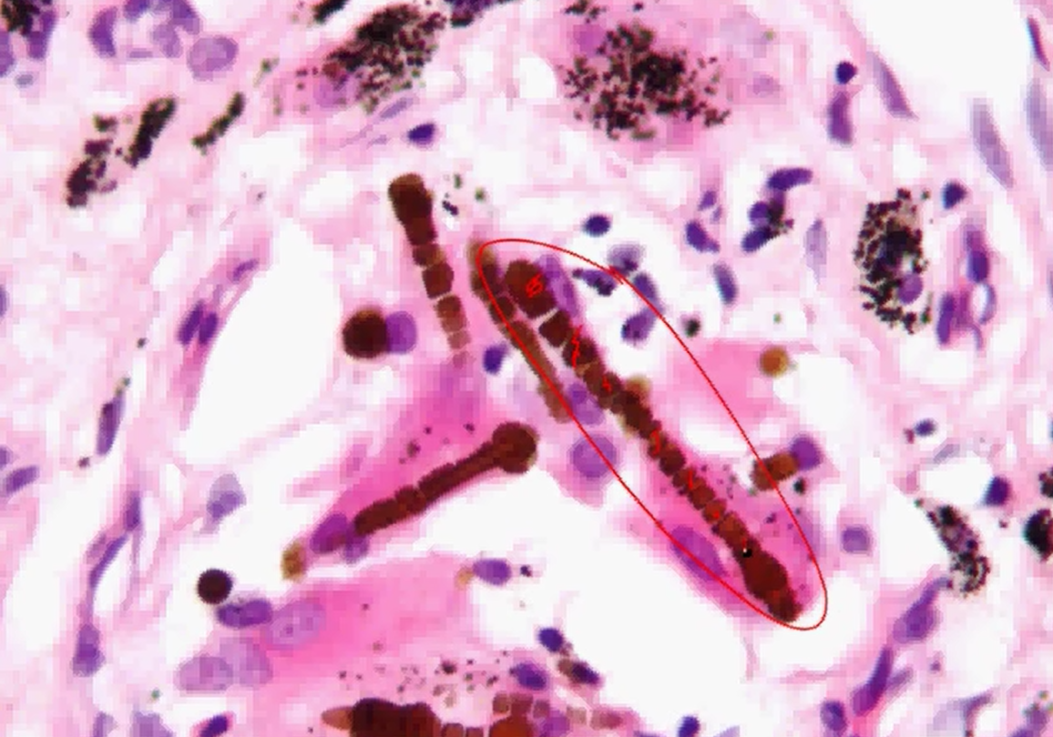
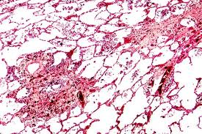
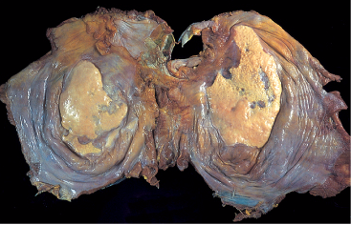
Occupational: Asbestosis
scarring containing asbestos bodies (ferruginous bodies).
  parietal pleural fibrocalcific plaques
Pleural fibrosis

Slide 34
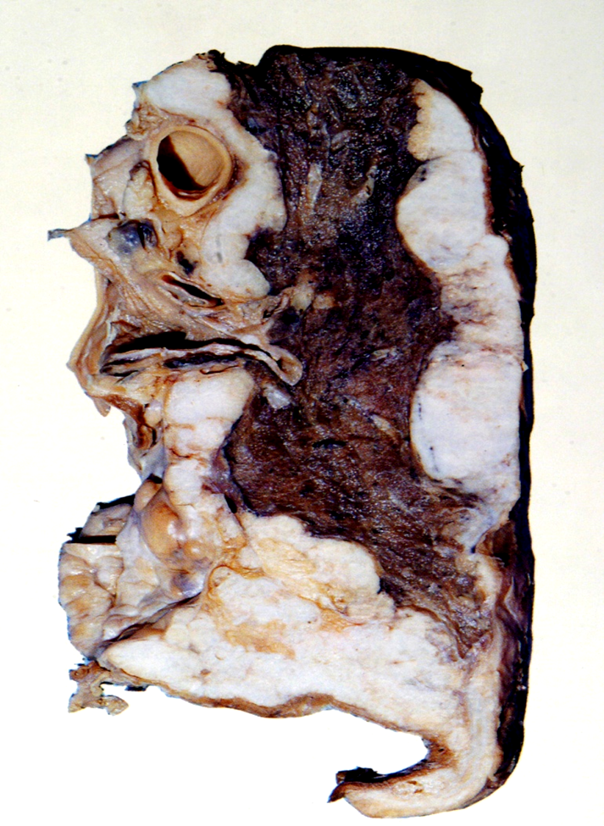
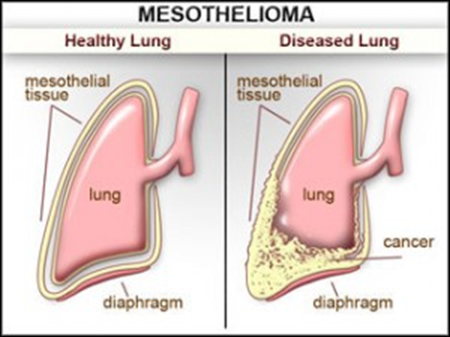
Occupational: Asbestosis
Asbestosis
Both bronchogenic carcinoma and mesothelioma develop in workers exposed to asbestos.
The risk of bronchogenic carcinoma is fivefold and for mesothelioma is 1000 fold greater

Slide 35
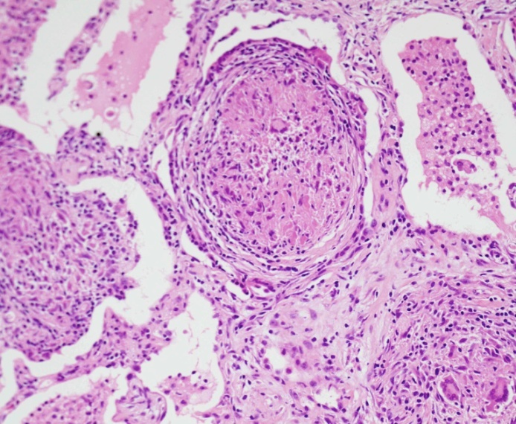
Occupational: Berylliosis
  Berylliosis
- Beryllium Mining, Aerospace manufacturing
non-necrotizing granulomata distributed in the parenchyma, LN and other organs
Pedispose to lung cancer

Slide 36
Occupational: Pneumoconiosis
Entity | Example | Pathological features | Comment
coal worker's pneumoconi-osis | coal dust in coal miners | -Simple coal worker’s -Complicated coal worker’s pneumoconiosis (with rheumatoid arthritis is called Caplan syndrome) | Anthracosis is the accumulation of coal without consequent cellular reaction in air polution /smoker
Silicosis | silicon dioxide | industries: mining of gold, tin, copper and coal, sandblasting, metal grinding, ceramic manufacturing | -Complicated progressive massive fibrosis -Predispose to lung cancer and TB
Berylliosis | Beryllium Mining, Aerospace manufacturing | non-necrotizing granulomata distributed in the parenchyma, LN and other organs | Pedispose to lung cancer
Asbestosis | Pipes, sheets, vinyl-asbestos floor tiles, asbestos paper in filtering and insulating products | Pulmonary fibrosis Pleural fibrosis | Bronchogenic Carcinoma and Malignant Mesothelioma

Slide 37
Chronic restrictive lung disease
Major Categories of Chronic Interstitial Lung Disease
Idiopathic fibrosing:
Usual interstitial pneumonia (idiopathic pulmonary fibrosis)
Drug:
Chemotherapy, methotrexate, bleomyxin toxicity
Occupational: Pneumoconiosis
  Anthracosis and coal worker's pneumoconiosis,
  Silicosis
  Berylliosis
  Asbestosis
Smoking related:
Eosinophilic granuloma
Desquamative interstitial pneumonia
Respiratory bronchiolitis-associated interstitial lung disease
Immune diseases:
Hypersensitibity pneumonitis (extrinsic allergic alveolitis)
Sarcoidosis
Goodpasture syndrome
Systemic lupus erythematosus
Systemic sclerosis (scleroderma)
Wegener granulomatosis
Radiation Reactions

Slide 38
Hypersensitivity pneumonitis
Prolonged exposure to inhaled organic antigens
Immune: Hypersensitivity pneumonitis
Hypersensitivity pneumonitis an immunologically mediated (type III or IV)
Caused by intense and often prolonged exposure to inhaled organic dust
It primarily affects the alveoli and is therefore often called allergic alveolitis
These dusts come from:
  Evaporative coolers (Desert coolers/ wet air cooler ) type AC
  Dairy and grain products
  Animal droppings and animal proteins
  Poultry and other bird handlers are commonly exposed to droppings, feathers, and serum proteins of pigeons etc.
The most common antigens are thermophilic Actinomycetes and avian proteins
The most common diseases are farmer’s lung and bird fancier's/handler’s lung.

Slide 39
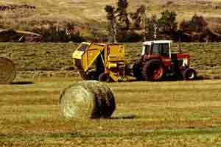

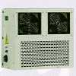
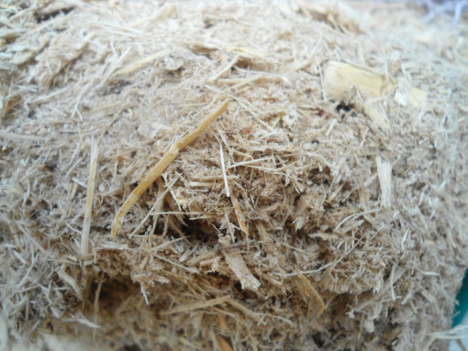
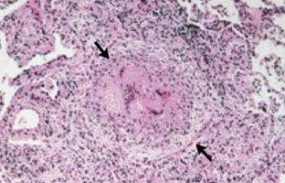
Hypersensitivity pneumonitis
Hypersensitivity pneumonitis
Causes: It is an occupational restrictive disease
Farmer’s lung
Thermophilic actinomycetes in hay
Pigeon breeder’s
Air-cooler lung
Thermophilic bacteria
Sugarcane bagasse (Bagassosis)

Slide 40
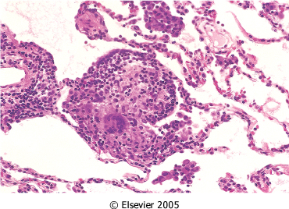
Hypersensitivity Pneumonitis
Hypersensitivity pneumonitis
Morphology: noncaseating interstitial granulomas (IV hypersensitivity reaction), bronchiolitis, interstitial pneumonitis, and diffuse interstitial fibrosis.
Clinical course is variable
Hypersensitivity pneumonitis can present as:
  Acute: fever, cough, dyspnea
  Subacute (intermittent)
  Chronic progressive: cough, dyspnea, malaise, and weight loss

Slide 41
Sarcoidosis
Immune diseases: Sarcoidosis
Sarcoidosis is an inflammatory disease
    Epidemiology: affecting all races and both sexes equally
    Cause: unknown
    Sites: predominantly affects the lungs and intrathoracic lymph nodes
      Other organs that may be involved include eyes, skin, liver, spleen and bone marrow.
      Occasionally kidney, heart, CNS and endocrine organs may be involved.
    Morphology: non-caseating/ non-necrotizing granulomas in affected organ tissues.

Slide 42
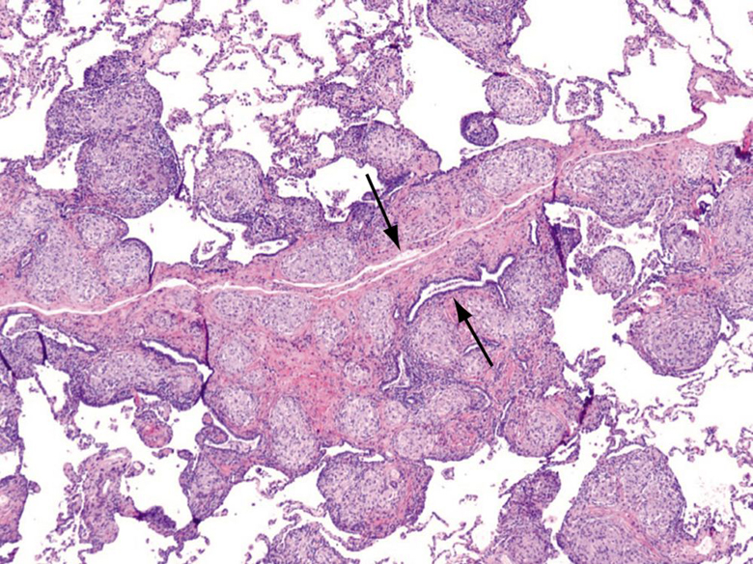
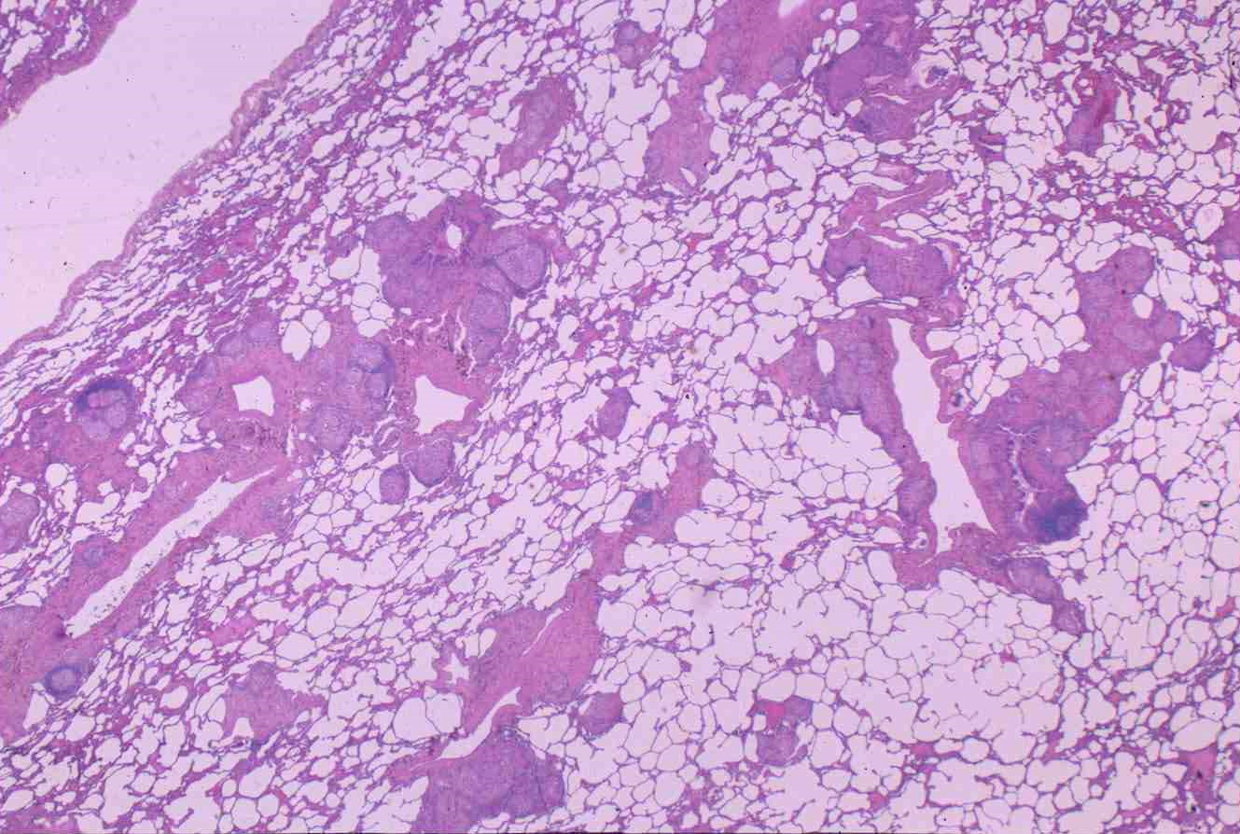
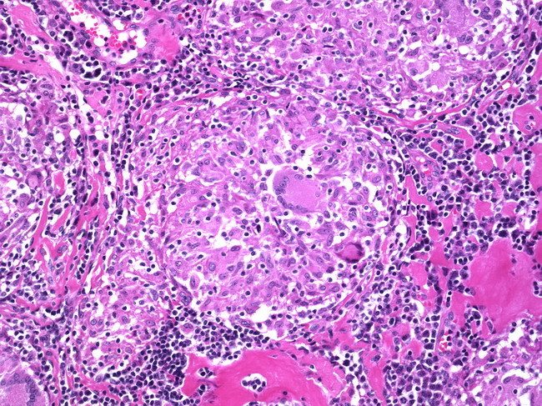
Immune diseases: Sarcoidosis
Sarcoidosis granulomas in the lung

Slide 43
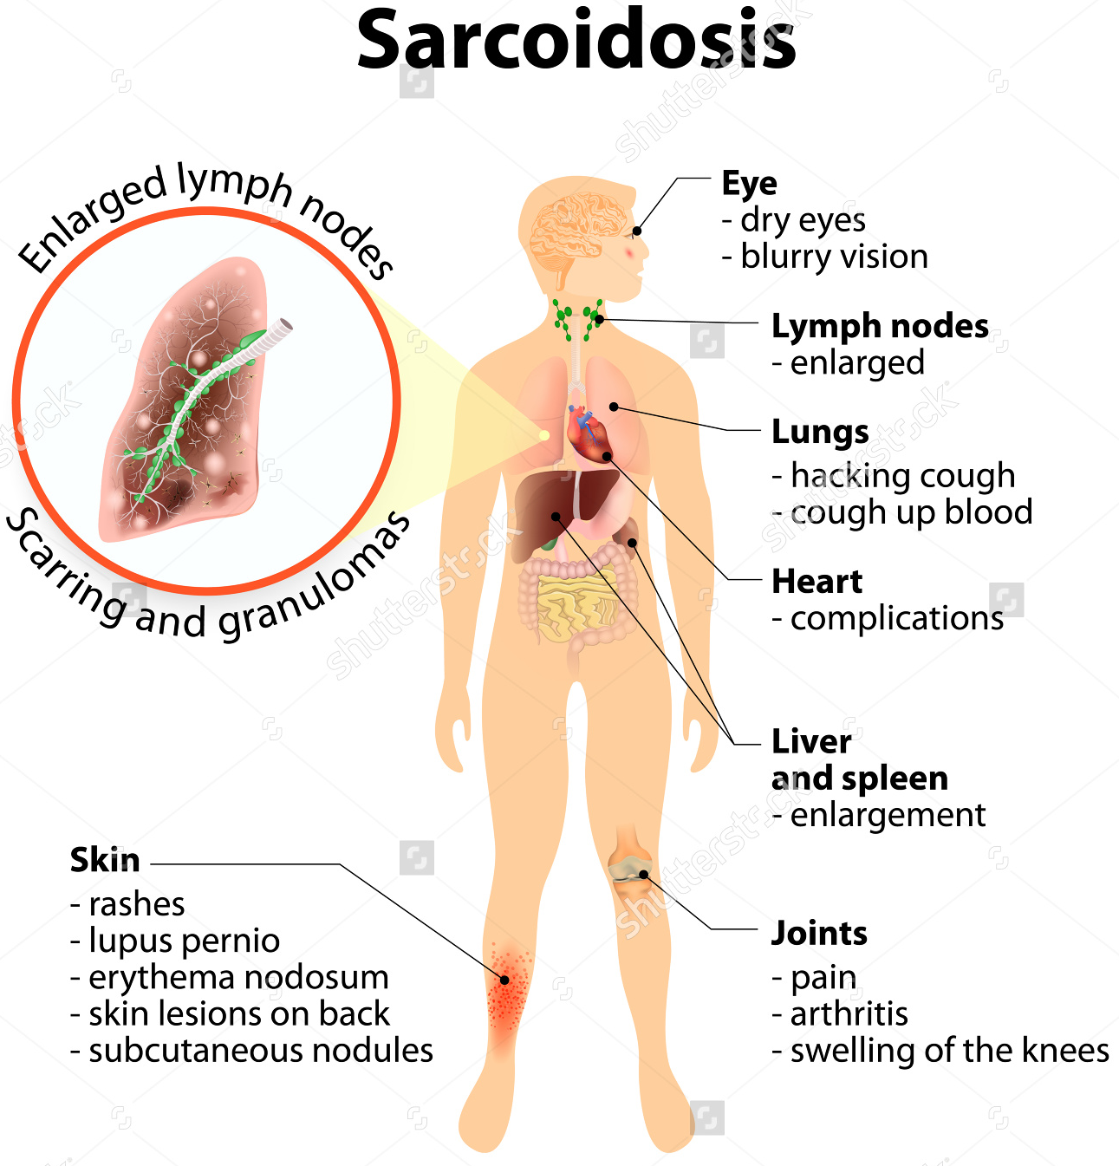
Immune diseases: Sarcoidosis
The prognosis of sarcoidosis is unpredictable. It can progressive and chronic. It may present as episodes of activity.
Majority of the patients respond well to treatment.

Slide 44
Goodpasture Syndrome/ Anti-GBM disease
Immune diseases
Rare autoimmune disorder
Is a triad of
  diffuse pulmonary hemorrhage,
  glomerulonephritis,
  circulating (anti-GBM) antibodies against alveolar and glomerular basement membranes
The antibody can usually be found in serum.
Morphology:
  The lung: acute necrotizing alveolitis with hemorrhage
  Kidney: rapidly progressive glomerulonephritis, may lead to renal failure
Clinical features:
  Pulmonary symptoms (hemoptysis and dyspnea)
  Renal symptoms (hematuria, proteinuria, RBC casts and renal failure)
  Arthralgias

Slide 45
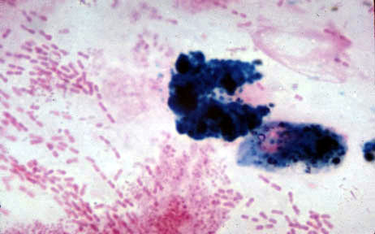
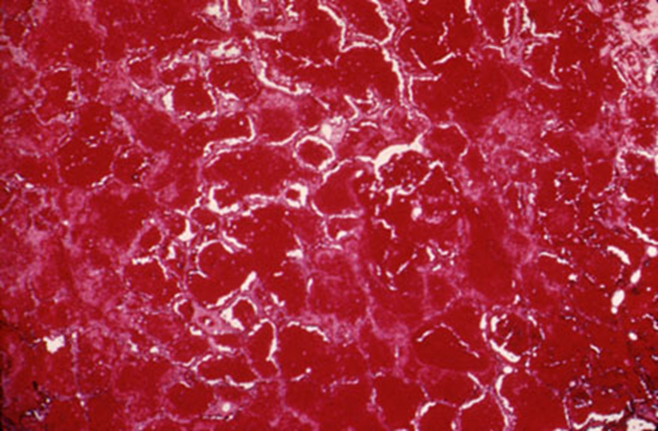
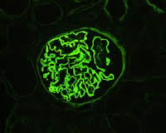
Goodpasture syndrome
Immune diseases
Iron stain in sputum
Immunofluorescence of renal biopsy staining for IgG in a linear pattern in patient with anti-glomerular basement membrane (anti-GBM) disease

Slide 46
Summary
Restrictive lung disease could be acute or chronic
Acute: Adult respiratory distress syndrome most commonly due to pneumonia or septic shock
Idiopathic fibrosing:
Usual interstitial pneumonia (idiopathic pulmonary fibrosis)
Drug:
Chemotherapy, methotrexate, bleomyxin toxicity
Occupational: Pneumoconiosis
  Anthracosis and coal worker's pneumoconiosis,
  Silicosis
  Berylliosis
  Asbestosis
Smoking related:
Eosinophilic granuloma
Desquamative interstitial pneumonia
Respiratory bronchiolitis-associated interstitial lung disease
Immune diseases:
Hypersensitibity pneumonitis (extrinsic allergic alveolitis)
Sarcoidosis
Goodpasture syndrome
Systemic lupus erythematosus
Systemic sclerosis (scleroderma)
Wegener granulomatosis
Radiation Reactions

