Slide 1
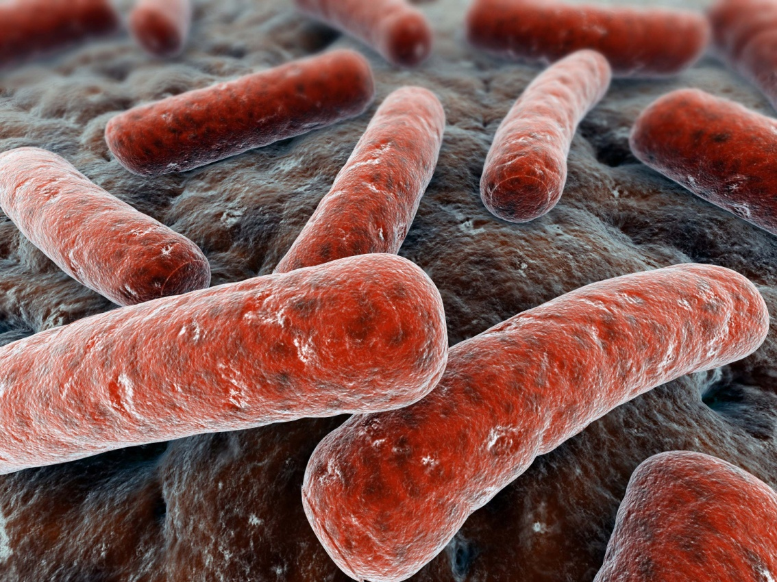
PATHOLOGY OF TUBERCULOSIS
Respiratory block
Pathology, 2018
Dr. Maha Arafah and Prof. Ammar Rikabi
Department of Pathology
KSU, Riyadh

Slide 2
TUBERCULOSIS Objectives:
Define tuberculosis
List the diseases caused by Mycobacteria
Know the epidemiology of tuberculosis (TB)
List conditions associated with increased risk of Tuberculosis
List factors predisposing to extension of the infection
Recognize the morphology of Mycobacteria and its special stain (the Ziehl-Neelsen) as well as the morphology of granulomas in TB (tubercles).
Know the Pathogenesis of tuberculosis
In regards to Mycobacterial lung infection: Compare and contrast the following in relation to their gross and histologic lung pathology:
Primary tuberculosis (include a definition of the Ghon complex).
Secondary or reactivation tuberculosis.
Miliary tuberculosis.
List organs other than lung that are commonly affected by tuberculosis.
Know the basis and use of tuberculin skin (Mantoux) test.
List the common clinical presentation of tuberculosis.
List the complication and prognosis of tuberculosis.

Slide 3
Define tuberculosis
Tuberculosis is a communicable chronic granulomatous disease caused by Mycobacterium tuberculosis.
It usually involves the lungs but may affect any organ or tissue in the body.

Slide 4
Diseases caused by Mycobacteria
Mycobacterium tuberculosis is the etiologic agent of Tuberculosis in humans. Humans are the only reservoir for the bacterium.
Mycobacterium bovis is the etiologic agent of TB in cows and rarely in humans. Both cows and humans can serve as reservoirs. Humans can also be infected by the consumption of unpasteurized milk. This route of transmission can lead to the development of extrapulmonary TB.
M. leprae : causes leprosy

Slide 5
Diseases caused by Mycobacteria
Others:
M. kansasii and M. avium intracellulare cause atypical mycobacterial infections in humans esp in AIDS. They cause respiratory and gastrointestinal symptoms and can involve other organs too.
M. ulcerans causes buruli ulcers of skin.

Slide 6
Epidemiology of tuberculosis
According to the World Health Organization (WHO), It is estimated that 1.7 billion individuals are infected by tuberculosis worldwide, with 8 to 10 million new cases and 1.5 million deaths per year.

Slide 7
Factors predisposing to extension of the infection:
Tuberculosis flourishes wherever there is
Poverty
crowding
malnutrion
chronic debilitating illness e.g.chronic lung disease (particularly silicosis), chronic renal failure etc.

Slide 8
Conditions associated with increased risk of Tuberculosis:
Certain disease states also increase the risk:
People with AIDS
Diabetes mellitus
Hodgkin's lymphoma
Alcoholism
Chronic lung disease (particularly silicosis)
Immunosuppression

Slide 9
Infection Vs. Disease
Infection: seeding of a focus with organisms, which may or may not cause clinically significant tissue damage and cannot transmit organisms to others
Disease: Person has a clinically significant tissue damage which may be life-threatening and can transmit organisms to others
only a small fraction of those who contract an infection develop disease
Infection leads to the development of delayed hypersensitivity, which can be detected by the tuberculin (Mantoux) test.

Slide 10
Pathogenesis of TB:
Infection - Immunity
Infection with M. tuberculosis typically leads to the development of delayed hypersensitivity, which can be detected by the tuberculin (Mantoux) test.

Slide 11
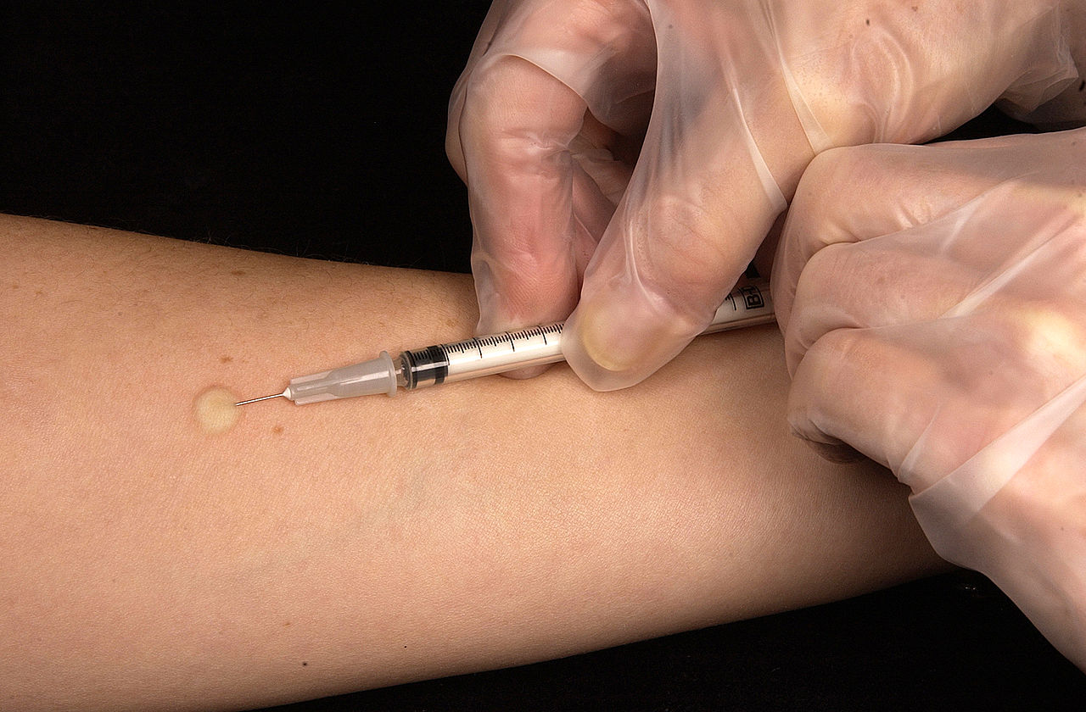
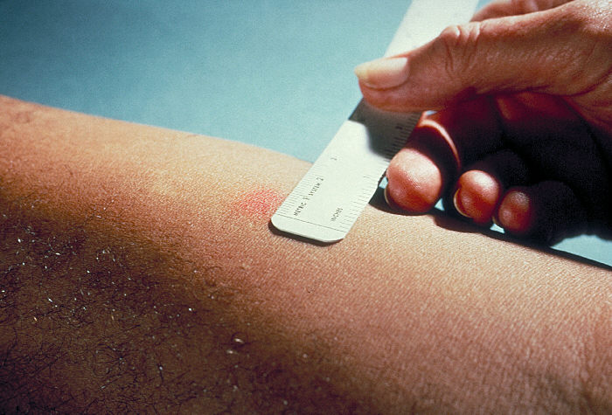
Mantoux) test
A positive tuberculin skin test result signifies cell-mediated hypersensitivity to tubercular antigens, but does not differentiate between infection and disease.
The size of induration is measured 48–72 hours later
Positive results: induces a visible and palpable induration (at least 5 mm in diameter)
False-negative reactions may be produced by certain viral infections, sarcoidosis, malnutrition, Hodgkin lymphoma, immunosuppression and AIDS.
False-positive reactions may result from infection by atypical mycobacteria

Slide 12
TB is a Granulomatous disease
A granuloma is a microscopic aggregation of
macrophages that are transformed into epithelium-like cells
surrounded by mononuclear leukocytes, principally lymphocytes and occasionally plasma cells.
Epithelioid cells fuse to form giant cells have 20 or more nuclei
These nuclei are arranged either peripherally (Langhans-type giant cell) or haphazardly (foreign body-type giant cell)
Fibrous connective tissue often surrounds granulomas
In TB areas within the granuloma can undergo necrosis (caseous necrosis). Necrosis can lead to calcification
TB granulomas are called tubercles, and if they are caseating in the center, called soft tubercles.

Slide 13
Granuloma: the predominant cell type is an activated macrophage with a modified epithelial-like (epithelioid) appearance. Also seen are lymphocytes, multinucealted giant cells and occasional plasma cells.
Recognize the morphology of granulomas in TB (tubercles).

Slide 14
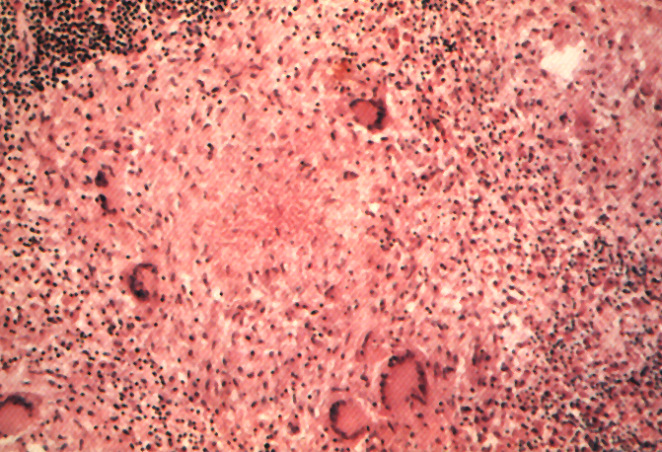
Recognize the morphology of granulomas in TB (tubercles).
Langhans Giant Cell
Lymphocytic Rim
Caseous Necrosis
Epithelioid Macrophage

Slide 15
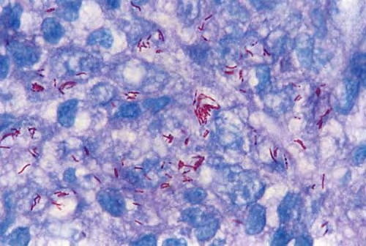
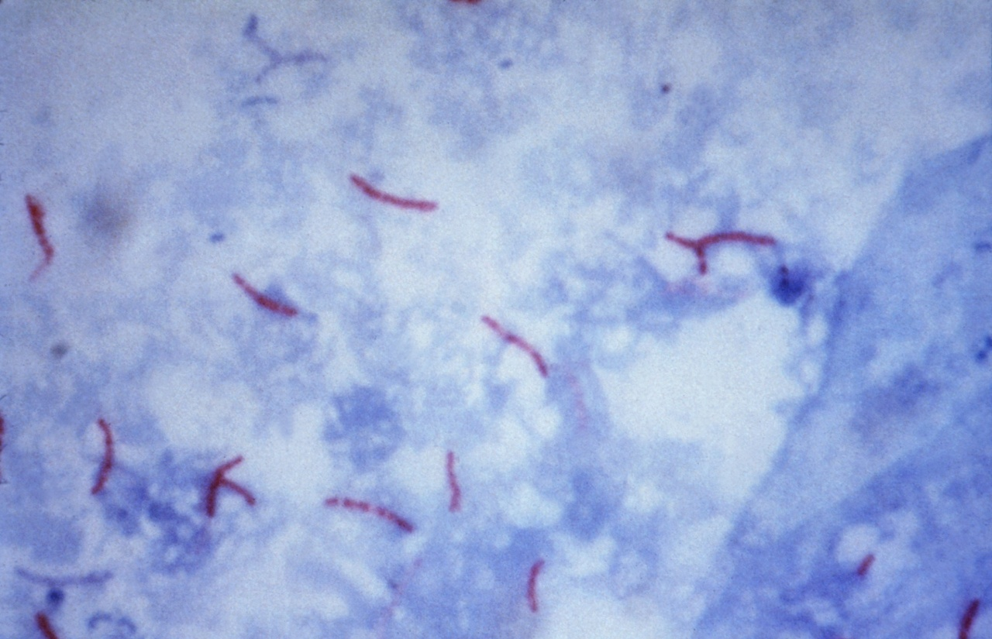
Recognize the morphology of Mycobacteria and its special stain (the Ziehl-Neelsen)
Ziehl-Neelsen stain is an acid-fast staining method to stain M. tuberculosis. The Acid-fast bacilli appear pink in a contrasting background.

Slide 16
Pathogenesis of tuberculosis
The steps in M. tuberculosis infection are:
1. Entry into macrophages:
Phagocytosis mediated by several receptors expressed on the phagocyte, including mannose binding lectin
2. Replication in macrophages.
M. tuberculosis inhibits maturation of the phagosome and blocks formation of the phagolysosome (by inhibiting Ca²⁺ signals), allowing the bacterium to replicate within the vesicle, protected from the microbicidal mechanisms of lysosomes.

Slide 17
Pathogenesis of primary TB
During the earliest stage of primary tuberculosis (<3 weeks) in the nonsensitized individual, bacteria proliferate in the pulmonary alveolar macrophages and air spaces, resulting in bacteremia and seeding of multiple sites. Despite the bacteremia, most people at this stage are asymptomatic or have a mild flu-like illness

Slide 18
Pathogenesis of Primary Tuberculosis
3. The T_{H}1 response. About 3 weeks after infection, a T-helper 1 (T_{H}1) response is mounted that activates macrophages, enabling them to become bactericidal.
Differentiation of T_{H}1 cells depends on IL-12, which is produced by antigen-presenting cells that have encountered the bacilli
TH1-mediated macrophage activation and killing of bacteria by produce IFN-γ
Macrophages activated by IFN-γ differentiate into the “epithelioid histiocytes” that aggregate to form granulomas

Slide 19
Pathogenesis of tuberculosis IFN-γ
4. T_{H}1-mediated macrophage activation and killing of bacteria by IFN-γ
IFN-γ is the critical mediator that enables macrophages to contain the M. tuberculosis infection.
How? It stimulates:
maturation of the phagolysosome in infected macrophages, exposing the bacteria to a lethal acidic, oxidizing environment.
expression of inducible nitric oxide synthase, which produces nitric oxide (NO
antimicrobial peptides (defensins) against the bacteria
autophagy, a process that sequesters and then destroys damaged the intracellular bacteria

Slide 20
Pathogenesis of granuloma
5. Granulomatous inflammation and tissue damage.
Macrophages activated by IFN-γ differentiate into the “epithelioid histiocytes” that aggregate to form granulomas; some epithelioid cells may fuse to form giant cells (langhans gaint cell)
Activated macrophages also secrete TNF and chemokines, which promote recruitment of more monocytes

Slide 21
Pathogenesis of granuloma
Host susceptibility to disease. People with genetic deficiencies in the IL-12 pathway and the IFN-γ pathway are vulnerable to severe mycobacterial infections.

Slide 22
Route of transmission of TB

Slide 23
Route of transmission of TB
M. bovis infections, acquired through drinking infected milk, usually start in the tonsils or Peyer's patches.

Slide 24
When the bacilli enter the body……
The bacilli have 5 potential fates upon entering the human body:
They may be killed by the immune system,
They may multiply and cause primary TB,
They may become dormant and remain asymptomatic,
They may proliferate after a latency period (reactivation disease). Reactivation TB may occur following either (2) or (3) above.
If immunosuppressed ---- Primary Progressive TB or Miliary TB

Slide 25
The clinical course or presentation of TB
The course of TB depends on the age and the immunity of the patient and the total burden of organism.
Some patients have only an indolent, asymptomatic infection while in others TB is a destructive disseminated disease.
Primary TB occurs on first exposure to the organism and can pursue either an indolent or aggressive course (primary progressive TB).
Secondary TB develops long after a primary infection, mostly as a result of reactivation of a primary infection. It can also be produced by exposure to exogenous organisms. Secondary TB is always an active disease.
Miliary TB

Slide 26
PRIMARY TB
Primary TB is a first exposure to tubercle bacilli. The inhaled organism is deposited in the alveoli.
Ingested by macrophages and they ellicit a type IV delayed hypersensitivity response
In a immunologically competent person a granulomatous response in produced. It takes 5-6 days invoke granuloma formation which are usually formed by 3 to 4 weeks
In immunocompromised persons, granulomas are poorly formed

Slide 27
PRIMARY TB
The lung lesion of primary TB is known as Ghon focus.
It is commonly found in the sub-pleural area.
It drains into the hilar lymph nodes.
The combination of the Ghon focus and the involved medistinal or hilar lymph nodes is called as Ghon complex.
Most of the time this Ghon complex heals undergoing shrinkage fibrous scarring and calcification. It takes 2 to 8 weeks for healing.

Slide 28
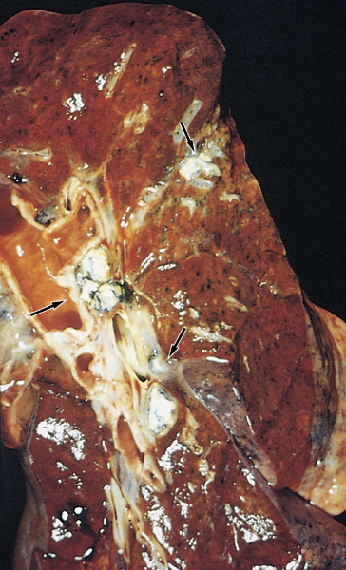
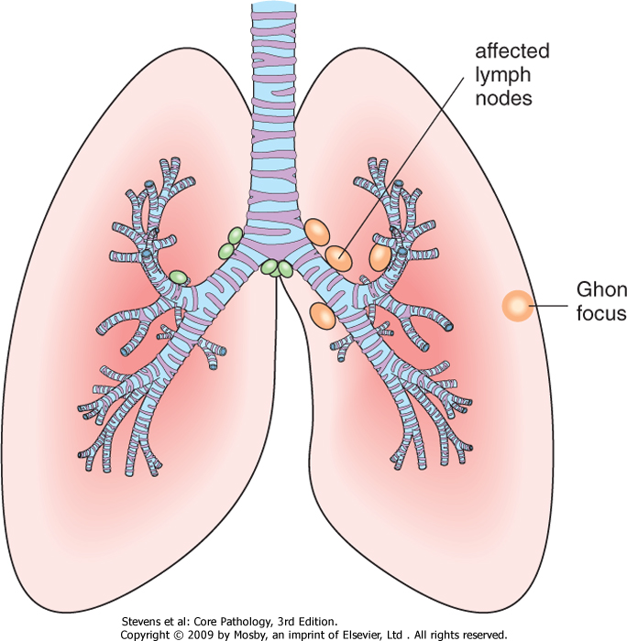
PRIMARY TUBERCULOSIS: Ghon Focus & Ghon complex
Ghon Focus: lung lesion of primary TB, involves upper segments of the lower lobes or lower segment of the upper lobe.
Ghon complex: combination of a peripheral ghon focus and involved mediastinal or hilar lymph node.
Microscopically the classic lesion of TB is a caseous granuloma

Slide 29
Caseating granulomas

Slide 30
Primary TB
Clinicaly: Primary TB is usually asymptomatic or present with low grade fever and flu like symptoms
Chest x-ray shows a subpleural midzonal round lesion with hilar lymph nodes enlargement.
Tuberculin skin test become positive

Slide 31
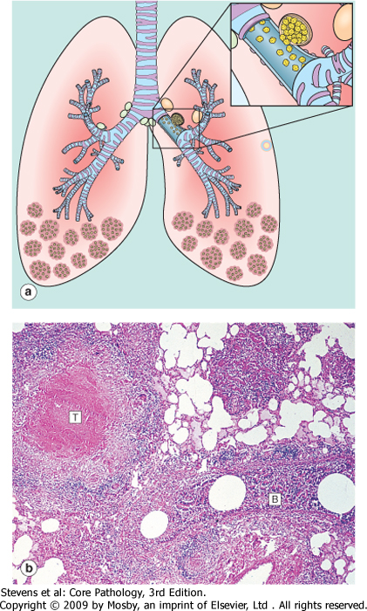
progressive primary tuberculosis
Possible sequalae of primary tuberculosis
No problems.
The disease may advance into progressive primary tuberculosis in immunocompromised patients such as AIDS patients, elderly, and malnourished children. The infection progresses and spreads to other areas of lung, lymph nodes or other multiple sites.
The foci of scarring may harbor a small number of organisms that remain viable for years and later if immune mechanisms wane or fail, these bacilli may multiply and cause reactivation of TB (secondary TB).

Slide 32
SECONDARY TUBERCULOSIS
It is post primary infection in an immunized individual.
The mycobacteria in secondary TB may be either coming from:
A reactivation of dormant organisms from old granulomas (dormant primary lesion).
This is more common.
It may develop even decades after primary infection.
Causes: various conditions including:
Cancer
Chemotherapy
AIDS
Old age
Or
Exogenous re-infection (newly acquired bacilli) by a high dose of virulent bacilli.
Seen more in endemic areas.

Slide 33
Pathologic features of secondary TB:
Secondary pulmonary tuberculosis can involve any organ but the lungs are the most common site.
In the lungs it is classically localized to the apex of the upper lobes of one or both lungs.
(M.tuberculosis bacilli love)
Appear grossly as sharply circumscribed firm mass with central cavity surrounded by fibrous wall.
The cavitation is loaded with the mycobacteria. It becomes an important source of infection because the patient now coughs sputum that contains bacilli.
Histologically: epithelioid granulomas with central caseation and Langhan’s type

Slide 34
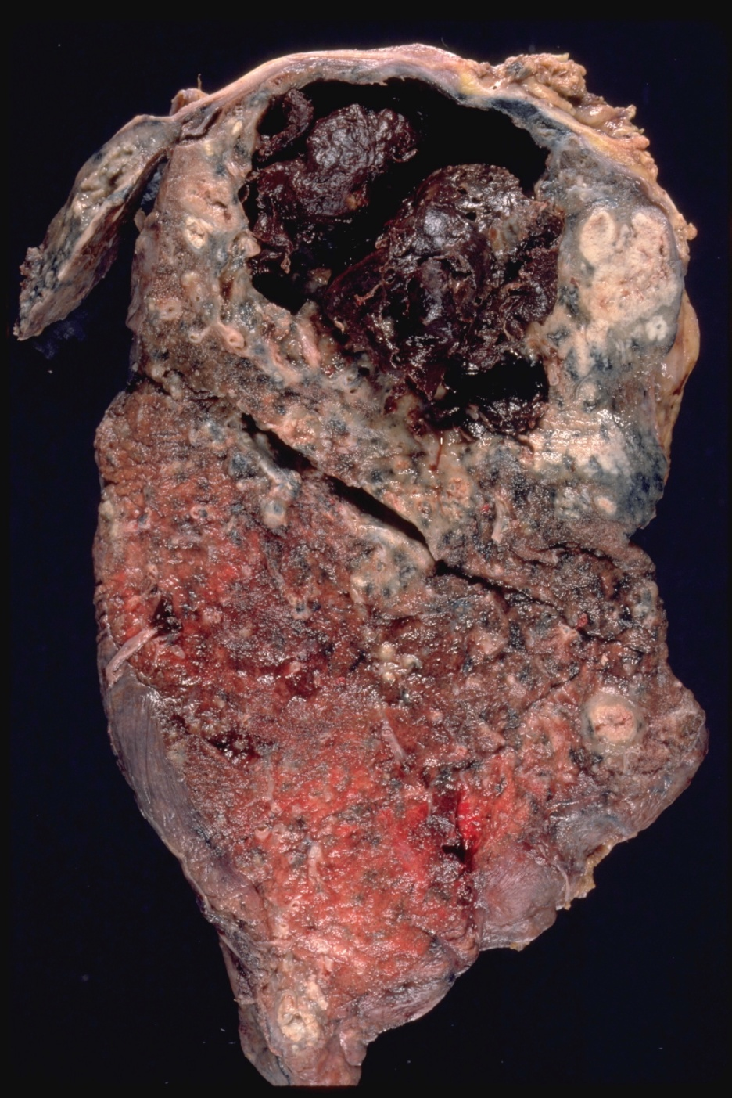
Scondary TB lung
Cavitatory tuberculosis with intracavitary hemorrhage. Extensive necrosis with cavitation, usually occurring in the upper lung lobe .

Slide 35
Complications of secondary TB
Scarring: It can heal by fibrosis leaving a residual apical scar.
Calcification (dystrophic)
Pleural fibrosis & adhesions
Local spread e.g. implantation of bacteria in the larynx leading to hoarseness or bronchial spread leads to bronchopneumonia
Systemic spread/milary TB, via:
Vein – via left ventricle to whole body
Artery – miliary spread within the lung

Slide 36
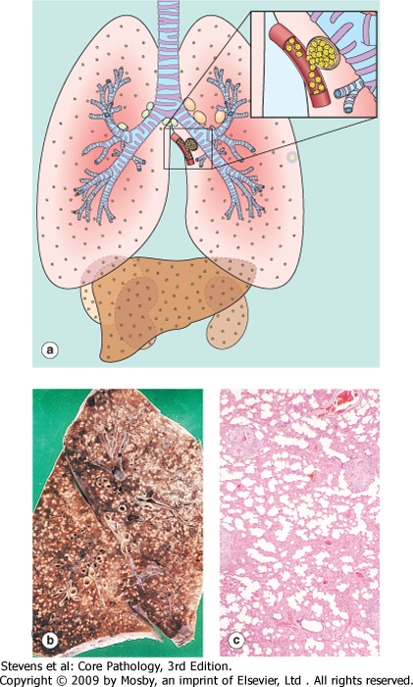
Miliary Tuberculosis: Haematogenous spreed of TB organism throughout the body
when bacteria in the lungs enters the pulmonary venous return to the heart; the organisms subsequently disseminate through the systemic arterial system and the lymphatic channels
Systemic miliary tuberculosis
It produces multiple small yellow nodular lesions in several organs. Almost every organ in the body may be seeded. Lesions resemble those in the lung.
In the lungs there multiple lesions either microscopic or small, visible (2-mm) foci of yellow-white consolidation scattered through the lung parenchyma.

Slide 37
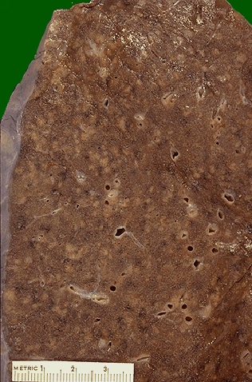
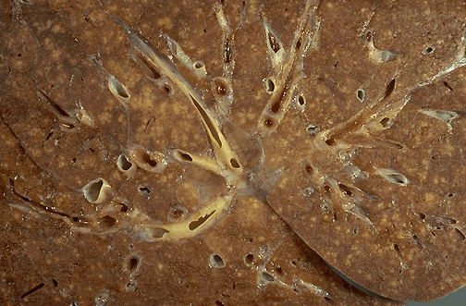
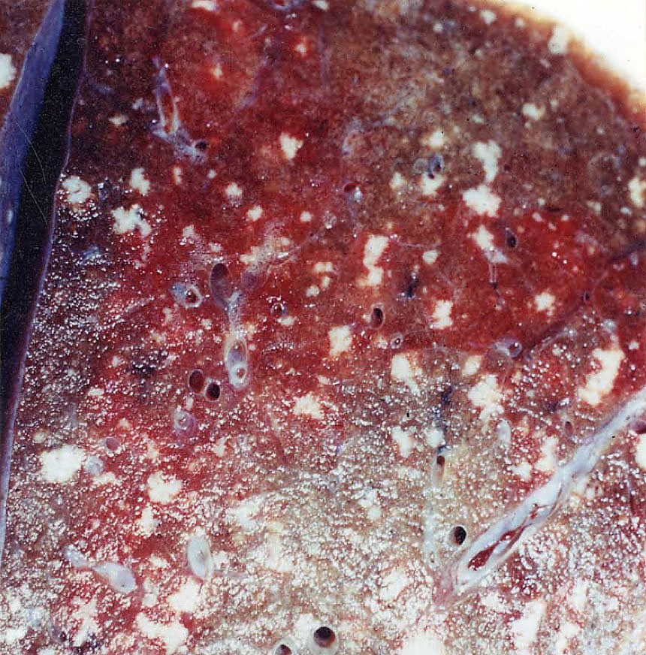
Miliary TB
Millet like – grain.
blood or bronchial spread

Slide 38
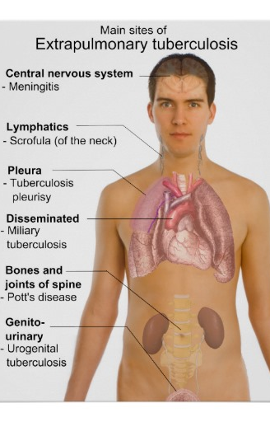
Extrapulmonary tuberculosis
Lymph nodes (tuberculous lymphadenitis): are the most frequent form of extrapulmonary tuberculosis esp. in the cervical region
Liver and spleen
adrenals
fallopian tube and endometrium
Epididymis and prostate
kidneys
meninges around the base of the brain (tuberculous meningitis),
Bone marrow
Vertebrae (Pott's disease).
Intestinal tuberculosis

Slide 39
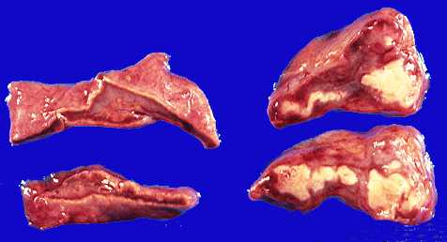
TB epididymis
TB adrenal gland

Slide 40
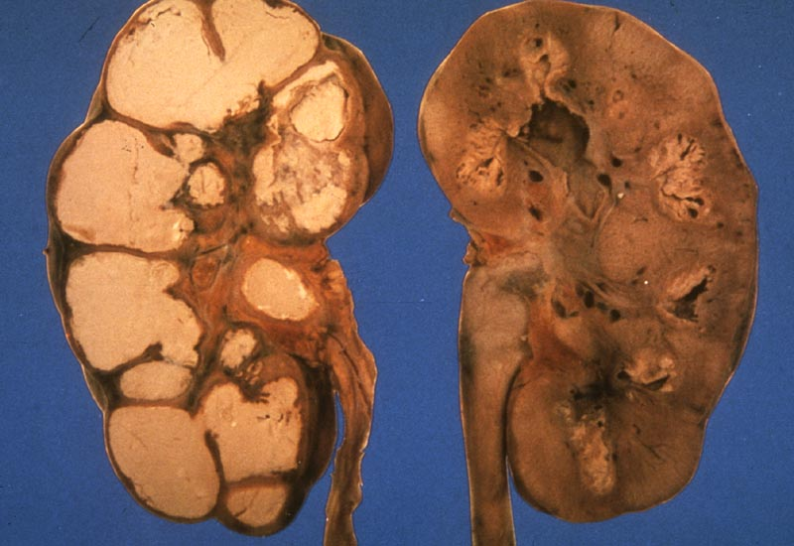
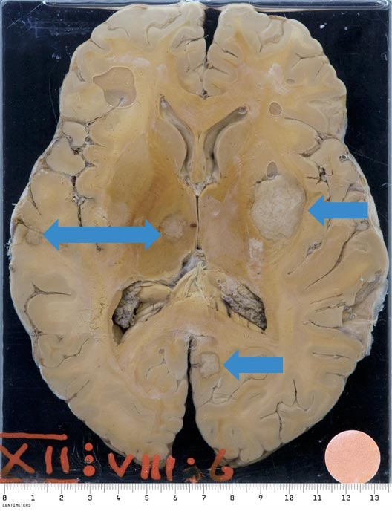
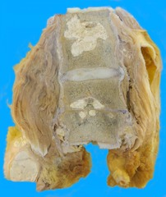
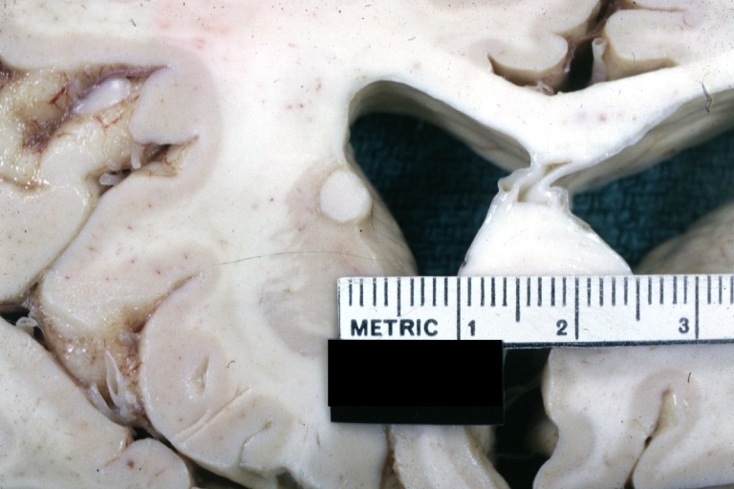
Tuberculoma
Renal TB
TB Vertebra (Potts Spine)

Slide 41
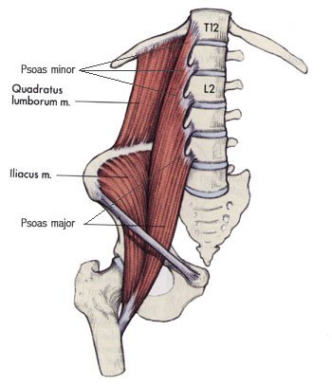
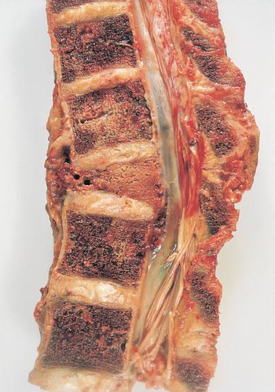
Pott’s disease
Psoas abscess
Vertebrae (Pott's disease). It collapses the spine and leads to paraspinal "cold" abscesses
in these patients, infected material may track along the tissue planes to present as an abdominal or pelvic mass

Slide 42
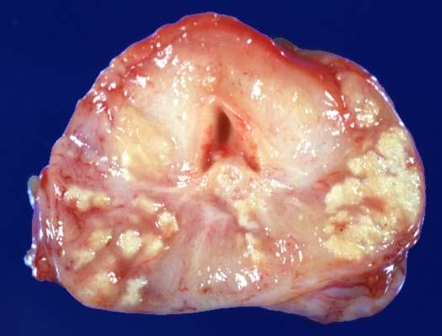
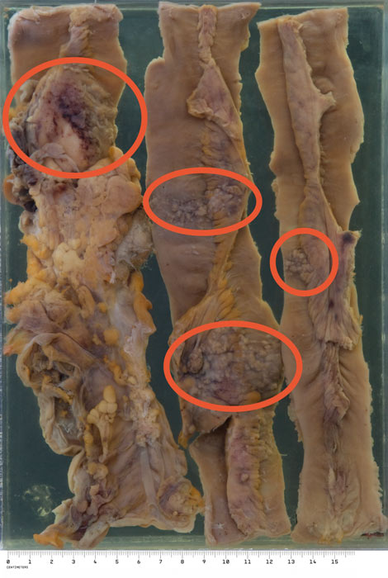
TB Prostate gland
TB intestine

Slide 43
Prognosis
The prognosis with proper treatment is generally good if infections are localized to the lungs, except when they are caused by drug-resistant strains or occur in aged debilitated, or immunosuppressed persons, who are at high risk for developing miliary TB

Slide 44
TAKE HOME MESSAGES:
Mycobacterium tuberculosis is the causative organism of tuberculosis (TB) in the lungs and elsewhere.
It gains access to the lung by inhalation and causes pulmonary TB.
A granuloma in TB is composed of activated macrophages, Langhans’ giant cells with surrounding lymphoid cells and fibroblasts with central caseation necrosis.
Primary tuberculosis is the form of disease that develops in a previously unexposed, and therefore unsensitized, person.
Secondary (reactivation) tuberculosis arises in previously exposed individuals when host immune defenses are compromised, and usually manifests as cavitary lesions in the lung apices.
Both progressive primary tuberculosis and secondary tuberculosis can result in systemic seeding, causing life-threatening forms such as miliary tuberculosis and tuberculous meningitis.
The outcome depends on the adequacy of the host immune response and treatment

Slide 45
