Slide 1
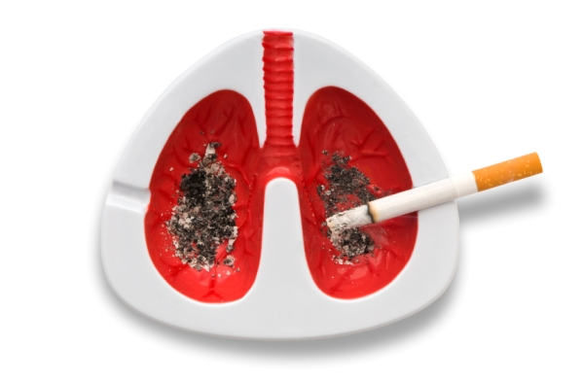
Tumors of the Lung
Dr. Maha Arafah and Prof. Ammar Rikabi
Department of Pathology
KSU, Riyadh
2018

Slide 2
Objectives
Know the epidemiology of lung cancer
Is aware of classification of bronchogenic carcinoma which include: squamous carcinoma, adenocarcinoma, small cell and large cell (anaplastic) carcinomas.
Understand the predisposing factors of bronchogenic carcinoma.
Understands the clinical features and gross pathology of bronchogenic carcinoma. Know the precursors of squamous carcinoma (squamous dysplasia) and adenocarcinoma (adenocarcinoma in situ and atypical adenomatous hyperplasia).
Have a basic knowledge about neuroendocrine tumours with special emphasis on small cell carcinoma and bronchial carcinoid.
Is aware that the lung is a frequent site for metastatic neoplasms.

Slide 3
Lung Tumors
Most lung tumors are malignant.
Primary lung cancer is a common disease BUT metastatic tumors are the most common lung carcinoma seen in clinical practice.
95% of primary lung tumors are carcinomas
5% carcinoids, mesenchymal malignancies (fibrosarcomas, leiomyomas) and lymphomas
The most common benign lesions are hamartoma

Slide 4
Epidemiology
1.Primary lung cancer is the most common fatal cancer in both men and women worldwide.
a. Accounts for >30% of cancer deaths in men
b. Accounts for >25% of cancer deaths in women
2.Incidence of lung cancer is declining in men but increasing in women.
3.Peak incidence is at 55 to 65 years of age.

Slide 5
Classification of bronchogenic carcinoma
Malignant epithelial tumors/ bronchogenic carcinoma
I. Non-Small Cell Lung Carcinoma (NSCC)
1. Squamous cell carcinoma
2. Adenocarcinoma
3. Large cell carcinoma
II. Small cell lung carcinoma (SCC)
III. Combine patterns
Carcinoid tumor
Others
Malignant mesothelial tumor
Malignant mesothelioma
Epithelial
Fibrous (spindle cell)
Biphasic
Miscellaneous malignant tumor
- Carcinosarcoma - Pulmonary blastoma - Melanoma - Lymphoma - Others

Slide 6
Classification of Malignant epithelial tumors of lung: (Bronchogenic carcinoma )
I. Non-Small Cell Lung Carcinoma (NSCC) (70%-75%)
1. Squamous cell carcinoma (25%-35%)
2. Adenocarcinoma, including bronchioloalveolar carcinoma (30%-35%).
3. Large cell carcinoma (10%-15%).
II. Small cell lung carcinoma (SCC) (20%-25%).
III. Combine patterns (5%-10%).
- Most frequent patterns:
- Mixed squamous cell ca and adenocarcinoma.
- Mixed squamous cell ca and SCLC.
IV. Carcinoid tumors
V. Others
Both small cell carcinoma and carcinoids are neuroendocrine tumors as both arise from the neurendocrine cells normally present in the lung

Slide 7
Bronchogenic carcinoma
is a common cause of cancer death in both men and women.
For therapeutic purposes, bronchogenic carcinoma are classified into:
Non- Small cell lung carcinoma (NSCC) which includes squamous cell, adenocarcinomas, and large-cell carcinomas.
Small cell lung carcinoma (SCC)

Slide 9
Bronchogenic carcinoma
It is important to differentiated NSCC from SCC because treatment are different.
NSCC therapy
SCC therapy
Surgical:- offers the best chance for curing.
Radiation:- controls local disease. Radiation therapy is most commonly used to palliate symptoms.
Chemotherapy:- not effective.
Chemotherapy is very effective because small cell carcinomas are highly responsive to chemotherapy

Slide 10
Predisposing factors of bronchogenic carcinoma 1. Tobacco smoking:
Some 85% of lung cancers occur in cigarette smokers. Most types are linked to cigarette smoking, but the strongest association is with squamous cell carcinoma and small cell carcinoma
The nonsmoker who develops cancer of the lung usually has an adenocarcinoma.
is directly proportional to the number of cigarettes smoked daily and the number of years of smoking.
Cessation of cigarette smoking for at least 15 years brings the risk down.
Passive smoking increases the risk to approximately twice than non-smokers.
Cigarette smokers show various histologic changes, including squamous metaplasia of the respiratory epithelium which may progress to dysplasia, carcinoma in situ and ultimately invasive carcinoma

Slide 11
Predisposing factors of bronchogenic carcinoma: Other causes
Radiation: All types of radiation may be carcinogenic and increase the risk of developing lung cancer. Tradium and uranium workers are at risk
Asbestos: increased incidence of cancer with asbestos exposure, especially in combination with cigarette smoking.
Industrial exposure to nickel and chromates, coal, mustard gas, arsenic, iron etc.
Air pollution: May play some role in increased incidence. Indoor air pollution especially by radon.
Scarring: sometimes old infarcts, wounds, scar, granulomatous infections are associated with adenocarcinoma.

Slide 12
Precursor Lesions
Three types of precursor epithelial lesions are recognized:
(1) Squamous dysplasia and carcinoma in situ can lead to:
(2) Atypical adenomatous hyperplasia can lead to:
(3) Diffuse idiopathic pulmonary neuroendocrine cell hyperplasia can lead to:
It should be noted that the term "precursor" does not
imply that progression to invasion will occur in all cases
Squamous cell carcinoma
Adenocarcinoma
Neuroendocrine tumors

Slide 13
Types of bronchogenic cancer:
I. Non-Small Cell Lung Carcinoma (NSCC) (70%-75%)
1. Squamous cell carcinoma (25%-35%)
2. Adenocarcinoma, including bronchioloalveolar carcinoma (30%-35%).
3. Large cell carcinoma (10%-15%).
II. Small cell lung carcinoma (SCC) (20%-25%).

Slide 14
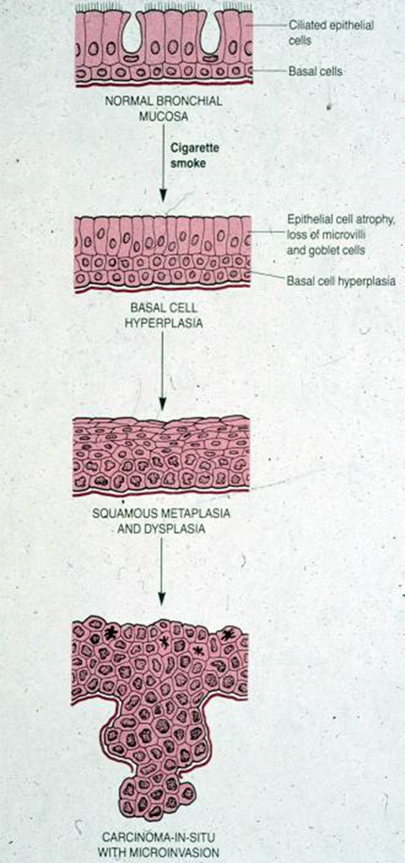
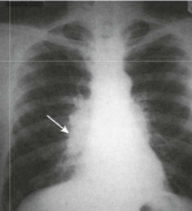
Squamous cell carcinoma (SCC)
Second most common bronchogenic carcinoma
Strong association with smoking (25 times risk)
Before Males >Females, now incidence in female rising because of smoking. It has poor prognosis
This type of cancer is preceded by years of progressive mucosal changes of respiratory epithelium to squamous metaplasia to dysplasia to carcinoma in situ to invasive SCC.
SCC arise in the central airways (centrally located). So they appears as a hilar mass.
Frequently cavitate
Tumor cells secrete a parathyroid hormone (PTH)- like peptide leading to hypercalcemia.

Slide 15
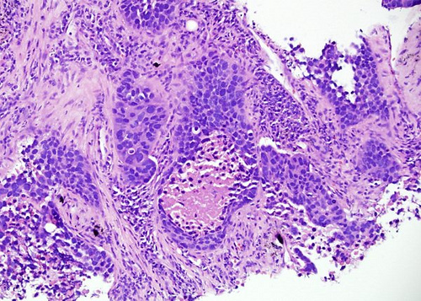
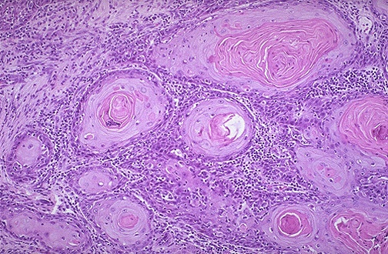
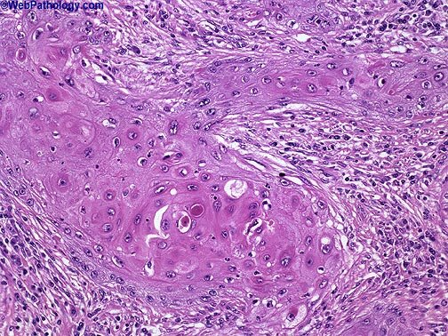
Squamous cell carcinoma (SqCC)
Histologically, these tumors are graded according to degree of squamous differentiation and tumors ranges from:
well-differentiated squamous cell carcinoma (A),
moderately differentiated SqCC (B) to
poorly differentiated SqCC (C).
C
A
B

Slide 16
Adenocarcinomas
Adenocarcinomas is now the most frequent histologic subtype of bronchogenic carcinoma; more common in women.
They do not have a clear link to smoking history
They are classically peripheral tumors arising from the peripheral airways and alveoli.

Slide 17
Adenocarcinoma Precursor Lesions
Atypical adenomatous hyperplasia is a small lesion (≤5 mm) characterized by dysplastic pneumocytes lining alveolar walls that are mildly fibrotic
Adenocarcinoma in situ; AIS (formerly called bronchioloalveolar carcinoma) is a lesion that is less than 3 cm and is composed entirely of dysplastic cells growing along preexisting alveolar septae, no growth patterns other than lepidic and no feature of necrosis or invasion
Minimally invasive adenocarcinoma of lung (MIA) ≤3 cm, describes small solitary adenocarcinomas with either pure lepidic growth or predominant lepidic growth with ≤5 mm of stromal invasion.

Slide 18
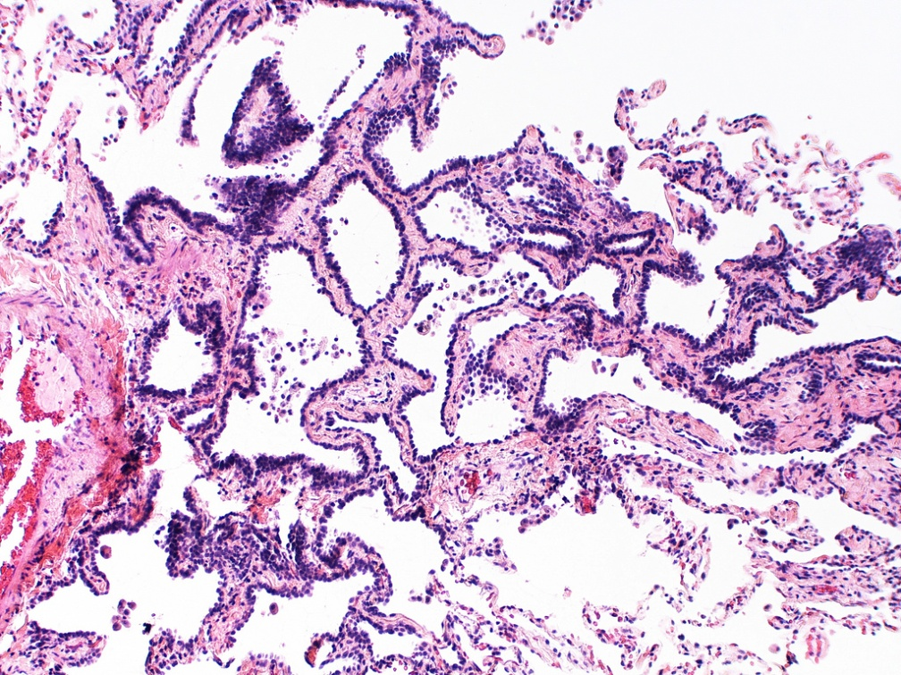
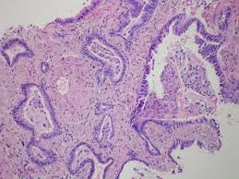
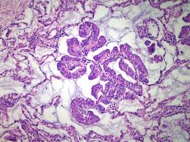
Atypical adenomatous hyperplasia
Minimally invasive adenocarcinoma of lung
Adenocarcinoma in situ (formerly called bronchioloalveolar carcinoma)

Slide 19
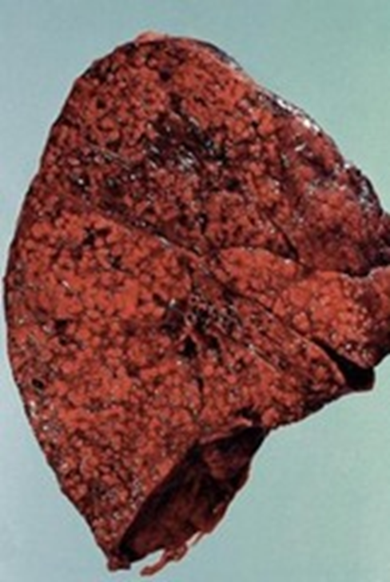
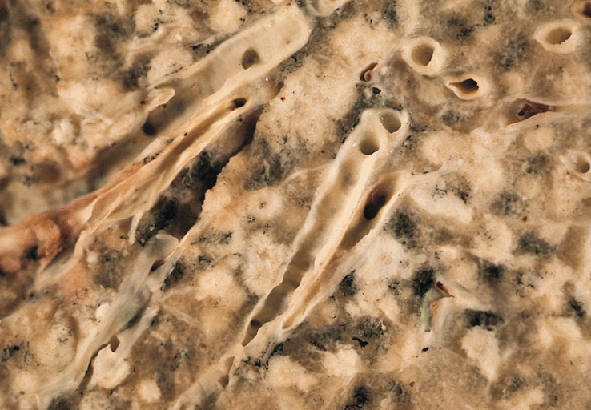
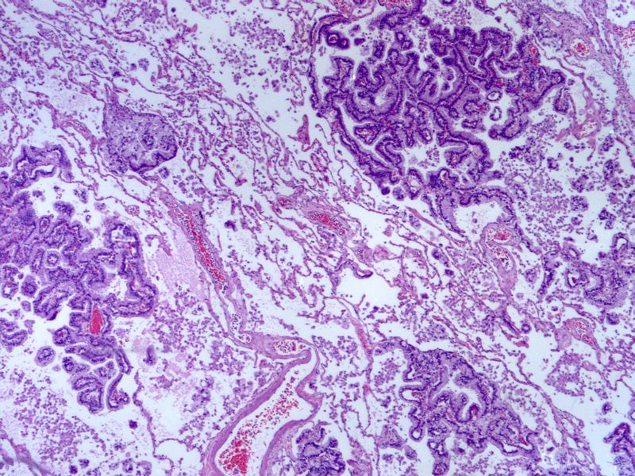
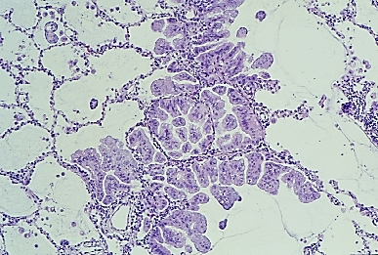
Adenocarcinoma in situ (formerly called bronchioloalveolar carcinoma
Malignant cells grow along alveolar septae
referred to as adenocarcinoma in situ according to the new classification of lung cancers

Slide 20
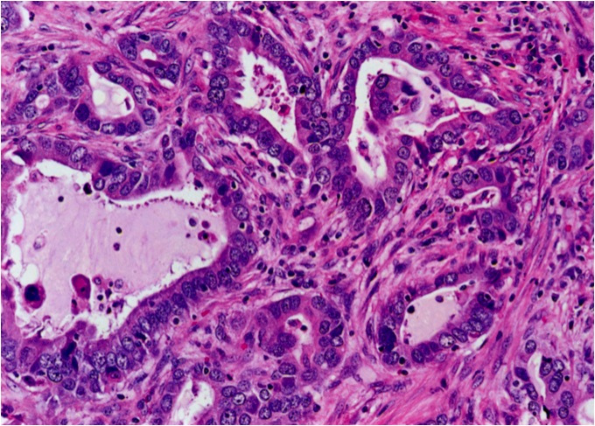
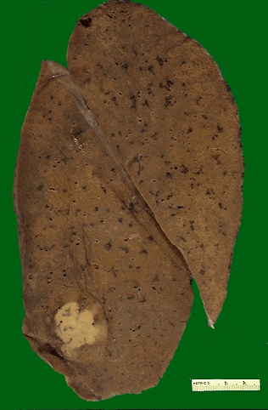
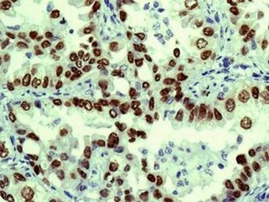
Adenocarcinomas
More common in patients under the age of 40, women and non-smokers.
Tend to metastasize widely at early stage
The hallmark of adenocarcinomas is the tendency to form glands that may or may not produce mucin.
Peripheral adenocarcinomas are sometimes associated with pulmonary scars (from a previous pulmonary inflammation/infection) and therefore is also referred to as scar carcinoma.
Rarely cavitate
TTF1

Slide 21
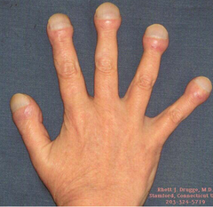
Adenocarcinoma
- Associated with hypertrophic
pulmonary osteoarthropathy
“Clubbing of the fingers”
- 20% of adenocarcinoma of the lung are associted with mutation of epidermal growth factor receptor (EGFR) and respond to its anti therapy

Slide 22
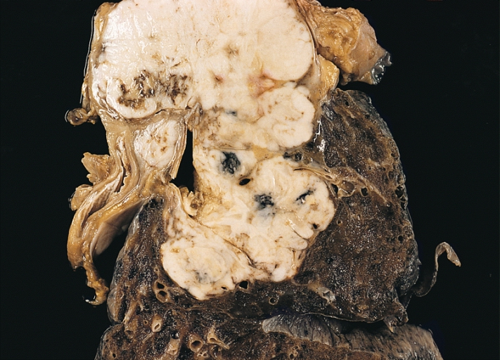
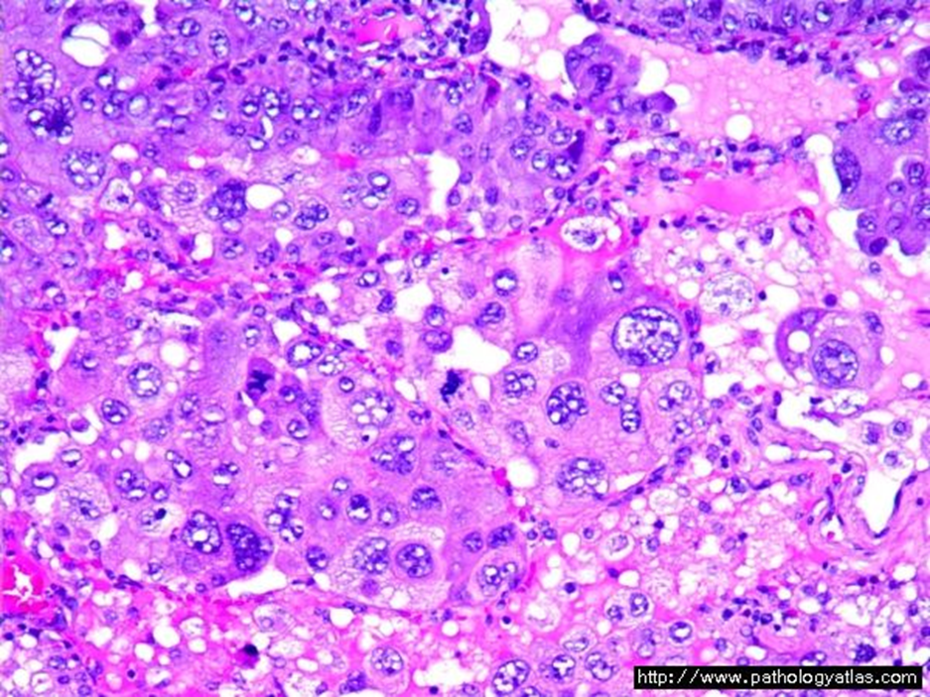
Large Cell Carcinoma
Frequency: 10 %
strongly associated with smoking
Large-cell carcinoma are usually located peripherally. These group of carcinomas are undifferentiated. They made up of large and anaplastic cells. They may exhibit neuroendocrine or glandular differentiation markers when studied by immunohistochemistry or electron microscopy.
Poor prognosis.

Slide 23
Small cell carcinomas
SCLC are a type neuroendocrine tumors arising from neuroendocrine cells. More common in men.
Highly malignant and aggressive tumor, poor prognosis, rarely resectable.
Strongly associated with cigarette smoking. 95% of patients are smokers
Centrally located perihilar mass with early metastases (Early involvement of the hilar and mediastinal nodes)
Chemotherapy responsive
least likely form to be cured by surgery; usually already metastatic at diagnosis
Ability to secrete a host of polypeptide hormones like ACTH, antidiuretic hormone (ADH), calcitonin, gastrin-releasing peptide and chromogranin.
It may be associated with paraneoplastic syndrome, Cushing’s, and Eaton-Lambert syndrome

Slide 24
Eaton-Lambert syndrome
is an autoimmune disease
The immune system attacks the connection between nerve and muscle (the neuromuscular junction) and interferes with the ability of nerve cells to send signals to muscle cells lead to muscle weakness

Slide 25
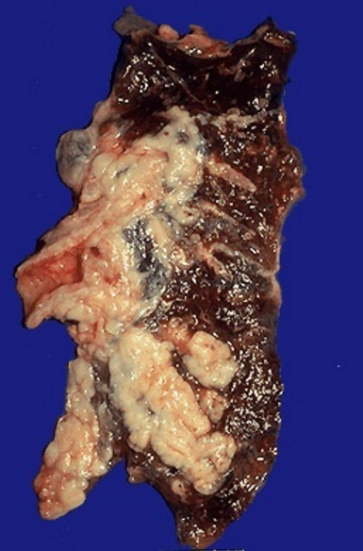
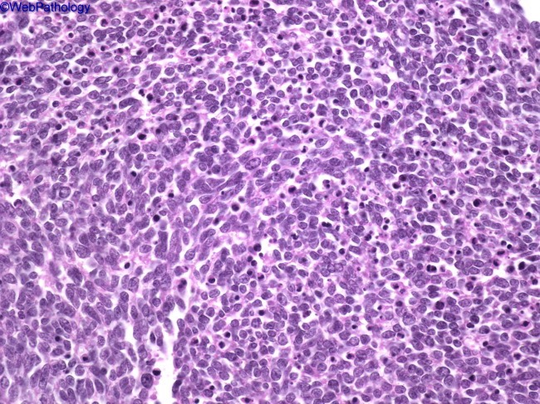
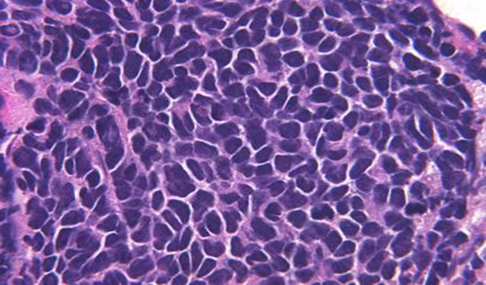
Small cell carcinomas
Microscopically composed of small, dark, round to oval, lymphocyte-like cells with little cytoplasm.
Electron microscopy: dense-core neurosecretory granules.

Slide 26
Bronchogenic carcinoma site
Central tumors
Peripheral tumors
Squamous cell CA
Small cell CA
Adenocarcinoma
- bronchial derived
- bronchioloalveolar ca
Large cell carcinoma

Slide 27
Molecular genetics in lung cancer
Most common oncogenes—KRAS, MYC family, HER-2/neu, BCL-2, EGFR
(epidermal growth factor receptor found in 20% of pulmonary adenocarcinoma, if certain mutation is positive, will respond to anti-tyrosin kinase therapy)
b. Most common suppressor genes—p53 (most common), RB1, p16

Slide 28
Clinical features of bronchogenic carcinoma
Can be silent or insidious lesions
Cough
Most common symptom (75% of cases)
Weight loss (40% of cases)
Chest pain (30% of cases)
Hemoptysis (25%–30% of cases)
Dyspnea
Hoarseness, chest pain, pericardial or pleural effusion.
Symptoms due to invasion and metastatic spread.

Slide 29
Clinical features: may also be manifest by the following
Superior vena cava syndrome: invasion leads to obstruction of venous drainage which leads to dilation of veins in the upper part of the chest and neck resulting in swelling and cyanosis of the face, neck, and arms
Pancoast tumor (superior sulcus tumor): Apical neoplasms may invade the brachial sympathetic plexus to cause severe pain, numbness and weakness in the distribution of the ulnar nerve.
Pancoast tumor is often accompanied by destruction of the first and second ribs and thoracic vertebrae. It often coexists with Horner syndrome
Horner syndrome: invasion of the cervical thoracic sympathetic nerves and it leads to ipsilateral enophthalmos, miosis, ptosis, and facial anhidrosis.
The combination of these clinical findings is known as Pancoast syndrome.

Slide 30
Complications of bronchogenic carcinoma
Bronchiectasis
Obstructive pneumonia
Pleural effusion, bloody
Hoarseness from recurrent laryngeal nerve paralysis
Paraneoplastic syndrome

Slide 31
Paraneoplastic syndrome
are extrapulmonary, remote effects of the tumor
3% to 10% of lung cancers develop paraneoplastic syndromes
Squamous cell carcinomas may secrete parathyroid hormone-like peptide lead to hypercalcemia
Adenocarcinomas can lead to hematologic manifestations and Digital clubbing due to reactive periosteal changes
Small cell carcinomas
ACTH (leading to Cushing's syndrome)
ADH ( water retention and hyponatremia)

Slide 32
Clinical features and complication of bronchogenic carcinoma

Slide 33
Spread of bronchogenic carcinoma
1. Lymphatic spread.
* successive chains of nodes (scalene nodes).
* involvement of the supraclavicular node
(Virchow’s node).
2. Extend into the pericardial or pleural spaces. Infiltrate the superior
vena cava.
A tumor may extend directly into the esophagus, producing obstruction, sometimes complicated by a fistula.
Phrenic nerve invasion usually causes diaphragmatic paralysis
5. May invade the brachial or cervical sympathetic plexus (Horner’s Syndrome).
6. Distant metastasis to liver (30-50%), adrenals (>50%), brain (20%) and bone (20%).

Slide 34
Prognosis:
Histological types and the stage of lung cancer determine the outcome
Survival is better for early stage disease, except for small cell carcinoma (very early metastases)
Non–small cell cancers fare better than small cell carcinoma
Overall combined 5-year survival rate is ~15%

Slide 35
Carcinoid tumor
Carcinoid tumors of the lung are neuroendocrine neoplasms
These neoplasms account for 2% of all primary lung cancers,
It shows no sex predilection, and are not related to cigarette smoking or other environmental factor.
Usually seen in adults
Can be central or peripheral in location.
Tumor cells produce serotonin and bradykinin leading to carcinoid syndrome
Can occur in patients with Multiple Endocrine Neoplasia (MEN-I)
Low grade malignancy, Often resectable and curable.
Spreads by direct extension into adjacent tissue

Slide 36
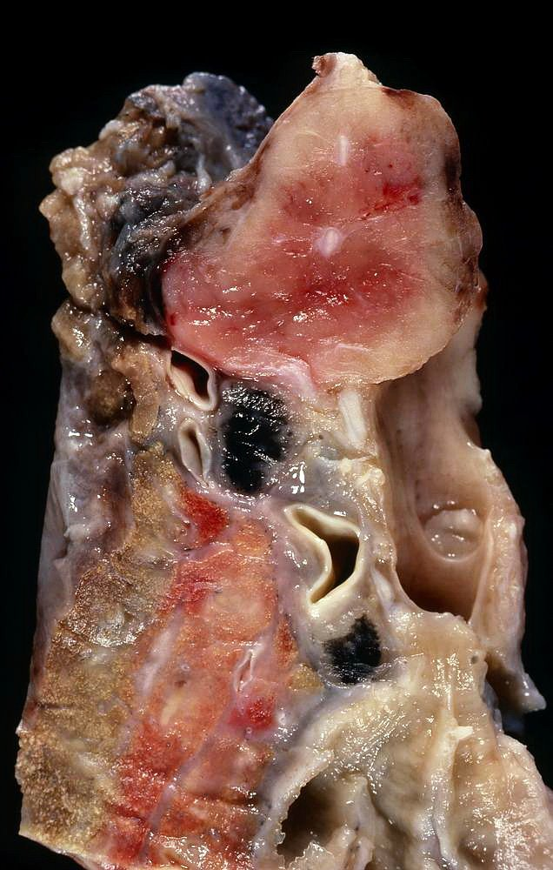
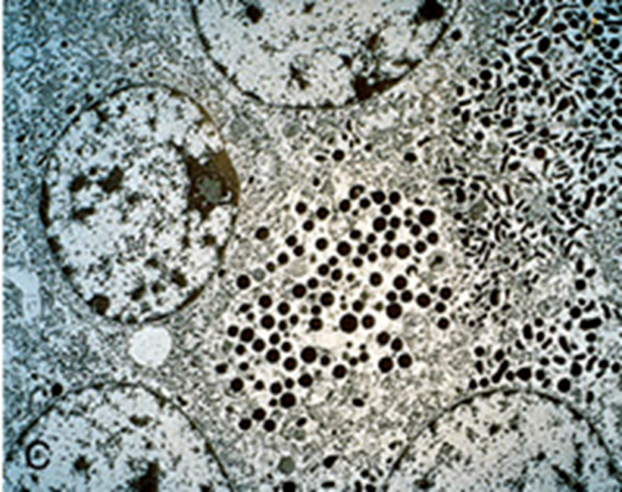
Morphology of typical carcinoid tuomors
Composed of uniform cuboidal cells that have regular round nuclei with few mitoses and little or no anaplasia.
Electron microscopy: dense-core neurosecretory granules

Slide 37
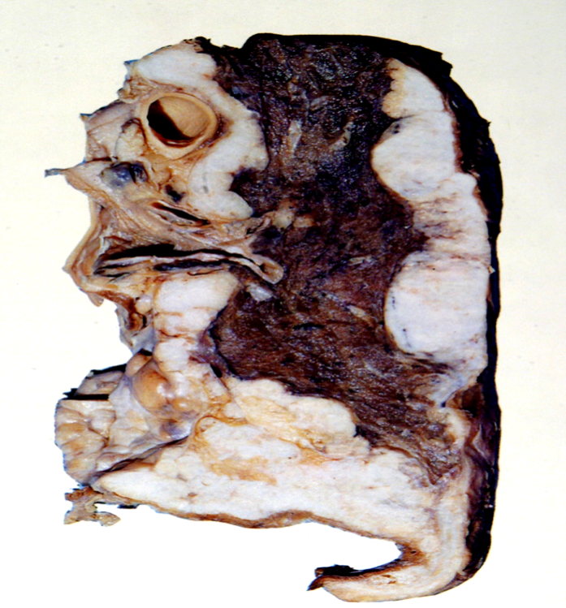
Mesothelioma
Malignant tumor of mesothelial cells lining the pleura
Highly malignant neoplasm
Most patients (70%) have a history of exposure to asbestos
Smoking is not related to mesothelioma
The age of patients with mesothelioma is 60 years.
Pleural mesotheliomas tend to spread locally within
the chest cavity, invading and compressing major structures.
Metastases can occur to the lung parenchyma and mediastinal lymph nodes, liver, bones, peritoneum etc.
Treatment is largely ineffective and prognosis is poor
few patients survive longer than 18 months after diagnosis

Slide 38
Carcinoma metastatic to the lung
Pulmonary metastases are more common than Primary Lung Tumors
Metastatic tumors in the lung are typically multiple and circumscribed. When large nodules are seen in the lungs radiologically, they are called cannon ball metastases
The common primary sites are the breast, stomach, pancreas, kidney and colon.

