Slide 1
1. TUBERCULOSIS 2. CANCER OF THE LUNG
Repiratory block
SECOND PRACTICAL
Pathology Dept. KSU
Respiratory Block

Slide 2
TUBERCULOSIS
Tuberculosis is a chronic inflammation caused by Mycobacterium tuberculosis
The most affected organ by tuberculosis is the lung.
Pulmonary tuberculosis is classified in primary and secondary.
Charactarized histologicaly by
Central caseous necrosis, epithelioid cells, multinucleated giant cells, Ghon’s complex.
Complications of TB are:
- Amyloidosis ,
- Tuberculous pneumonia
- Miliary tuberculosis
- Tuberculous meningitis
- Addison disease .
Pathology Dept. KSU
Respiratory Block

Slide 3
Pulmonary TB – Caseous Necrosis – Gross
Primary TB:
Primary tuberculosis is the pattern seen with initial infection with tuberculosis in children.
Reactivation, or secondary tuberculosis, is more typically seen in adults.
This is a gross appearance of caseous necrosis in a hilar lymphnode
The nodule have a cheesy tan to white appearance
Caseous necrosis is a combination of coagulation and liqufactive necrosis
Pathology Dept. KSU
Respiratory Block

Slide 4
Pulmonary TB - Ghon’s Complex – Gross Pathology
The Ghon’s focus is a sub pleural location of caseous necrosis
The Ghon’s complex is a combination of Ghon’s focus and hilar lymph node involvement
Pathology Dept. KSU
Respiratory Block

Slide 5
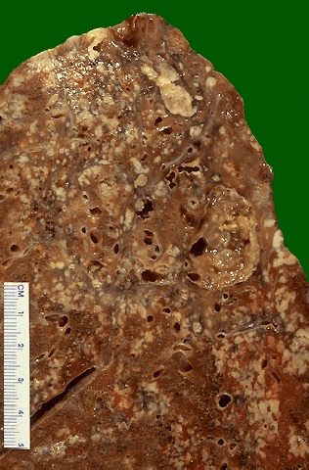
Pulmonary TB – Caseous Necrosis – Gross
Secondary TB
occur by the reactivation of the latent primary infection, the other cases resulting from reinfection with Mycobacterium tuberculosis.
The granulomatous inflammation is much florid and widespread
Typically , the upper lobes are most affected
Tissue destruction and Cavitation can occur

Slide 6
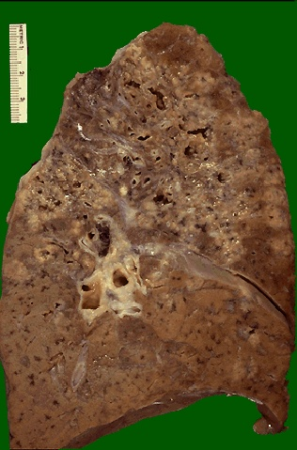
Pulmonary TB – Caseous Necrosis – Gross
Extensive caseation and the granulomas involve a larger bronchus causing soft, necrotic center to drain out and leave behind a cavity. Cavitation is typical for large granulomas with TB. Cavitation is more common in the upper lobes.
Pathology Dept. KSU
Respiratory Block

Slide 7
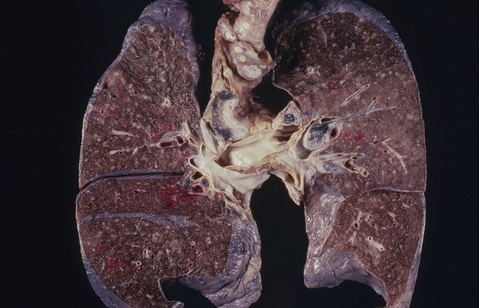
Miliary TB of the Lungs
Miliary TB can occur when TB lung lesions erode pulmonary veins or when extrapulmonary TB lesions erode systemic veins.
This results in hematogenous dissemination of tubercle bacilli producing myriads of 1-2 mm. lesions throughout the body in susceptible hosts.
Miliary spread limited to the lungs can occur following erosion of pulmonary arteries by TB lung lesions.
Pathology Dept. KSU
Respiratory Block

Slide 8
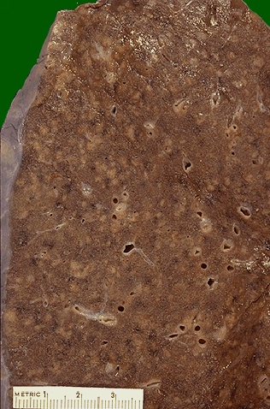
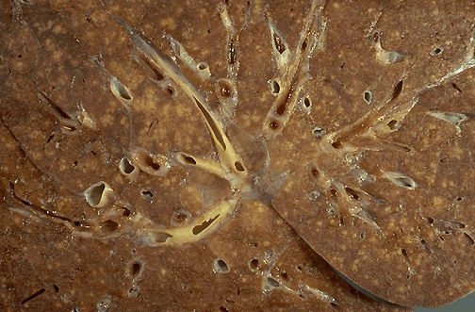
Miliary TB of the Lungs – Cut section
This is a "miliary" pattern of granulomas because there are a multitude of small tan granulomas, about 2 to 4 mm in size, scattered throughout the lung parenchyma. The miliary pattern gets its name from the resemblence of the granulomas to millet seeds.
Pathology Dept. KSU
Respiratory Block

Slide 9
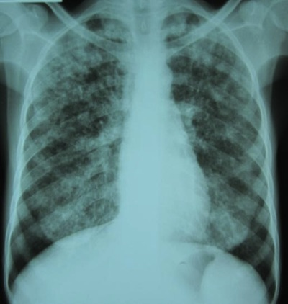
Miliary TB of the Lungs – X-Ray
This chest x-ray shows a patient with miliary TB.
Miliary nodules appear as 1-3 mm diameter, which are uniform in size and uniformly distributed.
Pathology Dept. KSU
Respiratory Block

Slide 10
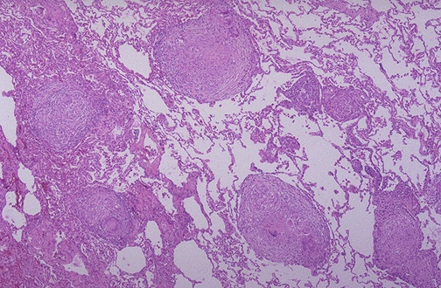
Tuberculous Granulomas - LPF
At low magnification, this micrograph reveals multiple granulomas. Granulomatous disease by chest radiograph appear as reticulonodular densities.
Pathology Dept. KSU
Respiratory Block

Slide 11
Tuberculous Granulomas - HPF
Well-defined granulomas are seen here.
They have rounded outlines.
contains several Langhan’s giant cells.
Granulomas are composed of transformed macrophages called epithelioid cells along with lymphocytes, occasional PMN's, plasma cells, and fibroblasts
Pathology Dept. KSU
Respiratory Block

Slide 12
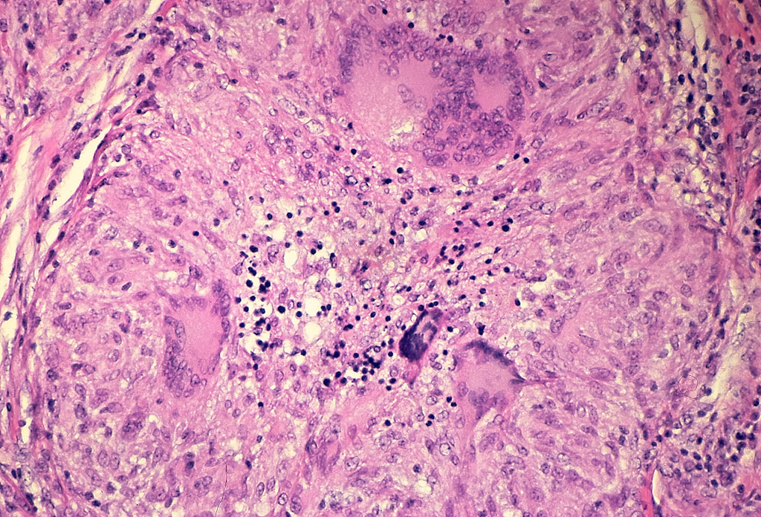
Pulmonary TB - Granuloma with central early necrosis
The pyknotic nuclei of epithelioid cells in the center of the granuloma (apoptotic bodies) are a precursor of necrosis.
Pathology Dept. KSU
Respiratory Block

Slide 13
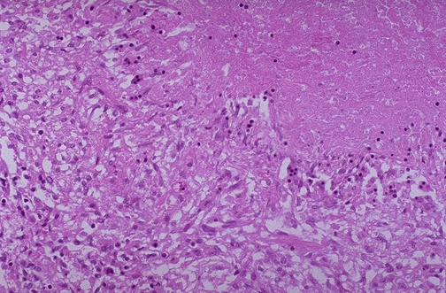
Tuberculous Granulomas - HPF
[1] The edge of a granuloma is shown here at high magnification. At the upper is amorphous pink caseous material composed of the necrotic elements of the granuloma as well as the infectious organisms.
[2] This area is ringed by the inflammatory component with epithelioid cells, lymphocytes, and fibroblasts.
1
2
Pathology Dept. KSU
Respiratory Block

Slide 14
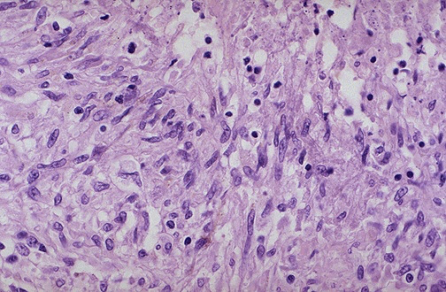
Epithelioid cell in Tuberculosis - HPF
These are epitheloid cells around the cener of a granuloma
They are activated macrophages With elongated, finely granular pale eosinophilic cytoplasm
They get their name from the fact that they have lots of pink cytoplasm similar to squamous epithelial cells
Their nuclei tend to be long

Slide 15
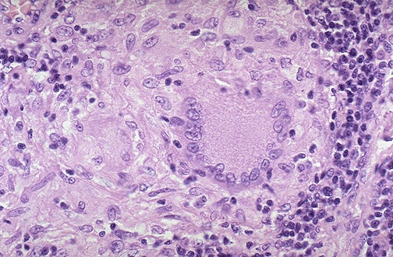
Epithelioid & Giant cell Granulomas in Tuberculosis
At high magnification, the granuloma demonstrates that the epithelioid macrophages are elongated with long, pale nuclei and pink cytoplasm. The macrophages organize into committees called giant cells. The typical giant cell for infectious granulomas is called a Langhan’s giant cell and has the nuclei lined up along one edge of the cell
Pathology Dept. KSU
Respiratory Block

Slide 16
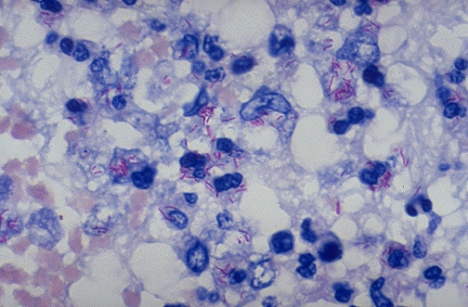
Acid Fast bacilli of Mycobacterium TB in the Lung
A stain for Acid Fast Bacilli is done (AFB stain) to find the mycobacteria .
The mycobacteria stain as red rods, as seen here at high magnification.
Pathology Dept. KSU
Respiratory Block

Slide 17
LUNG CARCINOMA
Pathology Dept. KSU
Respiratory Block

Slide 18
MAJOR CATIGORIES OF LUNG CARCINOMA
NON-SMALL CELL CARCINOMA
SQUAMOUS CELL CARCINOMA
ADENOCARCINOMA
LARGE CELL CARCINOMA
SMALL CELL CARCINOMA
The NON-small cell cancers behave and are treated similarly, the SMALL cell carcinomas are WORSE than the non-small cell carcinomas, but respond better to chemotherapy, often drastically!
Pathology Dept. KSU
Respiratory Block

Slide 19
1. Squamous Cell Carcinoma of the lung
Most commonly found in men
correlated with smoking.
Other etiology: industrial hazards, air pollution and genetic alterations
SCC are often preceded for years by squamous metaplasia or dysplasia in the bronchial epithelium which then Transforms to carcinoma in situ
Grading is based on the amount of keratin cytoplasm
well-differentiated with keratin whorls,
moderately differentiated
poorly differentiated tumors
Pathology Dept. KSU
Respiratory Block

Slide 20
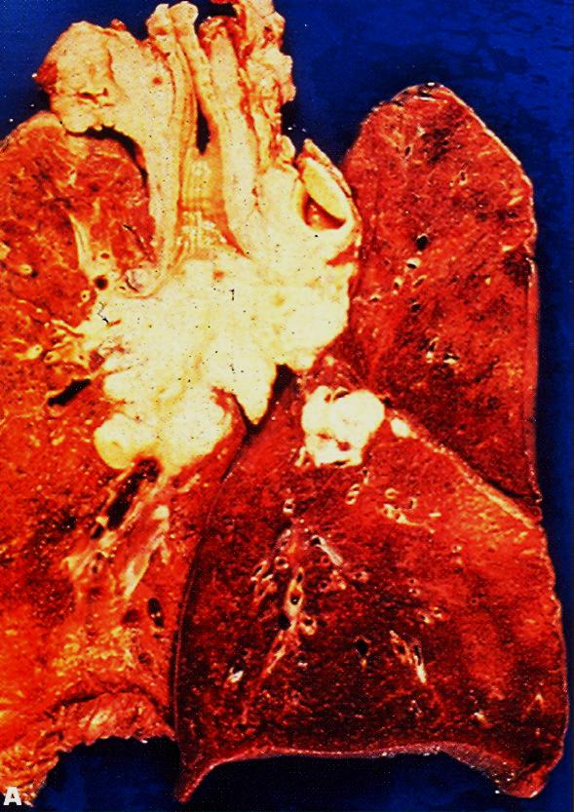
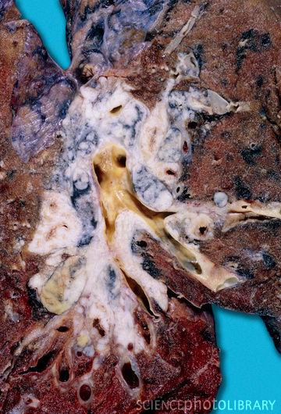
Squamous Cell Carcinoma of the Lung - Gross
This is a squamous cell carcinoma of the lung that is arising centrally in the lung (as most squamous cell carcinomas do). It is obstructing the right main bronchus. The neoplasm is very firm and has a pale white to tan cut surface.
Pathology Dept. KSU
Respiratory Block

Slide 21
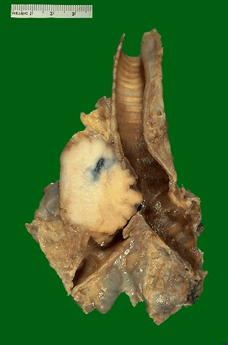
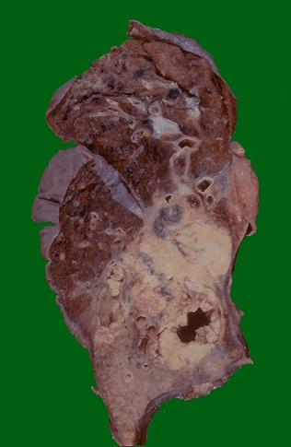
Squamous Cell Carcinoma of the Lung - Gross
This is a larger squamous cell carcinoma in which a portion of the tumor demonstrates central cavitation, probably because the tumor outgrew its blood supply and undergo central necrosis
Pathology Dept. KSU
Respiratory Block

Slide 22
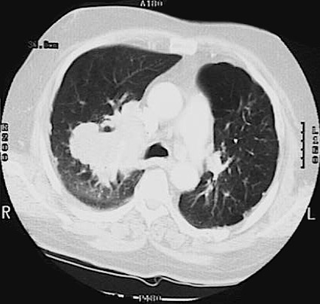
Squamous Cell Carcinoma of the Lung – CT scan
This chest CT scan view demonstrates a large squamous cell carcinoma of the right upper lobe that extends around the right main bronchus and also invades into the mediastinum and involves hilar lymph nodes.
Pathology Dept. KSU
Respiratory Block

Slide 23
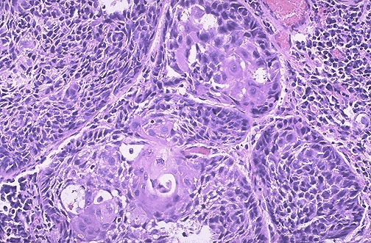
Squamous Cell Carcinoma of the Lung - HPF
Microscopic appearance of squamous cell carcinoma with nests of polygonal cells with pink cytoplasm and distinct cell borders. The nuclei are hyperchromatic and angular.
Pathology Dept. KSU
Respiratory Block

Slide 24
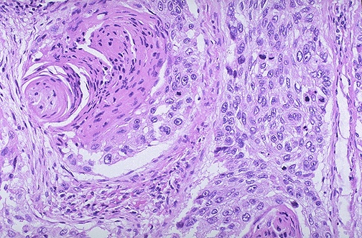
Squamous Cell Carcinoma of the Lung - HPF
R
L
In this squamous cell carcinoma at the upper right is a squamous eddy with a keratin pearl. At the left, the tumor is less differentiated and several dark mitotic figures are seen
Pathology Dept. KSU
Respiratory Block

Slide 25
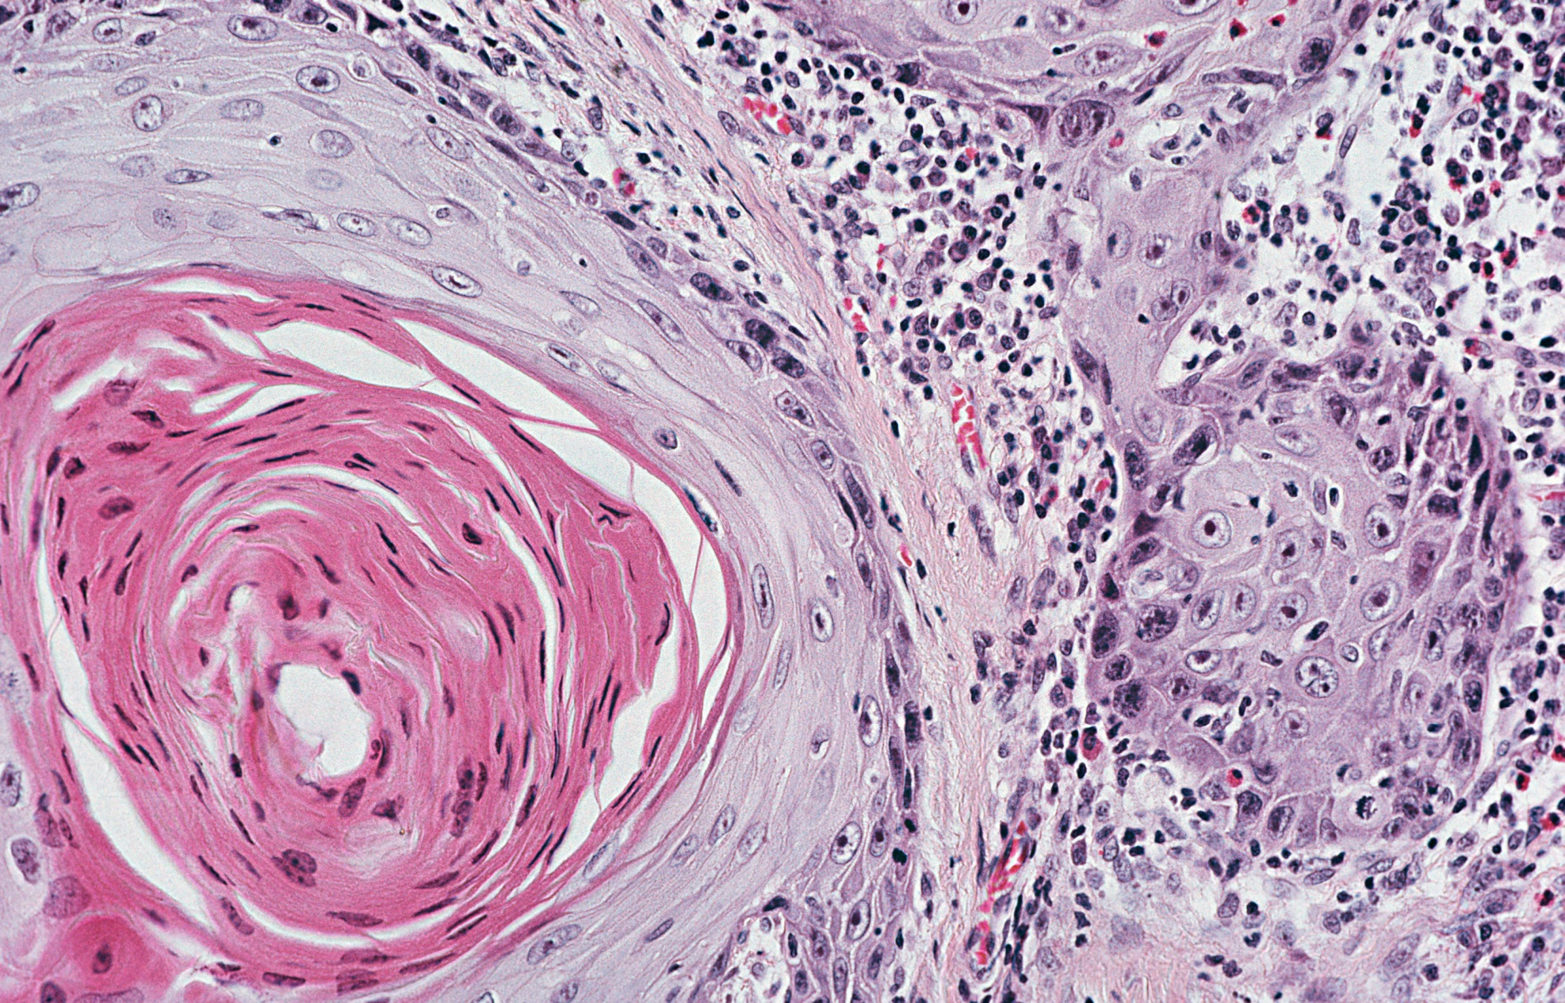
Squamous Cell Carcinoma of the Lung - HPF
Neoplastic squamous cells show pleomorphism, hyperchromatism, individual cell keratinization, mitoses and areas of necrosis.
Pathology Dept. KSU
Respiratory Block

Slide 26
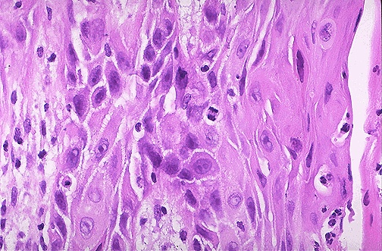
Squamous Cell Carcinoma of the Lung - HPF
The pink cytoplasm with distinct cell borders and intercellular bridges characteristic for a squamous cell carcinoma of the lung
Pathology Dept. KSU
Respiratory Block

Slide 27
2. Adenocarcinoma of the lung
The most common type of lung cancer, making up 30-40% of all cases.
Glandular differentiation by tumor cells and 80% of those cells produce mucin.
Not as strongly associated with a smoking history as compared to Squamous or Small Cell Carcinomas
Adenocarcinoma in situ - called bronchoalveolar carcinoma
Early and distant metastases
Adenocarcinoma grow in various patterns, including lepidic , acinar, papillary , micropapillary and solid
Pathology Dept. KSU
Respiratory Block

Slide 28
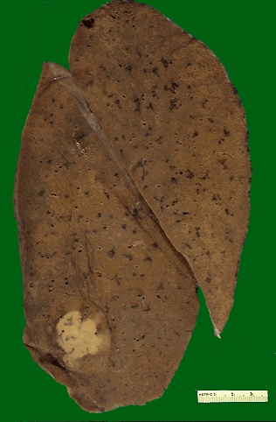
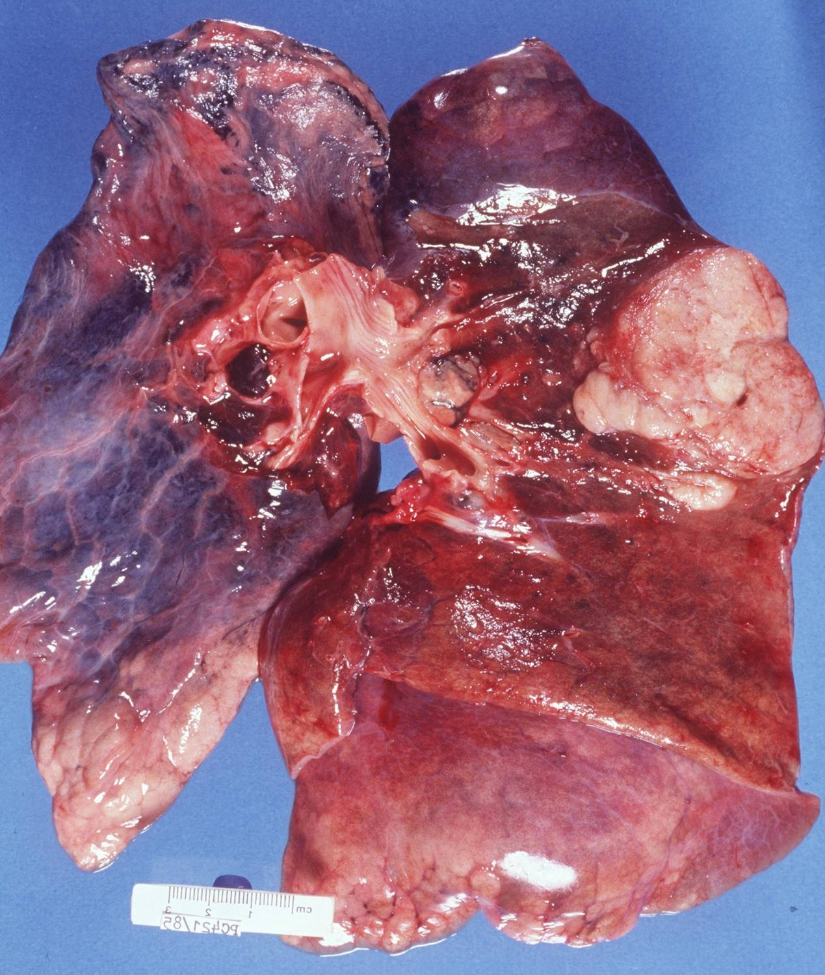
Adenocarcinoma of the Lung – Gross
A peripheral adenocarcinoma of the lung. Adenocarcinomas tend to occur more peripherally in lung. Adenocarcinoma is the one cell type of primary lung tumor that occurs more often in non-smokers and in smokers who have quit.
Grossly: white-tan solitary nodule and peripherally located
Pathology Dept. KSU
Respiratory Block

Slide 29
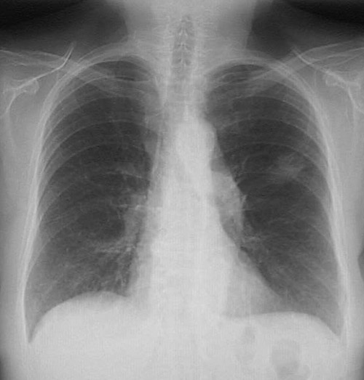
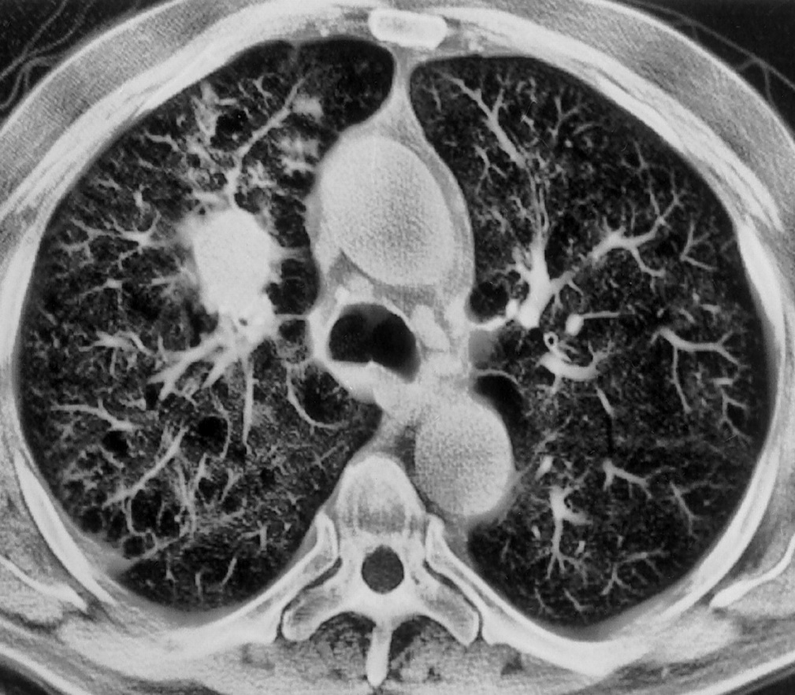
Adenocarcinoma of the Lung
X-Ray
CTscan
A peripheral adenocarcinoma of the lung appears in this chest radiograph of an elderly non-smoker woman.
CT scans in a 61-year-old man with adenocarcinoma of the lung
Pathology Dept. KSU
Respiratory Block

Slide 30
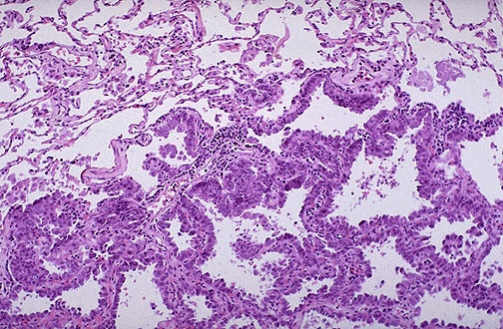
Adenocarcinoma of the Lung – LPF
Microscopically, the Adenocarcinoma in Situ ( Previously named Bronchioloalveolar Carcinoma) is composed of columnar cells that proliferate along the framework of alveolar septae. The cells are well-differentiated.
No evidence of stromal, vascular, or pleural invasion.
Pathology Dept. KSU
Respiratory Block

Slide 31
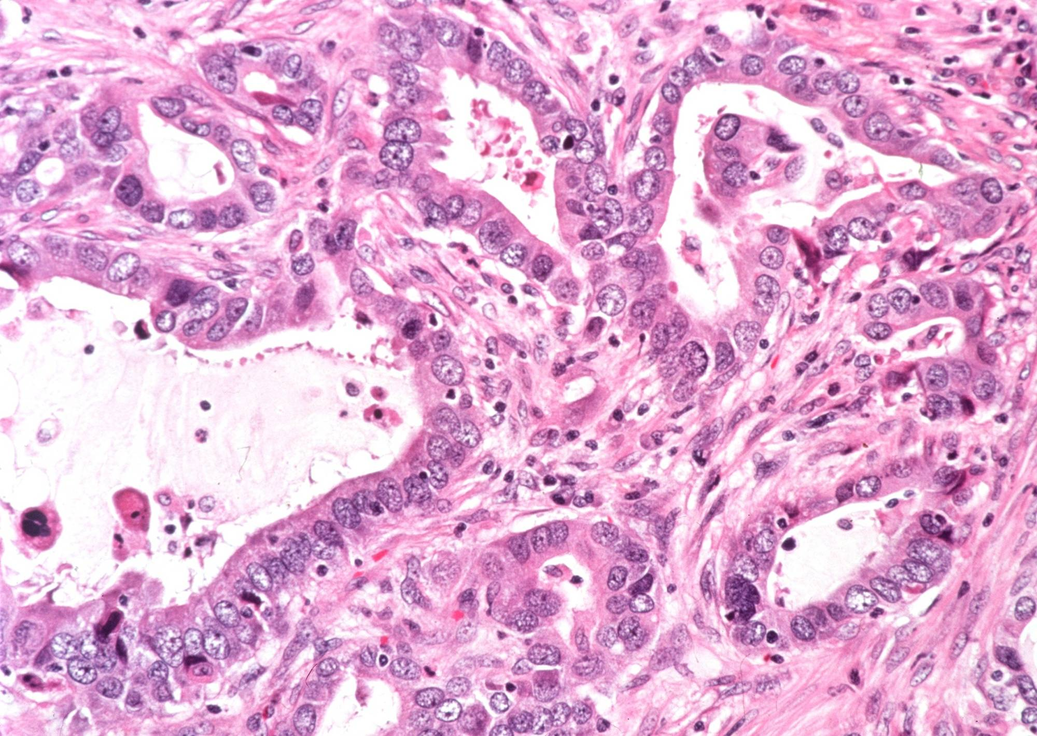
Adenocarcinoma of the Lung – HPF
Section of the tumor shows moderately differentiated malignant glands lined by pleomorphic and hyperchromatic malignant cells showing conspicuous nucleoli . Note the presence of tissue desmoplasia around the neoplastic glands .
Pathology Dept. KSU
Respiratory Block

Slide 32
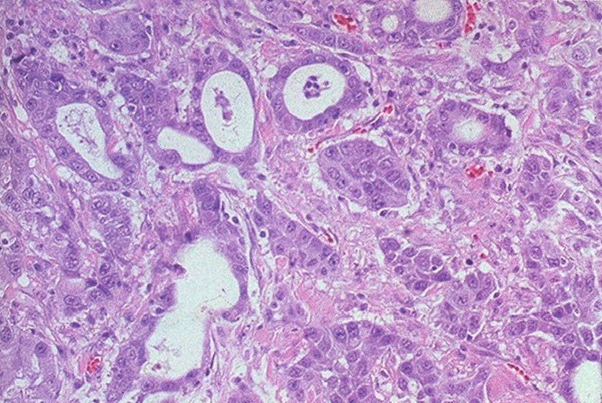
Adenocarcinoma of the Lung – HPF
Differentiated malignant glands lined by pleomorphic and hyperchromatic malignant cells showing conspicuous nucleoli
Pathology Dept. KSU
Respiratory Block

Slide 33
3. Large Cell Carcinoma of the lung
This is an undifferentiated malignant epithelial tumor that lacks the cytological features of small-cell carcinoma and glandular or squamous differentiation
They probably represent SCC and ADC
Other variant of LCC is Large cell neuroendocrine carcinoma
Pathology:
Large cells, variant in size and shape.
Large nuclei with prominent nucleoli.
Moderate amount of cytoplasm.
Early and distant metastases, sometimes cavitating.
Pathology Dept. KSU
Respiratory Block

Slide 34
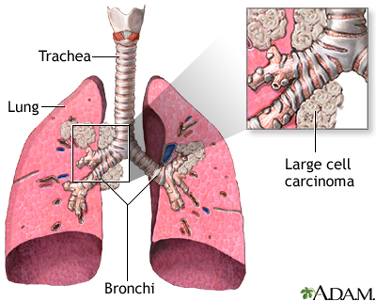
Large Cell Carcinoma of the Lung – Gross
Large cell cancer makes up 10% of all cases
LCC tends to grow rapidly and spread more quickly than other type of non small cell of lung cancer
Pathology Dept. KSU
Respiratory Block

Slide 35
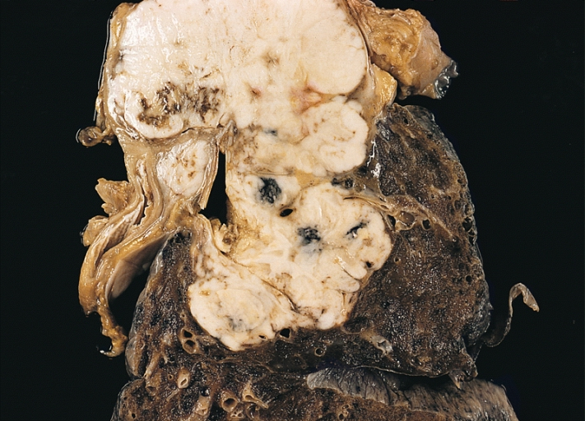
Undifferentiated Large Cell Carcinoma of the Lung – Gross
This large cell carcinoma at autopsy shows a large multilobulated tumor adjacent to the hilum.
A metastatically involved lymph node is present next to the bronchus.
Pathology Dept. KSU
Respiratory Block

Slide 36
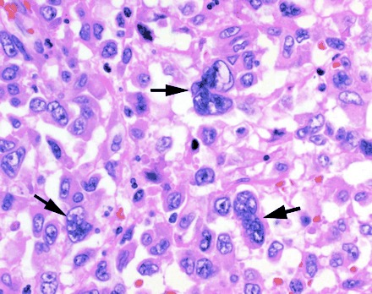
Large Cell Carcinoma of the Lung – HPF
Pleomorphic carcinoma of lung (large cell and giant cell subtype). It shows mixed composition of large cell carcinoma and pleomorphic multinucleated giant cells (arrows). (H and E, ×200)
Pathology Dept. KSU
Respiratory Block

Slide 37
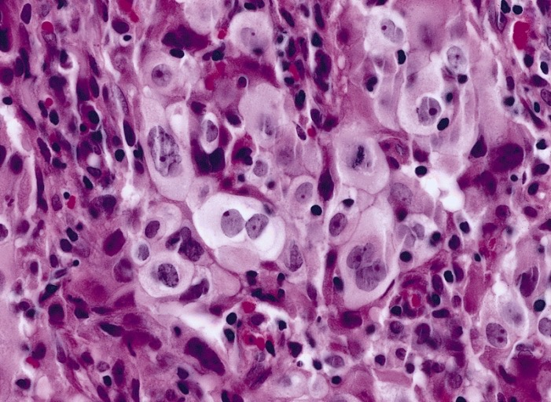
Large Cell Carcinoma of the Lung – HPF
This section from lower respiratory tract shows neoplastic cells with abundant pale eosinophilic cytoplasm and a surrounding infiltrate of inflammatory cells
Pathology Dept. KSU
Respiratory Block

Slide 38
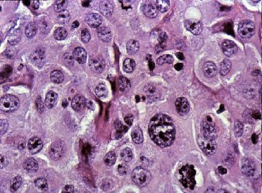
Large Cell Carcinoma of the Lung – HPF
This section shows neoplastic cells with abundant pale eosinophilic cytoplasm and pleomorphic multinucleated giant cells

Slide 39
Small cell carcinoma of the lung
Highly Malignant Tumor with distinctive cell type
Cells are small, with scant cytoplasm, ill-defined borders,
finely granular chromatin (salt & pepper pattern) and absent
or inconspicious nucleoli.
High mitotic count and often extensive necrosis.
Typically not graded as all SCLC are considered High Grade.
Very strong relationship with smoking.
Often lead to paraneoplastic syndromes??
Pathology Dept. KSU
Respiratory Block

Slide 40
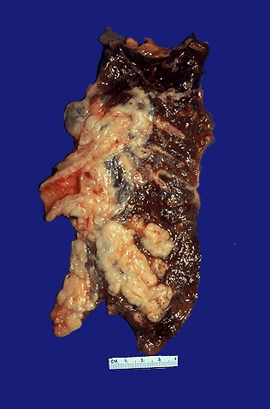
Small Cell Carcinoma of the Lung “Oat cell” – Gross
Arising centrally in this lung and spreading extensively is a small cell anaplastic (oat cell) carcinoma.
The cut surface show infiltrating tumor, soft in consistency, lobulated margins and white to tan appearance.
The tumor seen here has caused obstruction of the main bronchus to left lung so that the distal lung is collapsed
Pathology Dept. KSU
Respiratory Block

Slide 41
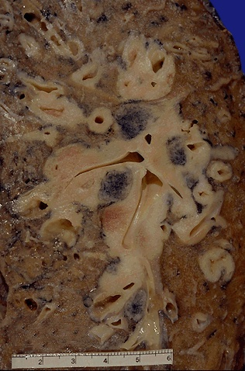
Small Cell Carcinoma of the Lung “Oat cell” – Gross
Oat cell carcinoma which is spreading along the bronchi. The speckled black rounded areas represent hilar lymph nodes with metastatic carcinoma
Pathology Dept. KSU
Respiratory Block

Slide 42
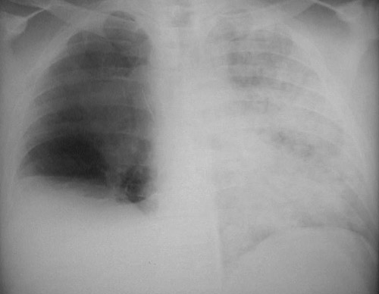
Small Cell Carcinoma of the Lung “Oat cell” : X-Ray
This chest radiograph demonstrates a mass lesion in the right upper lobe. This was an oat cell carcinoma (yellow arrow). It obstructed the right main bronchus, leading to atelectasis on the right, evidenced by a raised right hemidiaphragm. The patient aspirated gastric contents, producing a diffuse pneumonia (blue arrow) on the left (since aspirated material could not pass the obstruction on the right).

Slide 43
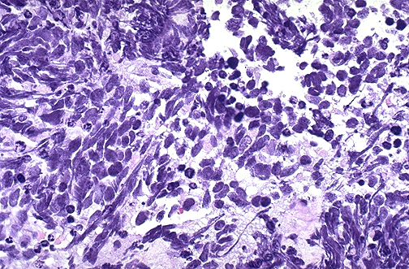
Small Cell Carcinoma of the Lung “Oat cell” – HPF
This is the microscopic pattern of a small cell anaplastic (oat cell) carcinoma in which small dark blue cells with minimal cytoplasm are packed together in sheets.
Pathology Dept. KSU
Respiratory Block

Slide 44
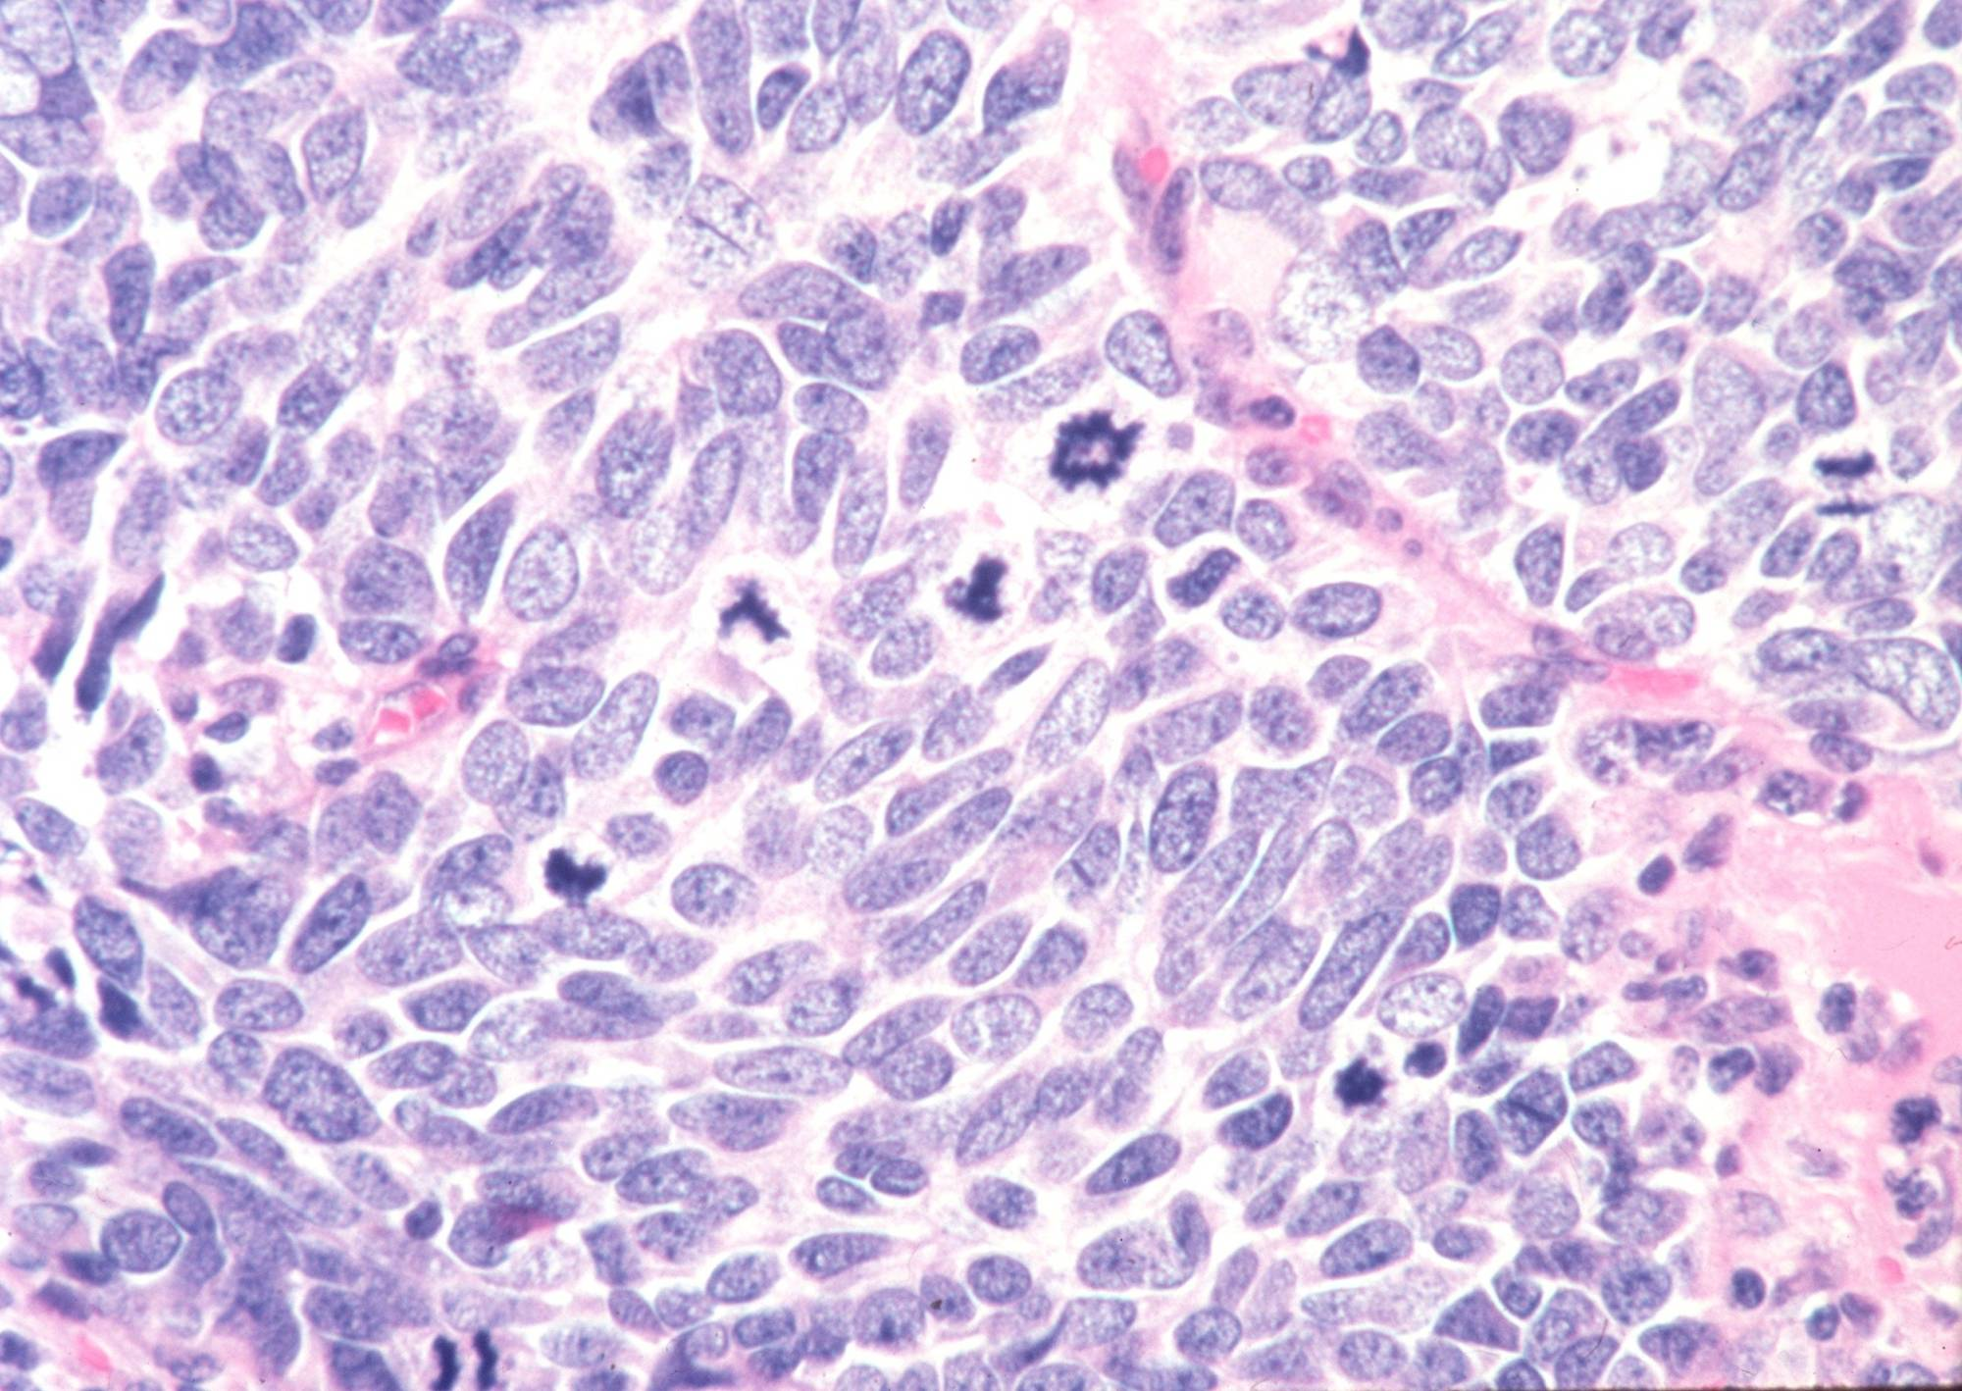
Small cell carcinoma “Oat cell” of the lung - HPF
Section of the tumor shows clusters of malignant cells which are small , round , oval , or spindle shaped cells
prominent nuclear molding
finely granular nuclear chromatin (salt and pepper pattern )
high mitotic count and focal necrosis
Pathology Dept. KSU
Respiratory Block

Slide 45
Metastatic tumours of the lung
Pathology Dept. KSU
Respiratory Block

Slide 46
METASTATIC TUMORS
LUNG is the MOST COMMON site for all metastatic tumors, regardless of the site of origin.
The most common cancers that spread to the lung are: breast, colorectal and renal cancer
Cancer spread to the lungs via blood or lymphatics or by direct continuity
It is the site of FIRST CHOICE for metastatic sarcomas for purely anatomic reasons !
Pathology Dept. KSU
Respiratory Block

Slide 47
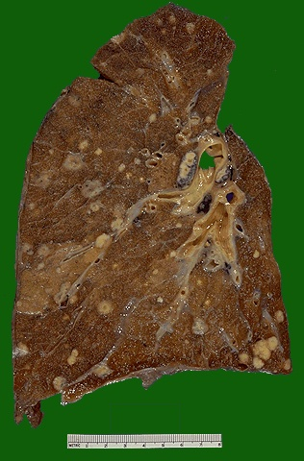
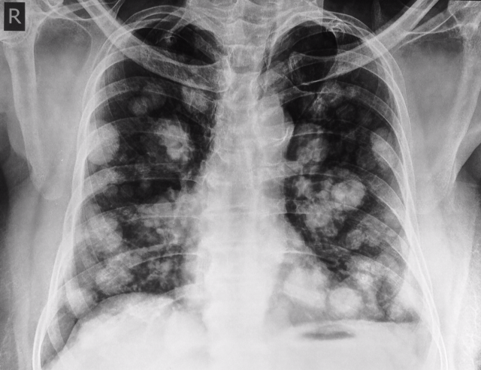
Metastatic Tumors of the Lung – Gross & X-ray
Multiple variably-sized masses are seen in all lung fields. These tan-white nodules are characteristic for metastatic carcinoma. Metastases to the lungs are more common even than primary lung neoplasms
Chest X-ray showing multiple cannon ball opacities in both lung fields.
Pathology Dept. KSU
Respiratory Block

Slide 48
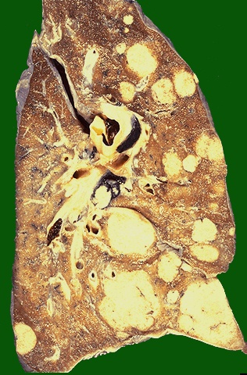
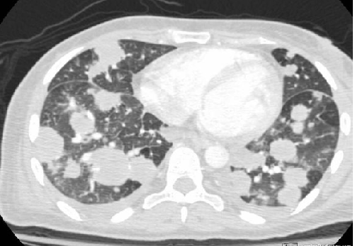
Metastatic Tumors of the Lung – Gross & CT scan
CT Lung shows Cannonball Metastases-large, hematogenously spread metastatic lesions in the lungs of varying sizes most often from colon, breast, renal, thyroid primaries
Here are larger but still variably-sized nodules of metastatic carcinoma in lung.
Pathology Dept. KSU
Respiratory Block

Slide 49
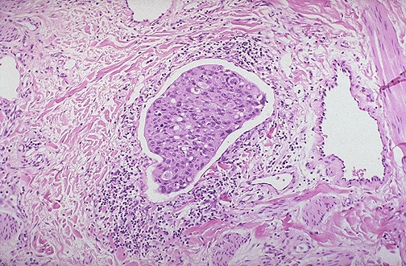
Metastatic Tumors of the Lung – LPF
A nest of metastatic infiltrating ductal carcinoma from breast is seen in a dilated lymphatic channel in the lung. Carcinomas often metastasize via lymphatics.
Pathology Dept. KSU
Respiratory Block

Slide 50
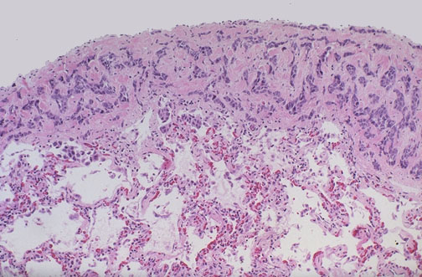
Metastatic Tumors of the Lung – LPF
A focus of metastatic carcinoma from breast is seen on the pleural surface of the lung. Such pleural metastases may lead to pleural effusions, including hemorrhagic effusions, and pleural fluid cytology can often reveal the malignant cells
Pathology Dept. KSU
Respiratory Block

Slide 51
Mesothelioma of the lung
Malignant pleural mesothelioma is a rare, aggressive cancer that develops in
the pleura, a thin layer of tissue surrounding the lungs.
Inhaling microscopic asbestos fibers is the primary cause of mesothelioma
Pathology Dept. KSU
Respiratory Block

Slide 52
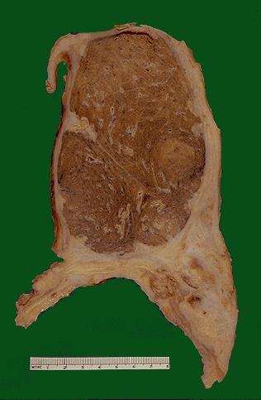
Mesothelioma of the Lung – Gross
The dense white encircling tumor mass is arising from the visceral pleura and is a mesothelioma. These are big bulky tumors that can fill the chest cavity. The risk factor for mesothelioma is asbestos exposure.
Pathology Dept. KSU
Respiratory Block

Slide 53
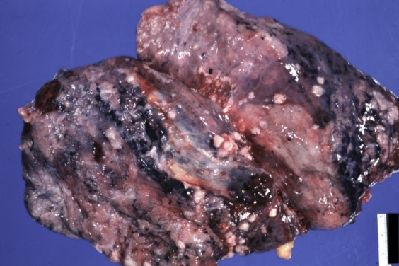
Mesothelioma of the Lung – Gross
RESPIRATORY: Pleura: Mesothelioma: Gross natural color external view of lung with nodules of tumor on pleura
Pathology Dept. KSU
Respiratory Block

Slide 54
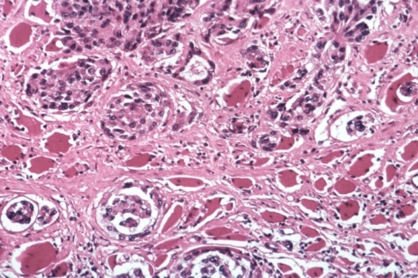
Mesothelioma of the Lung – MPF
Mesotheliomas have either spindle cells or plump rounded cells forming gland-like configurations, as seen here at high power microscopically. They are very difficult to diagnose cytologically.
Pathology Dept. KSU
Respiratory Block

Slide 55
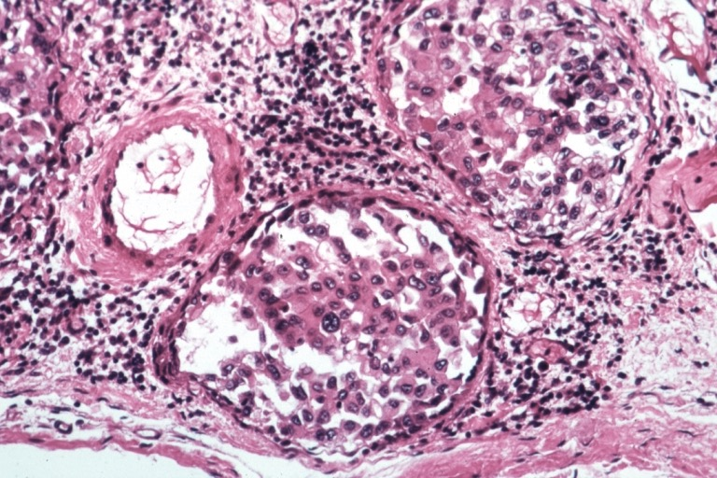
Mesothelioma of the Lung – HPF
Mesothelioma: Micro epithelial pattern plump rounded cells forming gland-like configurations
Pathology Dept. KSU
Respiratory Block

