Slide 1
Treatment of Respiratory Tract Infections
Prof. Mohammad Alhumayyd
Dr. Aliah Alshanwani
30-1-2018

Slide 2
Objectives of the lecture
At the end of lecture, the students should be able to understand the following:
The types of respiratory tract infections (RTI)
The antibiotics that are commonly used
to treat RTIs & their side effects
Understand the mechanism of action & pharmacokinetics of individual drugs.

Slide 3
Classification of RTIs
Upper respiratory tract infections (URTI)
Lower respiratory tract infections (LRTI)

Slide 5
Causes of URTIs
Viruses; Most URTIs are of viral etiology
(Should NOT be treated with antibiotics)
Treatment: rest & plenty of fluids, OTC cold & pain relievers
Bacteria (mainly Group A streptococcus, H. influenza)
Treatment: Antibiotics. The type depends on:
Type of bacteria
Sensitivity test.
Notes:
Streptococcus pyogenes also known as the group A streptococci (GAS), causes a wide variety of diseases in humans.

Slide 6
LRTIs (costly & more difficult to treat)
Bronchitis (inflammation of major bronchi & trachea)
Acute, or Chronic, or Acute exacerbation of chronic bronchitis
Causes: viruses or bacteria (H. influenza, Streptococcus pneumonia & Moraxella catarrhalis).
Pneumonia (Serious infection of bronchioles & alveoli)
Community –Acquired (CAP)
Hospital-acquired
Causes: Bacteria S. pneumonia**(66%), H. influenza (20%), M. catarrhalis (20%).
Notes:
The most common bacteria …..
M Catarrhalis is gm-ve aerobic bacteria
The pharynx has 3 parts: the nasopharynx, the oropharynx, & the laryngopharynx.
The tonsils contain lymphocytes that protect against invasion of foreign antigens that are inhaled.

Slide 7
Antibiotics commonly used in the treatment of RTIs
Beta-lactam antibiotics (Penicillins / Cephalosporins)
Macrolides
Fluoroquinolones
Aminoglycosides
Doxycycline.

Slide 8
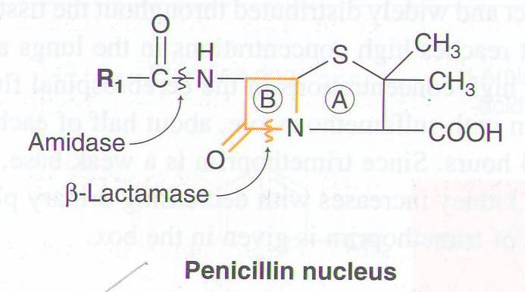
Penicillins
Notes:
The penicillins share features of chemistry, MOA, pharmacology, & immunologic characteristics with cephalosporins, monobactams, carbapenems, & β-lactamase inhibitors. All are β-lactam compounds, so named because of their four-membered lactam ring.
All penicillins have the basic structure shown in Figure. A thiazolidine ring (A) is attached to a β-lactam ring (B) that carries a secondary amino group (RNH–). Structural integrity of the 6-aminopenicillanic acid nucleus (rings A plus B) is essential for the biologic activity of these compounds. Hydrolysis of the β-lactam ring by bacterial β-lactamases yields penicilloic acid, which lacks antibacterial activity. Substituents (R; examples shown) can be attached to the amino group to give different penicillinS family (G, V, Amoxicillin, Ampicillin,,,).

Slide 9
Broad-spectrum penicillins
Amoxicillin-Clavulanic acid
Ampicillin-Sulbactam
Piperacillin-tazobactam
Act on both gram+ve & gram-ve microorganisms.
Notes:
It is a combination consisting of amoxicillin, a β-lactam antibiotic, & potassium clavulanate, a β-lactamase inhibitor. Ampicillin/sulbactam is a combination of the common penicillin-derived antibiotic ampicillin & sulbactam, an inhibitor of bacterial beta-lactamase inhibitor.
Piperacillin/tazobactam is a combination antibiotic containing the extended-spectrum penicillin antibiotic piperacillin & the β-lactamase inhibitor tazobactam. The combination has activity against many Gram-positive & Gram-negative pathogens & Pseudomonas aeruginosa.

Slide 10
Mechanism of action of Penicillins
Inhibit bacterial cell wall synthesis through inhibition of peptidoglycan layer of the cell wall.
Bactericidal.
Notes:
The peptidoglycan layer is unique to bacteria & is much thicker in gram+ive organisms than in gram–ive ones. Peptidoglycan, also known as murein, is a polymer consisting of sugars & amino acids that forms a mesh-like layer outside the plasma membrane of most bacteria, forming the cell wall.
The cell wall of Gram-ve bacteria consists of a thin layer of peptidoglycan in the periplasmic space between the inner & outer lipid membranes. The outer membrane contains lipopolysaccharides on its outer leaflet & facilitates non-vesicle-mediated transport through channels such as porins or specialized transporters. It is thought that vesicles from these organisms are produced by the pinching off of the outer membrane, resulting in outer-membrane vesicles (OMVs). The lack of an outer membrane, as well as the presence of a thick cell wall, in Gram+ve bacteria, mycobacteria & fungi led to a long-standing belief that these organisms did not produce extracellular vesicles. b Gram+ve bacteria have a single lipid membrane surrounded by a cell wall composed of a thick layer of peptidoglycan & lipoteichoic acid, which is anchored to the cell membrane by diacylglycerol.

Slide 11
Pharmacokinetics of Penicillins
Given po or parenterally
Not metabolized in human
Relatively lipid insoluble
Excreted mostly unchanged in urine
Probenecid slows their elimination & prolong their half live
Half-life 30-60 min (increased in renal failure).
Notes:
All of the penicillins are readily & actively secreted by the renal tubules & most are eliminated, almost completely unchanged, in the urine.
IV administration of penicillin G is preferred to the IM route because of irritation & local pain from IM injection of large doses.
Probenecid & sulfinpyrazone are uricosuric drugs employed to decrease the body pool of urate in patients with tophaceous gout or in those with increasingly frequent gouty attacks. Pharmacodynamics: Uricosuric drugs inhibit active transport sites for reabsorption & secretion in the proximal renal tubule so that net reabsorption of uric acid in the proximal tubule is decreased. Because aspirin in doses of less than 2.6 g daily causes net retention of uric acid by inhibiting the secretory transporter, it should not be used for analgesia in patients with gout. The secretion of other weak acids (eg, penicillin) is also reduced by uricosuric agents.

Slide 12
Adverse effects
Hypersensitivity reactions
Convulsions
(after high i.v. dose or in renal failure)
Nephritis
Diarrhea
Superinfections
Notes:
The penicillins are generally well tolerated, &, unfortunately, this may encourage inappropriate use. Most of the serious adverse effects are due to hypersensitivity.
In patients with renal failure, penicillin in high doses can cause seizures/convulsions. Large doses of penicillins given orally may lead to GI upset, particularly N, V & D.
Ampicillin has been associated with pseudomembranous colitis. Secondary infections such as vaginal candidiasis may occur.
The occurrence of a complete change in the bacterial flora, in the human body may be observed occasionally during the course of treatment with an AB. In these circumstances, the pathogenic organisms sensitive to the AB in use disappear, or become less in number, while the insensitive organisms may appear in large numbers & cause a new infection & its symptoms. For example, when using penicillin for an infection caused by a Gram+ve organism, one may encounter a secondary infection caused by a Gram-ve bacillus. The reverse may be true when one happens to use streptomycin.
The mechanism by which a new infection develops is not clear, but may be due to some disturbance in the state of equilibrium of bacterial antagonism, which is supposed to be normally present. It is also possible that the removal of bacteria by means of a specific AB allows insensitive organism to increase not only in number but also in virulence.
Though the incidence of new infections does not seem to be very high, the occurrence of superinfection in patients receiving penicillin treatment serves to emphasise the great need for frequent & careful bacteriologic examinations before, during, & after the course of treatment.

Slide 13
Therapeutic uses of Penicillins
URTIs
LRTIs.

Slide 14
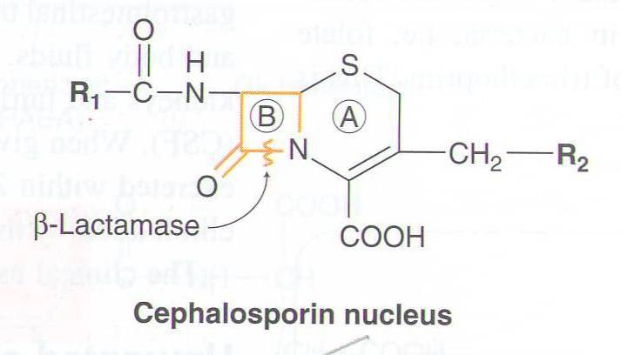
Cephalosporins
Notes:
Cephalosporins are similar to penicillins but more stable to many bacterial β lactamases & , therefore, have a broader spectrum of activity.
The attachment of various R1 and R2 groups has yielded hundreds of potent compounds, many with low toxicity.

Slide 15
Mechanism of action of Cephalosporins
Inhibit bacterial cell wall synthesis
Bactericidal
(Similar to Penicillins)
Classified into 3 gps:

Slide 16
1st Generation Cephalosporins
e.g. Cephalexin
Given po
Effective against gram positive bacteria
Effective in URTIs.
Notes:
Gram +ve cocci, such as streptococci & staphylococci

Slide 17
2nd Generation Cephalosporins
E.g. Cefuroxime, cefaclor
Given po
Effective mainly against Gram-negative bacteria
Well absorbed po
Active against β-lactamase –producing bacteria
Uses:
Upper & lower RTIs.
Notes:
The oral second-generation cephalosporins are active against β-lactamase-producing H influenzae or Moraxella catarrhalis

Slide 18
3rd Generation Cephalosporins
Ceftriaxone / Cefotaxime / Cefixime
Given by intravenous route
More effective against gram-negative bacilli
Effective in treatment of pneumonia.

Slide 19
Pharmacokinetics of Cephalosporins
Cephalosporins are given parenterally & po
Relatively lipid insoluble (like penicillins)
2
Hence, do not penetrate cells or the CNS, except for third generations
Mostly excreted unchanged by the kidney (glomerular & tubular secretion)
Probenecid slows their elimination & prolong their half lives
Half-life: 30-90 min; except ceftriaxone 4-7 hr.

Slide 20
Adverse effects of cephalosporins
1
Hypersensitivity reactions
2
Thrombophilibitis
3
Superinfections
4
Diarrhea
Notes:
Local irritation can produce pain after IM injection & thrombophlebitis after IV injection

Slide 21
Macrolides
Erythromycin
Azithromycin
Clarithromycin
Notes:
Erythromycin is the prototype
Clarithromycin & azithromycin are semisynthetic derivatives of erythromycin.

Slide 22
Mechanism of action
Inhibit bacterial protein synthesis by binding to 50S subunit of the bacterial ribosomal RNA
Bacteriostatic
Bactericidal at high concentrations.

Slide 23
Clarithromycin
More effective on G+ve bacteria
Stable at gastric acidity
Inhibits cytochrome P450 system
Metabolized in liver to active metabolite
Biliary route is the major route of elimination
Only 10-15% excreted unchanged in the urine
Half-life 6-8 hours.
Notes:
Erythromycin base is destroyed by stomach acid and must be administered with enteric coating. Clarithromycin is derived from erythromycin by addition of a methyl group and has improved acid stability and oral absorption compared with erythromycin.
Erythromycin & clarithromycin inh CytP 3A4
Erythromycin is active against susceptible strains of gram-positive organisms, especially pneumococci, streptococci, staphylococci, & corynebacteria. Mycoplasma pneumoniae, L pneumophila, Chlamydia trachomatis, Chlamydia psittaci, Chlamydia pneumoniae, H pylori, Listeria monocytogenes, & certain mycobacteria (Mycobacterium kansasii, Mycobacterium
scrofulaceum) are also susceptible.
Clarithromycin & erythromycin are similar with respect to antibacterial activity except that clarithromycin is > active against Mycobacterium avium complex.
The advantages of clarithromycin compared with erythromycin are lower incidence of GI intolerance & less frequent dosing.

Slide 24
Azithromycin
More effective on G-ve bacteria
Stable at gastric acidity
Undergo some hepatic metabolism (inactive metabolite)
Biliary route is the major route of elimination
Only 10-15% excreted unchanged in the urine
Half-life (3 days)
Once daily dosing
No effect on cytochrome P- 450.

Slide 25
Clinical uses of Macrolides
Chlamydial pneumonia
Legionella pneumonia.

Slide 26
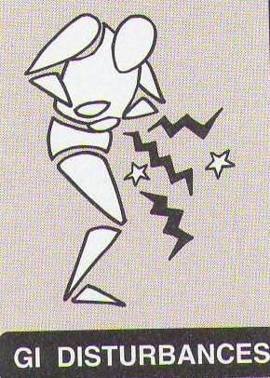
Adverse effects
Hypersensitivity Reactions.
Notes:
Anorexia, nausea, vomiting, & diarrhea are common. GI intolerance, which is due to a direct stimulation of gut motility, is the most common reason for discontinuing erythromycin & substituting another antibiotic.

Slide 27
Fluoroquinolones
Ciprofloxacin
Moxifloxacin
Gatifloxacin

Slide 28
Mechanism of action
Block bacterial DNA synthesis by inhibiting DNA Gyrase enzyme (an enzyme involved in DNA supercoiling).
Notes:
Inhibition of DNA gyrase prevents the relaxation of positively supercoiled DNA that is required for normal transcription & replication.

Slide 29
Antibacterial spectrum
Ciprofloxacin mainly effective against G–ve bacteria
Moxifloxacin & Gatifloxacin G –ve & G+ve & given once daily.
(highly active against Pseudomonas species)
Notes:
Fluoroquinolones were originally developed because of their excellent activity against gram-ive aerobic bacteria; they had limited activity against gram+ive organisms.
Several newer agents have improved activity against gram+ive cocci. This relative activity against gram-ive versus gram+ive species is useful for classification of these agents. Norfloxacin is the least active of the fluoroquinolones against both gram-ive & gram+ive organisms, with minimum inhibitory concentrations (MICs) fourfold to eightfold higher than those of ciprofloxacin.
Ciprofloxacin, enoxacin, lomefloxacin, levofloxacin, ofloxacin, & pefloxacin comprise a second group of similar agents possessing excellent gram-ive activity & moderate to good activity against gram+ive bacteria. MICs for gram-ive cocci & bacilli, including Enterobacter sp, P aeruginosa, Neisseria meningitidis, Haemophilus sp, & Campylobacter jejuni, are 1–2 mcg/mL & often less. Methicillin-susceptible strains of S aureus are generally susceptible to these fluoroquinolones, but methicillin-resistant strains of staphylococci are often resistant. Streptococci & enterococci tend to be less susceptible than staphylococci, & efficacy in infections caused by these organisms is limited. Ciprofloxacin is the most active agent of this group against gram-ive organisms, P aeruginosa in particular. Levofloxacin, the L-isomer of ofloxacin, has superior activity against gram+ive organisms, including Streptococcus pneumoniae.
Gatifloxacin & moxifloxacin make up a third group of fluoroquinolones with improved activity against gram+ive organisms, particularly S pneumoniae & some staphylococci. Although MICs of these agents for staphylococci are lower than those of ciprofloxacin (& the other compounds mentioned in the paragraph above), it is not known whether the enhanced activity is sufficient to permit use of these agents for treatment of infections caused by ciprofloxacin-resistant strains. In general, none of these agents is as active as ciprofloxacin against gram-ive organisms.

Slide 30
Pharmacokinetics
Given po or parenterally
Concentrates in many tissues (kidney, prostate, lung & bones/ joints)
Excreted mainly through the kidney
Their relatively long Half-life allow once daily (moxifloxacin & Gatifloxacin) & twice-daily (ciprofloxacin) dosing.
Notes:
After oral administration, the fluoroquinolones are well absorbed (bioavailability of 80–95%) & distributed widely in body fluids & tissues.

Slide 31
Clinical Uses
Acute exacerbation of chronic obstructive pulmonary disease
Community acquired pneumonia
Legionella pneumonia
1
2
3
Notes:
With their enhanced gram+ive activity & activity against atypical pneumonia agents (chlamydiae, Mycoplasma, & Legionella), levofloxacin, gatifloxacin, gemifloxacin, & moxifloxacin—so-called respiratory fluoroquinolones—are effective & used increasingly for treatment of upper & lower RTIs.

Slide 32
Adverse effects
Nausea, vomiting, diarrhea
CNS effects (confusion, insomnia, headache, anxiety)
Damage of growing cartilage (arthropathy)
Phototoxicity (avoid excessive sunlight).
Notes:
Fluoroquinolones are generally well tolerated. The most common effects are nausea, vomiting, & diarrhea. Occasionally, headache, dizziness, insomnia, skin rash, or abnormal liver function tests develop. Photosensitivity has been reported with lomefloxacin & pefloxacin.
Fluoroquinolones may damage growing cartilage & cause an arthropathy. Thus, these drugs are not routinely recommended for patients under 18 years of age. However, the arthropathy is reversible, & there is a growing consensus that fluoroquinolones may be used in children in some cases (eg, for treatment of pseudomonal infections in patients with cystic fibrosis).

Slide 33
Contraindications
Not recommended for patients younger than 18 years
Pregnancy
Breast feeding women.
Notes:
Fluoroquinolones should be avoided during pregnancy in the absence of specific data documenting their safety.

Slide 34
THANK YOU

