Slide 1
Respiratory ventilation
Dr. Laila Al-Dokhi
Assistant professor
Physiology Department

Slide 2
Learning objectives
By the end of the lecture you should be able to: -
1-Define the various lung volumes and capacities and provide typical values for each.
2-Define ventilation rates, their typical values, and their measurement.
3- Describe FEV₁ and its role in differentiating obstructive and restrictive lung diseases.
4- Describe the types of dead space. State a volume for the anatomical dead space.
5- Define the term minute ventilation and state a typical value.
6- Distinguish minute ventilation from alveolar ventilation.

Slide 3
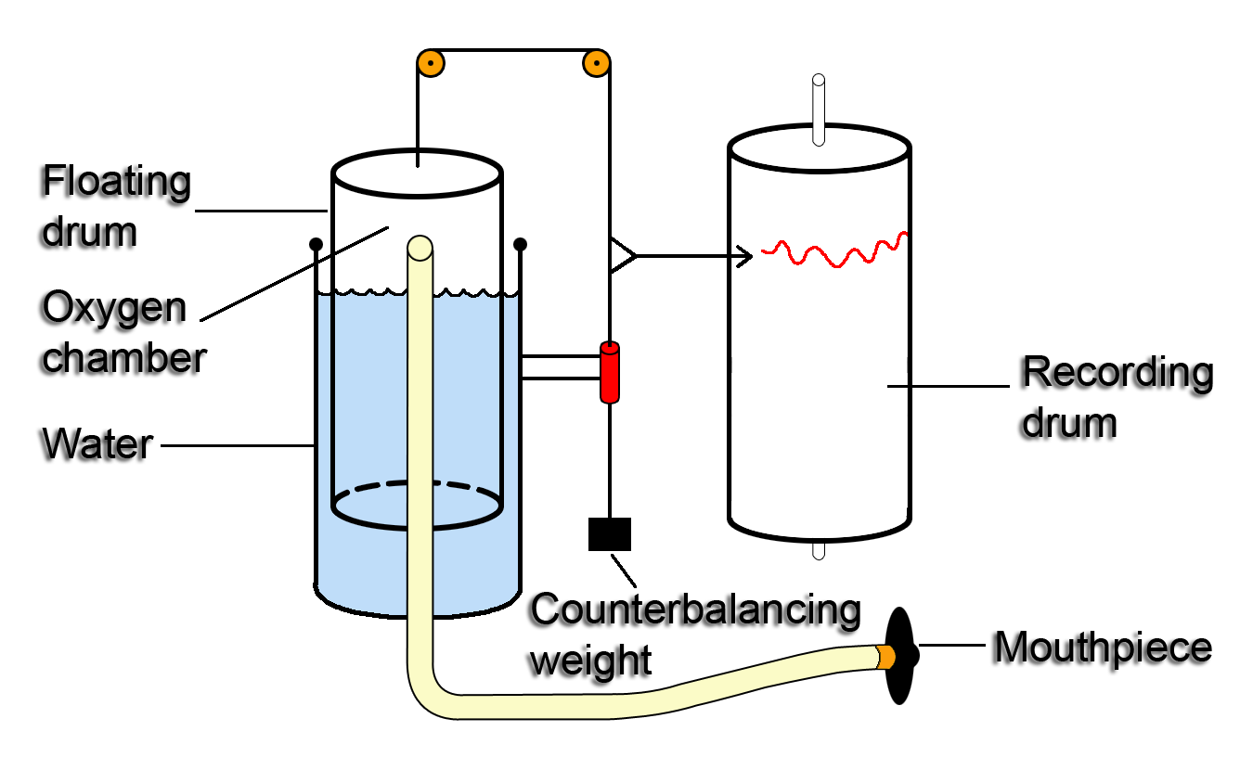

Slide 4
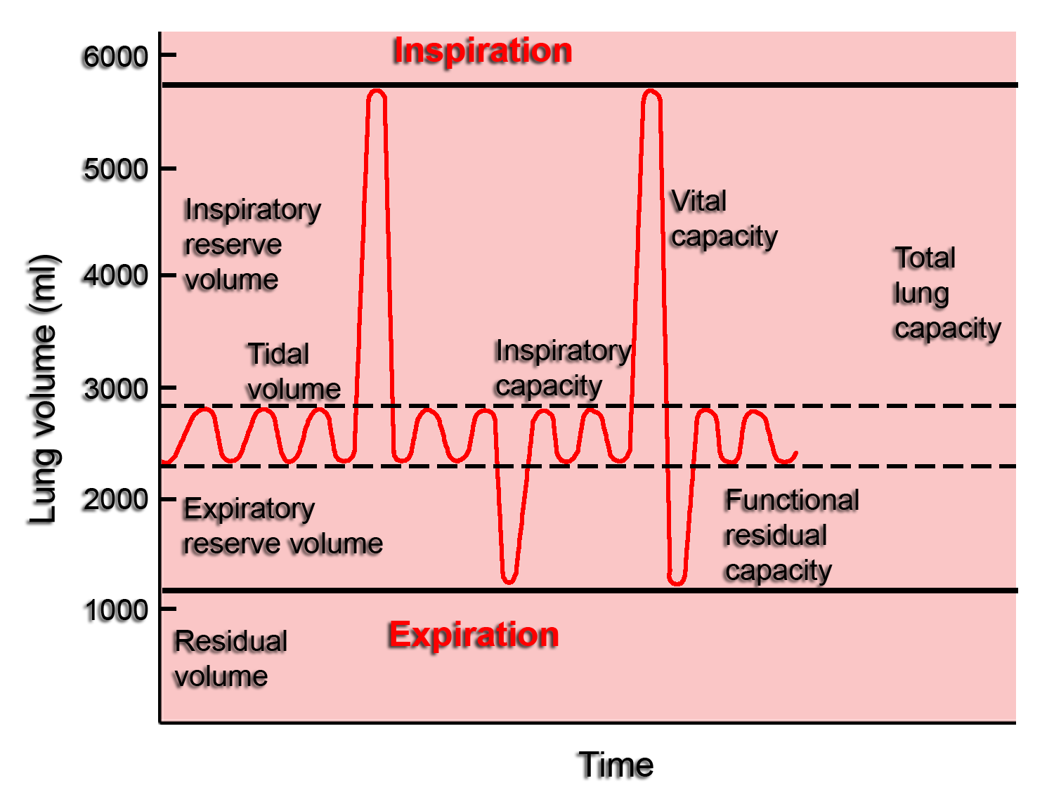

Slide 5
Pulmonary volumes and capacities
Pulmonary volumes (by using spirometer):
Tidal volume – is the volume of air inspired or expired with each normal breath = 500ml in young adult man.
Inspiratory reserve volume – is the extra volume of air that can be inspired over and beyond the normal tidal volume = 3000ml.
Expiratory reserve volume – is the extra amount of air that can be expired by forceful expiration after the end of a normal tidal expiration ~ 1100ml.
Residual volume – is the volume of air that still remain in the lungs after the most forceful expiration ~ 1200ml.

Slide 6
The pulmonary capacities
Comprises more than one volume:
Inspiratory capacity – is the volume of air inspired by a maximal inspiratory effort after normal expiration = 3500ml = inspiratory reserve volume + tidal volume.
The functional residual capacity – is the volume of air remaining in the lungs after normal expiration = 2300ml = expiratory reserve volume + residual volume.
The vital capacity – is the volume of air expired by a maximal expiratory effort after filling the lung to maximal inspiration then expiring to maximum extent~ 4600ml = inspiratory reserve volume + tidal volume + expiratory reserve volume.
Total lung capacity – is the maximum volume of air that can be accommodated in the lungs ~ 5800ml = vital capacity + residual volume.
Minute respiratory volume – is the volume of air breathed in or out of the lungs each minute = respiratory rate x tidal volume = 12 X 500ml = 6000ml/min.
All lung volume and capacity are about 20 to 25% less in women than in men and are greater in athletic persons than in small and asthenic persons.

Slide 7
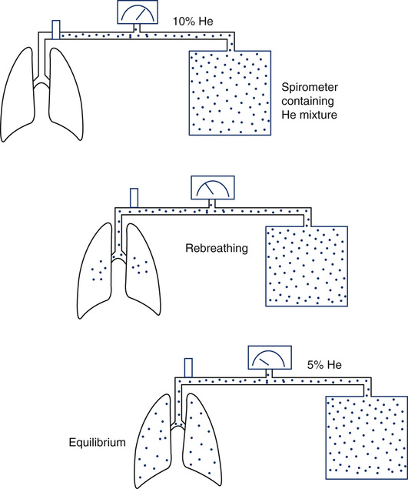
Closed circuit Helium Dilution Method
C1xV1 = C2xV2
C1: concentration of Hi in spirometry
V1: volume of air in the spirometry.
C2: Final concentration of helium
V2 :Volume of spirometry+ FRC
FRC = ( Ci He (C1) - 1) Vi Spi (V1)
Cf He (C2)

Slide 8
Forced Vital Capacity (FVC) and FEV1
(Timed vital capacity)
The person is asked to inspire as deeply as possible and then to breath out as hard and as fast as he can. The expiration is continued until he expired all the air out and thus forced vital capacity is obtained. During this process the volume of air expired in the first second is collected and is known as FEV1.

Slide 9
FEV1/FVC ratio
Normally it is about 80%.
This ratio differentiate between obstructive and restrictive lung diseases
Is normal in restrictive lung diseases (e.g interstitial pulmonary fibrosis)
It decreases in obstructive (bronchial asthma, emphysema)

Slide 10
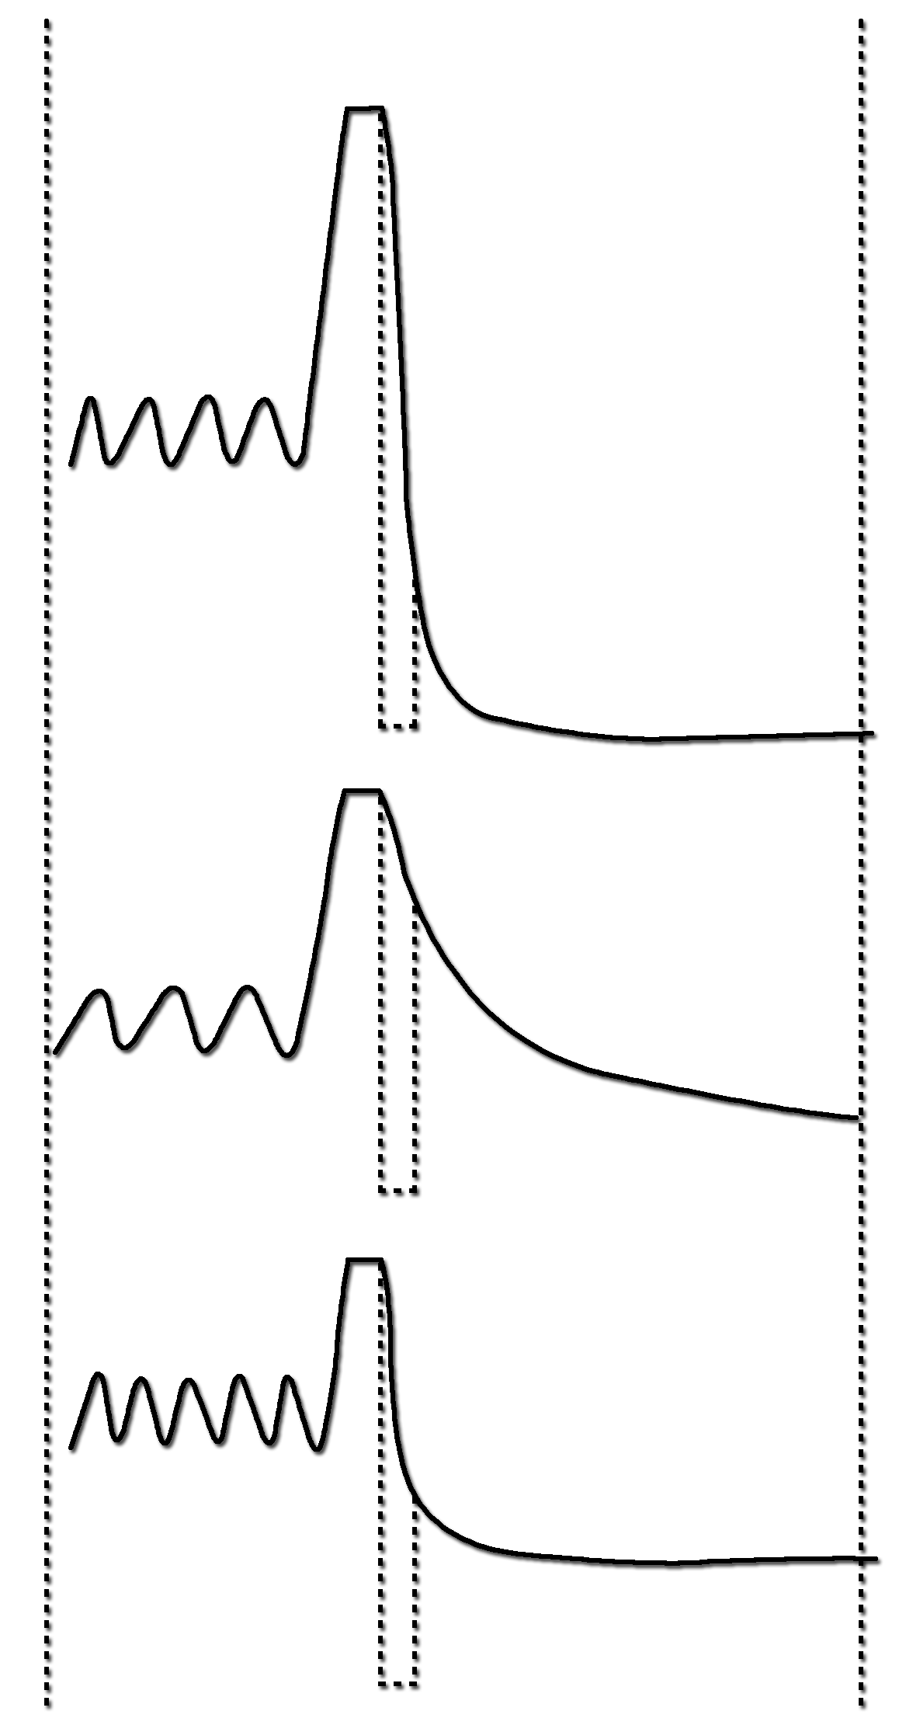
TIDAL
BREATHING
FORCED
EXPIRATION
NORMAL
FEV₁ = 3.0L
FVC = 4.2L
FEV₁/FVC = 72%
FEV₁
OBSTRUCTIVE
FEV₁ = 0.9L
FVC = 2.3L
FEV₁/FVC = 40%
FEV₁
RESTRICTIVE
FEV₁ =1.8L
FVC = 2.3L
FEV₁/FVC = 78%
FEV₁
1 SECOND

Slide 11
Minute respiratory volume
MRV = Respiratory rate x Tidal volume
= RR X TV
= 12 X 500 = 6L/min.
it could rise to 200 L/min or more than 30 times normal if RR = 40 TV = 4600 ml in young adults man

Slide 12
Anatomical dead space:-
Occupies the air-conducting system down to the terminal bronchioles
No gas exchange
Volume ≅ 150ml
Physiological dead space =
anatomical dead space + alveolar dead space
Respiratory zone:-
Occupies the space distal to the terminal bronchioles start from the respiratory bronchioles down to the alveolar sacs
Gas exchange takes place
Volume ≅ 350ml/min

Slide 13
The rate of alveolar ventilation
Alveolar ventilation per minute is the total volume of new air entering the alveoli and other adjacent gas exchange areas each minute.
Va = Respiratory rate X (Vt – Vd)
= Respiratory rate X (Vtidal volume – Vdead space)
= 12 X (500 – 150) = 4200ml

