Slide 1
Hypoxia and cyanosis
Dr. Laila Al-Dokhi
Assistant Professor
Physiology Department

Slide 2
Objectives
By the end of this lecture you should be able to:
Define hypoxia and list its various physiological and pathological causes.
Define hypo and hyper-ventilation in terms of arterial PCO2 and PO2.
Define cyanosis and its clinical presentation
Define ventilation/perfusion (V͎/Q) ratio and its normal values.

Slide 3
Hypoxia
Is defined as deficiency of oxygen in the tissue cells.
It can be classified into the following groups:-
Hypoxic or arterial hypoxia
Anemic hypoxia
Stagnant hypoxia
Histiotoxic hypoxia

Slide 4
I-Hypoxic or arterial hypoxia
Reduced arterial PO2 it can be due to
Alveolar hypoventilation
Diffusion abnormalities
Right to left shunt
Ventilation-perfusion imbalance
( including increased physiological dead space and physiological shunt).

Slide 5
II-Anemic hypoxia
It is caused by reduction in the oxygen carrying capacity of the blood, due to decreased amount of Hb or abnormal type of Hb which is unable to carry oxygen.
The PO2 and % Hb-O2 is normal.
Causes:
1- Anemia
2-Abnormal Hb e.g met hemoglobin, carboxyhemoglobin

Slide 6
III-Stagnant hypoxia:
Caused by reduced blood flow through the tissues,
so more and more oxygen is extracted from the blood, and due to slow circulation less oxygen is carried by the blood at the lung , leading to hypoxia.
Causes:
1-General slowing of the circulation, as in heart failure and shock
2-Local slowing e.g vasoconstriction, cold, arterial wall spasm.

Slide 7
IV- Histiotoxic hypoxia
This is inability of the tissues to use oxygen due to inhibition of the oxidative enzyme activity
e.g cyanide poisoning causing blockade of the cytochrome oxidase activity

Slide 8
Effects of hypoxia
According to the degree of hypoxia it could lead to:
Impairment of judgment,
Inability to perform complex calculations,
Headache, nausea, irritability, dyspnea, increased heart rate,
Reduction in muscle working capacity,
Coma and death may result.

Slide 9
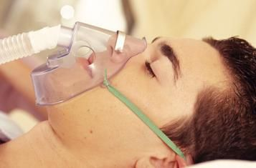
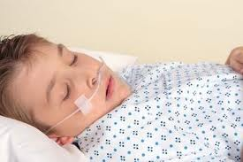
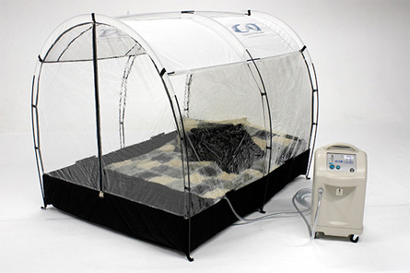
Treatment of hypoxia
Is by giving oxygen therapy in a tent or high oxygen tension mask.
This is useful in hypoxic hypoxia, but of less value in other types of hypoxia .
Histiotoxic hypoxia will not benefit from O2 therapy.

Slide 10
Hypercapnea
Excess of CO2 in body fluids, it usually occurs with hypoxia, PCO2 increases above 52 mmHg, it decreases the PH
Features of hypercapnea
Peripheral vasodilatation
Sweating
Warm extremities and bounding pulse
Muscle twitching
Headache, drowsiness and com
Papilledema ( swelling of optic disc)

Slide 11
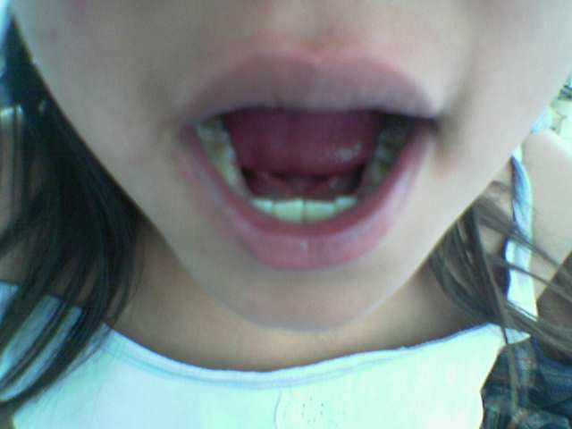
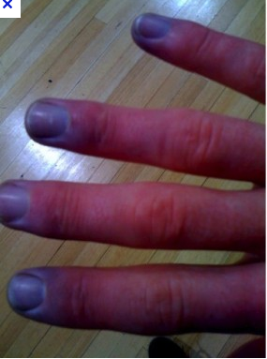
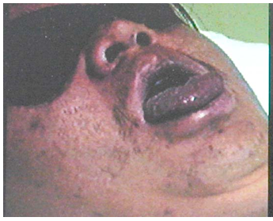
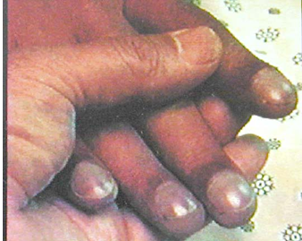
Cyanosis

Slide 12
Cyanosis
Blue discoloration of the skin and mucus membrane due to more than 5 g/dl of reduced (deoxygenated) hemoglobin in blood.
A person with anemia almost never develop cyanosis due to low amount of Hb for 5 grams to be deoxygenated /100ml blood.

Slide 13
Ventilation –perfusion ratio (V/Q)
It is the ratio of alveolar ventilation to pulmonary blood flow per minute.
The alveolar ventilation at rest (4.2 L/min)
The pulmonary blood flow is equal to right ventricular output per minute (5L/min)
SO V/Q ratio = 4.2 = 0.84
5

Slide 14
Cont…V/Q ratio
Average V/Q ratio across the lung is 0.8.
At the apex V/Q ratio = 3
At the base V/Q ratio=0.6
So the apex is more ventilated than perfused and the base is more perfused than ventilated.
During exercise the V/Q ratio becomes more homogenous among different parts of the lung

Slide 15
Ventilation/perfusion abnormalities

Slide 16
Cont… V/Q ratio
The main function of this ratio is to determine the state of oxygenation in the body.
Any mismatch in the ratio can result in hypoxia.
When the V/Q ratio is less than normal this is called physiologic shunt (a certain fraction of the venous blood is passing through the pulmonary capillaries without being oxygenated i.e shunted blood).
When V/Q is more than normal this is called Physiologic dead space (when the ventilation of some of the alveoli is great but the alveolar blood flow is low, ventilation of these alveoli is wasted).

Slide 17
Ventilation- Perfusion Lung Scan

Slide 18
Abnormalities of the V/Q ratio
In the Upper and Lower regions of the normal lung
Apex V/Q ratio = 3 (moderate degree of physiologic dead space)
Base V/Q ratio= 0.6 ( represent a physiologic shunt).
In Chronic Obstructive Lung disease COPD.
because of bronchial obstruction in some areas and destruction of the alveolar septa in other areas with patent alveoli those people has some areas of the lung exhibit serious physiologic shunt and other areas serious physiologic dead space.
COPD is the most prevalent cause of pulmonary disability today, lung effectiveness as a gas exchange organ may decrease to 10%

