Slide 1
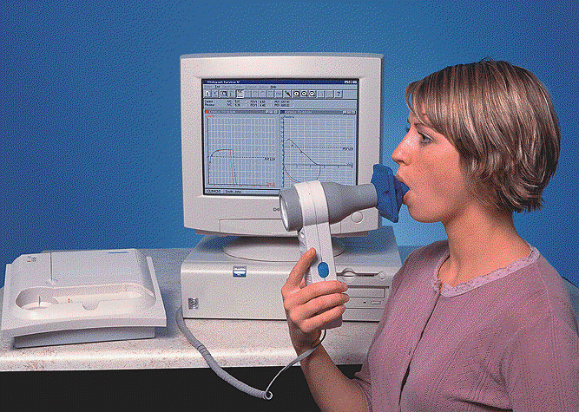
Dynamic Spirometry
Dr.Thouraya Said

Slide 2
It provides an objective measurement of lung function.
It analyzes volume and velocity of expired air
Spirometry

Slide 3
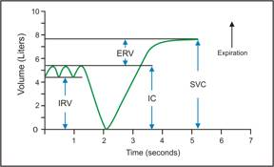
Static test
Performed without regard to time
Relaxed Vital capacity: Max Volume of air expired during relaxed expiration after a maximal inspiration

Slide 4
Dynamic test
Performed at forcible and max effort against time
Measures the rate at which the lung changes volume during forced breathing.
Forced vital capacity
The max volume of air that can be forcibly and rapidly exhaled following a max inspiration.

Slide 5
Two types of curves can be obtained
Forced expiratory curve
Flow Volume curve

Slide 6
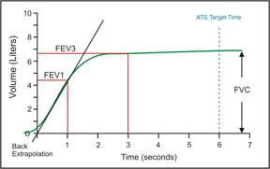
Forced Expiratory Curve
The subject takes a maximal inspiration and then exhales as rapidly, as forcibly,& as maximally as possible.
Duration of the forced effort: 3 – 5 sec
A plot of exhaled volume against time:

Slide 7
FEV1 : Volume of air expelled in the 1st sec of forced expiration starting from full inspiration
Plateau: FVC
FEV₁ % or ratio = (FEV1/FVC) * 100
Fraction of the VC expired during the 1st sec of a forced expiration (NL 70%-80%)

Slide 8
FEV₁ is a useful measure of how quickly the lungs can be emptied.
The ratio is a useful index of airflow limitation.

Slide 9
Normal Trace Showing FEV₁ and FVC
FVC
5
4
FEV₁ = 4L
FVC = 5L
FEV₁/FVC = 0.8
Volume, liters
3
2
1
1
2
3
4
5
6
1
Time, sec

Slide 10
The curve helps ≠
obstructive LD
Restrictive LD

Slide 11
Obstructive lung disease
5
A
4
B
Expired Volume (l)
FVC
3
2
1
0
1
2
3
4
5
Time (s)

Slide 12
Obstructive Disease
5
Normal
FEV₁ = 1.8L
FVC = 3.2L
FEV₁/FVC = 0.56
=56%
4
3
Volume, liters
2
1
Obstructive
1
2
3
4
5
6
Time, seconds

Slide 13
Restrictive lung disease
5
A
4
Expired Volume (l)
3
C
2
1
0
1
2
3
4
5
Time (s)

Slide 14
Restrictive Disease
5
Normal
Restrictive
4
3
Volume, liters
FEV₁ = 1.9L
FVC = 2.0L
FEV₁/FVC = 0.95
= 95%
2
1
1
2
3
4
5
6
Time, seconds

Slide 15
5
A
4
B
Expired Volume (l)
3
C
2
1
0
1
2
3
4
5
Time (s)

Slide 16
The normal and restrictive expire fully in 2 sec.
The obstructive needs more than 2 sec, the curve rises slowly to reach its highest point.
He may need more than 6 sec.
He can or not get rid of all VC depending on the severity of the disease.

Slide 17
Obstructive lung disease
FEV1 ↓↓ ↓↓
FVC ↓ or ↔
FEV1/ FVC ↓

Slide 18
Restrictive lung disease
FEV1 ↓ ↓
FVC ↓ ↓
FEV1/FVC ↔ or ↑

Slide 19
Volume | Normal | Obstructive | Restrictive
FVC | 5 | ↓ or ↔ (5) | ↓ (3)
FEV1 | 4 | ↓↓↓ (2) | ↓ (2.7)
FEV1% | 80% | ↓ (40%) (↓ airflow) | ↔ or ↑ (90) (Normal airflow)

Slide 20
Results interpretation
Results are reported as absolute values (litre) ,and as percentages of predicted values based on age, height, sex, ethnicity.
Normal: Both FVC and FEV1 ≥ 75% of predicted
If any of FVC and FEV1 is < 75% of predicted, calculate FEV1 ratio:
FEV1% ≥ 70% ------→ Restrictive
FEV1% < 70 % ------→ Obstructive

Slide 22
Flow Volume loop
breathes normally(TV)
max inspiratº
Exhales Fast
rapid max inspiratº

Slide 23
This measures exp & insp flow as a function of exhaled volume rather then against time.
Maximum expiratory flow (PEF)
Expiratory flow rate
L/sec
FVC
RV
TLC
Inspiratory flow rate
L/sec
Volume (L)

Slide 24
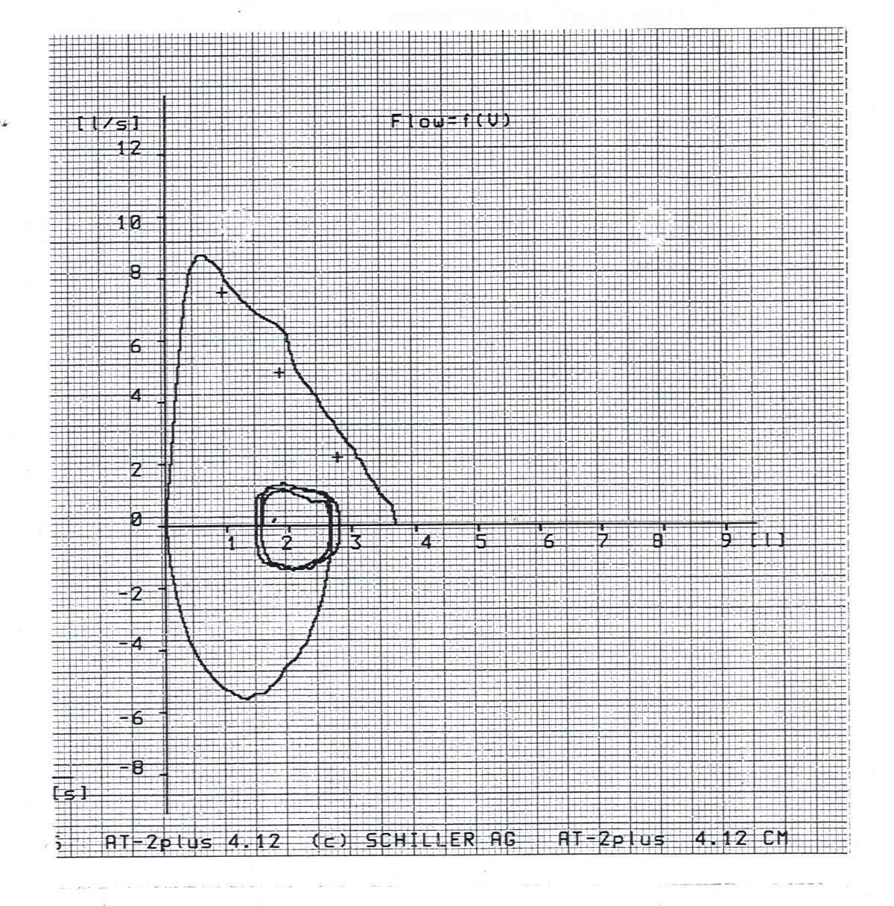

Slide 25
Flow Volume loop

Slide 26
Measurements on flow V loop
MEF50: max expiratory flow at 50% of FVC = 4-6 l
PIFR = max flow speed achieved during forceful inspiratory effort=6 l/sec
PEFR : Greatest flow achieved during the maneuvre = 6- 12 l/sec
FVC measured over the X-axis

Slide 27
Maximal Flow
The inspiratory and the 1st early expiratory flow rates (flows generated near the TLC) are effort (muscle) dependent: the greater one can raise pleural pressure (the harder one forces the air out), the greater the resulting air flow.

Slide 28
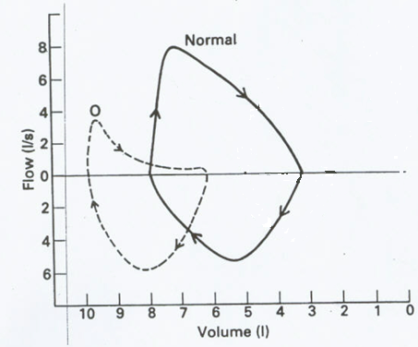
MEF50↓
Effort independent part of curve: concave (Curvilinear)
PEFR normal or↓in severe cases
Inspiratory loop Normal
Obstructive LD

Slide 29
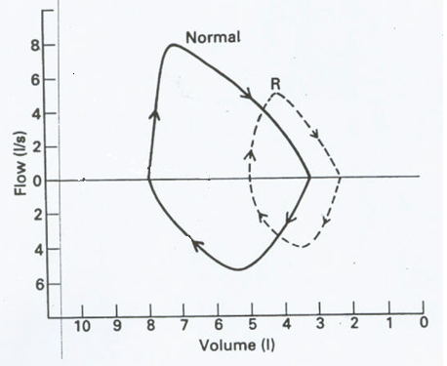
Restrictive LD
Miniature loop (elliptical)
All flow parameters ↓

Slide 30
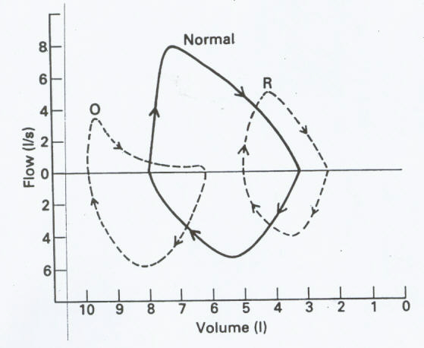

Slide 31
Importance of spirometry
Assess physical fitness.
Follow disease progression.
Helps in the diagnosis of certain pulmonary diseases (obstructive & restrictive).

Slide 32
Thank You

