Slide 1
OSPE Anatomy
Respiratory Block

Slide 2
Please note that these figures are not necessarily
those present in the exam
THANK YOU
PROF. AHMED FATHALLA IBRAHIM

Slide 3
OSPE
According to Prof. Ahmed the OSPE will only be identifying structures (theoretical questions are in the SAQ)
SAQ content is at the end of this document

Slide 4
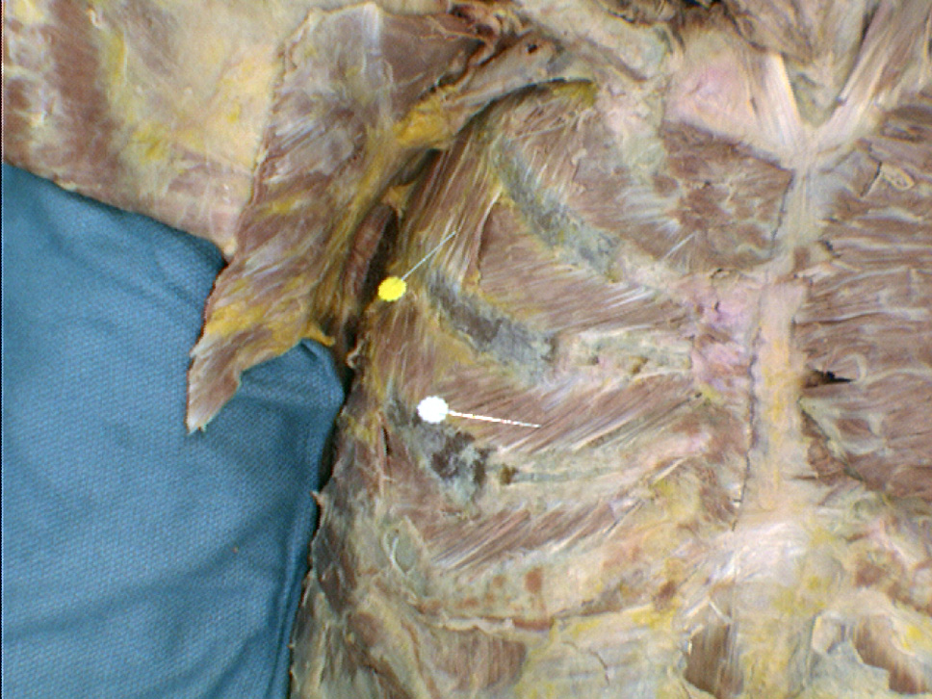
MUSCLES INVOLVED IN RESPIRATION: Action- Nerve supply
Intercostal Muscles
External Intercostal Muscle
Nerve supply: intercostal nerves
Action: rib elevators (inspiratory)
Internal Intercostal Muscle
Nerve supply: intercostal nerves
Action: rib depressors
Innermost Intercostal Muscle
Nerve supply: intercostal nerves
Action: rib depressors
Yellow :external intercostal muscle
White : internal intercostal muscle
Note the directions of the fibers

Slide 5
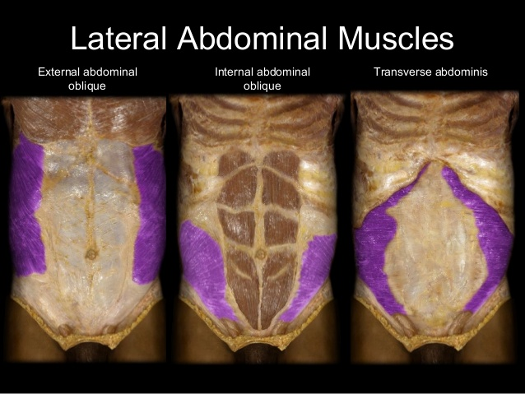
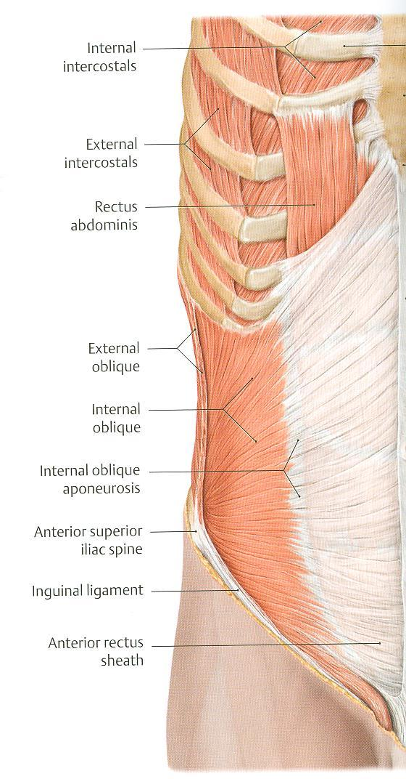
MUSCLES INVOLVED IN RESPIRATION Action- Nerve supply
Anterior Abdominal Wall Muscles
External Oblique Muscle &
Internal Oblique Muscle
Nerve supply:
lower intercostal nerves (T7 – T11),
subcostal nerve (T12), and
first lumbar nerve.
Action:
Compression of abdominal viscera to help in ascent of diaphragm (during forced expiration)
You only need to be able to identify the muscles for the OSPE

Slide 6
MUSCLES INVOLVED IN RESPIRATION Action- Nerve supply
Anterior Abdominal Wall Muscles
Transversus Abdominis
Nerve supply:
lower intercostal nerves (T7 – T11),
subcostal nerve (T12), and
first lumbar nerve.
Action:
Compression of abdominal viscera to help in ascent of diaphragm (during forced expiration)
You only need to be able to identify the muscles for the OSPE

Slide 7
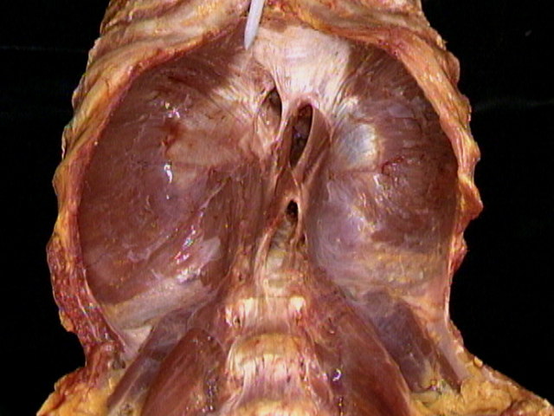
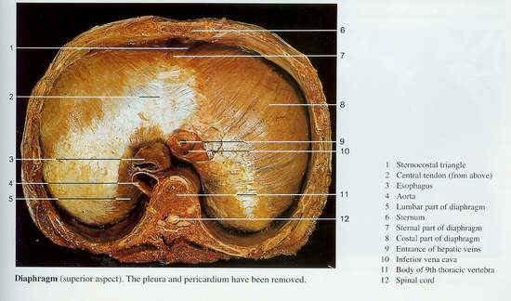
DIAPHRAGM
Central tendon
Caval aperture
(inferior vena cava)
T8
Esophageal aperture
T10
Aortic aperture
T12
We must know the structures passing through the diaphragm

Slide 8
NASAL CAVITY
Soft palate
Hard palate

Slide 9
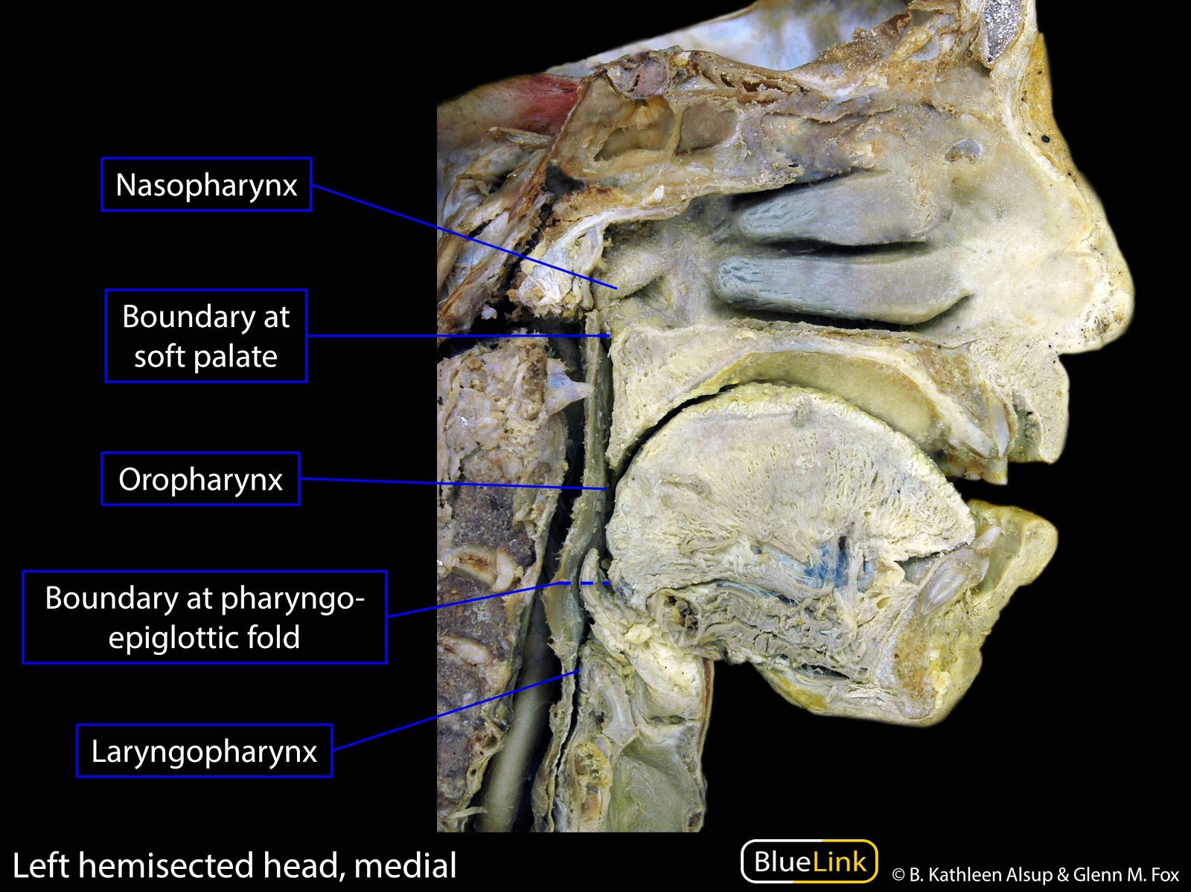
NASAL CAVITY, LARYNX, PHARYNX, TRACHEA
Frontal air sinus
Sphenoidal air sinus
Nasal septum
Hard palate
Opening of pharyngo-
tympanic tube
Palatine tonsil
Epiglottis
Trachea
N.B.: Site of drainage of the sinuses – important structures in the wall of pharynx- blood supply – lymphatic drainage

Slide 10
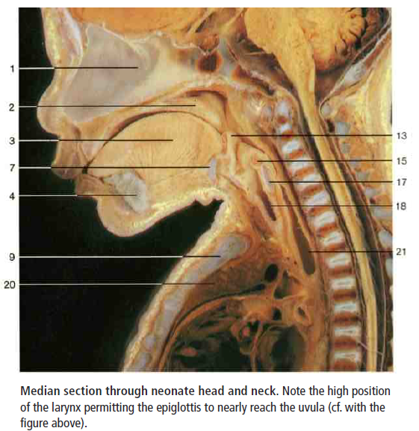
1 Nasal septum
2 Uvula
3 Genioglossus muscle
4 Mandible
5 Geniohyoid muscle
6 Mylohyoid muscle
7 Hyoid bone
8 Thyroid cartilage
9 Manubrium sterni
10 Sphenoidal sinus
11 Nasopharynx
12 Oropharynx
13 Epiglottis
14 Laryngopharynx
15 Arytenoid muscle
16 Vocal fold
17 Cricoid cartilage
18 Trachea
19 Left brachiocephalic vein
20 Thymus
21 Esophagus

Slide 11
1 Scalenus anterior muscle 2 Scalenus medius and posterior muscles 3 Right recurrent laryngeal nerve 4 Right subclavian artery 5 Brachiocephalic trunk 6 Aortic arch 7 Hyoid bone 8 Internal branch of superior laryngeal nerve 9 Thyrohyoid membrane 10 External branch of superior laryngeal nerve 11 Vagus nerve 12 Thyroid cartilage 13 Cricothyroid muscle 14 Trachea 15 Left recurrent laryngeal nerve 16 Esophagus 17 Left subclavian artery 18 Left common carotid artery 19 Second rib 20 Tongue 21 Superior cervical ganglion 22 Sympathetic trunk 23 Inferior constrictor muscle of pharynx 24 Inferior thyroid artery 25 Glossopharyngeal nerve 26 Superior laryngeal nerve 27 Epiglottis 28 Posterior crico-arytenoid muscle and cricoid cartilage 29 Inferior laryngeal branch of recurrent laryngeal nerve 30 Thyroid gland 31 Superior thyroid artery 32 Thyrocervical trunk 33 Internal thoracic artery 34 Phrenic nerve 35 Hypoglossal nerve 36 Transverse cervical artery 37 Middle cervical ganglion 38 Middle cervical cardiac nerves (branches of sympathetic trunk) 39 Ligamentum arteriosum
1 Scalenus anterior muscle 3. Right recurrent laryngeal nerve 6 Aortic arch 8 Internal branch of superior laryngeal nerve 10 External branch of superior laryngeal nerve 11 Vagus nerve 12 Thyroid cartilage 13 Cricothyroid muscle 14 Trachea 15 Left recurrent laryngeal nerve 17 Left subclavian artery 22 Sympathetic trunk 24 Inferior thyroid artery 30 Thyroid gland 31 Superior thyroid artery 33 Internal thoracic artery 34 Phrenic nerve 35 Hypoglossal nerve 39 Ligamentum arteriosum
Note the thyroid gland covering the cartilage
(he said he’s going to use a picture without the gland)

Slide 12
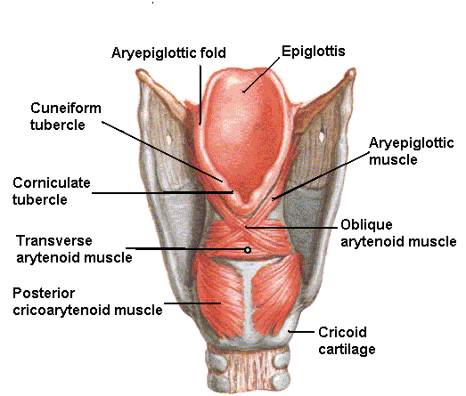
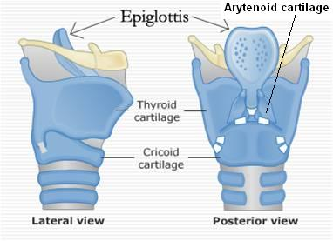
LARYNX, TRACHEA
The cartilaginous skeleton is composed of 9 cartilages:
3 Single:
Thyroid 2. Cricoid 3. Epiglottis
3 Paired:
4. Arytenoid 5. Corniculate 6. Cuneiform
6
3
5
3
1
1
4
4
2
2
Structure | Beginning | Termination
Pharynx | Base of skull | C6 vertebra
Larynx | Laryngeal inlet | Lower border of cricoid (C6)
Trachea | Lower border of cricoid (C6) | Sternal Angle (T4)
Level of beginning and termination of larynx, trachea and pharynx
Cartilages of larynx

Slide 13
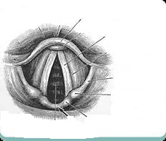
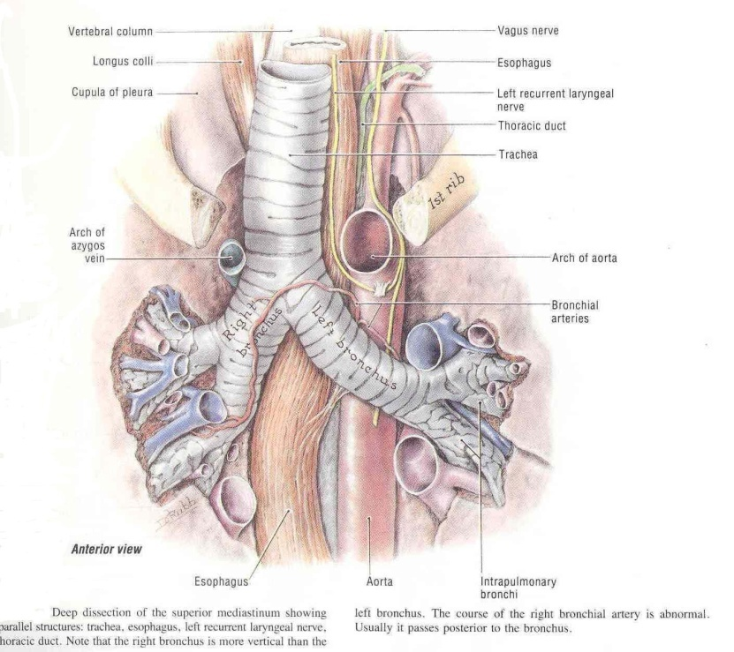
- Identify the following labelled structures :
a ………………………….
b…………………………..
c……………………………..
d……………………………….
e……………………………….
TRACHEA & BRONCHI
a
b
c
d
e
- Answers :
epiglottis.
Vocal cord.
Aryepiglottic fold.
Cuniform cartilage.
Corniculate cartilage.

Slide 14
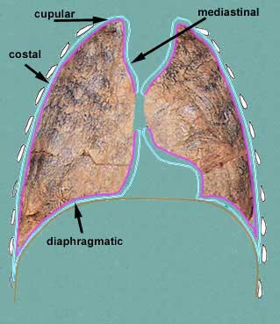
LUNG & PLEURA
Nerve Supply
Pleura | Visceral pleura |  | supplied by the autonomic fibers from the pulmonary plexus.
 | Parietal pleura | Costal pleura | segmentally supplied by the intercostal nerves.
 |  | Mediastinal pleura | phrenic nerves
 |  | Diaphragmatic pleura | central part by phrenic nerves, around the periphery by lower 6 intercostal nerves
Lungs |  |  | Pulmonary plexus at the root of lung….is formed of autonomic N.S. from sympathetic & parasympathetic fibers. 1- Sympathetic Fibers From: sympathetic trunk 2- Parasympathetic Fibers From: Vagus nerve
Nerve supply- Surface Anatomy
Cervical

Slide 15
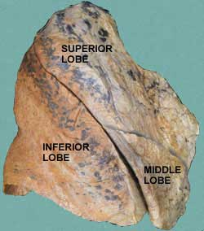
LUNG & PLEURA
Surface anatomy of fissures and cardiac notch
Transverse (horizontal) fissure
Oblique fissure

Slide 16
RIGHT LUNG
SVC = Superior Vena Cava
IVC = Inferior Vena Cava
Phrenicnerve
S
V
C
Superior lobar bronchus
Transverse fissure
Azygos vein
Inferior lobar bronchus
Superior pulmonary
vein
Pulmonary artery
Inferior pulmonary
vein
I
V
C
Esophagus
Cardiac impression
Vagus nerve
Oblique fissure

Slide 17
LEFT LUNG
Common carotid artery
Phrenic nerve
Subclavian artery
Aortic arch
Pulmonary artery
Bronchus
Superior pulmonary
vein
Inferior
pulmonary vein
Cardiac impression
Pulmonary ligament
Area related to
diaphragm
Oblique fissure
Descending aorta
Vagus nerve
Lingula

Slide 18
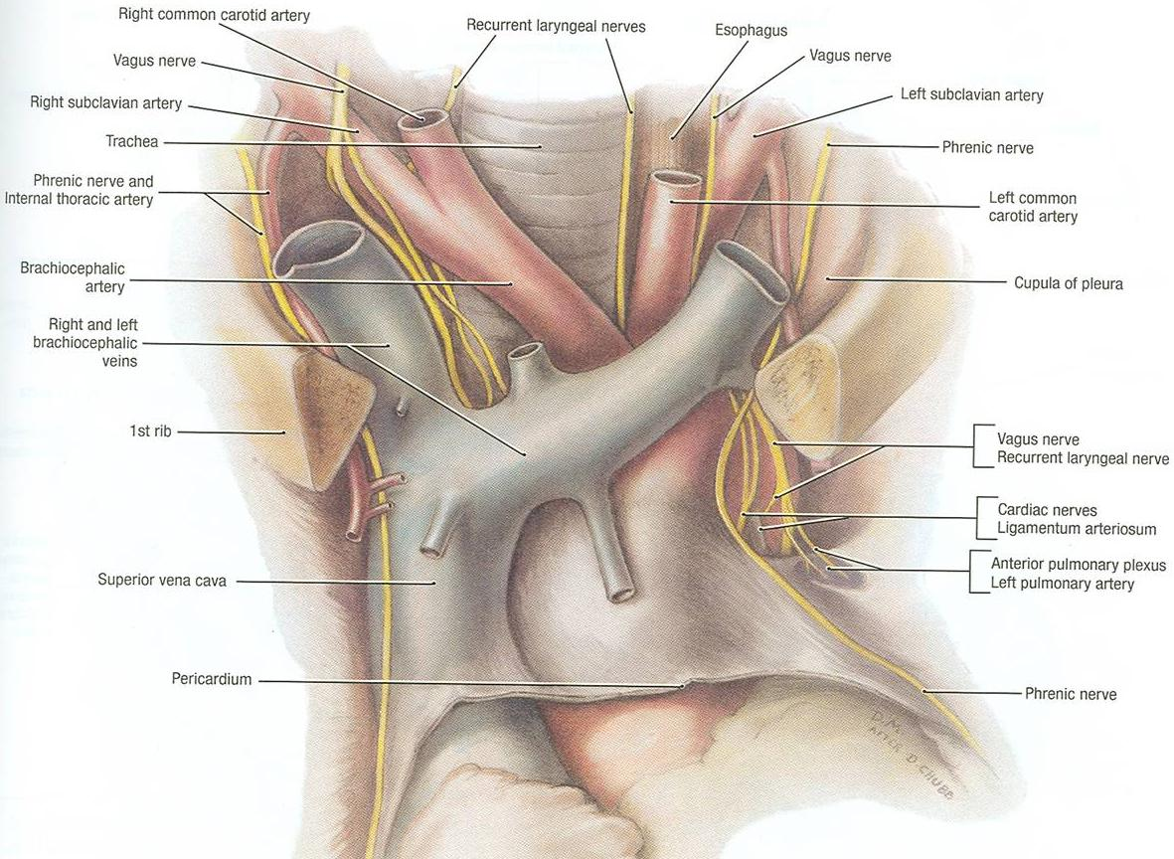
MEDIASTINUM Contents

Slide 19
MEDIASTINUM Contents
T4 is the level of:
Sternal angle
Second costal cartilage
1.Bifurcation of trachea
2. Bifurcation of pulmonary trunk
3. Beginning & termination of arch of aorta
Descending aorta
N.B:. LEVEL OF T4

Slide 20
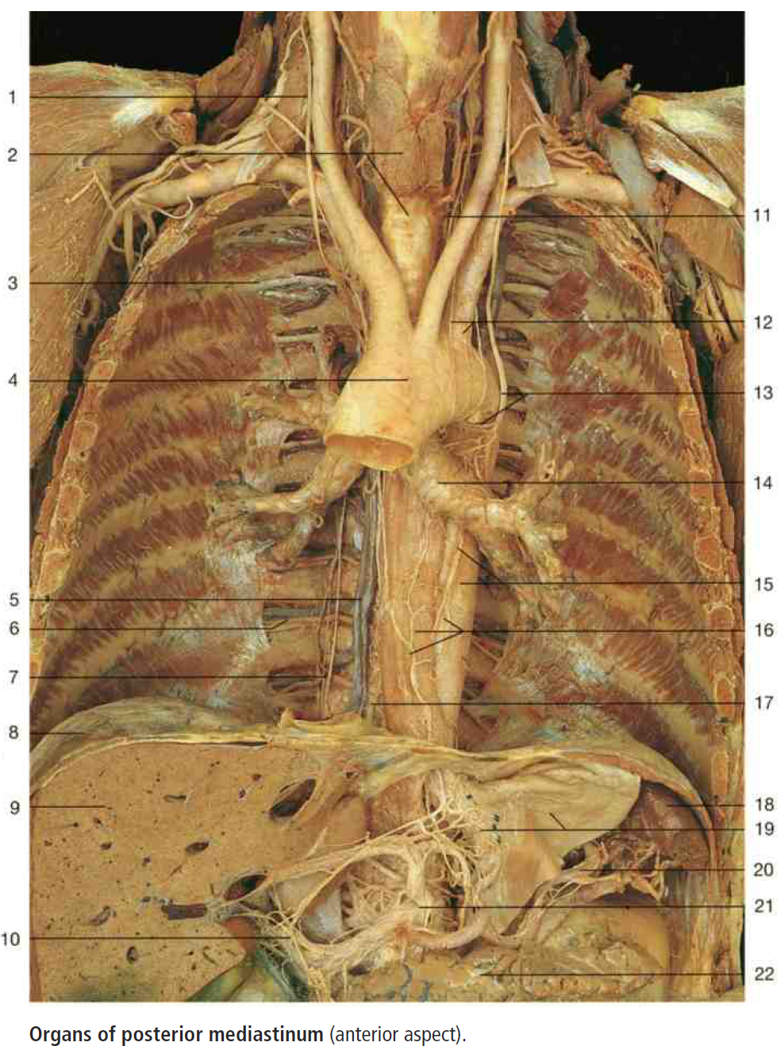
Superior-Posterior Mediastinum
1 .Right vagus nerve
2. Thyroid gland & Trachea
11. Left recurrent laryngeal nerve
3. Intercostal nerve
4. Aortic arch
13. Left vagus & left recurrent laryngeal nerve
14. Left primary bronchus
5.Azygos vein
15. Thoracic aorta
16. Esophagus & esophageal plexuses
17. Thoracic duct
8. Diaphragm
18. Spleen
9. Liver
19. Anterior gastric plexus of stomach

Slide 21
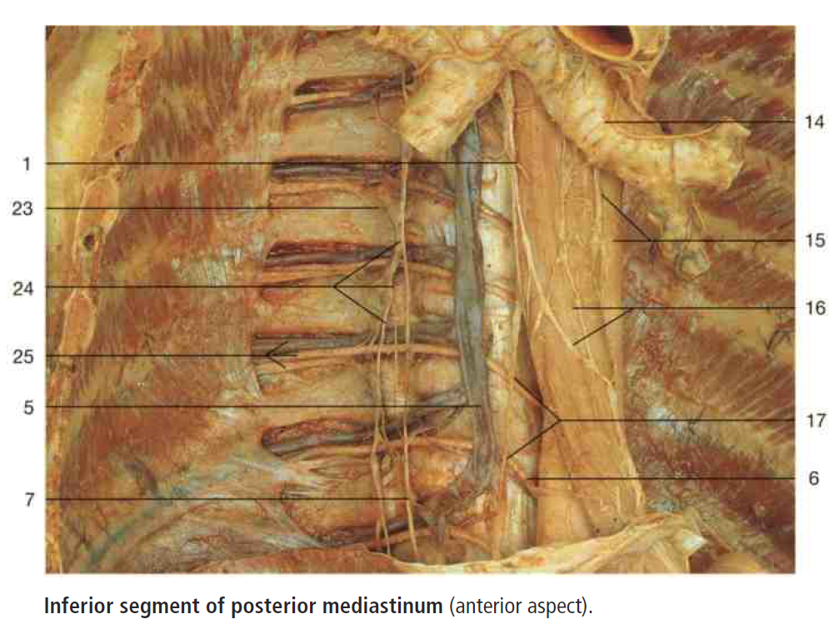
Inferior-Posterior Mediastinum
1 Right vagus nerve
2 Thyroid gland and trache
3 Intercostal nerve
4 Aortic arch
5 Azygos vein
6 Posterior intercostal artery
7 Greater splanchnic nerve
8 Diaphragm
9 Liver
10 Proper hepatic artery and hepatic plexus
11 Left recurrent laryngeal nerve
12 Inferior cervical cardiac nerves
13 Left vagus nerve and left recurrent laryngeal
nerve
14 Left primary bronchus
15 Thoracic aorta and left vagus nerve
16 Esophagus and esophageal plexus
17 Thoracic duct
18 Spleen
19 Anterior gastric plexus and stomach (divided)
20 Splenic artery and splenic plexus
21 Celiac trunk and celiac plexus
22 Pancreas
23 Ramus communicans
24 Sympathetic trunk and sympathetic ganglion
25 Posterior intercostal vein and artery
and intercostal nerve
26 Right brachiocephalic vein
27 Superior vena cava
28 Ascending lumbar vein
29 Lumbar veins
30 Right external iliac vein
31 Trachea
32 Accessory hemiazygos vein
33 Posterior intercostal veins
34 Hemiazygos vein
35 Inferior vena cava
36 Median sacral vein
37 Internal iliac vein
14. Left primary bronchus
1 .Right vagus nerve
23. Ramus communicans
15. Left vagus nerve
24. Sympathetic trunk & ganglia
15. Thoracic aorta
25. Posterior intercostal artery
16. Esophagus & esophageal plexuses
25. Posterior intercostal vein
5.Azygos vein

Slide 22
RADIOLOGY
Trachea
Clavicle
Aortic knuckle
Scapula
Apex of heart
(left ventricle)
Cardiophrenic angle
Left dome
of diaphragm
Right dome
of diaphragm
Right atrium

Slide 23
RADIOLOGY
T
T: Trachea
B: Bronchus (primary)
B

Slide 24
RADIOLOGY
Barium swallow
Esophagus

Slide 25
SAQ

Slide 26
Intercostals & Abdominal Muscles
Intercostal Muscles
External Intercostal Muscle
Nerve supply: intercostal nerves
Action: rib elevators (inspiratory)
Internal Intercostal Muscle
Nerve supply: intercostal nerves
Action: rib depressors
Innermost Intercostal Muscle
Nerve supply: intercostal nerves
Action: rib depressors
Anterior Abdominal Wall Muscles
Transversus Abdominis
External oblique muscle
Internal oblique muscle
Nerve supply:
lower intercostal nerves (T7 – T11),
subcostal nerve (T12), and
first lumbar nerve.
Action:
Compression of abdominal viscera to help in ascent of diaphragm (during forced expiration)

Slide 27
Diaphragm
Nerve supply:
Phrenic nerve (C3,4,5),
Action:
contraction (descent) of diaphragm increase vertical diameter of thoracic cavity essential for normal breathing.
Origin:
1) Costal: lower 6 costal cartilages
2) Vertebral: upper 3 lumbar vertebrae
(right & left crus + arcuate ligaments)
3) Sternal: xiphoid process of sternum
Insertion:
Central Tendon (lies at the level of xiphisternal joint , at 9th thoracic vertebra)
Major openings of diaphragm
The thoracic spinal levels at which the three major structures pass through the diaphragm can be remembered by the number of letters contained in each structure:
Vena Cava (8 letters) – Passes through the diaphragm at T8.
Esophagus (10 letters) – Passes through the diaphragm at T10.
Aortic Hiatus (12 letters) – "Passes" through the diaphragm at T12
Mnemonic of major openings of diaphragm: I ate (8) 10 Eggs At 12.
(I 8= inferior vena cava pierce at T8,
10 Eggs= Esophagus pierces at T10 ,
At 12 = Aorta pierces at T12)

Slide 28
NASAL CAVITY, LARYNX, PHARYNX, TRACHEA
Pharynx | Arterial supply | from branches of the following arteries: 1- Ascending pharyngeal 2- Ascending palatine 3- Facial 4- Maxillary 5- Lingual
 | Veins | drain into pharyngeal venous plexus, which drains into the internal jugular vein
 | Lymphatics | drain into the deep cervical lymph nodes either directly, or indirectly via the retropharyngeal or paratracheal lymph nodes
Larynx: Nerve Supply
Sensory | Above the vocal cords: | - Internal laryngeal nerve - branch of the superior laryngeal of the vagus nerve.
 | Below the vocal cords: | Recurrent laryngeal nerve of the vagus nerve
Motor | All intrinsic muscles supplied by the recurrent laryngeal nerve except the cricothyroid The cricothyroid is supplied by the external laryngeal nerve of superior laryngeal of vagus.

Slide 29
NASAL CAVITY, LARYNX, PHARYNX, TRACHEA
Pharynx | Structures in the lateral wall
Nasopharynx | Opening of auditory tube Tubal elevation Pharyngeal recess Salpingopharyngeal fold Pharyngeal Tonsil Tubal Tonsil
Oropharynx | Palatopharyngeal fold Palatoglossal fold Palatine Tonsil
Laryngopharynx | Piriform Fossa
Site of Drainage | Sinus
Spheno-ethmoidal recess | sphenoidal sinus
Superior meatus | posterior ethmoidal sinus
Middle meatus | middle ethmoidal, anterior ethmoidal , maxillary, and frontal sinuses
Inferior meatus | nasolacrimal duct.

Slide 30
LARYNX, TRACHEA
The cartilaginous skeleton is composed of 9 cartilages:
3 Single:
Thyroid 2. Cricoid 3. Epiglottis
3 Paired:
4. Arytenoid 5. Corniculate 6. Cuneiform
Structure | Beginning | Termination
Pharynx | Base of skull | C6 vertebra
Larynx | Laryngeal inlet | Lower border of cricoid (C6)
Trachea | Lower border of cricoid (C6) | Sternal Angle (T4)
6
3
3
5
1
1
4
4
2
2
Level of beginning and termination of larynx, trachea and pharynx
Cartilages of larynx

Slide 31
LUNG & PLEURA
Nerve Supply
Pleura | Visceral pleura |  | supplied by the autonomic fibers from the pulmonary plexus.
 | Parietal pleura | Costal pleura | segmentally supplied by the intercostal nerves.
 |  | Mediastinal pleura | phrenic nerves
 |  | Diaphragmatic pleura | central part by phrenic nerves, around the periphery by lower 6 intercostal nerves
Lungs |  |  | Pulmonary plexus at the root of lung….is formed of autonomic N.S. from sympathetic & parasympathetic fibers. 1- Sympathetic Fibers From: sympathetic trunk 2- Parasympathetic Fibers From: Vagus nerve

Slide 32
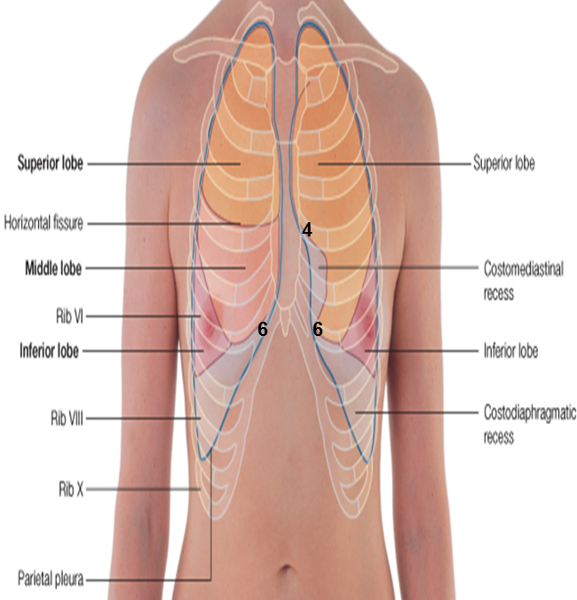
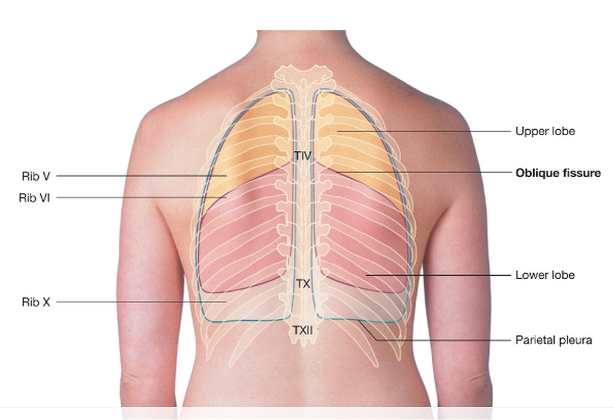
Surface Anatomy
435 SAQ
Describe the SUFACE ANATOMY OF lung fissures??
Oblique fissure: Represented by a line extending from 3rd thoracic spine, obliquely ending at 6th costal cartilage.
Transverse fissure: Only in the right lung: represented by a line extending from 4th right costal cartilage to meet the oblique fissure.
Describe the SUFACE ANATOMY OF PLEURA??
Apex: lies one inch above the medial 1/3 of the clavicle.
Right pleura: The anterior margin extends vertically from sterno-clavicular joint to 6th costal cartilage.
Left pleura: The anterior margin extends from sternoclavicular joint to the 4th costal cartilage, then deviates for about 1 inch to left at 6th costal cartilage to form cardiac notch
Inferior margin : passes around the chest wall, on the 8th rib in midclavicular line, 10th rib in mid-axillary line and finally reaching to the last thoracic spine (T12 spine).
Posterior margin : along the vertebral column from the apex to the inferior margin ( T12 spine).
Describe the SUFACE ANATOMY OF cardiac notch??
The anterior margin of left pleura extends from sternoclavicular joint to the 4th costal cartilage, then deviates for about 1 inch to left at 6th costal cartilage to form cardiac notch
Describe the SUFACE ANATOMY OF the lung??
Apex, anterior border and posterior border: correspond nearly to the lines of pleura but are slightly away from the median plane.
Inferior margin : as the pleura but more horizontally and finally reaching to the 10th thoracic spine.

Slide 33
GOOD LUCK!
Mohammed BinMayouf
Faisal Al-Saif
Abduljabbar Alyamane
Lamia Alkuwaiz
Alanoud AlMufarrej
Special thanks for team 436.

