Slide 3
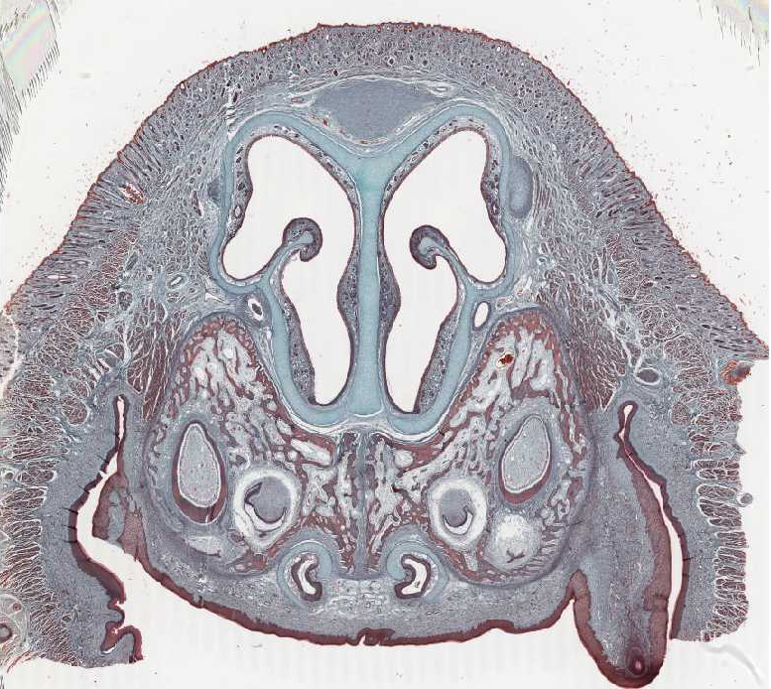
Nasal cavity and septum
Q1: Identify the structure?
Nasal cavity and septum
Q2: What is the lining epithelium?
Pseudo-stratified ciliated columnar epithelium with goblet cells
Q3: What is the type of cartilage found in this structure?
Hyaline cartilage
Nasal Septum

Slide 4
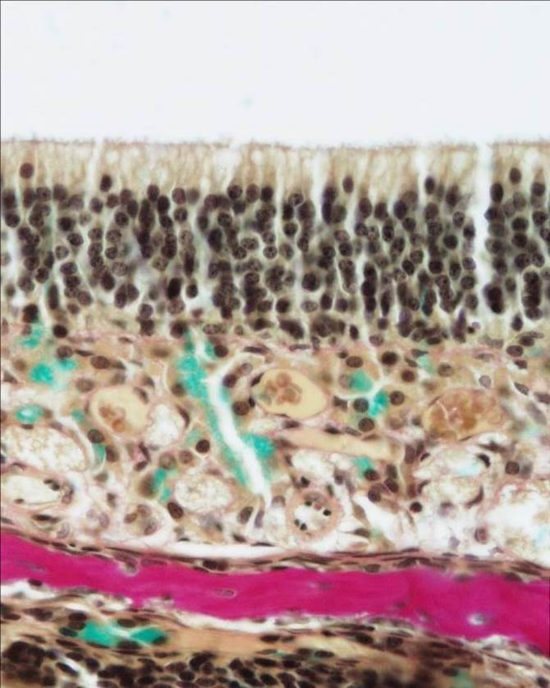
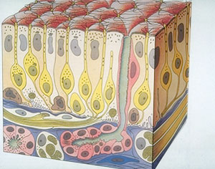
Olfactory mucosa
Q1: Identify the structure?
Olfactory Mucosa
Q2: What is the lining epithelium?
pseudo-stratified columnar epithelium
This type of epithelium is found on roof of nasal cavity.
Q3: What are the type of cells found in olfactory epithelium?
Bipolar neurons
Sustentacular (supporting) cells
Basal cells

Slide 5
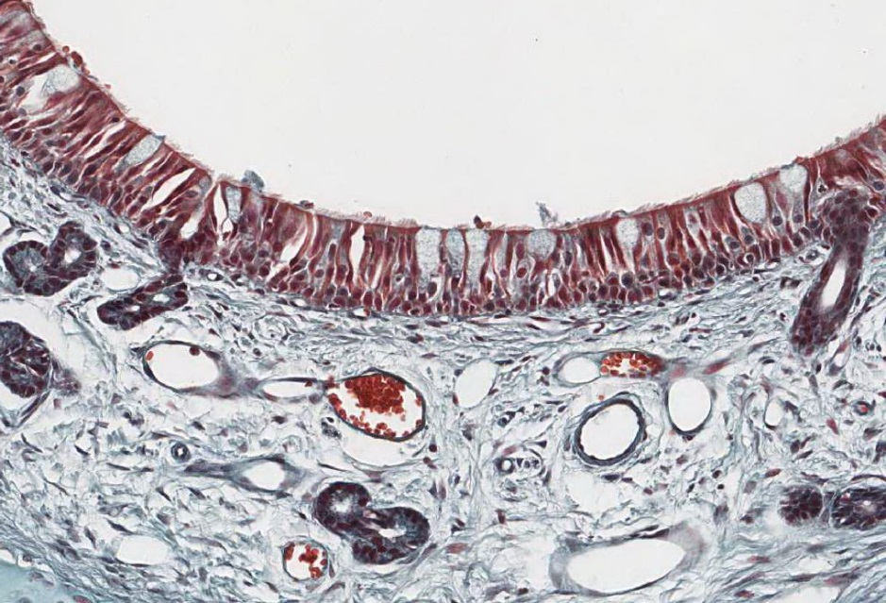
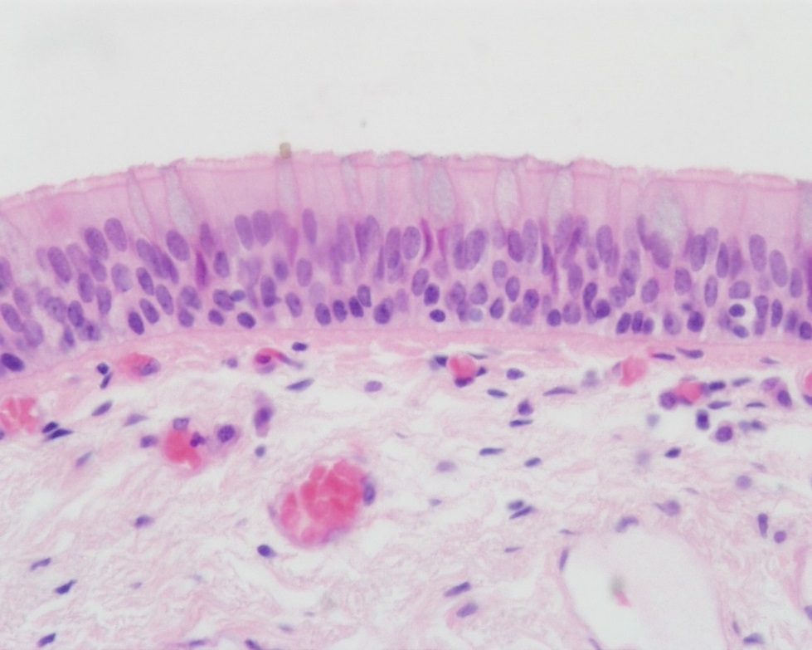
Respiratory mucosa
Q1: Identify the structure?
Respiratory mucosa
Q2: What is main structure of this mucosa?
Lining respiratory epithelium
C.T. lamina propria rich in seromucous glands, vascular plexuses, and lymphoid elements
Q3: What is the lining epithelium?
Pseudo-stratified ciliated columnar epithelium with goblet cells
Seromucous glands

Slide 6
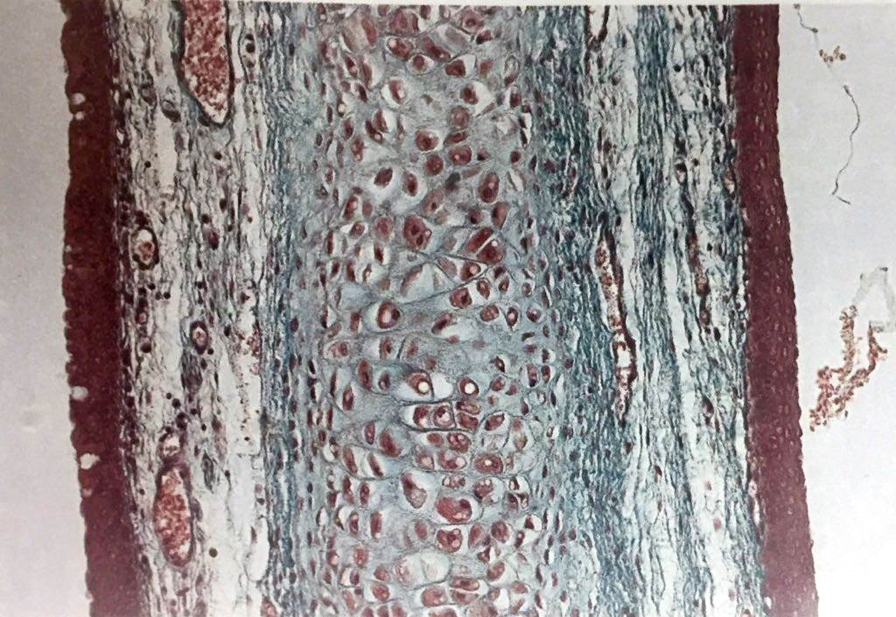
The Epiglottis
Q1: Identify the structure?
The epiglottis
Q2: What is the lining epithelium?
Anterior: stratified squamous epithelium non keratinized
Posterior: pseudo stratified columnar epithelium
Q3: What is the type of cartilage found in this structure?
Elastic cartilages

Slide 7
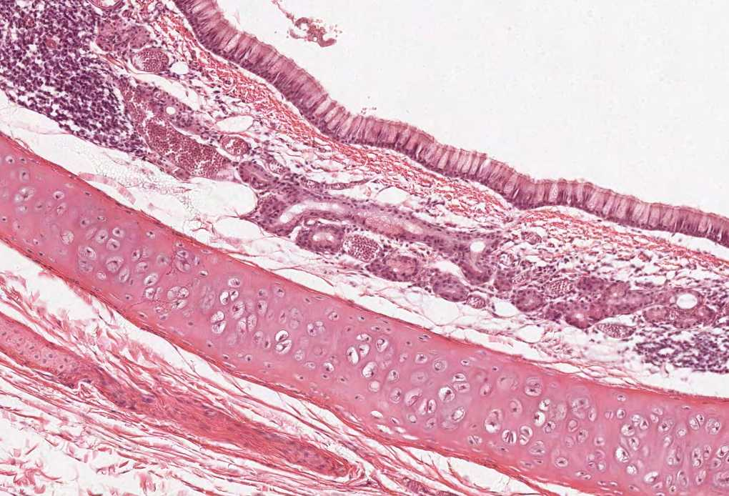
Trachea
Q1: Identify the structure?
Trachea
Q2: What is the lining epithelium?
Pseudo-stratified ciliated columnar epithelium with goblet cells
Q3: What are the layers of this structure?
Mucosa
Submucosa
adventitia
Q4: What is the type of cartilage found in this structure?
C-shaped rings of hyaline cartilage in the adventitia

Slide 8
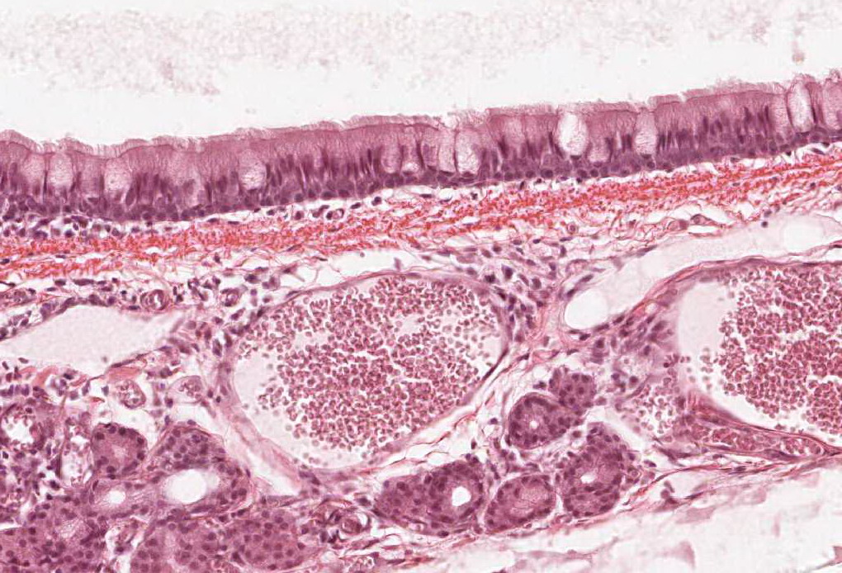
Tracheal mucosa
Q1: Identify the structure?
Tracheal mucosa
Q2: What is the lining epithelium?
Pseudo-stratified ciliated columnar epithelium with goblet cells
Q3: What are the contents of the submucosa of this structure?
Numerous Mucous & seromucous glands
Lymphoid elements
Connective tissue

Slide 9
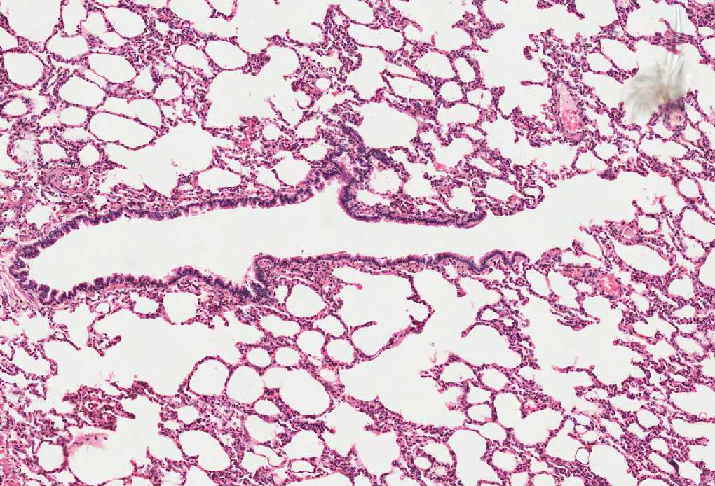
YOU SHOULD KNOW THE DIFFERENT STRUCTURES IN THIS PICTURE
Lung
Alveolar duct
Terminal
Bronchiole
Pulmonary
alveoli

Slide 10
Lung
Q1: Identify the structure?
The Lung
Q2: What are the contents of the structure?
Intrapulmonary bronchi
Bronchioles
Pulmonary Alveoli

Slide 11
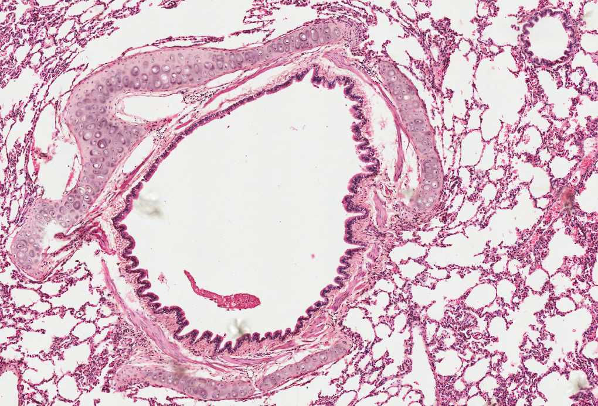
Intrapulmonary bronchus
Q1: Identify the structure?
Intrapulmonary bronchus
Q2: What is the lining epithelium?
Pseudo-stratified ciliated columnar epithelium with goblet cells
Q3: What is the type of cartilage found in this structure?
Plates of hyaline cartilage

Slide 12
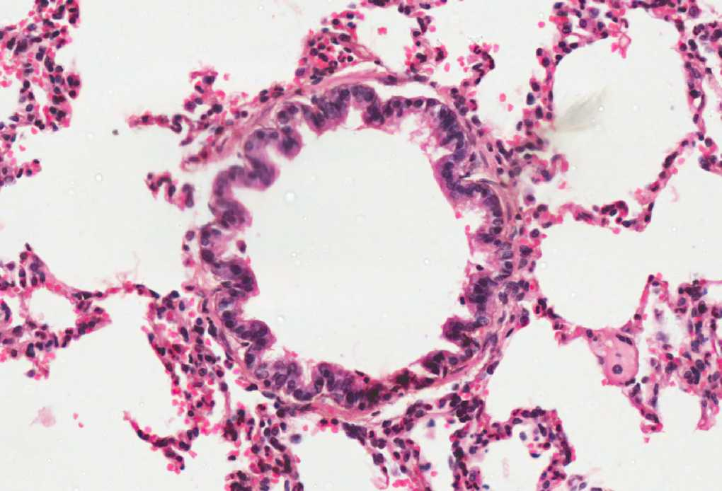
Terminal bronchiole
Q1: Identify the structure?
Terminal Bronchiole
Q2: What is the lining epithelium?
Simple cuboidal partially ciliated epithelium with Clara cells
NO GOLBET CELLS
Q3: What is the function of clara cells?
Degrade toxins in inhaled air (immune cell like function)
Divide to regenerate the bronchiolar epithelium
Produce surfactant-like material

Slide 13
Pulmonary alveoli
Q1: Identify the structure?
Pulmonary Alveoli
Q2: What is the lining epithelium?
Simple squamous epithelium
Q3: What are the types of cells found
in the Alveolar epithelium?
Type I Pneumocytes
Type II Pneumocytes
Q4: What are the compartment of the
blood-gas barrier?
Surfactant
Type I Pneumocyte
Fused basement membrane of both type I pneumocyte and endothelial cells of pulmonary capillaries
Endothelial cells
Alveolar duct
Alveoli

Slide 14
From Dr.Raeesa
 | Type I Pneumocytes | Type II Pneumocytes
Structure | Simple squamous “flattened” no lamellar bodies | Cuboidal “rounded” have lamellar bodies
Number | Less than type II | More numerous than type I
Function | Gas exchange | Secrete surfactant
What is the differences between intrapulmonary bronchus and the bronchiole?
1. Bronchiole has not cartilage
2. Bronchiole is more rich in smooth muscle bundles
3. No seromucous glands or lymphoid nodules in bronchioles
4. in bronchioles the lining epithelium is simple type
5. Goblet cells are less in number in the bronchioles

