Slide 1
Muscles involved in respiration
Lecture 1
Please check our Editing File.
هذا العمل لا يغني عن المصدر الأساسي للمذاكرة

Slide 2
Objectives
Describe the components of the thoracic cage and their articulations.
Describe in brief the respiratory movements.
List the muscles involved in inspiration and in expiration.
Describe the attachments of each muscle to the thoracic cage and its nerve supply.
Describe the origin, insertion, nerve supply of diaphragm.

Slide 3
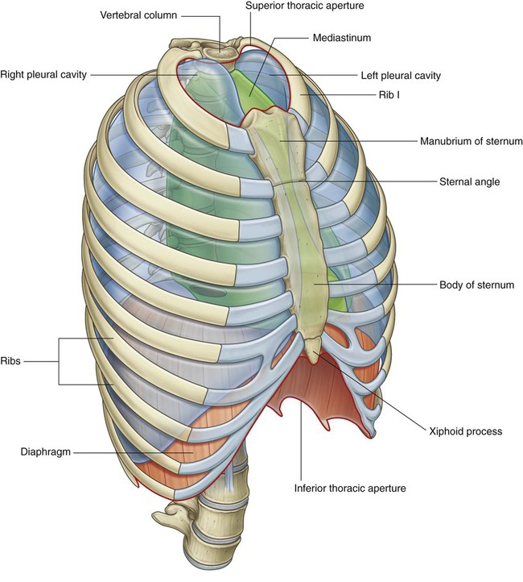
Thoracic Cage
Conical ( مخروطي ) in shape. it has 2 apertures ( openings ): 1- superior: (thoracic outlet): narrow, open, continuous with neck. 2- inferior: wide, closed by diaphragm.
formed of : A- Anteriorly: Sternum and costal cartilages. B- Laterally: Twelve pairs of ribs. C- Posteriorly: Twelve thoracic vertebrae.

Slide 4
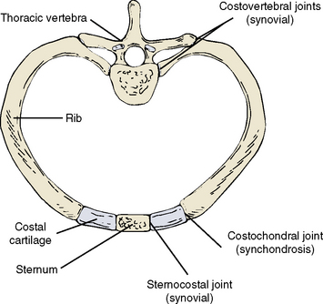
The articulations related to the thoracic cage
1- Costochondral ( Primary cartilaginous joint ):is an articulation between the ribs and the costal cartilages.
2- Sternocostal (1st cartilage with manubrium by primary cartilaginous joint it ossifies later // 2nd to 7th cartilages with sternum by plane synovial joint ) is an articulation between the cartilage of true ribs and the sternum.
3- costovertebral ( plane synovial joint ): is an articulation between the thoracic vertebrae and the heads of the ribs.
4- Interchondral (Primary cartilaginous): between the 8,9, and 10 costal cartilages, and they all formed what is called costal margin

Slide 5
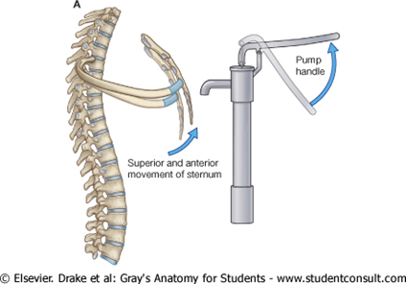
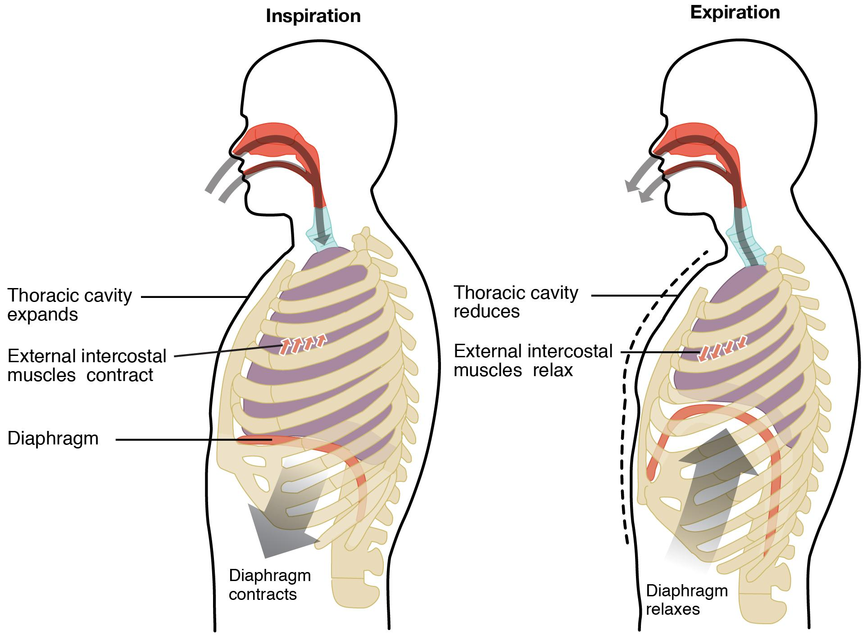
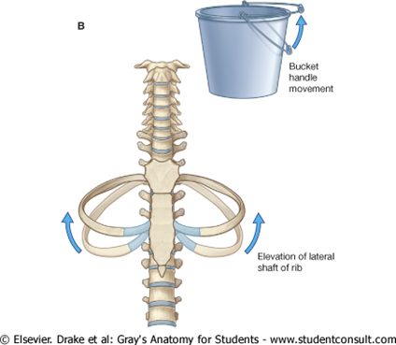
Thoracic cage Ribs movement video
Respiratory movements
B- MOVEMENTS OF RIBS (In Normal inspiration)
1- PUMP HANDLE MOVEMENT:
2- BUCKET HANDLE MOVEMENT:
Elevation of ribs Increase in antero-posterior diameter of thoracic cavity
A-MOVEMENTS OF DIAPHRAGM
Inspiration:
Contractions (descend) of diaphragm Increase of vertical diameter of thoracic cavity
Expiration:
Relaxation (ascend) of diaphragm
Elevation of ribs Increase in lateral (transverse) diameter of thoracic cavity

Slide 6
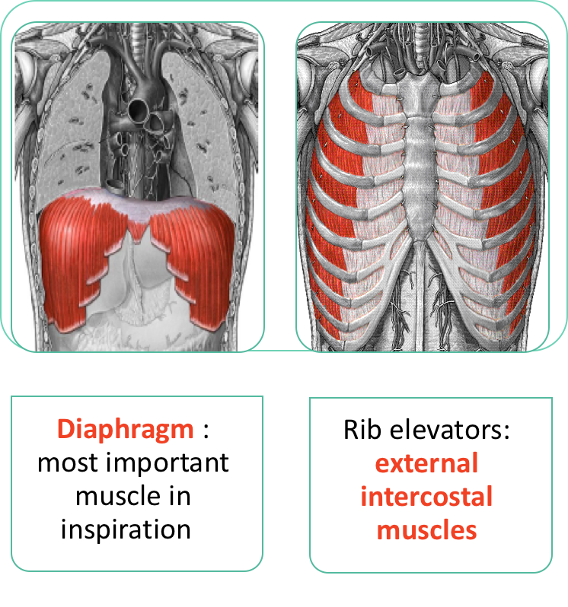
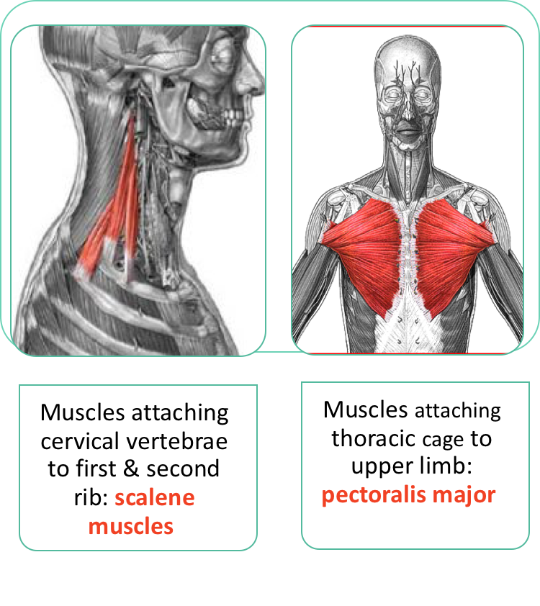
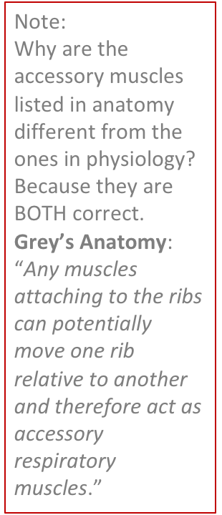
Inspiratory Muscle
Team 436
Accessory muscle
(only during forced inspiration)
Note: their main function isn’t inspiration
Muscle used in rest and forced inspiration

Slide 7
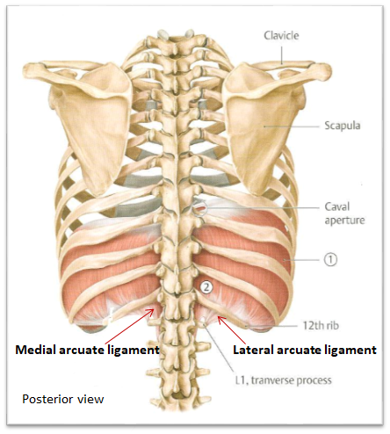
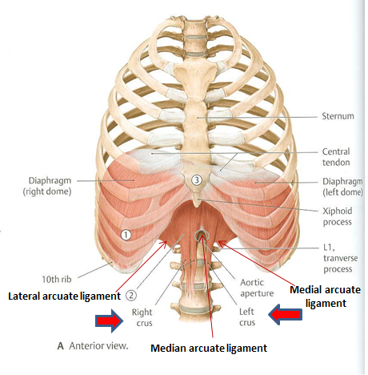
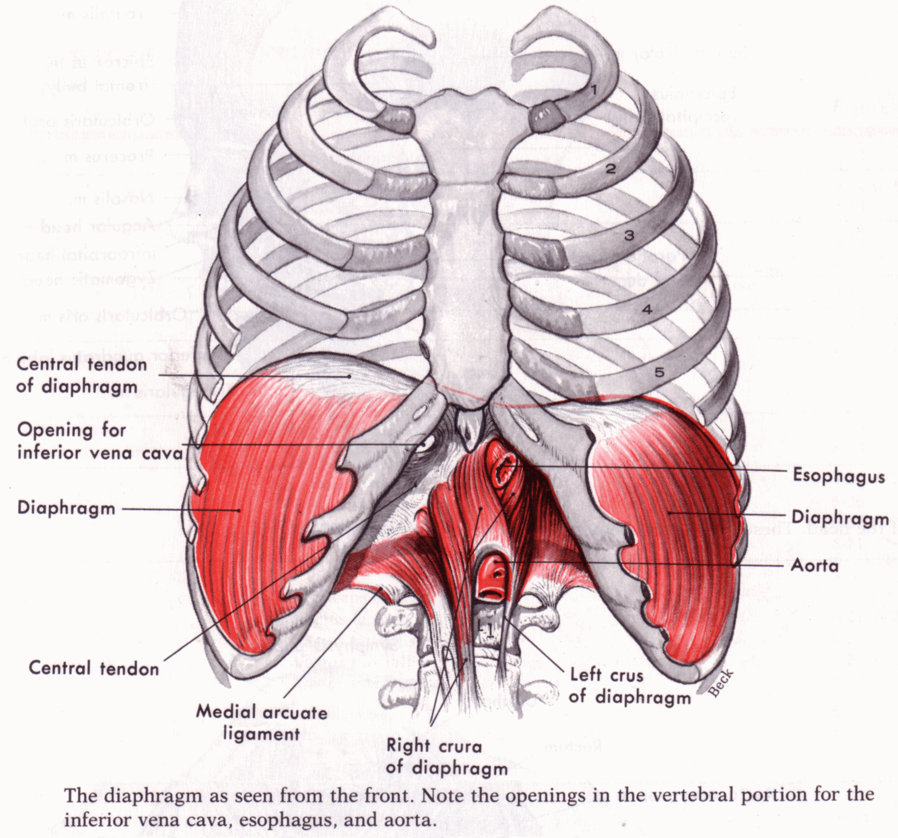
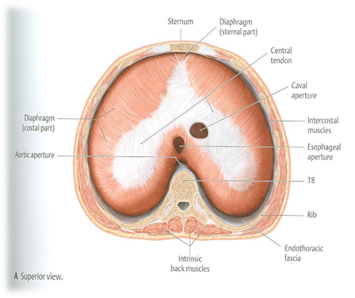
Diaphragm
A musculotendinous partition between thoracic & abdominal cavity
Convex toward thoracic & concave toward abdominal cavity
Fibers converge to join the central tendon
Nerve supply: phrenic nerve (C3,4,5), penetrates diaphragm & innervates it from abdominal surface
 | origin | attachment | insertion | action
Diaphragm | costal: lower 6 costal cartilages vertebral: upper 3 lumbar vertebrae ( right and left crus + arcuate ligament) sternal: xiphoid process of sternum | sternum costal cartilages 12th rib lumbar vertebrae | central tendon (Lies at the level of xiphisternal joint , at 9th thoracic vertebra) | contraction (descent) of diaphragm increase the vertical diameter of thoracic cavity (essential for normal breathing)

Slide 8
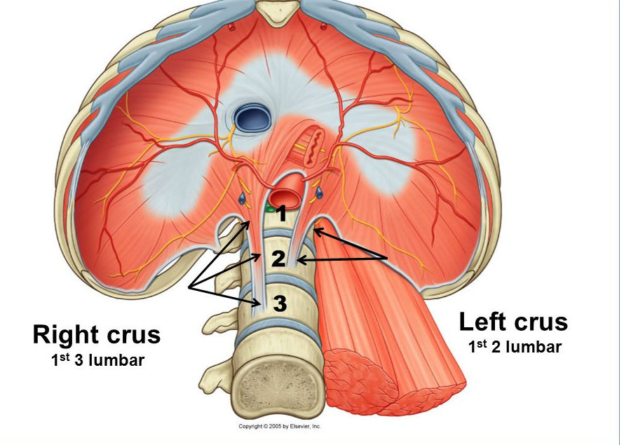
Vertebral origin of diaphragm Extra slide but was explained by the doctors!
formed of 2 crura:
Right crus: larger than the left crus, and attached to the upper 3 lumbar vertebrae.
it form the physiological sphincter of the stomach.
Left crus: smaller than the right crus, and attached to the upper 2 lumbar vertebrae.
they (right and left crura) are supplemented by 5 arcuate ligaments
Arcuate ligaments:
median arcuate ligament: connecting both crura, and forming the anterior boundary of the aortic opening.
2 medial arcuate ligaments: from each crus to the transverse process of L1
2 lateral arcuate ligaments: from the transverse process of L1 to the last 3 transverse process on each side (L3-L4-L5).

Slide 9
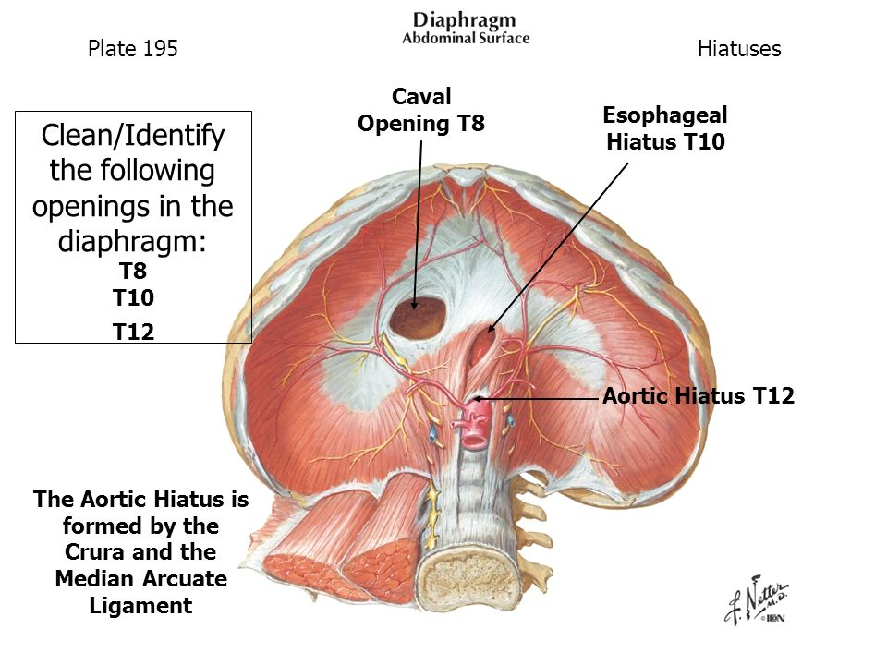
Openings of diaphragm (extra)
3 openings:
Vena caval opening: left side of the diaphragm, 0.5 inches from the median line, at T8.
Oesophageal opening (esophagus): right side of diaphragm, 0,5 inches from the median line, at T10.
Aortic opening: at the middle of diaphragm, at T12.
mnemonic to remember them: Voice of Arab (from left to right)

Slide 10
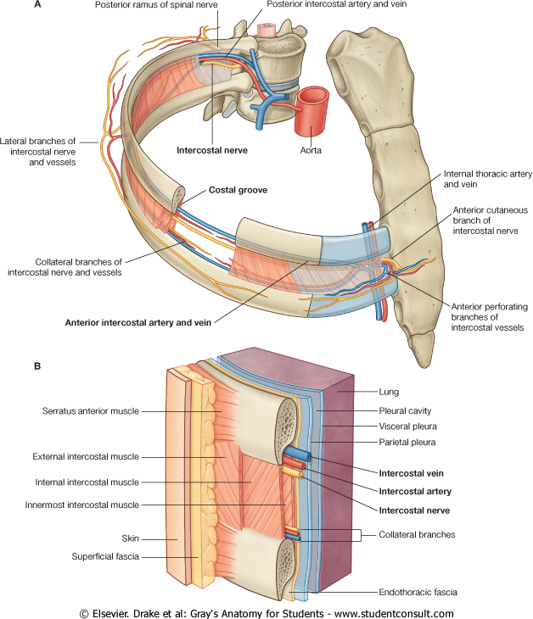
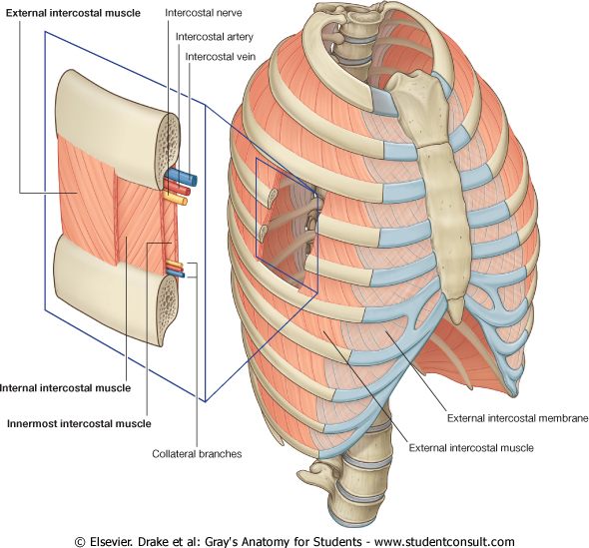
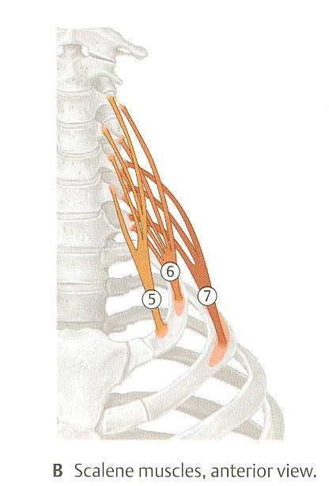
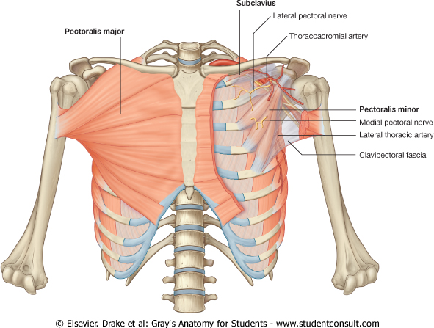
Inspiratory muscles
EXTERNAL INTERCOSTAL MUSCLES
11 muscles.
Attachments: from lower border of rib above to upper border of rib below.
Direction of fibers: downward & medially (and forward).
Nerve supply: intercostal nerves (T1-T11), subcostal nerve (T12).
Action: rib elevators (inspiratory).
5- Scalenus anterior
6. Scalenus medius
7. Scalenus posterior
Accessory muscles in forced Inspiration: | Origin | Insertion | Action
PECTORALIS MAJOR | Sternum + costal cartilages. | Bicipital groove of Humerus. | Increases anteroposterior diameter of thoracic cavity, when arm is fixed (inspiratory).
SCALENE MUSCLES | Cervical vertebrae. | 1st (anterior and medius) & 2nd (posterior) ribs. | Elevates 1st & 2nd ribs (inspiratory), main action is lateral flexion of the neck.
Cervical vertebrae

Slide 11
Expiratory Muscles
in quiet/normal expiration there is no need for muscles (passive) , However
ONLY in forced expiration (exercising,running,etc.. ) these muscles is needed and will be Active.
Expiratory Muscles is divided into:~
A-Rib Depressors:
Function: (depress/bring down the ribs)
Nerve supply: Intercostal nerves (ventral rami of T1-T11)
1-internal intercostal
2-innermost intercostal
3-subcostals
4-transversus thoracis (or sterno costalis)
B- Anterior abdominal wall muscles:
Function:(Compression of abdominal viscera to help in ascent diaphragm)
1-external oblique
2-internal oblique
3-transversus abdominis
4-rectus abdominis

Slide 12
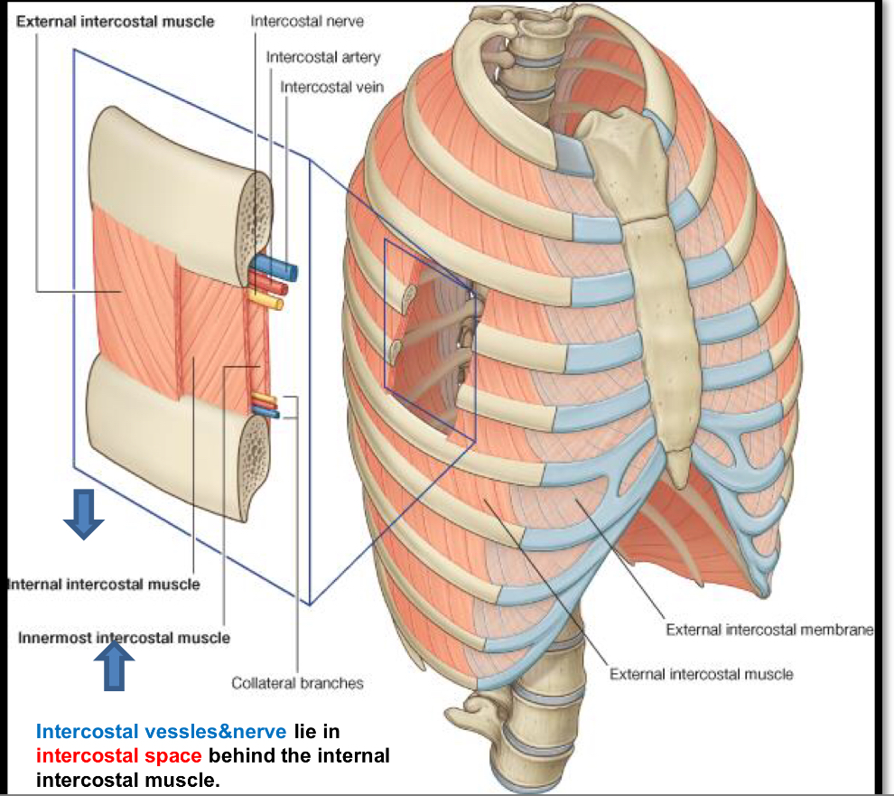
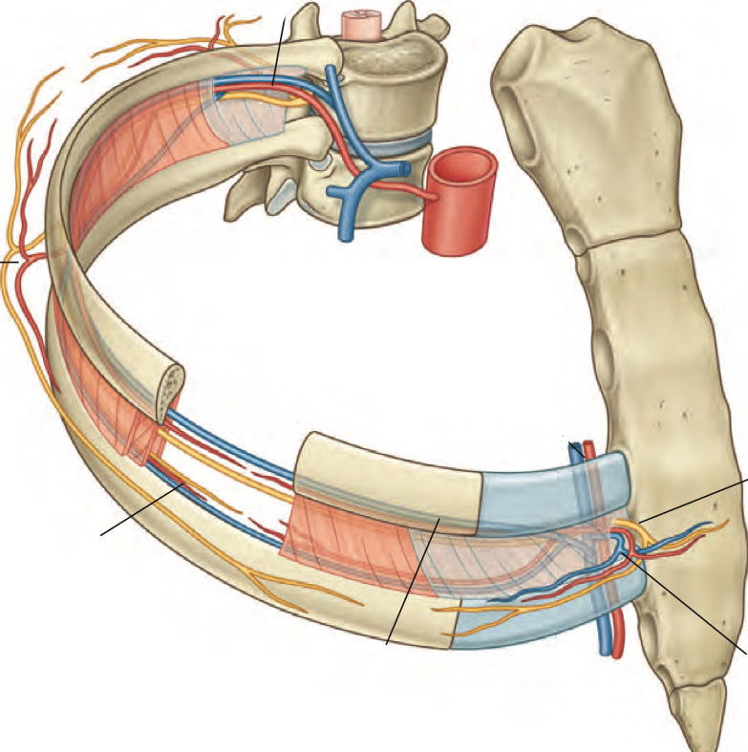
Rib Depressors (the rest of intercostal muscles):
1-internal intercostal
2-innermost intercostal
(Direction:Upward and Medially)
Lies between these two muscles the intercostal vessels and nerves in a space called the intercostal space behind internal intercostal muscle.

Slide 13
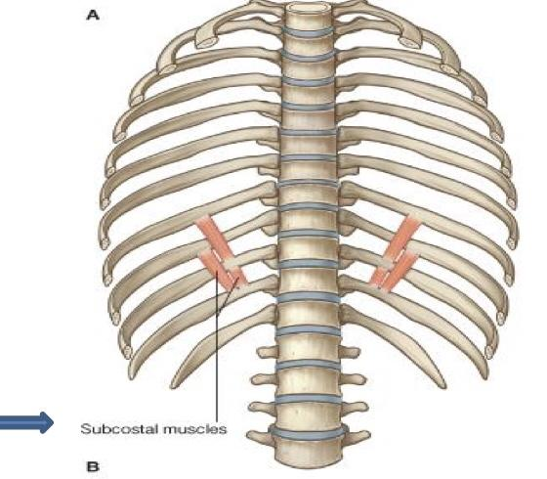
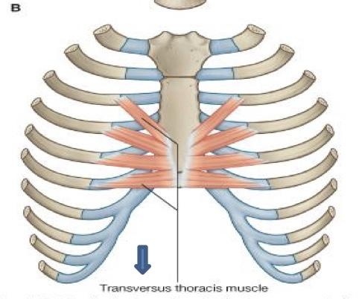
Rib Depressors (the rest of intercostal muscles):
3- Subcostal muscle
4-transversus thoracis
‘’note,the intercostal muscles are 5:- (with same nerve supply, intercostal nerves)
1-External intercostal (Rib elevator~inspiratory)
2-internal intercostal , 3-innermost intercostal ,4-subcostalis ,5-transversus thoracis (rib depressors~expiratory)

Slide 14
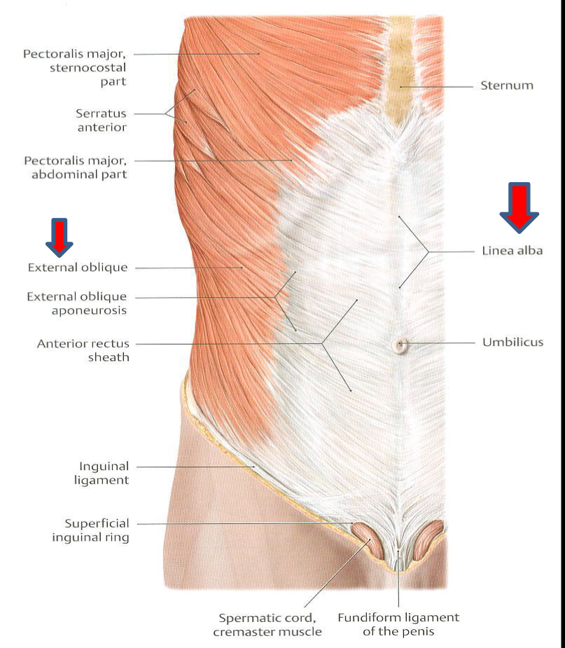
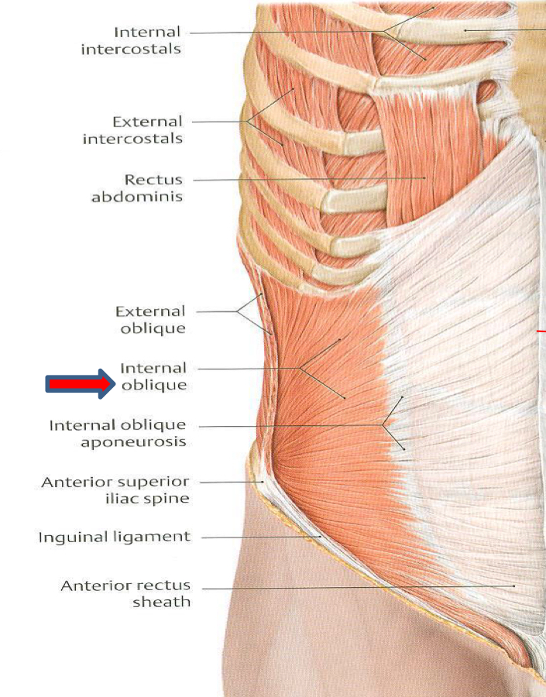
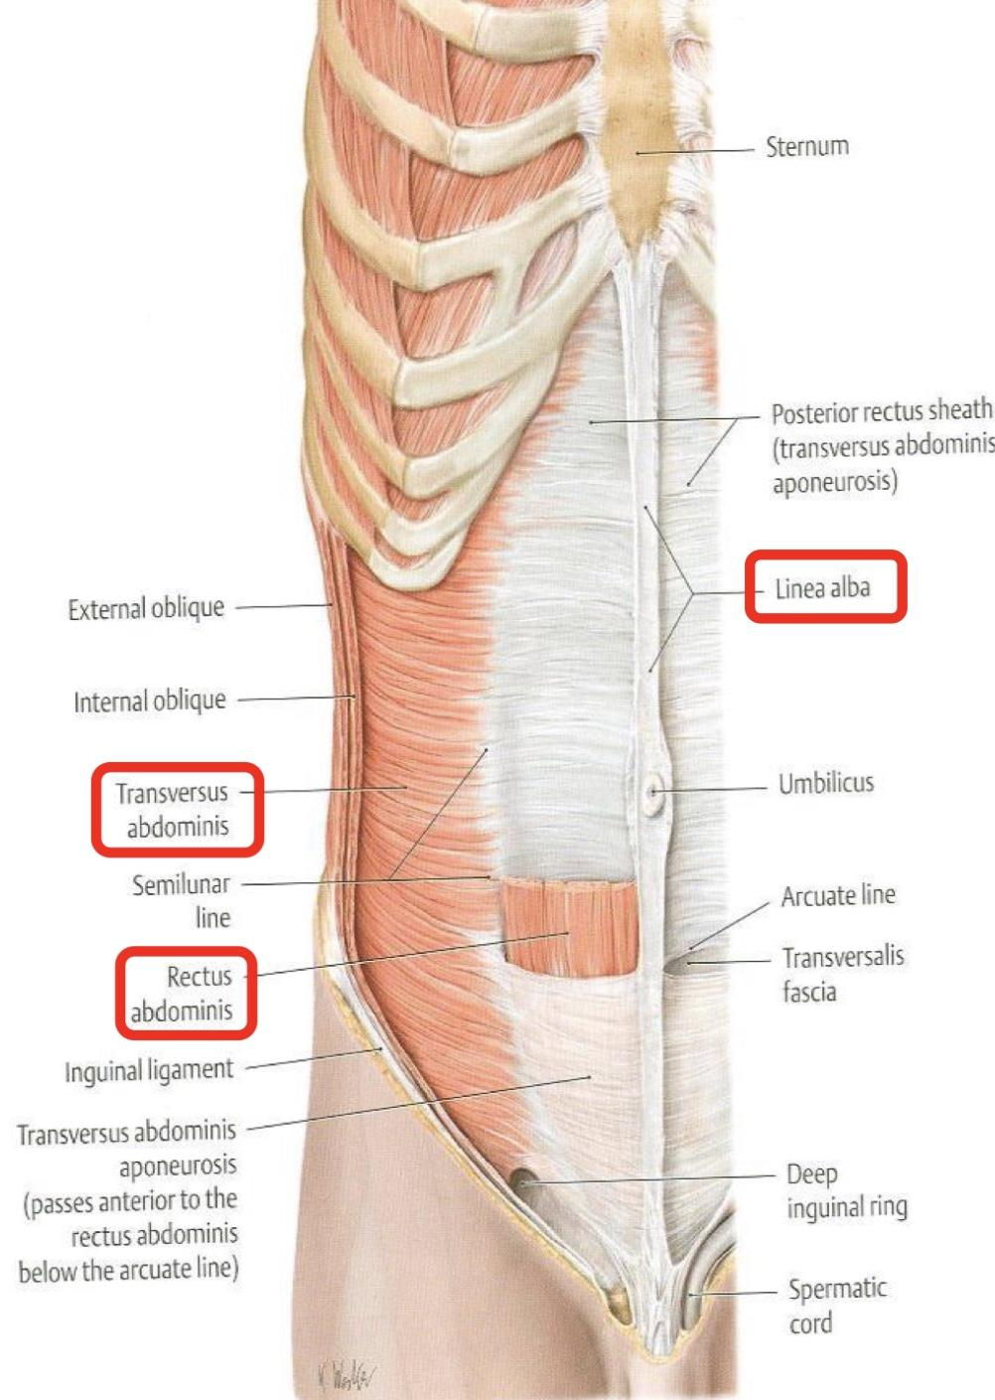
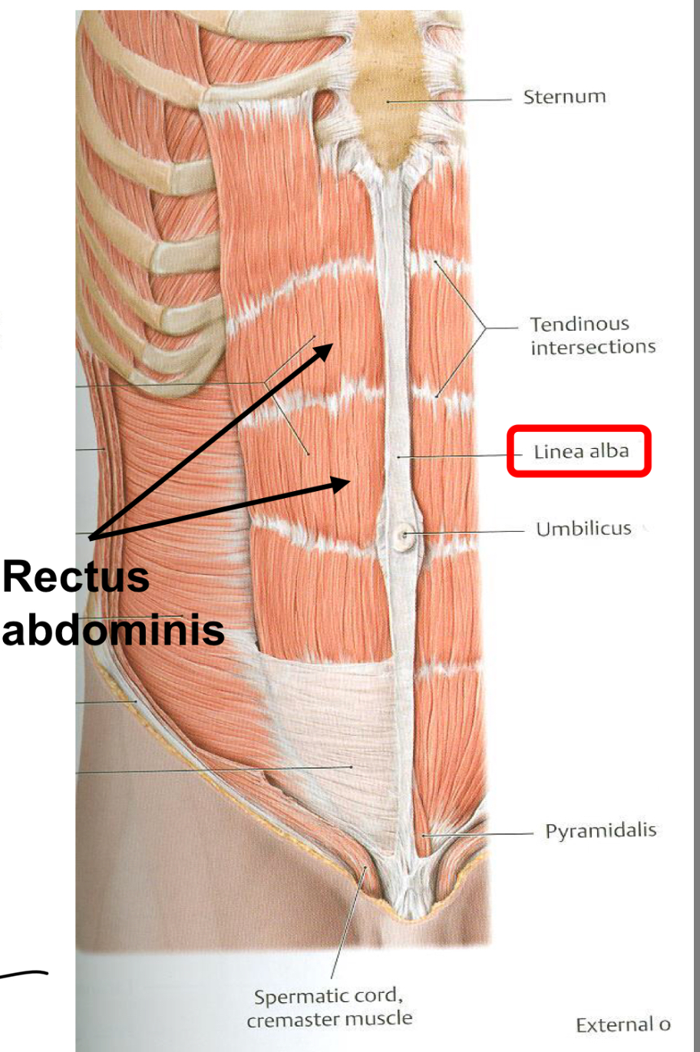
Anterior Abdominal wall
is made of 4 muscles 3 are Layers and 1 is normal muscle (not layer)
1-External Oblique (outer layer)
Direction: Downward & Medialy
2-Internal Oblique (middle layer)
Direction: Upward and Medially
3-Transversus abdominis (inner layer)
Direction: Transverse
4-Rectus abdominis: (forms the six-packs)
Direction: vertical

Slide 15
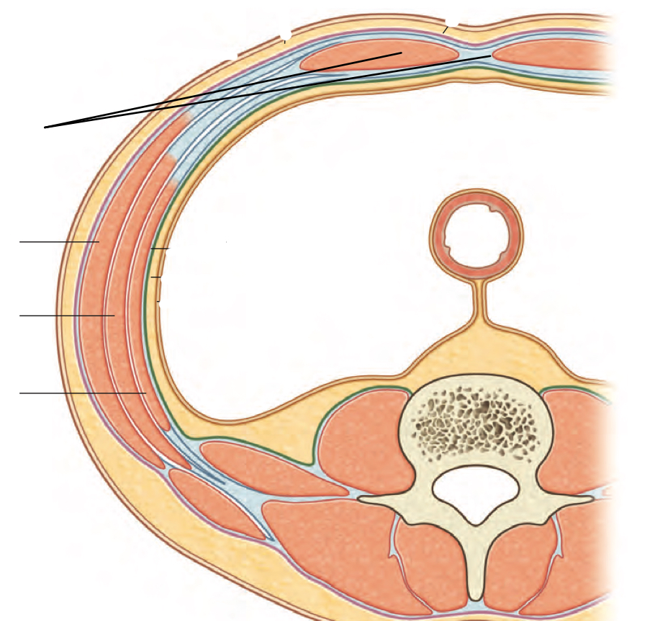
Extra
rectus
abdominis
* a way to remember directions of muscles :
-oblique means inclined (مائل) so any
muscle have oblique in it means its direction is NOT straight (direction of external oblique+internal oblique is not straight)
-Rectus means straight so if rectus in the muscle name that mean IT IS straight (direction of rectus abdominis=vertical)
-direction of transversus abdominis = transverse
external oblique
internal oblique
transversus abdominis
1-linea alba*(white line in latin): fused aponeurosis (NOT tendinous) of 6 muscles from xiphoid process to pubic symphysis
2-Rectus abdominis:(LOCATED BETWEEN- 4 internal and 5 transversus)
3-External Oblique
4-Internal Oblique
5-Transversus abdominis

Slide 16
Anterior Abdominal wall
Is formed of 3 layers of muscles of fibers running in different directions (to increase strength of anterior abdominal wall).
The 3 muscles form a sheath in which a fourth muscles lies(Rectus abdominis).
Muscles are attached to: sternum, costal cartilages and ribs + hip bones
The aponeurosis of the 3 muscles on both sides fuse in the Midline to form Linea alba.
Action (during forced expiration): Compression of abdominal viscera to help in ascent of diaphragm (during forced expiration).
Nerve supply: lower 5 intercostal nerves (T7 – T11), subcostal nerve (T12) and first lumbar nerve (L1).

Slide 17
Summary of Respiratory Movement
Expiration
Inspiration
Forced
Quite
Forced
Quite
Contraction(Descent) of diaphragm
Elevation of ribs
(External intercostal)
1. Elastic recoil of lung
2. Relaxation of diaphragm & external intercostal
Contraction of anterior Abdominal wall muscle
Depression of ribs
(Rest of intercostal muscles)
Accessory muscles of inspiration:
1. Pectoralis major
2. Scalene muscles
Compression of abdominal viscera
In vertical diameter
In :
-Anteroposterior diameter.
-Lateral diameter
Ascent of diaphragm

Slide 18
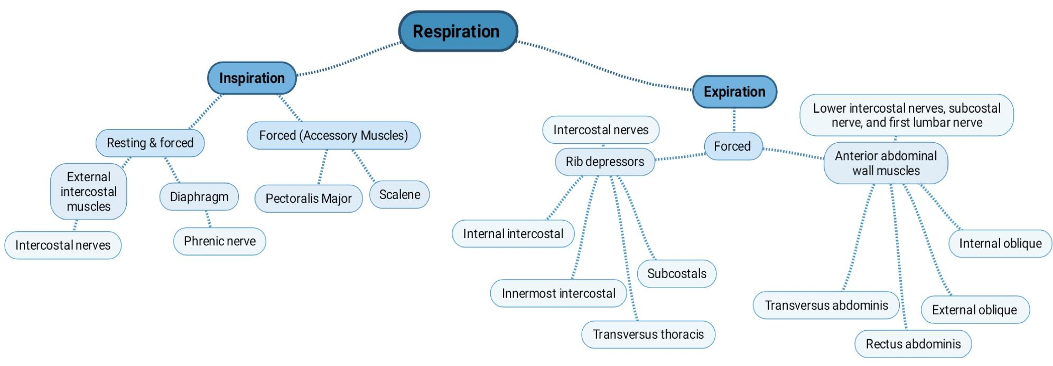
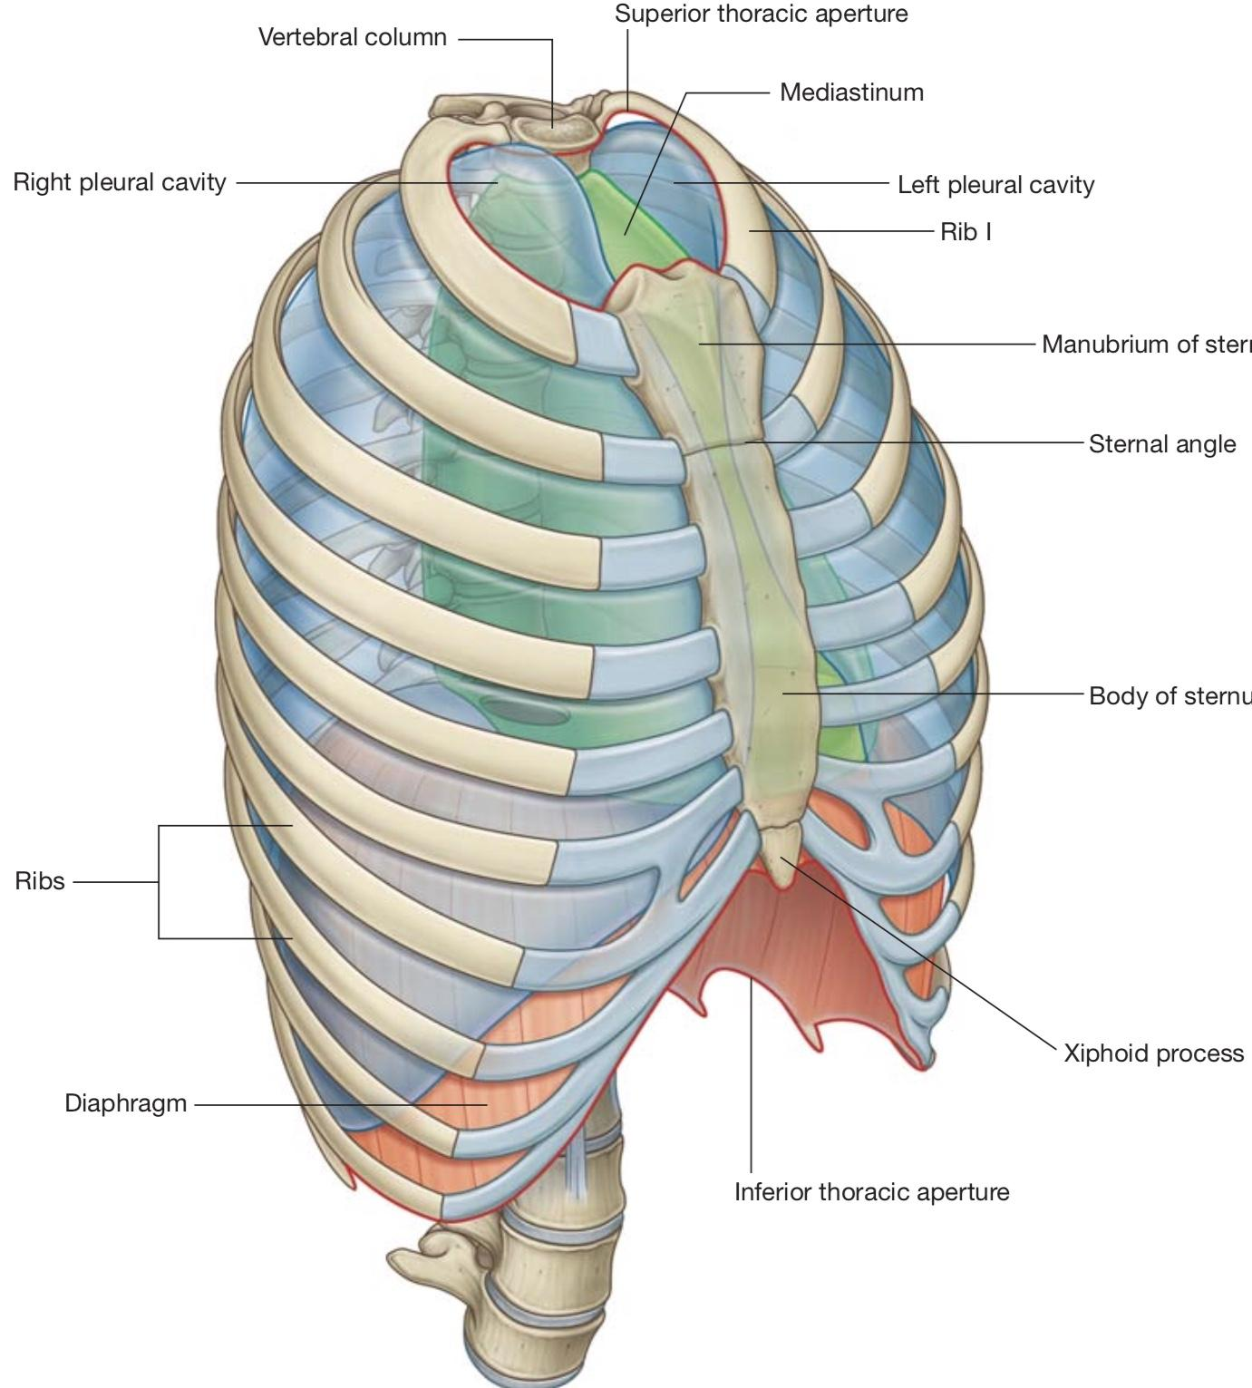
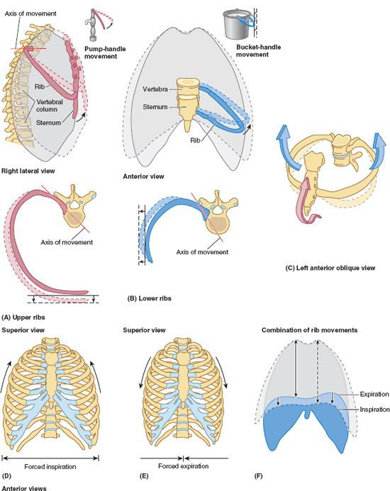
Summary
Thoracic wall : posteriorly, it is made up of twelve thoracic vertebrae and their intervening intervertebral discs; ■ laterally, the wall is formed by ribs (twelve on each side) and three layers of flat muscles, which span the intercostal spaces between adjacent ribs, move the ribs and provide support for the intercostal spaces; ■ anteriorly, the wall is made up of the sternum, which consists of the manubrium of sternum, body of sternum, and xiphoid process.

Slide 19
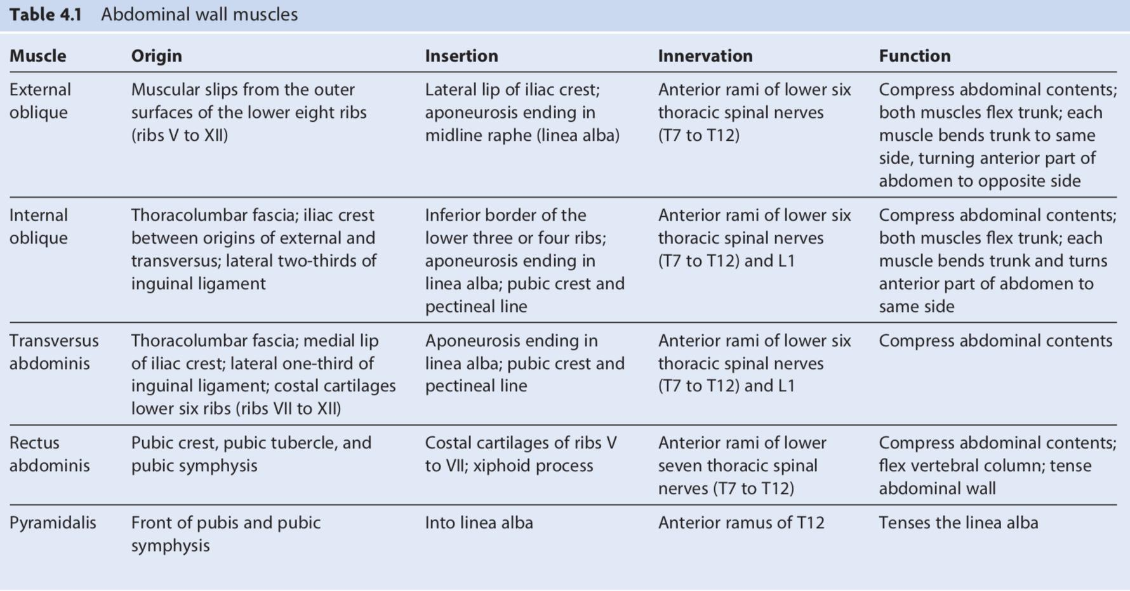
Summary

Slide 20
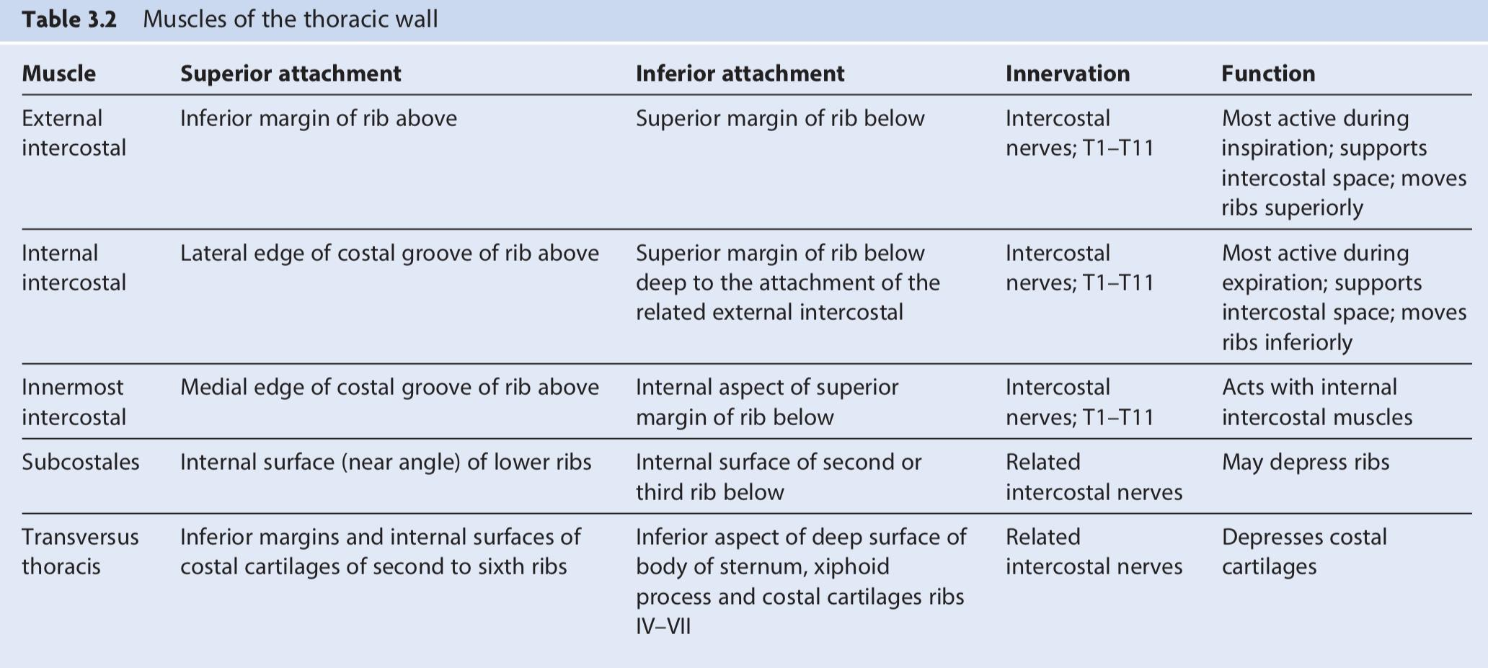
Summary

Slide 21
Questions ( MCQs ):
1- the joint between the 1st cartilage and the manubrium is:
A- primary cartilaginous B- secondary cartilaginous C- plane synovial joint D- none of these.
2- which of these statements is true:
A- the superior aperture of the thoracic cage is narrow, closed and continuous with neck
B- the inferior aperture of the thoracic cage is wide and unclosed by the diaphragm
C- the thoracic cage is pyramidal in shape
D- the thoracic cage is formed of costal cartilages anteriorly.
3-What is the respiratory function of Anterior abdominal wall muscles ?
A-Rib elevator
B-Rib Depressor
C-Compression of abdominal viscera to help in ascent diaphragm
D-Compression of abdominal viscera to help in descent diaphragm
4-How many Intercostal Muscle does the regular human have?
A-2 B-3 C-4 D-5
Answers:
1)A
2)D
3)C
4)D

Slide 22
Team Members
Lamia Abdullah Alkuwaiz (Team Leader)
Rawan Mohammad Alharbi
Abeer Alabduljabbar Afnan Abdulaziz Almustafa Ahad Ahmed Algrain Albandari Alshaye AlFhadah abdullah alsaleem Ghaida Alsanad Layan Hassan Alwatban Lojain Azizalrahman Maha Barakah Majd Khalid AlBarrak Nouf Alotaibi Rinad Musaed Alghoraiby Wafa Alotaibi Wejdan Fahad Albadrani
Faisal Fahad Alsaif (Team Leader)
Abdulaziz Al dukhayel ‏Abdulelah Aldossari ‏Abdulrahman Alduhayyim ‏Hamdan Aldossari ‏Mohammed Alomar ‏Saud Alghufaily ‏Hassan Aloraini ‏Abdullah Alomar ‏Fahad Alfaiz ‏Saad Aloqile ‏Abdulmajeed Alwardi ‏Rayyan Almousa ‏Sultan Alfuhaid ‏Ali Alammari ‏Fahad alshughaithry ‏‏
Fayez Ghiyath Aldarsouni
Mohammed Alquwayfili ‏Saleh Almoaiqel ‏Abdullah Almeaither Abduljabbar Al-yamane ‏Sultan Al-nasser ‏Majed Aljohani ‏Zeyad Al-khenaizan ‏Mohammed Nouri ‏Abdulaziz Al-drgam ‏Fahad Aldhowaihy ‏Omar alyabis ‏Akram Alfandi ‏Abdulhaziz Alabdulkareem

