Slide 1
Lung & Pleura
Lecture 4
Please check our Editing File.
هذا العمل لا يغني عن المصدر الأساسي للمذاكرة

Slide 2
Objectives
Describe the anatomy of the pleura:
Subdivisions into parietal & visceral pleura, nerve supply of each part.
List the parts of parietal pleura and its recesses.
Describe the surface anatomy of both pleura and lungs.
Describe the anatomy of lungs: shape, relations, nerve supply, blood supply.
Describe the difference between right & left lungs.
Describe the formation of bronchopulmonary segments and the main characteristics of these segment in the lung.
Text in BLUE was found only in the boys’ slides
Text in PINK was found only in the girls’ slides
Text in RED is considered important
Text in GREY is considered extra notes

Slide 3
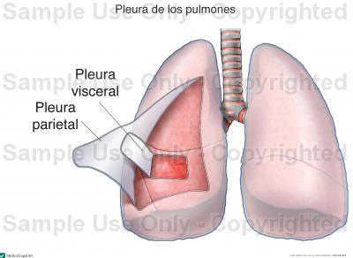
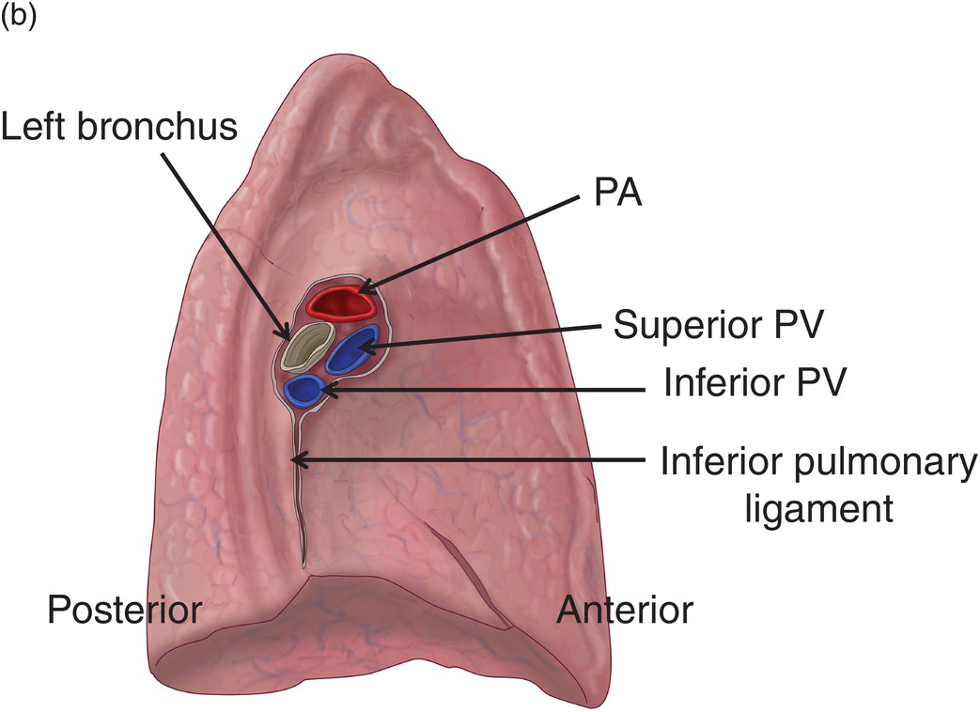
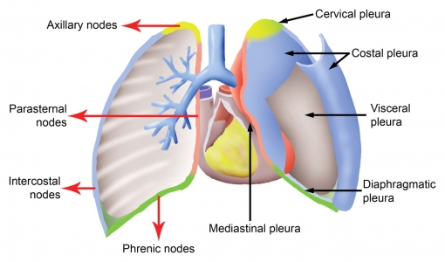
What is Pleura?
Parietal Pleura
Double-layered serous Membrane / Membranous sac enclosing the lung.
Has two layers:
Parietal layer, which lines the thoracic walls.
Visceral layer, which covers the surfaces of the lung.
The two layers continue with each other around the root* of the lung, where it forms a loose cuff hanging down called the:
Pulmonary ligament.
The space between the 2 layers:
Is the Pleural cavity.
It contains a very thin film of pleural fluid (5-10 ml.).**
*ال ROOT مكوّن من الأشياء اللي تدخل و تطلع من ال Hilum of Lung زي الأعصاب و الأوعية الدموية.
** ال FLUID يسهل الحركة و يمنع التصاق الغشائين مع بعضهم البعض.
It is divided according to the region in which it lies and the surfaces it covers, into:
Cervical.
Costal.
Mediastinal.
Diaphragmatic.

Slide 4
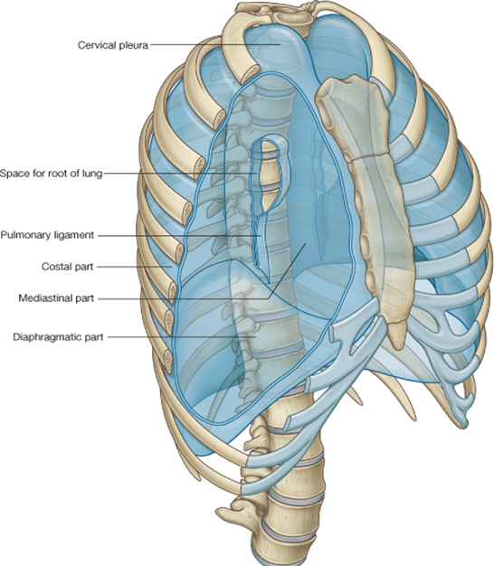
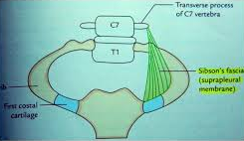
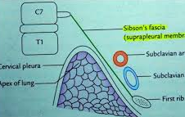
Parietal Pleura
Cervical Pleura:
Projects upward into the root of the neck:
About one inch above the medial 1/3rd of clavicle.
It lines the under surface of the Suprapleural membrane.
Costal pleura:
lines, the back of the:
Sternum.
Ribs.
Costal cartilages.
Intercostal spaces.
Sides of vertebral bodies.
Mediastinal pleura:
Covers the Mediastinum:
At the Hilum.
It is reflected on to the vessels and bronchi, that enter the hilum of the lung.
It is continuous with the visceral pleura.
Diaphragmatic pleura:
Covers the:
Upper (thoracic) surface of the diaphragm.

Slide 5
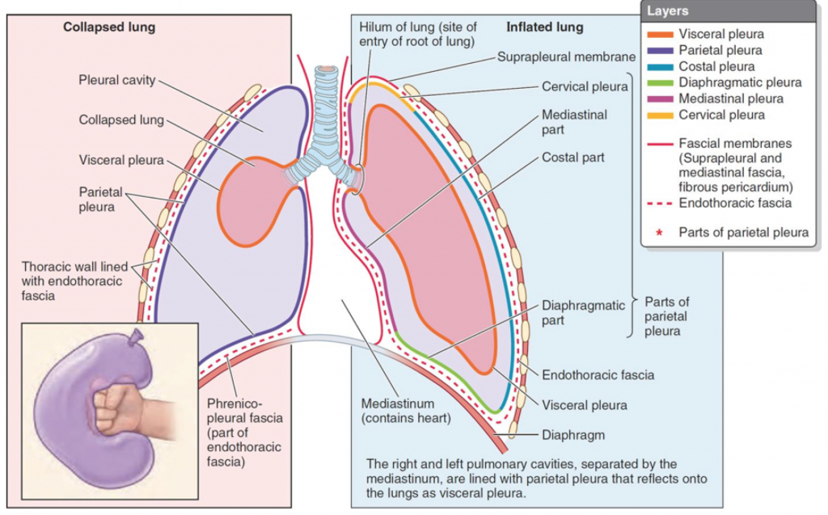
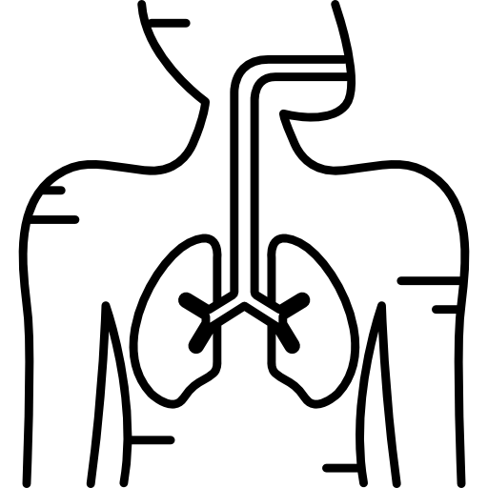
Making It Clear...
watch Dr..Sam for better understanding :)
(press the icon)

Slide 6
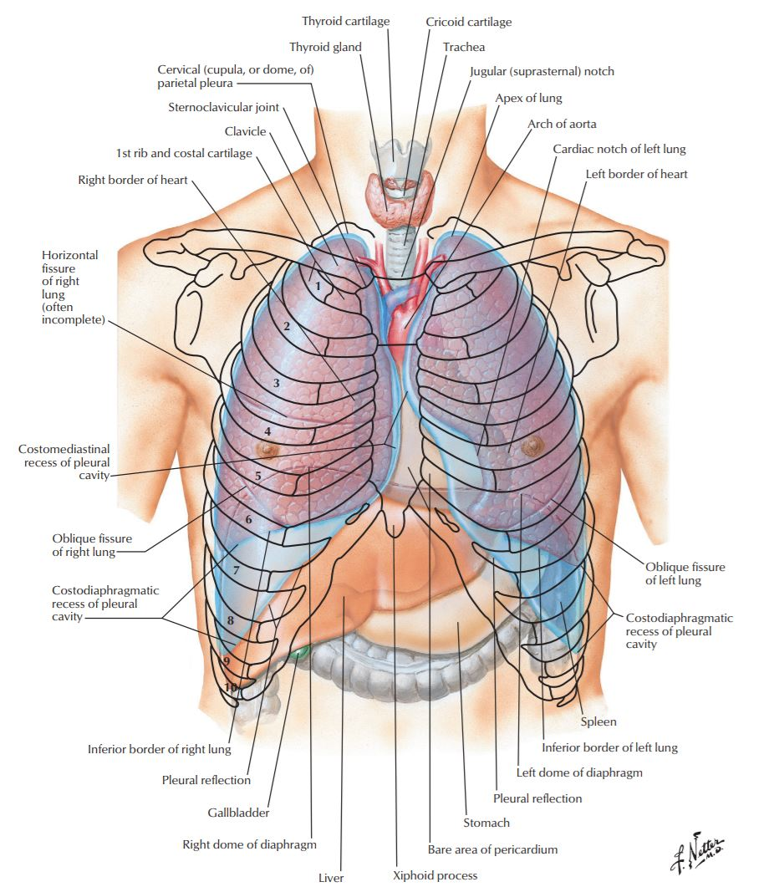
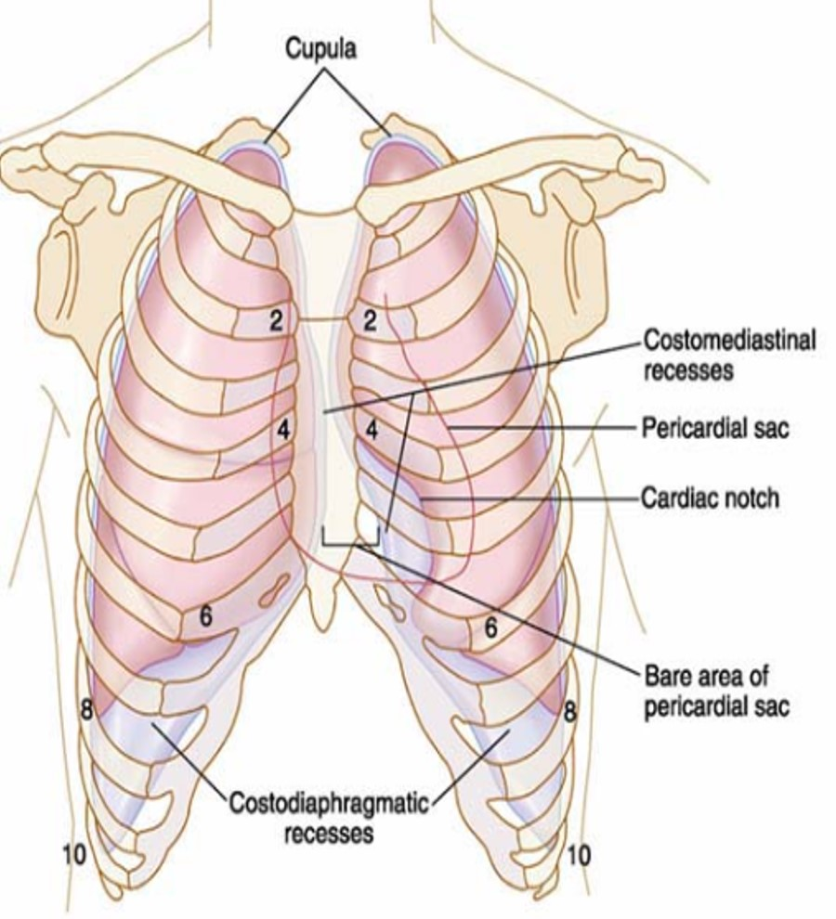
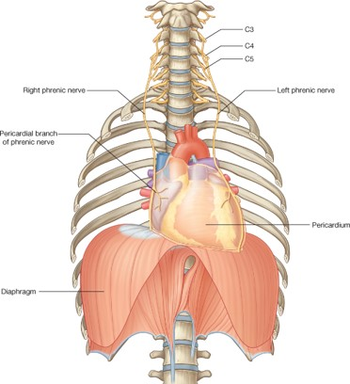
Pleural Recesses
Pleura: Nerve Supply
Costodiaphragmatic Recess:
Slit like space* between Costal & Diaphragmatic Pleurae
Along the inferior border of the lung.
The lung enters through it in deep inspiration.
Costomediastinal Recess:
Slit like space between Costal and Mediastinal Pleurae, along the anterior border of the lung.
The lung enters through it in deep inspiration.
*فراغ يشبه الشق
Parietal pleura: (PPTT).
Sensitive to Pain, Pressure, Temperature, and Touch.
It is supplied as follows:
Costal pleura is segmentally supplied by the intercostal nerves.
Mediastinal pleura is supplied by phrenic nerves.
Diaphragmatic pleura is supplied as follow:
Central part (over diaphragmatic domes) by phrenic nerves.
Around the periphery by lower 6 intercostal nerves.
Visceral pleura:
sensitive to stretch only and is supplied by the autonomic fibers from the pulmonary plexus.

Slide 7
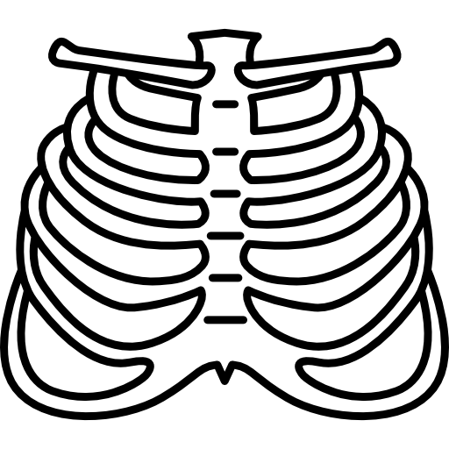
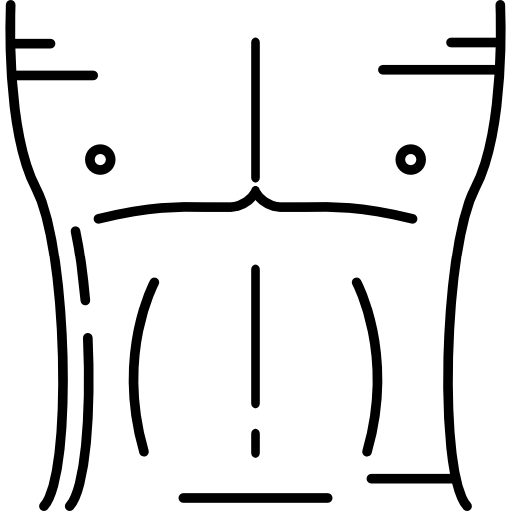
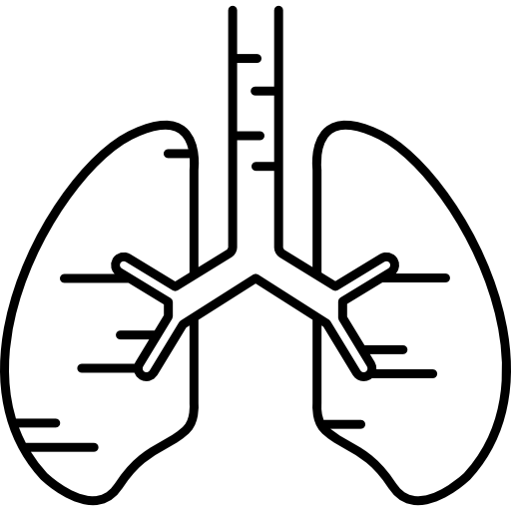
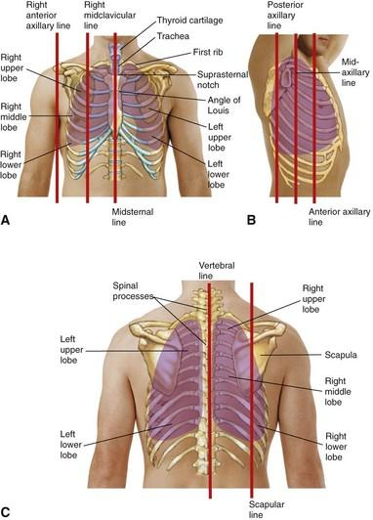
Surface Anatomy of the Pleura
Surface Anatomy of the Lung
Apex:
Lies one inch above the medial 1/3 of the Clavicle.
Right pleura:
The anterior margin extends vertically from Sternoclavicular joint to 6th costal cartilage.
Left pleura:
The anterior margin extends from Sternoclavicular joint to the 4th costal cartilage, then deviates for about 1 inch to left at 6th Costal cartilage to form the Cardiac notch.
Inferior margin:
Passes around the chest wall, on the 8th rib in midclavicular line, 10th rib in mid-axillary line and finally reaching to the last Thoracic spine(T12 spine).
Posterior margin:
Along the vertebral column from the apex to the inferior margin (T12 spine).
Apex, anterior border and posterior border:
Correspond nearly to the lines of Pleura but are slightly away from the median plane.
Inferior margin:
As the pleura but more horizontally and finally reaching to the 10th thoracic spine.
Oblique fissure:
Represented by a line extending from 3rd thoracic spine, obliquely ending at 6th costal cartilage.
Transverse fissure: Only in the right lung:
Represented by a line extending from 4th right costal cartilage to meet the oblique fissure.

Slide 8
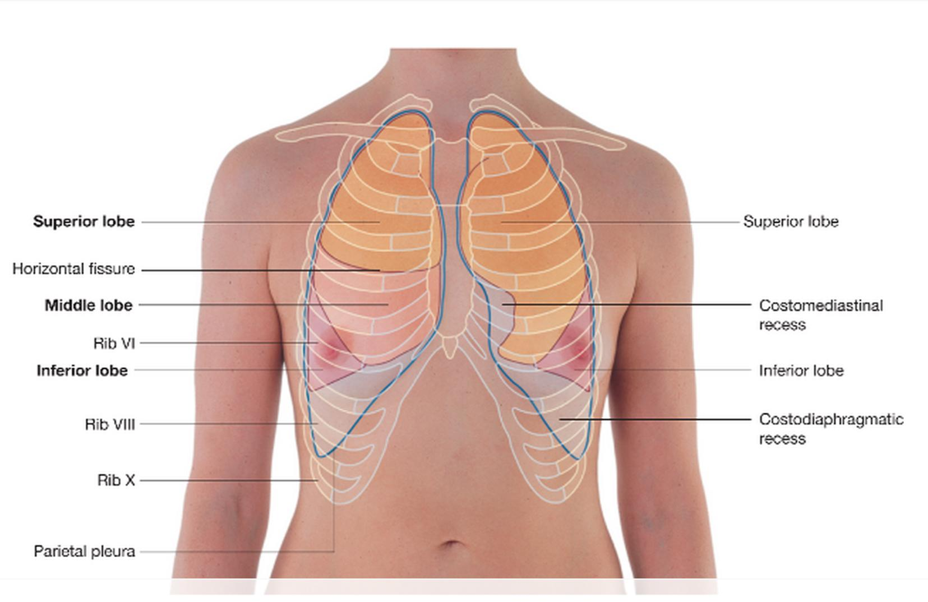
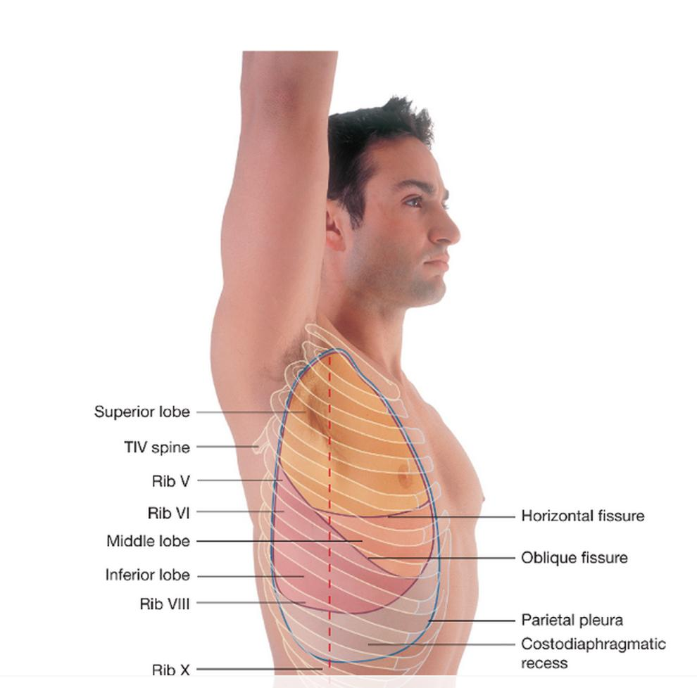
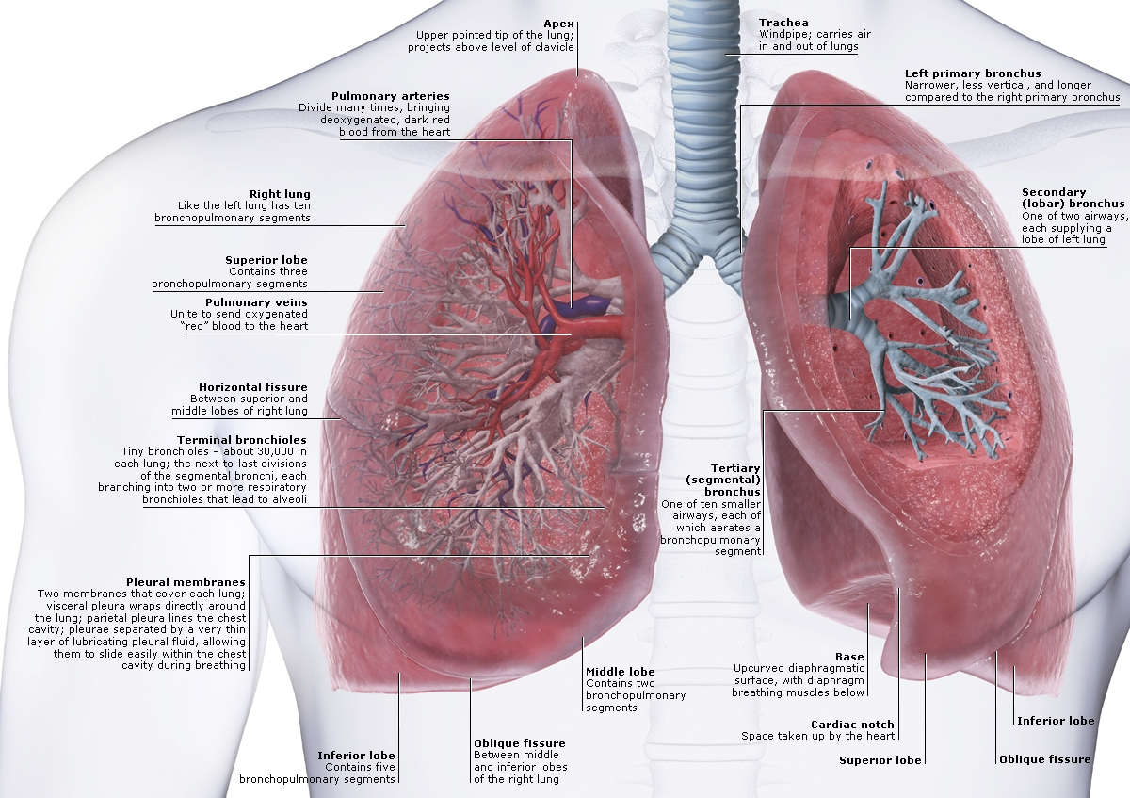
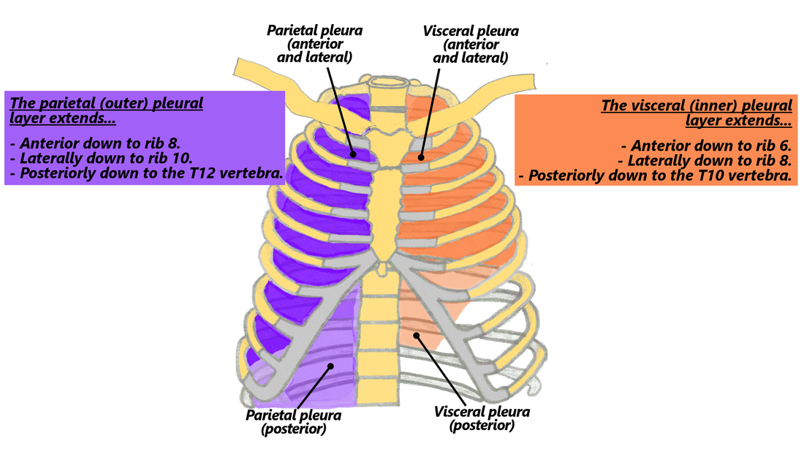
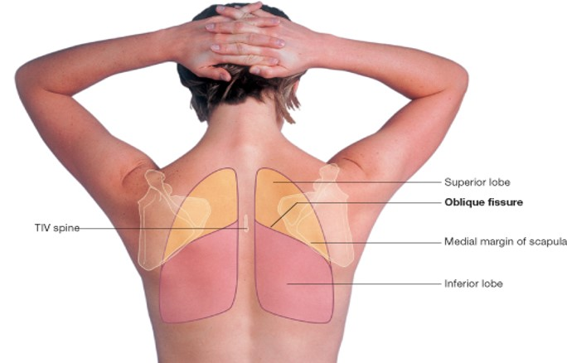
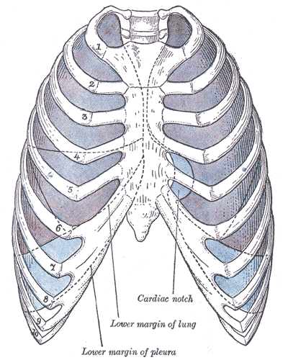
Surface Anatomy of the Lungs & Pleura Cont.

Slide 9
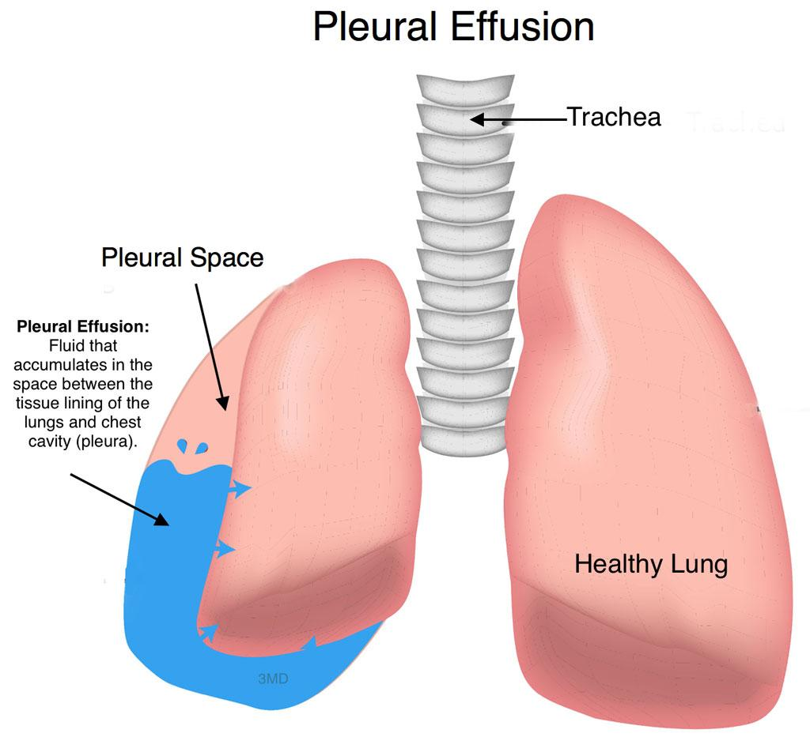
Pleural effusion
It is an abnormal accumulation of pleural fluid about 300 ml.
In the Costodiaphragmatic pleural recess, (normally 5-10 ml fluid).
Causes:
inflammation.
TB.
Congestive heart disease.
Malignancy, (Mesothelioma of the pleural sac).
The lung is compressed & the bronchi are narrowed.
Auscultation would reveal only faint & decreased breathing sounds over compressed or collapsed lung lobe.
Dullness on percussion over the effusion*.
*Percussion is a method of tapping on a surface to determine the underlying structure.
Dullness replaces resonance when fluid or solid tissue replaces air-containing lung tissues, such as occurs with pneumonia, pleural effusions, or tumors.

Slide 10
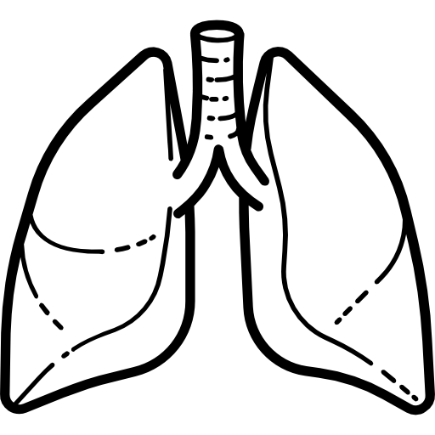
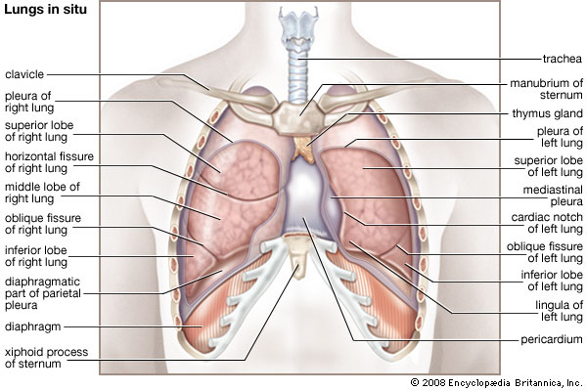
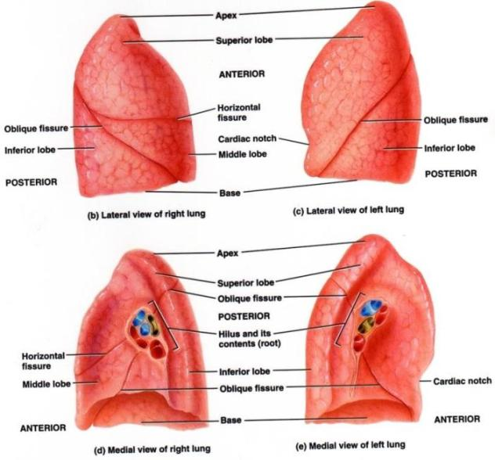
Lungs
Located in the Thoracic cavity, one on each side of the Mediastinum.
Each lung is:
Conical in shape.* شكل مخروطي
Covered by the visceral pleura.
Suspended free in its own pleural cavity.
Attached to the mediastinum only by its root.
Each lung has:
Apex and Base:
Identify the top and bottom of the lung, respectively.
Costal surface:
Surrounded by the ribs and intercostal spaces from front, side & back.
Medial surface:
Where the bronchi, blood vessels, and lymphatic vessels enter or leave the lung at the Hilum.
It is also related to the structures forming the Mediastinum.

Slide 11
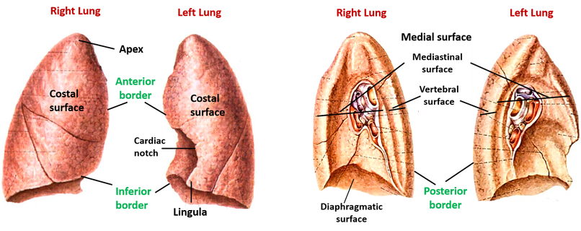
Lungs
Borders:
Anterior & Posterior
Surfaces:
Costal & Mediastinal
Right lung has 3 lobes; Left has Less Lobes (2) and Lingula
Costal surface:
Convex.
Covered by Costal pleura which separates the lung from:
Ribs, costal cartilages & intercostal muscles.
Medial surface:
It is divided into 2 parts:
Anterior (Mediastinal) part:
Contains a Hilum in the middle (it is a depression in which bronchi, vessels, & nerves forming the root of lung).
Posterior (Vertebral) part:
It is related to:
Bodies of thoracic vertebrae, Intervertebral discs, Posterior intercostal vessels, Sympathetic trunk.
Apex:
Projects into the root of the neck.
(1/2 an inch above medial 1/3 of the clavicle).
It is covered by cervical pleura.
It is grooved anteriorly by subclavian artery.
Base:
Inferior, (diaphragmatic surface) is concave and rests on the diaphragm.
Anterior border:
It is sharp, thin and overlaps the heart.
Anterior border of left lung presents a Cardiac Notch at its lower end.
It has a thin projection called the Lingula below the Cardiac Notch.
Posterior border:
It is thick and rounded, and lies along the vertebral column.

Slide 12
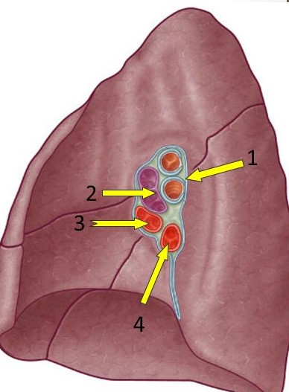
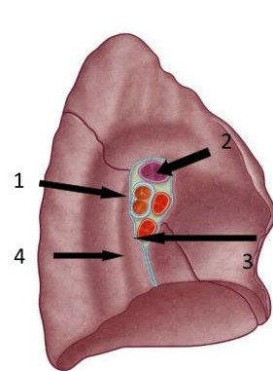
Lung Roots
Right Lung Root
Left Lung Root
Arteries are vessels which take blood from the heart no matter it was Oxygenated or Deoxygenated.
Here it’s shown Blue so it’s Deoxygenated.
For that you mustn’t confuse such thing. ^-^
2 bronchi:
Middle & Inferior lobar bronchi.
Lies Most posterior.
Pulmonary artery:
Is Most superior.
Pulmonary veins:
Are Most Anterior and Most Inferior.
One Bronchus:
Lies Most posterior.
Pulmonary artery:
Is Most superior.
Pulmonary veins:
Are Most Anterior and Most Inferior.

Slide 13
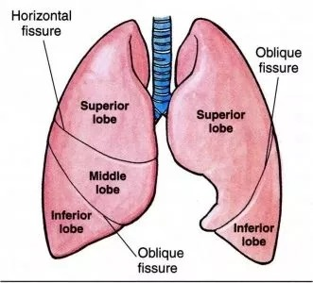
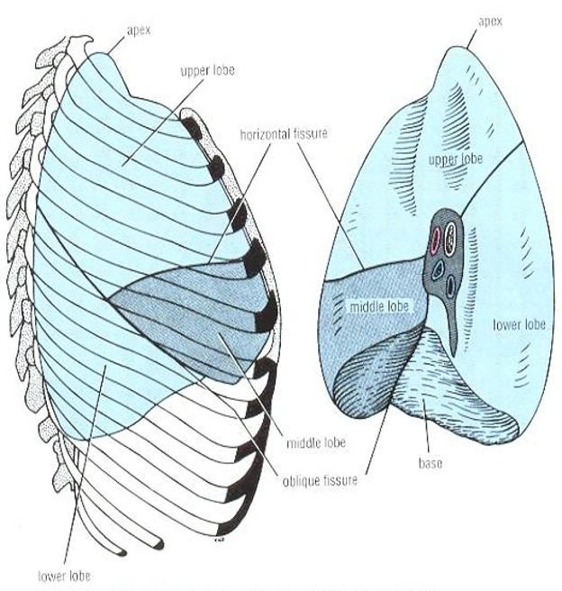
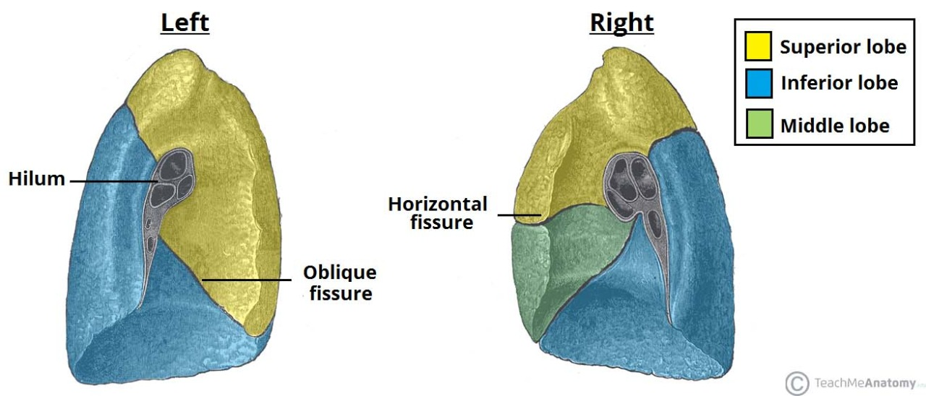
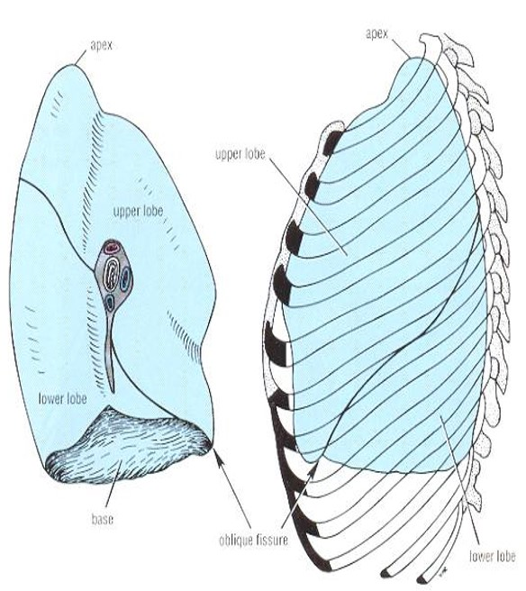
Lungs
Right Lung
Left Lung
Larger & shorter than left lung.
Divided by:
2 fissures:
Oblique fissure.
Horizontal fissure.
Into 3 lobes:
Upper lobe.
Middle lobe.
Lower lobe.
Divided by:
1 fissure:
Oblique fissure.
Into 2 lobes:
Upper lobe.
Lower lobe.
It has NO Horizontal fissure.
It has a Cardiac Notch of its anterior border.

Slide 14
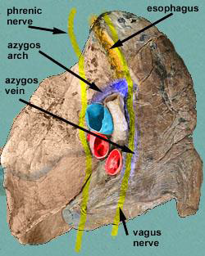
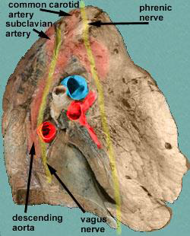
Mediastinal Surfaces
Mediastinal Surface of Right Lung
Mediastinal Surface of Left Lung
On the Mediastinal surface of the right lung, you find these structures:
Azygos vein and its Arch (posterior and over the root of the lung).
Vagus nerve posterior to the root of the lung.
Esophagus posterior to the root.
Phrenic nerve anterior to the root of the lung.
Cardiac impression:
Related to right atrium.
Below Hilum and in front of Pulmonary ligament:
groove for I.V.C.*
Cardiac Impression
*I.V.C: Inferior Vena Cava.
On the Mediastinal surface of the right lung, you find these structures:
Descending Aorta posterior to the root.
Vagus nerve posterior to the root of the lung.
Arch of the aorta over the root of the lung.
Groove for:
Left common carotid artery.
Left subclavian artery.
Phrenic nerve anterior to the root of the lung.
Cardiac impression:
Related to left ventricle.
Arch of aorta
Cardiac Impression

Slide 15
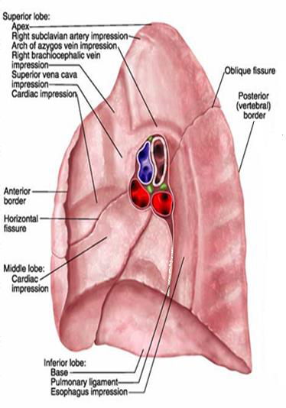
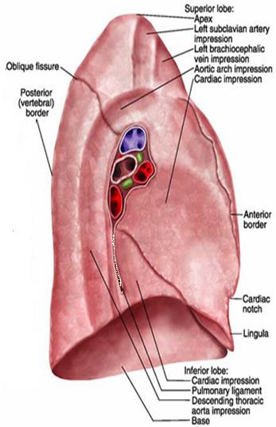
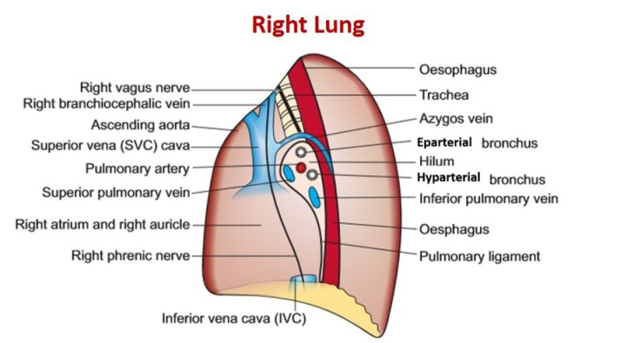
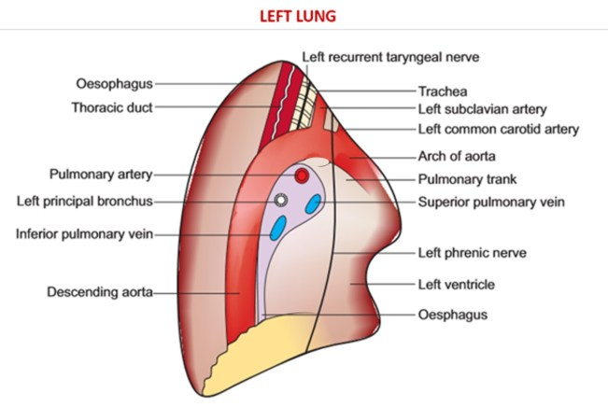
Mediastinal surface of the right lung
Mediastinal surface of the left lung

Slide 16
Blood Supply of the Lung
Nerve Supply of the Lung
Bronchial arteries (From descending aorta):
It supply oxygenated blood to:
Bronchi.
Lung tissue.
Visceral pleura.
Bronchial veins:
Drain into:
Azygos Vein.
Hemiazygos Vein.
Pulmonary artery:
Carries Non-oxygenated blood from right ventricle to the lung alveoli.
2 Pulmonary veins:
Carry oxygenated blood from lung alveoli to the left atrium of the heart.
Pulmonary plexus at the root of lung:
Is formed of Autonomic Nervous System:
Sympathetic fibers.
Parasympathetic fibers.
Sympathetic Fibers:
From:
Sympathetic trunk.
Action:
broncho-dilatation.
vasoconstriction.
Parasympathetic Fibers:
From:
Vagus nerve.
Action:
Broncho-constriction.
Secretomotor to bronchial glands.
Vasodilatation.

Slide 17
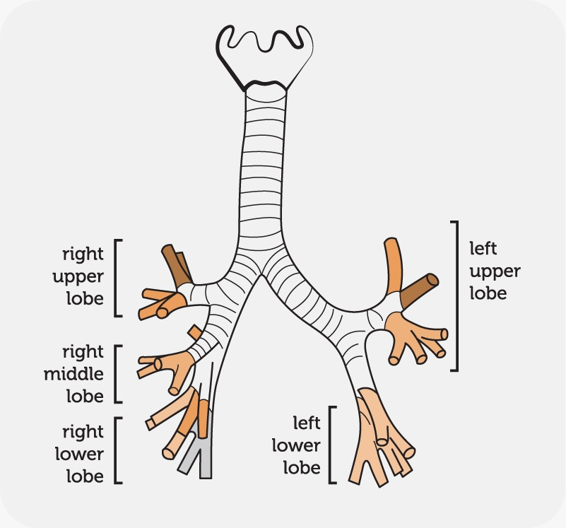
Bronchi
The Trachea divides into 2 Main Bronchi:
Right main bronchus, which divides:
Before entering the Hilum, it gives:
Superior lobar (secondary) bronchus.
On entering hilum, it divides into:
Middle lobar bronchus.
Inferior lobar bronchus.
Left main bronchus:
On entering hilum, it divides into:
Superior lobar bronchus.
Inferior lobar bronchus.

Slide 18
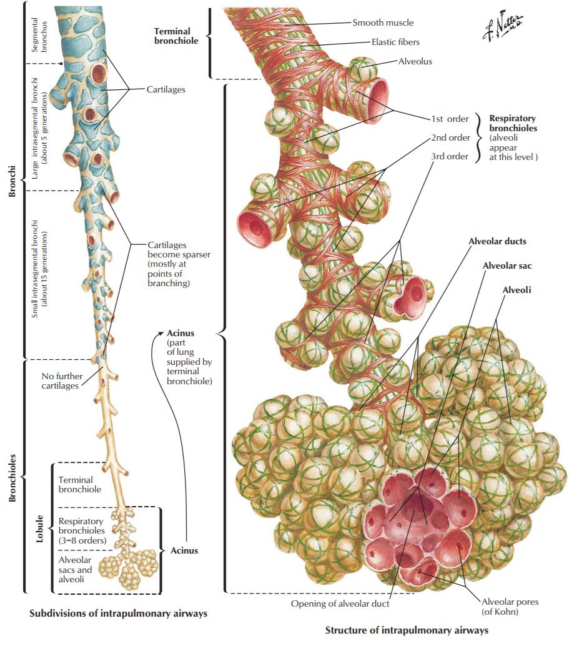
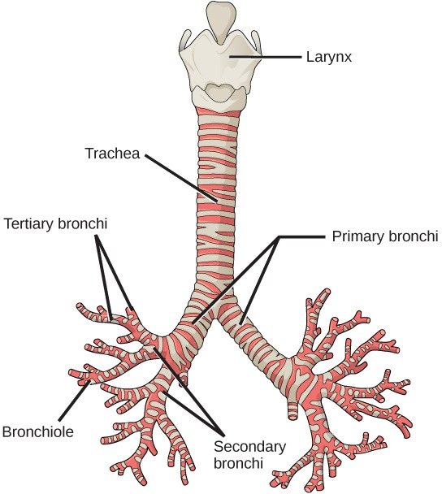
Bronchopulmonary Segments
These are the Anatomical, Functional, and Surgical units of the lungs.
Each lobar (secondary) bronchus gives segmental (tertiary) bronchi.
Each segmental bronchus divides repeatedly into bronchioles.
Bronchioles divide into terminal bronchioles, which show delicate outpouchings* ‘the respiratory bronchioles’.
The respiratory bronchioles end by branching into alveolar ducts, which lead into alveolar sacs.
The alveolar sacs:
Consist of several alveoli.
Each alveolus is surrounded by a network of blood capillaries for gas exchange.
*Outpouchings: تجيّب خارجي

Slide 19
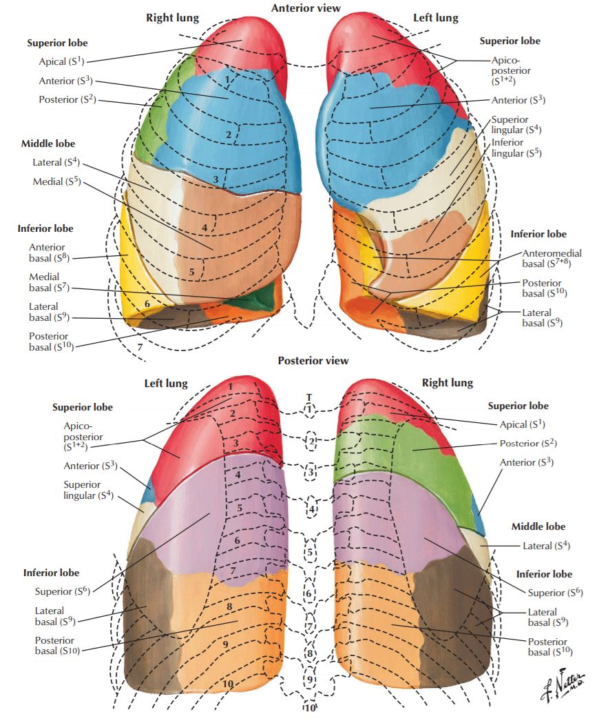
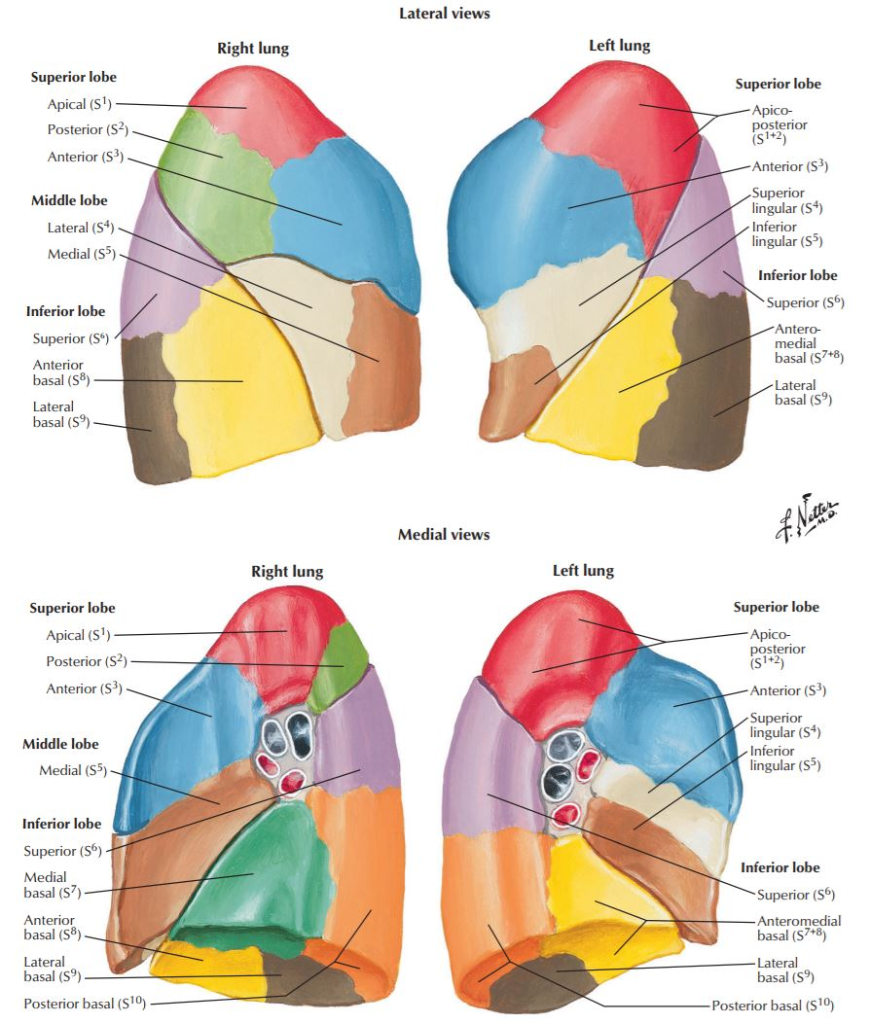
Bronchopulmonary Segments
The main characteristics of a bronchopulmonary segment:
It is a subdivision of a lung lobe.
It is pyramidal shaped.
Its apex toward the lung root.
It is surrounded by connective tissue septa.
It has a:
Segmental bronchus.
Segmental artery.
Lymph vessels.
Autonomic nerves.
The segmental vein lies in the inter- segmental connective tissue septa between the segments.
A diseased segment can be removed surgically, because it is a structural unit.
ملاحظة: لسنا مُطالبون بحفظ الأسماء، المطلوب منا معرفة تواجد هذه الأجزاء. ^-^

Slide 20
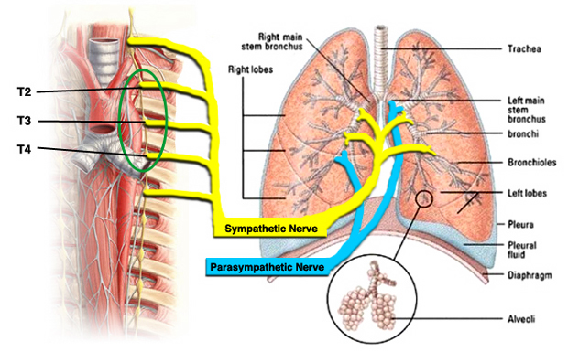
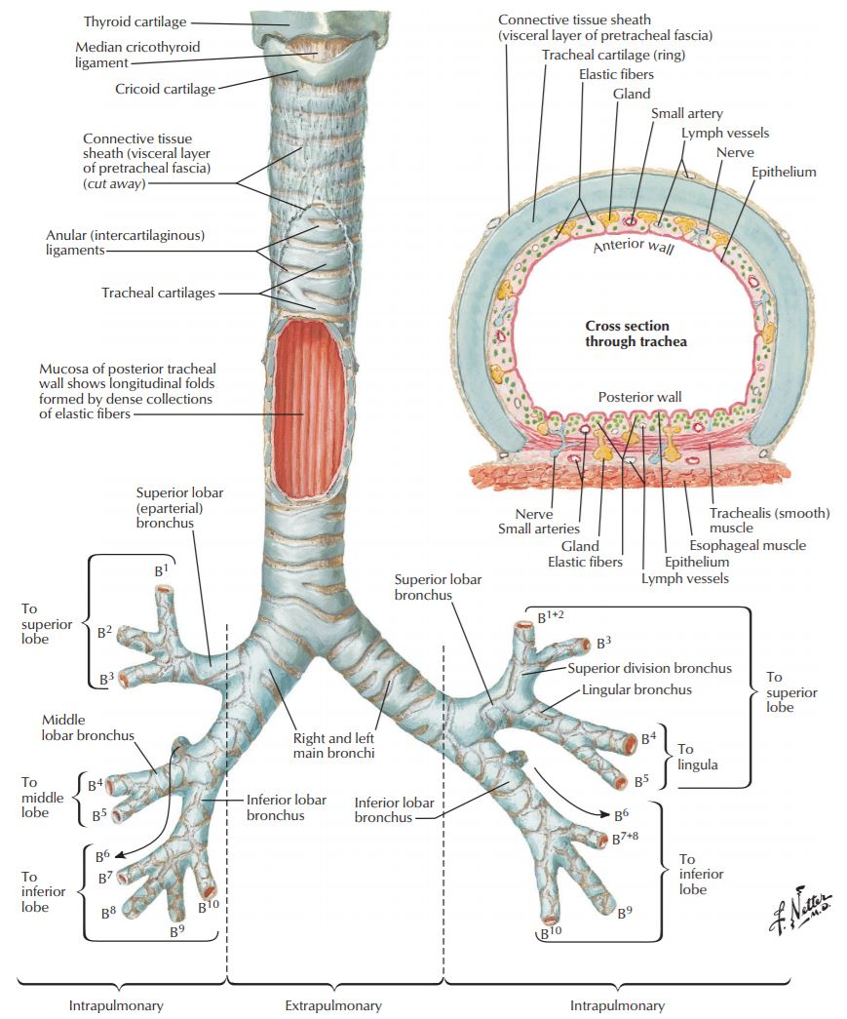
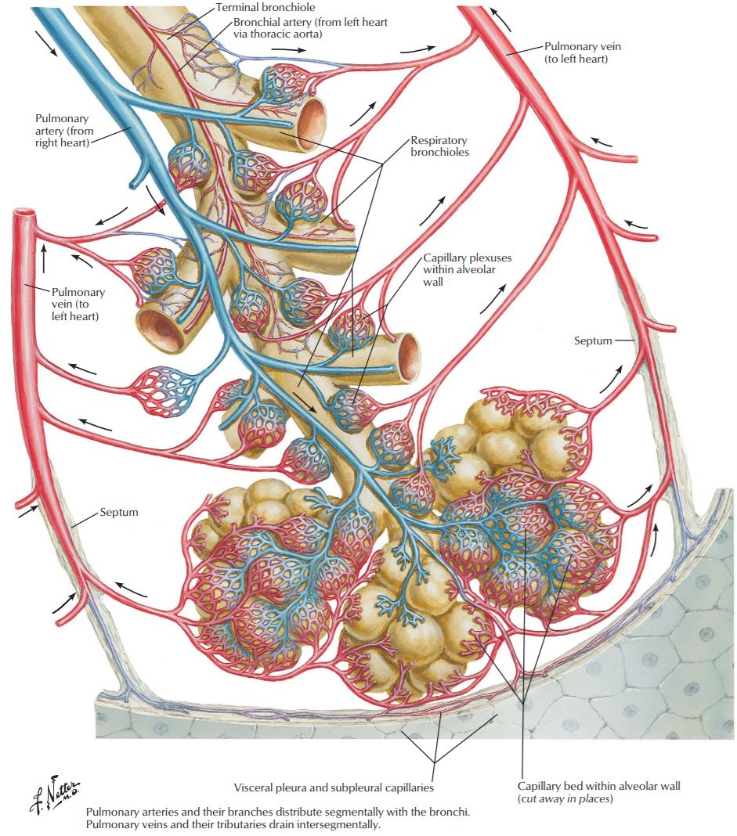
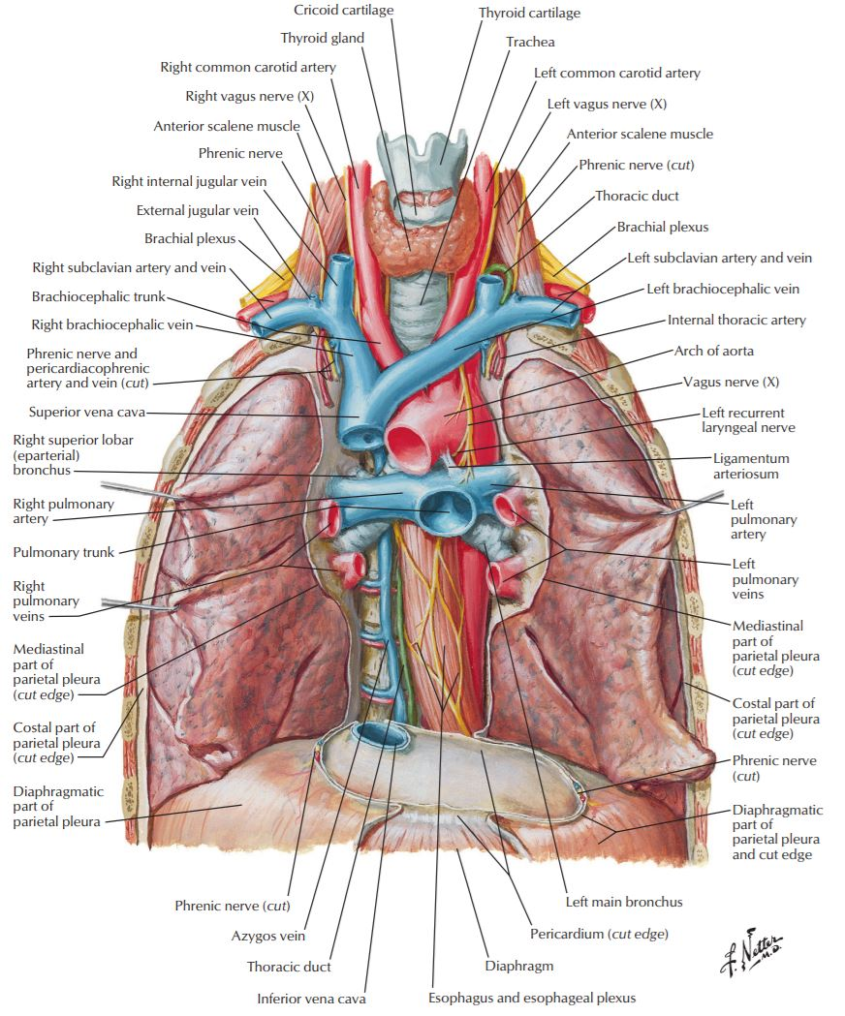
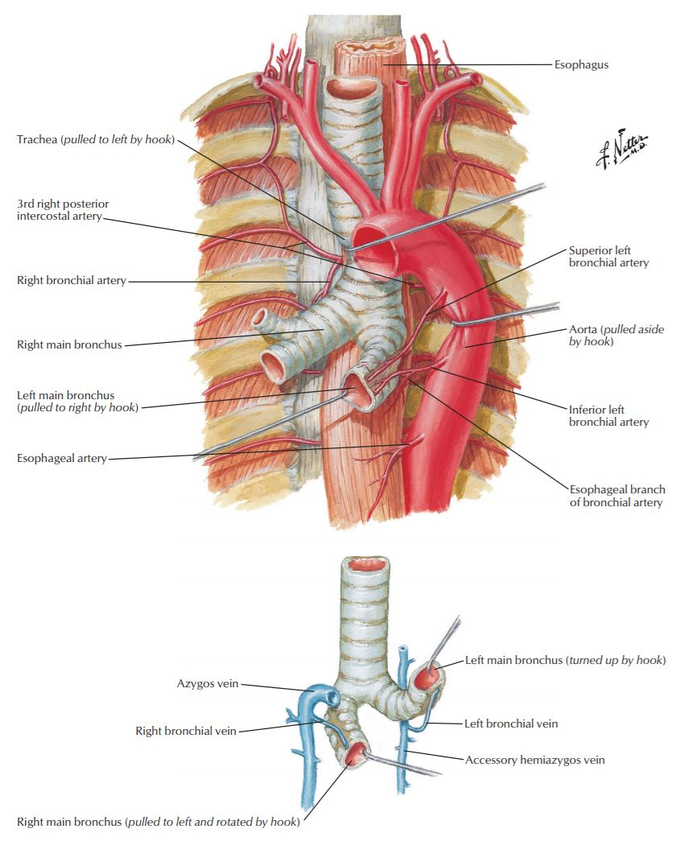
Extra Visuals May Help You Understand More About Lung Structures
Lungs Innervation
From Atlas
Trachea
&
Bronchi
Intrapulmonary
Blood
Circulation
Thorax
Blood
Supply
Vessels that
Supply
Bronchi

Slide 21
MCQs:
1- The volume in the pleural cavity is:
A- 20-30 ml
B- 15-20 ml
C- 5-10 ml
D- 8-12 ml
2- How many regions are in the parietal pleura?
A- 7
B- 4
C- 5
D- 3
3- Costal pleura covers:
A- The back of the sternum.
B- The front of the ribs.
C- The front of the costal cartilages.
D- The front of the intercostal spaces.
4- Diaphragmatic pleura covers:
A- The mediastinum.
B- The upper surface of the diaphragm.
C- The back of the sternum.
D- The sides of the vertebral bodies.
1-C
2-B
3-A
4-B

Slide 22
5- What is the normal volume of fluid in pleura?
A- 300 ml.
B- 100 ml.
C- 5-10 ml.
D- 60- 70 ml.
6- Pleura is a ......... serous membranous sac enclosing the lung.
A- Single-layered.
B- Double-layered.
C- Triple-layered.
D- Quadruple-layered.
7- Layer lines between the thoracic walls.
A- Parietal layer.
B- Visceral layer.
C- Oblique fissure.
D- Horizontal fissure.
8- Which part of parietal pleura lines under surface of the Suprapleural membrane?
A- Costal.
B- Mediastinal.
C- Cervical.
D- Diaphragmatic.
5-C
6-B
7-A
8-C

Slide 23
9- Which part of parietal pleura is supplied only by phrenic nerves?
A- Costal.
B- Mediastinal.
C- Cervical.
D- Diaphragmatic.
10- Visceral pleura is supplied by:
A- Autonomic fibers.
B- Phrenic nerves.
C- intercostal nerves.
D- thoracic nerve.
11- The Cardiac notch in the left pleura is formed at:
A- 4th costal cartilage.
B- 5th costal cartilage.
C- 6th costal cartilage.
D- 7th costal cartilage.
12- Which of the following is not a cause of pleural effusion?
A- Inflammation.
B- TB.
C- Myopathy.
D- Heart disease.
E- Tumors.
9-B
10-A
11-C
12-C

Slide 24
13- Which of the following is NOT a characteristic of the left lung?
A- It has a horizontal fissure.
B- It has a cardiac notch.
C- It has an oblique fissure.
D- It is divided into 2 lobes.
14- The cardiac impression in the mediastinal surface of the right lunge is related to:
A- Left atrium.
B- Right atrium.
C- Left Ventricle.
D- Right ventricle.
15- Which of the following you can find only on the mediastinal surface of the right lung
A- Vagus nerve.
B- Phrenic nerve.
C- Descending aorta.
D- Azygos vein.
16- The main bronchus is the:
A- Right bronchus.
B- Left bronchus.
17- What is the action of sympathetic fibers?
A- Broncho-dilatation
B- Broncho-constriction
C- Secretomotor to bronchial glands
13- A
14-B
15-D
16-B
17-A

Slide 25
Team Members
Lamia Abdullah Alkuwaiz (Team Leader)
Rawan Mohammad Alharbi
Abeer Alabduljabbar Afnan Abdulaziz Almustafa Ahad Ahmed Algrain Albandari Alshaye AlFhadah abdullah alsaleem Ghaida Alsanad Layan Hassan Alwatban Lojain Azizalrahman Maha Barakah Majd Khalid AlBarrak Nouf Alotaibi Rinad Musaed Alghoraiby Wafa Alotaibi Wejdan Fahad Albadrani
Faisal Fahad Alsaif (Team Leader)
Abdulaziz Al dukhayel ‏Abdulelah Aldossari ‏Abdulrahman Alduhayyim ‏Hamdan Aldossari ‏Mohammed Alomar ‏Saud Alghufaily ‏Hassan Aloraini ‏Abdullah Alomar ‏Fahad Alfaiz ‏Saad Aloqile ‏Abdulmajeed Alwardi ‏Rayyan Almousa ‏Sultan Alfuhaid ‏Ali Alammari ‏Fahad alshughaithry ‏‏
Fayez Ghiyath Aldarsouni
Mohammed Alquwayfili ‏Saleh Almoaiqel ‏Abdullah Almeaither Abduljabbar Al-yamane ‏Sultan Al-nasser ‏Majed Aljohani ‏Zeyad Al-khenaizan ‏Mohammed Nouri ‏Abdulaziz Al-drgam ‏Fahad Aldhowaihy ‏Omar alyabis ‏Akram Alfandi ‏Abdulhaziz Alabdulkareem

