Slide 3
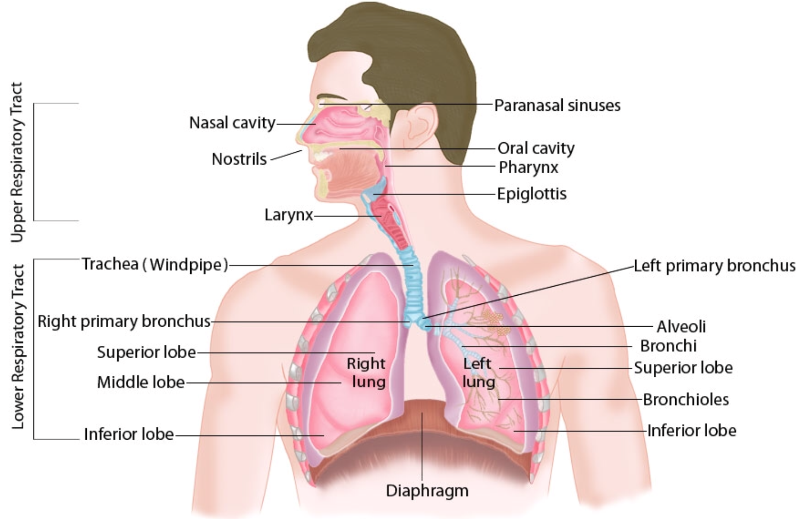
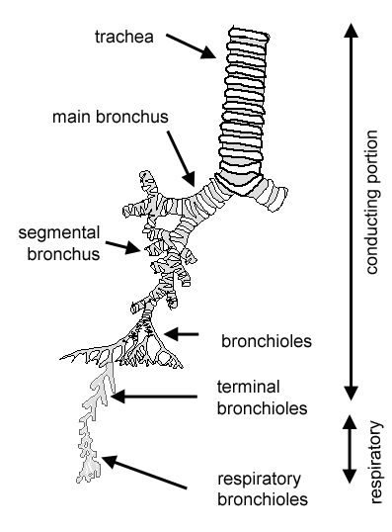
Respiratory System
Conducting
Nasal cavity
Nasopharynx
Respiratory
Respiratory bronchioles
Larynx
Alveolar ducts
Alveolar sacs
preterminal bronchioles
Trachea
Extrapulmonary bronchi
Intrapulmonary bronchi
Terminal bronchioles
Pulmonary alveoli
Tracts
Upper
Nasal cavity
Paranasal sinuses
Lower
Trachea
Larynx
Bronchi
Bronchioles
lung
Portions

Slide 4
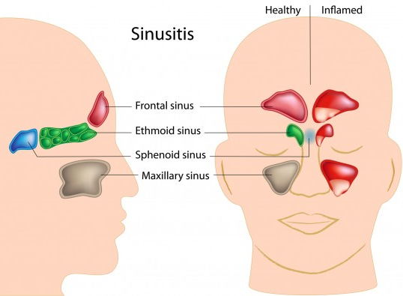
Nasal Cavity (N.C.)
Vestibule
Anterior portion of N.C. : Vestibule
Posterior portion of N.C. : - Respiratory region - Olfactory region
The nasal septum divides the nasal cavity into two halves (right and left).
Lining (line with thin skin) 1- Epidermis: (Keratinized stratified Squamous epithelium). 2- Dermis.
Contents: 1- Vibrissae: stiff hairs. 2- Sebaceous glands. 3- Sweat glands
Wall: 1- Hyaline cartilage. 2- Cancellous (spongy) bone
Lining: 1- Respiratory Epithelium. 2- Lamina propria.
Clinical application: Sinusitis: “إلتهاب الجيوب الأنفية” Accumulation of air and bacteria in close sinuses
Paranasal sinuses

Slide 5
Respiratory region (Area) of nasal cavity
Respiratory Epithelium
Lamina propria ( Sub-epithelial C.T.)
Pseudo-stratified ciliated columnar epithelium with goblet cells.
Main Types of cells (all touch the basement membrane)
1- Ciliated columnar cells. 2- Goblet cells. 3- Basal cells: are stem cells. 4- DNES cells: e.g. serotonin.
mucosa (mucous membrane)
1- Large arterial plexuses & venous sinuses (Highly vascularized C.T.) 2- Many seromucous glands (acini). 3- Abundant lymphoid elements: Including occasional lymphoid nodules, plasma cells & mast cells.
Epithelium + connective tissue in wet area known as mucus membrane
Skin is not mucus membrane because it dry
Function of Paranasal sinuses is Lighten the skull and it help in speech
Olfactory area is the only site that dose not have mucus secretion but it has serous secretion
The only neuron that can renewing from his stem cell located in olfactory area

Slide 6
Olfactory region (Area) of nasal cavity
olfactory Epithelium
Lamina propria
pseudo-stratified columnar epithelium 1- olfactory cells (olfactory nerve cells): - bipolar neurons
- Dendrite has olfactory vesicle that has nonmotile cilia - Axons are unmyelinated with Schwann-like cells - Axons will collect in the lamina propria to form bundles of nerve fibers - Bundles will collect to form the olfactory nerve 2- sustentacular (supporting) cells: are columnar cells Function: Physical support and nourishment for olfactory cells 3- basal cells: pyramidal in shape, basal in position and act as stem cells
(Site) 1-roof of nasal cavity. 2-upper part of nasal septum. 3-over superior concha.
Highly (richly) vascularized loose C.T. Contents: 1- Bowman’s glands (olfactory glands): are serous acini 2- Bundles of unmyelinated nerve fibers: are axons of olfactory nerve cells + Schwann-like cells (glial cells) 3- Rich vascular plexus 4- Numerous lymphoid elements
(Olfactory mucosa)

Slide 7
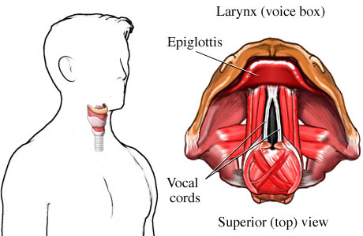
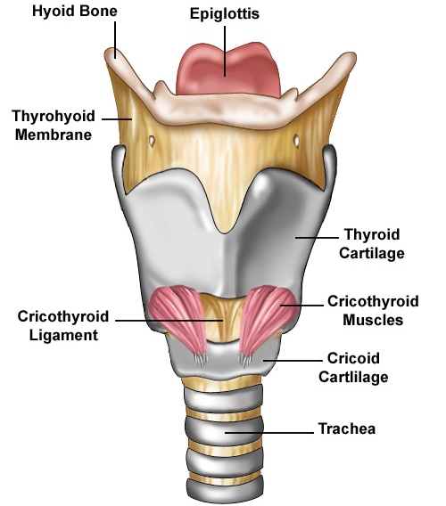
Larynx
Epiglottis cover by tow type of epithelium:
Anterior: stratified squamous epithelium non keratinized
Posterior: pseudo stratified columnar epithelium

Slide 8
Larynx
MUCOSA
Epithelium |  | Lamina propria | 2 pairs of shelf-like mucosal folds
Respiratory epithelium | Non keratinized stratified squamous epithelium |  | Vestibular folds Immovable | Vocal folds (cords) No lymphoid nodules No seromucous glands
Pseudostratified ciliated columnar epithelium with goblet cells | - Vocal folds - Superior surface of epiglottis |  | - Respiratory epithelium - Lamina propria: Loose C.T. with seromucous glands lymphoid elements & adipose cells. | - epithelium: Non keratinized stratified squamous epithelium - Lamina propria: C.T. containing bundles of elastic fibers and skeletal muscle .
 |  |  | - Respiratory epithelium - Lamina propria: Loose C.T. with seromucous glands lymphoid elements & adipose cells | - epithelium: Non keratinized stratified squamous epithelium - Lamina propria: C.T. containing bundles of elastic fibers and skeletal muscle
CARTILAGE |  | MUSCLES |  | LIGAMENTS
1- Hyaline cartilages: ex- Thyroid cartilage 2- Elastic cartilages: Ex- Epiglottis |  | Extrinsic and intrinsic muscles: all are skeletal |  | -

