Slide 3
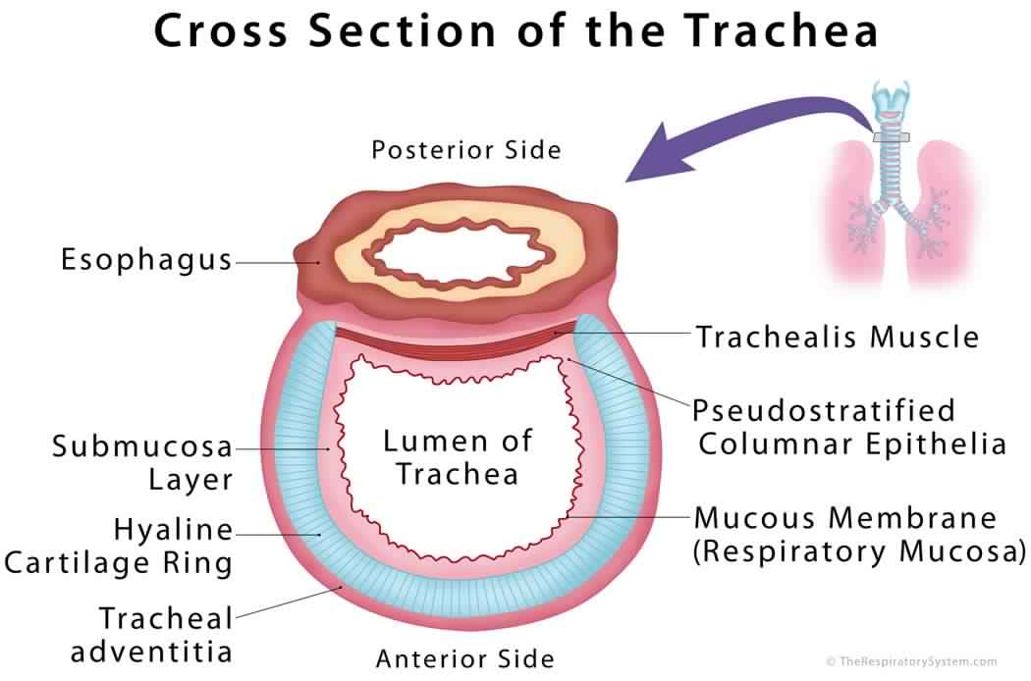
EXTRA :

Slide 4
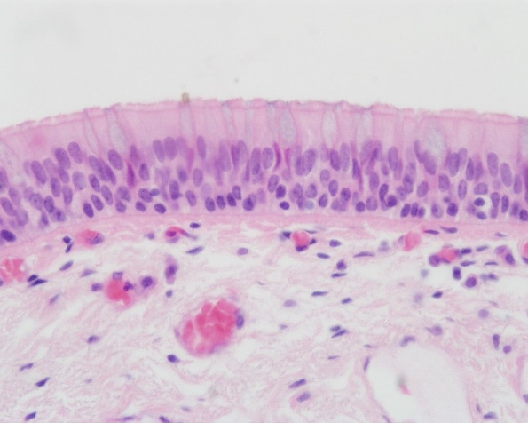
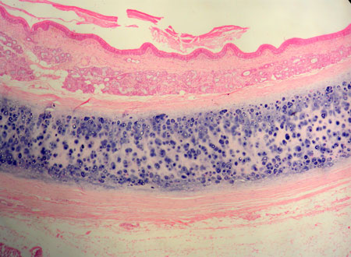
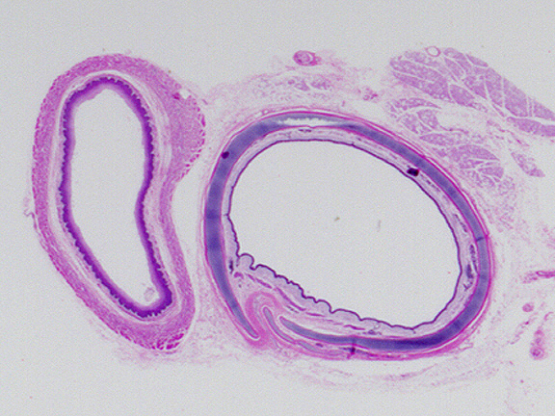
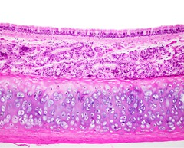
0 | Epithelium - Respiratory epithelium (pseudo-stratified Ciliated columnar Epithelium with goblet cell) | Mucosa The only mucosa that composed of three layers
 | Lamina propria
 | Elastic lamina It is formed of elastic fibers. It separates lamina propria from submucosa
 | Connective tissue (loose connective tissue) | Submucosa sub=under
 | Numerous mucous & seromucous glands Numerous mucous & seromucous glands known as Trachealis gland
 | Lymphoid elements
 | Fibroelastic Connective tissue | Adventitia
 | C-shaped rings (12-16) of hyaline cartilage. Trachealis muscle (bundle of smooth muscle fibers) connects the 2 ends of each C-shaped (incomplete) rings of cartilage Trachealis muscle is smooth muscle and it help in contraction and dilatation of the trachea
TRACHEA
The wall of trachea is formed of

Slide 5
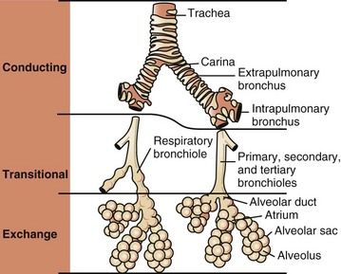
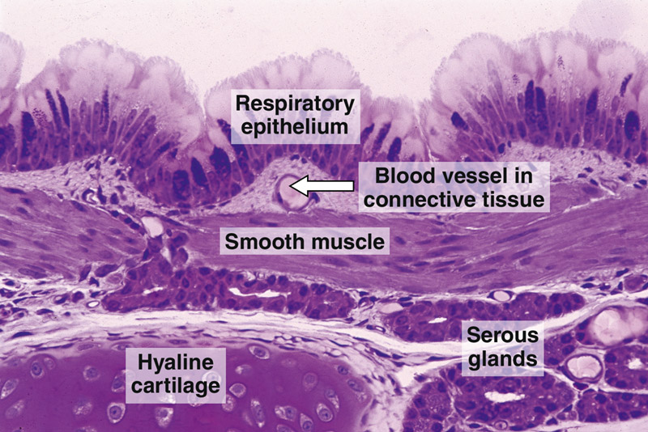
EXTRAPULMONARY BRONCHUS (1ry BRONCHUS) Generally have the same histological appearance as the trachea but different in diameter.
INTRAPULMONARY BRONCHI (2ry & 3ry BRONCHI)
Mucosa
A) Epithelium: Respiratory Epithelium
B) Lamina propria
N.B. No elastic lamina
Muscle coat (complete)
Two distinct layers of smooth muscle fibers spirally arranged in opposite direction.
Submucosa
C.T. contains:
A) Seromucous glands
B) Lymphoid elements
Adventitia
A) Loose C.T.
B) Irregular plates of hyaline cartilage (complete layer)
C) Solitary lymphoid nodules
Remember: trachea & extrapulmonary bronchus have (mucosa, submucosa & adventitia) Intrapulmonary bronchus have (mucosa, submucosa, adventitia & Muscle coat) * Present of cartilage in trachea and bronchus prevent them from collapse

Slide 6
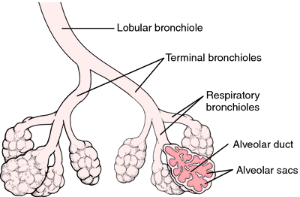
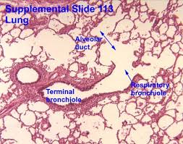
BRONCHIOLES
BRONCHIOLES
Preterminal (lobular) ( 1ry ) Bronchioles:
Are less than 1mm in diameter.
Terminal ( 2ry ) Bronchioles
Are less than 0.5mm in diameter.
the last part of the conduction zone
Respiratory ( 3ry ) Bronchioles
the first part of the respiratory zone
Note: don’t confuse the Bronchus with Bronchioles.
The difference between the bronchioles and the bronchus is the absent of: Cartilages, Submucosa, Lymph nodules, Goblet cells and Seromucous glands.

Slide 7
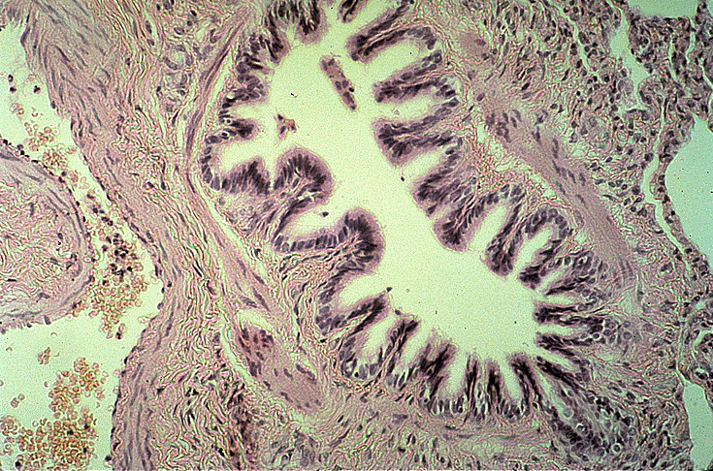
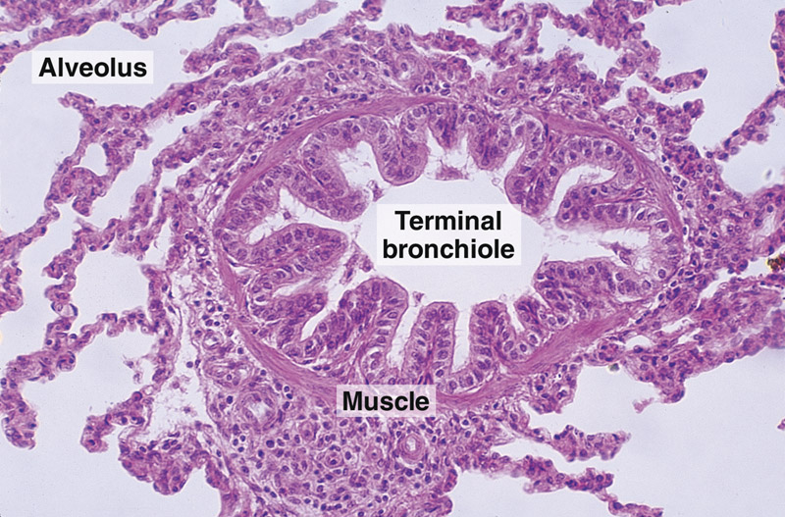
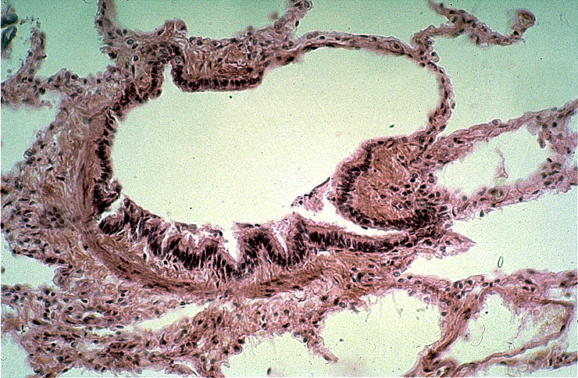
 | 1- Mucosa: has longitudinal folds: (A) Epithelium: Simple ciliated columnar Epithelium. With occasional goblet cells. (B) Lamina propria: Connective tissue rich in elastic fibers. 2- Smooth muscle: 2 helically arranged smooth muscle layers. 3- Adventitia: Connective tissue. | Preterminal Bronchioles NOTE: No cartilage No seromucous glands No lymph nodules | Bronchioles
 | Similar structure to preterminal bronchioles, BUT: Epithelium: Simple cuboidal partially ciliated epithelium With Clara cells (NO goblet cells) | Terminal Bronchioles
 | Similar structure to terminal bronchioles, BUT: their walls are interrupted by the presence of few pulmonary alveoli. | Respiratory Bronchioles

Slide 8
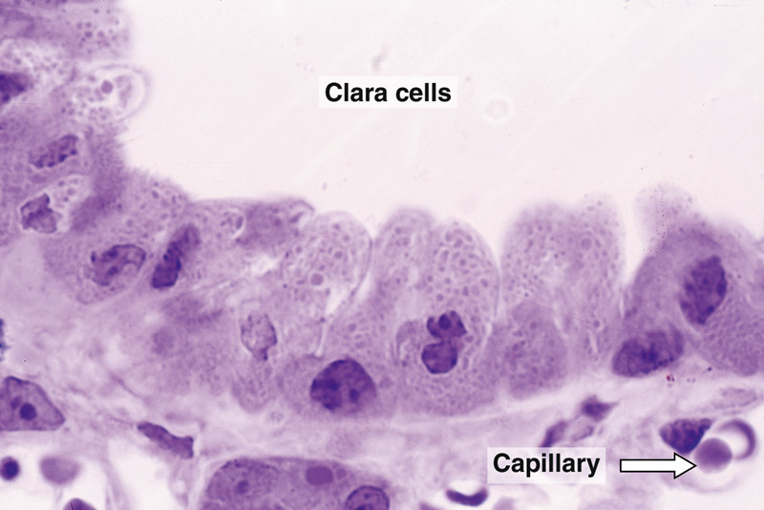
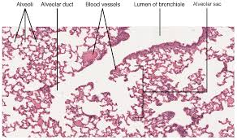
CLARA CELLS
columnar cells (non ciliated).
Function:
1- Degrade toxins in inhaled air.
2- Divide to regenerate the bronchiolar epithelium.
3- Produce surfactant-like material.
Note: found in 2ry & 3ry bronchioles.
ALVEOLAR DUCTS
The wall of alveolar ducts consist almost of pulmonary alveoli.
Note: Alveolar duct ends by atrium communicates with: 2-3 alveolar sacs
* Atrium is 2 or more alveolus opening on each other and it open in alveolar duct. * Alveolar sac is 2 or more alveolus opening on each other.

Slide 9
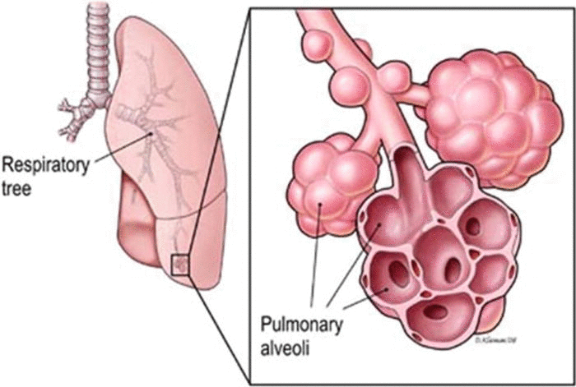
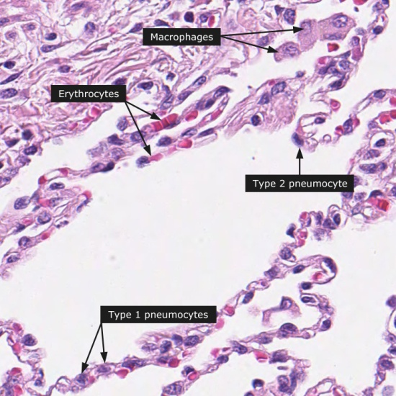
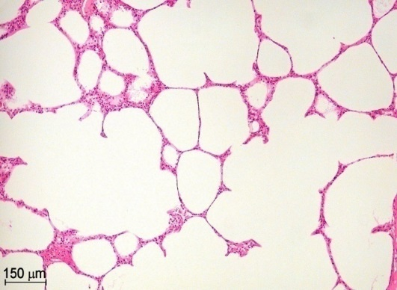
PULMONARY ALVEOLI
They are small out-pouching of respiratory bronchioles, alveolar ducts & alveolar sacs.
PULMONARY ALVEOLI
Alveolar epithelium
lines both sides of interalveolar septum
Interalveolar septa
The region between 2 adjacent alveoli
Alveolar phagocytes
(Lung macrophages)
Note: the number of elastic fibers increase as we go deeper

Slide 10
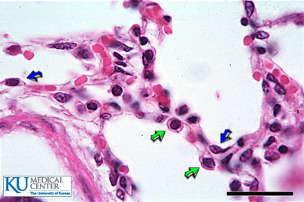
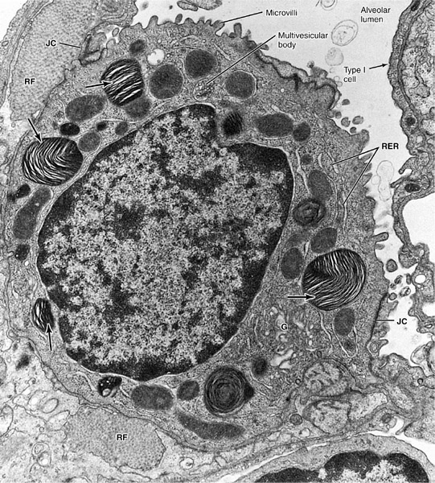
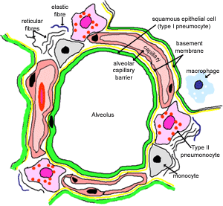
 | - line 95% of the alveolar surface. - Are less numerous than type II pneumocytes. - L/M: simple squamous epithelium. Function: - Exchange of gases. | Type I Pneumocytes (blue arrows) | Alveolar Epithelium | INTERALVEOLAR SEPTA
 | - Line 5% of the alveolar surfaces. Are more numerous than type I pneumocytes. - Are cuboidal or rounded cells, With Foamy cytoplasm. -Nucleus: central & rounded. -The cytoplasm contains membrane-bound Lamellar bodies (contain pulmonary surfactant). Function: 1- Synthesis & secretion of pulmonary surfactant. 2- Renewal of alveolar epithelial cells: Type II cells can divide to regenerate both type I & type II pneumocytes. | Type II Pneumocytes (green arrows) * Have less surface area than Type I but more number of cells * It looks like foam because it has a lot of vesicles that contain surfactant
 | C.T. Fibers: elastic fibers & type III collagen (reticular fibers). C.T. Cells: Fibroblasts, Macrophages, Mast cells, Lymphocytes. | Interstitial connective tissue | Interstitium Pulmonary Capillaries is Continuous and it has thick basement membrane to prevent any toxic materials inter the circulation
 | Continuous Pulmonary Capillaries

Slide 11
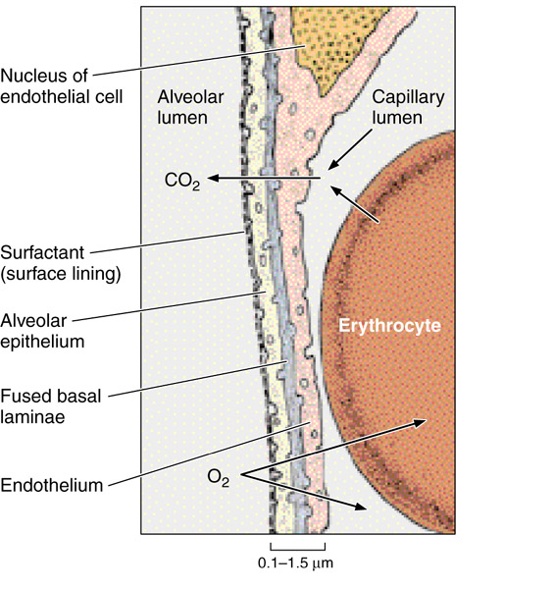
BLOOD-GAS BARRIER = (BLOOD-AIR BARRIER)
It is the region of the interalveolar septum that is traversed by O2 & CO2.
Note: the O2 molecules will pass through these 4 structures respectively to diffuse from Alveoli to the capillaries.
Components:
1- Thin layer of surfactant.
2- Type I pneumocyte.
3- Fused basal laminae of type I pneumocytes & endothelial cells of the pulmonary capillary.
4- Endothelial cells of the pulmonary capillary.

Slide 12
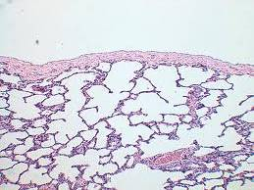
Alveolar phagocytes = (Alveolar Macrophages) = (Dust Cells)
Sites:
1- In the lumen of pulmonary alveoli. 2- In the interstitium of interalveolar septa.
Function:
Phagocytose particulate matter (e.g. dust) & bacteria in the lumen of pulmonary alveoli and in the interstitium of interalveolar septa.
Pleura
Is formed of two layers: - Parietal and visceral. It is formed of simple squamous mesothelium. The two layers are separated by serous fluid. The visceral layer has sub-epithelium loose C.T. that extends into the lung tissue

