Slide 1
1- Immunology of Bronchial Asthma
Objectives :
Immunology team - 437
To know the difference between extrinsic and intrinsic asthma.
To be familiar with the types of allergens and their role in allergic sensitization.
To understand the inflammatory processes operating in allergic asthma.
To know about airway remodeling.

Slide 2
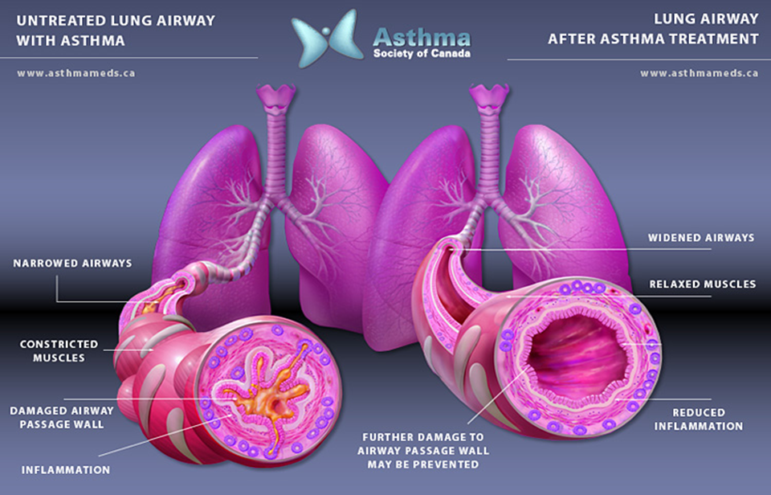
Asthma
Characterized by:
Episodes of reversible airway obstruction
Increased bronchial reactivity
Airway inflammation
Asthma symptoms:
Breathlessness (difficulty breathing)
Wheezing
Persistent cough
Chest tightness
Classification of asthma:
Intrinsic (non-atopic)
Extrinsic (atopic)
Atopy: genetic tendency to develop allergy

Slide 3
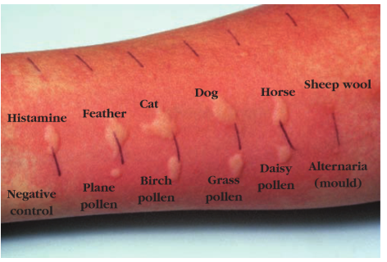
Classification of asthma:
Intrinsic (non-atopic)
Extrinsic (atopic)(genetic)
Role of antigens:
Allergen sensitization is linked to the risk of developing asthma
Allergen is an antigen that triggers an allergic reaction.
The main cause of hypersensitivity type I
( 10-33% of asthmatics )
Allergies trigger asthma attacks in:
(60-90% of Children and 50% of adults)
Approximately 75-85% of patients with asthma have positive (immediate) skin test reactions to various allergens
Serum IgE level elevated
Immune response
Negative skin test (used in hypersensitivity I)
No clinical/family history
Serum IgE level are usually normal
Older patients
More severe
Indoor allergens
Outdoor allergens
– House dust mites
– Domestic pets (cat fur & dander)
– Cockroaches (insects)
– Molds (fungal spores)
- Fungal spores (e.g. Alternaria)
- Grass, tree, & weed pollen
Notes:
Add notes here if you have any I'll edit them later
Ok
Add pictures of allergins

Slide 4
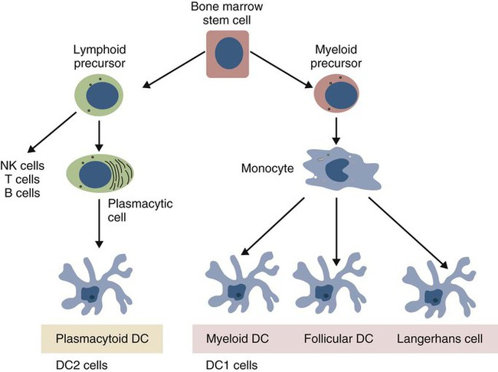
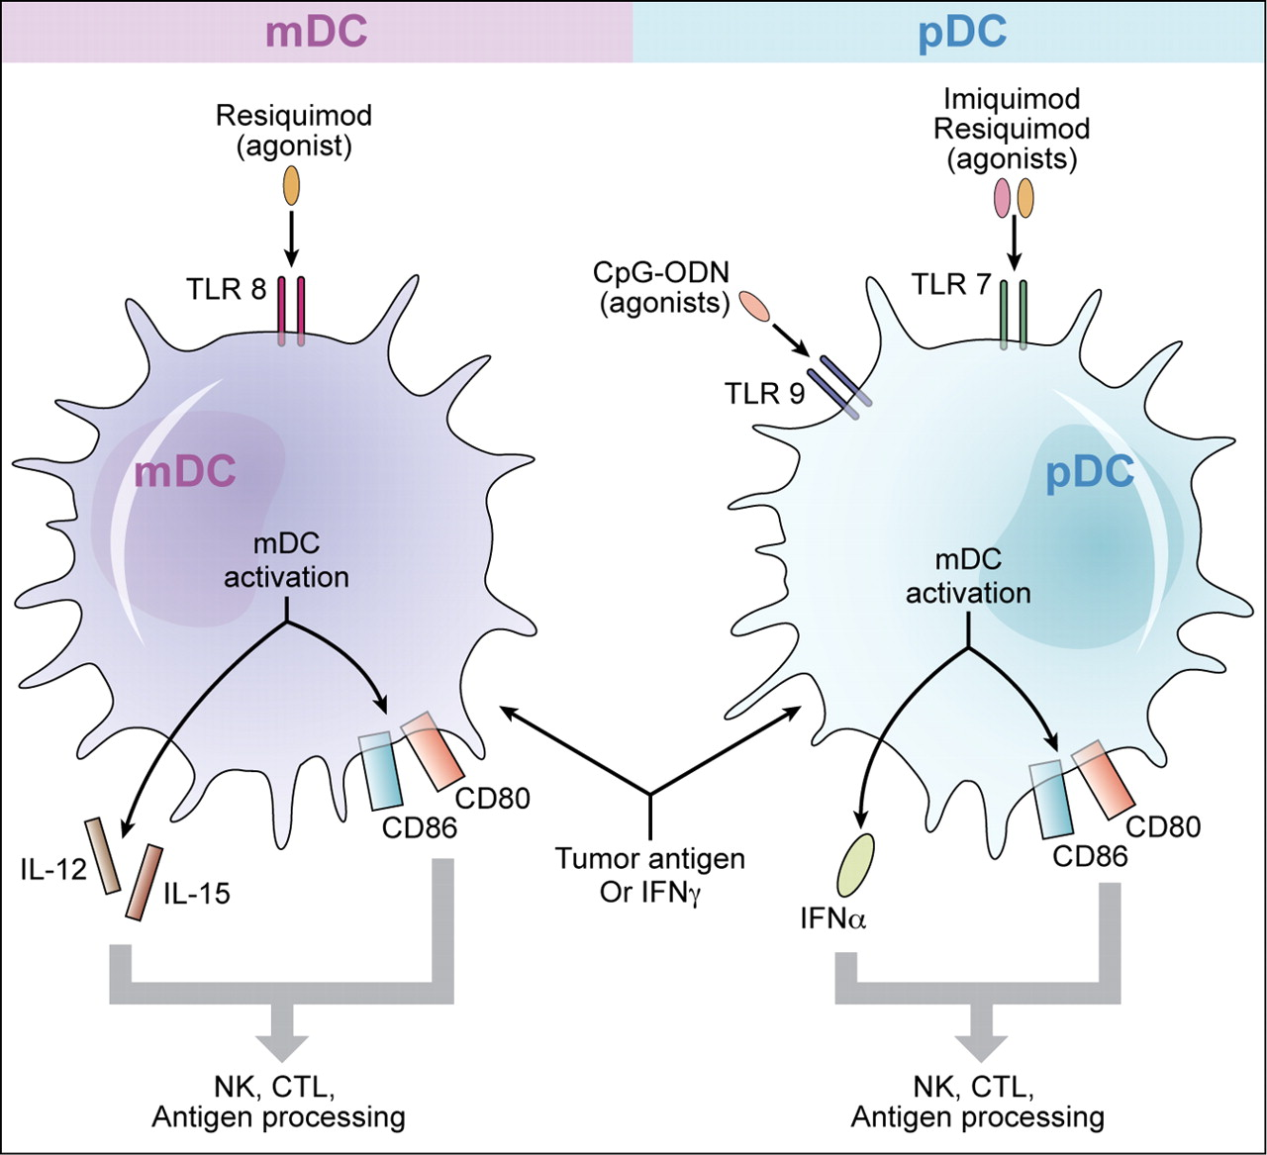
Antigen presenting cells (APCs) in the lung:
In susceptible individuals (people who are prone to develop asthma):
Two subsets of dendritic cells (DCs) in the lungs:
Myeloid DCs (mDCs): help in the development of asthma symptoms
Plasmacytoid DCs (pDCs): aid in respiratory tolerance to allergens
First encounter with allergens activate B-cells to produce IgE
Subsequently, Inhaled allergens activate submucosal mast cells in the lower airways
Mediators are released within seconds causing:
Bronchoconstriction.
Influx of eosinophils & other inflammatory cells.
Notes:
Recall: we have to phases for the hypersensitivity reaction:-
1- Sensitization phase (first encounter)
2- challenge phase

Slide 5
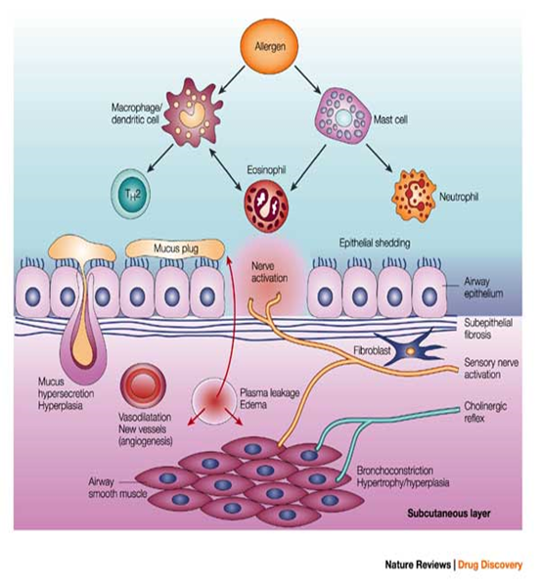
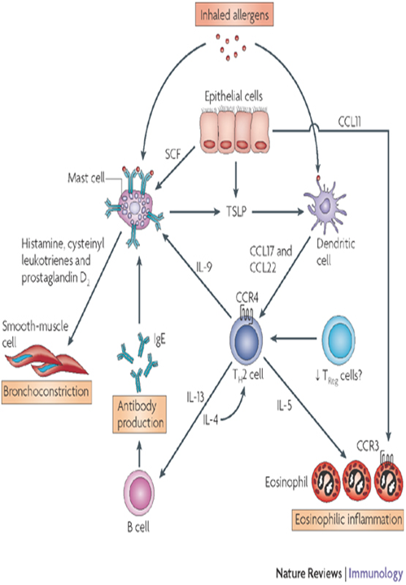
Asthma results from complex interactions among the inflammatory cells that involve:
1- Inhaled allergen
2- Submucosal mast cells in lower airways
1- Airway epithelium
2- Nervous system
3- Bronchial smooth muscles
Nice video explaining the pathophysiology of asthma

Slide 6
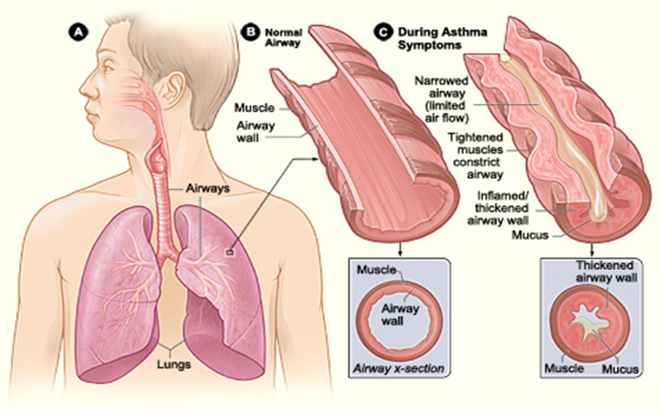
Factors contributing to airflow obstruction leading to difficulty in breathing include:
1- Narrowed airway
2- Contracted (constricted) muscles
3- Inflamed/thickened airway wall
4- Excessive mucus production

Slide 7
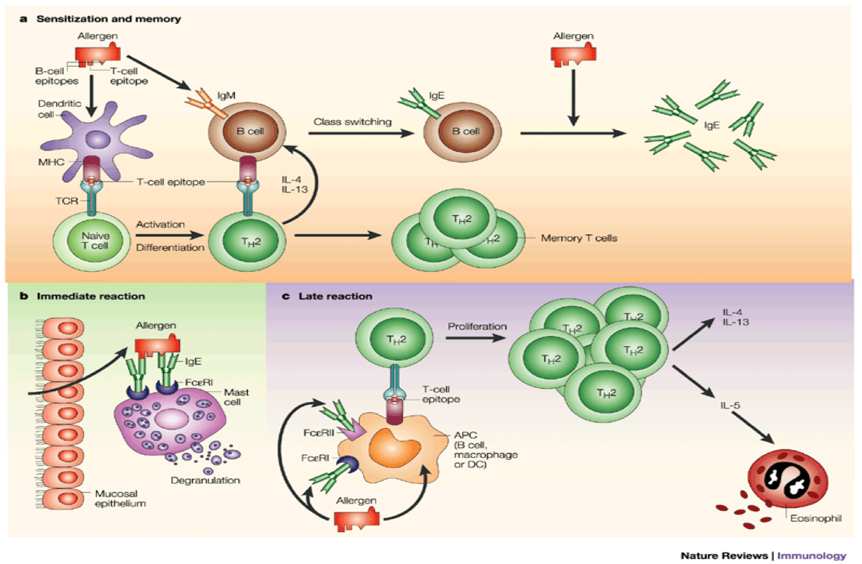
Response to allergens occur in two phases
1st phase sensitization phase:
→First encounter with allergen
→Activation of B lymphocytes into plasma cells
→Secretion of IgE
→Binding of IgE to mast cells
- 2nd phase challenge phase
→Recurrent encounter with same allergen
→Antigens Bind to IgE
→Degranulation of mast cells
→Release of histamine
→Physiological actions
Notes:
Add explanation, minimize photo & look for alternative

Slide 8
The types of allergic responses
Early allergic response | Late allergic response
Occurs within minutes | Appears 4 to 10 hours later
Manifests clinically as: Bronchial constriction Airway edema Mucus plugging | Results from infiltration by inflammatory cells. Activation of lymphocytes & eosinophils
Is reversible and responds to bronchodilators (treatment) | Responds to steroids (Anti-inflammatory drugs)
Notes:
Edit borders to be black

Slide 9
Th2 cells and role of cytokines in allergic asthma
Allergens drive T-cells towards Th2 type:
Th2 secrete the cytokines:
IL-4, IL-5, IL-9 & IL-13
which promote :
1. Production of IgE by B cells
2. Eosinophil attraction and infiltration
3. Airway inflammation
4. Increased bronchial reactivity
Notes:
Put it in a schedule with the next two slides

Slide 10
Role of IL-4 in allergic asthma | Role of IL-13 in allergic asthma | Role of IL-5 in allergic asthma
The main role of IL-4 is carried out during the initial priming of Th2 cells : 1. Regulates isotype switching in B cells to IgE. (naive B cells usually contain IgM & IgD antibodies but with the help of IL-4 it switches(isotype switching) to IgE which plays a role in allergic reactions) 2. Induces MHC II on antigen-presenting cells. 3. Induces adhesion molecule expression. (important in chemo-attraction) 4. Activate mast cells and eosinophils. | IL-13 induces inflammation. Stimulates mucus hypersecretion. Induces subepithelial fibrosis. | IL-5 induces an increase in eosinophil production in the bone marrow. Release of eosinophils from the bone marrow into circulation.
(picture from previous slides showing isotype switching)
Notes:
Good effort, but still unsightly thanks for your effort

Slide 11
Role of:
eosinophils in allergic asthma | regulatory T-cells
Products of the inflammatory cells act on :
Eosinophils initiate asthmatic symptoms by causing tissue damage in the airways of the lungs. | suppress the effector mechanisms that induce asthmatic symptoms.
Production of eosinophils is inhibited by IL-10. | Asthmatics may lack functional regulatory T cells that can inhibit an asthmatic response.
1. Airway smooth muscle cells 2. Lung fibroblasts 3. Mucous glands
and cause : Airway Remodeling
*Activation of inflammatory cells (mast cells, eosinophils etc,) is a major inducer of airway inflammation.
Increased bronchial reactivity
Which will lead to
*Airway inflammation is the hallmark in the asthmatic lung.

Slide 12
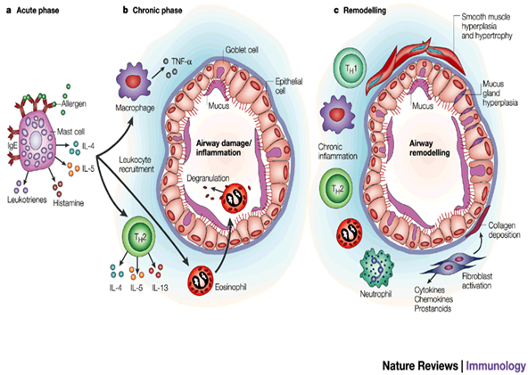
Airway remodeling refers to:
1. Smooth muscle hyperplasia and hypertrophy
2. Mucous gland hyperplasia
3. Collagen deposition
4. Fibroblast activation
5. Chronic inflammation
Increased bronchial reactivity
Inflammatory cells & their mediators Airway inflammation
Airway remodelling
Notes:
Remodeling edit later , inquire the photo for later editing and color optimization

Slide 13
Outcome of increased airway reactivity:
Predisposes patients to develop asthma attacks on exposure to non-specific irritants:
1. Chemical irritants
2. Smoke & strong perfumes
3. Sulphur dioxide & air pollutants
4. Viral and bacterial respiratory infections أكثر من الشخص الطبيعي
Team 436: (Those are non-specific irritants which means they don’t cause asthma they are NOT allergens, but they are considered as triggers of asthma attacks in people with asthma)
Outcome of airway remodeling
Can ultimately lead to fibrosis and irreversible airway obstruction in some patients.

Slide 14
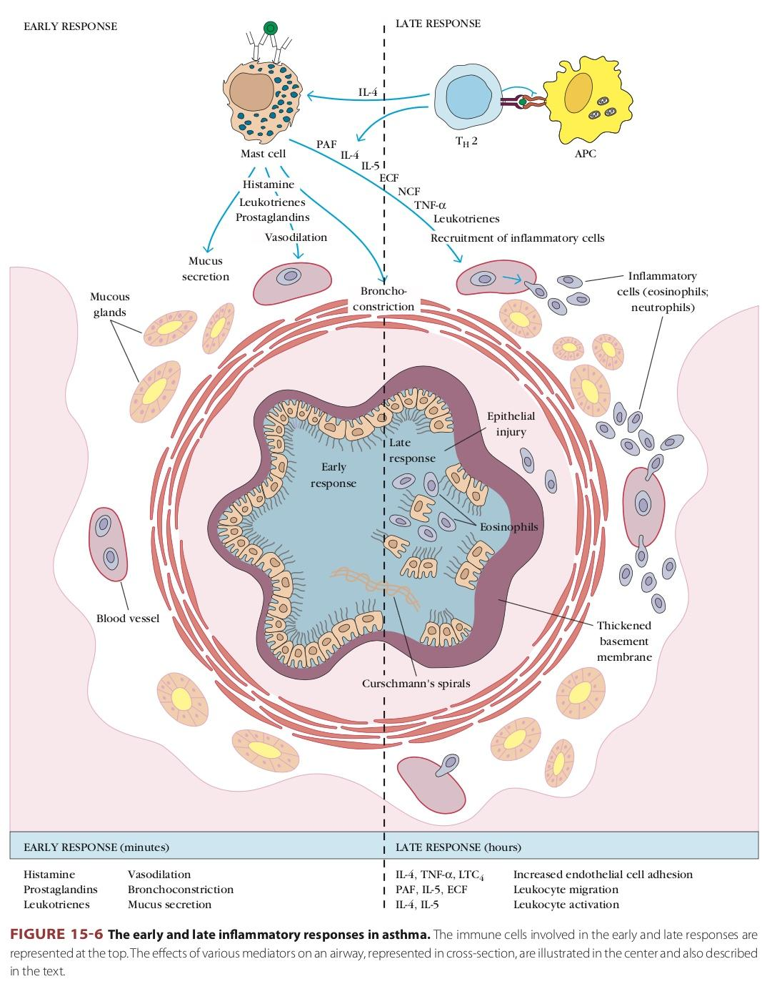
Take home messages
1. Asthma is characterized by episodic reversible airway obstruction.
2. Classified in 2 types: intrinsic & extrinsic.
3. In the extrinsic type allergens drive T-cells into Th2 pattern.
4. Airway inflammation is a hallmark finding in the asthmatic lung.
5. Inflammatory cells lead to increased bronchial reactions & airway remodeling which is not revisable.

Slide 15
Quiz: Test Yourself!
1- Non-atopic asthma can be detected by skin test. A) True B) False 2- Which of the following will aid in respiratory tolerance to allergens? A) Macrophages B) Eosinophils
C) Myeloid dendritic cells D) Plasmacytoid dendritic cells 3- First encounter with allergens activate B-cells to produce: A) IgM B) IgA C.IgE D.IgA 4- Which of the following induces MHC II on antigen-presenting cells? A) IL-4 B) IL-5 C) IL-9 D) IL-13 5- Which of the following stimulates mucus hypersecretion? A) IL-4 B) IL-5 C) IL-9 D) IL-13
6- Which of the following induces an increase in eosinophil production in the bone marrow? A) IL-4 B) IL-5 C) IL-9 D) IL-13 7- The cell which suppresses the effector mechanisms that induce asthmatic symptoms is: A) Self reacting T cell B) T helper cell
C) Mast cells D)Regulatory T cells 8- In extrinsic type asthma, allergens drive T-cells into? A) Th1 pattern B) Th2 pattern C) Tc pattern D) Self reacting T cell pattern 9- The hallmark in an asthmatic lung is: A) Increased mucus secretion B) Decreased bronchial reactivity C) Airway inflammation D) Edema 10- Which one of the following is an indoor allergen? A) Grass B) Cockroaches C) Pollens D) Alternaria
1:B
2:D
3:C
4:A
5:C
6:B
7:D
8:B
9:C
10:B
Notes:
Saq ??

Slide 16
Team members :
Team leaders :
١- العنود المنصور
٢- غادة الحيدري
٣- شيرين حمادي
٤- العنود المعيثم
٥- غادة الحناكي
١-زياد الخنيزان
٢-عبدالإلٰه الدوسري
٣-عبدالله العمر
٤-عبدالعزيز الدخيل
٥-عبدالرحمن الداوود
٦-فيصل السيف
٧-حسين علامي
٨-عبدالرحمن العوجان
٩-محمد بن معيوف
١٠-فهد الفايز
١١-عبدالعزيز الجهني
عبدالعزيز الضرغام رهف الشمري

