Slide 1
Community acquired pneumonia
Please check the editing file to see if there are any changes
Important!
Doctor’s Notes
Only found in females’ slides
Only found in males’ slides
Extra Notes
This lecture is made by Physiology team
“ I’m not telling you it’s going to be easy. I’m telling you it’s going to be worth it.”

Slide 2
Objectives
Discuss the epidemiology and pathophysiology of pneumonia and CAP
Explain the different classifications of pneumonia
Recognize clinical presentations associated with CAP
Discuss the diagnosis and treatment of CAP
Identify common etiological agents causing CAP and discuss their laboratory work up
Discuss virulence factors and prevention of Streptococcus pneumoniae.

Slide 3
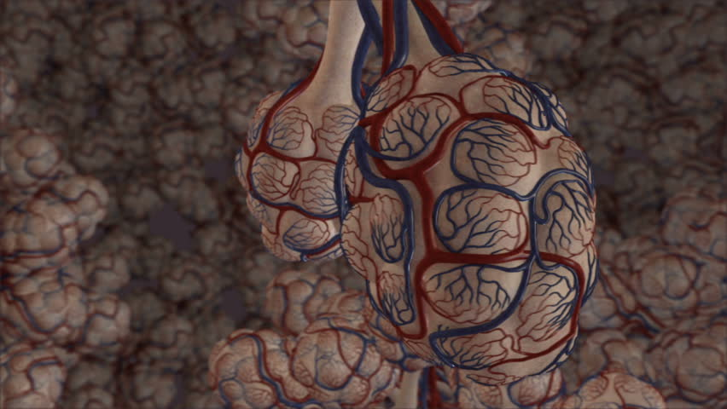
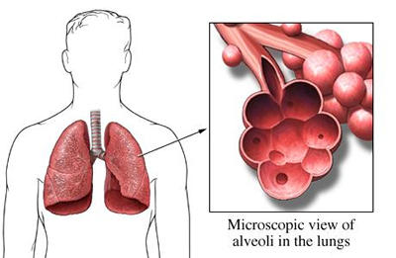
Definition
Pneumonia: is an infection that leads to inflammation of the parenchyma of the lung (the alveoli) (consolidation and exudation) .
It may present as acute, fulminant clinical disease or as a chronic disease with a more prolonged course .
Risk factors
Age < 2 yrs, > 65 yrs
Alcoholism
Smoking
Asthma and COPD
Aspiration
Dementia (a chronic mental disorder marked by memory loss, personality changes and impaired reasoning)
Prior influenza
HIV ; Immunosuppression
Institutionalization
Recent hotel : Legionella
Travel, pets, occupational exposures- birds (C. psittaci)
Epidemiology
Overall the rate of CAP 5-6 cases per 1000 persons per year. Usually Its transmission by droplet.
Mortality 23%
High, especially in old people
Almost 1 million annual episodes of CAP in adults > 65 yrs in the US.

Slide 4
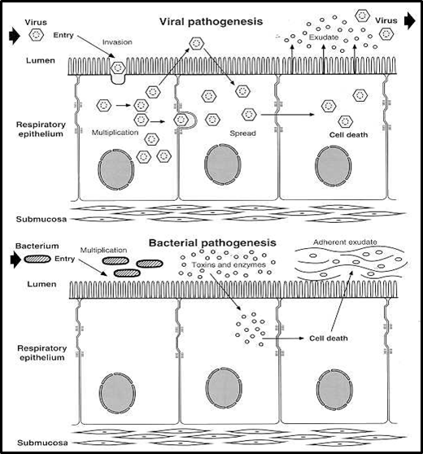
Etiological agents
Infectious:
Bacterial
Fungal
Viral
Parasitic
Non-infectious like:
Chemical
Allergen related
They’re rare and usually effect immunespurrsed
Pathogenesis
Two factors involved in the formation of pneumonia
Pathogens
Host defenses.

Slide 5
Defense mechanism of respiratory tract
Filtration and deposition of environmental pathogens in the upper airways
Cough reflux
Mucociliary clearance
Alveolar macrophages
Humoral and cellular immunity
Oxidative metabolism of neutrophils
Pathophysiology
Inhalation or aspiration(لما يدخل شيء للرئة بالغلط) of pulmonary pathogenic organisms into a lung segment or lobe.
Results from secondary bacteraemia from a distant source, such as Escherichia coli urinary tract infection and/or bacteraemia (less commonly).
Aspiration of oropharyngeal contents (multiple pathogens).

Slide 6
Pneumonia is classified according to:
Acquired environment
Fungal
Candida
Aspergillosis
Pneumocystis carn
Pathogen
Parasite
Anatomy
community acquired pneumonia.
hospital acquired pneumonia.
nursing home acquired pneumonia.
Bacterial
Typical:
Gram-positive : Streptococcus pneumoniae(most common) , Staphylococcus aureus, Group A hemolytic streptococci.
Gram-negative : Klebsiella pneumoniae, Hemophilus influenzae, Moraxella catarrhal and Escherichia coli.
Atypical:
Mycoplasma pneumoniae(most common), chlamydophila pneumoniae and legionella. Anaerobic bacteria
- Lobar: entire lobe.
- Bronchopneumonia.
- Interstitial.
Viral
the most common cause of pneumonia in children < than 5 years
- Adenoviruses
- Respiratory syncytial virus
- Influenza virus
- Cytomegalovirus
- Herpes simplex virus

Slide 7
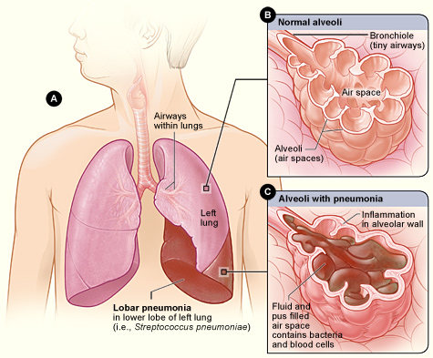
Strep pneumoniae causes lobar and sometimes legionella does

Slide 8
Community acquired pneumonia pathogens
•Strep pneumonia (the most) 48%
•Viral 23%
•Atypical orgs (MP,LG,CP) 22%
•Haemophilus influenza 7%
•Moraxella catharralis 2%
•Staph aureus 1.5%
•Gram –ive orgs 1.4%
•Anaerobes

Slide 9
According to pathogens :
Thanks to 436 team
1)Streptococcus pneumoniae, H.influenzae and Moraxella: have cell wall therefore are gram stained and respond to Penicillin and B-lactam
2)Mycoplasma pneumoniae, Legionella and chlamydia: doesn’t have cell wall (resistant to drugs that work on cell wall E.g (penicillin and B-lactam)
Actually legionella has cell wall but a little bit different

Slide 10
Clinical Manifestation
Signs and symptoms are quite similar but Atypical pneumonia is less severe.
Typical Pneumonia
Atypical Pneumonia
The onset is acute (2-3 days)
Prior viral upper respiratory infection (follows viral infection) غالبا قبل ما المريض يصاب بالنومونيا يكون أصابه فيروس فيهيئ الايروايز للنومونيا
Fever
Shaking chilis
Cough with sputum production (rusty-sputum)
Chest pain or pleurisy(inflammation of the pleura)
Shortness of breath ( dyspnea)
Gradual onset
Usually mild to moderate but in case of legionella it could be severe
Headache, malaise and low grade fever
Dry cough
Arthralgia / Myalgia ألم في المفاصل والعضلات
In case of doctor examination , signs such as minimal, few crackles and rhonchi could notify.

Slide 11
Diagnosis
Typical Pneumonia
Atypical Pneumonia
CBC: Complete blood count
LFTs : Liver function test
Clinical examinations ( history & physical )
X-ray ( to determine whether the pneumonia is lobar, lobular or interstitial)
Laboratory
CBC test shows leukocytosis
Sputum either gram stain( low sensitivity due to normal flora) or culture
4. Blood culture not always but usually in case of pneumococcal pneumonia
5. Culture of pleural fluid if there is effusion
Clinical examinations ( history & physical)
X-ray ( to determine whether the pneumonia is lobar, lobular or interstitial)
Laboratory
CBC test shows mild elevation of WBC
LFTs show elevation of ALT & Alk Phos
Sputum culture in case of Legionella
Detection of antibodies
DNA detection
4. Urine antigen for Legionella

Slide 12
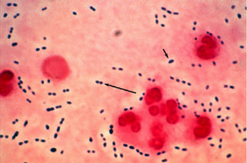
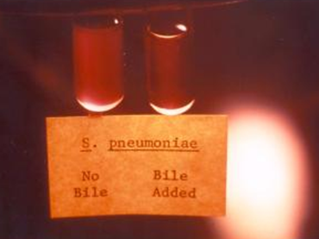
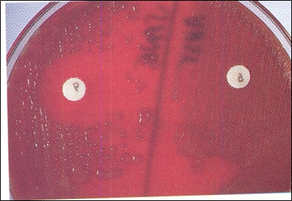
Streptococcus pneumonia
Gram Positive diplococci - Alpha hemolytic - Catalase negative - Normal flora of UPT in 20-40% of people.
Can cause respiratory infections such as pneumonia, sinusitis and otitis. Also, can cause non respiratory infections such as meningitis and bacteremia.
Neutrophils
important
Gram + diplococci
Virulence Factors:
Capsule “ most important virulence factor”
There are more than 90 types of capsule.
Pneumolysin (pore forming toxin, also stimulates cytokines and disrupts the cilia of respiratory epithelial cells released on lysis of organism by autolysin)
Autolysin
Neuraminidase(cleaves sialic acid)
Prevention: There is vaccination for S.pneumonia but it does not cover all the types of capsule.
-Alpha hemolytic consist of two broad groups S.Pneumonia and S.Viridans.
- S.Pneumonia sensitive to Optochin unlike S.Viridans which is resistance.”1”
- S.Pneumonia lysed”soluble” by bile unlike S.Viridans which insoluble in bile.”2”
This two tests differentiate between S.pneumonia & S. Viridans
عشان هالخاصيتين لما تسوي له كلتشر باللاب أول يومين ينمو بشكل طبيعي بعدها يكون شكل العينة مسطح وكأنها ماتت
“2”
SENSITIVE TO OPTOCHIN
“1”
BILE W/O BACTERIA
BILE WITH LYSED BACTERIA

Slide 13
Atypical Pneumonia
General Principles
Causative Agents
•Approximately 15% of all CAP.
•Not detectable on gram stain.
•Won’t grow on standard media.
•Most don’t have a bacterial cell wall “Don’t respond to β-lactams “.
• Usually less severe than Typical Pneumonia with some exceptions.
•Chlamydia pneumonia
•Mycoplasma pneumonia
•Legionella spp
•Psittacosis (Chlamydia psittaci)
•Q fever (Coxiella burnettii)
•Viral (Influenza, Adenovirus, Rhinovirus)
• Pneumocystis Jiroveci

Slide 14
Atypical(interstitial) pneumonia
هذي والي بعدها مكررة لكن لو تبي تتركها عشان يوضح أننا بدينا بالاتيبكال
Symptoms
Insidious onset
Mild to severe
Headache
Malaise
Fever
Dry cough
Arthralgia myalgia
Signs
Minimal
Low grade fever
Crackles
Rhonchi (similar to wheezing)

Slide 15
Diagnosis and treatment
Diagnosis:
X-ray
CBC
U&E test (urea and electrolytes)
Low serum Na (legionella)
LFT (Liver function test)
ALT ALK phos
Sputum culture on special media(BCYE)
Urine antigen for legionella
Serology for detecting antibodies
DNA detection
Treatment:
Macrolides
Quinolones
Tetracycline
B lactams have no effect
Because there is no cell wall to be destroyed
Treat for 10-14 days
-CBC is general infection detector
-X-ray because it's pulmonary and we need to see the pattern (lobar,interstitial…)
-We culture to see the microorganisms
- organisms specific signs like ALT
We use every group that we have study except B-lactam

Slide 16
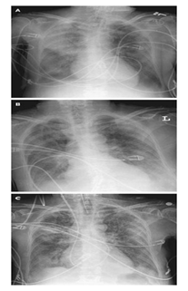
●Eaton’s agent (1944)
●No cell wall
●Common
●Rare in children and in > 65
●People younger than 40.
●Crowded places like schools,
homeless shelters, prisons.
●Can cause URT symptoms
●Usually mild and responds well to antibiotics.
●Can be very serious
May be associated with
extra-pulmonary findings:
skin rash, hemolysis, myocarditis, pancreatitis, encephalitis
Diagnosis:
Serology
NAAT Nucleic acid amplification tests. Done on throat or Np (nasopharynx) swab
Culture can be done but requires special media and slow grower (weeks)
Cold agglutinins test not specific but can be helpful
Al Rekabi notes:
Hard to culture
Can be detected by
Complement fixation test
But the better way is
The cold agglutination test

Slide 17
Chlamydia pneumonia
●Obligate intracellular organism
●50% of adults sero-positive
●Mild disease
●Sub clinical infections common
●5-10% of community acquired pneumonia
●Diagnosis:
○Serology
○NAAT
Al Rekabi notes:
Causes three diseases:
Pneumonia
Urethritis
trachomatis

Slide 18
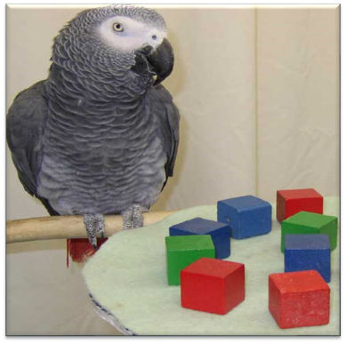
Psittacosis
•Chlamydia psittaci
•Exposure to birds
•Bird owners, pet shop employees, vets
•Parrots, pigeons and poultry
•Birds often asymptomatic.
The disease/infection that come from animals are called zoonotic.
Less common more severe

Slide 19
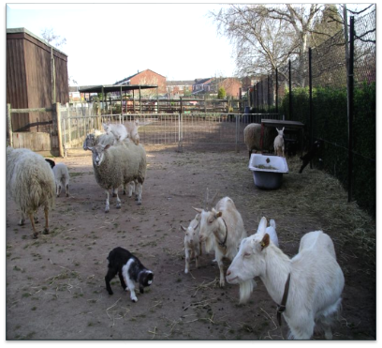
Q fever (Coxiella burnetti)
•Exposure to farm animals mainly sheep
•Spread by inhalation of infected animal birth products
•Pneumonia is acute form of infection
•Diagnosis: serology
Drs note: know that its from animal
like sheep

Slide 20
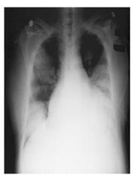
Legionella pneumophila
Very important
●Legionnaire's disease
●Serious outbreaks linked to exposure to cooling towers
●Can be very severe and lead to ICU admission.
●Diagnosis:
○Specimen: sputum(not accurate)
-Culture on specialized media (BCYE)
-DFA (low sensitivity)
-NAAT
○Urine antigen testing
Can cause
Hyponatraemia common
(<130mMol)
Bradycardia
WBC < 15,000
Abnormal LFTs
Raised CPK
Acute Renal failure
Pontiac fever:
Non pneumonic
Influenza like illness
Self limiting
Related to exposure to environmental aerosols containing Legionella (potentially reaction to bacterial endotoxins)
Legionella presents on X-Ray as: interstitial pneumonia but can present as lobar or any other type
تعيش في المكيفات المركزية والمياة عشان كذا في البداية قلنا الفنادق من

Slide 21
Antibiotic Treatment of CAP
Factors to consider in selection of antibiotic:
Co morbidities
Previous antibiotic exposure in last 3 months
Severity
Out patient management vs requiring inpatient admission vs requiring ICU

Slide 22
Treatment
 |  | Macrolides E.g. Erythromycin .. | Doxycycline Like Tetracycline but wider range | Levofloxacin From quinolones | B-lactam And Macrolide B-lactam includes Penicillin And cephalosporins | B-lactam And Levo To cover everything
Outpatient, healthy patient with no exposure to antibiotics in the last 3 months | -S. pneumoniae -Atypical pathogens -Viral
Outpatient, patient with comorbidity or exposure to antibiotics in the last 3 months | As above + Anaerobes S. aureus
Inpatient : Not ICU | Same as above + coliforms
Inpatient : ICU | Same as above + Pseudomonas

Slide 23
Quiz
Which of the following most common causes of the community acquired pneumonia?
A-S.pneumonia
B-viral
C-H.influenza
D-M.catharralis
Which of the following is true about S.pneumonia ?
A-gram+ and beta hemolytic
B-gram- and beta hemolytic
C-gram+ and alpha hemolytic
D-gram- and alpha hemolytic
Which of the following organism don't have cell wall ?
A-s.pneumonia
B-s.aureus
C-gram - organisms
D-Mycoplasma pneumonia
Which of the following organism is transmitted by exposure to birds ?
A-Legionella
B-Mycoplasma
C-S.pneumonia
D-Chlamydia psittaci
Which of the following culture is used for diagnosis legionella ?
A-SDA
B-BCYE
C-Lowenstein-Jensen
D-Blood agar
Which of the following antibiotics is best choice for legionella ?
A-Azithromycin
B-clarithromycin
C-cephalosporins
D-penicillin
1-A 2-C 3-D 4-D 5-B 6-A (because legionella is gram - and azithromycin effect against gram - bacteria )

Slide 24
Team Leaders
Team Members
Alanoud Almansour & Omar Alsuhaibani
Please contact us if you have any suggestion, correction, or question: Microbiology.med437@gmail.com
Khaled Alogaili
Abdullah Alzaid
Rayan Almousa
Abdurhman Aldeheem
Saif Almeshary
Abduhakim Alonaiq

