Slide 1
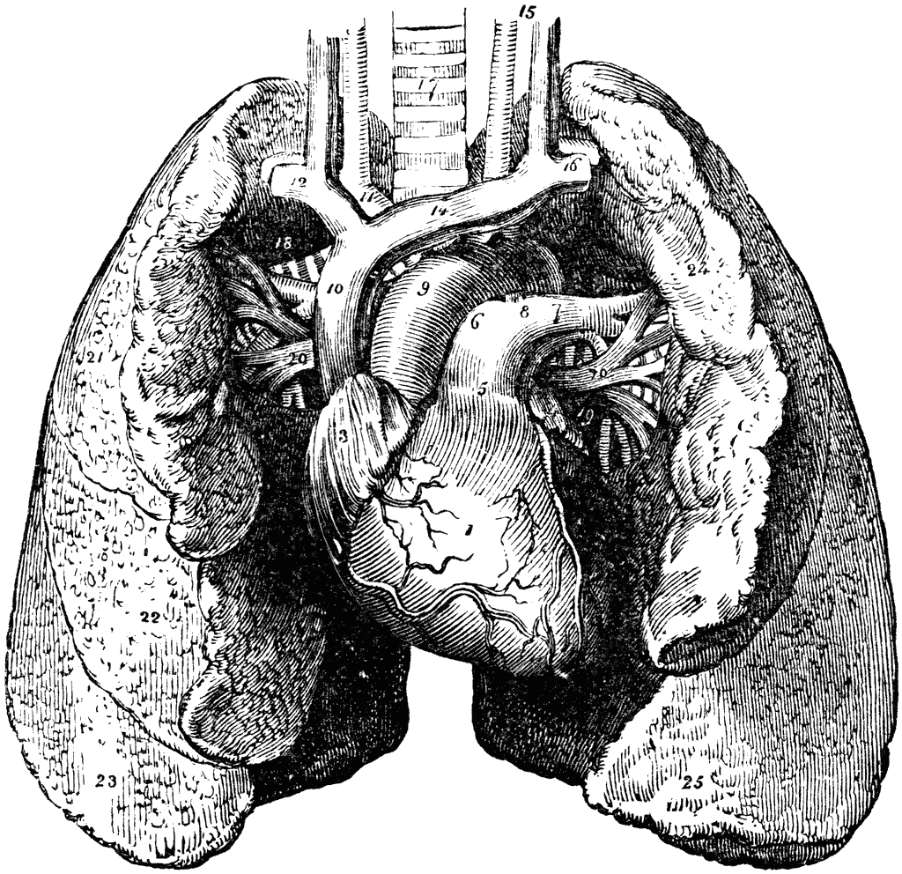
Pathology
teamwork
Lecture ( 3 ) :
pathology of restrictive lung disease including allergic alveolitis
Color Index :-
VERY IMPORTANT
Extra explanation
Examples
Diseases names: Underlined
Definitions
* كيف تعلُّك الدُنيا بشيءٍ ..وأنت لعلةِ الدُنيا طبيبُ؟..

Slide 2
\
Understand the structure and constituents of the lung interstitium as well as the restrictive changes which occur in diseases of the interstituim (ILD)
Know the symptoms of ILD: progressive breathlessness and cough
Know subtypes of ILD: acute and chronic
Discuss the causes, morphology and outcome of acute ILD
Appreciate the pathogenesis of chronic ILD regardless of their type.
Become aware of the classification of interstitial lung diseases.
Discuss examples of interstitial lung diseases including:
idiopathic pulmonary fibrosis
Pneumoconiosis
Hypersensitibity pneumonitis
Goodpasture syndrome
Sarcoidosis
Objectives :

Slide 3
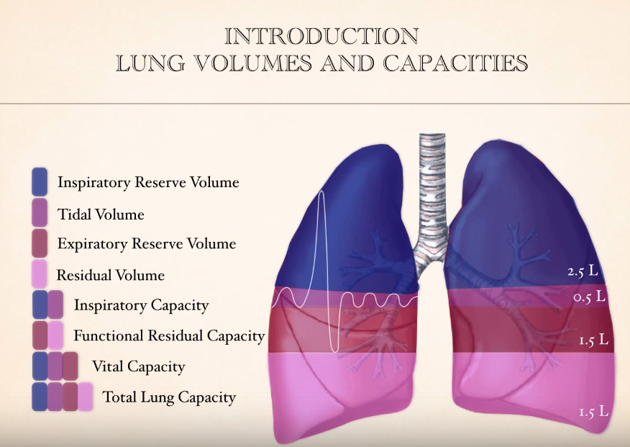
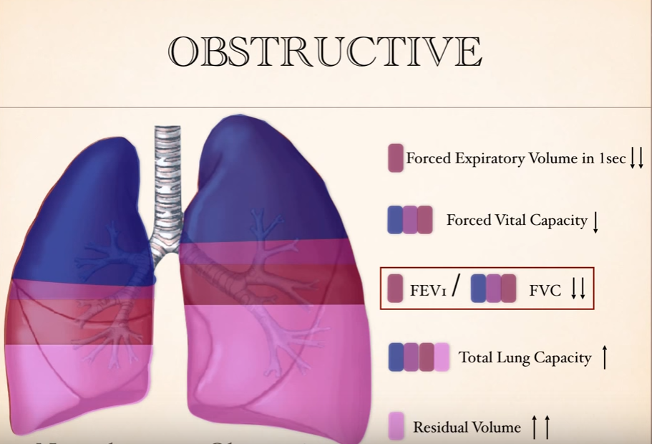
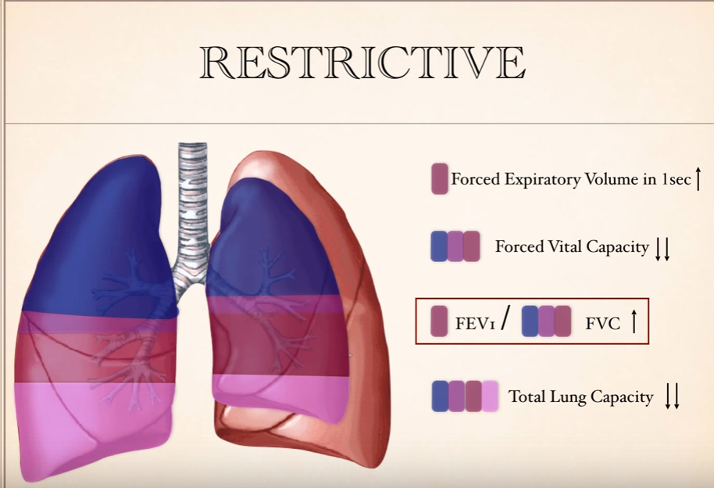
Introduction :
Restrictive lung diseases : are a category of diseases that restrict lung expansion resulting in a decreased lung volume so the airways are fine but the problem here is that there is something that restrict the lung such as fibrosis. But you might find a problem in the airways but in this case it's a secondary problem to the restriction.
Remember that : total lung volume and forced expiratory volume in one second (FEV1) and forced vital capacity (FVC) are reduced with normal to high FEV1/FVC قسمة عدد صغير على صغير يساوي عدد كبير

Slide 4
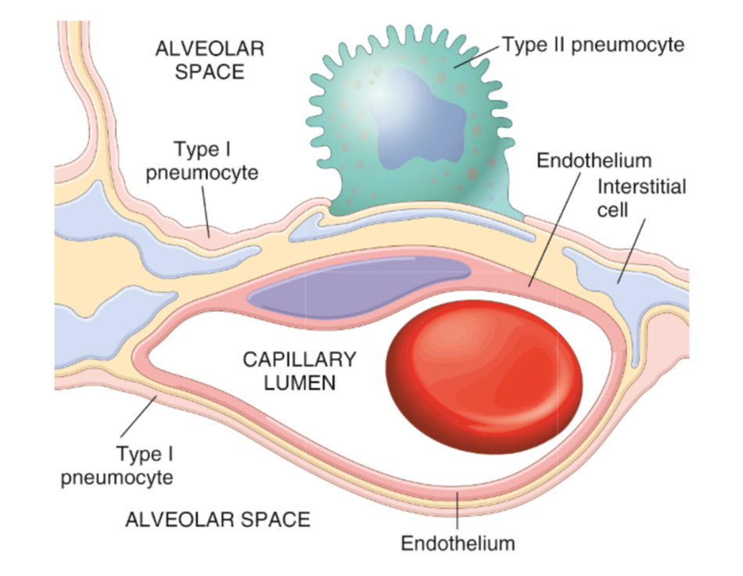
Restrictive lung disease
The restrictive lung diseases are divided into:
Intrinsic lung disease / disease of the lung parenchyma / primary ILD | Extrinsic disorders or extraparenchymal diseases
The disease cause : -inflammation -scarring of the lung tissue (ILD) -Result in filling of the air spaces with exudate and debris (pneumonitis ) | The chest wall, pleura, and respiratory muscles are the components of the respiratory pump, and they need to function normally for effective ventilation. Abnormalities of the chest wall include: -bony abnormalities (kyphosis or kypho-scoliosis) -massive pleural effusion -morbid obesity -neuromuscular disease of respiratory muscles results in respiratory muscle
They are characterized by: -Inflammatory infiltrates in the interstitial space - The interstitium becomes thickened and fibrotic (stiff lung )
There is decreased oxygen-diffusing capacity. ( they are acute or chronic ) | weakness and respiratory failure e.g. myopathy or myositis, quadriplegia, or phrenic neuropathy from infectious or metabolic causes
Guillain-Barré Syndrome:
is a neurological disease , can manifest with paralysis with limbs , upper limbs or lower , sometimes effect the respiratory muscles , intercostal or diaphragm , could lead to Restrictive lung disease
مجموعة امراض أدت ل مرض الرئة العاصرة
Constituents of the lung interstitium

Slide 5
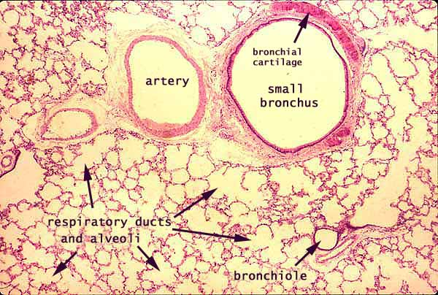
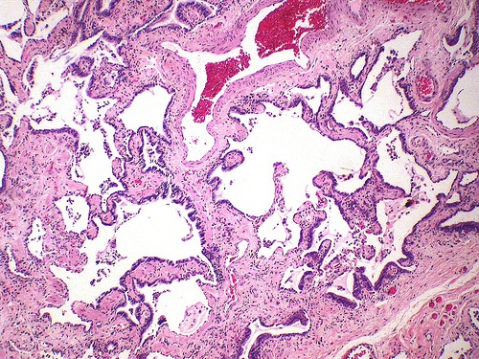
Intrinsic type of Restrictive lung diseases
Characterized
By :
Important sign and symptoms
Dyspnea
Hypoxia
Intrinsic type of restrictive lung diseases
reduced compliance of the lung.
It can be :
Acute or Chronic.
severe hypoxia
hypercapnia
Cyanosis
respiratory failure
cor pulmonale.
In advanced cases of restrictive lung
disease there is
The final stage of all restrictive lung disease is extensive fibrosis with honeycomb lung. The lung becomes more stiff and solid.
End stage lung disease: Honeycomb lung (both alveoli and bronchioles coalescence to form cysts lined with cuboidal or columnar epithelium and seperated by inflammatory fibrous tissue).
To differentiate between all types we have to see:
Clinically features
X-ray
Grossly
Microscopic
Other laboratory tests
Normal
Honeycomb lung
Extra explanation:
-why is there "dyspnea" ? because the hallmark of this disease is reduce compliance ( more pressure is required to expand the lung because they are stiff) which in turn necessitate increased of breathing leading to dyspnea
-why it causes hypoxia? Because there is damage to the alveolar epithelium and interstitial vasculature produces abnormalities in the ventilation-perfusion ratio leading to hypoxia.

Slide 6
Acute restrictive lung diseases (INTRINSIC TYPE)
Adult respiratory distress syndromes
Neonatal respiratory distress syndromes
ARDS overview
NRDS overview
Adult Respiratory Distress Syndrome (ARDS)
Very useful video
What is AEDS?
ARDS is a severe acute lung injury with diffuse alveolar injury. * هو عباره عند اي انجري تحدث فجأه للرئتان وتأثر على .. مثل احتراق المنزل واستنشاق الدخان أو حادث مرور وأثر على الرئه
What is the other names for ARDS?
shock lung / diffuse alveolar damage / adult respiratory failure/acute alveolar injury/ traumatic wet lung
What are the clinical Features of ARDS?
rapid acute onset progressive severe life threatening respiratory insufficiency, cyanosis, severe arterial hypoxia
refractory to oxygen therapy and that may progress to multi- organ failure **
bilateral (both lungs) pulmonary infiltrates (edema) in the absence of evidence of left sided heart failure (because the left sided heart failure also can cause a bilateral pulmonary edema so we should make sure of absence of evidence of left sided heart failure)
What does it cause?
It is the most common cause of non-cardiogenic pulmonary edema
What cause ARDS?
It can be caused by many conditions such as
Direct lung injury (look in the next slide for more information)
Indirect lung injury (look in the next slide for more information)
What is the most common cause of ARDS?
Pneumonia and sepsis are the most common cause
*ARDS is an accumulation of fluid in the alveoli due to increase permeability of alviolar blood capillary
** wont able to exchange the oxygen since the alveoli is full of fluid and will lead to decrease Po2 in the blood and may lead to multi- organ failure if the oxygen multi- organ failure is not enough

Slide 7
Direct injury to lung
Pneumonia
Fat embolism
Aspiration of gastric contents Pulmonary trauma ³
Near drowning
Toxic inhalation injury ²
Post lung transplant
Severe acute respiratory syndrome (SARS) ¹
¹ The virus is a coronavirus that destroys the type II pneumocytes and causes diffuse alveolar damage
² Irritants such as chlorine, O2 toxicity
³ Aspiration of oropharyngeal or gastric contents into the lower respiratory tract
indirect injury to lung
Sepsis
Cardiopulmonary bypass
Shock
Severe trauma ⁴
Acute pancreatitis
Transfusion
Uremia ⁸
Overdose with street drugs ⁷
Therape-utic drugs ⁶
Hematologic conditions ⁵
⁴ e.g. bone fractures, head injury, burns, radiation
⁵ e.g multiple transfusion,
coagulation disorders
⁶ such as bleomycin
⁷ such as heroin
⁸ blood in the urine

Slide 8
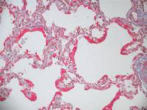
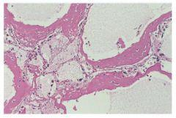
Pathophysiology of ARDS
ARDS is associated with diffuse alveolar damage.
It is initiated by injury to:
alveolar capillary endothelium with a resultant increase in alveolar capillary permeability
alveolar epithelium
The injury is induced by :
Neutrophils releasing substances toxic to alveolar wall.
Activation of the coagulation cascade.
O2 toxicity (due to formation of free radicals).
This causes leakage of protein-rich fluid into alveoli, form alveolar hyaline membranes, line the inner surface of alveoli (the membrane is composed of fibrin and cellular debris)
The lungs become remarkably heavy and stiff due to
inflammation
edema
later interstitial fibrosis.
What you can see in chest x-ray?
bilateral and diffuse pulmonary infiltrates (look at pic3)
What is the outcome of ARDS?
Mortality was 100% but Now 30 -40% with good ICU support
Poor prognosis in case of:
old age
multisystem failure
high level of IL-1
Important
pic1
pic2
pic3

Slide 9
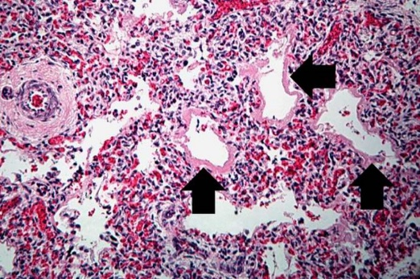
Extra picture
In normal situation there is a little amount of fluid in the interstitial space between the alveoli and capillaries due to the hydrostatic pressure but it will drain in the lymphatic vessels and nothing will make it to the alveoli but in some cases it will due to injury in the alveolar blood capillary which will increase the blood permeability to the interstitial space or due to injury in the alveolar epithelium itself the so the fluid will get inside the alveoli and prevent gas exchange
So what cause the injury of the capillaries or alveolar epithelium?
Neutrophils releasing substances toxic to alveolar wall
Activation of the coagulation cascade
O2 toxicity (due to formation of free radicals)
Neonatal Respiratory Distress Syndrome
What is the other name for NRDS?
Hyaline membrane disease
What does it cause?
It is the most common cause of respiratory failure in the newborn and is the most common cause of death in premature infants.
What cause it?
It is the same as ARDS except that it is caused by a deficiency of pulmonary surfactants in new borns, most often as a result of immaturity.

Slide 10
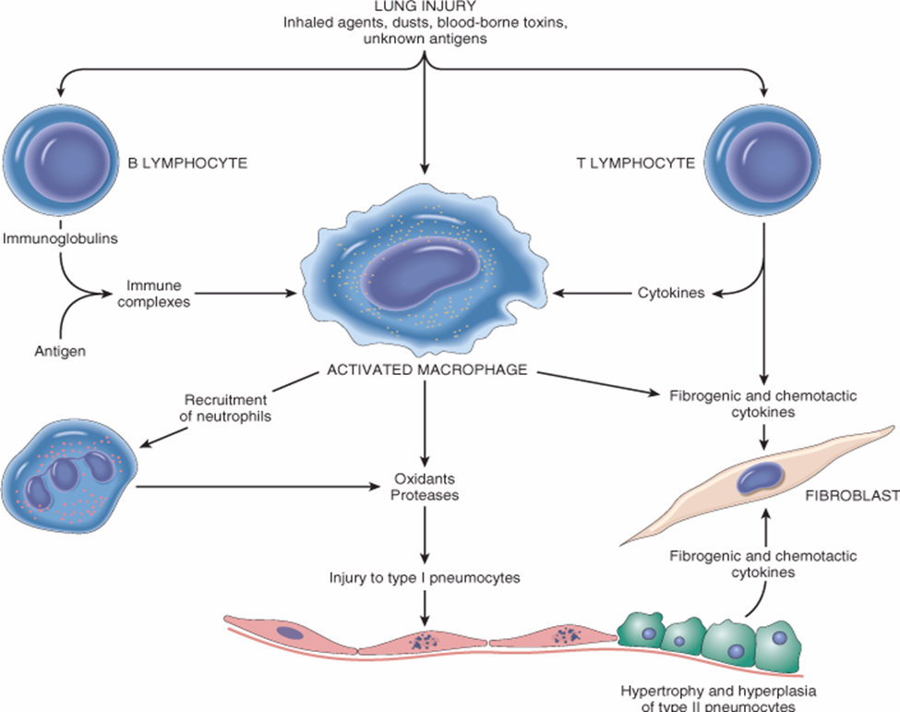
Chronic restrictive lung disease (Intrinsic type)
Definition:
Are a heterogenous group of diseases.
Many entities “existence” are of unknown cause and pathogenesis.
They have similar clinical signs, symptoms, radiographic alterations and pathophysiologic changes.
Account for about 15% of non-infectious lung diseases.
End-stage: diffuse interstitial pulmonary fibrosis.
Pathogenesis:
Lung injury
Influx of inflammatory cells into the alveoli and alveolar walls
Release of chemical mediators and promotion of fibrosis
Distortion of the normal structure of alveoli

Slide 11
Categories:
Idiopathic fibrosing:
Occupational: Pneumoconiosis
Immune diseases:
Usual interstitial pneumonia (idiopathic pulmonary fibrosis)
Anthracosis and coal worker’s pneumoconiosis,
Silicosis
Berylliosis
Asbestosis
Goodpasture syndrome
Hypersensitibity pneumonitis (extrinsic allergic alveolitis)
Systemic lupus erythematosus
Systemic sclerosis (scleroderma)
Wegener granulomatosis
Sarcoidosis
Drug:
Smoking related:
Radiation Reactions:
Chemotherapy, methotrexate, bleomyxin toxicity
Occur after radiation with diffuse alveolar damage, severe atypia of hyperplastic type II cells and fibroblasts
Eosinophilic granuloma
Desquamative interstitial pneumonia
Respiratory bronchiolitis-associated interstitial lung disease
Extra notes on Restrictive Lung Disease : امراض الرئة الحاصرة Heterogeneous group of disease Characterized by: Reduction of lung volume Pure lung complains Inability of the lung to expand Vital capacity is induced FEV1 normal or reduce so the ratio may not change Dry cough , progressive dyspnea When a patient has a disease, interstitial lung is effect the lung parenchyma . The pathological change usually have fibrosis Usually effect the basement membrane, the wall of alveoli , the connective tissue of the lung , the wall of blood vessel It doesn’t effect the airways and that is the difference between it and the chronic air way

Slide 12
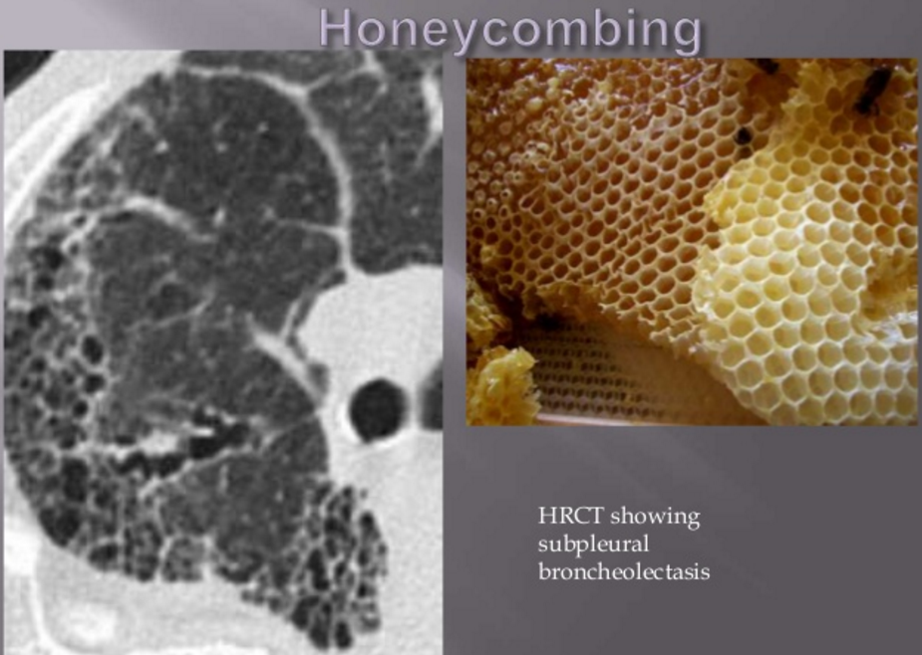
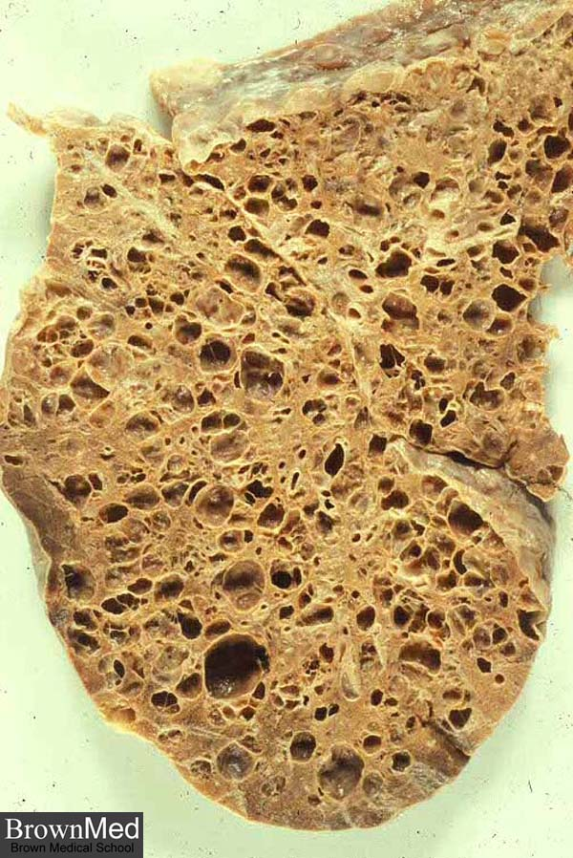
Idiopathic Pulmonary Fibrosis Fibrosing Alveolitis Hamman-Rich Syndrome Usual Interstitial Pneumonia (UIP)
Definition:
UIP is progressive fibrosing disorder of unknown cause.
It is an idiopathic interstitial pneumonia with diffuse interstitial fibrosis and inflammation (Scars formation along the interlobular septa)
Age: Adults 30 to 50 years they will improve respiratory failure from 6 months – 2 years then die so these treatment will prolong life
Usually affects lower lobe
Prognosis: poor.
Respiratory and heart failure may develop within few years.
No effective therapy is available for the treatment of idiopathic pulmonary fibrosis.
Lung transplant is the only solution
Pathogenesis:
Smoke. environmental pollutants ,dust ,viral infections & gastroesophageal reflux disease.
Clinical features:
Most patients present with exertional dyspnea and a nonproductive cough
A chest radiograph and high-resolution computed tomography typically reveals diffuse reticular opacities.
Honeycombing

Slide 13
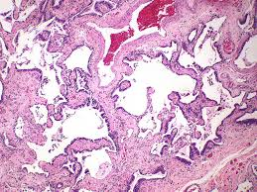
Morphology:
The morphologic changes vary according to the stage of the disease.
Early cases:
Intra-alveolar and interstial inflammation.
Hyperplasia of type II pneumocytes
Advancing disease:
Prominent interstitial fibrosis.
Alternating areas of fibrosis and normal tissue will be seen.
In the end, the lung consists of peripheral cystic spaces lined by cuboidal or columnar epithelium separated by inflammatory fibrous tissue (honeycomb lung).
Foci of normal lung tissue were also seen, It is the end stage of lung disease.
Scars formation along the interlobular septa
Dr. Rikabi’s Notes:
We need’ biopsy to see it by transbronchial biopsy or open lung biopsy and stain it by connective tissue stain وهذه الصبغة تصبغ الفايبر باللون الأزرق ونلاحظ أنه الفايبر تحيط بواحدة وتترك اللي بعدها بشكل غير منتظم

Slide 14
Pneumoconiosis
Pneumoconiosis is a group of pulmonary diseases caused by chronic exposure to inorganic mineral dust inhalation and this leads to lung damage.
More than 40 inhaled minerals can cause lung problems.
They include carbon dust, silica, asbestos, beryllium etc.
Pathophysiology:
The development of pneumoconiosis is dependent on:
The amount of dust retained in the lung and airways.
Concentration of the dust in the ambient air.
Duration of the exposure.
Effectiveness of the clearance mechanisms.
The size (1-5μ) shape.
Their solubility and physiochemical activity.
The possible additional effects of other irritants, tobacco smoking.
Alveolar macrophages ingest the particles, become activated, and release cytokines and chemotactic factors that recruit other inflammatory cells.
Inflammation damages lung cells and damages the interstitium of the lung by degrading the extracellular matrix glycoproteins.
Fibroblasts are stimulated and proliferated to produce collagen; fibrosis results.
As the disease progresses the blood vessels become compromised, and ischemic necrosis may occur.

Slide 15
Coal workers pneumoconiosis
Coal worker's pneumoconiosis (CWP) can be defined as the accumulation of coal dust in the lungs and the tissue's reaction to its presence.
The disease is divided into 2 categories:
Simple coal worker’s pneumoconiosis
Complicated coal worker’s pneumoconiosis (CCWP), or pulmonary massive fibrosis (PMF), depending on the extent of the disease.
Pulmonary massive fibrosis in association with rheumatoid arthritis is known as Caplan syndrome.
Anthracosis
The asymptomatic, milder type of pneumoconiosis, caused by the accumulation of carbon in the lungs due to repeated exposure to air pollution or inhalation of smoke or coal dust particles.
Simple coal worker pneumoconiosis
Black macules (1 to 5 mm) are scattered through the lung.
Complicated coal worker’s pneumoconiosis
- Black scars exceed 2 -10 cm
- Fibrous scarring appears (progressive massive fibrosis)
- Produces cough, dyspnea, and lung function impairment.
- Cor pulmonale
- No convincing evidence that coal dust increases susceptibility to tuberculosis or cancer (non-smoker)
(it does not increase the susceptibility to cancer and TB in nonsmokers.)

Slide 16
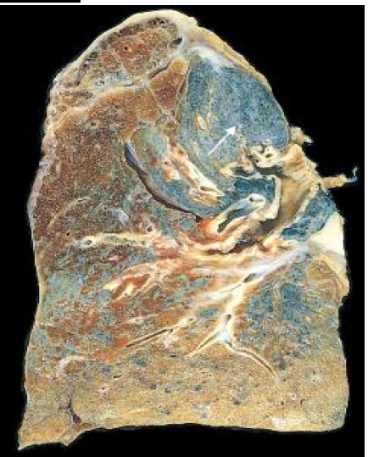
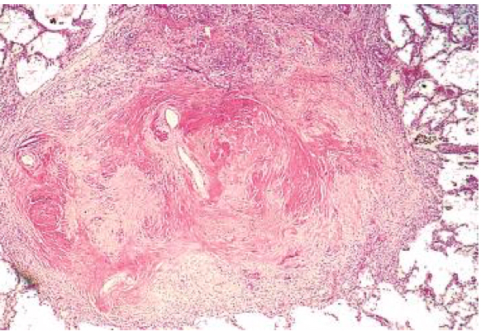
2.Silicosis
Silicosis is a fibro-nodular lung disease caused by long term exposure to inhalation of crystalline silica particles (alpha-quartz or silicon dioxide).
Industrial exposure: mining of gold, tin, copper and coal ,sandblasting, metal grinding, ceramic manufacturing.
Chronic forms manifest after several years of exposure
The symptoms may be indolent or progressive: complicated progressive massive fibrosis.
Silicosis predispose to lung cancer and tuberculosis.
Pathogenesis:
• Crystalline silica is highly fibrogenic.
• Scattered lymphocytes and macrophages are drawn rapidly with fibrosis.
• Some particles are transported to lymph nodes.
Morphology
• Tiny collagenous nodules that enlarge forming stony-hard large fibrous scars usually in the upper lobes.
• Calcifications may appear(eggshell calcification)
• Similar collagenous nodules within the lymph nodes.
• Fibrous pleural plaques may develop.
Hyalinized collagen fiber surround an amorphous center (fibrous nodules).
Scarring progress to progressive massive fibrosis.
Prognosis:
Scarring extending and encroching the pulmonary arteries leading to Cor pulmonale.
Increased susceptibility to tuberculosis (crystalline silica inhibits the ability of pulmonary macrophages to kill phagocytosed mycobacteria)
Patients with silicosis have double the risk for developing lung cancer

Slide 17
3.Asbestosis
4.berylliosis
Caused by asbestos inhalation.
Asbestos fibers are long and thin. They can curved or straight.
All types of asbestos (crocidolite and amosite) are fibrogenic to lungs. • Asbestosis occurs decades after exposure has ended.
Characterized by scars containing asbestos bodies “ferruginous bodies” (long, thin asbestos fibers coated with hemosiderin and protein to form brown filaments with a beaded or drumstick pattern.).
They can cause:
➢ pleural effusion.
➢ pleural adhesions.
➢ parietal pleural fibrocalcific plaques.
➢ Some types of asbestos are carcinogenic(especially crocidolite) and prolong asbestos exposure can predisposes to bronchogenic carcinoma and malignant mesothelioma.
Both bronchogeniccarcinoma andmesothelioma develop in workersexposed to asbestos. The risk of bronchogenic carcinoma is fivefold and for mesothelioma is 1000 fold greater
Beryllium Mining, Aerospace manufacturing.
-non-necrotizing granulomata distributed in the parenchyma, LN and other organs.
Pedispose to lung cancer.

Slide 18
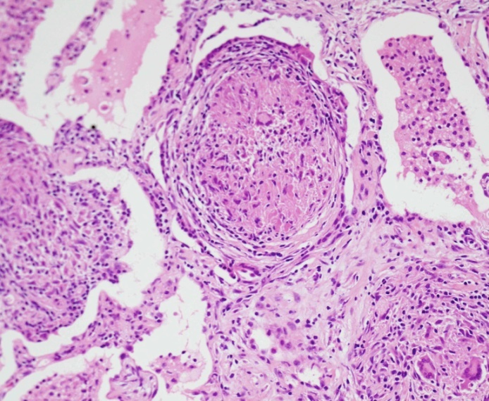
Pneumoconiosis Berylliosis
 | - Beryllium Mining, Aerospace manufacturing non-necrotizing granulomata distributed in the parenchyma, LN and other organs Pedispose to lung cancer
summary
Entity | Example | Pathological features | Comment
coal worker's pneumoconi-osis | coal dust in coal miners | -Simple coal worker’s -Complicated coal worker’s pneumoconiosis (with rheumatoid arthritis is called Caplan syndrome) | Anthracosis is the accumulation of coal without consequent cellular reaction in air polution /smoker
Silicosis | silicon dioxide | industries: mining of gold, tin, copper and coal, sandblasting, metal grinding, ceramic manufacturing | -Complicated progressive massive fibrosis -Predispose to lung cancer and TB
Berylliosis | Beryllium Mining, Aerospace manufacturing | non-necrotizing granulomata distributed in the parenchyma, LN and other organs | Pedispose to lung cancer
Asbestosis | Pipes, sheets, vinyl-asbestos floor tiles, asbestos paper in filtering and insulating products | Pulmonary fibrosis Pleural fibrosis | Bronchogenic Carcinoma and Malignant Mesothelioma

Slide 19
Hypersensitivity pneumonitis
Prolonged exposure to inhaled organic antigens
Hypersensitivity pneumonitis an immunologically mediated (type III or IV)
Caused by intense and often prolonged exposure to inhaled organic dust
It primarily affects the alveoli and is therefore often called allergic alveolitis
These dusts come from:
Evaporative coolers (Desert coolers/ wet air cooler ) type AC
Dairy and grain products
Animal droppings and animal proteins
Poultry and other bird handlers are commonly exposed to droppings, feathers, and serum proteins of pigeons etc.
The most common antigens are thermophilic Actinomycetes and avian proteins
The most common diseases are farmer’s lung and bird fancier's/handler’s lung.

Slide 20
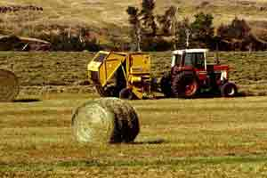
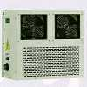
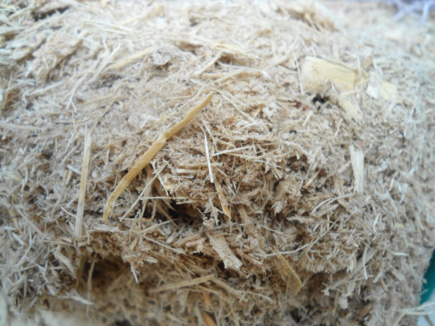
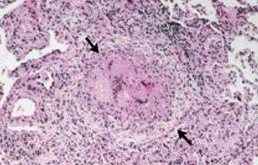
Hypersensitivity pneumonitis
Farmer’s lung
Thermophilic actinomycetes in hay
Pigeon breeder’s
Air-cooler lung
Thermophilic bacteria
Sugarcane bagasse (Bagassosis)

Slide 21
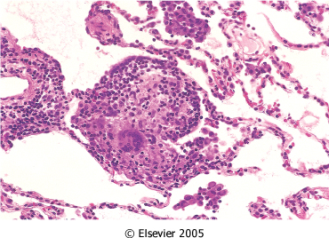
Hypersensitivity Pneumonitis
 | Morphology: noncaseating interstitial granulomas (IV hypersensitivity reaction), bronchiolitis, interstitial pneumonitis, and diffuse interstitial fibrosis. Clinical course is variable
Hypersensitivity pneumonitis can present as:
Acute: fever, cough, dyspnea
Subacute (intermittent)
Chronic progressive: cough, dyspnea, malaise, and weight loss

Slide 22
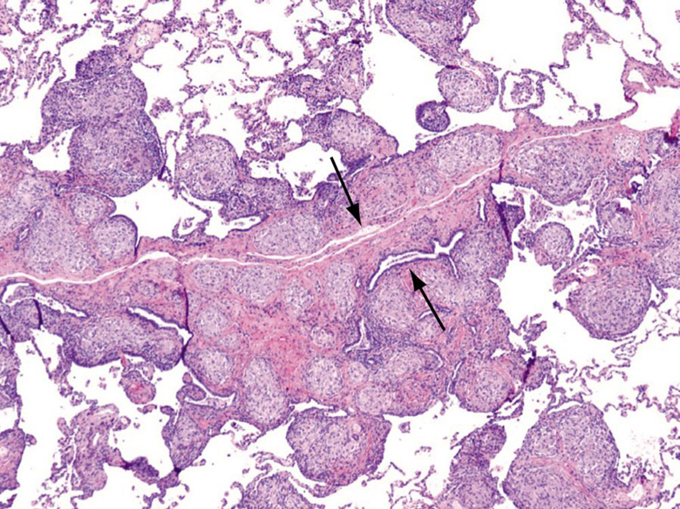
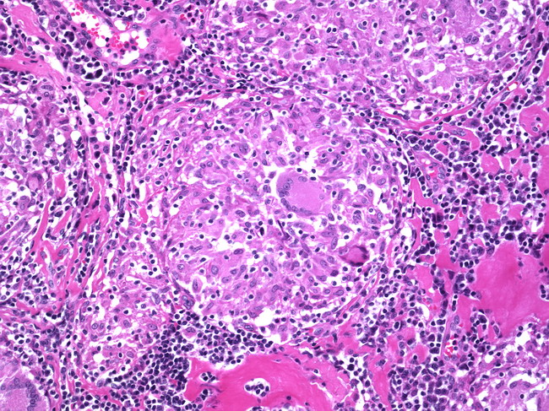
Sarcoidosis immune disease
Sarcoidosis is an inflammatory disease
Epidemiology: affecting all races and both sexes equally
Cause: unknown
Sites: predominantly affects the lungs and intrathoracic lymph nodes
Other organs that may be involved include eyes, skin, liver, spleen and bone marrow.
Occasionally kidney, heart, CNS and endocrine organs may be involved.
Morphology: non-caseating/ non-necrotizing granulomas in affected organ tissues.
Sarcoidosis granulomas in the lung
The prognosis of sarcoidosis is unpredictable. It can progressive and chronic. It may present as episodes of activity.
Majority of the patients respond well to treatment.

Slide 23
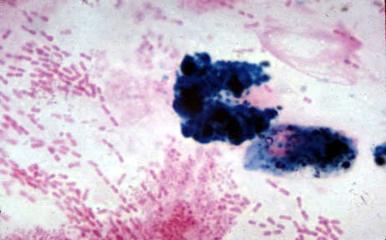
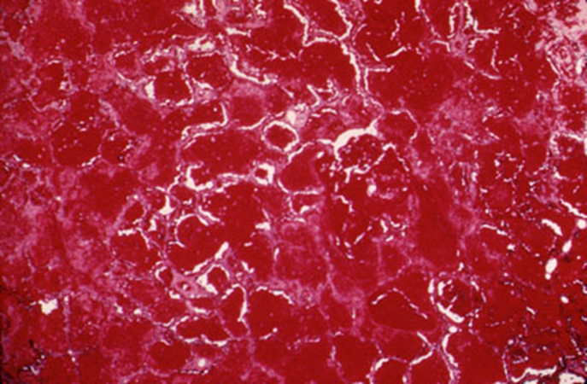
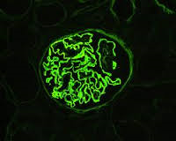
Goodpasture Syndrome/ Anti-GBM disease immune disease
Rare autoimmune disorder
Is a triad of
diffuse pulmonary hemorrhage,
glomerulonephritis,
circulating (anti-GBM) antibodies against alveolar and glomerular basement membranes
The antibody can usually be found in serum.
Morphology:
The lung: acute necrotizing alveolitis with hemorrhage
Kidney: rapidly progressive glomerulonephritis, may lead to renal failure
Clinical features:
Pulmonary symptoms (hemoptysis and dyspnea)
Renal symptoms (hematuria, proteinuria, RBC casts and renal failure)
Arthralgias
* only the kidney and the lungs are affected
Iron stain in sputum
Immunofluorescence of renal biopsy staining for IgG in a linear pattern in patient with anti-glomerular basement membrane (anti-GBM) disease.

Slide 24
Summary:
Restrictive lung disease could be acute or chronic
Chronic:
- Idiopathic fibrosing
- Occupational
- Immune diseases
Acute: Adult respiratory distress syndrome most commonly due to pneumonia or septic shock

Slide 25
Females:
-Leader : بثينة آل ماجد
فاطمة بالشرف
روان الحربي
رهف الشمري
رناد الفرم
هديل عورتاني
منيره المسعد
الجوهرة الشنيفي
رزان الزهراني
روان مشعل
نوف العتيبي
ابتسام المطيري
غرام جليدان
بلقيس الراجحي
نورة القاضي
آلاء الصويغ
ريم القحطاني
شوق القحطاني
Males:
-Leader :محمد باحاذق
فهد عبدالله الفايز
سيف المشاري
محمد الأصقه
خالد المطيري
داود اسماعيل
خالد محمد العقيلي
احمد وليد الراشد
فهد النهابي
عبدالله السرجاني
رشيد سليمان البلاع
معاذ ابراهيم الحمود
فايز غياث الدرسوني
عبدالحكيم إبراهيم العنيّق
خالد محمد العقيلي
عبدالله سليمان احمد بالعبيد
أنس عبدالله السيف
سعد محمد الفوزان
عبدالعزيز بن خالد السرحاني
عبد الإله الحسين

Slide 26
Kindly contact us if you have any questions/comments and suggestions:
* EMAIL: pathology437@gmail.com
* TWITTER : @pathology437
GOOD LUCK ! ☺
*references:
-Robbins Basic Pathology
- doctor’s slides
Pathology
teamwork

