Slide 1
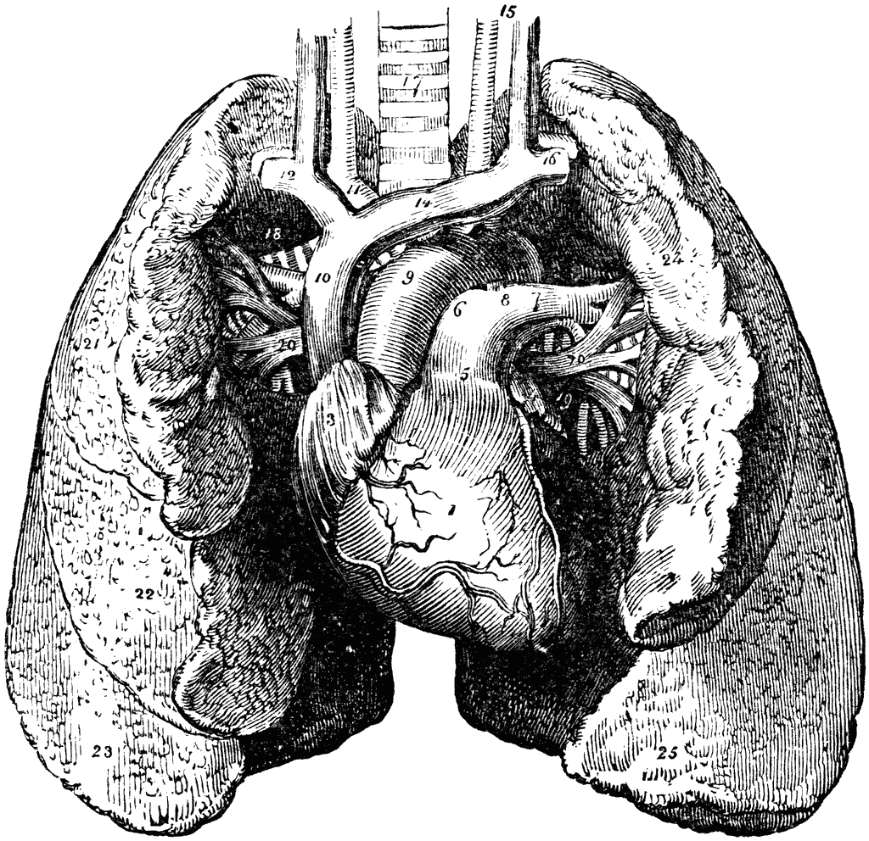
Pathology
teamwork
Lecture (5) :
Lung tumors
Color Index :-
VERY IMPORTANT
Extra explanation
Examples
Diseases names: Underlined
Definitions
* كيف تعلُّك الدُنيا بشيءٍ ..وأنت لعلةِ الدُنيا طبيبُ؟..

Slide 2
\
1- Know the epidemiology of lung cancer
2-Is aware of classification of bronchogenic carcinoma which include: squamous carcinoma, adenocarcinoma, small cell and large cell (anaplastic) carcinomas.
3- Understand the predisposing factors of bronchogenic carcinoma.
4 -Understands the clinical features and gross pathology of bronchogenic carcinoma. Know the precursors of squamous carcinoma (squamous dysplasia) and adenocarcinoma (adenocarcinoma in situ and atypical adenomatous hyperplasia).
5- Have a basic knowledge about neuroendocrine tumors with special emphasis on small cell carcinoma and bronchial carcinoid.
6- Is aware that the lung is a frequent site for metastatic neoplasms.
Objectives :

Slide 3
Lung tumors
Most lung tumors are malignant.
Primary lung cancer is a common disease BUT metastatic tumors are the most common lung carcinoma seen in clinical practice.
95% of primary lung tumors are carcinomas
5% carcinoids, mesenchymal malignancies (fibrosarcomas, leiomyomas) and lymphomas
The most common benign lesions are hamartomas
Epidemiology
1. Primary lung cancer is the most common fatal cancer in both men and women worldwide.
a. Accounts for >30% of cancer deaths in men
b. Accounts for >25% of cancer deaths in women
2. Incidence of lung cancer is declining in men but increasing in women.
3. Peak incidence is at 55 to 65 years of age.
Classification of bronchogenic carcinoma
Malignant epithelial tumors/ bronchogenic carcinoma
Malignant mesothelial tumor
Miscellaneous malignant tumor
1- Non-Small Cell Lung Carcinoma (NSCC) :
2- Small cell lung carcinoma (SCC)
3-Combine patterns
4- Carcinoid tumor
1- Carcinosarcoma
2- Pulmonary blastoma
3- Melanoma
4- Lymphoma
5- Others
Malignant mesothelioma
Epithelial
Fibrous (spindle cell)
Biphasic
1. Squamous cell carcinoma
3. Large cell carcinoma
2. Adenocarcinoma
5- Others

Slide 4
Dr. Rikabi’s Notes - Hamartoma
Hamartomas are abnormal tissue growth in the lung that are normal somewhere else. E.g. in the liver, or kidney…
Hamartomas usually present as a coin like lesion.
They represent 5% of all cases.
30 to 40% of hamartoma cases involve a mutation in the P53 gene.
They usually have well defined outlines (Well circumscribed).
The patient doesn’t complain or doesn’t know that it’s there.
It’s called a ”Leave me alone” lesion due to the big operation to remove it by a lobar or partial lobarsectomy.
It consists of cartilage, C.T, fat, glandular tissue, and some inflammatory cells.

Slide 5
Classification of malignant epithelial tumors of lung: (bronchogenic carcinoma)
1. Non-Small Cell Lung Carcinoma (NSCC) (70%-75%)
1. Squamous cell carcinoma (25%-35%)
2. Adenocarcinoma, including bronchioloalveolar carcinoma (30%-35%).
3. Large cell carcinoma (10%-15%).
2. Small cell lung carcinoma (SCC) (20%-25%).
3. Combine patterns (5%-10%).
- Most frequent patterns:
- Mixed squamous cell carcinoma and adenocarcinoma.
- Mixed squamous cell carcinoma and SCLC.
4. Carcinoid tumors
5. Others
Both small cell carcinoma and carcinoids are neuroendocrine tumors as both arise from the neurendocrine cells normally present in the lung
Bronchogenic carcinoma
It is important to differentiated NSCC from SCC because treatment are different
NSCC therapy | SCC Therapy
Surgical:- offers the best chance for curing. Radiation:- controls local disease. Radiation therapy is most commonly used to palliate symptoms. Chemotherapy:- not effective. | Chemotherapy is very effective because small cell carcinomas are highly responsive to chemotherapy

Slide 6
Predisposing factors of bronchogenic carcinoma
1- Tobacco smoking:
2- Radiation:
3- Asbestos:
6- Scarring:
4- Industrial exposure:
5- Air pollution:
The nonsmoker who develops cancer of the lung usually has an adenocarcinoma.
Is directly proportional to the number of cigarettes smoked daily and the number of years of smoking.
Cessation “انقطاع تام” of cigarette smoking for at least 15 years brings the risk down.
Passive smoking “inhaling of smoke from other people's cigarettes” increases the risk to approximately twice than non-smokers.
Cigarette smokers show various histologic changes, including squamous metaplasia of the respiratory epithelium which may progress to dysplasia, carcinoma in situ and ultimately invasive carcinoma.
Some 85% of lung cancers occur in cigarette smokers.
All types of radiation may be carcinogenic and increase the risk of developing lung cancer. Tradium and uranium workers are at risk
increased incidence of cancer with asbestos exposure, especially in combination with cigarette smoking.
to nickel and chromates, coal, mustard gas, arsenic, iron etc.
May play some role in increased incidence.
sometimes old infarcts, wounds, scar, granulomatous infections are associated with adenocarcinoma.
Most types are linked to cigarette smoking, but the strongest association is with squamous cell carcinoma and small cell carcinoma.
Indoor air pollution especially by radon “chemical element (noble gas series)”

Slide 7
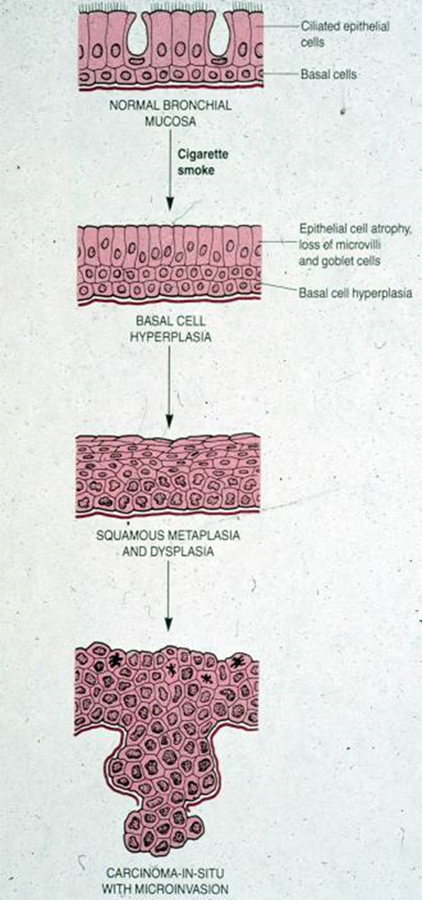
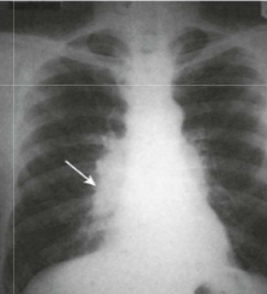
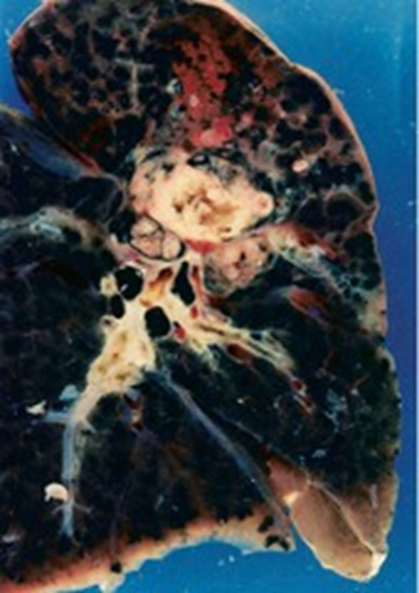
Precursor lesions
Three types of precursor epithelial lesions are recognized:
It should be noted that the term "precursor" does not imply that progression to invasion will occur in all cases.
Squamous cell carcinoma (SCC)
Second most common bronchogenic carcinoma
Strong association with smoking (25 times risk)
Before Males >Females, now incidence in females is rising because of smoking.
It has a poor prognosis
This type of cancer is preceded by:
SCC arise in the central airways (centrally located).
So they appear as a hilar mass, frequently cavitate
Tumor cells secrete a parathyroid hormone (PTH)- like peptide leading to hypercalcemia.
Histologically, these tumors are graded according to degree of squamous differentiation and tumors ranges from:
Squamous dysplasia and carcinoma in situ can lead to:
Squamous cell carcinoma
Atypical adenomatous hyperplasia can lead to:
Adenocarcinoma
Diffuse idiopathic pulmonary neuroendocrine cell hyperplasia can lead to:
Neuroendocrine tumors
Types:
I. Non-Small Cell Lung Carcinoma (NSCC) (70%-75%)
II. Small cell lung carcinoma (SCC) (20%-25%).
3. Large cell carcinoma (10%-15%)
1. Squamous cell carcinoma (25%-35%)
2. Adenocarcinoma, including bronchioloalveolar carcinoma (30%-35%)
Types of bronchogenic cancer:
years of progressive mucosal changes of respiratory epithelium
carcinoma in situ
invasive SCC
dysplasia
squamous metaplasia
(A ) (B) (C)
well-differentiated squamous cell carcinoma
moderately differentiated SqCC
poorly differentiated SqCC

Slide 8
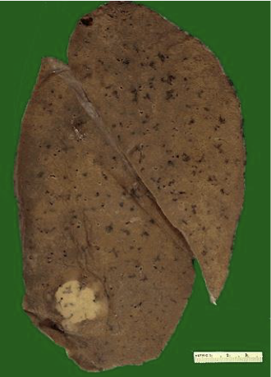
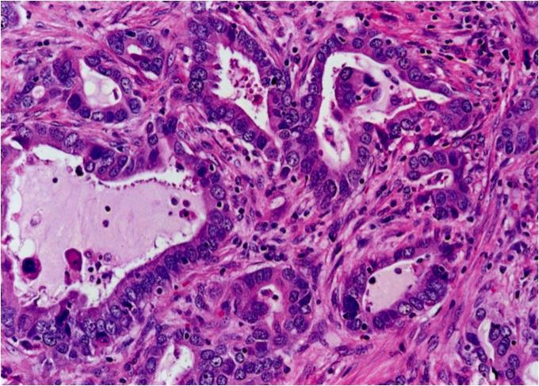
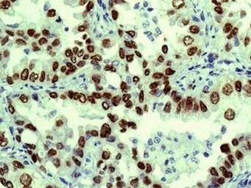
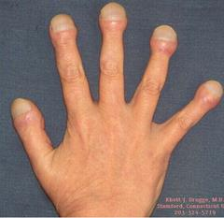
Adenocarcinomas
Adenocarcinomas is now the most frequent histologic subtype of bronchogenic carcinoma ( before the squamous cell carcinoma was the first)
More common in patients under the age of 40, women and non-smokers (They do not have a clear link to smoking history)
Peripheral adenocarcinomas are sometimes associated with pulmonary scars (from a previous pulmonary inflammation/infection) and therefore are also referred to as scar carcinomas. (adenocarcinoma is peripherally located not related to smoking but its related to scars and that’s why it call scar carcinoma)
Tend to metastasize widely at early stage
They are classically peripheral tumors arising from the peripheral airways and alveoli.
The hallmark of adenocarcinomas is the tendency to form glands that may or may not produce mucin.
Rarely cavitate
Associated with hypertrophic pulmonary osteoarthropathy “Clubbing of the fingers”(look at pic4)
20% of adenocarcinoma of the lung are associated with mutations of epidermal growth factor receptor (EGFR) and respond to its anti therapy
pic1
pic2
Pic3 : TTF₁
pic4

Slide 9
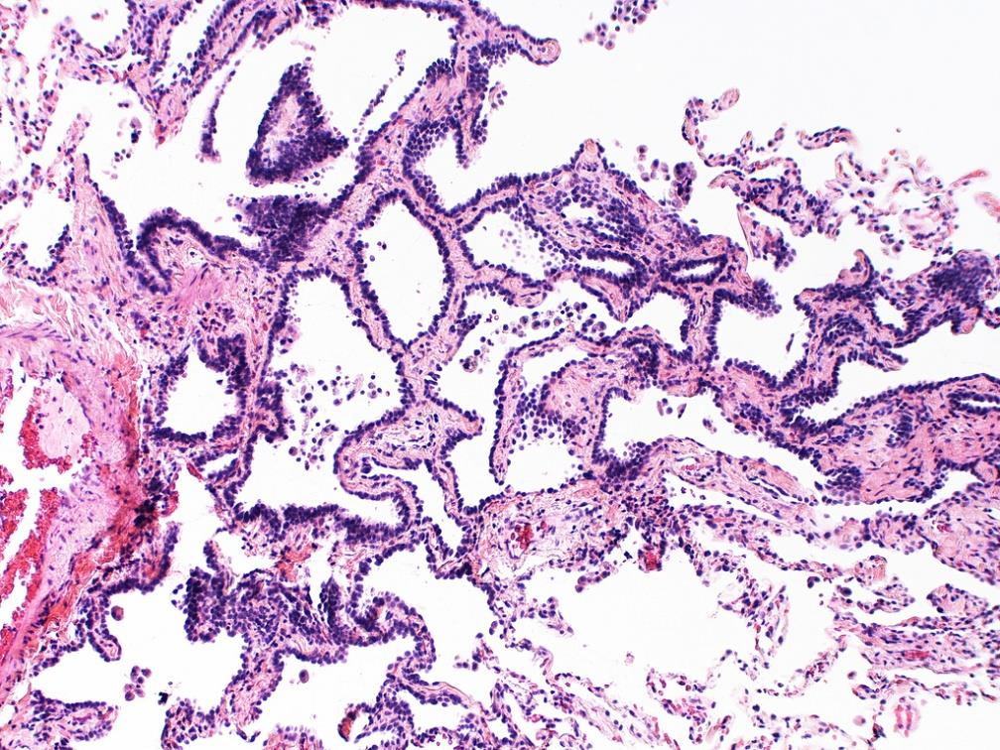
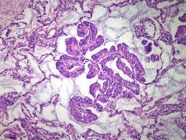
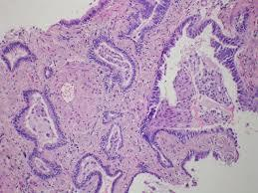
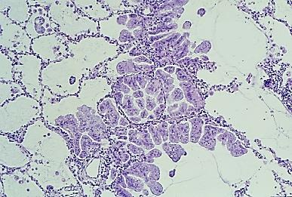
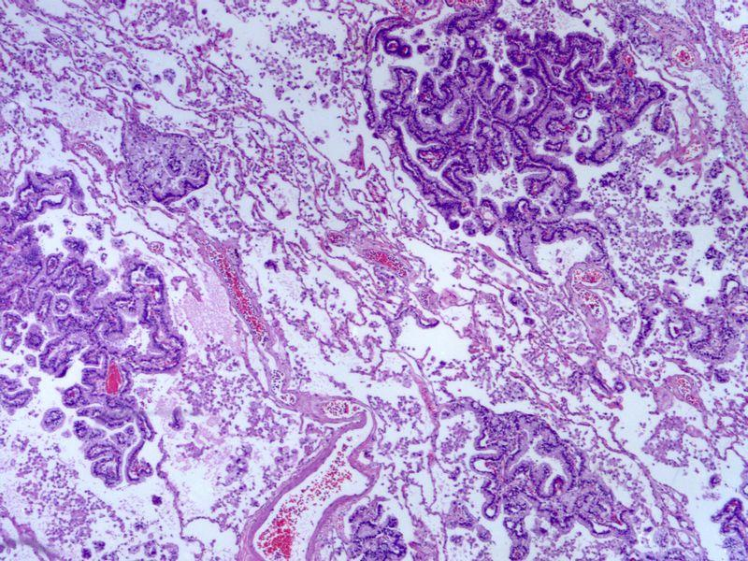
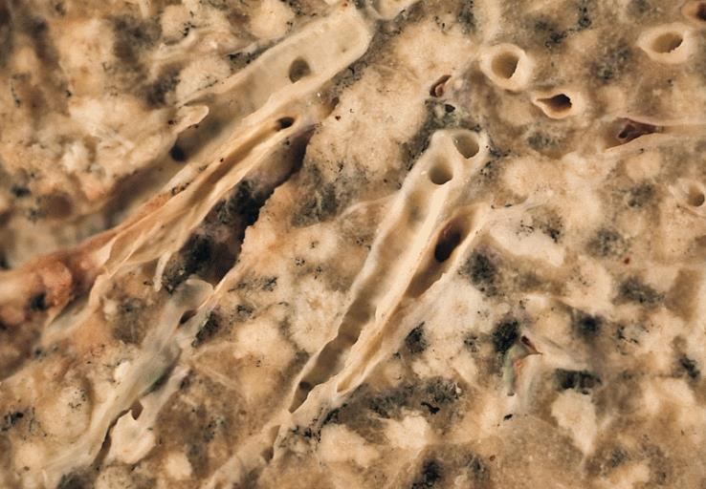
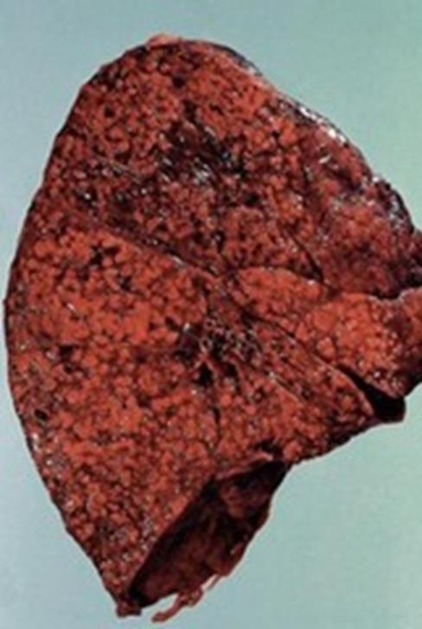
Adenocarcinoma Precursor Lesions
Minimally invasive adenocarcinoma of lung (MIA) | Adenocarcinoma in situ (AIS)* | Atypical adenomatous hyperplasia
Lesion ≤3 cm describes small solitary adenocarcinomas with either pure lepidic growth or predominant lepidic growth with ≤5 mm of stromal invasion. | lesion less than 3 cm composed entirely of dysplastic cells growing along preexisting alveolar septa Lepidic growth pattern no feature of necrosis or invasion | small lesion (≤5 mm) characterized by dysplastic pneumocytes lining alveolar walls that are mildly fibrotic
*AIS
Formerly called bronchioloalveolar carcinoma but now it’s referred to as adenocarcinoma in situ according to the new classification of lung cancers
What is AIS ? malignant cells grow along alveolar septa
** ” tumor cells which may be nonluminous, mucinous or mixed grow on a monolayer along the alveolar septa which serve as scaffold this has been termed as a lepidic growth pattern, an allusion to the resemblance of neoplastic cells to bufferflies sitting on a fence” Robbins

Slide 10
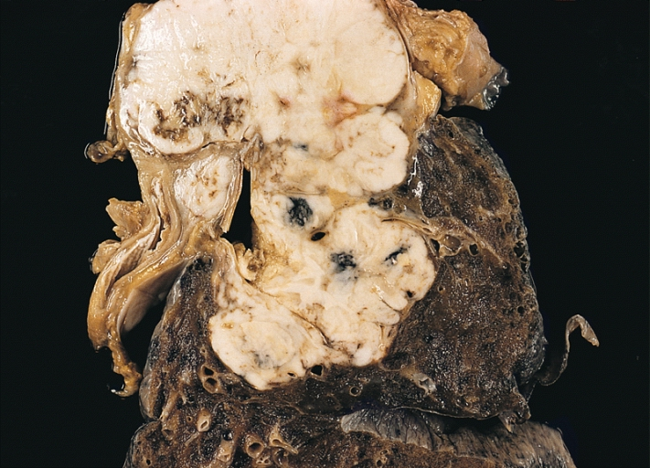
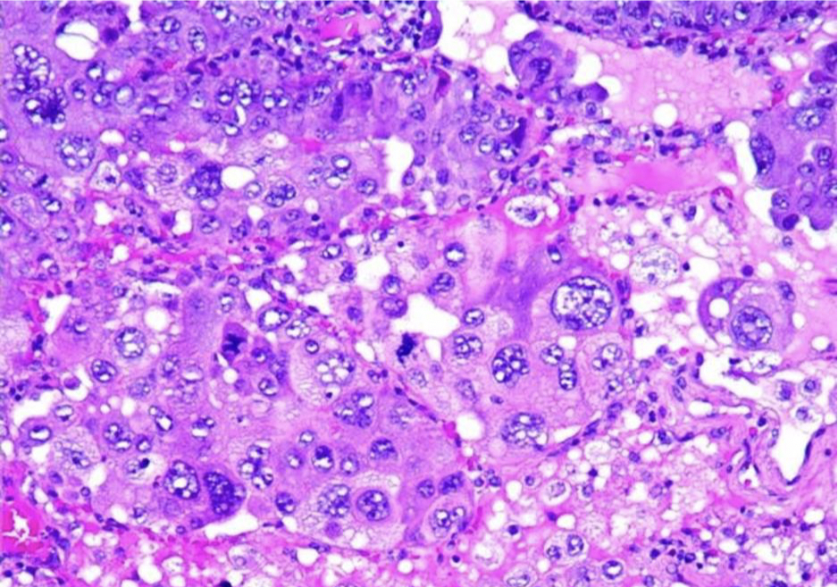
Large Cell Carcinoma*
Frequency: 10 %
strongly associated with smoking
usually located peripherally.
This group of carcinomas is undifferentiated.
They are made up of large and anaplastic cells.
They may exhibit neuroendocrine or glandular differentiation markers when studied by immunohistochemistry or electron microscopy.
Poor prognosis.
* “Large cell carcinomas are undifferentiated malignant epithelial tumors that lack the cytologic features of small cell carcinoma and have no glandular or squamous differentiation. The cells typically have large nuclei, prominent nucleoli, and a moderate amount of cytoplasm. Large cell carcinomas probably represent squamous cell or adenocarcinomas that are so undifferentiated that they can no longer be recognized by means of light microscopy. On ultrastructural examination, however, minimal glandular or squamous differentiation is common.” robbins

Slide 11
Small cell carcinomas
SCLC are a type neuroendocrine tumors arising from neuroendocrine cells + more common in men.
Highly malignant and aggressive tumor, poor prognosis, rarely resectable.
Strongly associated with cigarette smoking. 95% of patients are smokers
Centrally located perihilar mass with early metastases (Early involvement of the hilar and mediastinal nodes)
- Chemotherapy responsive
- least likely form to be cured by surgery; usually already metastatic at diagnosis
Able to secrete a host of polypeptide hormones like ACTH, antidiuretic hormone (ADH), calcitonin, gastrin-releasing peptide and chromogranin.
It may be associated with paraneoplastic syndrome, Cushing’s, and Eaton-Lambert syndrome
Eaton-Lambert syndrome
An autoimmune disease
The immune system attacks the connection between nerve and muscle (the neuromuscular junction) and interferes with the ability of nerve cells to send signals to muscle cells lead to muscle weakness

Slide 12
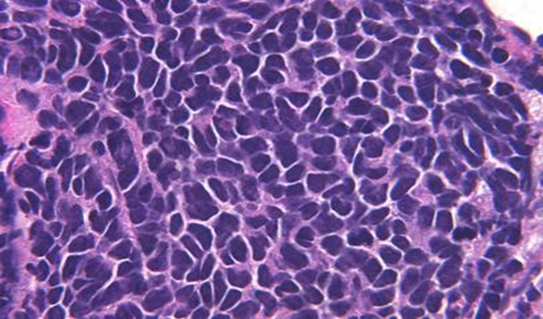
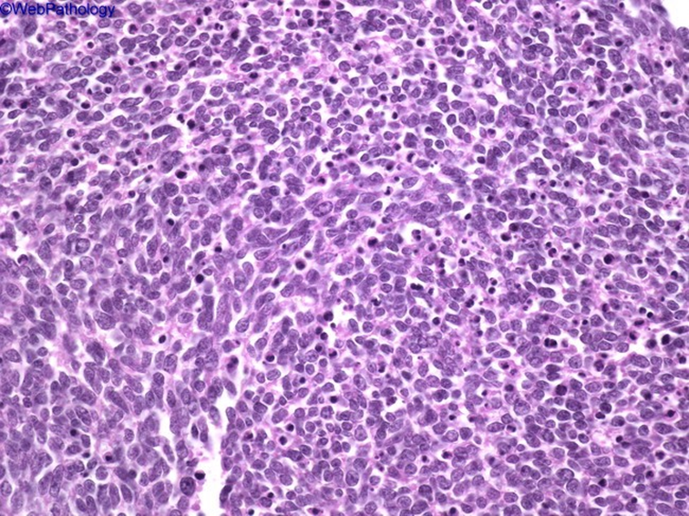
Microscopically composed of small, dark, round to oval, lymphocyte-like cells with little cytoplasm.
Electron microscopy: dense-core neurosecretory granules.
Bronchogenic carcinoma sites:
Central tumors
Squamous cell CA
Small cell CA
Peripheral tumors
Adenocarcinoma
Large cell carcinoma
- bronchioloalveolar ca
- bronchial derived

Slide 13
Molecular genetics in lung cancer:
Most common oncogenes*: KRAS, MYC family, HER-2/neu, BCL-2, EGFR
(epidermal growth factor receptor found in 20% of pulmonary adenocarcinomas, if certain mutation is positive, will respond to anti-tyrosine kinase therapy**)
*A mutated form of a gene involved in normal cell growth, may cause the growth of cancer cells.
**Is targeted therapy that interferes with specific cell signaling pathways allowing target-specific therapy for selected malignancies. Tyrosine kinases are an important target because they play an important role in the modulation of growth factor signaling.
If the KRAS gene is not present then ALC I targeted treatment can be used. Anti PDLI is used for Squamous Carcinoma.
Most common suppressor* genes: p53 (most common), RB1, p16
*When this gene mutates to cause a loss or reduction in its function, the cell can progress to cancer.
Clinical features of bronchogenic carcinoma:
Can be silent *early stage, no symptoms or insidious lesions.
Cough *when the tumor gets larger -Most common symptom (75% of cases)-
Weight loss (40% of cases)
Chest pain (30% of cases)
Hemoptysis (25%–30% of cases) *especially when cavitation starts.
Dyspnea *when it’s enlarged and obstructing the lung.
Hoarseness *because of invasion of hilum –recurrent laryngeal nerve paralysis-, chest pain *especially when it reaches pleura, pericardial or pleural effusion.
Symptoms due to invasion and metastatic spread.
May also be manifest by the following:
Superior vena cava syndrome: invasion leads to obstruction of venous drainage which leads to dilation of veins in the upper part of the chest and neck resulting in swelling and cyanosis of the face, neck, and arms.
Pancoast tumor (superior sulcus tumor): Apical neoplasms may invade the brachial sympathetic plexus to cause severe pain, numbness and weakness in the distribution of the ulnar nerve.
Pancoast tumor is often accompanied by destruction of the first and second ribs and thoracic vertebrae. It often coexists with Horner syndrome
Horner syndrome: invasion of the cervical thoracic sympathetic nerves and it leads to ipsilateral enophthalmos (displacement of the eyeball within the orbit –eyes goes inside-)., miosis, ptosis, and facial anhidrosis. (Anhidrosis is the inability to sweat normally –leads to dryness in facial areas-)
The combination of these clinical findings is known as Pancoast syndrome.

Slide 14
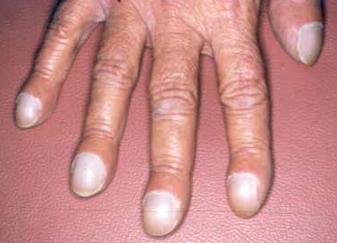
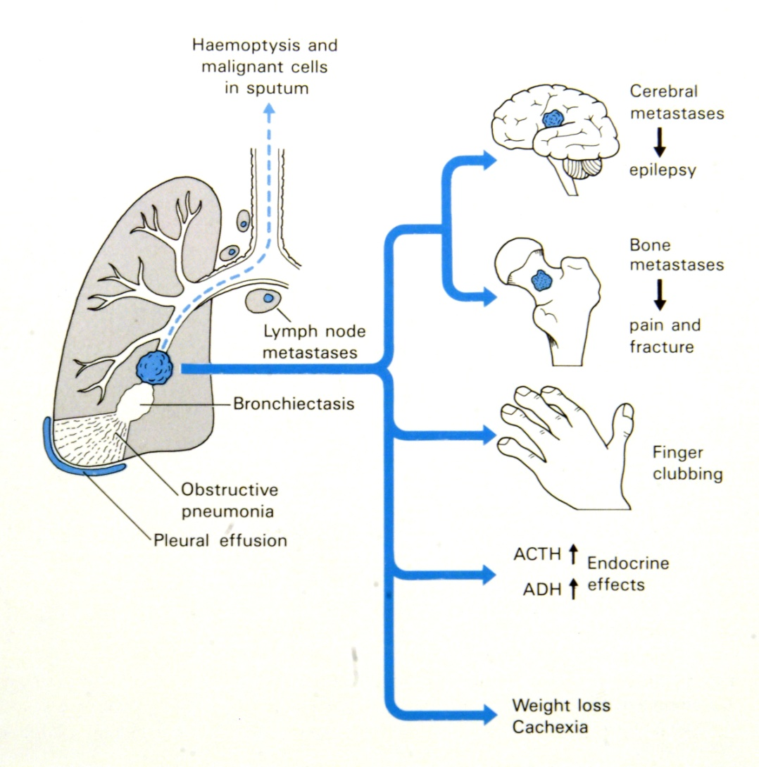
Complications of bronchogenic carcinoma:
Bronchiectasis
Obstructive pneumonia
Pleural effusion, bloody
Hoarseness from recurrent laryngeal nerve paralysis
Paraneoplastic syndrome
Paraneoplastic syndrome:
Are extrapulmonary, remote effects of the tumor.
3% to 10% of lung cancers develop paraneoplastic syndromes.
Squamous cell carcinomas may secrete parathyroid hormone-like peptide leading to hypercalcemia.
Adenocarcinomas can lead to hematologic manifestations (repeated coagulations, thrombosis in different parts of the body) and Digital clubbing due to reactive periosteal changes
Small cell carcinomas
ACTH (leading to Cushing's syndrome)
ADH (water retention and hyponatremia)
Clinical features and complications of bronchogenic carcinoma

Slide 15
Spread of bronchogenic carcinoma:
Lymphatic spread.
Successive chains of nodes (scalene nodes).
Involvement of the supraclavicular node (Virchow’s node).
Extend into the pericardial or pleural spaces. Infiltrate the superior vena cava.
A tumor may extend directly into the esophagus, producing obstruction, sometimes complicated by a fistula.
Phrenic nerve invasion usually causes diaphragmatic paralysis
May invade the brachial or cervical sympathetic plexus (Horner’s Syndrome). Or Pancoast syndrome
Distant metastasis to liver (30-50%), adrenals (>50%), brain (20%) and bone (20%).
* If we check X-Ray and there’s a mass in the lung. And the abdominal scan shows bilateral adrenal gland enlargement. Then it is bronchogenic carcinoma with metastasis to adrenals.
Prognosis: (poor in general, especially if there’s metastasis)
Histological types and the stage of lung cancer determine the outcome
Survival is better for early stage disease, except for small cell carcinoma (very early metastases)
Non–small cell cancers fare better than small cell carcinoma
Overall combined 5-year survival rate is ~15%

Slide 16
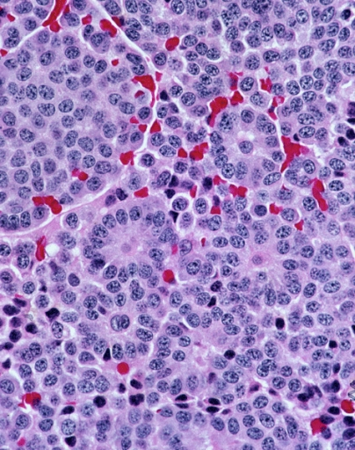
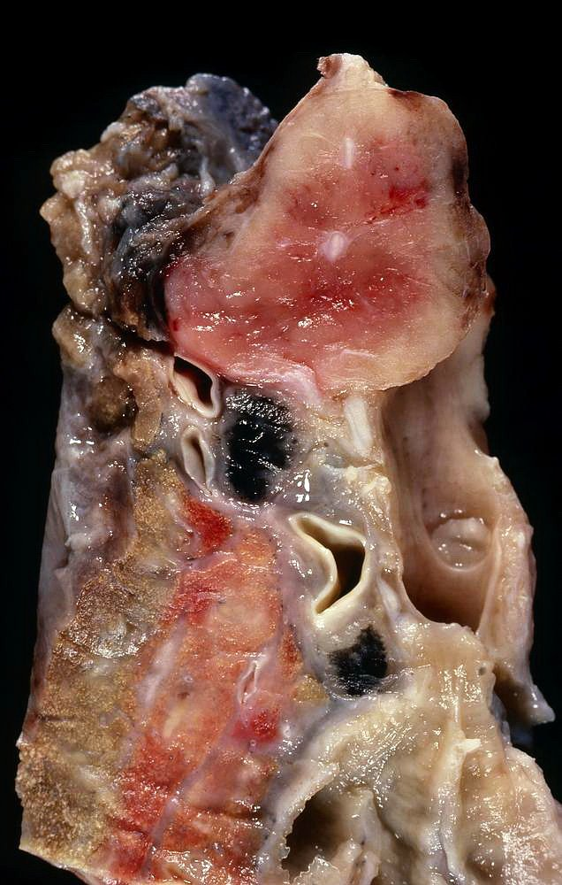
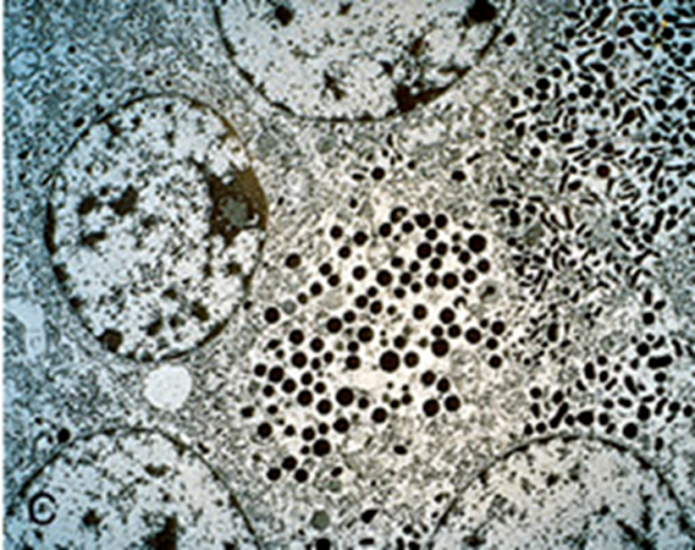
Carcinoid tumor
Carcinoid tumors of the lung are neuroendocrine neoplasms
These neoplasms account for 2% of all primary lung cancers,
It shows no sex predilection, and are not related to cigarette smoking or other environmental factors.
Usually seen in adults
Can be central or peripheral in location.
Tumor cells produce serotonin and bradykinin leading to carcinoid syndrome
Can occur in patients with Multiple Endocrine Neoplasia (MEN-I)
Low grade malignancy, Often resectable and curable.
Spreads by direct extension into adjacent tissue
Morphology of typical carcinoid tuomors
Composed of uniform cuboidal cells that have regular round nuclei with few mitoses and little or no anaplasia.
Electron microscopy: dense-core neurosecretory granules

Slide 17
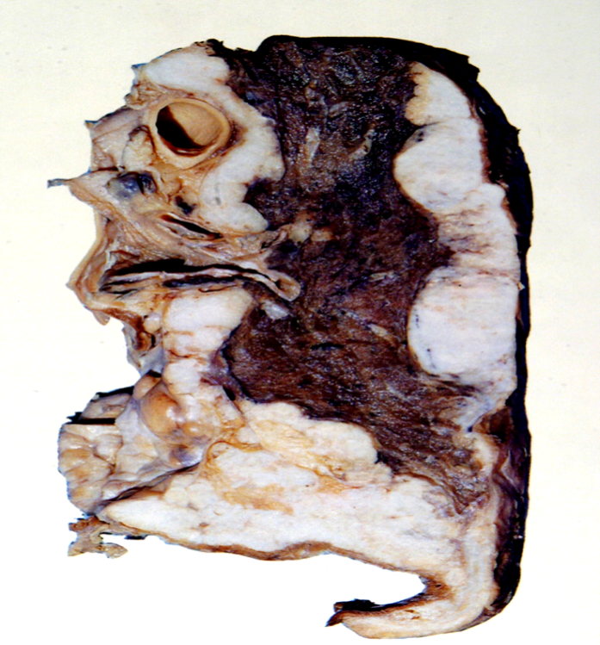
Mesothelioma
Malignant tumor of mesothelial cells lining the pleura
Highly malignant neoplasm
Most patients (70%) have a history of exposure to asbestos
Smoking is not related to mesothelioma
The age of patients with mesothelioma is 60 years.
Pleural mesotheliomas tend to spread locally within
the chest cavity, invading and compressing major structures.
Metastases can occur to the lung parenchyma and mediastinal lymph nodes, liver, bones, peritoneum etc.
Treatment is largely ineffective and prognosis is poor
Few patients survive longer than 18 months after diagnosis
Carcinoma metastatic to the lung
Pulmonary metastases are more common than Primary Lung Tumors
Metastatic tumors in the lung are typically multiple and circumscribed. When large nodules are seen in the lungs radiologically, they are called cannon ball metastases
The common primary sites are the breast, stomach, pancreas, kidney and colon.

Slide 18
Summary:

Slide 19
MCQ’s:
1- Which of the following is the most aggressive bronchogenic carcinoma ?
a) Small cell carcinoma
b) Adenocarcinoma
c) Squamous cell carcinoma
2- Which of the following is develop in the site of pulmonary inflammation ?
a) Small cell carcinoma
b) Adenocarcinoma (scar carcinoma)
c) Bronchoalveolar adenocarcinoma
3- Which of the following is primary neoplastic lesion of pleura?
a) Adenocarcinoma
b) Squamous cell carcinoma
c) Mesothelioma
4- Which of the following is more common in women and nonsmokers?
a) Squamous cell carcinoma
b) Carcinoid
c) Adenocarcinoma
5- Which of the following is clearly linked to smoking?
a) Adenocarcinoma
b) Squamous cell carcinoma
c) Large cell carcinoma
Answers: 1- A 2- B 3- C 4- C 5- B

Slide 20
Cases:
1- A 67 year old non smoker female presents with worsening dyspnea for the past 6 weeks. She has noticed 13 kg weight loss and occasional excessive sweating. On examination, she is in mild respiratory distress. Her RR is 22 and her BP is 134\76. The physician has also noticed ptosis on her left eye and miosis . chest X-ray shows peripheral mass in her right upper lobe of the right lung . what the most probable diagnosis :
a) Large cell carcinoma
b) Small cell carcinoma
c) Adenocarcinoma
d) Squamous cell carcinoma
2- A 53-year-old male smoker presents to the emergency department with exertional dyspnea that has progressed to dyspnea at rest and a cough for 1 month. Two weeks ago, he started having headaches and noticed swelling of his face. He noticed some urination disorders. Laboratory tests has shows excessive concentration of ADH (antidiuretic hormone ).A chest radiograph demonstrates a suspicious nodule in the right hilar region. Which of the following types of lung cancer is most commonly associated with the signs and symptoms this patient is experiencing?
a) Adenocarcinoma of the lung
b) Small cell lung cancer (SCLC)
c) Large cell carcinoma
d) Squamous cell lung cancer .
Answers: 1)c 2)b

Slide 21
Cases:
3- 49-year-old man has sudden onset of severe lower abdominal pain with hematuria. He passes a ureteral calculus. Laboratory studies show that the calculus is composed of calcium oxalate. He is found to have a serum calcium concentration of 10.2 mg/dL, serum phosphorus level of 2.9 mg/dL, and serum albumin level of 4.6 g/dL. A chest radiograph shows a 7-cm hilar mass in the right lung. Chest CT scan shows prominent central necrosis in this mass. Which of the following neoplasms is most likely to be associated with these findings?
a) Metastatic colonic adenocarcinoma
b) Small cell anaplastic carcinoma
c) Bronchioloalveolar carcinoma
d) Squamous cell carcinoma
4- A 57-year-old woman comes to her physician because she has had a cough and pleuritic chest pain for the past 3 weeks. On physical examination, she is afebrile. Some crackles are audible over the left lower lung on auscultation. A chest radiograph shows an ill-defined area of opacification in the left lower lobe. After 1 month of antibiotic therapy, her condition has not improved, and the lesion is still visible radiographically. CT-guided needle biopsy of the left lower lobe of the lung is performed, and the specimen has the histologic appearance of neoplastic growth along pre existing alveolar septa without invasion . Which of the following neoplasms is most likely to be present in this patient?
A) Adenocarcinoma
b) Bronchioloalveolar carcinoma
c) Hamartoma
d) Squamous cell carcinoma
5- A 40-year-old woman has never smoked and works as a file clerk at a university that designates all work areas as “nonsmoking.” She goes to the physician for a routine health maintenance examination. On physical examination, there are no remarkable findings. A routine chest radiograph shows a 3-cm, sharply demarcated mass in the left upper lobe of the lung. Fine-needle aspiration of the mass is attempted, but the pathologist performing the procedure remarks, “This is like trying to biopsy a ping-pong ball.” No tissue is obtained. Thoracotomy with wedge resection is performed. On sectioning, the mass has a firm, glistening, bluish white cut surface. A culture of the mass yields no growth. Which of the following terms best describes this mass?
a) Hamartoma
b) Adenocarcinoma
c) Large-cell carcinoma
d) Squamous cell carcinoma
Answers: 3) D 4) B 5) A

Slide 22
Females:
-Leader : بثينة آل ماجد
فاطمة بالشرف
روان الحربي
رهف الشمري
رناد الفرم
هديل عورتاني
منيره المسعد
الجوهرة الشنيفي
رزان الزهراني
روان مشعل
نوف العتيبي
ابتسام المطيري
غرام جليدان
بلقيس الراجحي
نورة القاضي
آلاء الصويغ
ريم القحطاني
شوق القحطاني
Males:
-Leader :محمد باحاذق
فهد عبدالله الفايز
سيف المشاري
محمد الأصقه
خالد المطيري
داود اسماعيل
خالد محمد العقيلي
احمد وليد الراشد
فهد النهابي
عبدالله السرجاني
رشيد سليمان البلاع
معاذ ابراهيم الحمود
فايز غياث الدرسوني
عبدالحكيم إبراهيم العنيّق
خالد محمد العقيلي
عبدالله سليمان احمد بالعبيد
أنس عبدالله السيف
سعد محمد الفوزان
عبدالعزيز بن خالد السرحاني
عبد الإله الحسين
عبدالجبار اليماني

Slide 23
Kindly contact us if you have any questions/comments and suggestions:
* EMAIL: pathology437@gmail.com
* TWITTER : @pathology437
GOOD LUCK ! ☺
*references:
-Robbins Basic Pathology
- doctor’s slides
Pathology
teamwork

