Slide 1
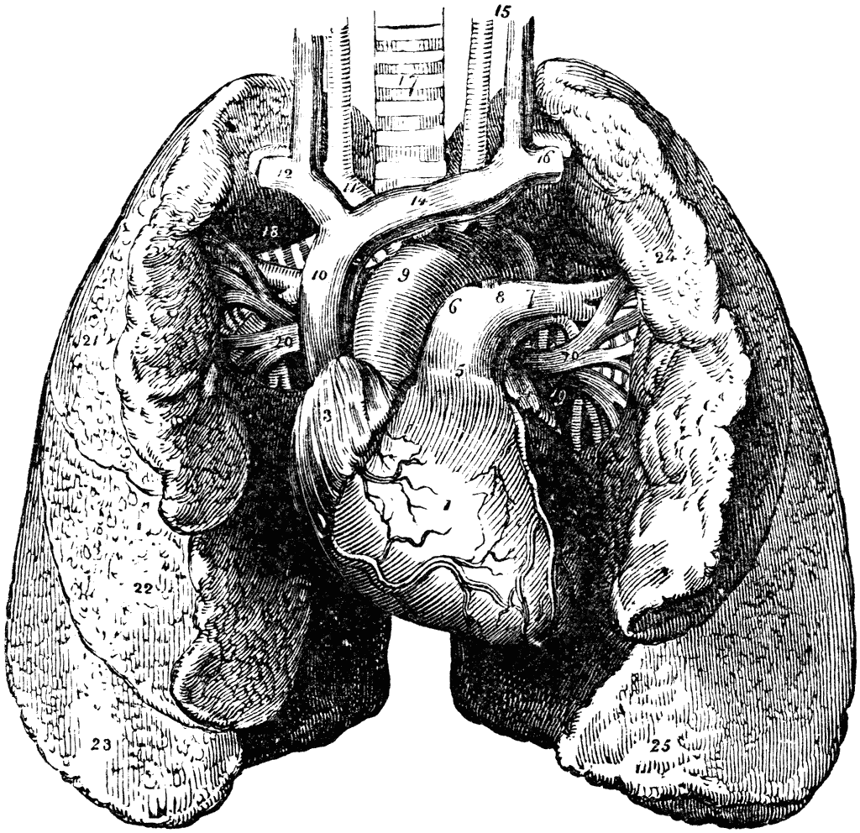
Pathology
teamwork
Click here for
Editing File
Color Index :-
VERY IMPORTANT
Extra explanation
Examples
Diseases names: Underlined
Definitions
*وإنَّ الطِّبَّ مهنةُ كُلِّ حُرٍّ، رأى أنْ يَبذلَ الجهدَ اجتهادا

