Slide 1
Hypoxia & Cyanosis
Color index:
Red: important
Green: doctor’s notes
Grey: extra information
Pink: found only in female’s slides
Blue: found only in male’s slides
Yellow: numbers
contact us at:
physiologyteam437@gmail.com
@physio437
Editing file
Physiology 437 team work

Slide 2
objectives:
By the end of the lecture you will be able to:
•By the end of this lecture you should be able to:
•Define hypoxia and list its various physiological and pathological causes.
•Define hypo and hyper-ventilation in terms of arterial PCO2 and PO2.
•Define cyanosis and its clinical presentation
•Define ventilation/perfusion (V͎/Q) ratio and its normal values.
الدكتور سلطان ما وضعها في سلايداته وقت المحاضرة لكن سلايدات المراجعة وضعها ونبه على أهميتها

Slide 3
Hypoxia
Hypoxia vs hypoxemia:
Hypoxia is the deficiency of O₂ in tissue
Hypoxemia is the deficiency of O₂ in blood
Hypoxia is defined as an inadequate supply of oxygen to the body tissues. (deficiency of oxygen in the tissue cells)
It can be classified in the following types:
Hypoxic hypoxia (arterial hypoxia) e.g. at high altitudes, low O₂ in air
Anemic hypoxia decreased percentage of hemoglobin in blood with respect to age & gender, could be caused by severe loss of blood
Stagnant hypoxia (Hypokinetic or Ischemic hypoxia) lack of blood supply
Histotoxic hypoxia tissues are unable to utilize O₂

Slide 4
CLASSIFICATION BASED ON THE CAUSES OF HYPOXIA
Only in male’s slides.
Inadequate oxygenation of the blood in the lungs because of extrinsic reasons
a. Deficiency of oxygen in the atmosphere
b. Hypoventilation (neuromuscular disorders)
2. Pulmonary disease
a. Hypoventilation caused by increased airway resistance or decreased pulmonary compliance
b. Abnormal alveolar ventilation-perfusion ratio (including either increased physiologic dead space or increased physiologic shunt) from alveolar damage c. Diminished respiratory membrane diffusion due to increased thickness of membrane e.g. emphysema
3. Venous-to-arterial shunts (“right-to-left” cardiac shunts). Damage of septum between atria or ventricles → deoxygenated blood in systemic circulation →hypoxia

Slide 5
Cont.
Only in male’s slides.
4. Inadequate oxygen transport to the tissues by the blood
a. Anemia or abnormal hemoglobin
b. General circulatory deficiency
c. Localized circulatory deficiency (peripheral, cerebral, coronary vessels)
d. Tissue edema e.g. pleural edema impairs diffusion of gases → hypoxia
5. Inadequate tissue capability of using oxygen tissue receives O₂ but can’t use it
a. Poisoning of cellular oxidation enzymes this is how cyanide works
b. Diminished cellular metabolic capacity for using oxygen, because of toxicity, vitamin deficiency, or other factors.

Slide 6
Hypoxic Hypoxia
باختصار هي أن الأكسجين ما يقدر يكون بتركيز كافي في الدم مع أن الدم سليم
Hypoxic hypoxia is also known as arterial hypoxia. This is seen when there is a lack of oxygenation of blood in the lungs, which leads to a low PO2 in arterial blood. Since less amounts of Hb is converted to oxy-Hb. The tissues are supplied with blood deficient (نقص) in oxygen. Hypoxic hypoxia can occur in the following conditions:
High altitude (leading cause)
Fluid in the lungs (pulmonary edema)
Obstruction in the respiratory passages e.g. obstruction of bronchi
Emphysema

Slide 7
Hypoxic Hypoxia
Other causes of hypoxic hypoxia:
Alveolar hypoventilation
Diffusion abnormalities. E.g pulmonary edema & pneumonia
Right to left shunt
Ventilation-perfusion imbalance (including increased physiological dead space and physiological shunt → similar to Venous-to-arterial shunt. Only treatment is through surgery of septum).
Alveolar hypoventilation:
e.g.
Reduced PO2 in inspired air (high altitude).
Increased airway resistance.
Reduced lung compliance. Compliance is the ease at which the lung can expand
Paralysis of respiratory muscles
Depressed respiratory centre.
Only in male’s slides.

Slide 8
Hypoxic Hypoxia
Only in male’s slides.
Diffusion abnormalities:
Impaired diffusion from alveolar to pulmonary capillary blood can lead to arterial hypoxia. It is seen in conditions like alveolar-capillary block.
Ventilation-perfusion imbalance (including increased physiological dead space and physiological shunt):
If ventilation and blood flow are mismatched in various parts of the lung, impairment of both oxygen and carbon dioxide diffusion results.
Ventilation perfusion imbalance may be caused by uneven ventilation, (e.g. obstructive lung conditions) , or uneven perfusion, (e.g. consolidation of the lung).
Right to left shunt:
Blood passes from the systemic venous without going through the gas exchanging part of the lungs. This type of hypoxia can be differentiated clinically from other types by giving the subject 100% oxygen to breathe. Hypoxia because of the shunt will not be abolished while in other types PO2 in the arterial system will improve considerably. It’s congenital disorder.

Slide 9
Anemic Hypoxia
This condition is characterized by decreased oxygen carrying capacity of the blood due to decreased hemoglobin level or abnormal type of hemoglobin which is unable to carry oxygen.
Causes:
Anemia.
Abnormal Hb (Altered haemoglobin formation) e.g. methaemoglobin, sulfhemoglobin, and carboxyhemoglobin. High concentrations of abnormal Hb impair the blood’s capacity to carry oxygen
Hemorrhagic anemia [Decreased RBC / quality].Quantity could be decreased from trauma or any other loss of blood. While quality could be caused by improper formation of RBCs.*
The failure of hemoglobin to carry its normal concentration of oxygen, as in carbon monoxide (CO) poisoning.
*Presence of the Nucleus in RBCs is a clear indicator of improper formation

Slide 10
Stagnant Hypoxia
Stagnant hypoxia (Hypokinetic or Ischemic hypoxia) occurs in conditions in which there is a decreased rate of blood flow throughout the body or a part of the body (tissue). so more and more oxygen is extracted from the blood, and due to slow circulation less oxygen is carried by the blood at the lung , leading to hypoxia.
Causes:
It may be caused by congestive heart failure, circulatory shock and arteriosclerosis*.
General slowing of circulation (heart failure and shock).
Local slowing: vasoconstriction, cold and arterial wall spasm.
Arteriosclerosis: decrease of the diameter of a blood vessel due to fat deposition
الدكتور شبهها بمثل لما تضغط بشدة على مفصل اليد وتحبس الدم عنها فصار stagnant hypoxia in the hand.

Slide 11
Histotoxic Hypoxia
In histotoxic hypoxia the tissues are unable to use oxygen even though plenty of oxygen is available.
Caused by: inhibition of the tissue respiration electron transport chain (inhibition of the oxidative enzyme activity)
The best example: cyanide poisoning, where tissue cytochrome oxidases are knocked out and tissue is unable to utilize oxygen.

Slide 12
Hypoxia & Clinical features
Signs and symptoms of hypoxia : clinical features depend on how fast and how severely partial pressure of O2 is decreased.
Fulminant hypoxia
Acute hypoxia
Chronic hypoxia
This occurs very rapidly, within seconds. Unconsciousness occurs in 15-20 seconds and brain tissue death occurs in 4-5 minutes.
In acute hypoxia body reflexes are slowed, there may be slurred speech, unconsciousness, coma and death may occur.
The symptoms of chronic hypoxia, fatigue, difficulty in breathing, and shortness of breath can occur.
Signs of hypoxia : Cyanosis, Tachycardia and Tachypnea (breathing rapidly).

Slide 13
Effects of hypoxia on the body
Hypoxia, if severe enough, can cause death of cells throughout the body, but in less severe degrees it causes principally depressed mental activity, sometimes culminating in coma, reduced work capacity of the muscles.
At 12,000 feet, drowsiness, lassitude, mental and muscle fatigue, sometimes headache, occasionally nausea, and euphoria. These effects progress to a stage of twitchings or seizures above 18,000 feet and above 23,000 feet in the unacclimatized person, in coma, followed shortly thereafter by death.
One of the most important effects of hypoxia is decreased mental proficiency, which decreased judgment, memory,Inability to perform complex calculations and performance of discrete motor movements. If an unacclimatized aviator stays at 15,000 feet for 1 hour, mental proficiency ordinarily falls to about 50% of normal, and after 18 hours at this level it falls to about 20% of normal.

Slide 14
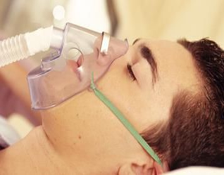
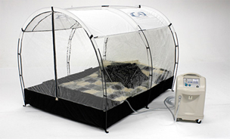
Treatment of hypoxia
ONLY IN FEMALES’ SLIDES
Hypercapnia
Administration root: Is giving by oxygen therapy in a tent or high oxygen tension mask.
This is useful in hypoxic hypoxia, but of less value in other types of hypoxia.
Histotoxic hypoxia will not benefit from O2 therapy
Excess of CO2 in body fluid, it usually occurs with hypoxia, PCO2 increases above 52 mmHg, it decreases the PH.
Features of hypercapnia :
Peripheral vasodilation
Sweating
Warm extremities and bounding pulse
Muscle twitching
headache, drowsiness and coma
Papilledema ( swelling of optic disc)

Slide 15
Cyanosis
The term cyanosis means blueness of the skin and mucous membrane, and is caused by excessive amounts of deoxygenated hemoglobin in the skin blood vessels, especially in the capillaries.
This deoxygenated hemoglobin has an intense dark blue-purple color that is transmitted through the skin.
Cyanosis appears whenever the arterial blood contains more than 5 grams of deoxygenated hemoglobin in each 100 millimeters of blood.

Slide 16
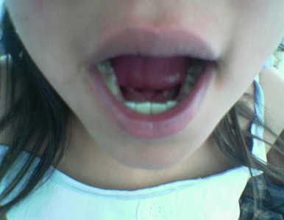
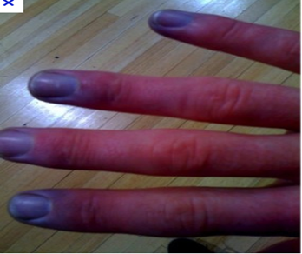
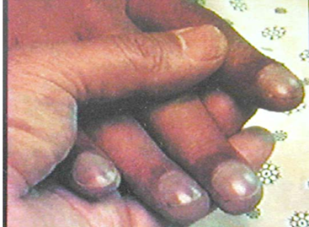
CYANOSIS
A person with anemia almost never becomes cyanotic because there is not enough hemoglobin for 5 grams to be deoxygenated in 100 milliliters of arterial blood. (Anemia > Less blood cells > Less hemoglobin to be deoxygenated > Cyanosis cannot be achieved due to the lack of hemoglobin and red blood cells).
Conversely, in a person with excess red blood cells, as occurs in polycythemia vera, the great excess of available hemoglobin that can become deoxygenated leads frequently to cyanosis, even under otherwise normal conditions.
(Polycythemia > More blood cells > More hemoglobin to be deoxygenated > Cyanosis can be achieved due to the excess hemoglobin and red blood cells.)

Slide 17
ONLY IN MALES’ SLIDES
Causes of Cyanosis
Inadequate oxygenation of blood in the lungs
Presence of an aerated shunt between vessels
Other Causes
•High altitude
•Obstruction of respiratory passages
•Pneumoconiosis (a disease of the lungs due to inhalation of dust, characterized by inflammation, coughing, and fibrosis)
•Emphysema
•CO-poisoning
•Coarctation of aorta
•Fallot's tetralogy
• Moderate cold
•Diminished blood flow to tissues

Slide 18
ONLY IN MALES’ SLIDES
Types of cyanosis
Local cyanosis:
This is seen during decreased blood flow through a part of the body as in Raynaud’s disease. In this disease, circulation through the upper limb is impaired, it causes local cyanosis.
Generalized cyanosis:
Generalized impairment of circulation as in the case of heart failure leads to generalized cyanosis. It also occurs in hypoxic hypoxia.

Slide 19
CYANOSIS
ONLY IN MALES’ SLIDES
Dr. Sultan says it’s not very important
Causes of central cyanosis:
•Cyanotic congenital heart-disease
•Fallot tetralogy
•Tricuspid atresia
•Ebstein’s anomaly
•Pulmonary arteriovenous fistula
•Pulmonary diseases
•Acute pulmonary embolism
•Pneumonia
•Atelectasis
•Chronic Obstructive airway disease
•Restrictive lung disease
•Hemoglobin abnormalities
Causes of peripheral cyanosis
• Reduced cardiac output, as in congestive heart failure, mitral stenosis
• Exposure to cold
• Arterial obstruction
• Venous obstruction
• Raynauds disease
• Polycythemia vera

Slide 20
Ventilation–perfusion ratio (V/Q)
ONLY IN FEMALES’ SLIDES
3;32
• It is the ratio of alveolar ventilation to pulmonary blood flow per minute.
• The alveolar ventilation at rest (4.2 L/min)
• The pulmonary blood flow is equal to right ventricular output per minute (5L/min)
SO, V/Q ratio = 4.2\5 = 0.84
• Average V/Q ratio across the lung is 0.8
• At the apex V/Q ratio = 3
• At the base V/Q ratio=0.6
So the apex is more ventilated than perfused and the base is more perfused than ventilated.
• During exercise the V/Q ratio becomes more homogenous among different parts of the lung.
اكبر فلما اقسم كبير على صغير تطلع النسبة كبيرةVentilation
اكبر فلما اقسم على مقام كبير تطلع النسبة صغيرة perfusion

Slide 21
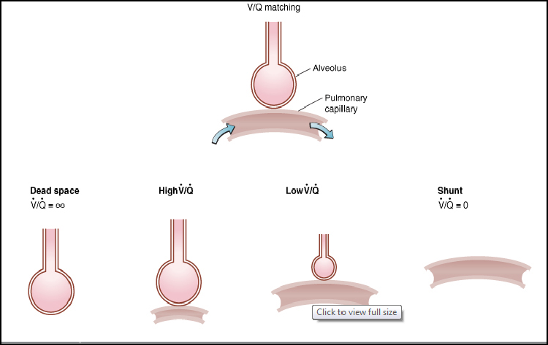
Ventilation/perfusion abnormalities
ONLY IN FEMALES’ SLIDES
Perfusion بس ما فيه Ventilation فيه
Perfusionو Ventilation
اكبرVentilation ولكن
Perfusionو Ventilation
اكبرPerfusionولكن
Ventilation بس ما فيه perfusion فيه
ليه صار انفينتي ؟ لأن قسمنا على Q=0 والي يهمنا هو أن ما فيه قاز اكستشينج

Slide 22
Ventilation–perfusion ratio (V/Q)
ONLY IN FEMALES’ SLIDES
يشبه الي قبله لكن أوضح شوي 3:34
• The main function of this ratio is to determine the state of oxygenation in the body.
• Any mismatch in the ratio can result in hypoxia.
• When the V/Q ratio is less than normal this is called physiologic shunt (a certain fraction of the venous blood is passing through the pulmonary capillaries without being oxygenated i.e shunted blood).
• When V/Q is more than normal this is called Physiologic dead space (when the ventilation of some of the alveoli is great but the alveolar blood flow is low, ventilation of these alveoli is wasted).
عكس بعض وحده النقص في الهواء الي يدخل والثانية نقص في البلود فلو

Slide 23
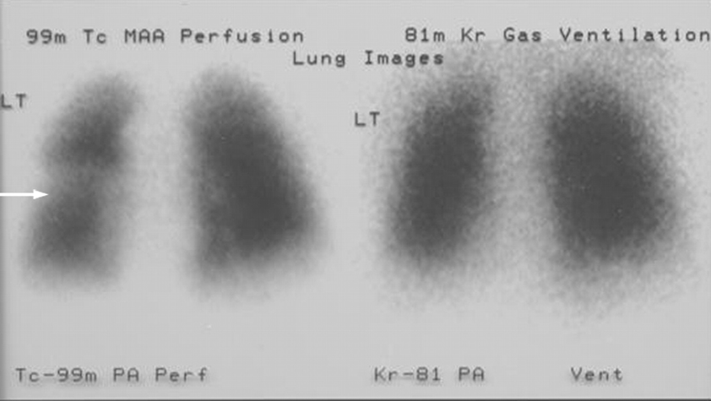
Ventilation- Perfusion Lung Scan
ONLY IN FEMALES’ SLIDES
Lungs الدكتورة قالت يعطون المريض مادة في الدم ويصورون ال
Ventilation لو طلعت الصورة واضحة تكون المشكلة
Perfusion لو ما طلعت واضحة تكون المشكلة

Slide 24
Abnormalities of the V/Q ratio
ONLY IN FEMALES’ SLIDES
• In the Upper and Lower regions of the normal lung
- Apex V/Q ratio = 3 (moderate degree of physiologic dead space)
- Base V/Q ratio= 0.6 ( represent a physiologic shunt).
• In Chronic Obstructive Lung disease COPD because of bronchial obstruction in some areas and destruction of the alveolar septa in other areas with patent alveoli those people has some areas of the lung exhibit serious physiologic shunt and in other areas serious physiologic dead space.
• COPD is the most prevalent cause of pulmonary disability today, lung effectiveness as a gas exchange organ may decrease to 10%

Slide 25
SUMMARY
Hypoxia is defined as an inadequate supply of oxygen to the body tissues.
Hypoxic Hypoxia :
This is seen when there is a lack of oxygenation of blood in the lungs, which leads to a low PO2 in arterial blood.
Hypoxia types :
1-Hypoxic hypoxia
2-Anemic hypoxia
3-Stagnant hypoxia
4-Histotoxic hypoxia
Classification Based On The Causes Of Hypoxia :
1-Inadequate oxygenation of the blood.
2-Pulmonary disease.
3-Venous-to-arterial shunts.
4-Inadequate oxygen transport to the tissues.
5-Inadequate tissue capability of using oxygen.
Anemic Hypoxia :
This condition is characterized by decreased oxygen carrying capacity of the blood due to decreased hemoglobin level or abnormal type of hemoglobin which is unable to carry oxygen.

Slide 26
SUMMARY
Stagnant Hypoxia :
occurs in conditions in which there is a decreased rate of blood flow throughout the body or a part of the body (tissue).
Histotoxic Hypoxia :
In histotoxic hypoxia the tissues are unable to use oxygen even though plenty of oxygen is available.
Cyanosis
The term cyanosis means blueness of the skin and cause is excessive amounts of deoxygenated hemoglobin in the skin blood vessels, especially in the capillaries.
Clinical features :
1-Fulminant hypoxia
2-Acute hypoxia
3-Chronic hypoxia
Signs of hypoxia :
1-Cyanosis
2-Tachycardia
3-Tachypnea
Causes of Cyanosis
1-inadequate oxygenation of blood in the lungs
2-Presence of an aerated shunt between vessels
3-Other Causes
Types of cyanosis
1-Local cyanosis
2-Generalized cyanosis

Slide 27
Female’s team:
Leader: Alanoud Salman Alotaiby
Members:
Majd AlBarrak
Dimah Alaraifi
Maha Barakah
Maha Alnahdi
Sarah AlFlaij
Male’s team:
Leader: Abdulhakim AlOnaiq
Members:
Rayyan Almousa
Abduljabbar Alyamani
Notes:
team members please put your names here

