Slide 1
Control Of breathing
Color index:
Red: important
Green: doctor’s notes
Grey: extra information
Pink: found only in female’s slides
Blue: found only in male’s slides
Yellow: numbers
contact us at:
physiologyteam437@gmail.com
@physio437
Editing file
Physiology 437 team work

Slide 2
objectives:
By the end of the lecture you will be able to:
Understand the role of the medulla oblongata in determining the basic pattern of respiratory activity.
List some factors that can modify the basic breathing pattern e.g.
The Hering-Breuer reflexes
The proprioceptor reflexes
The protective reflexes, like the irritant, and the J-receptors.
Understand the respiratory consequences of changing PO2 , PCO2 , and PH.
Describe the locations and roles of the peripheral and central chemoreceptors.
Compare and contrast metabolic and respiratory acidosis and metabolic and respiratory alkalosis

Slide 3
Controls of rate and depth of respiration
Rate: Normal 8-12 breaths per min
Depth of breathing two types : normal”superficial and deep
Arterial PO2 (oxygen pressure) “ Normal arterial PO2=100”
When PO2 is VERY low (Hypoxia), ventilation increases. “Less sensitive , major changes in PO2 will cause increase ventilation”
Arterial PCO2 ( Carbon dioxide pressure) “ Normal arterial PCO2=40”
The most important regulator of ventilation is PCO2, small increases in PCO2, greatly increases ventilation. يعني ان زيادة بسيطه في تركيز ثاني اكسيد الكربون تعطي زيادة كبيرة في معدل التهوية “most sensitive , any minor changes in PCO2 , ventilation will greatly increase”
Arterial pH “ Normal pH=7.4”
As hydrogen ions increase (acidosis)(الحمضية), alveolar ventilation increases. بعض الرياضيين يزيدون الحموضة في دمهم عشان يفكون ارتباط الاكسجين فيغذي العضلات

Slide 4
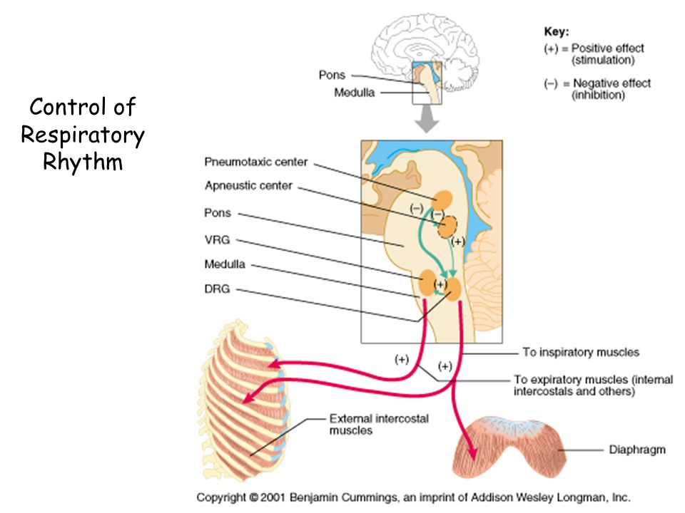
Controlling of Respiratory Rhythm is done or maintained by Medulla Oblongata which contains VRG, DRG, Pneumotaxic center and apneustic center.
الصورة مهمه ارجع لها بعد ما تنتهي من الدرس
عملية التنفس عملية ارادية الى درجة معينة فتتحول وتصبح غير ارادية" لا يمكن لشخص كتمان نفسه حتى الموت " وكذلك يوجد عوامل كثيرة تؤثر على عملية التنفس ومنها تركيز الاكسجين وثاني اكيد الكربون.

Slide 5
Medullary Respiratory centers
The first system that controls respiration is CNS
Inspiratory area (Dorsal Respiratory Group) DRG
-Determines basic rhythm of breathing. Damage of this area lead to breathing arrhythmia
-Causes contraction of diaphragm and external intercostals. “inspiration”
Expiratory area (Ventral Respiratory Group) VRG
-Although it contains both inspiratory and expiratory neurons. It is inactive during normal quiet breathing. As you know normal expiration is a passive process no need for muscles
-Activated by inspiratory area during forceful breathing.
-Causes contraction of the internal intercostals and abdominal muscles.
The medullary respiratory center stimulates basic inspiration for about 2 seconds and then basic expiration for about 3 seconds (5breaths/sec = 12breaths/min). Inspiration last for 2 seconds which is shorter than expiratory that last for 3 seconds !!! why? Because inspiration is an active process that involves muscles while expiration is an inactive process depend upon lung recoiling and inspiratory muscles relaxation.
The respiratory center is composed of several groups of neurons located bilaterally in the medulla oblongata and pons of the brainstem, It is divided into three major collections of neurons:
(1) a dorsal respiratory group, located in the dorsal portion of the medulla, which mainly causes inspiration; (2) a ventral respiratory group, located in the ventrolateral part of the medulla, which mainly causes expiration; and (3)The pneumotaxic center, located dorsally in the superior portion of the pons,which mainly controls rate and depth of breathing.

Slide 6
Pontine Respiratory centers
Transition”التبديل” between inhalation and exhalation is controlled by:
These two areas contribute in switching off of inhalation or exhalation to prevent continuous inhalation or exhalation
1- Pneumotaxic area
Inhibits inspiratory area of medulla to stop inhalation. Therefore, breathing is more rapid when pneumotaxic area is active.
2- Apneustic area
Stimulates inspiratory area of medulla to prolong inhalation. Therefore slow respiration and prolonged respiratory cycles will result if it is stimulated.
A Pneumotaxic Center Limits the Duration of
Inspiration and Increases the Respiratory Rate A pneumotaxic center, located dorsally in the nucleus parabrachialis of the upper pons, transmits signals to the inspiratory area. The primary effect of this center is to control the “switch-off” point of the inspiratory ramp, thus controlling the duration of the filling phase of the lung cycle. When the pneumotaxic signal is strong, inspiration might last for as little as 0.5 second,thus filling the lungs only slightly; when the pneumotaxic signal is weak, inspiration might continue for 5 or more seconds, thus filling the lungs with a great excess of air.The function of the pneumotaxic center is primarily to limit inspiration.This has a secondary effect of increasing the rate of breathing because limitation of inspiration also shortens expiration and the entire period of each respiration. A strong pneumotaxic signal can increase the rate of breathing to 30 to 40 breaths per minute, whereas a weak pneumotaxic signal may reduce the rate to only 3 to 5 breaths per minute.
The apneustic center of pons sends signals to the dorsal respiratory center in the medulla to delay the 'switch off' signal of the inspiratory ramp provided by the pneumotaxic center of pons. It controls the intensity of breathing. The apneustic center is inhibited by pulmonary stretch receptors

Slide 7
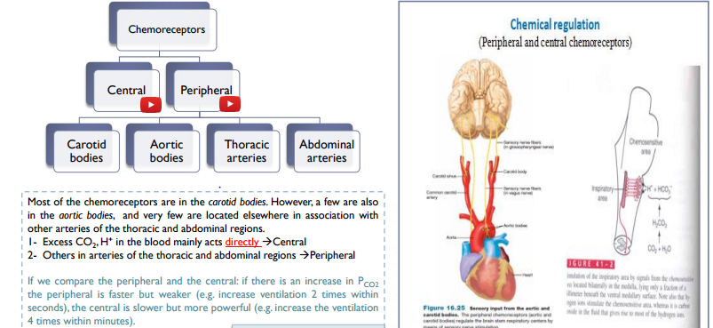
Special thanks to team 436
As we said , there are some chemical substances that regulate respiration such as Oxygen and Carbon dioxide. Receptors detect changes in a substance level so,it will send signals to CNS to influence and overcome the condition.
Excess carbon dioxide or excess hydrogen ions in the blood mainly act directly on the respiratory center itself, causing greatly increased strength of both the inspiratory and the expiratory motor signals to the respiratory muscles.
In addition to control of respiratory activity by the respiratory center itself, still another mechanism is available for controlling respiration. This is the peripheral chemoreceptor system, shown in Figure 41-4. Special nervous chemical receptors, calledchemoreceptors, are located in several areas outside the brain. They are especially important for detecting changes in oxygen in the blood, although they also respond to a lesser extent to changes in carbon dioxide and hydrogen ion concentrations. The chemoreceptors transmit nervous signals to the respiratory center in the brain to help regulate respiratory activity.
Most of the chemoreceptors are in the carotid bodies. However, a few are also in the aortic bodies, shown in the lower part of Figure 41-4, and a very few are located elsewhere in association with other arteries of the thoracic and abdominal regions.

Slide 8
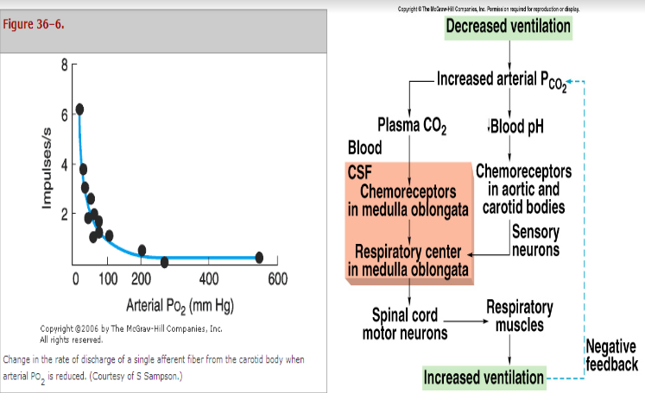
Chemoreceptor Control of Breathing
1st
2nd
If the person has acidosis due to metabolic problem only the 2nd pathway will be stimulated, but if he has a problem which leads to an increase in Pco2 the two pathways will be stimulated, so it will have a bigger impact than if the problem were only in the pH.
Chemical Control of Respiration
Oxygen, in contrast, with CO2 does not have a significant direct effect on the respiratory center of the brain in controlling respiration. Instead, it acts almost entirely on peripheral chemoreceptors located in the carotidand aortic bodies, and these in turn transmit appropriate nervous signals to the respiratory center for control of respiration.

Slide 9
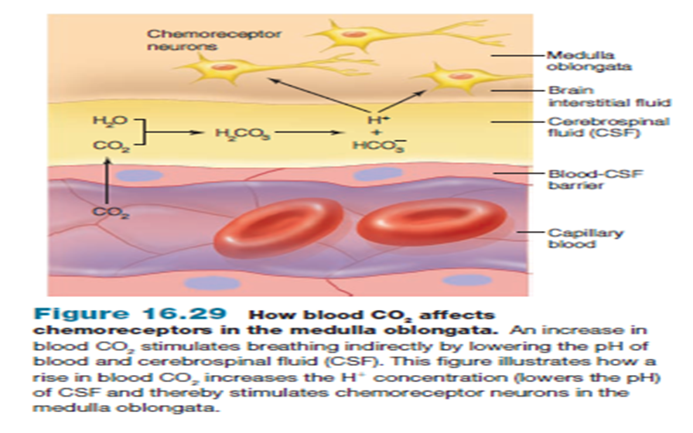
Effect of blood CO2 level on central chemoreceptors

Slide 10
Hering-Breuer inflation reflex
Some references call it stretch reflex
•When the lung becomes overstretched (tidal volume is 1 L or more), stretch receptors located in the wall bronchi and bronchioles transmit signals through vagus nerve to DRG producing effect similar to pneumotaxic center stimulation. اذا عبيت صدرك زيادة عن الطبيعي , هذه الزيادة بتحسس مستقبلات على جدار الرئة عشان توقف عملية التنفس
• Switches off inspiratory signals and thus stops further inspiration .
•This reflex also increases the rate of respiration as does the pneumotaxic center.
Lung Inflation Signals Limit Inspiration—The Hering-BreuerInflation Reflex
In addition to the central nervous system respiratory control mechanisms operating entirely within the brain stem, sensory nerve signals from the lungs also help control respiration. Most important, located in the muscular portions of the walls of the bronchi and bronchioles throughout the lungs are stretch receptors that transmit signals through the vagi into the dorsal respiratory group of neurons when the lungs become overstretched. These signals affect inspiration in much the same way as signals from the pneumotaxic center; that is, when the lungs become overly inflated, the stretch receptors activate an appropriate feedback response that “switches off” the inspiratory ramp and thus stops further inspiration. This is called the Hering-Breuer inflation reflex. This reflex also increases the rate of respiration, as is true for signals from the pneumotaxic center.
In humans, the Hering-Breuer reflex probably is not activated until the tidal volume increases to more than three times normal (>≈ 1.5 liters per breath). Therefore, this reflex appears to be mainly a protective mechanism for preventing excess lung inflation rather than an important ingredient in normal control of ventilation.

Slide 11
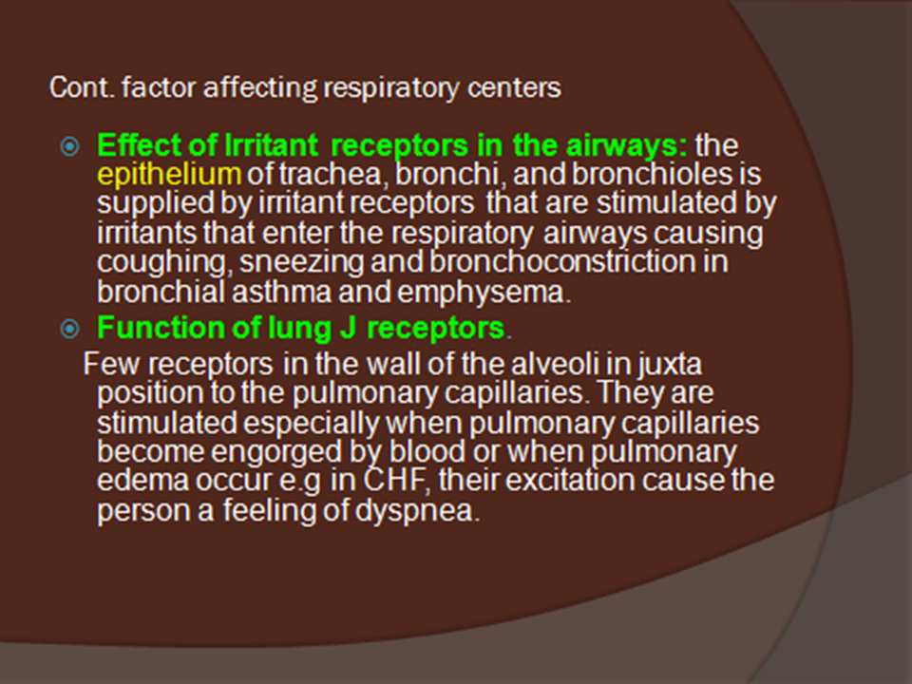
These are factors that can exert effect on respiration
These are receptors found mainly in the epithelium of conduction zone of respiratory system known as irritant receptors that detect any foreign body that enters ,so it will stimulate cough or sneezing reflex to get rid of the foreign body.
Lung J receptors are found in the wall of alveoli that is in contact with pulmonary capillaries. In case of pulmonary edema, these receptors will get activated and try to increase rate of respiration to compensate since edema will narrow the gases exchange area.
Notes:
Juxta: placed close together
Congestive heart failure (CHF)
Engorged: cause to swell with blood, water, or another fluid.

Slide 12
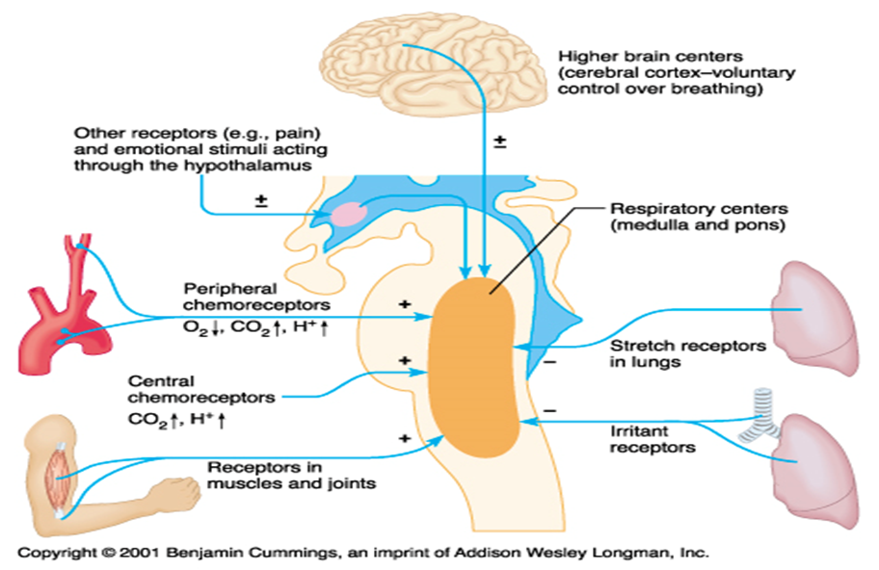
Factors Influencing Respiration
Summary of the factors the influence respiration

Slide 13
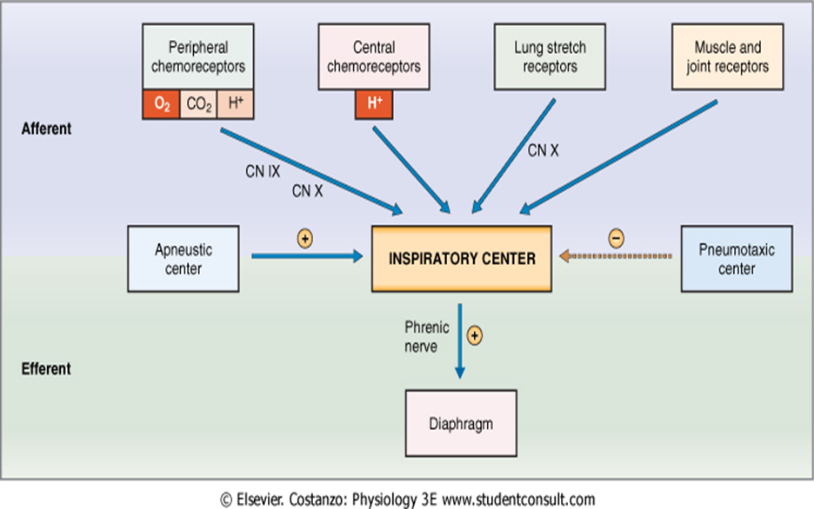
Cont..factors affecting respiration

Slide 14
Respiratory Acidosis
Respiratory Alkalosis
In level of gases
-Hypoventilation.
-Accumulation of CO₂ in the tissues .
P_{CO2} increases
pH decreases.
P_{O2} decreases.
-Hyperventilation.”washing out CO2”
-Excessive loss of CO₂.
P_{CO2} decreases (↓35 mmHg).
pH increases.
P_{O2} increase.
تنفس بقوة لمدة نصف دقيقة
Gases change acidity or basicity of the blood

Slide 15
Metabolic Acidosis
Metabolic Alkalosis
Ingestion, infusion, or production of a fixed acid.
decreased renal excretion of hydrogen ions. H+
loss of bicarbonate or other bases from the extracellular compartment. HCO3-
pH decrease “ more acidic”
In level of cells
Excessive loss of fixed acids from the body.
Ingestion, infusion, or excessive renal reabsorption of bases such as bicarbonate HCO3-
pH increases.” more basic”
Products of the cell change acidity or basicity of the blood
The respiratory system can compensate for metabolic acidosis or alkalosis by altering alveolar ventilation. Hypoventilation Hyperventilation

Slide 16
Female’s team:
Leader: Alanoud Salman Alotaiby
Members:
Sarah Alflaij
Male’s team:
Leader: Abdulhakim AlOnaiq
Members:
Naif Almutairi
Abdullah Alzaid
Saad alfawzan
Notes:
team members please put your names here

