Slide 1
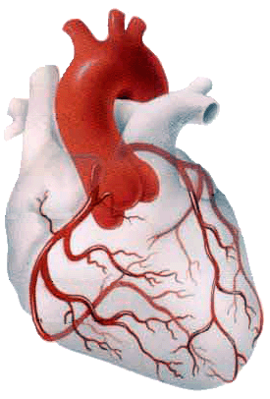
BLOOD SUPPLY OF THE HEART
Dr Jamila EL medany
&
Dr Essam Salama

Slide 2
Objectives
At the end of the lecture the student should be able to know about;
The arterial supply of the cardiac muscle regarding (origin, course, distribution and branches).
The coronary anastmosis.
The arterial supply to the conducting system of the heart.
The venous drainage of the heart regarding (origin, tributaries and termination).

Slide 3
Arterial Supply
The arterial supply of the heart is provided by Two Coronary Arteries :
Right Coronary artery &
Left Coronary artery
They are distributed over the cardiac surface, within the subepicadium connective tissue.
L Coronary artery

Slide 4
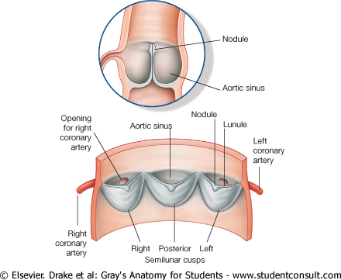
Origin of Coronary Arteries
RCA
LCA
They arise from the initial part of the Ascending Aorta (Aortic Sinuses), immediately above the aortic valve.
AA

Slide 5
Right Coronary Artery
Arises from the anterior aortic sinus of the ascending aorta.
Descends in the right atrioventricular groove between the Right Auricle and the Pulmonary trunk.
At the inferior border of the heart it continues posteriorly to anastomose with the left coronary.

Slide 6
(RCA ) Supplies:
Right atrium,
Right ventricle,
part of Left Atrium,
Left ventricle & Atrioventricular septum.
Most of conducting system

Slide 7
Branches
Right Conus;
For infundibulum and upper part of anterior wall of the right ventricle.
Anterior ventricular branches;
2-3 branches supply anterior surface of the right ventricle.
Marginal artery is the largest branch, runs along the lower margin of the sternocostal surface.
It is accompanied by the Small Cardiac vein.
Right conus

Slide 8
Atrial branches;
Supply anterior and lateral surfaces of the right atrium
One branch supplies posterior surface of both atria
Artery of the Sinuatrial Node
Supplies the SAN and both atria
In 35% it arises from the left coronary.
Posterior ventricular branches;
About 2 supply the diaphragmatic surface of the right ventricle.
Posterior Interventricular artery;(accompanied by Middle Cardiac vein)
Lies in the posterior interventricular groove, it supplies the Right and Left Ventricles, including their inferior wall, posterior part of ventricular septum, Not the Apical part,

Slide 9
Left Coronary Artery
The Larger of the two coronaries.
Arises from the left posterior aortic sinus of the ascending aorta.
Descends:
1. Between the pulmonary trunk and the left auricle.
2. In the IV groove to the apex of the heart.
Divides into two terminal branches:
Anterior Interventricular & Circumflex arteries.
.

Slide 10
Branches
(A)Anterior Interventricular
Descends in the anterior interventricular groove to the apex of the heart (accompanied by the Great cardiac vein)
in most individuals it passes around the apex to anastomose with terminal branches of the right coronary , in 1\3 it ends at the apex ) It supplies the right and left ventricles and anterior part of ventricular septum
It gives:
1. Left conus artery for pulmonary conus.
2. Anterior ventricular and Posterior ventricular ;
Supply left ventricle
3. Atrial branches ;
Supply greater part of left atrium

Slide 11
4. Left diagonal artery
one of the ventricular branches or may arises from left coronary,
(B) Circumflex Artery;
Winds around the left margin of the heart in the atrioventricular groove
C. Left Marginal artery ;
Supplies the left margin of the left ventricle down to the apex

Slide 12
Variations of the Coronary Arteries
Right Dominance:
In (90 %) of population, the Posterior Interventricular artery is a branch of the Right Coronary.
Left Dominance:
In the rest (10%), the Posterior Interventricular artery arises from the Circumflex branch of the Left Coronary A

Slide 13
Coronary Anastomosis
In MOST of people, the terminal branches of the right and left coronaries anastomose in the posterior part of the IV groove
However this anastomoses is not large enough to provide adequate blood supply in case of coronary occlusion, (Functional End arteries)

Slide 14
Arterial Supply of Conducting System
SAN, AVN & AVB are usually supplied by Right coronary.
Right Bundle Branch (RBB) of (AVB) is supplied by Left coronary
LBB of (AVB) is supplied by both Right and Left coronaries

Slide 15
Coronary Sinus
Drains most of the Venous Blood of the heart.
It lies in the Posterior part of the AV groove.
Origin :
It is the direct continuation of the Great Cardiac Vein.
Tributaries:
(3) Cardiac Veins:
A. Great.
B. Middle.
C. Small.
Oblique vein of left atrium (vein of Marshall).

Slide 16
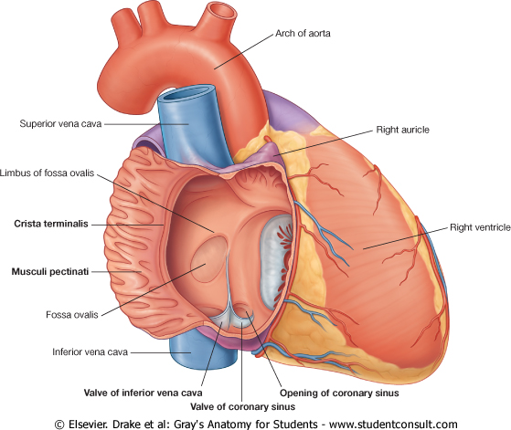
Termination:
It empties into Right Atrium.
Its opening is inferior & to the left of the IVC opening.
It is guarded by a valve.

Slide 17
Veins Draining outside Coronary Sinus
1. Anterior cardiac veins:
Open directly into the Right Atrium.
2. Venae Cordis minime (small cardiac veins):
Open into the heart chambers.

Slide 18
Thank You

