Slide 1
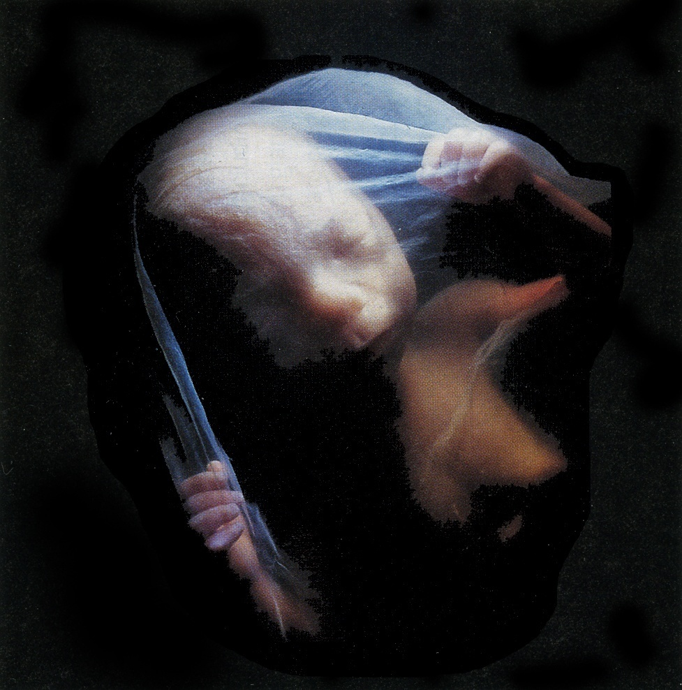
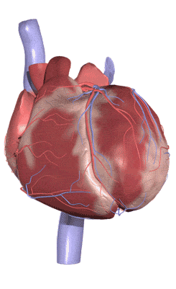
DEVELOPMENT OF HEART
Prof. Saeed Abuel Makarem
Dr. Jamila El Medany

Slide 2
Objectives
By the end of this lecture the student should be able to:
Describe the formation, sit, union divisions of the of the heart tubes.
Describe the formation and fate of the sinus venosus.
Describe the partitioning of the common atrium and common ventricle.
Describe the partitioning of the truncus arteriosus.
List the most common cardiac anomalies.

Slide 3
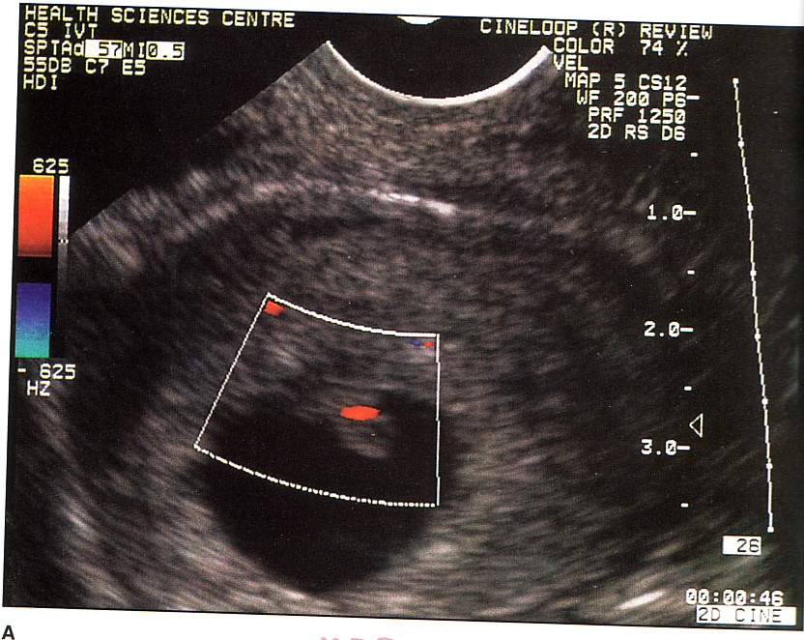
The CVS is the first major system to function in the embryo.
The heart begins to beat at (22nd – 23rd ) days.
Blood flow begins during the beginning of the fourth week and can be visualized by Ultrasound Doppler

Slide 4
Notochord:
stimulates neural tube
formation
Somatic mesoderm
Splanchnic mesoderm

Slide 5
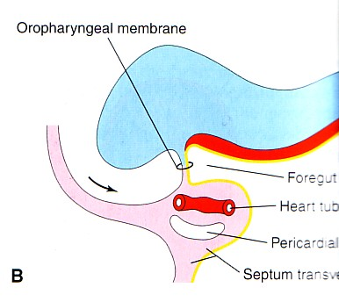
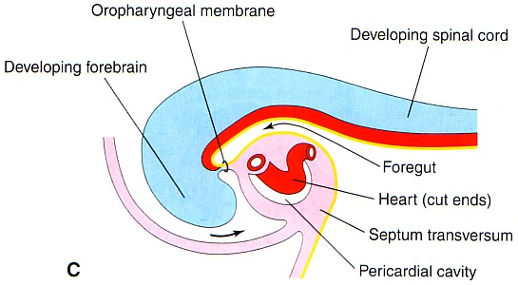
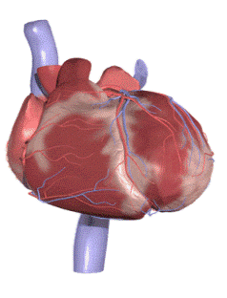
FORMATION OF THE HEART TUBE
The heart is the first functional organ to develop.
It develops from Splanchnic Mesoderm in the wall of the yolk sac (Cardiogenic Area): Cranial to the developing Mouth & Nervous system and Ventral to the developing Pericardial sac.
The heart primordium is first evident at day 18 (as an Angioplastic cords which soon canalize to form the 2 heart tubes).
As the Head Fold completed, the developing heart tubes change their position and become in the Ventral aspect of the embryo, Dorsal to the developing Pericardial sac.
.

Slide 6
Development of the Heart tube
After Lateral Folding of the embryo, the 2 heart tubes approach each other and fuse to form a single Endocardial Heart tube within the pericardial sac.
Fusion of the two tubes occurs in a Craniocaudal direction.

Slide 7
What is the shape of the Heart Tube?
The heart tube grows faster than the pericardial sac, so it shows 5 alternate dilations separated by constrictions.
These are:
Sinus Venosus.
Truncus Arteriosus.
Bulbus Cordis.
Common Ventricle.
Common Atrium.
The endocardial heart tube has 2 ends:
1. Venous end (Caudal): Sinus Venosus.
2. Arterial end (Cranial): Truncus arteriosus
2
2
1
1

Slide 8
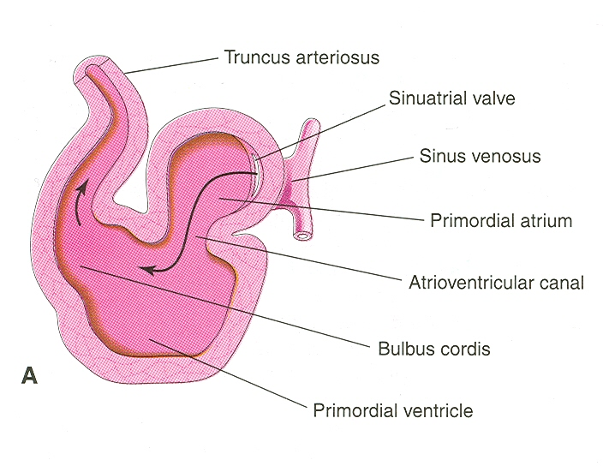
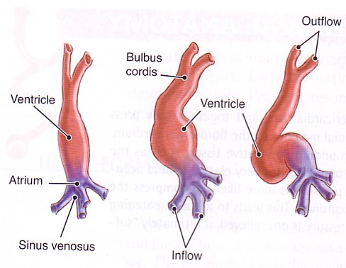
U-SHAPED HEART TUBE
Bulbus cordis and ventricle grow faster than other regions.
So the heart bends upon itself, forming
The U-shaped heart tube, (Bulboventricular loop).

Slide 9
S-Shaped Heart Tube
As the heart tube develops it bends, upon itself and forms S shaped heart tube:
SO, the Atrium and Sinus venosus become Cranial in position & Dorsal to the Truncus arteriosus, Bulbus cordis, and Ventricle.
By this stage the sinus venosus (opens in the dorsal surface of the atrium) has developed 2 lateral expansions, (Horns) :Right and Left

Slide 10
Veins Draining into Sinus Venosus
Each horn of the sinus venosus receives
3 veins:
1.Common cardinal
2.Vitelline
3.Umbilical
C Cardinal vein from the fetal body.
Vitelline from the yolk sac.
Umbilical from the placenta.

Slide 11
Fate of Sinus Venosus
The Right Horn forms the smooth posterior part of the right atrium.
The Left Horn and Body atrophy and form the Coronary Sinus.
The Left Common cardinal vein forms the Oblique Vein of the Left Atrium.

Slide 12
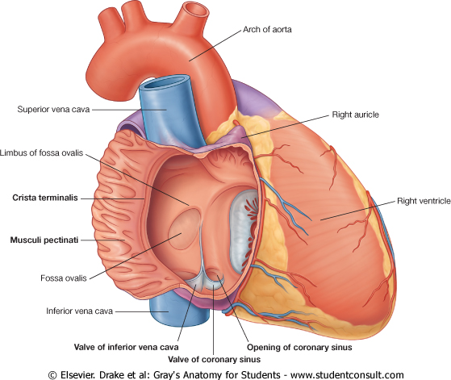
Right Atrium
The right horn of the sinus venosus forms the smooth posterior part of the right atrium.
Rough Trabeculated anterior part (musculi pectanti) of the right atrium is derived from the primordial common atrium.
These two parts are demarcated by the crista terminalis internally and sulcus terminalis externally.

Slide 13
Left Atrium
Rough Trabeculated part: derived from the common primordial atrium.
The smooth part:
derived from the absorbed Pulmonary Veins.

Slide 14
Partitioning of Primordial Heart
Partitioning of:
1- Atrioventricular canal.
2- Common atrium.
3- Common ventricle.
4- Truncus arteriosus & Bulbus cordis.
It begins by the
middle of 4th week.
It is completed by
the end of 5th week.

Slide 15
Endocardial Cushions
They appear around the middle of the 4th week as Mesenchymal Proliferation They participate in formation of :
(1) A.V canals and valves.
(2) Atrial septa.
(3) Membranous part of Ventricular septum.
(4) Aortic and Pulmonary channels (Spiral septum).

Slide 16
Partitioning of the atrioventricular canal
Two Endocardial Cushions are formed on the dorsal and ventral walls of the AV canal.
The AV endocardial cushions approach each other and fuse to form the Septum Intermedium.
Dividing the AV canal into right & left canals.
These canals partially separate the primordial atrium from the ventricle.

Slide 17
Partition of the Common Atrium
Septum Primum
It is sickle- shaped septum that grows from the roof of the common atrium towards the fusing endocardial cushions (septum intermedium)
So it divides the common atrium into right & left halves.

Slide 18
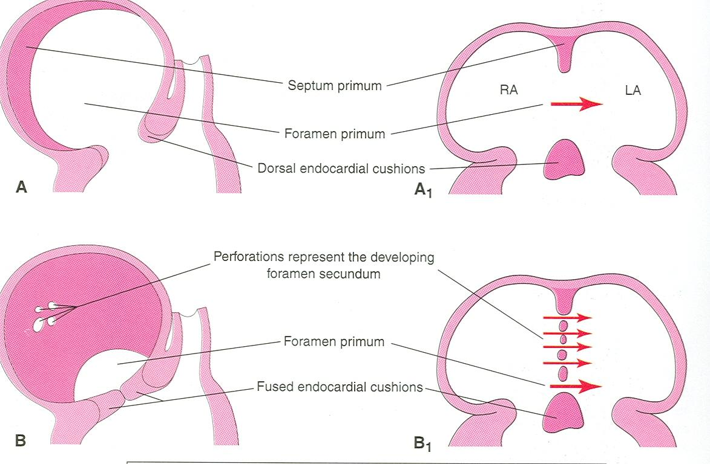
Ostium Primum
The two ends of septum primum reach to the growing endocardial cushions before its central part.
Now the septum primum bounds a foramen called ostium primum.
It serves as a shunt, enabling the oxygenated blood to pass from right to left atrium.
The ostium primum become smaller and disappears as the septum primum fuses completely with the septum intermedium to form the AV septum.

Slide 19
Septum Secundum
The upper part of septum primum that is attached to the roof of the common atrium shows gradual resorption forming an opening called ostium secondum.
Another septum descends on the right side of the septum primum called Septum Secundum.
It forms an incomplete partition between the two atria.
Consequently a valvular oval foramen forms, (Foramen Ovale)

Slide 20
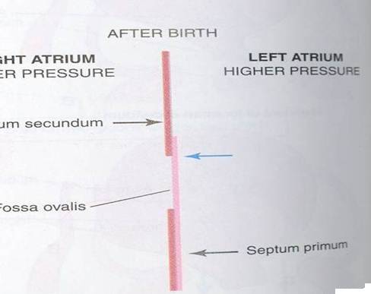
Fate of foramen Ovale
At birth when the lung circulation begins, the pressure in the left atrium increases.
The valve of the foramen ovale is pressed against the septum secundum and obliterates the foramen ovale.
Its site is represented by the Fossa Ovalis:
Its floor represents the persistent part of the septum primum.
Its limbus (anulus) is the lower edge of the septum secundum.

Slide 21
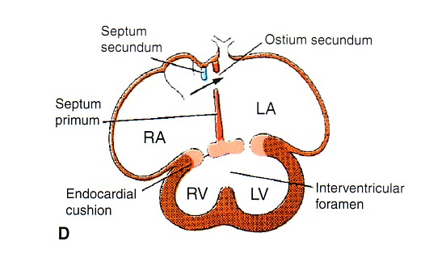
Partitioning of Primordial Ventricle
Muscular part of the interventricular septum:
Division of the primordial ventricle is first indicated by a median muscular ridge, the primordial interventricular septum.
It is a thick crescentic fold which has a concave upper free edge.
This septum bounds a temporary connection between the two ventricles called Interventricular foramen.

Slide 22
Interventricular Septum
The Membranous part
of the IV septum: derived from
1- A tissue extension from the right side of the Endocardial Cushion.
2- Aorticopulmonary septum.
3- Thick Muscular part of the IV septum.

Slide 23
BULBUS CORDIS
The bulbus cordis forms the smooth upper part of the two ventricles.
Right Ventricle:
Conus Arteriosus or (Infundibulum) which leads to the pulmonary trunk.
Left ventricle:
Aortic Vestibule leading to ascending aorta.

Slide 24
Partition of Truncus Arteriosus
In the 5th week, proliferation of mesenchymal cells (Endocardial Cushions) appear in the wall of the truncus arteriosus ,they form a Spiral Septum:
A. It divides the Lower part of the T A into Right & Left parts
B. It divides the Middle part of TA into Anterior & Posterior parts.
C. It divides the Upper part of the TA into Left & Right parts.

Slide 25
This explains the origin of pulmonary trunk from R ventricle & ascending aorta from L ventricle & their position to each other.

Slide 26
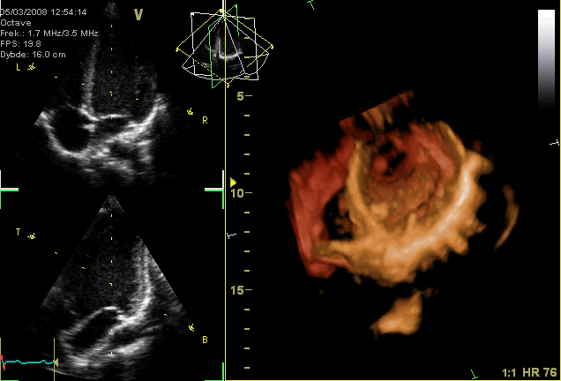
MAJOR CARDIAC ANOMALIES

Slide 27
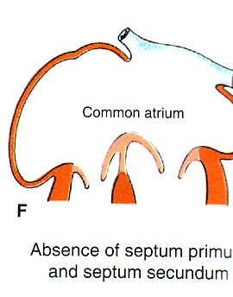
Atrial Septal Defects (ASD)
Types :
1. Absence of both septum primum and septum secundum, leads to Common Atrium.
2. Absence of Septum Secundum

Slide 28
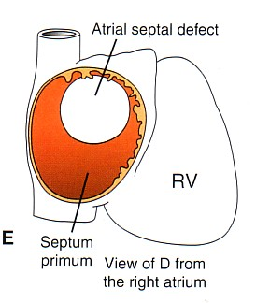
3. Large (Patent) foramen ovale : Excessive resorption of septum primum

Slide 29
VENTRICULAR SEPTAL DEFECT (VSD)
Roger’s disease
Absence of the Membranous part of interventricular septum (persistent IV Foramen).
Usually accompanied by other cardiac defects.

Slide 30
TETRALOGY OF FALLOT
Blue Baby
Fallot’s Tetralogy:
1-VSD.
2- Pulmonary stenosis.
3-Overriding of the aorta
4- Right ventricular hypertrophy.

Slide 31
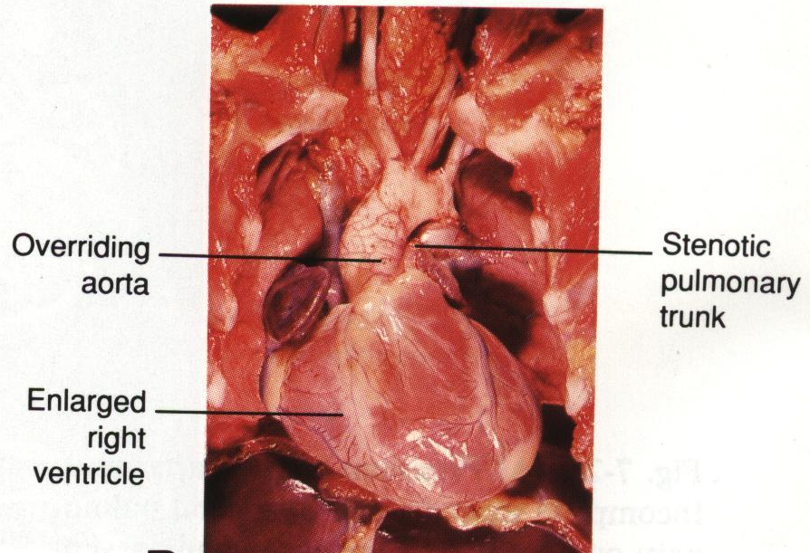
TETRALOGY OF
FALLOT
Blue Baby

Slide 32
TRANSPOSITION OF GREAT ARTERIES (TGA)
TGA is due to abnormal rotation or malformation of the aorticopulmonary septum, so the right ventricle joins the aorta, while the left ventricle joins the pulmonary artery.
It is one of the most common causes of cyanotic heart disease in the newborn
Often associated with ASD or VSD
Blue Baby

Slide 33
Persistent Truncus Arteriosus
It is due to
failure of the
development of
aorticopulmonary
(spiral) septum.
It is usually
accompanied with
VSD.
It forms a single arterial trunk arising from the heart and supplies the systemic , pulmonary & coronary circulations.

Slide 34
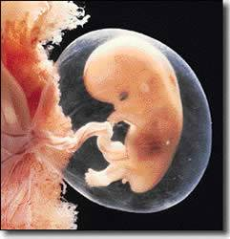
THANK YOU

