Slide 1
Myocarditis and Pericarditis
Dr. Khalifa Binkhamis
Department of Pathology ,College Of Medicine

Slide 2
Objectives
Describe the epidemiology, risk factor for myocarditis.
Explain the pathogenesis of myopericarditis.
Differential between the various types of myocarditis and pericarditis.
Name various etiological agents causing myocarditis and pericarditis.
Describe the clinical presentation and differential diagnosis of myocarditis and pericarditis.
Discuss the microbiological and non microbiological methods for diagnosis of myocarditis and pericarditis.
Explain the management ,complication and prognosis of patient with myocarditis and/or pericarditis.

Slide 3
Myocarditis
Myocarditis is inflammatory disease of the heart muscle.
Mild & self-limited with few symptoms OR severe with progression to congestive heart failure & dilated cardiac muscle.
localized or diffuse
Myocarditis can be due to a variety of infectious and non infectious causes eg. toxins, drugs and hypersensitivity immune response.
Viral infection is the most common cause

Slide 4
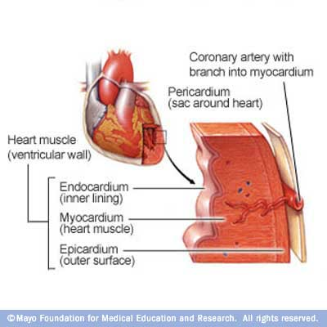

Slide 5
Myocarditis

Slide 6
Epidemiology ,Etiology and Risk Factors
Epidemiology : no accurate estimate of incidence as many cases are mild & brief and diagnosis is not made.
Etiology : Coxsackie virus B is the most common cause of myocarditis.
Other virus : Coxsackie virus A, Echoviruses, Adenoviruses ,Influenza, EBV, Rubella, Varicella, Mumps, Rabies, Hepatitis viruses and HIV.
Bacterial causes include Corynebacterium diphtheriae, Syphilis ,Lyme disease or as a complication of bacterial endocarditis.

Slide 7
Etiology-continue
Parasitic causes includes Chagas diseases, Trichinella spiralis, Taxoplasma gondii and Echinococcus.
Others organisms includes Rickettsiae, Fungi, Chlamydia, enteric pathogens, Legionella and Mycobacterium tuberculosis.
Giant cell myocarditis due to Thymoma, SLE (systemic lupus erythromatosis ) or Thyrotoxicosis.

Slide 8
Infectious | Noninfectious
Viruses Coxsackie B HIV | Systemic Diseases SLE Sarcoidosis Vasculities(Wegener’s disease) Celiac disease
Bacterial 1. Corynebacterium diphtheriae (diphtheria) | Neoplastic infiltration
Protozoan 1. Trypanosoma cruzi (Chagas disease) | Drugs & Toxins Ethanol Cocaine Radiation Chemotherapeutic agents - Doxorubicin
Spirochete Borrelia burgdorferi ( Lyme disease)

Slide 9
Clinical Presentation of myocarditis
Highly variable: may occur days to weeks after onset of acute febrile illness or with heart failure without any known antecedent symptoms .
Fever, headache, muscle aches, diarrhea, sore throat and rashes similar to most viral infections
Chest pain, arrhythmias ,sweating , fatigue and may present with congestive heart failure.

Slide 10
Differential Diagnosis
Acute Myocarditis
Vasculitis
Cardiomyopathy (due to drugs or radiation)

Slide 11
Diagnosis of myocarditis
WBCs, ESR, Troponin and CK-MB usually elevated
ECG (nonspecific ST-T changes and conduction delays are common)
Blood culture
Viral serology and other specific tests for Lyme disease, diphtheria and Chagas disease may be indicated on a case by case basis.
Chest X-rays : show cardiomegaly
Radiology : MRI and Echocardiogram
Heart muscle biopsy (for some cases)

Slide 12
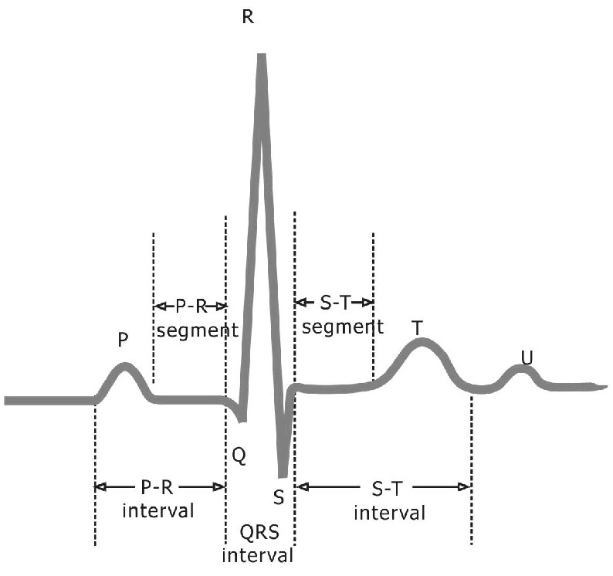
ECGs of normal heart

Slide 13
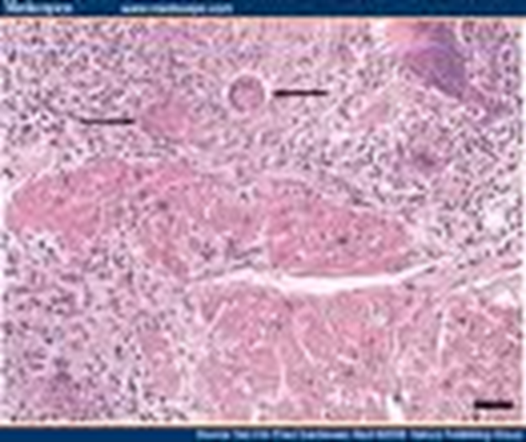
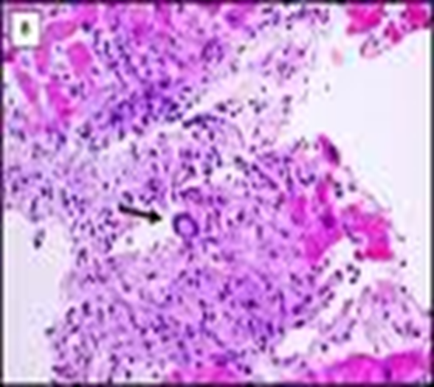
Endomyocardial Diagnosis
Pathologic examination is not sensitive . It may reveal lymphocytic inflammatory response with necrosis. “Giant cells” may be seen.

Slide 14
Management of myocarditis
Often supportive: restricted physical activity in heart failure.
Specific antimicrobial therapy is indicated when an infecting agent is identified.
Treatment of heart failure arrhythmia
Other drugs indicated in special situations like anticoagulant, NSAID (non-steroidal anti-inflammatory drugs) , steroid or immunosuppressive immunomodulatory agents.
Heart transplant
Notes:
Heart transplant in patient with intractable heart failure and cardiomyopathy.

Slide 15
Management of myocarditis
Most cases of viral myocarditis are self limited.
One third of the patients are left with lifelong complications, ranging from mild conduction defects to severe heart failure.
Patient should be followed regularly every 1-3 months.
Sudden death may be the presentation of myocarditis in about 10% of cases.

Slide 16
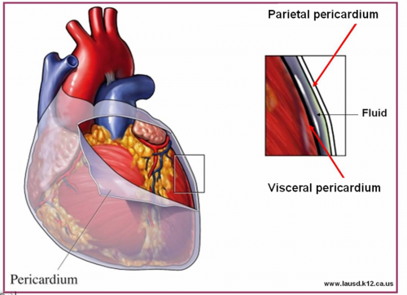
Acute Pericarditis

Slide 17
Pericarditis
Pericarditis is an inflammation of the pericardium usually of infectious etiology ( viruses, bacterial, fungal or parasitic)
Etiology : (infectious and non-infectious).
Infectious causes :
Viral Pericarditis:
Coxsackie virus A and B, Echovirus are the most common causes.
Other viruses includes Herpes viruses, Hepatitis B , Mumps, Influenza, Adenovirus ,Varicella and HIV.

Slide 18
Bacterial Pericarditis usually a complication of pulmonary infections (e.g. pneumonia ,empyema):
organisms: S. pneumoniae, M. tuberculosis, S. aureus, H. influenzae, K. pneumoniae & Legionella.
HIV patients may develop pericardial effusions caused by: M.tuberculosis or M. avium complex.
Disseminated fungal infection caused by : Histoplasma, Coccidioides.
Parasitic infections eg.disseminated toxoplasmosis, contagious spread of Entamoeba histolytica - are rare causes.

Slide 19
Non-infectious pericarditis:
Causes:
Immune mediated : as in rheumatoid fever & SLE
Miscellaneous : eg. due to myocardial infarction , malignancy and uremia.

Slide 20
Pathophysiology
Contiguous spread
lungs, pleura, mediastinal lymph nodes, myocardium, aorta, esophagus, liver.
Hematogenous spread
septicemia, toxins, neoplasm, metabolic
Lymphangetic spread
Traumatic or irradiation

Slide 21
Pathophysiology
Inflammation provokes fibrinous exudate with or without serous effusion
The normal transparent and glistening pericardium is turned into a dull, opaque, and “sandy” sac
Can cause pericardial scarring with adhesions and fibrosis.

Slide 22
Types of Pericarditis
Caseous Pericarditis commonly tuberculous in origin.
Serous Pericarditis due to autoimmune diseases (rheumatoid arthritis, SLE), viral infections
Transudative serous fluid
Fibrinous Pericarditis due to acute MI, uremia, radiation
Fibrinous exudative fluid

Slide 23
Types of Pericarditis
Purulent/Suppurative pericarditis due to bacteria, fungi or parasits.
Purulent exudative fluid
Hemorrhagic pericarditis usually caused by infection (e.g. TB) or malignancy
blood mixed with a fibrinous or suppurative effusion

Slide 24
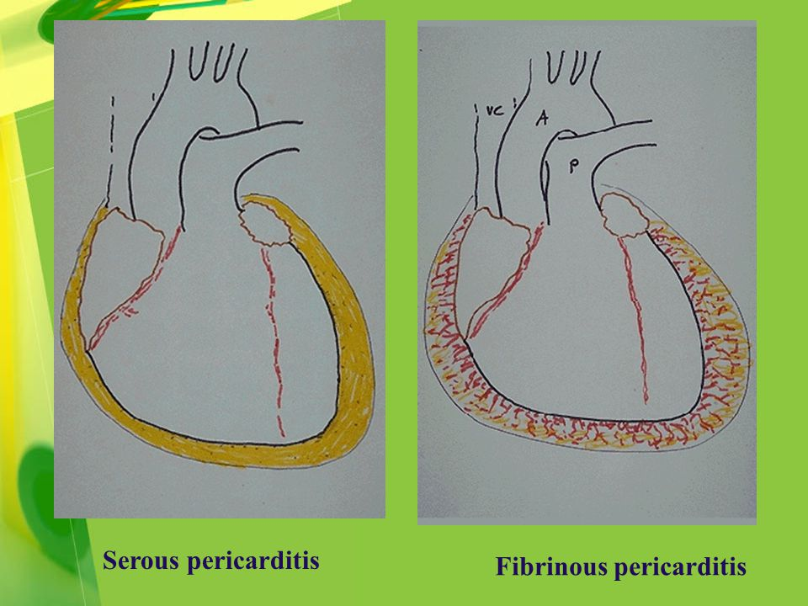
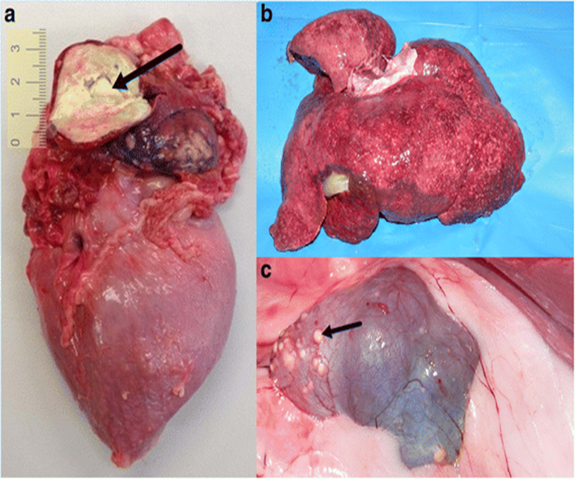
Types of pericarditis:

Slide 25
Constrictive Pericarditis causes:
Idiopathic
Radiotherapy
Cardiac surgery
Connective tissue disorders
Dialysis
Bacterial infection ( viral, TB, fungal)

Slide 26
Clinical presentation of pericarditis
Acute pericarditis:
Sudden pleuritic chest pain which is positional retrosternal l(relieved by setting forward)
Dyspnea
Fever
On examination : Pericardial rub, exaggerated pulses , paradoxus JVP (jugular venous pressure) and tachycardia.
As the pericardial pressure increases, palpitations , presyncope or syncope may occur.
Chronic pericarditis:
Tuberculous pericarditis has insidious onset .

Slide 27
Tuberculous Pericarditis
Incidence of pericarditis in patients with pulmonary TB ranges from 1 – 8 %
Clinical findings: fever, pericardial friction rub, hepatomegaly
Tuberculin skin test usually positive
Fluid smear for acid fast bacilli (AFB ) often negative
Pericardial biopsy more definitive

Slide 28
Acute Pericarditis Differential Diagnosis
Acute myocardial infarction
Pulmonary embolism
Pneumonia
Aortic dissection

Slide 29
Investigations & Diagnosis
ECG will show ST elevation, PR depression and T-wave inversion may occur later.
Blood culture
Leukocytosis and an elevated ESR are typical
Other routine testing : urea and creatinine.
Tuberculin skin test is usually positive in tuberculous pericarditis cases.
Chest x-ray may show enlarged cardiac shadow or calcified pericardium and CT scan show pericardial thickening >5mm.
Pericardial fluid or pericardial biopsy specimens for fungi.
Immunology /Serology: Antinuclear antibody tests and Histoplasmosis complement fixation indicated in endemic area.

Slide 30
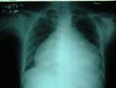
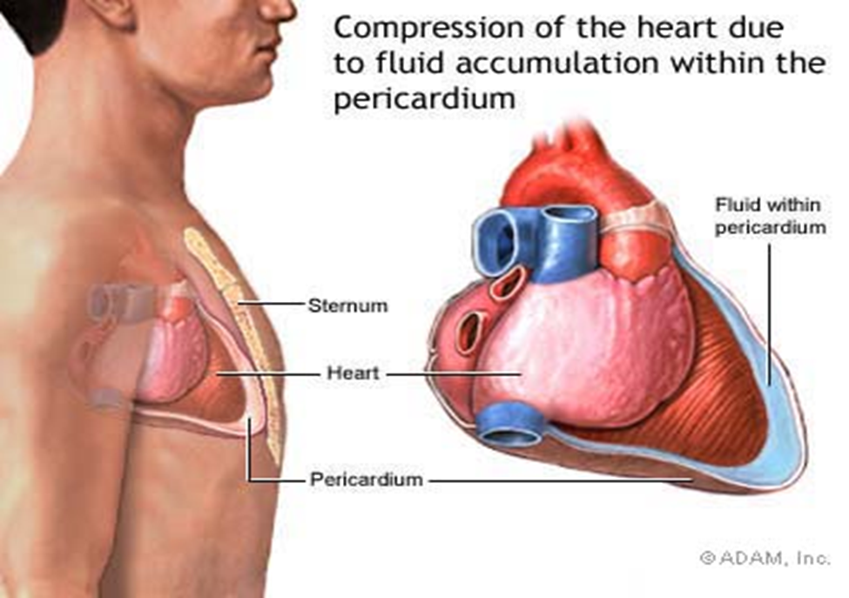
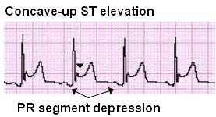

Slide 31
Management of pericarditis
Management is largely supportive for cases of idiopathic and viral pericarditis including bed rest , NSAIDS and Colchicine.
Corticosteroid use is controversial and anticoagulants usually contraindicated.
Specific antibiotics must include activity against S. aureus and respiratory bacteria.
Antiviral:
Acyclovir for Herpes simplex or Varicella . Ganciclovir for CMV .

Slide 32
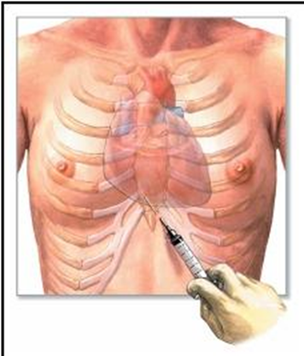
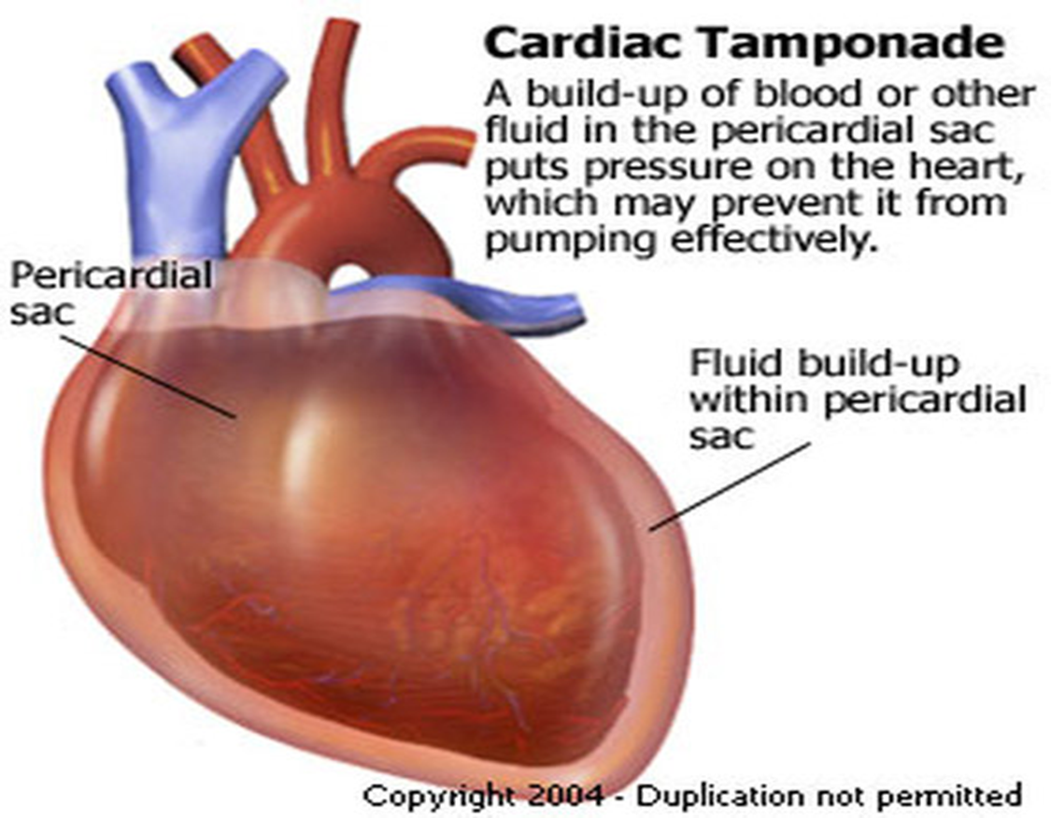
Pericardiocentesis

Slide 33
Management of pericarditis
Pericardiocentesis : a therapeutic procedure to remove fluid from the pericardium (to relief Tamponade) in severe cases with pericardial effusion.
Patients who recovered should be observed for recurrence.
Symptoms due to viral pericarditis usually subsided within one month.

