Slide 1
Sympatholytic & adrenergic blockers α-receptor Antagonists
Prof. Hanan Hagar
Pharmacology Unit
College of Medicine

Slide 2
Adrenergic Neuron Blockers
Adrenoceptor Blockers
Alpha & beta- adrenergic receptor blockers

Slide 3
Classification of sympatholytics
Adrenergic neuron blockers
Adrenergic receptor blockers

Slide 4
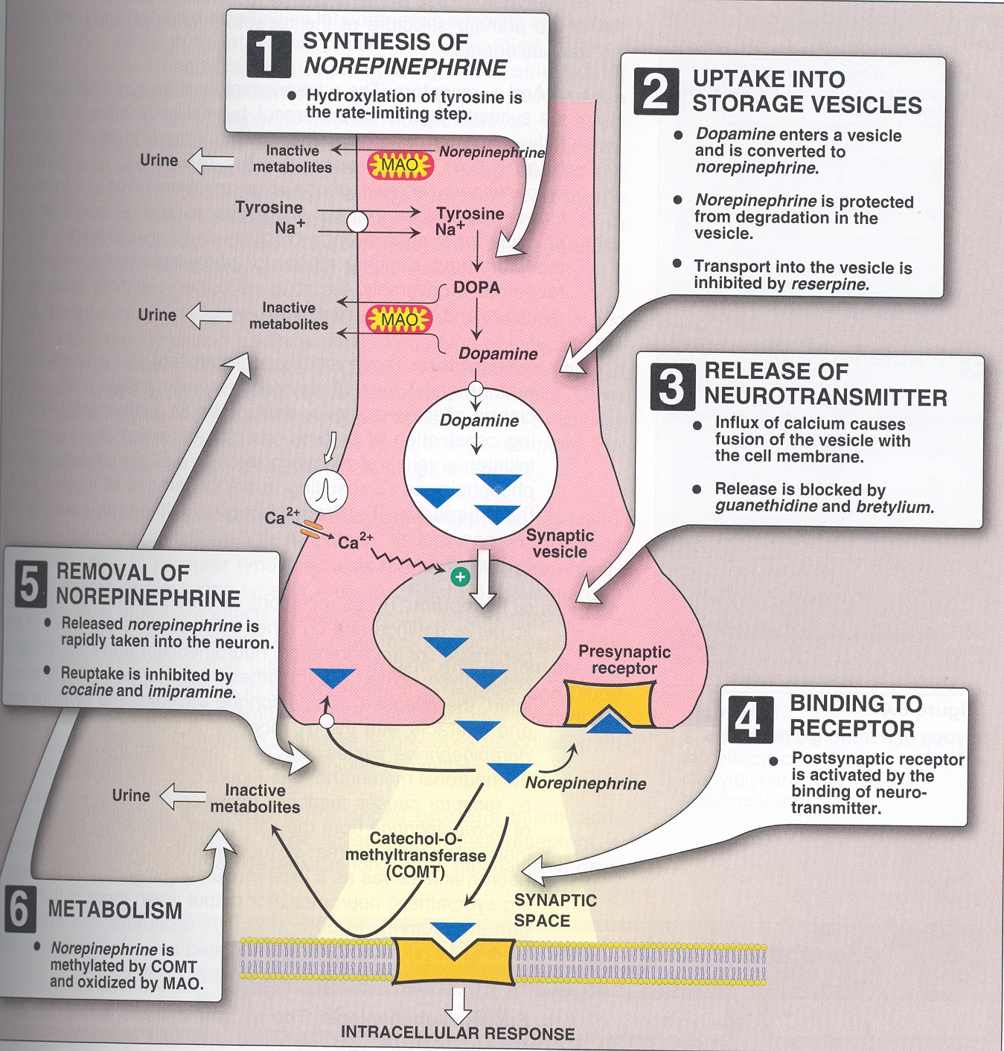
Classification of sympatholytics
Adrenergic receptor blockers
α-receptor antagonists
β-receptor antagonists

Slide 5
Classification of sympatholytics
Adrenergic neuron blockers
Formation of False Transmitters
e.g. α-Methyl dopa
Depletion of storage sites
e.g. reserpine
Inhibition of release & enhance uptake
e.g. guanethidine
Stimulation of presynaptic α₂ receptors
e.g. Clonidine and α-Methyl dopa

Slide 6
Classification of sympatholytics Adrenergic neuron blockers
α-Methyl dopa
Forms false transmitter that is released instead of NE
Acts as central α₂ receptor agonist to inhibit NE release
Drug of choice in
Treatment of hypertension in pregnancy ( gestational hypertension- pre-eclampsia).

Slide 7
Classification of sympatholytics
Clonidine
Acts as central α₂ receptor agonist to inhibit NE release
suppresses sympathetic outflow activity from the brain.
Little used as antihypertensive agent due to rebound hypertension upon abrupt withdrawal.
Apraclonidine
is used in open angle glaucoma as eye drops.
acts by decreasing aqueous humor formation.

Slide 8
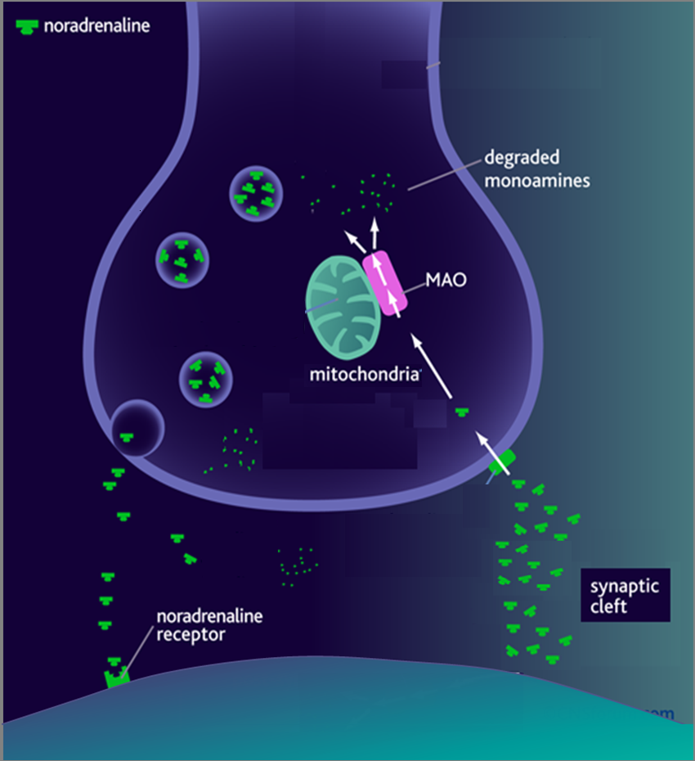
1. Adrenergic Neuron Blockers [SYMPATHOLYTICS]
1. METHYLDOPA
α-methyl tyrosine
Norepinephrine (NE)
Na
Dopa
Tyrosine
False Transmitters
Tyrosine
◉
Antihypertensive in PREGNANCY
DA
2. RESERPINE
NE
Depletes Stores
α₂
NET
4. Clonidine
Presynaptic α₂ agonist
3. Gaunthidine
○ Inhibit Release
○ Enhance Uptake
2. Adrenoceptor Blockers [ADRENOLYTICS]
α₁
β₁
β₂
COMT

Slide 9
Adrenergic receptor blockers
Include
α-receptor antagonists
β-receptor antagonists

Slide 10
Classification of α-receptor Antagonists
Non-selective antagonists e.g. phenoxybenzamine & phentolamine.
α₁-selective antagonists e.g. prazosin, doxazosin.
α₂-selective antagonists e.g. yohimbine

Slide 11
Non-Selective α- Adrenoceptor Antagonists
Phenoxybenzamine:
Irreversible block of
both α₁ and α₂ receptors
Long-acting (24 hrs)
Phentolamine:
reversible blocking of
α₁ & α₂ receptors.
Short acting (4 hrs).

Slide 12
Pharmacological actions
Both drugs cause:
Decrease peripheral vascular resistance
Postural hypotension.
Reflex tachycardia.
Reflex tachycardia due to the fall in B.P,
mediated by baroreceptor reflex and due to
block α₂ in heart.

Slide 13
Therapeutic Uses:
Pheochromocytoma: Should be given before
surgical removal to protect against hypertensive
crisis.
Both drugs can precipitate arrhythmias and
angina and are contra-indicated in patients with
decreased coronary perfusion.

Slide 14
Adverse Effects of non-Selective α- Adrenoceptor
Antagonists :
Postural hypotension
Tachycardia
Headache
Nasal stuffiness or congestion
Vertigo & drowsiness
Male sexual dysfunction (inhibits ejaculation).

Slide 15
Selective α1- Antagonists
Prazosin, doxazosin, terazosin .
Prazosin (short half-life)
Doxazosin, terazosin (long half life)

Slide 16
Selective α1- Antagonists
Pharmacological effects of α₁–antagonists:
Vasodilatation due to relaxation of arterial and venous smooth muscles
Fall in arterial pressure
less reflex tachycardia than with non-selective α blockers

Slide 17
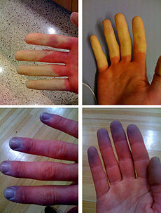
Therapeutic Uses:
Treatment of essential hypertension
Urinary obstruction of benign prostatic hypertrophy (BPH).
Raynaud's disease.

Slide 18
Selective α_{1A}–antagonists Tamsulosin
Is a selective α_{1A} antagonist.
Tamsulosin produce: relaxation of smooth muscles of bladder neck & prostate →improve urine flow.
Has minimal effect on blood pressure.
Tamsulosin is used in the treatment of benign prostatic hypertrophy (BPH).

Slide 19
Selective α_{1A} antagonist Tamsulosin
Tamsulosin
Relaxation of bladder neck can improve urine flow
BPH
Adverse effects of α1A- Antagonists
as before with non selective but to a lesser degree

Slide 20
α₂-selective antagonists
e.g. yohimbine
Used as aphrodisiac in the treatment of erectile dysfunction.
Increase nitric oxide released in the corpus cavernosum thus producing vasodilator action and contributing to the erectile process.

