Slide 1
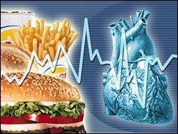
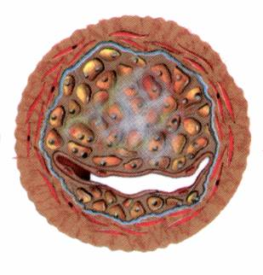
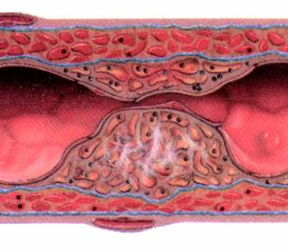
Drugs for hyperlipidemia
Prof. Yieldez Bassiouni

Slide 2
ILOs
By the end of those 2 lectures the student will be able to:
Define hyperlipidemia vs normal lipid levels
Discuss the non-pharmacological treatment of hyperlipidemia
Classify lipid lowering agents targeting exogenous & endogenous pathways
Expand on the pharmacology of drugs related to each group
Hint on adjuvant drugs that can help in lipid lowering

Slide 3
Hyperlipidemia
Hyperlipidemia is a major cause of atherosclerosis which may lead to CAD and ischemic cerebrovascular disease
Denotes abnormally  levels of any or all Lipids and/or Lipoproteins [LP] in blood
Lipids originate from two sources:
endogenous lipids, synthesized in the liver
exogenous lipids, ingested and processed in the intestine
The principle lipids in the blood are:
- Cholesterol (C) - Triglycerides (TG)
- Phospholipids (PL) - Cholesterol esters (CE)
- Non-estrified fatty acids (NEFA)

Slide 4
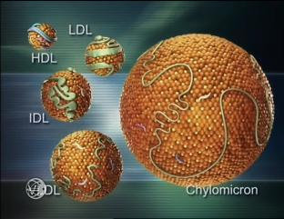
Lipoprotein Classes
- Endogenous molecules that contain both proteins and lipids in
their structure
- transport (carry) lipids around the body in the blood

Slide 5
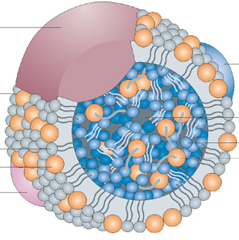
LP
Chylomicrons
[CM]
Very low Density lipoprotein
[VLDL]
Low Density lipoprotein
[LDL]
High Density lipoproteins
[HDL]
Apoprotein
Outer Coat
Inner Core
Phospholipids Cholesterol
Triglycerides
Cholesterol esters
Hydrophilic Gps.
Lipophylic Gps.
- Lipoproteins are classified into five major families
which differ in the amounts of C, TG and types of
apoproteins they contain
-Chylomicrons (CM)
-Very low density - lipoproteins (VLDL)
-Intermediate - density lipoproteins (IDL)
-Low density - lipoproteins (LDL)
-High density- lipoproteins (HDL)

Slide 6
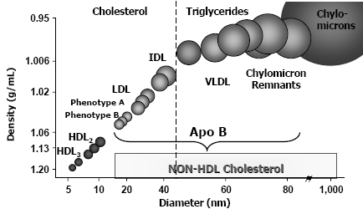
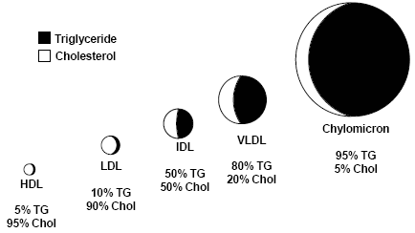
Atherogenic Particles

Slide 7
Normal Lipid levels
C < 200 mg/dl
TGs < 220 mg/dl
LDL < 130 mg/dl (Bad C)
HDL > 50 mg/dl (Good C)
Lipids levels are detected in serum after a 12-hour fast

Slide 8
Factors promoting elevated blood lipids
family history of CAD
smoking (reduced levels of HDL, cytotoxic effects on the endothelium, increased oxidation of lipoproteins, and stimulation of thrombogenesis)
hypertension
obesity
DM (increased generation of VLDL and free fatty acids presented to the liver)
inactivity / lack of exercise
alcohol intake ( increases TGs)
Notes:
f

Slide 9
Familial Hyperlipoproteinemia
LProteinemia | LP | Lipids | Risk
Type I | CM | TGs | -
Type IIa | LDL | C | 
Type IIb | VLDL & LDL | TG & C | 
Type III | IDL | TGs & C | 
Type IV | VLDL | TGs | 
Type V | VLDL & CM | TGs & C | _

Slide 10
Therapeutic strategies for treatment of hyperlipidemia
Therapeutic lifestyle changes
Antihyperlipidemic agents
1. Healthy diet; optimal Quantitative & Qualitative fat content:
Diet has <30% of calories as fat, <7% as saturated fat and <200mg cholesterol/day
Avoid trans-fatty acids & acute increase in C intake
Use vegetable oils rich in unsaturated fatty acids: oleic acid, linoleic acid & linolenic acids. Diet should also contain plant stanols (interfere with the formation of micellar cholesterol) & soluble fibers
Eat food high in antioxidants vitamins
2. Regular exercise
3. Cessation of hazards habits; smoking, alcohol, …etc
4. Loss of weight
Can achieve a fall in LDL-C of 8-15% … but long-term compliance is a problem

Slide 11
Antihyperlipidemic agents
According to the mechanism of action:
1- Inhibits cholesterol absorption in the intestine
Ezetimibe
2-Sequester bile acids in the intestine
Exchange resins
3-Inhibits synthesis of cholesterol
Inhibitors of hydroxymethylglutaryl coenzyme A reductase (Statins)
4-Alter relative levels & patterns of different plasma LPs
Fibrates, Nicotinic acids

Slide 12
I-Agents targeting exogenous cholesterol
Ezetimibe
Colestipol & cholestyramine
II-Agents targeting endogenous cholesterol
Statins
Fibrates
Nicotinic acid
III-Adjuvant agents
Omega-3-Fatty Acids, Stanols

Slide 13
Hepatic Cholesterol Metabolism
C synthesized
in extrahepatic tissues
De novo synthesis
Diet
Absorption
Liver cholesterol pool
Secretion of VLDL and HDL
Conversion to
bile salts/acids
Free C
in bile

Slide 14
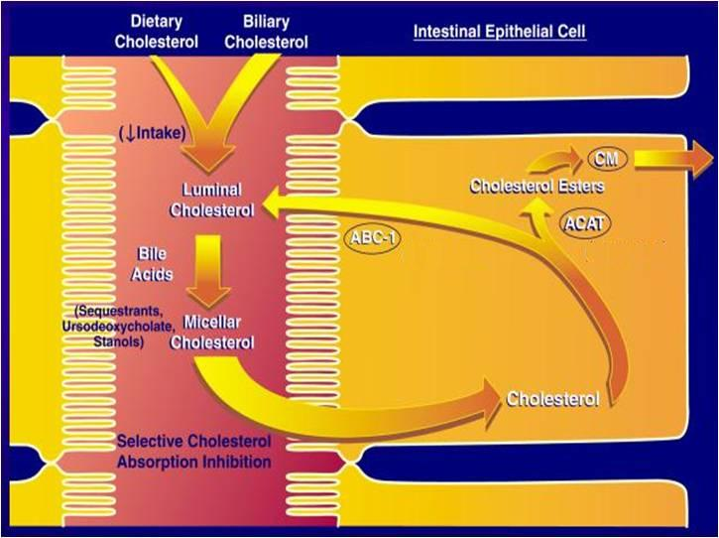
I-Agents Targeting Exogenous Cholesterol
Colestipol
Cholestyramine
NPC1L1
Ezetimibe

Slide 15
Exchange resins Bile acid sequestrants
Cholestyramine & Colestipol
Colesevelam

Slide 16
Resins: Mechanism of Action
They disrupt the enterohepatic circulation of bile acids

Slide 17
Bile Acid-Binding Resins
Moderately effective with excellent safety record
Large MW polymers which bind to bile acids and the acid-resin complex is excreted so their fecal excretion  10 folds
prevents enterohepatic cycling of bile acids
obligates the liver to synthesize replacement bile acids from cholesterol
The liver increases the number of LDL receptors to obtain more cholesterol
The levels of LDL-C in the serum are reduced as more cholesterol is delivered to the liver
Excellent choice for people that cannot tolerate other types of drugs

Slide 18
Resins : Adverse Effects
Resins are clinically safe as they are not systemically absorbed
GIT upset: abdominal discomfort, bloating, constipation
Decreased absorption of: fat soluble vitamins (Vitamin A, D, K)
The concentration of HDL-C is unchanged

Slide 19
Resins: Drugs interactions
Interfere with the absorption of:
Statins, Ezetimibe
Chlothiazides, Digoxin, Warfarin
N.B. wait 1 hour before or 4 hrs after administration of resins
Colesevelam has not been shown to interfere with the absorption of co-administered medications and is a better choice for patients on multiple drug regimens

Slide 20
Contraindications of resins
1- Complete biliary obstruction ( because bile is not secreted into the intestine)
2- Chronic constipation
3-Severe hypertriglyceridemia (TG >400 mg/dL) ??
The bile acid binding resins can raise triglycerides modestly ( about 5%) and cannot be used if the triglycerides are elevated.

Slide 21
Cholesterol Absorption Inhibitors
Ezetimibe
Notes:
Bile Acid Sequestrants

Slide 22
Cholesterol Absorption Inhibitors
LDL
Liver
Duodenum
VLDL
X
Jejunum
Ezetimibe
Ileum
CM Remnant
CM
Colon

Slide 23
Mechanism of action of Ezetimibe
Ezetimibe reduces C absorption. Therefore, ezetimibe reduces the flux of C from the intestine to the liver.
Because this C is packaged and resecreted by the liver into the blood as VLDL (precursor of LDL in plasma), reduced flux of C to VLDL particles will lower LDL-C.

Slide 24
Pharmacological action
LDL 20%  TG 8% ,  HDL 1-4%
No effect on steroids, lipid-soluble vitamins, bile acids.
Pharmacokinetics
Absorbed & conjugated in intestine to active glucuronide
Reaches peak blood level in 12–14 hours
Undergoes enterohepatic circulation
Its half-life is 22 hours
Most of the drug is excreted in feces

Slide 25
Indications
As Monotherapy;
Primary prevention of low risk of CHD which needs modestLDL
As Combination Therapy; safe
-With statins; synergistic in
moderate/severe  LDL
-Or If must  statin dose because of side effects
-Or with other lipid lowering drugs; as fibrates
ADRs
Not common
GIT disturbance, headache, fatigue, artheralgia & myalgia
Ezatimibe

Slide 26
HMG-Co A Reductase Inhibitors
Statins
Notes:
Bile Acid Sequestrants

Slide 27
HMG-Co A Reductase Inhibitors
Hydroxy MethylGlutaryl-Coenzyme A reductase inhibitors or statins are the most effective and best-tolerated agents for treating hyperlipidemia
Statins are considered as first-line drugs when LDL-lowering drugs are indicated

Slide 28
Statins: Mechanism of Action
Statins are potent competitive inhibitors of 3-hydroxy-3-methyl glutaryl coenzyme A (HMG-CoA) reductase, which catalyzes an early, rate-limiting step in do-novo hepatic C synthesis. Thus, HMG-Co A is not converted to mevalonic acid

Slide 29
Statins: Mechanism of Action

Slide 30
1- Statins lower blood C levels by inhibiting de-
novo hepatic C synthesis
2- The liver compensates by the number of LDL receptors on the surface of hepatocytes (upregulation of LDL- R)
3- This results in removal of LDL from the blood and lowering of serum LDL- C levels
4- Because C is required for the synthesis of (the precursor of LDL-C), production of VLDL
5- Statins cause modest in plasma TG and slight
in HDL-C

Slide 31
PLEIOTROPIC EFFECTS OF STATINS
Beyond cholesterol lowering , recent studies indicate that some of the cholesterol-independent or "pleiotropic" effects of statins involve:
improving endothelial function,
enhancing the stability of atherosclerotic plaques,
decreasing oxidative stress and inflammation,
inhibiting the thrombogenic response.
Furthermore, statins have beneficial extrahepatic effects on the immune system, CNS, and bone.

Slide 32
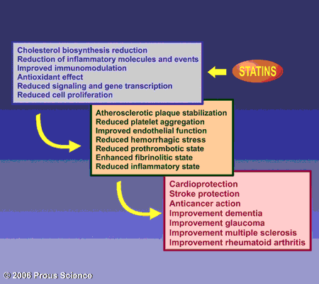
Statins: Advantages
PLEIOTROPIC EFFECTS OF STATINS
Pleiotropic effects of statins include improvement of endothelial dysfunction, increased nitric oxide bioavailability, antioxidant properties, inhibition of inflammatory responses, and stabilization of atherosclerotic plaques
So statins are drugs of choice in patients with high risk of CV disease, they reduce MI, strokes and mortality
Statins are the drug of first choice for treating hypercholesterolaemia and moderate triglyceridaemia
LDL 18-55%
 HDL 5-10%
◉ TG & VLDL 10-30%
Used alone or with other anti-hyperlipidemic drugs in R/ of elevated plasma levels of LDL-C

Slide 33
Statins: Preparations
Rosuvastatin (Crestor)
Atorvastatin (Lipitor)
Simvastatin (Zocor)
Pravastatin (Pravachol)
Lovastatin (Mevacor)
Used alone or with other anti-hyperlipidemic drugs ( ezetimibe ) for treatment of drug-resistant dyslipidaemia

Slide 34
Statins: Pharmacokinetics
Most statins have a high first-pass clearance by the liver
Greater than 95% of most of these drugs are bound to plasma proteins with short half-life
Drug-drug interactions involve specific interactions with the cytochrome P-450 drug metabolizing system, especially CYP3A4
All statins are taken orally at bedtime because of hepatic C synthesis is maximal between midnight and 2:00 a.m. , except atorvastatin taken at any time because of its long half-life (14 hours)

Slide 35
Indications
As monotherapy;
2nd ry Prevention; In all ischemic insults [stroke, AMI, …..etc.] So given from the 1st day of ischemic attack
Pry Prevention;
1. Patients with hyperlipidemia and with other risks for ischemic insults.
2. Type IIa Hyperlipoprotinemia.
If no control  combine (sequestrants / ezetimibe, niacin,.. ) to  C
As Combination therapy;
1. Mixed dyslipidaemias; added to fibrates or niacin if necessary
2. In diabetics and patients with insulin resistance [metabolic syndrome] because these patients will possess small dense LDL (severely atherogenic) + evident endothelial dysfunction + increased thrombotic profile

Slide 36
Statins: Adverse Effects
Common side effects: Headache , myalgia, fatigue, GI intolerance, and flu-like symptoms
Hepatotoxicity, raised concentrations of liver enzymes (serum aminotransferases)
Myopathy (increased creatine kinase [CK] released from muscles)
Teratogenicity, statins should be avoided during pregnancy

Slide 37
Statins: Drug Interactions
Statins potentiate the action of oral anticoagulant and anti-diabetic drugs (by displacement from plasma protein binding sites)
Drugs that increase the risk of statin-induced myopathy include:
Other antihyperlipidemics ( fibrates )
Drugs metabolized by 3A4 isoform of cytochrome P450: erythromycin, verapamil, cyclosporin, ketoconazole
Pravastatin and fluvastatin are the statins of choice in patients taking other drugs metabolized by cytochrome 3A4 system.

Slide 38
Statin-induced myopathy
Muscle aches, soreness, or weakness associated with an elevation of creatine kinase (CK) , are the best indicator of statin-induced myopathy.
Failure to recognize myopathy and to discontinue drug therapy can lead to rhabdomyolysis, myoglobinuria, and acute renal necrosis.
serum transaminase  can progress to evident hepatotoxicity
So lab investigations recommended every 6 month  if levels  up
to 3 folds at any time, statin must be stopped then dose adjusted.
 creatine kinase activity (index of muscle injury) 
Measured only if myalgia or myositis develops  if  3-5 folds  we
◉ statin doses / omit combination with fibrates…..

Slide 39
Niacin (Nicotinic Acid)

Slide 40
Niacin (Nicotinic Acid)
Water soluble B-complex vitamin with multiple actions
Niacin is the most effective medication for increasing HDL cholesterol levels and it has positive effects on the complete lipid profile
It is useful for patients with mixed dyslipidemias
Niacin exerts greatest beneficial effects on wide range of lipoprotein abnormalities

Slide 41
Mechanism of action:
In adipose tissue: it binds to adipose nicotinic acid receptors, this will lead to decrease in free fatty acids mobilization from adipocytes to the liver resulting in ↓ TG and thus VLDL synthesis
In liver: niacin inhibits hepatocyte diacylglycerol acyltransferase-2, a key enzyme for TG synthesis
Thus, it decreases VLDL production (decreased TG synthesis and estrification)
3. In plasma: it increases LPL activity that increases clearance of VLDL & chylomicron
Niacin also promotes hepatic apoA-I production and slows hepatic clearance of apoA-I and HDL

Slide 42
Pharmacological actions
Effect on VLDL:  VLDL by:
1)  synthesis in liver
2) increased clearance in plasma
3)  mobilization of free fatty acids from adipose tissue
Effect on LDL:  LDL due to reduction in its precursor (VLDL)
Effect on HDL: Induces modest increase in HDL-C (The catabolism of HDL can be inhibited by nicotinic acid through a mechanism that is largely unknown)
Niacin also promotes hepatic apoA-I production and slows hepatic clearance of apoA-I and HDL

Slide 43
Niacin : Adverse Effects
The most common side effect is cutaneous flushing, (which is prostaglandin -mediated , can be avoided by low dose aspirin ½ h before niacin)
GIT disturbances: Dyspepsia , nausea , vomiting , reactivation of peptic ulcer ( can be decreased if taken after meal)
High doses:
Reversible  liver enzymes hepatotoxicity.
Impairment of glucose tolerance  overt diabetes
 uric acid

Slide 44
Indications
Monotherapy or in combination with fibrate, resin or statin
Type IIa, IIb hypercholesterolemia & any combined hyperlipidemia
Patient with hypertriglyceridemia & low HDL-C
Contraindications
Gout
Peptic ulcer
Hepatotoxicity
Diabetes mellitus

Slide 45
Fibric acid Derivatives (Fibrates)

Slide 46
Fibrates :Mechanism of Action
Fibrates are agonists of peroxisome proliferator activated receptors (PPARα) which are a class of intracellular receptors that modulate fat metabolism
They increase genes transcription for lipoprotein lipase (LPL) leading to increased catabolism of TG in VLDL and chylomicrons
Examples: Clofibrate & Gemfibrozil & Fenofibrate

Slide 47
Fibrates: pharmacological effects
 LPL activity, which increases clearance of VLDL & chylomicron in plasma
A marked reduction in TG (due to stimulation of catabolism of VLDL)
 FFA uptake by the liver
 LDL-C uptake by the liver
in HDL-C (by increasing the production of the apoprotein components of HDL)
 excretion of hepatic C in bile , thus endogenous hepatic C synthesis may be decreased

Slide 48
Fibrates : Adverse Effects
GIT (indigestion, abdominal pain, diarrhea)
Myositis : can occur resulting in weakness and tenderness of muscles, use of fibrates with statins is generally inadvisable
Gallstones: Clofibrate increases C content of bile, predisposes to gallstones, and its use is therefore limited to patients who have cholecystectomy
Notes:
.

Slide 49
Indication of Fibrates
1st-line defense for:
*mixed dyslipidemia (i.e. raised serum TG and C)
* Patients with low HDL and high risk of atheromatous disease (often type 2 diabetic patients)
* Patients with severe treatment- resistant dyslipidemia (combination with other lipid-lowering drugs).

Slide 50
ADRs
1. G.I.T upset, headache, fatigue, weight gain
2. Rash, urticaria, hair loss
3. Myalagia, Myositis, Rhabdomyolysis Acute renal failure  Occurs >
-In alcoholics,
-If combined with statins
-Or In impaired renal function
4. fibrates should be used with caution in patients with biliary tract disease, as they increase the risk of cholesterol gallstones as a result of an increase in the cholesterol content of bile.
Interactions
They displace warfarin from their protein binding sites   bleeding tendency  anticoagulant dose must be adjusted
They  metabolism of statins  toxicity  myalgia, myositis, …….etc. Give lower doses

Slide 51
Drug interactions
Increased risk of myopathy when combined with statins.
Displace drugs from plasma proteins (e.g. oral anticoagulants and oral hypoglycemic drugs)
Contraindications
Patients with impaired renal functions
Pregnant or nursing women
Preexisting gall bladder disease

Slide 52
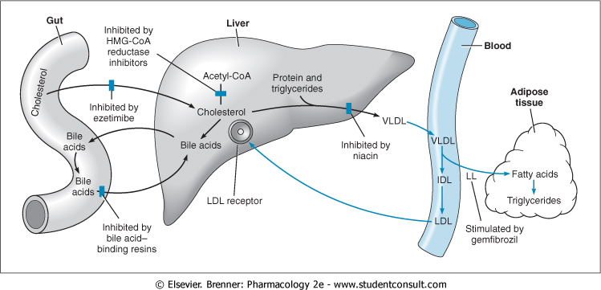
Sites and mechanism of drugs for hyperlipidemia

Slide 53
Medications for Hyperlipidemia
Drug Class | Agents | Effects (% change) | Side Effects
HMG CoA reductase inhibitors | Lovastatin Pravastatin | ↓LDL (18-55), ↑ HDL (5-15) ↓ Triglycerides (7-30) | Myopathy, increased liver enzymes
Cholesterol absorption inhibitor | Ezetimibe | LDL( 14-18), ↑ HDL (1-3) ↓Triglyceride (2) | Headache, GI distress
Nicotinic Acid |  | ↓LDL (15-30), ↑ HDL (15-35) ↓ Triglyceride (20-50) | Flushing, Hyperglycemia, Hyperuricemia, GI distress, hepatotoxicity
Fibric Acids | Gemfibrozil Fenofibrate | ↓LDL (5-20), ↑HDL (10-20) ↓Triglyceride (20-50) | Dyspepsia, gallstones, myopathy
Bile Acid sequestrants | Cholestyramine | ↓ LDL ↑ HDL ↑ triglycerides | GI distress, constipation, decreased absorption of other drugs

Slide 54
Antihyperlipedemic combinations
Indications:
Severe hypertriglycerdemia or severe hypercholesterolemia
To take lower doses of each drug
High LDL or VLDL not normalized with a single drug.

Slide 55
Resins: decreases the absorption of statins and ezetimibe ??
Statin & ezetimibe (synergistic combination)
Statin blocks synthesis of endogenous cholesterol while ezetimibe blocks absorption of exogenous cholesterol
Statins & Fibrates
Contraindicated (in full dose) because the incidence of myopathy may increase
So, use not more than ¼ maximum dose of statin and use pravastatin

Slide 56
Adjuvants in hyperlipidemia

Slide 57
Omega -3-FA
found in fish oils containing highly unsaturated FA
Mechanism
Pharmacological Effects
◉ enzymes involved in TG synthesis
 beta-oxidation of FFA
◉ TGs
◉ platelet function
Prolongation of bleeding time
Anti-inflammatory effects
Some vascular protection
Indications
Approved as adjunctive for treatment of very high TGs
β-Sitosterol
found in plants with structure similar to C
Mechanism & Pharmacological Effects
Compete with dietary & biliary C absorption  levels LDL levels +10%
Indications
Given as food supplement before meal in hypercholestrolemia

